Slide 1
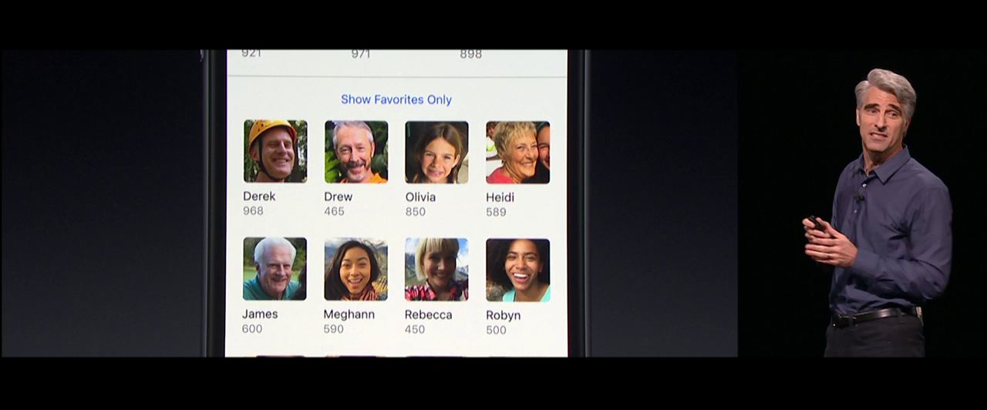
Chapter 8. Classification: Evaluation
Meng Jiang
CSE 40647/60647 Data Science Fall 2017
Introduction to Data Mining

Slide 2
Classification: Basic Concepts
Classification: Basic Concepts
Decision Tree Induction
Bayes Classification Methods
Model Evaluation and Selection
Techniques to Improve Classification Accuracy: Ensemble Methods

Slide 3
Model Evaluation and Selection
Evaluation metrics: How can we measure accuracy? Other metrics to consider?
Use validation test set of class-labeled tuples instead of training set when assessing accuracy
Methods for estimating a classifier’s accuracy:
Holdout method
Cross-validation

Slide 4
Classifier Evaluation Metrics: Confusion Matrix
Given m classes, an entry, CM_{i,j} in a confusion matrix indicates # of tuples in class i that were labeled by the classifier as class j
May have extra rows/columns to provide totals
Confusion Matrix:
Actual class\Predicted class | C₁ | ¬ C₁
C₁ | True Positives (TP) | False Negatives (FN)
¬ C₁ | False Positives (FP) | True Negatives (TN)
Example of Confusion Matrix:
Actual class\Predicted class | buy_computer = yes | buy_computer = no | Total
buy_computer = yes | 6,954 | 46 | 7,000
buy_computer = no | 412 | 2,588 | 3,000
Total | 7,366 | 2,634 | 10,000

Slide 5
Classifier Evaluation Metrics: Accuracy, Error Rate, Sensitivity and Specificity
Classifier Accuracy, or recognition rate: percentage of test set tuples that are correctly classified
Accuracy = (TP + TN)/All
Error rate: 1 – accuracy, or
Error rate = (FP + FN)/All
Class Imbalance Problem:
One class may be rare, e.g. fraud, or HIV-positive
Significant majority of the negative class and minority of the positive class
Sensitivity: True Positive recognition rate
Sensitivity = TP/P
Specificity: True Negative recognition rate
Specificity = TN/N
A\P | C | ¬C
C | TP | FN | P
¬C | FP | TN | N
 | P’ | N’ | All

Slide 6
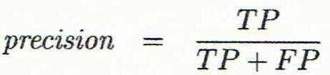
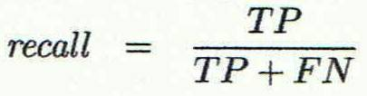
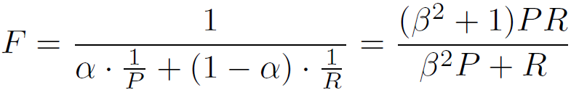
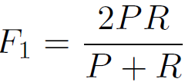
Classifier Evaluation Metrics: Precision and Recall, and F-measures
Precision: exactness: what % of tuples that the classifier labeled as positive are actually positive
Recall: completeness – what % of positive tuples did the classifier label as positive?
Comment:
Perfect score is 1.0
Inverse relationship between precision & recall
F measure (or F-score): harmonic mean of precision and recall
In general, it is the weighted measure of precision & recall
F1-measure (balanced F-measure)
That is, when β = 1,
Assigning β times as much weight to recall as to precision)

Slide 7
Classifier Evaluation Metrics: Example
Actual Class\Predicted class | cancer = yes | cancer = no | Total | Recognition(%)
cancer = yes | 90 | 210 | 300 | 30.00 (sensitivity)
cancer = no | 140 | 9,560 | 9,700 | 98.56 (specificity)
Total | 230 | 9,770 | 10,000 | 96.40 (accuracy)
Precision = 90/230 = 39.13% Recall = 90/300 = 30.00%

Slide 8
Evaluating Classifier Accuracy: Holdout & Cross-Validation Methods
Holdout method
Given data is randomly partitioned into two independent sets
Training set (e.g., 2/3) for model construction
Test set (e.g., 1/3) for accuracy estimation
Random sampling: a variation of holdout
Repeat holdout k times, accuracy = avg. of the accuracies obtained
Cross-validation (k-fold, where k = 10 is most popular)
Randomly partition the data into k mutually exclusive subsets, each approximately equal size
At i-th iteration, use D_{i} as test set and others as training set
Leave-one-out: k folds where k = # of tuples, for small sized data
*Stratified cross-validation*: folds are stratified so that class dist. in each fold is approx. the same as that in the initial data

Slide 9
Model Selection: ROC Curves
ROC (Receiver Operating Characteristics) curves: for visual comparison of classification models
Originated from signal detection theory
Shows the trade-off between the true positive rate and the false positive rate
The area under the ROC curve is a measure of the accuracy of the model
Rank the test tuples in decreasing order: the one that is most likely to belong to the positive class appears at the top of the list
The closer to the diagonal line (i.e., the closer the area is to 0.5), the less accurate is the model
Vertical axis represents the true positive rate
Horizontal axis rep. the false positive rate
The plot also shows a diagonal line
A model with perfect accuracy will have an area of 1.0

Slide 10
Issues Affecting Model Selection
Accuracy
classifier accuracy: predicting class label
Speed
time to construct the model (training time)
time to use the model (classification/prediction time)
Robustness: handling noise and missing values
Scalability: efficiency in disk-resident databases
Interpretability
understanding and insight provided by the model
Other measures, e.g., goodness of rules, such as decision tree size or compactness of classification rules

Slide 11
Classification: Basic Concepts
Classification: Basic Concepts
Decision Tree Induction
Bayes Classification Methods
Model Evaluation and Selection
Techniques to Improve Classification Accuracy: Ensemble Methods

Slide 12
Ensemble Methods: Increasing the Accuracy
Ensemble methods
Use a combination of models to increase accuracy
Combine a series of k learned models, M₁, M₂, …, M_{k}, with the aim of creating an improved model M*
Popular ensemble methods
Bagging: averaging the prediction over a collection of classifiers
Boosting: weighted vote with a collection of classifiers
Ensemble: combining a set of heterogeneous classifiers

Slide 13
Bagging
Analogy: Diagnosis based on multiple doctors’ majority vote
Training
Given a set D of d tuples, at each iteration i, a training set D_{i} of d tuples is sampled with replacement from D
A classifier model M_{i} is learned for each training set D_{i}
Classification: classify an unknown sample X
Each classifier M_{i} returns its class prediction
The bagged classifier M* counts the votes and assigns the class with the most votes to X
Prediction: can be applied to the prediction of continuous values by taking the average value of each prediction for a given test tuple
Accuracy: Proved improved accuracy in prediction
Often significantly better than a single classifier derived from D
For noise data: not considerably worse, more robust

Slide 14
Boosting
Analogy: Consult several doctors, based on a combination of weighted diagnoses—weight assigned based on the previous diagnosis accuracy
How boosting works?
Weights are assigned to each training tuple
A series of k classifiers is iteratively learned
After a classifier M_{i} is learned, the weights are updated to allow the subsequent classifier, M_{i+1}, to pay more attention to the training tuples that were misclassified by M_{i}
The final M* combines the votes of each individual classifier, where the weight of each classifier's vote is a function of its accuracy
Boosting algorithm can be extended for numeric prediction
Comparing with bagging: Boosting tends to have greater accuracy, but it also risks overfitting the model to misclassified data

Slide 15
Ensemble: Adaboost (Freund and Schapire, 1997)
Given a set of d class-labeled tuples, (X₁, y₁), …, (X_{d}, y_{d})
Initially, all the weights of tuples are set the same (1/d)
Generate k classifiers in k rounds. At round i,
Tuples from D are sampled (with replacement) to form a training set D_{i} of the same size
Each tuple’s chance of being selected is based on its weight
A classification model M_{i} is derived from D_{i}
Its error rate is calculated using D_{i} as a test set
If a tuple is misclassified, its weight is increased, o.w. it is decreased
Error rate: err(X_{j}) is the misclassification error of tuple X_{j}. Classifier M_{i} error rate is the sum of the weights of the misclassified tuples:
The weight of classifier M_{i}’s vote is

Slide 16
Summary
Classification: Extracting models describing important data classes
Effective and scalable methods
Decision tree induction, Naive Bayesian classification, and many other classification methods
Evaluation metrics:
Accuracy, sensitivity, specificity, precision, recall, F measure, and F_{ß} measure
Stratified k-fold cross-validation is recommended for accuracy estimation
Ensemble: Bagging and boosting can be used to increase overall accuracy by learning and combining a series of individual models
Adaboost
No single method has been found to be superior over all others for all data sets

Slide 17
References
C. Apte and S. Weiss. Data mining with decision trees and decision rules. Future Generation Computer Systems, 13, 1997
P. K. Chan and S. J. Stolfo. Learning arbiter and combiner trees from partitioned data for scaling machine learning. KDD'95
A. J. Dobson. An Introduction to Generalized Linear Models. Chapman & Hall, 1990.
R. O. Duda, P. E. Hart, and D. G. Stork. Pattern Classification, 2ed. John Wiley, 2001
U. M. Fayyad. Branching on attribute values in decision tree generation. AAAI’94.
Y. Freund and R. E. Schapire. A decision-theoretic generalization of on-line learning and an application to boosting. J. Computer and System Sciences, 1997.
J. Gehrke, R. Ramakrishnan, and V. Ganti. Rainforest: A framework for fast decision tree construction of large datasets. VLDB’98.
J. Gehrke, V. Gant, R. Ramakrishnan, and W.-Y. Loh, BOAT -- Optimistic Decision Tree Construction. SIGMOD'99.
T. Hastie, R. Tibshirani, and J. Friedman. The Elements of Statistical Learning: Data Mining, Inference, and Prediction. Springer-Verlag, 2001.
T.-S. Lim, W.-Y. Loh, and Y.-S. Shih. A comparison of prediction accuracy, complexity, and training time of thirty-three old and new classification algorithms. Machine Learning, 2000

Slide 18
References (cont.)
J. Magidson. The Chaid approach to segmentation modeling: Chi-squared automatic interaction detection. In R. P. Bagozzi, editor, Advanced Methods of Marketing Research, Blackwell Business, 1994
M. Mehta, R. Agrawal, and J. Rissanen. SLIQ : A fast scalable classifier for data mining. EDBT'96
T. M. Mitchell. Machine Learning. McGraw Hill, 1997
S. K. Murthy, Automatic Construction of Decision Trees from Data: A Multi-Disciplinary Survey, Data Mining and Knowledge Discovery 2(4): 345-389, 1998
J. R. Quinlan. Induction of decision trees. Machine Learning, 1:81-106, 1986.
J. R. Quinlan. C4.5: Programs for Machine Learning. Morgan Kaufmann, 1993.
J. R. Quinlan. Bagging, boosting, and c4.5. AAAI‘96.
R. Rastogi and K. Shim. Public: A decision tree classifier that integrates building and pruning. VLDB’98
J. Shafer, R. Agrawal, and M. Mehta. SPRINT : A scalable parallel classifier for data mining. VLDB’96
J. W. Shavlik and T. G. Dietterich. Readings in Machine Learning. Morgan Kaufmann, 1990
P. Tan, M. Steinbach, and V. Kumar. Introduction to Data Mining. Addison Wesley, 2005
S. M. Weiss and C. A. Kulikowski. Computer Systems that Learn: Classification and Prediction Methods from Statistics, Neural Nets, Machine Learning, and Expert Systems. Morgan Kaufman, 1991
S. M. Weiss and N. Indurkhya. Predictive Data Mining. Morgan Kaufmann, 1997
I. H. Witten and E. Frank. Data Mining: Practical Machine Learning Tools and Techniques, 2ed. Morgan Kaufmann, 2005

