Slide 1
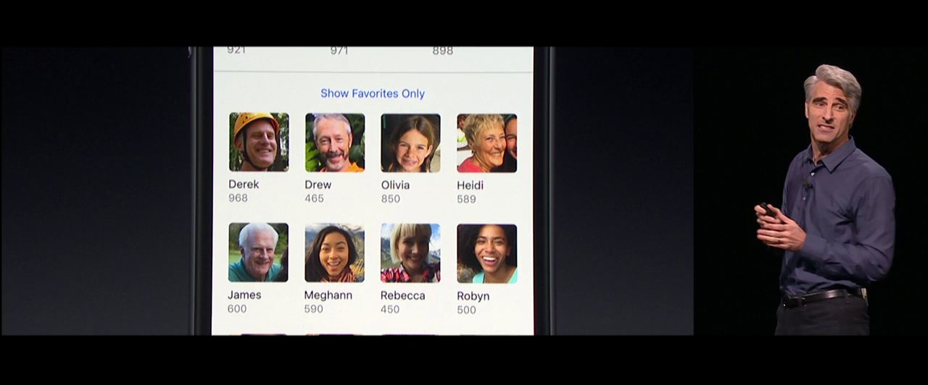
Chapter 9. Advanced Classification: SVM
Meng Jiang
CSE 40647/60647 Data Science Fall 2017
Introduction to Data Mining

Slide 2
Classification: A Mathematical Mapping
Classification: predicts categorical class labels
E.g., Personal homepage classification
x_{i} = (x₁, x₂, x₃, …), y_{i} = +1 or –1
x₁ : # of word “homepage”
x₂ : # of word “welcome”
Mathematically, x ∈ X = ℜ^{n}, y ∈ Y = {+1, –1},
We want to derive a function f: X → Y
Linear Classification
Binary Classification problem
Data above the red line belongs to class ‘x’
Data below red line belongs to class ‘o’
Examples: SVM, Perceptron, Probabilistic Classifiers
x
x
x
x
x
x
x
x
x
o
o
x
o
o
o
o
o
o
o
o
o
o
o

Slide 3
Discriminative Classifiers
Advantages
Prediction accuracy is generally high
As compared to Bayesian methods
Robust, works when training examples contain errors
Fast evaluation of the learned target function
Bayesian networks are normally slow
Criticism
Long training time
Difficult to understand the learned function (weights)
Bayesian networks can be used easily for pattern discovery
Not easy to incorporate domain knowledge
Easy in the form of priors on the data or distributions

Slide 4
SVM: Support Vector Machines
A relatively new classification method for both linear and nonlinear data
With the new dimension, it searches for the linear optimal separating hyperplane (i.e., “decision boundary”)
With an appropriate nonlinear mapping to a sufficiently high dimension, data from two classes can always be separated by a hyperplane
SVM finds this hyperplane using support vectors (“essential” training tuples) and margins (defined by the support vectors)

Slide 5
SVM: History and Applications
Vapnik and colleagues (1992)—groundwork from Vapnik & Chervonenkis’ statistical learning theory in 1960s
Features: training can be slow but accuracy is high owing to their ability to model complex nonlinear decision boundaries (margin maximization)
Used for: classification and numeric prediction
Applications:
handwritten digit recognition, object recognition, speaker identification, benchmarking time-series prediction tests

Slide 6
SVM: General Philosophy
Small Margin
Large Margin
Support Vectors

Slide 7
SVM: When Data Is Linearly Separable
Let data D be (X₁, y₁), …, (X_{|D|}, y_{|D|}), where X_{i} is the set of training tuples associated with the class labels y_{i}
There are infinite lines (hyperplanes) separating the two classes but we want to find the best one (the one that minimizes classification error on unseen data)
SVM searches for the hyperplane with the largest margin, i.e., maximum marginal hyperplane (MMH)
m

Slide 8
SVM: Linearly Separable
A separating hyperplane can be written as
W ● X + b = 0
where W={w₁, w₂, …, w_{n}} is a weight vector and b a scalar (bias)
For 2-D it can be written as: w₀ + w₁ x₁ + w₂ x₂ = 0
The hyperplane defining the sides of the margin:
H₁: w₀ + w₁ x₁ + w₂ x₂ ≥ 1 for y_{i} = +1, and
H₂: w₀ + w₁ x₁ + w₂ x₂ ≤ – 1 for y_{i} = –1
Any training tuples that fall on hyperplanes H₁ or H₂ (i.e., the sides defining the margin) are support vectors
This becomes a constrained (convex) quadratic optimization problem:
Quadratic objective function and linear constraints → Quadratic Programming (QP) → Lagrangian multipliers

Slide 9
Optimization: Maximize Margin Width
M=Margin Width
x⁺
“Predict Class = +1” zone
H₁: wx_{i} + b ≥ 1 for y_{i} = +1
H₂: wx_{i} + b ≤ -1 for y_{i} = -1
→ y_{i} (wx_{i} + b) ≥ 1 for all i
X⁻
wx+b=1
wx+b=0
“Predict Class = -1” zone
max
wx+b=-1
same as min
What we know:
w . x⁺ + b = +1
w . x⁻ + b = -1
w . (x⁺-x⁻) = 2
Quadratic optimization problem:
min
s.t.
for all i

Slide 10
Solving the Optimization Problem
Need to optimize a quadratic function subject to linear constraints.
Quadratic optimization problems are a well-known class of mathematical programming problems, and many (rather intricate) algorithms exist for solving them.
The solution involves constructing a dual problem where a Lagrange multiplier α_{i} is associated with every constraint in the primary problem:
Find w and b such that
Φ(w) =½ w^{T}w is minimized;
and for all {(x_{i} ,y_{i})}: y_{i} (w^{T}x_{i} + b) ≥ 1
Find α₁…α_{N} such that
Q(α) =Σα_{i} - ½ΣΣα_{i}α_{j}y_{i}y_{j}x_{i}^{T}x_{j}
is maximized and
(1) Σα_{i}y_{i} = 0
(2) α_{i} ≥ 0 for all α_{i}

Slide 11
LinearSVMs
The classifier is a separating hyperplane.
Most “important” training points are support vectors; they define the hyperplane.
Quadratic optimization algorithms can identify which training points x_{i} are support vectors with non-zero Lagrangian multipliers α_{i}.
Both in the dual formulation of the problem and in the solution training points appear only inside dot products:
Find α₁…α_{N} such that
Q(α) = Σα_{i} - ½ΣΣα_{i}α_{j}y_{i}y_{j}x_{i}^{T}x_{j} is maximized and
(1) Σα_{i}y_{i} = 0
(2) 0 ≤ α_{i} ≤ C for all α_{i}

Slide 12
Why is SVM Effective on High Dimensional Data?
The complexity of trained classifier is characterized by the # of support vectors rather than the dimensionality of the data
The support vectors are the essential or critical training examples — they lie closest to the decision boundary
If all other training examples are removed and the training is repeated, the same separating hyperplane would be found

Slide 13
Non-linear SVMs: Feature Spaces
General idea: The original input space can always be mapped to some higher-dimensional feature space where the training set is separable:
Φ: x → φ(x)

Slide 14
The “Kernel Trick”
The classifier relies on dot product between vectors K(x_{i},x_{j})=x_{i}^{T}x_{j}
If every data point is mapped into high-dimensional space via some transformation Φ: x → φ(x), the dot product becomes:
K(x_{i},x_{j})= φ(x_{i}) ^{T}φ(x_{j})
A kernel function is some function that corresponds to an inner product in some expanded feature space.
Example:
2-dimensional vectors x=[x₁ x₂]; let K(x_{i},x_{j})=(1 + x_{i}^{T}x_{j})²,
Need to show that K(x_{i},x_{j})= φ(x_{i}) ^{T}φ(x_{j}):
K(x_{i},x_{j})=(1 + x_{i}^{T}x_{j})²,
= 1+ x_{i1}²x_{j1}² + 2 x_{i1}x_{j1} x_{i2}x_{j2}+ x_{i2}²x_{j2}² + 2x_{i1}x_{j1} + 2x_{i2}x_{j2}
= [1 x_{i1}² √2 x_{i1}x_{i2} x_{i2}² √2x_{i1} √2x_{i2}]^{T} [1 x_{j1}² √2 x_{j1}x_{j2} x_{j2}² √2x_{j1} √2x_{j2}]
= φ(x_{i}) ^{T}φ(x_{j}), where φ(x) = [1 x₁² √2 x₁x₂ x₂² √2x₁ √2x₂]

Slide 15
What Functions are Kernels?
For some functions K(x_{i},x_{j}) checking that
K(x_{i},x_{j})= φ(x_{i}) ^{T}φ(x_{j}) can be cumbersome.
Mercer’s theorem:
Every semi-positive definite symmetric function is a kernel
Semi-positive definite symmetric functions correspond to a semi-positive definite symmetric Gram matrix:
K(x₁,x₁) | K(x₁,x₂) | K(x₁,x₃) | … | K(x₁,x_{N})
K(x₂,x₁) | K(x₂,x₂) | K(x₂,x₃) |  | K(x₂,x_{N})
… | … | … | … | …
K(x_{N},x₁) | K(x_{N},x₂) | K(x_{N},x₃) | … | K(x_{N},x_{N})
K=

Slide 16
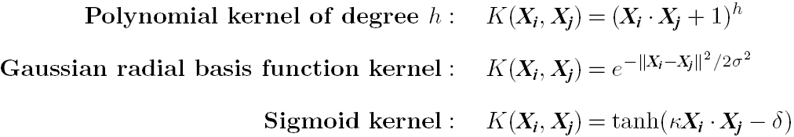
Kernel Functions for Nonlinear Classification
Instead of computing the dot product on the transformed data, it is mathematically equivalent to applying a kernel function K(X_{i}, X_{j}) to the original data, i.e.,
K(X_{i}, X_{j}) = Φ(X_{i}) Φ(X_{j})
Typical Kernel Functions

Slide 17
Non-linear SVMs: Optimization
Dual problem formulation:
The solution is:
Optimization techniques for finding α_{i}’s remain the same!
Find α₁…α_{N} such that
Q(α) =Σα_{i} - ½ΣΣα_{i}α_{j}y_{i}y_{j}K(x_{i}, x_{j}) is maximized and
(1) Σα_{i}y_{i} = 0
(2) α_{i} ≥ 0 for all α_{i}
f(x) = Σα_{i}y_{i}K(x_{i}, x_{j})+ b

Slide 18
SVM Applications
SVM has been used successfully in many real-world problems
Text (and hypertext) categorization
Image classification
Bioinformatics (Protein classification, Cancer classification)
Hand-written character recognition

Slide 19
SVM Related Links
SVM Website: http://www.kernel-machines.org/
Representative implementations
LIBSVM: an efficient implementation of SVM, multi-class classifications, nu-SVM, one-class SVM, including also various interfaces with java, python, etc.
SVM-light: simpler but performance is not better than LIBSVM, support only binary classification and only in C
SVM-torch: another recent implementation also written in C

Slide 20
References
C. M. Bishop, Neural Networks for Pattern Recognition. Oxford University Press, 1995
L. Breiman, J. Friedman, R. Olshen, and C. Stone. Classification and Regression Trees. Wadsworth International Group, 1984
C. J. C. Burges. A Tutorial on Support Vector Machines for Pattern Recognition. Data Mining and Knowledge Discovery, 2(2): 121-168, 1998
N. Cristianini and J. Shawe-Taylor, Introduction to Support Vector Machines and Other Kernel-Based Learning Methods, Cambridge University Press, 2000
H. Yu, J. Yang, and J. Han. Classifying large data sets using SVM with hierarchical clusters. KDD'03
A. J. Dobson. An Introduction to Generalized Linear Models. Chapman & Hall, 1990
R. O. Duda, P. E. Hart, and D. G. Stork. Pattern Classification, 2ed. John Wiley, 2001
T. Hastie, R. Tibshirani, and J. Friedman. The Elements of Statistical Learning: Data Mining, Inference, and Prediction. Springer-Verlag, 2001
S. Haykin, Neural Networks and Learning Machines, Prentice Hall, 2008
D. Heckerman, D. Geiger, and D. M. Chickering. Learning Bayesian networks: The combination of knowledge and statistical data. Machine Learning, 1995
H. Cheng, X. Yan, J. Han & C.-W. Hsu, Discriminative Frequent Pattern Analysis for Effective Classification, ICDE‘07
W. Cohen. Fast effective rule induction. ICML'95

Slide 21
References (cont.)
H. Cheng, X. Yan, J. Han & P. S. Yu, Direct Discriminative Pattern Mining for Effective Classification, ICDE’08
G. Cong, K. Tan, A. Tung & X. Xu. Mining Top-k Covering Rule Groups for Gene Expression Data, SIGMOD’05
M. Deshpande, M. Kuramochi, N. Wale & G. Karypis. Frequent Substructure-based Approaches for Classifying Chemical Compounds, TKDE’05
G. Dong & J. Li. Efficient Mining of Emerging Patterns: Discovering Trends and Differences, KDD’99
W. Fan, K. Zhang, H. Cheng, J. Gao, X. Yan, J. Han, P. S. Yu & O. Verscheure. Direct Mining of Discriminative and Essential Graphical and Itemset Features via Model-based Search Tree, KDD’08
W. Li, J. Han & J. Pei. CMAR: Accurate and Efficient Classification based on Multiple Class-association Rules, ICDM’01
B. Liu, W. Hsu & Y. Ma. Integrating Classification and Association Rule Mining, KDD’98
J. R. Quinlan and R. M. Cameron-Jones. FOIL: A midterm report. ECML’93
Jingbo Shang, Wenzhu Tong, Jian Peng, and Jiawei Han, "DPClass: An Effective but Concise Discriminative Patterns-Based Classification Framework", SDM’16
J. Wang and G. Karypis. HARMONY: Efficiently Mining the Best Rules for Classification, SDM’05
X. Yin & J. Han. CPAR: Classification Based on Predictive Association Rules, SDM’03

