Slide 1
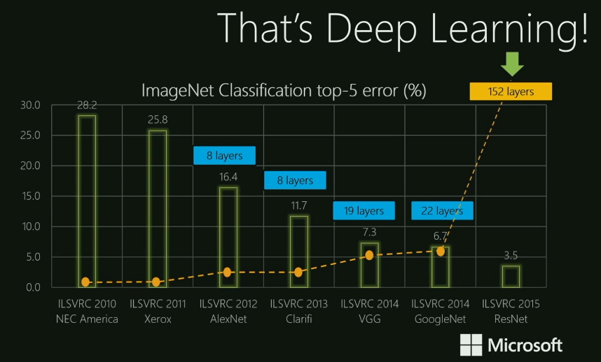
Chapter 9. Advanced Classification: Neural Networks
Meng Jiang
CSE 40647/60647 Data Science Fall 2017
Introduction to Data Mining

Slide 2
Neural Network for Classification
Started by psychologists and neurobiologists to develop and test computational analogues of neurons
A neural network: A set of connected input/output units where each connection has a weight associated with it
During the learning phase, the network learns by adjusting the weights so as to be able to predict the correct class label of the input tuples
Also referred to as connectionist learning due to the connections between units

Slide 3
Neuron: A Hidden/Output Layer Unit
An n-dimensional input vector x is mapped into variable y by means of the scalar product and a nonlinear function mapping
The inputs to unit are outputs from the previous layer. They are multiplied by their corresponding weights to form a weighted sum, which is added to the bias associated with unit. Then a nonlinear activation function is applied to it.
bias
x₀
w₀
m_{k}
x₁
w₁
å
f
output y
x_{n}
w_{n}
Input
vector x
weight
vector w
weighted
sum
Activation
function

Slide 4
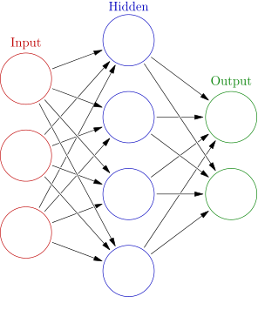
A Multi-Layer Feed-Forward Neural Network
Output vector
Output layer
Hidden layer
w_{ij}
Input layer
Input vector: X

Slide 5
How a Multi-Layer Neural Network Works
The inputs to the network correspond to the attributes measured for each training tuple
Inputs are fed simultaneously into the units making up the input layer
They are then weighted and fed simultaneously to a hidden layer
The number of hidden layers is arbitrary, although usually only one
The weighted outputs of the last hidden layer are input to units making up the output layer, which emits the network's prediction
The network is feed-forward: None of the weights cycles back to an input unit or to an output unit of a previous layer
From a statistical point of view, networks perform nonlinear regression
Given enough hidden units and enough training samples (and what?), they can closely approximate any function

Slide 6
Defining a Network Topology
Decide the network topology
Specify # of units in the input layer, # of hidden layers (if > 1), # of units in each hidden layer, and # of units in the output layer
Normalize the input values for each attribute measured in the training tuples to [0.0—1.0]
Once a network has been trained and its accuracy is unacceptable, repeat the training process with a different network topology or a different set of initial weights

Slide 7
From Neural Networks to Deep Learning
Train networks with many layers (vs. shallow nets with just a couple of layers)
Multiple layers work to build an improved feature space
First layer learns 1st order features (e.g., edges, …)
2nd layer learns higher order features (combinations of first layer features, combinations of edges, etc.)
In current models, layers often learn in an unsupervised mode and discover general features of the input space—serving multiple tasks related to the unsupervised instances (image recognition, etc.)
Then final layer features are fed into supervised layer(s)
And entire network is often subsequently tuned using supervised training of the entire net, using the initial weightings learned in the unsupervised phase

Slide 8

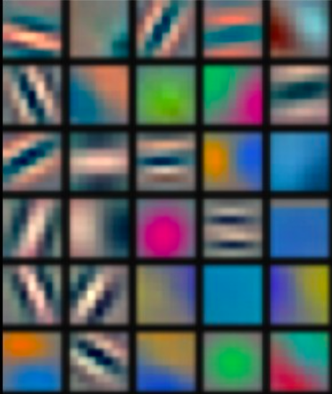
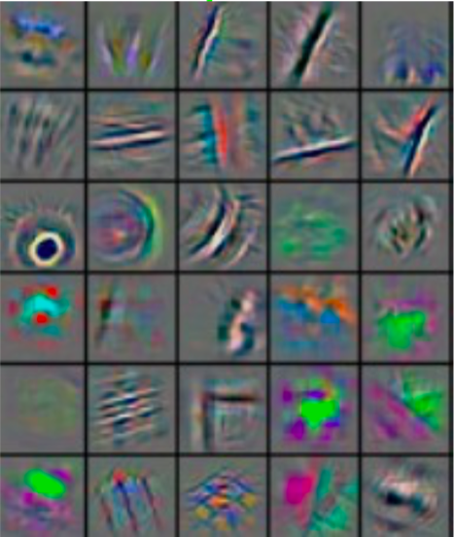
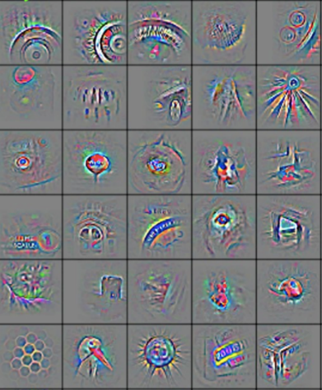
Deep Learning: Feature Visualization
Deep learning (a.k.a. representation learning) seeks to learn rich hierarchical representations (i.e. features) automatically through multiple stage of feature learning process.
Low-level features
Mid-level features
High-level features
Trainable classifier
output
Feature visualization of convolutional net trained on ImageNet (Zeiler and Fergus, 2013)

Slide 9
Deep Learning on ImageNet

Slide 10
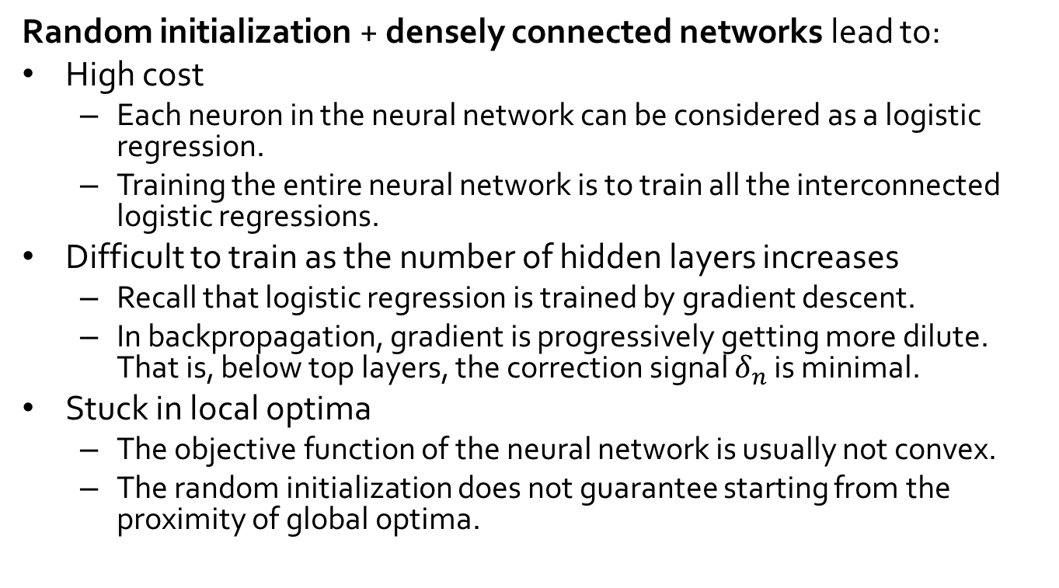
Limitations of Neural Networks
Random initialization + densely connected networks lead to:
High cost
Each neuron in the neural network can be considered as a logistic regression.
Training the entire neural network is to train all the interconnected logistic regressions.
Difficult to train as the number of hidden layers increases
Recall that logistic regression is trained by gradient descent.
In backpropagation, gradient is progressively getting more dilute. That is, below top layers, the correction signal $δ_{n}$ is minimal.
Stuck in local optima
The objective function of the neural network is usually not convex.
The random initialization does not guarantee starting from the proximity of global optima.

Slide 11
References
C. M. Bishop, Neural Networks for Pattern Recognition. Oxford University Press, 1995
L. Breiman, J. Friedman, R. Olshen, and C. Stone. Classification and Regression Trees. Wadsworth International Group, 1984
C. J. C. Burges. A Tutorial on Support Vector Machines for Pattern Recognition. Data Mining and Knowledge Discovery, 2(2): 121-168, 1998
N. Cristianini and J. Shawe-Taylor, Introduction to Support Vector Machines and Other Kernel-Based Learning Methods, Cambridge University Press, 2000
H. Yu, J. Yang, and J. Han. Classifying large data sets using SVM with hierarchical clusters. KDD'03
A. J. Dobson. An Introduction to Generalized Linear Models. Chapman & Hall, 1990
R. O. Duda, P. E. Hart, and D. G. Stork. Pattern Classification, 2ed. John Wiley, 2001
T. Hastie, R. Tibshirani, and J. Friedman. The Elements of Statistical Learning: Data Mining, Inference, and Prediction. Springer-Verlag, 2001
S. Haykin, Neural Networks and Learning Machines, Prentice Hall, 2008
D. Heckerman, D. Geiger, and D. M. Chickering. Learning Bayesian networks: The combination of knowledge and statistical data. Machine Learning, 1995
H. Cheng, X. Yan, J. Han & C.-W. Hsu, Discriminative Frequent Pattern Analysis for Effective Classification, ICDE‘07
W. Cohen. Fast effective rule induction. ICML'95

Slide 12
References (cont.)
H. Cheng, X. Yan, J. Han & P. S. Yu, Direct Discriminative Pattern Mining for Effective Classification, ICDE’08
G. Cong, K. Tan, A. Tung & X. Xu. Mining Top-k Covering Rule Groups for Gene Expression Data, SIGMOD’05
M. Deshpande, M. Kuramochi, N. Wale & G. Karypis. Frequent Substructure-based Approaches for Classifying Chemical Compounds, TKDE’05
G. Dong & J. Li. Efficient Mining of Emerging Patterns: Discovering Trends and Differences, KDD’99
W. Fan, K. Zhang, H. Cheng, J. Gao, X. Yan, J. Han, P. S. Yu & O. Verscheure. Direct Mining of Discriminative and Essential Graphical and Itemset Features via Model-based Search Tree, KDD’08
W. Li, J. Han & J. Pei. CMAR: Accurate and Efficient Classification based on Multiple Class-association Rules, ICDM’01
B. Liu, W. Hsu & Y. Ma. Integrating Classification and Association Rule Mining, KDD’98
J. R. Quinlan and R. M. Cameron-Jones. FOIL: A midterm report. ECML’93
Jingbo Shang, Wenzhu Tong, Jian Peng, and Jiawei Han, "DPClass: An Effective but Concise Discriminative Patterns-Based Classification Framework", SDM’16
J. Wang and G. Karypis. HARMONY: Efficiently Mining the Best Rules for Classification, SDM’05
X. Yin & J. Han. CPAR: Classification Based on Predictive Association Rules, SDM’03

Slide 13
Deep Learning Short Tutorial: CNNs
Acknowledgement: Many of the pictures, results, and other materials are taken from:
Aarti Singh, Carnegie Mellon University
Andrew Ng, Stanford University
Barnabas Poczos, Carnegie Mellon University
Christopher Manning, Stanford University
Geoffrey Hinton, Google & University of Toronto
Richard Socher, MetaMind
Richard Turner, University of Cambridge
Yann LeCun, New York University
Yoshua Bengio, Universite de Montreal

Slide 14
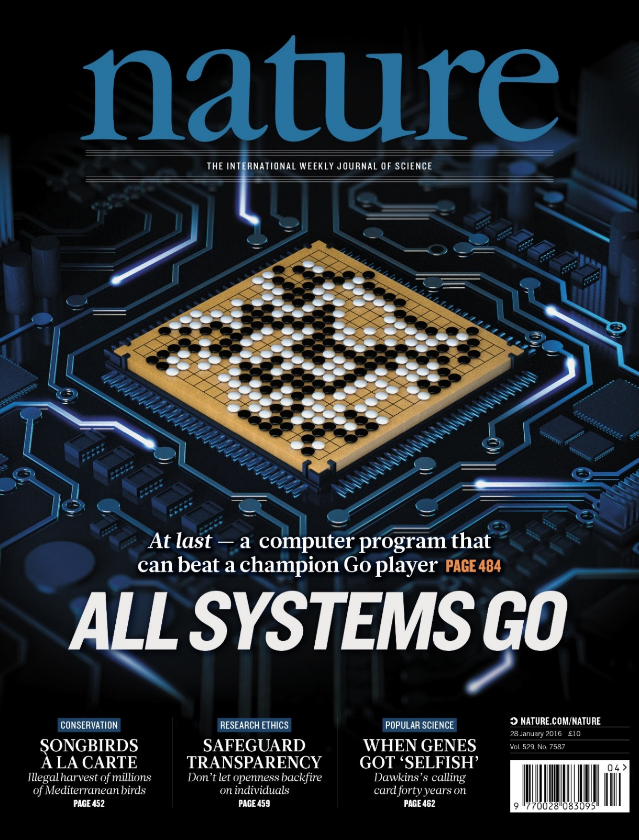
In “Nature” 27 January 2016:
“AlphaGo was not preprogrammed to play Go: rather, it learned using a general-purpose algorithm that allowed it to interpret the game’s patterns.”
“…AlphaGo program applied deep learning in neural networks (convolutional NN) — brain-inspired programs in which connections between layers of simulated neurons are strengthened through examples and experience.”

Slide 15
Deep Learning Today
Advancement in speech recognition
A few long-standing performance records were broken with deep learning methods
Microsoft and Google have both deployed DL-based speech recognition systems in their products
Advancement in Computer Vision
Feature engineering is the bread-and-butter of a large portion of the CV community, which creates some resistance to feature learning
But the record holders on ImageNet and Semantic Segmentation are convolutional nets
Advancement in Natural Language Processing
Fine-grained sentiment analysis, syntactic parsing
Language model, machine translation, question answering

Slide 16
Motivations for Deep Architectures
Insufficient depth can hurt
With shallow architecture (SVM, NB, KNN, etc.), the required number of nodes in the graph (i.e. computations, and also number of parameters, when we try to learn the function) may grow very large.
Many functions that can be represented efficiently with a deep architecture cannot be represented efficiently with a shallow one.
The brain has a deep architecture
The visual cortex shows a sequence of areas each of which contains a representation of the input, and signals flow from one to the next.
Note that representations in the brain are in between dense distributed and purely local: they are sparse: about 1% of neurons are active simultaneously in the brain.
Cognitive processes seem deep
Humans organize their ideas and concepts hierarchically.
Humans first learn simpler concepts and then compose them to represent more abstract ones.
Engineers break-up solutions into multiple levels of abstraction and processing

Slide 17
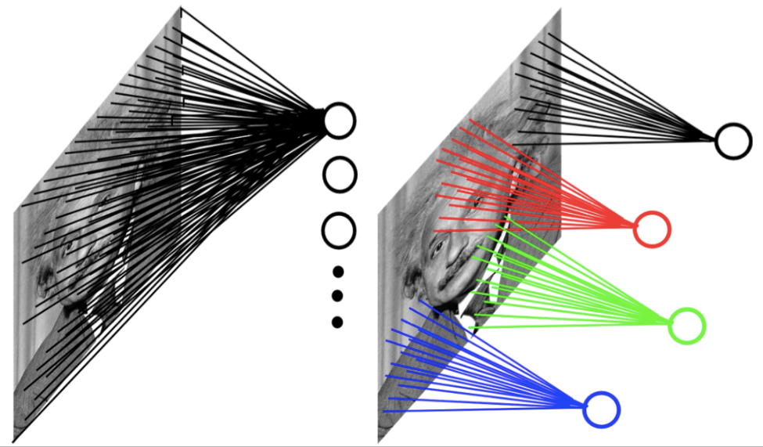
Convolutional Neural Networks
Input can have very high dimension. Using a fully-connected neural network would need a large amount of parameters.
Inspired by the neurophysiological experiments conducted by [Hubel & Wiesel 1962], CNNs are a special type of neural network whose hidden units are only connected to local receptive field. The number of parameters needed by CNNs is much smaller.
Example: 200x200 image
fully connected: 40,000 hidden units => 1.6 billion parameters
CNN: 5x5 kernel, 100 feature maps => 2,500 parameters

Slide 18
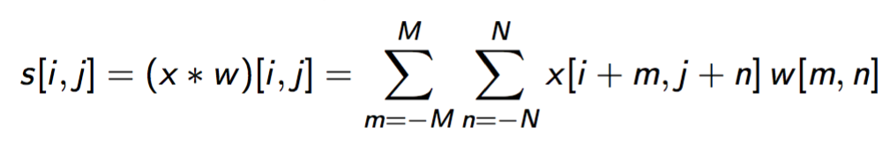
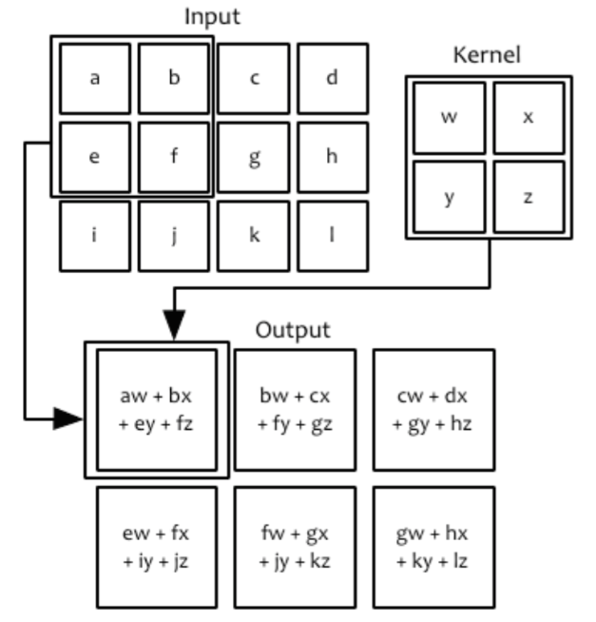
Convolution Operation in CNNs
Input: an image (2-D array) x
Convolution kernel/operator(2-D array of learnable parameters): w
Feature map (2-D array of processed data): s
Convolution operation in 2-D domains:

Slide 19
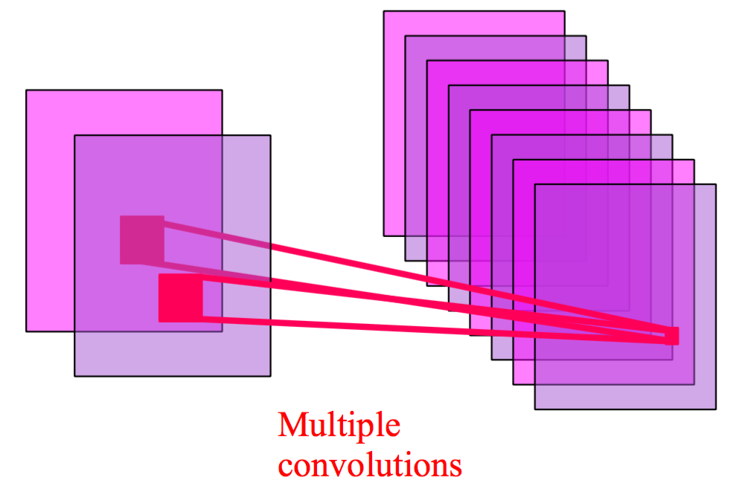
Multiple Convolutions
Usually there are multiple feature maps, one for each convolution operator.

Slide 20
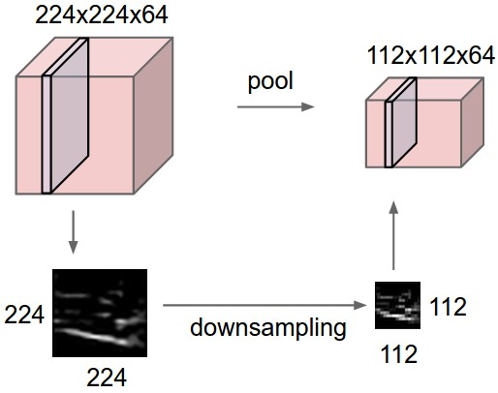
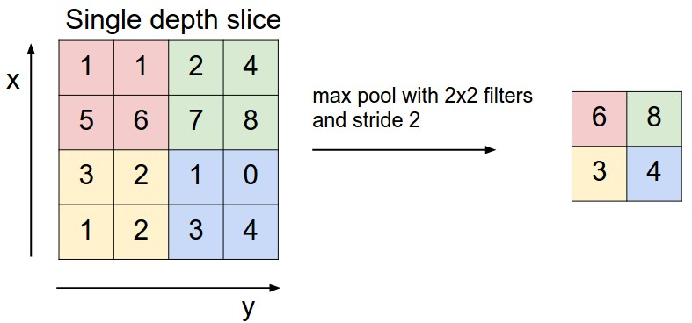
Pooling Layer
Intuition: to progressively reduce the spatial size of the representation to reduce the amount of parameters and computation in the network, and hence to also control overfitting
Pooling partitions the input image into a set of non-overlapping rectangles and, for each such sub-region, outputs the maximum value of the features in that region.

Slide 21
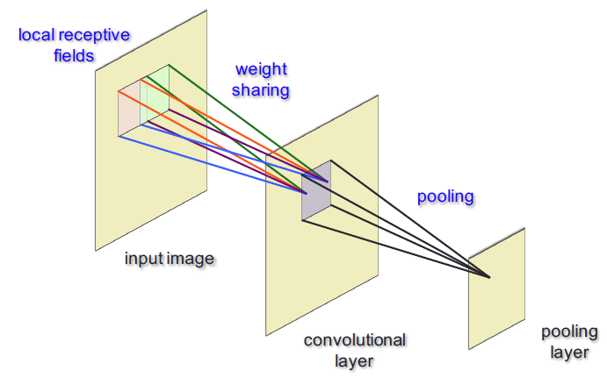
Pooling
Common pooling operations:
Max pooling: reports the maximum output within a rectangular neighborhood.
Average pooling: reports the average output of a rectangular neighborhood (possibly weighted by the distance from the central pixel).

Slide 22
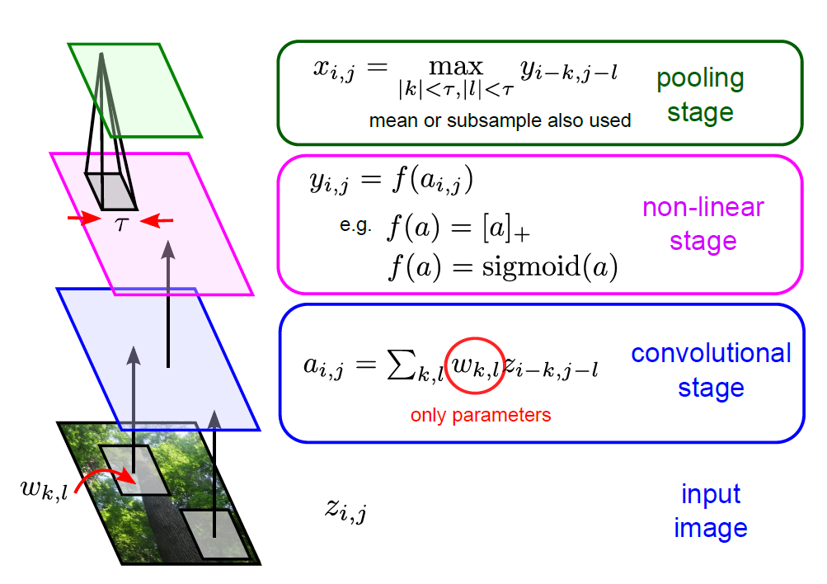
Deep CNN: Layers, Stages

Slide 23
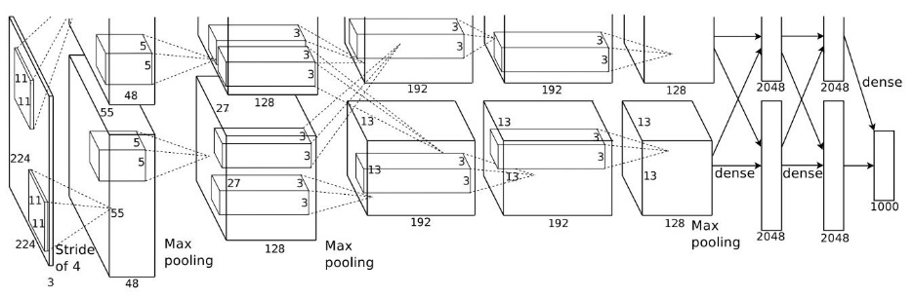
Deep CNN: Winner of ImageNet 2012
Multiple feature maps per convolutional layer.
Multiple convolutional layers for extracting features at different levels.
Higher-level layers take the feature maps in lower-level layers as input.
(Alex et al., 2012)

Slide 24
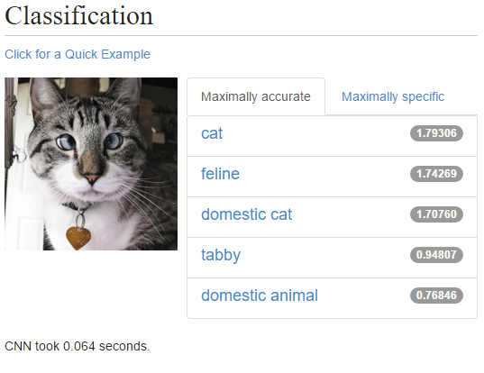
Deep CNN for Image Classification
Try out a live demo at http://demo.caffe.berkeleyvision.org/

Slide 25
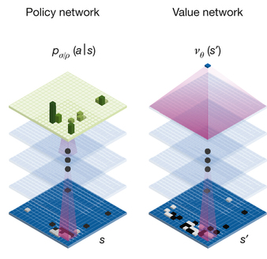
Deep CNN in AlphaGO
Policy network:
Input: 19x19, 48 input channels
Layer 1: 5x5 kernel, 192 filters
Layer 2 to 12: 3x3 kernel, 192 filters
Layer 13: 1x1 kernel, 1 filter
Value network has similar architecture to policy network
(Silver et al, 2016)

Slide 26
Other Deep Learning Models
Recurrent Neural Networks (RNNs)
Long Short-Term Memory (LSTM)
(Deep) Reinforcement Learning
Deep Q-networks, Q learning
Policy-based
Value-based
Model-based

Slide 27
References
Antol, S., Agrawal, A., Lu, J., Mitchell, M., Batra, D., Lawrence Zitnick, C., & Parikh, D. (2015). VQA: Visual question answering. In Proceedings of the IEEE International Conference on Computer Vision (pp. 2425-2433).
Hinton, G. E., & Salakhutdinov, R. R. (2006). Reducing the dimensionality of data with neural networks. Science, 313(5786), 504-507.
Schuster, M., & Paliwal, K. K. (1997). Bidirectional recurrent neural networks. Signal Processing, IEEE Transactions on, 45(11), 2673-2681.
Krizhevsky, A., Sutskever, I., & Hinton, G. E. (2012). Imagenet classification with deep convolutional neural networks. In Advances in neural information processing systems (pp. 1097-1105).
Hochreiter, S., & Schmidhuber, J. (1997). Long short-term memory. Neural computation, 9(8), 1735-1780.
Mnih, Volodymyr, et al. "Playing atari with deep reinforcement learning."arXiv preprint arXiv:1312.5602 (2013).
Mnih, Volodymyr, et al. "Human-level control through deep reinforcement learning." Nature 518.7540 (2015): 529-533.
Silver, David, et al. "Mastering the game of Go with deep neural networks and tree search." Nature 529.7587 (2016): 484-489.
Silver, D. (2015). Deep Reinforcement Learning [Powerpoint slides]. Retrieve from http://www.iclr.cc/lib/exe/fetch.php?media=iclr2015:silver-iclr2015.pdf
Lecun, Y., & Ranzato, M. (2013). Deep Learning Tutorial [Powerpoint slides]. Retrieved from http://www.cs.nyu.edu/~yann/talks/lecun-ranzato-icml2013.pdf

