Slide 1
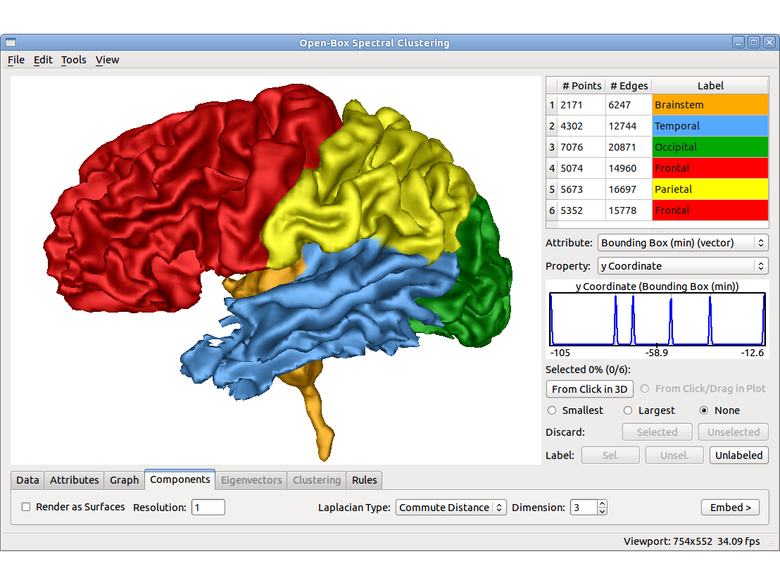
Chapter 10. Cluster Analysis: Concepts
Meng Jiang
CSE 40647/60647 Data Science Fall 2017
Introduction to Data Mining

Slide 2
Cluster Analysis
Cluster Analysis: An Introduction
Partitioning Methods
Density-based Methods
Evaluation of Clustering

Slide 3
What Is Cluster Analysis?
What is a cluster?
A cluster is a collection of data objects which are
Similar (or related) to one another within the same group (i.e., cluster)
Dissimilar (or unrelated) to the objects in other groups (i.e., clusters)
Cluster analysis (or clustering, data segmentation, …)
Given a set of data points, partition them into a set of groups (i.e., clusters) which are as similar as possible
Cluster analysis is unsupervised learning (i.e., no predefined classes)
This contrasts with classification (i.e., supervised learning)
Typical ways to use/apply cluster analysis
As a stand-alone tool to get insight into data distribution, or
As a preprocessing (or intermediate) step for other algorithms

Slide 4
What Is Good Clustering?
A good clustering method will produce high quality clusters which should have
High intra-class similarity: Cohesive within clusters
Low inter-class similarity: Distinctive between clusters
Quality function
There is usually a separate “quality” function that measures the “goodness” of a cluster
It is hard to define “similar enough” or “good enough”
The answer is typically highly subjective
There exist many similarity measures and/or functions for different applications
Similarity measure is critical for cluster analysis

Slide 5
Cluster Analysis: Applications
A key intermediate step for other data mining tasks
Generating a compact summary of data for classification, pattern discovery, hypothesis generation and testing, etc.
Outlier detection: Outliers—those “far away” from any cluster
Data summarization, compression, and reduction
Ex. Image processing: Vector quantization
Collaborative filtering, recommendation systems, or customer segmentation
Find like-minded users or similar products
Dynamic trend detection
Clustering stream data and detecting trends and patterns
Multimedia data analysis, biological data analysis and social network analysis
Ex. Clustering images or video/audio clips, gene/protein sequences, etc.

Slide 6
Considerations for Cluster Analysis
Partitioning criteria
Single level vs. hierarchical partitioning (often, multi-level hierarchical partitioning is desirable, e.g., grouping topical terms)
Separation of clusters
Exclusive (e.g., one customer belongs to only one region) vs. non-exclusive (e.g., one document may belong to more than one class)
Similarity measure
Distance-based (e.g., Euclidean, road network, vector) vs. connectivity-based (e.g., density or contiguity)
Clustering space
Full space (often when low dimensional) vs. subspaces (often in high-dimensional clustering)

Slide 7
Requirements and Challenges
Quality
Ability to deal with different types of attributes: Numerical, categorical, text, multimedia, networks, and mixture of multiple types
Discovery of clusters with arbitrary shape
Ability to deal with noisy data
Scalability
Clustering all the data instead of only on samples
High dimensionality
Incremental or stream clustering and insensitivity to input order
Constraint-based clustering
User-given preferences or constraints; domain knowledge; user queries
Interpretability and usability

Slide 8
Cluster Analysis: A Multi-Dimensional Categorization
Technique-Centered
Distance-based methods
Density-based and grid-based methods
Probabilistic and generative models
Leveraging dimensionality reduction methods
High-dimensional clustering
Scalable techniques for cluster analysis
Data Type-Centered
Clustering numerical data, categorical data, text data, multimedia data, time-series data, sequences, stream data, networked data, uncertain data
Additional Insight-Centered
Visual insights, semi-supervised, ensemble-based, validation-based

Slide 9
Typical Clustering Methodologies
Distance-based methods
Partitioning algorithms: K-Means, K-Medians, K-Medoids
Hierarchical algorithms: Agglomerative vs. divisive methods
Density-based and grid-based methods
Density-based: Data space is explored at a high-level of granularity and then post-processing to put together dense regions into an arbitrary shape
Grid-based: Individual regions of the data space are formed into a grid-like structure
Probabilistic and generative models: Modeling data from a generative process
Assume a specific form of the generative model (e.g., mixture of Gaussians)
Model parameters are estimated with the Expectation-Maximization (EM) algorithm (using the available dataset, for a maximum likelihood fit)
Then estimate the generative probability of the underlying data points

Slide 10
Clustering Different Types of Data (I)
Numerical data
Most earliest clustering algorithms were designed for numerical data
Categorical data (including binary data)
Discrete data, no natural order (e.g., sex, race, zip-code, and market-basket)
Text data: Popular in social media, Web, and social networks
Features: High-dimensional, sparse, value corresponding to word frequencies
Methods: Combination of k-means and agglomerative; topic modeling; co-clustering
Multimedia data: Image, audio, video (e.g., on Flickr, YouTube)
Multi-modal (often combined with text data)
Contextual: Containing both behavioral and contextual attributes
Images: Position of a pixel represents its context, value represents its behavior
Video and music data: Temporal ordering of records represents its meaning

Slide 11
Clustering Different Types of Data (II)
Time-series data: Sensor data, stock markets, temporal tracking, forecasting, etc.
Data are temporally dependent
Time: contextual attribute; data value: behavioral attribute
Correlation-based online analysis (e.g., online clustering of stock to find stock tickers)
Shape-based offline analysis (e.g., cluster ECG based on overall shapes)
Sequence data: Weblogs, biological sequences, system command sequences
Contextual attribute: Placement (rather than time)
Similarity functions: Hamming distance, edit distance, longest common subsequence
Sequence clustering: Suffix tree; generative model (e.g., Hidden Markov Model)
Stream data:
Real-time, evolution and concept drift, single pass algorithm
Create efficient intermediate representation, e.g., micro-clustering

Slide 12
Clustering Different Types of Data (III)
Graphs and homogeneous networks
Every kind of data can be represented as a graph with similarity values as edges
Methods: Generative models; combinatorial algorithms (graph cuts); spectral methods; non-negative matrix factorization methods
Heterogeneous networks
A network consists of multiple typed nodes and edges (e.g., bibliographical data)
Clustering different typed nodes/links together (e.g., NetClus)
Uncertain data: Noise, approximate values, multiple possible values
Incorporation of probabilistic information will improve the quality of clustering
Big data: Model systems may store and process very big data (e.g., weblogs)
Ex. Google’s MapReduce framework
Use Map function to distribute the computation across different machines
Use Reduce function to aggregate results obtained from the Map step

Slide 13
User Insights and Interactions in Clustering
Visual insights: One picture is worth a thousand words
Human eyes: High-speed processor linking with a rich knowledge-base
A human can provide intuitive insights; HD-eye: visualizing HD clusters
Semi-supervised insights: Passing user’s insights or intention to system
User-seeding: A user provides a number of labeled examples, approximately representing categories of interest
Multi-view and ensemble-based insights
Multi-view clustering: Multiple clusterings represent different perspectives
Multiple clustering results can be ensembled to provide a more robust solution
Validation-based insights: Evaluation of the quality of clusters generated
May use case studies, specific measures, or pre-existing labels

Slide 14
References: (I) Cluster Analysis: An Introduction
Jiawei Han, Micheline Kamber, and Jian Pei. Data Mining: Concepts and Techniques. Morgan Kaufmann, 3rd ed. , 2011 (Chapters 10 & 11)
Charu Aggarwal and Chandran K. Reddy (eds.). Data Clustering: Algorithms and Applications. CRC Press, 2014
Mohammed J. Zaki and Wagner Meira, Jr.. Data Mining and Analysis: Fundamental Concepts and Algorithms. Cambridge University Press, 2014
L. Kaufman and P. J. Rousseeuw, Finding Groups in Data: An Introduction to Cluster Analysis, John Wiley & Sons, 1990
Charu Aggarwal. An Introduction to Clustering Analysis. in Aggarwal and Reddy (eds.). Data Clustering: Algorithms and Applications (Chapter 1). CRC Press, 2014

