Slide 1
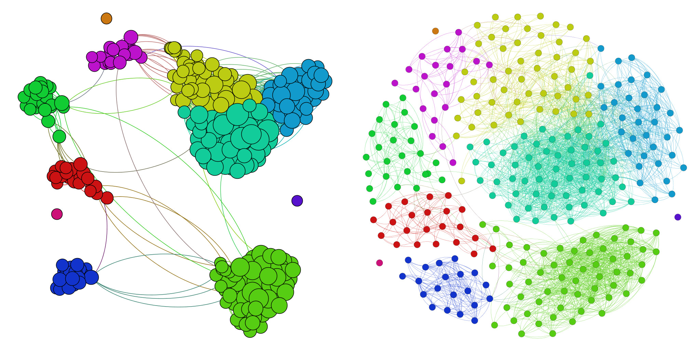
Chapter 10. Cluster Analysis: K-Partitioning
Meng Jiang
CSE 40647/60647 Data Science Fall 2017
Introduction to Data Mining

Slide 2
Cluster Analysis
Cluster Analysis: An Introduction
Partitioning Methods
Density-based Methods
Evaluation of Clustering

Slide 3
Partitioning-Based Clustering Methods
Basic Concepts of Partitioning Algorithms
The K-Means Clustering Method
Initialization of K-Means Clustering
The K-Medoids Clustering Method
The K-Medians and K-Modes Clustering Methods
The Kernel K-Means Clustering Method

Slide 4
Partitioning Algorithms: Basic Concepts
Partitioning method: Discovering the groupings in the data by optimizing a specific objective function and iteratively improving the quality of partitions
K-partitioning method: Partitioning a dataset D of n objects into a set of K clusters so that an objective function is optimized (e.g., the sum of squared distances is minimized, where c_{k} is the centroid or medoid of cluster C_{k})
A typical objective function: Sum of Squared Errors (SSE)
Problem definition: Given K, find a partition of K clusters that optimizes the chosen partitioning criterion
Global optimal: Needs to exhaustively enumerate all partitions
Heuristic methods (i.e., greedy algorithms): K-Means, K-Medians, K-Medoids, etc.

Slide 5
The K-Means Clustering Method
K-Means (MacQueen’67, Lloyd’57/’82)
Each cluster is represented by the center of the cluster
Given K, the number of clusters, the K-Means clustering algorithm is outlined as follows
Select K points as initial centroids
Repeat
Form K clusters by assigning each point to its closest centroid
Re-compute the centroids (i.e., mean point) of each cluster
Until convergence criterion is satisfied
Different kinds of measures can be used
Manhattan distance (L₁ norm), Euclidean distance (L₂ norm), Cosine similarity

Slide 6
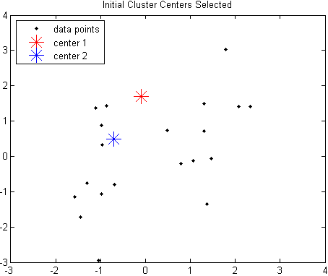
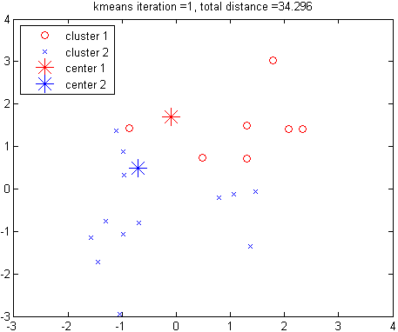
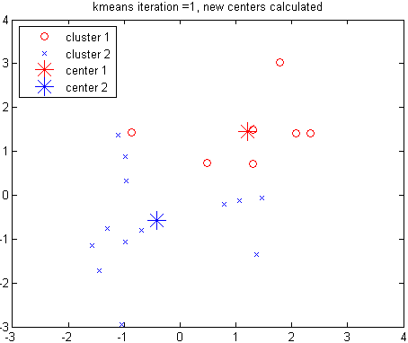
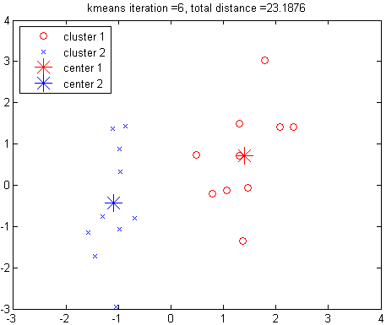
Example: K-Means Clustering
Assign points to clusters
Re-compute cluster centers
The original data points & randomly select K = 2 centroids
Redo point assignment
Execution of the K-Means Clustering Algorithm
Select K points as initial centroids
Repeat
Form K clusters by assigning each point to its closest centroid
Re-compute the centroids (i.e., mean point) of each cluster
Until convergence criterion is satisfied

Slide 7
Discussion on the K-Means Method
Efficiency: O(tKn) where n: # of objects, K: # of clusters, and t: # of iterations
Normally, K, t << n; thus, an efficient method
K-means clustering often terminates at a local optimal
Initialization can be important to find high-quality clusters
Need to specify K, the number of clusters, in advance
There are ways to automatically determine the “best” K
In practice, one often runs a range of values and selected the “best” K value
Sensitive to noisy data and outliers
Variations: Using K-medians, K-medoids, etc.
K-means is applicable only to objects in a continuous n-dimensional space
Using the K-modes for categorical data
Not suitable to discover clusters with non-convex shapes
Using density-based clustering, kernel K-means, etc.

Slide 8
Variations of K-Means
There are many variants of the K-Means method, varying in different aspects
Choosing better initial centroid estimates
K-means++, Intelligent K-Means, Genetic K-Means
Choosing different representative prototypes for the clusters
K-Medoids, K-Medians, K-Modes
Applying feature transformation techniques
Weighted K-Means, Kernel K-Means

Slide 9
Initialization of K-Means
Different initializations may generate rather different clustering results (some could be far from optimal)
Original proposal (MacQueen’67): Select K seeds randomly
Need to run the algorithm multiple times using different seeds
There are many methods proposed for better initialization of k seeds
K-Means++ (Arthur & Vassilvitskii’07):
The first centroid is selected at random
The next centroid selected is the one that is farthest from the currently selected (selection is based on a weighted probability score)
The selection continues until K centroids are obtained

Slide 10
Handling Outliers: From K-Means to K-Medoids
The K-Means algorithm is sensitive to outliers!—since an object with an extremely large value may substantially distort the distribution of the data
K-Medoids: Instead of taking the mean value of the object in a cluster as a reference point, medoids can be used, which is the most centrally located object in a cluster
The K-Medoids clustering algorithm:
Select K points as the initial representative objects (i.e., as initial K medoids)
Repeat
Assigning each point to the cluster with the closest medoid
Randomly select a non-representative object o_{i}
Compute the total cost S of swapping the medoid m with o_{i}
If S < 0, then swap m with o_{i} to form the new set of medoids
Until convergence criterion is satisfied

Slide 11
PAM: A Typical K-Medoids Algorithm
10
9
8
Arbitrary choose K object as initial medoids
Assign each remaining object to nearest medoids
7
6
5
4
3
2
1
0
0
1
2
3
4
5
6
7
8
9
10
K = 2
Swapping O and O_{ramdom}
If quality is improved
Randomly select a non-medoid object,O_{ramdom}
Select initial K medoids randomly
Repeat
Object re-assignment
Swap medoid m with o_{i} if it improves the clustering quality
Until convergence criterion is satisfied
10
Compute total cost of swapping
10
9
9
8
8
7
7
6
6
5
5
4
4
3
3
2
2
1
1
0
0
1
2
3
4
5
6
7
8
9
10
0
0
1
2
3
4
5
6
7
8
9
10

Slide 12
Discussion on K-Medoids Clustering
K-Medoids Clustering: Find representative objects (medoids) in clusters
PAM (Partitioning Around Medoids: Kaufmann & Rousseeuw 1987)
Starts from an initial set of medoids, and
Iteratively replaces one of the medoids by one of the non-medoids if it improves the total sum of the squared errors (SSE) of the resulting clustering
PAM works effectively for small data sets but does not scale well for large data sets (due to the computational complexity)
Computational complexity: PAM: O(K(n − K)²) (quite expensive!)
Efficiency improvements on PAM
CLARA (Kaufmann & Rousseeuw, 1990):
PAM on samples; O(Ks² + K(n − K)), s is the sample size
CLARANS (Ng & Han, 1994): Randomized re-sampling, ensuring efficiency + quality

Slide 13
K-Medians: Handling Outliers by Computing Medians
Medians are less sensitive to outliers than means
Think of the median salary vs. mean salary of a large firm when adding a few top executives!
K-Medians: Instead of taking the mean value of the object in a cluster as a reference point, medians are used (L₁-norm as the distance measure)
The criterion function for the K-Medians algorithm:
The K-Medians clustering algorithm:
Select K points as the initial representative objects (i.e., as initial K medians)
Repeat
Assign every point to its nearest median
Re-compute the median using the median of each individual feature
Until convergence criterion is satisfied

Slide 14
K-Modes: Clustering Categorical Data
K-Means cannot handle non-numerical (categorical) data
Mapping categorical value to 1/0 cannot generate quality clusters for high-dimensional data
K-Modes: An extension to K-Means by replacing means of clusters with modes
Dissimilarity measure between object X and the center of a cluster Z
Φ(x_{j}, z_{j}) = 1 – n_{j}^{r}/n_{l} when x_{j} = z_{j} ; 1 when x_{j} ǂ z_{j}
where z_{j} is the categorical value of attribute j in Z_{l}, n_{l} is the number of objects in cluster l, and n_{j}^{r} is the number of objects whose attribute value is r
This dissimilarity measure (distance function) is frequency-based
Algorithm is still based on iterative object cluster assignment and centroid update
A fuzzy K-Modes method is proposed to calculate a fuzzy cluster membership value for each object to each cluster

Slide 15
References: (II) Partitioning Methods
J. MacQueen. Some Methods for Classification and Analysis of Multivariate Observations. In Proc. of the 5th Berkeley Symp. on Mathematical Statistics and Probability, 1967
S. Lloyd. Least Squares Quantization in PCM. IEEE Trans. on Information Theory, 28(2), 1982
A. K. Jain and R. C. Dubes. Algorithms for Clustering Data. Prentice Hall, 1988
R. Ng and J. Han. Efficient and Effective Clustering Method for Spatial Data Mining. VLDB'94
B. Schölkopf, A. Smola, and K. R. Müller. Nonlinear Component Analysis as a Kernel Eigenvalue Problem. Neural computation, 10(5):1299–1319, 1998
I. S. Dhillon, Y. Guan, and B. Kulis. Kernel K-Means: Spectral Clustering and Normalized Cuts. KDD’04
D. Arthur and S. Vassilvitskii. K-means++: The Advantages of Careful Seeding. SODA’07
C. K. Reddy and B. Vinzamuri. A Survey of Partitional and Hierarchical Clustering Algorithms, in (Chap. 4) Aggarwal and Reddy (eds.), Data Clustering: Algorithms and Applications. CRC Press, 2014

