Slide 1
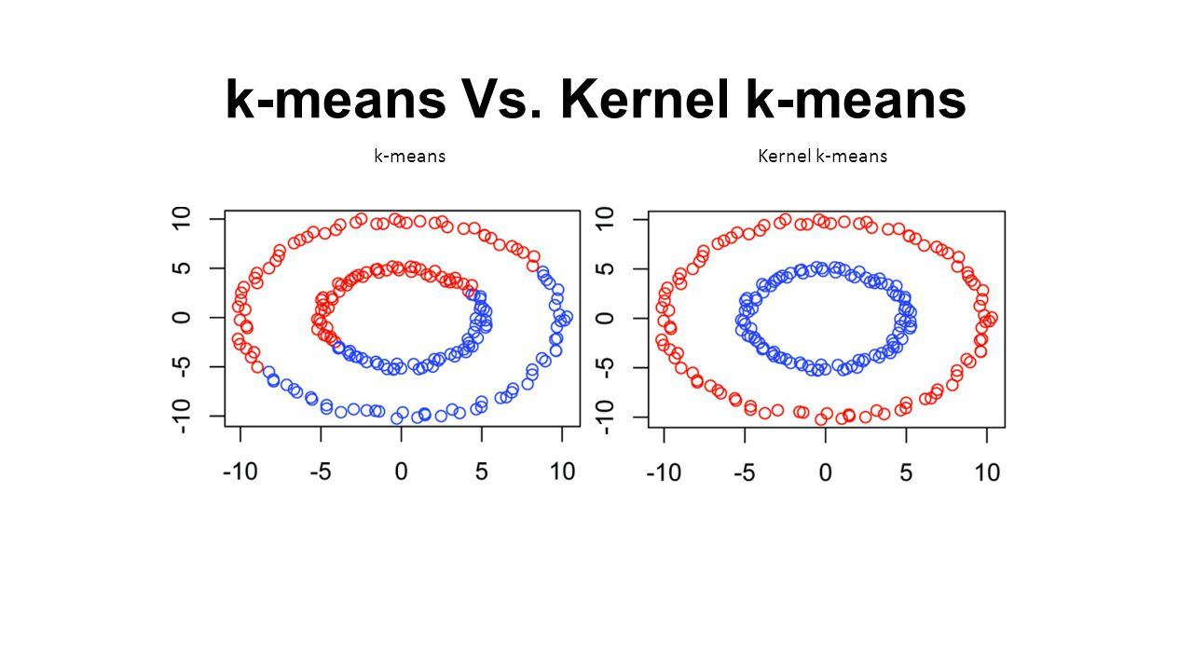
Chapter 10. Cluster Analysis: Kernel K-Means
Meng Jiang
CSE 40647/60647 Data Science Fall 2017
Introduction to Data Mining

Slide 2
Partitioning-Based Clustering Methods
Basic Concepts of Partitioning Algorithms
The K-Means Clustering Method
Initialization of K-Means Clustering
The K-Medoids Clustering Method
The K-Medians and K-Modes Clustering Methods
The Kernel K-Means Clustering Method

Slide 3
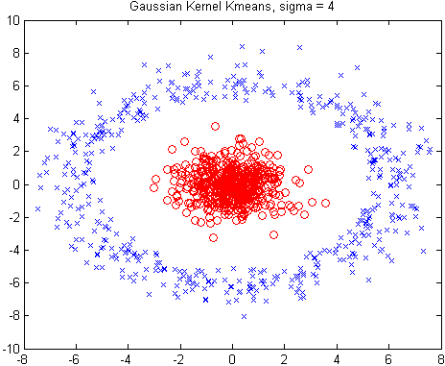
Kernel K-Means Clustering
Kernel K-Means can be used to
detect non-convex clusters
K-Means can only detect clusters
that are linearly separable
Idea: Project data onto the high-dimensional kernel space, and then perform K-Means clustering
Map data points in the input space onto a high-dimensional feature space using the kernel function
Perform K-Means on the mapped feature space
Computational complexity is higher than K-Means
Need to compute and store n x n kernel matrix generated from the kernel function on the original data
The widely studied spectral clustering can be considered as a variant of Kernel K-Means clustering

Slide 4
Kernel Functions and Kernel K-Means Clustering
Kernel matrix:
inner-product(i, j) matrix √
similarity
distance(i, j) matrix ×
Typical kernel functions:
Polynomial kernel of degree h: K(X_{i}, X_{j}) = (X_{i}∙X_{j} + c)^{h}
Gaussian radial basis function (RBF) kernel: K(X_{i}, X_{j}) =
Sigmoid kernel: K(X_{i}, X_{j}) = tanh(κX_{i}∙X_{j} −δ)
The formula for kernel matrix K for any two points x_{i}, x_{j} є C_{k} is
The SSE criterion of kernel K-means:
The formula for the cluster centroid:
Inderjit S. Dhillon, Yiqiang Guan, Brian Kulis (Univ. of Texas at Austin). “Kernel K-means, Spectral Clustering and Normalized Cuts”, KDD 04.
http://www.cs.utexas.edu/users/inderjit/public_papers/kdd_spectral_kernelkmeans.pdf

Slide 5
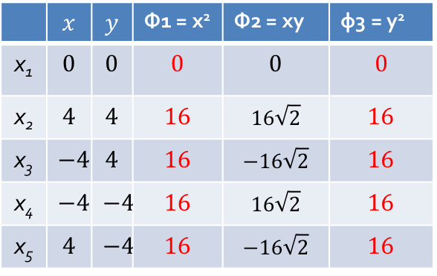


Example: Kernel Functions and Kernel K-Means Clustering
Polynomial kernel of degree h=2: K(X_{i}, X_{j}) = X_{i}∙X_{j} ² → φ(x, y) = (x², $\sqrt{2}$xy, y²)
Suppose there are 5 original 2-dimensional points:
x₁(0, 0), x₂(4, 4), x₃(-4, 4), x₄(-4, -4), x₅(4, -4)
Φ3
x₂
Now linearly separable!!!
x₃
Φ2
x₂
x₄
x₃
x₅
x₅
Φ1
x₄
 | $$x$$ | $$y$$ | Φ1 = x² | Φ2 = xy | φ3 = y²
x₁ | $$0$$ | $$0$$ | $$0$$ | $$0$$ | $$0$$
x₂ | $$4$$ | $$4$$ | $$16$$ | $$16\sqrt{2}$$ | $$16$$
x₃ | $$−4$$ | $$4$$ | $$16$$ | $$−16\sqrt{2}$$ | $$16$$
x₄ | $$−4$$ | $$−4$$ | $$16$$ | $$16\sqrt{2}$$ | $$16$$
x₅ | $$4$$ | $$−4$$ | $$16$$ | $$−16\sqrt{2}$$ | $$16$$
$$K(x_{i},x_{1})$$ | $$K(x_{i},x_{2})$$ | $$K(x_{i},x_{3})$$ | $$K(x_{i},x_{4})$$ | $$K(x_{i},x_{5})$$
$$0$$ | $$0$$ | $$0$$ | $$0$$ | $$0$$
$$0$$ | $$322$$ | $$0$$ | $$322$$ | $$0$$
$$0$$ | $$0$$ | $$322$$ | $$0$$ | $$322$$
$$0$$ | $$322$$ | $$0$$ | $$322$$ | $$0$$
$$0$$ | $$0$$ | $$322$$ | $$0$$ | $$322$$

Slide 6
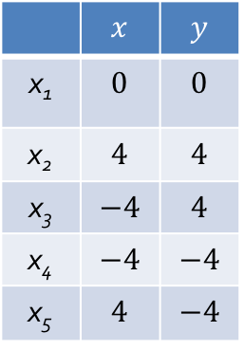
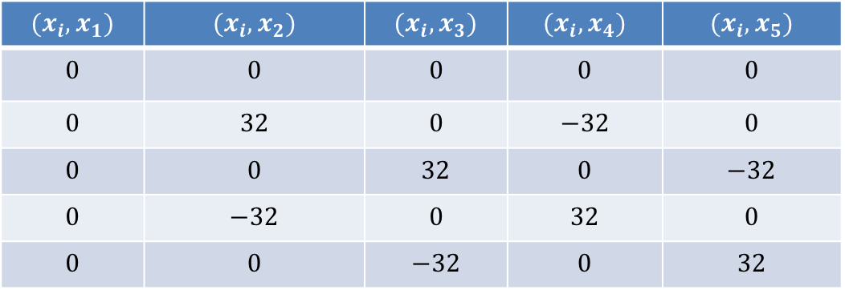
Example: Kernel Functions and Kernel K-Means Clustering
Suppose there are 5 original 2-dimensional points:
x₁(0, 0), x₂(4, 4), x₃(-4, 4), x₄(-4, -4), x₅(4, -4)
Original Space
 | $$x$$ | $$y$$
x₁ | $$0$$ | $$0$$
x₂ | $$4$$ | $$4$$
x₃ | $$−4$$ | $$4$$
x₄ | $$−4$$ | $$−4$$
x₅ | $$4$$ | $$−4$$
$$(x_{i},x_{1})$$ | $$(x_{i},x_{2})$$ | $$(x_{i},x_{3})$$ | $$(x_{i},x_{4})$$ | $$(x_{i},x_{5})$$
$$0$$ | $$0$$ | $$0$$ | $$0$$ | $$0$$
$$0$$ | $$32$$ | $$0$$ | $$−32$$ | $$0$$
$$0$$ | $$0$$ | $$32$$ | $$0$$ | $$−32$$
$$0$$ | $$−32$$ | $$0$$ | $$32$$ | $$0$$
$$0$$ | $$0$$ | $$−32$$ | $$0$$ | $$32$$

Slide 7

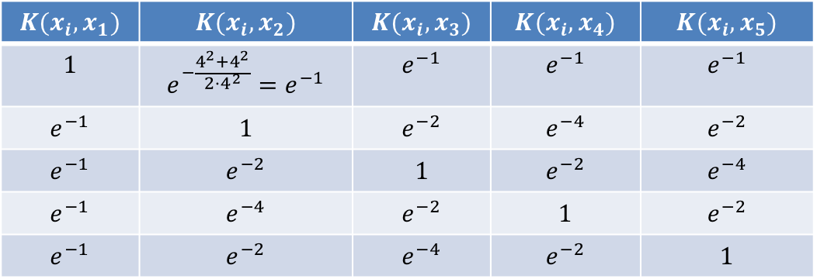

Example: Kernel Functions and Kernel K-Means Clustering
Gaussian radial basis function (RBF) kernel: K(X_{i}, X_{j}) =
Suppose there are 5 original 2-dimensional points:
x₁(0, 0), x₂(4, 4), x₃(-4, 4), x₄(-4, -4), x₅(4, -4)
If we set $σ$ to 4, we will have the following points in the kernel space
E.g., ${\left|\left|x_{1}−x_{2}\right|\right|}^{2}={\left(0−4\right)}^{2}+{\left(0−4\right)}^{2}=32$, therefore, $K\left(x_{1},x_{2}\right)=e^{−\frac{32}{2⋅4^{2}}}=e^{−1}$
Original Space
RBF Kernel Space ($σ=4$)
 | $$x$$ | $$y$$
x₁ | $$0$$ | $$0$$
x₂ | $$4$$ | $$4$$
x₃ | $$−4$$ | $$4$$
x₄ | $$−4$$ | $$−4$$
x₅ | $$4$$ | $$−4$$
$$K(x_{i},x_{1})$$ | $$K(x_{i},x_{2})$$ | $$K(x_{i},x_{3})$$ | $$K(x_{i},x_{4})$$ | $$K(x_{i},x_{5})$$
$$1$$ | $$e^{−\frac{4^{2}+4^{2}}{2⋅4^{2}}}=e^{−1}$$ | $$e^{−1}$$ | $$e^{−1}$$ | $$e^{−1}$$
$$e^{−1}$$ | $$1$$ | $$e^{−2}$$ | $$e^{−4}$$ | $$e^{−2}$$
$$e^{−1}$$ | $$e^{−2}$$ | $$1$$ | $$e^{−2}$$ | $$e^{−4}$$
$$e^{−1}$$ | $$e^{−4}$$ | $$e^{−2}$$ | $$1$$ | $$e^{−2}$$
$$e^{−1}$$ | $$e^{−2}$$ | $$e^{−4}$$ | $$e^{−2}$$ | $$1$$

Slide 8
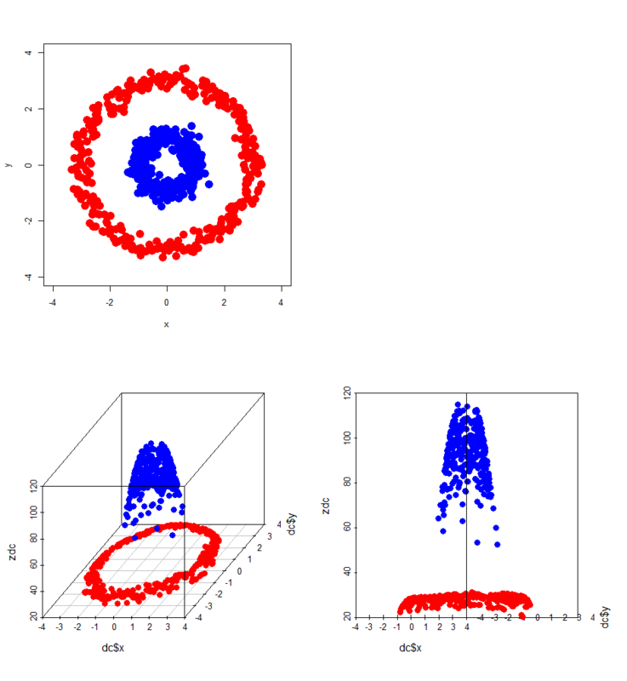
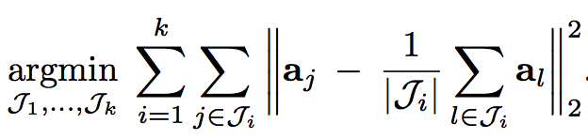
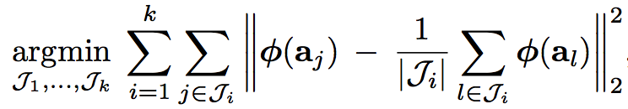

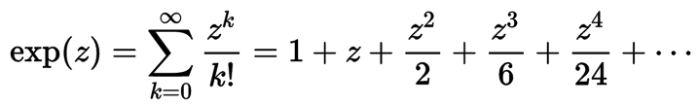
Example: Kernel Functions and Kernel K-Means Clustering
Gaussian radial basis function (RBF) kernel: K(X_{i}, X_{j}) =
Now linearly separable!!!
Countless new features in RBF kernel space…

Slide 9
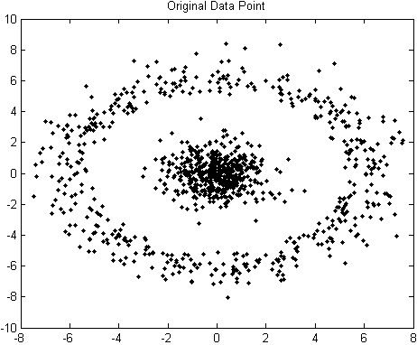
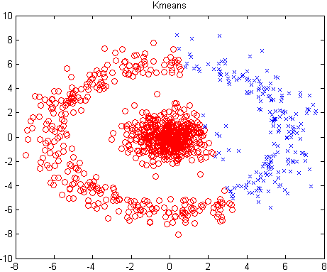
Example: Kernel K-Means Clustering
The above data set cannot generate quality clusters by K-Means since it contains non-convex clusters
Gaussian RBF Kernel transformation maps data to a kernel matrix K for any two points x_{i}, x_{j}: and Gaussian kernel: K(X_{i}, X_{j}) =
K-Means clustering is conducted on the mapped data, generating quality clusters
The original data set
The result of Gaussian Kernel K-Means clustering
The result of K-Means clustering

Slide 10
References: (II) Partitioning Methods
J. MacQueen. Some Methods for Classification and Analysis of Multivariate Observations. In Proc. of the 5th Berkeley Symp. on Mathematical Statistics and Probability, 1967
S. Lloyd. Least Squares Quantization in PCM. IEEE Trans. on Information Theory, 28(2), 1982
A. K. Jain and R. C. Dubes. Algorithms for Clustering Data. Prentice Hall, 1988
R. Ng and J. Han. Efficient and Effective Clustering Method for Spatial Data Mining. VLDB'94
B. Schölkopf, A. Smola, and K. R. Müller. Nonlinear Component Analysis as a Kernel Eigenvalue Problem. Neural computation, 10(5):1299–1319, 1998
I. S. Dhillon, Y. Guan, and B. Kulis. Kernel K-Means: Spectral Clustering and Normalized Cuts. KDD’04
D. Arthur and S. Vassilvitskii. K-means++: The Advantages of Careful Seeding. SODA’07
C. K. Reddy and B. Vinzamuri. A Survey of Partitional and Hierarchical Clustering Algorithms, in (Chap. 4) Aggarwal and Reddy (eds.), Data Clustering: Algorithms and Applications. CRC Press, 2014

