Slide 1
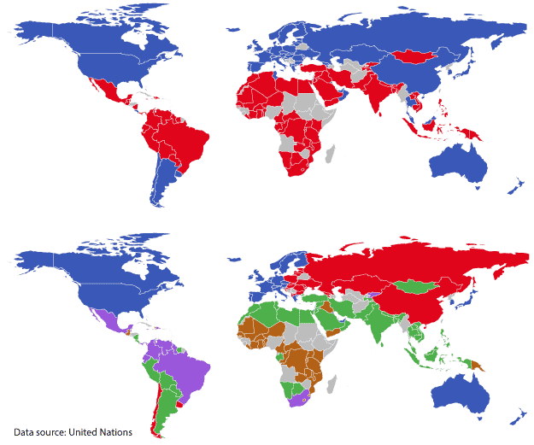
Chapter 10. Cluster Analysis: Evaluation
Meng Jiang
CSE 40647/60647 Data Science Fall 2017
Introduction to Data Mining

Slide 2
Cluster Analysis
Cluster Analysis: An Introduction
Partitioning Methods
Density-based Methods
Evaluation of Clustering

Slide 3
Clustering Validation
Clustering Validation: Basic Concepts
Clustering Evaluation: Measuring Clustering Quality
External Measures for Clustering Validation
I: Matching-Based Measures
II: Pairwise Measures
III: Entropy-Based Measures
Internal Measures for Clustering Validation: BetaCV
Relative Measures for Clustering Validation

Slide 4
Clustering Validation and Assessment
Major issues on clustering validation and assessment
Clustering evaluation
Evaluating the goodness of the clustering
Clustering stability
To understand the sensitivity of the clustering result to various algorithm parameters, e.g., # of clusters
Clustering tendency
Assess the suitability of clustering, i.e., whether the data has any inherent grouping structure

Slide 5
Measuring Clustering Quality
Clustering Evaluation: Evaluating the goodness of clustering results
No commonly recognized best suitable measure in practice
Three categorization of measures: External, internal, and relative
External: Supervised, employ criteria not inherent to the dataset
Compare a clustering against prior or expert-specified knowledge (i.e., the ground truth) using certain clustering quality measure
Internal: Unsupervised, criteria derived from data itself
Evaluate the goodness of a clustering by considering how well the clusters are separated and how compact the clusters are, e.g., silhouette coefficient
Relative: Directly compare different clusterings, usually those obtained via different parameter settings for the same algorithm

Slide 6
Measuring Clustering Quality: External Methods
Given the ground truth T, Q(C, T) is the quality measure for a clustering C
Q(C, T) is good if it satisfies the following four essential criteria
Cluster homogeneity
The purer, the better
Cluster completeness
Assign objects belonging to the same category in the ground truth to the same cluster
Rag bag better than alien
Putting a heterogeneous object into a pure cluster should be penalized more than putting it into a rag bag (i.e., “miscellaneous” or “other” category)
Small cluster preservation
Splitting a small category into pieces is more harmful than splitting a large category into pieces

Slide 7
Commonly Used External Measures
Matching-based measures
Purity, maximum matching, F-measure
Pairwise measures
Four possibilities: True positive (TP), FN, FP, TN
Jaccard coefficient, Rand statistic, Fowlkes-Mallow measure
Entropy-Based Measures
Conditional entropy
Normalized mutual information (NMI)
Variation of information
Ground truth partitioning T₁
T₂
Cluster C₁
Cluster C₂

Slide 8
Matching-Based Measures (I): Purity vs. Maximum Matching
Purity: Quantifies the extent that cluster C_{i} contains points only from one (ground truth) partition:
Total purity of clustering C:
Perfect clustering if purity = 1 and r = k (the number of clusters obtained is the same as that in the ground truth)
Ex. 1 (green or orange): purity₁ = 30/50; purity₂ = 20/25; purity₃ = 25/25; purity = (30 + 20 + 25)/100 = 0.75
Two clusters may share the same majority partition
Maximum matching: Only one cluster can match one partition
Maximum weight matching: Paire-wise
Ex2. (green) match = purity = 0.75; (orange) match = 0.65 > 0.6
Ground Truth T₁
T₂
T₃
Cluster C₁
C₂
C₃
C\T | T₁ | T₂ | T₃ | Sum
C₁ | 0 | 20 | 30 | 50
C₂ | 0 | 20 | 5 | 25
C₃ | 25 | 0 | 0 | 25
m_{j} | 25 | 40 | 35 | 100
C\T | T₁ | T₂ | T₃ | Sum
C₁ | 0 | 30 | 20 | 50
C₂ | 0 | 20 | 5 | 25
C₃ | 25 | 0 | 0 | 25
m_{j} | 25 | 50 | 25 | 100

Slide 9
Matching-Based Measures (II): F-Measure
Precision: The fraction of points in C_{i} from the majority partition (i.e., the same as purity), where j_{i} is the partition that contains the maximum # of points from C_{i}
Ex. For the green table
prec₁ = 30/50; prec₂ = 20/25; prec₃ = 25/25
Recall: The fraction of point in partition shared in common with cluster C_{i}, where
Ex. For the green table
recall₁ = 30/35; recall₂ = 20/40; recall₃ = 25/25
F-measure for C_{i}: The harmonic means of prec_{i} and recall_{i}:
F-measure for clustering C: average of all clusters:
Ex. For the green table
F₁ = 60/85; F₂ = 40/65; F₃ = 1; F = 0.774
Ground Truth T₁
T₂
T₃
Cluster C₁
C₂
C₃
C\T | T₁ | T₂ | T₃ | Sum
C₁ | 0 | 20 | 30 | 50
C₂ | 0 | 20 | 5 | 25
C₃ | 25 | 0 | 0 | 25
m_{j} | 25 | 40 | 35 | 100

Slide 10
Pairwise Measures: Four Possibilities for Truth Assignment
Four possibilities based on the agreement between cluster label and partition label
TP: true positive—Two points x_{i} and x_{j} belong to the same partition T , and they also in the same cluster C
where y_{i}: the true partition label , and : the cluster label for point x_{i}
FN: false negative:
FP: false positive
TN: true negative
Calculate the four measures:
Total # of pairs of points

Slide 11
Pairwise Measures: Jaccard Coefficient and Rand Statistic
Jaccard coefficient: Fraction of true positive point pairs, but after ignoring the true negatives (thus asymmetric)
Jaccard = TP/(TP + FN + FP) [i.e., denominator ignores TN]
Perfect clustering: Jaccard = 1
Rand Statistic:
Rand = (TP + TN)/N_total
Symmetric; perfect clustering: Rand = 1
Fowlkes-Mallow Measure:
Geometric mean of precision and recall
Using the above formulas, one can calculate all the measures for the green table (leave as an exercise)
C\T | T₁ | T₂ | T₃ | Sum
C₁ | 0 | 20 | 30 | 50
C₂ | 0 | 20 | 5 | 25
C₃ | 25 | 0 | 0 | 25
m_{j} | 25 | 40 | 35 | 100

Slide 12
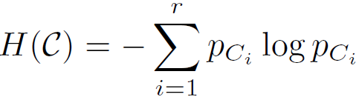
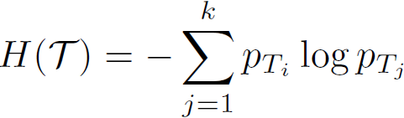
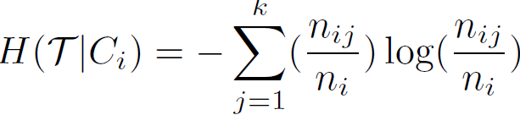
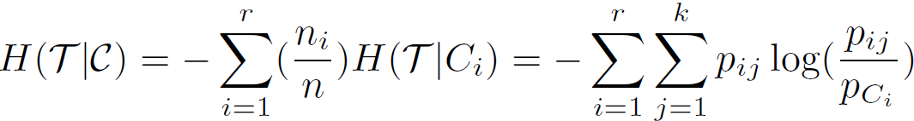

Entropy-Based Measures (I): Conditional Entropy
Entropy of clustering C:
Entropy of partitioning T:
Entropy of T with respect to cluster C_{i}:
Conditional entropy of T with respect to clustering C:
The more a cluster’s members are split into different partitions, the higher the conditional entropy
For a perfect clustering, the conditional entropy value is 0, where the worst possible conditional entropy value is log k

Slide 13

Entropy-Based Measures (II): Normalized Mutual Information (NMI)
Mutual information:
Quantifies the amount of shared info between
the clustering C and partitioning T
Measures the dependency between the observed joint probability p_{ij} of C and T, and the expected joint probability p_{Ci} . p_{Tj} under the independence assumption
When C and T are independent, p_{ij} = p_{Ci} . p_{Tj}, I(C, T) = 0. However, there is no upper bound on the mutual information
Normalized mutual information (NMI)
Value range of NMI: [0,1]. Value close to 1 indicates a good clustering

Slide 14
Internal Measures: BetaCV Measure
A trade-off in maximizing intra-cluster compactness and inter-cluster separation
Given a clustering C = {C₁, . . ., C_{k}} with k clusters, cluster C_{i} containing n_{i} = |C_{i}| points
Let W(S, R) be sum of weights on all edges with one vertex in S and the other in R
The sum of all the intra-cluster weights over all clusters:
The sum of all the inter-cluster weights:
The number of distinct intra-cluster edges:
The number of distinct inter-cluster edges:
Beta-CV measure:
The ratio of the mean intra-cluster distance to the mean inter-cluster distance
The smaller, the better the clustering

Slide 15
Summary
Cluster Analysis: An Introduction
Partitioning Methods
Density-based Methods
Evaluation of Clustering

Slide 16
References: (IV) Evaluation of Clustering
M. J. Zaki and W. Meira, Jr.. Data Mining and Analysis: Fundamental Concepts and Algorithms. Cambridge University Press, 2014
L. Hubert and P. Arabie. Comparing Partitions. Journal of Classification, 2:193–218, 1985
A. K. Jain and R. C. Dubes. Algorithms for Clustering Data. Printice Hall, 1988
M. Halkidi, Y. Batistakis, and M. Vazirgiannis. On Clustering Validation Techniques. Journal of Intelligent Info. Systems, 17(2-3):107–145, 2001
J. Han, M. Kamber, and J. Pei. Data Mining: Concepts and Techniques. Morgan Kaufmann, 3rd ed. , 2011
H. Xiong and Z. Li. Clustering Validation Measures. in (Chapter 23) C. Aggarwal and C. K. Reddy (eds.), Data Clustering: Algorithms and Applications. CRC Press, 2014

