Slide 1

Chapter 11. Outlier Analysis:
Methods
Meng Jiang
CSE 40647/60647 Data Science Fall 2017
Introduction to Data Mining

Slide 2
Outlier Analysis
Basic Concepts
Outlier Detection Methods
Statistical Approaches
Clustering-Based Approaches
Classification-Based Approaches

Slide 3
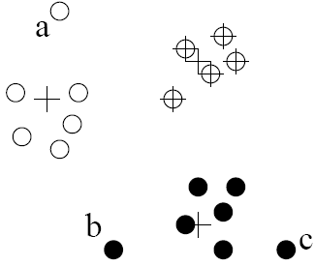
Clustering-Based Outlier Detection (1 & 2): Not belong to any cluster, or far from the closest one
An object is an outlier if (1) it does not belong to any cluster, (2) there is a large distance between the object and its closest cluster , or (3) it belongs to a small or sparse cluster
Case I: Not belong to any cluster
Identify animals not part of a flock: Using a density-based clustering method such as DBSCAN
Case 2: Far from its closest cluster
Using k-means, partition data points of into clusters
For each object o, assign an outlier score based on its distance from its closest center
If dist(o, co)/avg_dist(co) is large, likely an outlier
Ex. Intrusion detection: Consider the similarity between data points and the clusters in a training data set
Use a training set to find patterns of “normal” data, e.g., frequent itemsets in each segment, and cluster similar connections into groups
Compare new data points with the clusters mined—Outliers are possible attacks

Slide 4
Clustering-Based Outlier Detection (3): Detecting Outliers in Small Clusters
FindCBLOF: Detect outliers in small clusters
Find clusters, and sort them in decreasing size
To each data point, assign a cluster-based local outlier factor (CBLOF):
If obj p belongs to a large cluster, CBLOF = cluster_size X similarity between p and cluster
If p belongs to a small one, CBLOF = cluster size X similarity betw. p and the closest large cluster
Ex. In the figure, o is outlier since its closest large cluster is C1, but the similarity between o and C1 is small. For any point in C3, its closest large cluster is C2 but its similarity from C2 is low, plus |C3| = 3 is small

Slide 5
Clustering-Based Method: Strength and Weakness
Strength
Detect outliers without requiring any labeled data
Work for many types of data
Clusters can be regarded as summaries of the data
Once the cluster are obtained, need only compare any object against the clusters to determine whether it is an outlier (fast)
Weakness
Effectiveness depends highly on the clustering method used—they may not be optimized for outlier detection
High computational cost: Need to first find clusters
A method to reduce the cost: Fixed-width clustering
A point is assigned to a cluster if the center of the cluster is within a pre-defined distance threshold from the point
If a point cannot be assigned to any existing cluster, a new cluster is created and the distance threshold may be learned from the training data under certain conditions

Slide 6
Outlier Analysis
Basic Concepts
Outlier Detection Methods
Statistical Approaches
Clustering-Based Approaches
Classification-Based Approaches

Slide 7
Classification-Based Method I: One-Class Model
Idea: Train a classification model that can distinguish “normal” data from outliers
A brute-force approach: Consider a training set that contains samples labeled as “normal” and others labeled as “outlier”
But, the training set is typically heavily biased: # of “normal” samples likely far exceeds # of outlier samples
Cannot detect unseen anomaly
One-class model: A classifier is built to describe only the normal class.
Learn the decision boundary of the normal class using classification methods such as SVM
Any samples that do not belong to the normal class (not within the decision boundary) are declared as outliers
Adv: can detect new outliers that may not appear close to any outlier objects in the training set
Extension: Normal objects may belong to multiple classes

Slide 8
Classification-Based Method II: Semi-Supervised Learning
Semi-supervised learning: Combining classification-based and clustering-based methods
Method
Using a clustering-based approach, find a large cluster, C, and a small cluster, C₁
Since some objects in C carry the label “normal”, treat all objects in C as normal
Use the one-class model of this cluster to identify normal objects in outlier detection
Since some objects in cluster C₁ carry the label “outlier”, declare all objects in C₁ as outliers
Any object that does not fall into the model for C (such as a) is considered an outlier as well

Slide 9
Classification-Based Method: Strength and Weakness
Strength: Outlier detection is fast
Bottleneck: Quality heavily depends on the availability and quality of the training set, but often difficult to obtain representative and high-quality training data

Slide 10
Summary
Basic Concepts
Outlier Detection Methods
Statistical Approaches
Clustering-Based Approaches
Classification-Based Approaches

Slide 11
References (1)
B. Abraham and G.E.P. Box. Bayesian analysis of some outlier problems in time series. Biometrika, 1979.
Malik Agyemang, Ken Barker, and Rada Alhajj. A comprehensive survey of numeric and symbolic outlier mining techniques. Intell. Data Anal., 2006.
Deepak Agarwal. Detecting anomalies in cross-classied streams: a bayesian approach. Knowl. Inf. Syst., 2006.
C. C. Aggarwal and P. S. Yu. Outlier detection for high dimensional data. SIGMOD'01.
M. M. Breunig, H.-P. Kriegel, R. T. Ng, and J. Sander. Optics-of: Identifying local outliers. PKDD '99
M. M. Breunig, H.-P. Kriegel, R. Ng, and J. Sander. LOF: Identifying density-based local outliers. SIGMOD'00.
V. Chandola, A. Banerjee, and V. Kumar. Anomaly detection: A survey. ACM Comput. Surv., 2009.
D. Dasgupta and N.S. Majumdar. Anomaly detection in multidimensional data using negative selection algorithm. Computational Intelligence, 2002.
E. Eskin, A. Arnold, M. Prerau, L. Portnoy, and S. Stolfo. A geometric framework for unsupervised anomaly detection: Detecting intrusions in unlabeled data. In Proc. 2002 Int. Conf. of Data Mining for Security Applications, 2002.
E. Eskin. Anomaly detection over noisy data using learned probability distributions. ICML’00.
T. Fawcett and F. Provost. Adaptive fraud detection. Data Mining and Knowledge Discovery, 1997.
R. Fujimaki, T. Yairi, and K. Machida. An approach to spacecraft anomaly detection problem using kernel feature space. KDD '05
F. E. Grubbs. Procedures for detecting outlying observations in samples. Technometrics, 1969.

Slide 12
References (2)
V. Hodge and J. Austin. A survey of outlier detection methodologies. Artif. Intell. Rev., 2004.
Douglas M Hawkins. Identification of Outliers. Chapman and Hall, 1980.
P. S. Horn, L. Feng, Y. Li, and A. J. Pesce. Effect of Outliers and Nonhealthy Individuals on Reference Interval Estimation. Clin Chem, 2001.
W. Jin, A. K. H. Tung, J. Han, and W. Wang. Ranking outliers using symmetric neighborhood relationship. PAKDD'06
E. Knorr and R. Ng. Algorithms for mining distance-based outliers in large datasets. VLDB’98
M. Markou and S. Singh.. Novelty detection: a review| part 1: statistical approaches. Signal Process., 83(12), 2003.
M. Markou and S. Singh. Novelty detection: a review| part 2: neural network based approaches. Signal Process., 83(12), 2003.
S. Papadimitriou, H. Kitagawa, P. B. Gibbons, and C. Faloutsos. Loci: Fast outlier detection using the local correlation integral. ICDE'03.
A. Patcha and J.-M. Park. An overview of anomaly detection techniques: Existing solutions and latest technological trends. Comput. Netw., 51(12):3448{3470, 2007.
W. Stefansky. Rejecting outliers in factorial designs. Technometrics, 14(2):469{479, 1972.
X. Song, M. Wu, C. Jermaine, and S. Ranka. Conditional anomaly detection. IEEE Trans. on Knowl. and Data Eng., 19(5):631{645, 2007.
Y. Tao, X. Xiao, and S. Zhou. Mining distance-based outliers from large databases in any metric space. KDD '06:
N. Ye and Q. Chen. An anomaly detection technique based on a chi-square statistic for detecting intrusions into information systems. Quality and Reliability Engineering International, 2001.

Slide 13
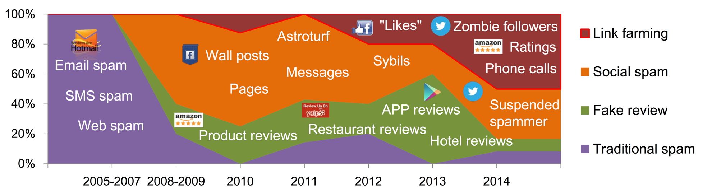
Suspicious Behavior Detection
Meng Jiang, Peng Cui, and Christos Faloutsos. “Suspicious behavior detection: current trends and future directions.” IEEE Intelligent Systems, 2016. (Survey paper)
Social Link Farming

Slide 14


Catching Social Link Farming

Slide 15


Catching Zombie Followers
“Your best followers!”
“Delivery within 1-2 days”

Slide 16


Catching Zombie Followers
Fake account detection [Egele and Stringhini et al. NDSS’13; Yang and Wilson et al. TKDD’14; Viswanath and Bashir et al. USENIX Security Symposium’14]
product managers
engineers
Knowledge from manual inspection:
#followees, #followers, #tweets, #hashtags, #urls…
“Your best followers!”
“Delivery within 1-2 days”
Learning models (classifiers)
Poor accuracy
(serious complaints from users)

Slide 17

Is this account a zombie follower???
0 tweet

Slide 18
Methodology
Large (“who-follows-whom”) graphs
Knowledge of differences between normal and zombie followers

Slide 19
Methodology
Large (“who-follows-whom”) graphs
Behavioral theory
(Think what they have to do, not what they can do!)
Knowledge of differences between normal and zombie followers
“Your best followers!”
“Delivery within 1-2 days”
Consistently Connecting to Customers

Slide 20
Methodology
Large (“who-follows-whom”) graphs
Behavioral theory
(Think what they have to do, not what they can do!)
Observation from
the graph data
Distort the graph structure?
Knowledge of differences between normal and zombie followers
“Your best followers!”
“Delivery within 1-2 days”
Consistently Connecting to Customers

Slide 21
Methodology
Large (“who-follows-whom”) graphs
Behavioral theory
(Think what they have to do, not what they can do!)
Observation from
the graph data
Distort the graph structure?
Knowledge of differences between normal and zombie followers
Algorithm: Catching zombie followers
Performance?

Slide 22
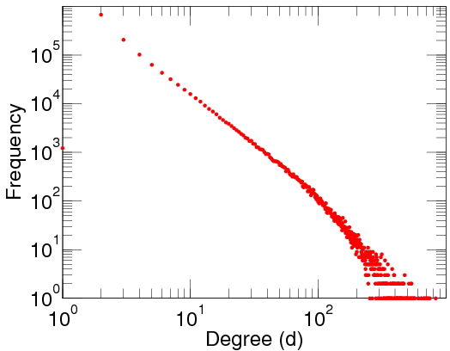
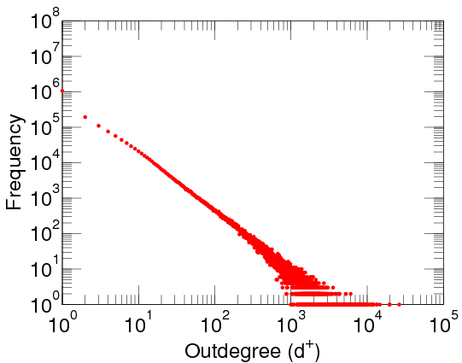
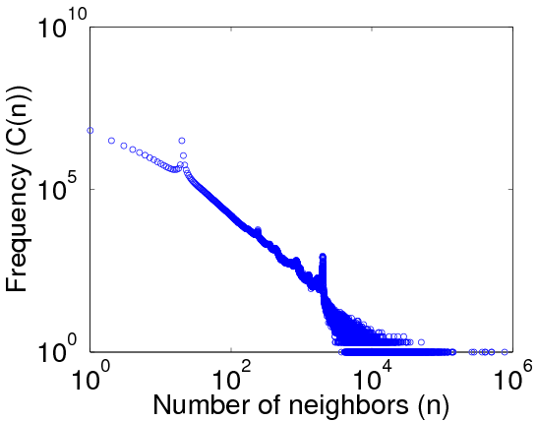
Out-Degree Distributions: Power Law Expected
Power-law distributions in networks [Faloutsos et al. SIGCOMM’99; Chung et al. PNAS’02]
DBLP Author-publication | Flickr User-user | Twitter Who-follows-whom
[konect.uni-koblenz.de/networks/]

Slide 23


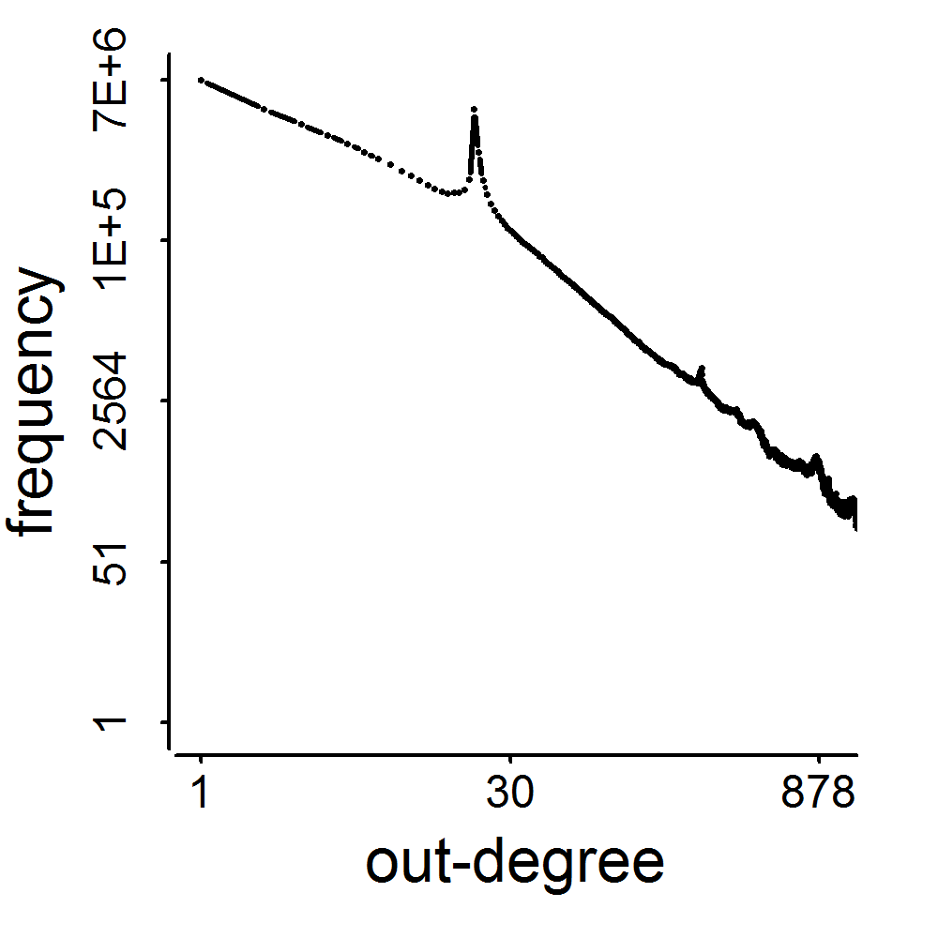
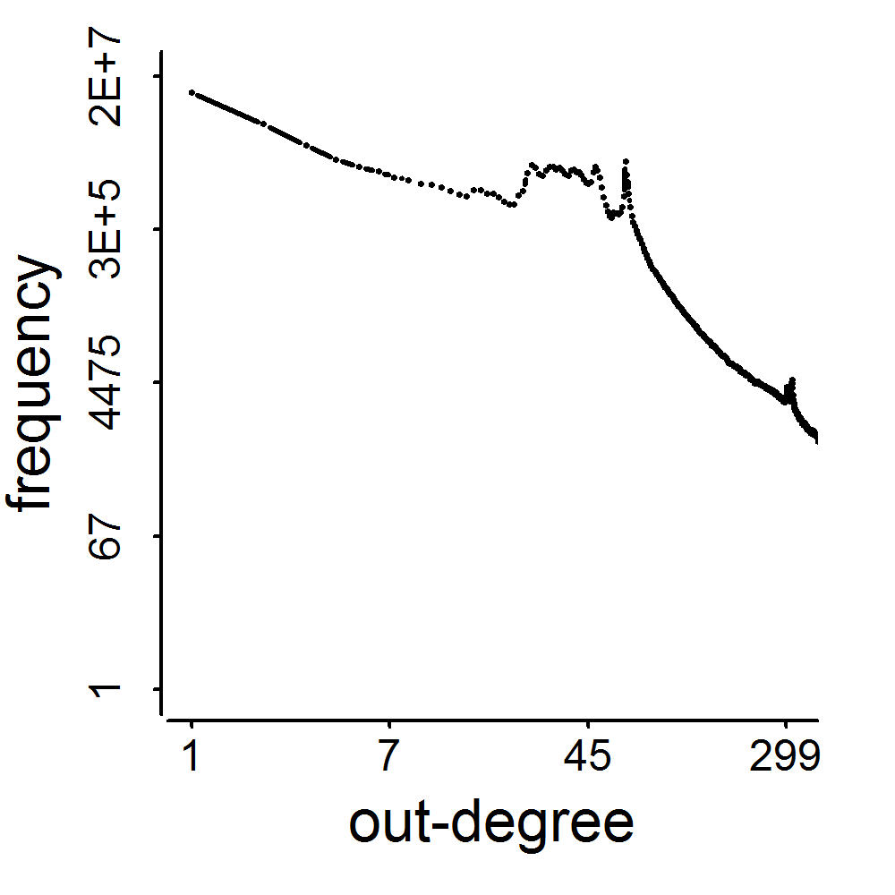
Spikes!
2009
41M
2011
117M
3.17M
1.91M
0.41M
0.44M
d=20
d=64

Slide 24
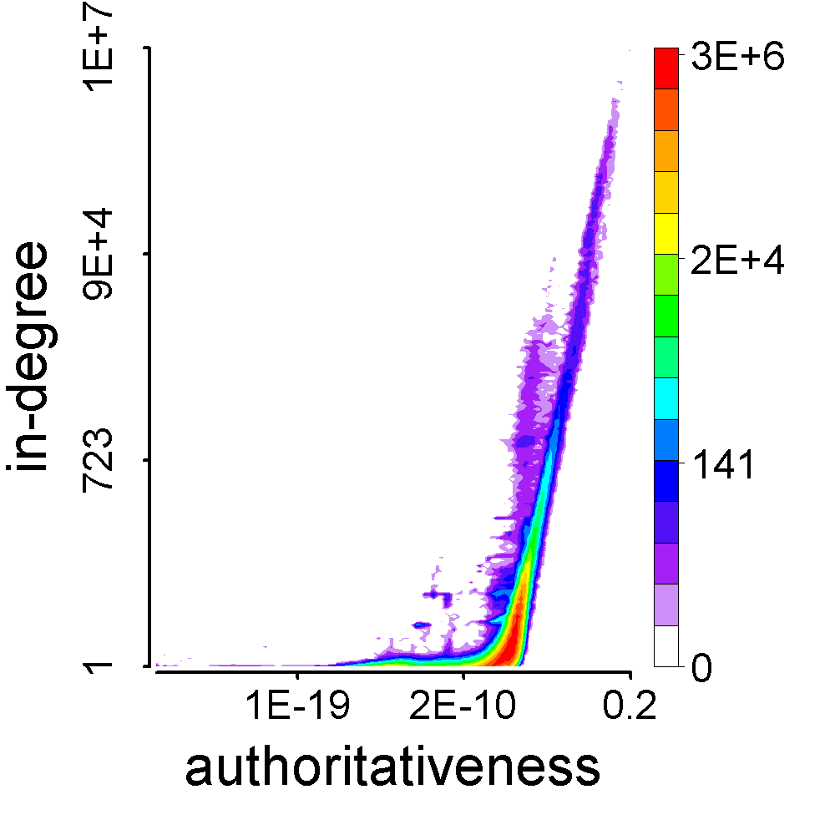
How We/They Connect to Our/Their Followees
Barack Obama
The HITS algorithm. Kleinberg. “Authoritative sources in a hyperlinked environment.” JACM’99.
Meng Jiang

Slide 25
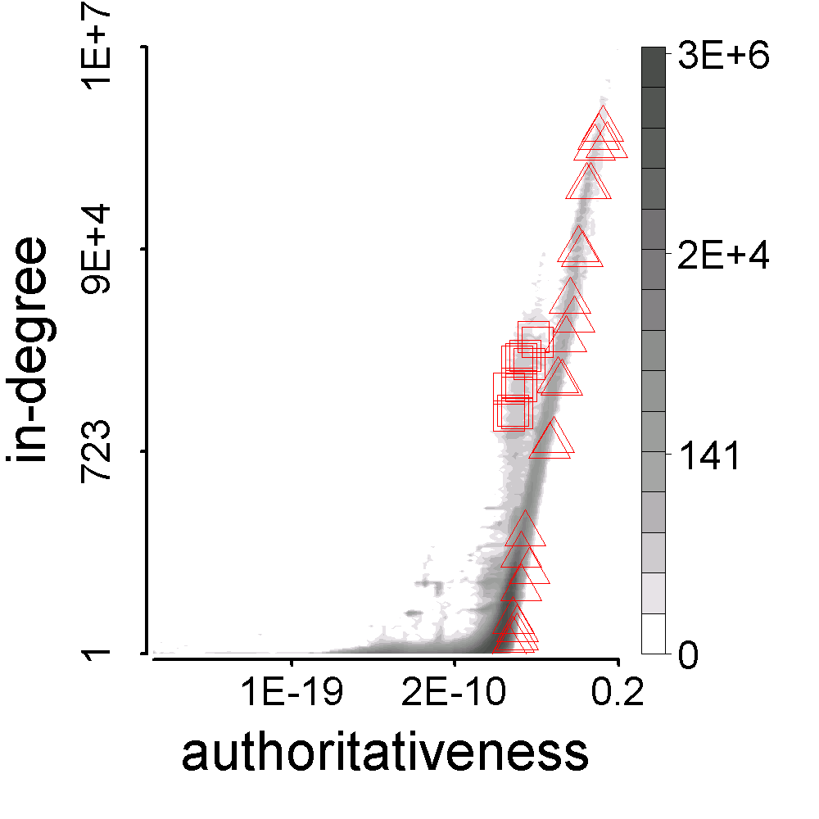

How We/They Connect to Our/Their Followees
Meng Jiang’s
followees
Buy AB22’s
followees

Slide 26
How We/They Connect to Our/Their Followees
Meng Jiang’s
followees
Buy AB22’s
followees
Synchronized: too similar with each other
Abnormal: too different from the majority

Slide 27
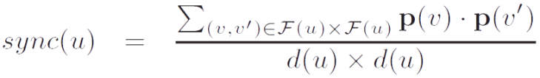
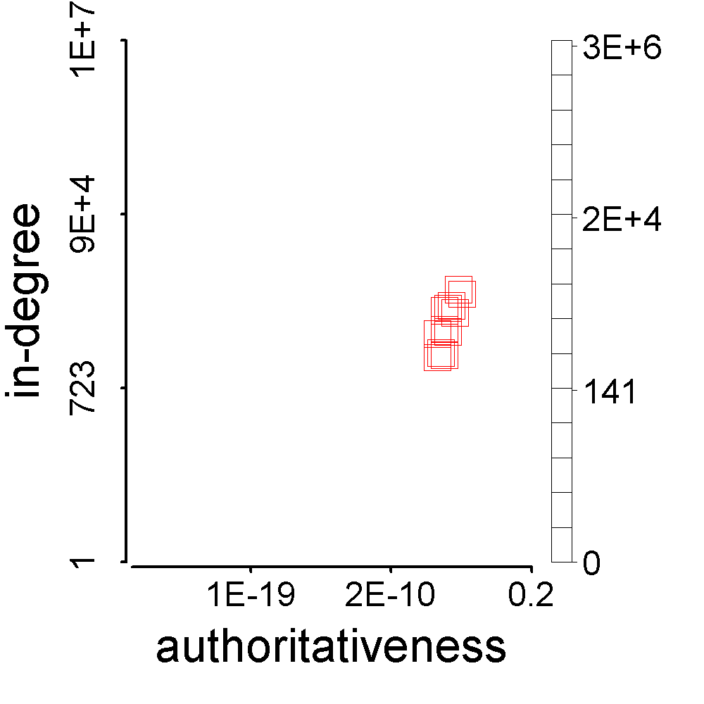
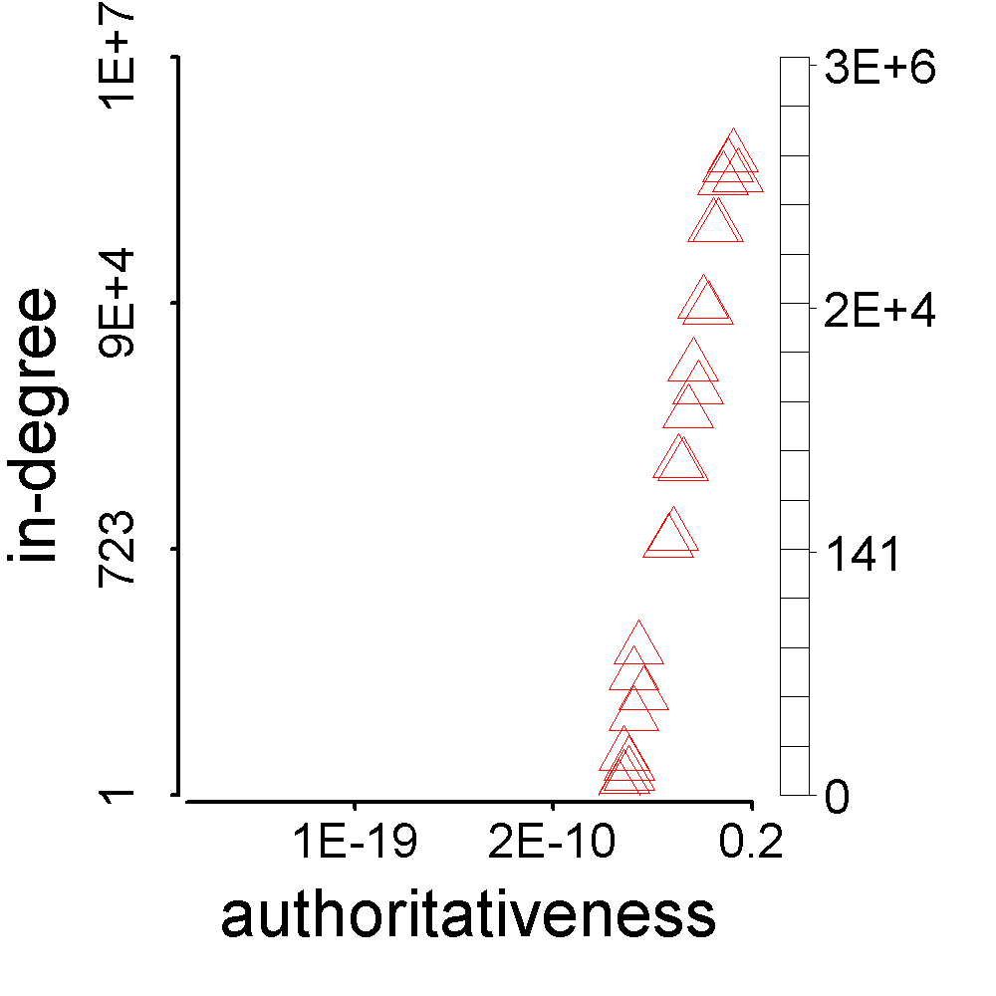
Definition: Synchronicity
Buy AB22’s
followees
Meng Jiang’s
followees
>

Slide 28
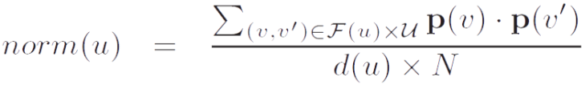
Definition: Normality
Buy AB22’s
followee
<
Meng Jiang’s
followee

Slide 29
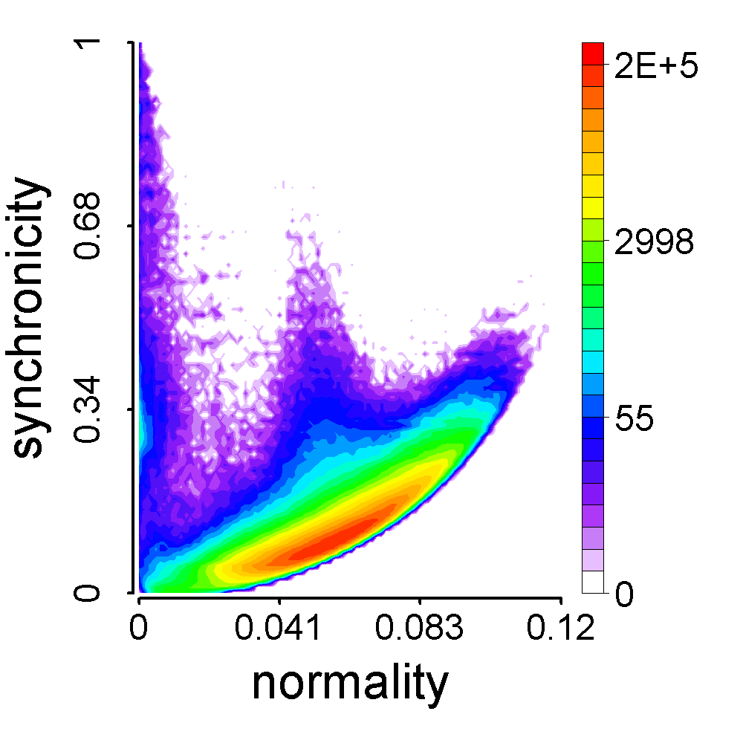
When is the Synchronicity Too High?
Problem: Given a normality value (n) of a follower, find the minimal synchronicity value (s_{min}).
Theorem:
Our CatchSync:
– G n² + 2 n – s_{b}
1 – G s_{b}
s_{min} =
(parabolic lower limit)
Buy AB22 &
Aisling Walsh
Meng Jiang

Slide 30

Proof
G grids
fp_{g}: #foreground points in grid g
∑ fp_{g} = F = d(u) (#followees of u)
Given normality
n = ∑ (fp_{g}/F) (bp_{g}/B) = ∑ f_{g}b_{g},
find minimal synchronicity
s_{min} = ∑ (fp_{g}/F) (fp_{g}/F) = ∑ f_{g}²
where
∑f_{g} = 1, ∑b_{g} = 1
bp_{g}: #background points in grid g
∑ bp_{g} = B = N (#all users)

Slide 31
Proof
Lagrange multiplier:
minimize s(f_{g}) = ∑ f_{g}²
subject to ∑ f_{g} = 1, ∑ f_{g}b_{g} = n
Lagrange function:
F(f_{g}, λ, μ) = (∑ f_{g}²) + λ (∑ f_{g} – 1) + μ (∑ f_{g}b_{g} – n)
Gradients:
▽f_{g}F = 2 f_{g} + λ + μ b_{g} = 0
▽λF = ∑ f_{g} – 1 = 0
▽μF = ∑ f_{g}b_{g} – n = 0
2 + λ G + μ = 0
2 n + λ + μ s_{b} = 0
2 s_{min} + λ + μ n = 0
where s_{b} = ∑ b_{g}².
Therefore,
– G n² + 2 n – s_{b}
1 – G s_{b}
G grids
∑
× b_{g} ∑
× f_{g} ∑
s_{min} =

Slide 32
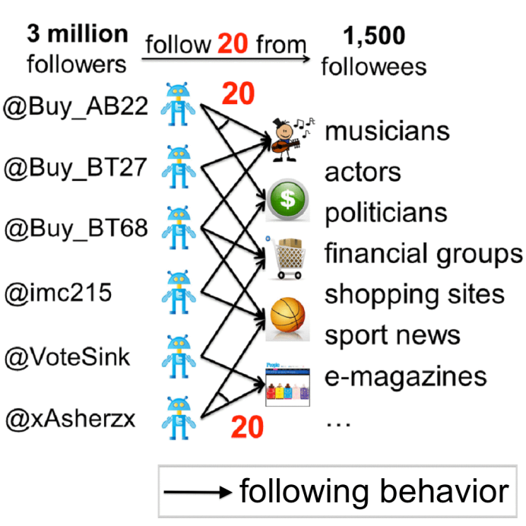
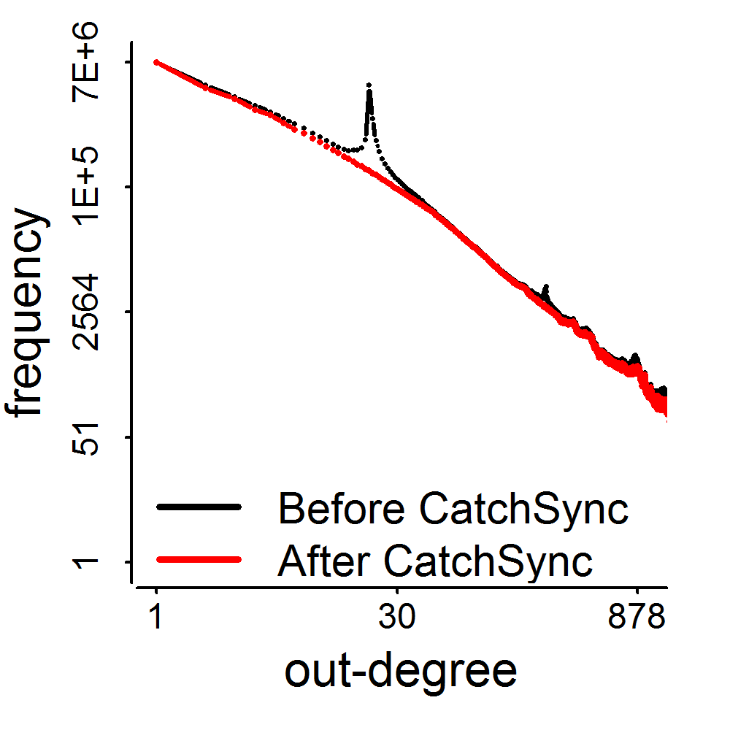
The Distribution was Recovered!
3.17M
0.41M
d=20

Slide 33
Discussion
What kind of outliers?
Unsupervised learning for collective outliers
Camouflage?

