Slide 1
Mid-term Exam Stats
37 students
100: 3
Afzal Hossain
Rosaura Vidal Mata
Hao Zheng
95-99: 7
90-94: 13
85-89: 10
< 85: 4 (min: 75)
91 (Mean) ± 6 (Stdev)
Median: 92
Mode: 94
Get your graded exam paper after class.

Slide 2
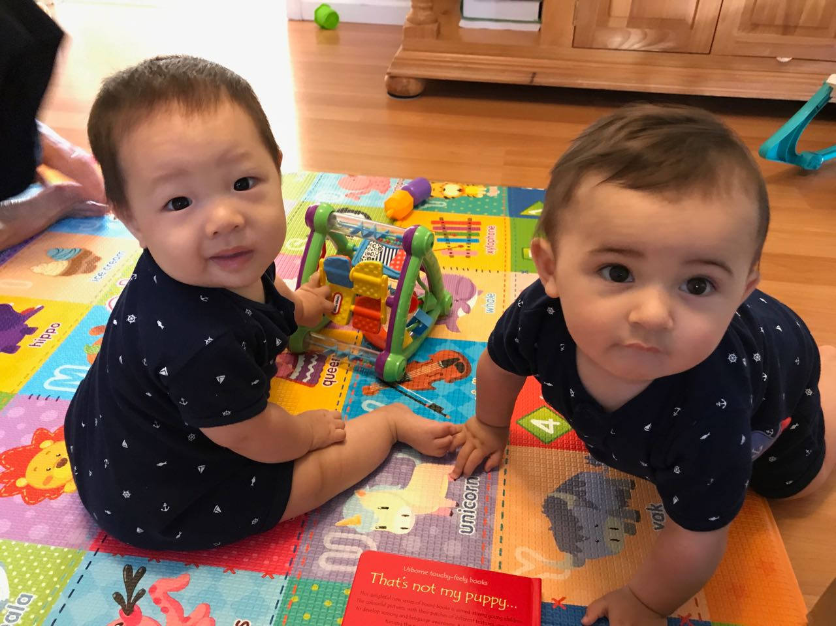
Project Team Pairing
12 two-member teams!
3 single-member teams:
Afzal Hossain (graduate)
Rachel Krohn (graduate)
Lauren Ferrara (underg.)
❤ Graduates:
Anselme Mucunguzi
Satyaki Sikdar
Famim Talukder
Kuang Wu
Shengsheng Yuan
❤ Undergraduates:
Aron Lam
Collin Klenke
David Durkin
Chris Rho
Luis Prieb
Matthew Reily

Slide 3

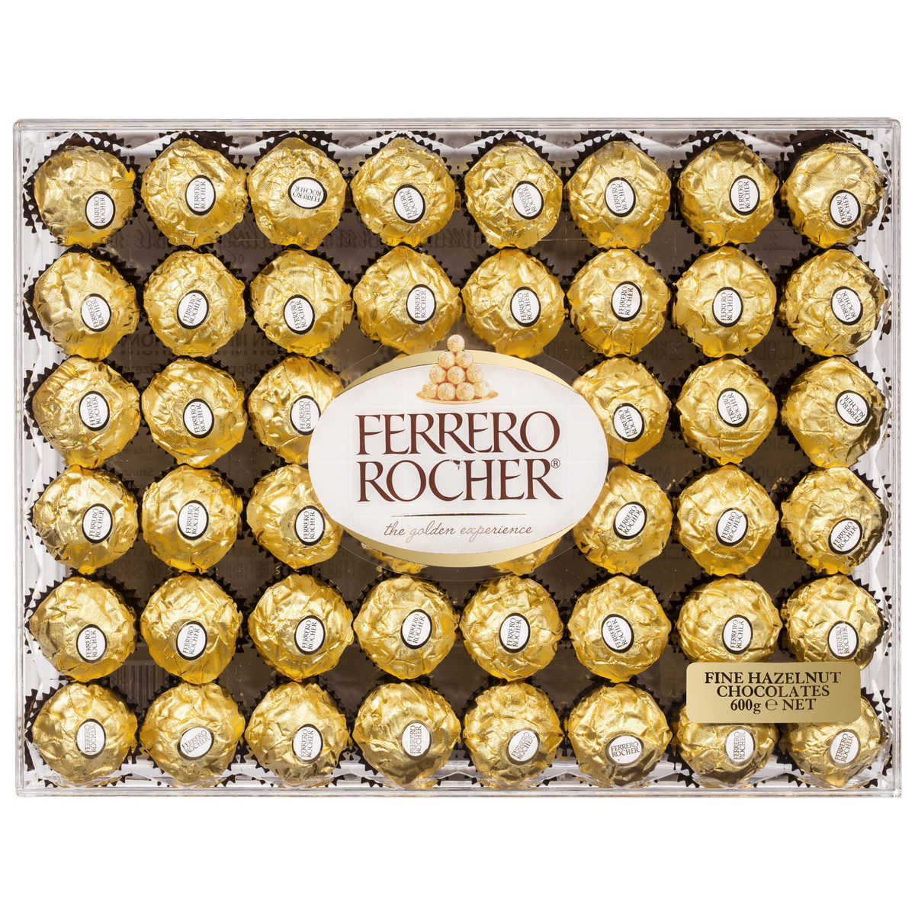
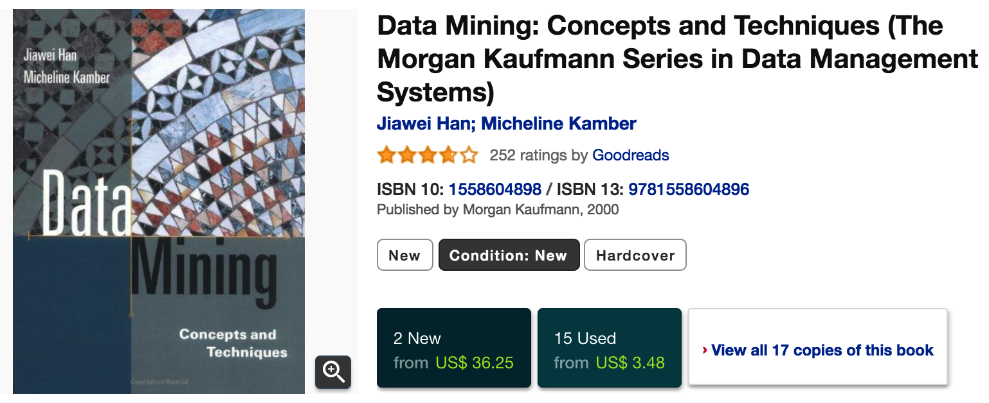
Best Project Awards (2)

Slide 4
Moving Office Hour?
Thursday 3:30pm – 4:30pm
Other options:
Wednesday 10am – 11am
Wednesday 11am – 12pm
Thursday 10am – 11am

Slide 5
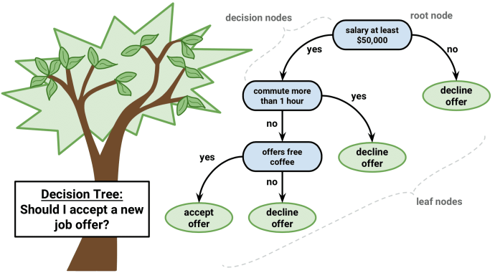
Chapter 8. Classification: Decision Trees
Meng Jiang
CSE 40647/60647 Data Science Fall 2017
Introduction to Data Mining

Slide 6
Supervised vs. Unsupervised Learning
Supervised learning (classification)
Supervision: The training data instances and their attributes/features are accompanied by labels indicating the class of the instances.
Predict class labels for testing data instances.
Unsupervised learning (clustering)
The class labels of training data is unknown
Given a set of attributes, with the aim of establishing the existence of classes or clusters.

Slide 7
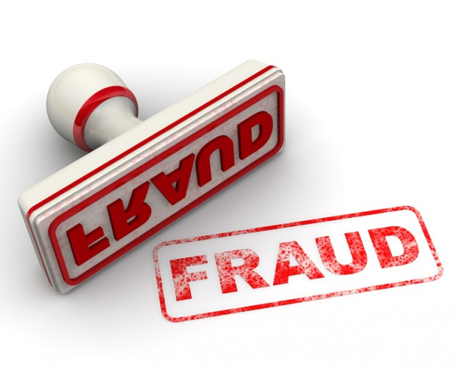
Classification: Applications
Credit/loan approval
Medical diagnosis: if a tumor is cancerous or benign
Fraud detection: if a transaction is fraudulent
Web page categorization: which category it is
…

Slide 8
Classification: A Two-Step Process
Model construction
Models: Decision trees, Naïve Bayes, SVM, Neural Networks, etc.
Model usage
Estimate accuracy of the model
Accuracy: % of test instances that are correctly classified
Test set is independent of training set (otherwise overfitting)
If the accuracy is acceptable, use the model to classify new data
Testing
Data
Training
Data
Classification
Algorithms
Classifier
(Model)
Unseen Data

Slide 9
How to Construct a Decision-Trees Model for Classification?
Let’s play a game first!
{Barack Obama, Hillary Clinton, Ellen DeGeneres, Abraham Lincoln, Superman, …}
Is … ?
yes
no
Does … ?
yes
no
Is … ?
{…}
Notes:
Cameron Smick and Luke Brennan?
Juliana Yee and Laura Syers?

Slide 10
Decision Trees
A directed tree structure comprised of nodes
Each node specified an evaluation on a feature
Each branch corresponds to a feature value
Each leaf signified a categorical decision or class
{Barack Obama, Hillary Clinton, Ellen DeGeneres, Abraham Lincoln, Superman, …}
Is … ?
yes
no
Does … ?
yes
no
Is … ?
{…}

Slide 11
Constructing Decision Trees
Top down, recursive divide-and-conquer
Select best feature for root node
Construct branch for each possible feature value
Split data into mutually exclusive subsets along each branch
Repeat procedure recursively for each branch
Terminate into leaf node after adequate performance
{Barack Obama, Hillary Clinton, Ellen DeGeneres, Abraham Lincoln, Superman, …}
Is … ?
Q: Which feature to select?
yes
no
Does … ?
yes
no
Is … ?
{…}

Slide 12
PRINCIPLE
Reduce uncertainty as much as possible
max ReducedUncertainty(Y|X)
= Uncertainty({instances at the root node})
– Uncertainty({instances at child nodes*|selected_attribute})
*child nodes: values of the selected attributes

Slide 13
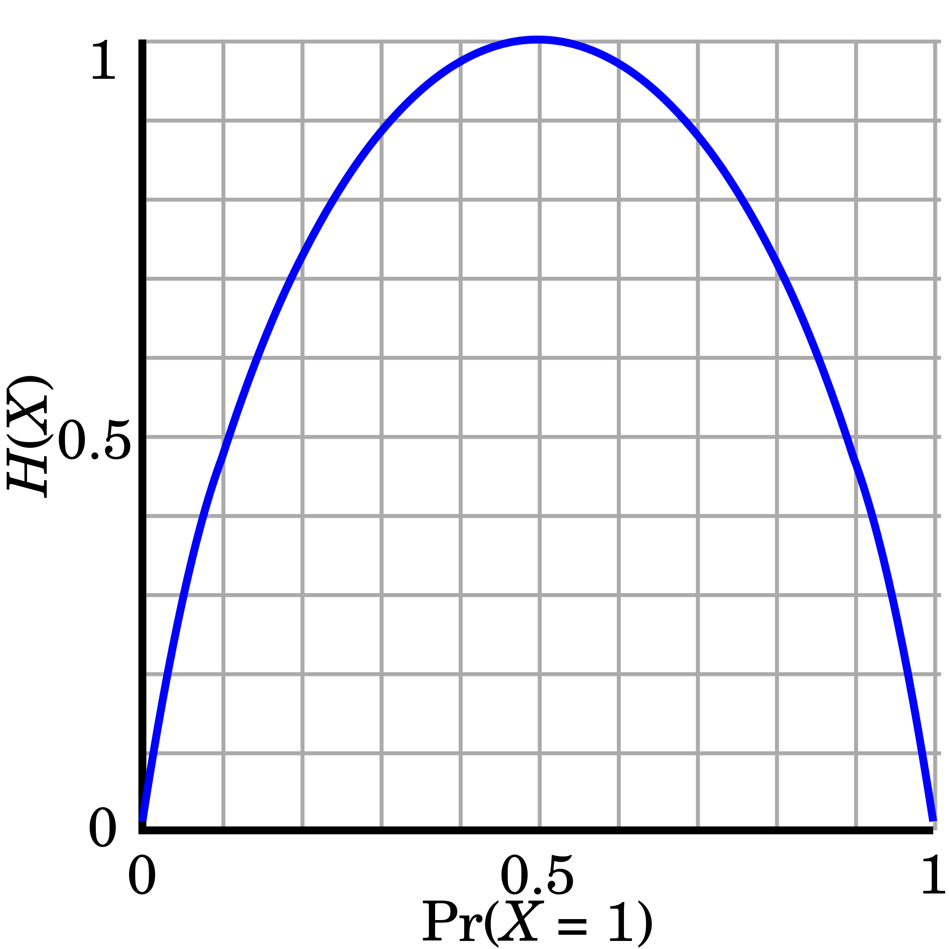
Revisiting Entropy
Entropy (Information Theory)
A measure of uncertainty associated with a random number
Calculation: For a discrete random variable Y taking m distinct values {y₁, y₂, …, y_{m}}
H(Pr(X=1)=0.5) = -0.5log₂(0.5)-0.5log₂(0.5) = 1
H(Pr(X=1)=0 or 1) = -0log₂(𝛆)-1log₂(1-𝛆) = 0
(𝛆→o)
Interpretation
Higher entropy → higher uncertainty
Lower entropy → lower uncertainty
Conditional entropy
m = 2

Slide 14
Information Gain
Can be defined as expected reduction in entropy by partitioning set of instances according to feature X:
max_X IG(Y|X) = H(Y) – H(Y|X)
Conditional entropy of class Y given feature X
Information gain of class Y given feature X
Unconditional entropy of class Y

Slide 15
Game Classification (Result Prediction)
 |  |  | Is Home/Away? | Is Opponent in AP Top 25 at Preseason? | Media | Label: Win/Lose
1 | 9/2/17 | Temple | Home | Out | 1-NBC | Win
2 | 9/9/17 | Georgia | Home | In | 1-NBC | Lose
3 | 9/16/17 | Boston College | Away | Out | 2-ESPN | Win
4 | 9/23/17 | Michigan State | Away | Out | 3-FOX | Win
5 | 9/30/17 | Miami Ohio | Home | Out | 1-NBC | Win
6 | 10/7/17 | North Carolina | Away | Out | 4-ABC | Win
Partitioning set of instances according to feature
Is Home/Away?
Is Opponent …Top25?
Media?
Home
Away
In
Out
NBC
ABC
ESPN
FOX
Win
Lose
Win
Win
Win
Win
Lose
Win
Win
Win
Win
Win
Win
Lose
Win
Win
Win
Win

Slide 16
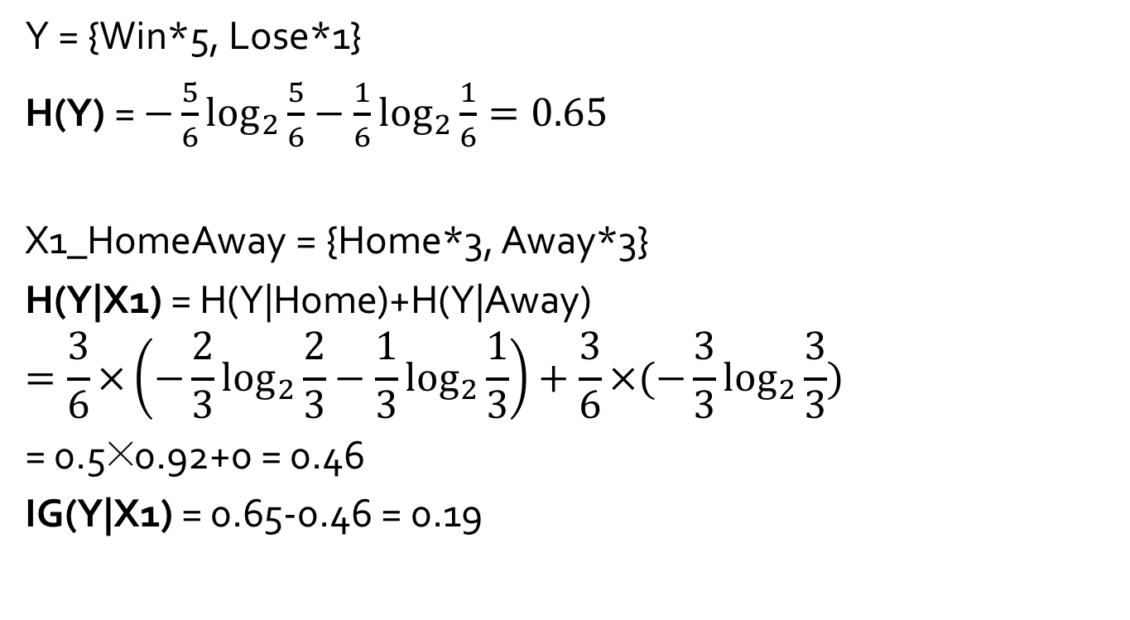
Information Gain Calculation
Y = {Win*5, Lose*1}
H(Y) = $−\frac{5}{6}\log_{2}{\frac{5}{6}}−\frac{1}{6}\log_{2}{\frac{1}{6}}=0.65$
X1_HomeAway = {Home*3, Away*3}
H(Y|X1) = H(Y|Home)+H(Y|Away)
$$=\frac{3}{6}×\left(−\frac{2}{3}\log_{2}{\frac{2}{3}}−\frac{1}{3}\log_{2}{\frac{1}{3}}\right)+\frac{3}{6}×(−\frac{3}{3}\log_{2}{\frac{3}{3}})$$
= 0.5×0.92+0 = 0.46
IG(Y|X1) = 0.65-0.46 = 0.19

Slide 17
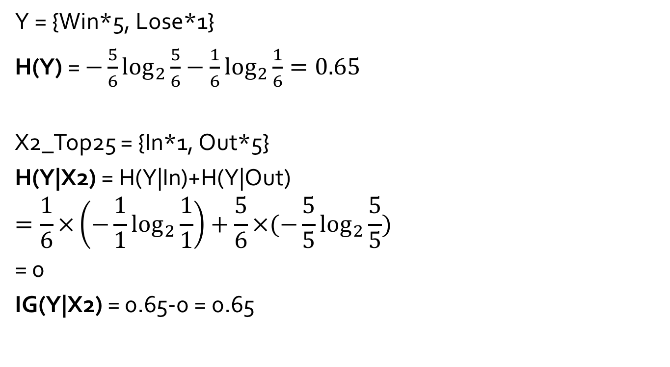
Information Gain Calculation
Y = {Win*5, Lose*1}
H(Y) = $−\frac{5}{6}\log_{2}{\frac{5}{6}}−\frac{1}{6}\log_{2}{\frac{1}{6}}=0.65$
X2_Top25 = {In*1, Out*5}
H(Y|X2) = H(Y|In)+H(Y|Out)
$$=\frac{1}{6}×\left(−\frac{1}{1}\log_{2}{\frac{1}{1}}\right)+\frac{5}{6}×(−\frac{5}{5}\log_{2}{\frac{5}{5}})$$
= 0
IG(Y|X2) = 0.65-0 = 0.65

Slide 18
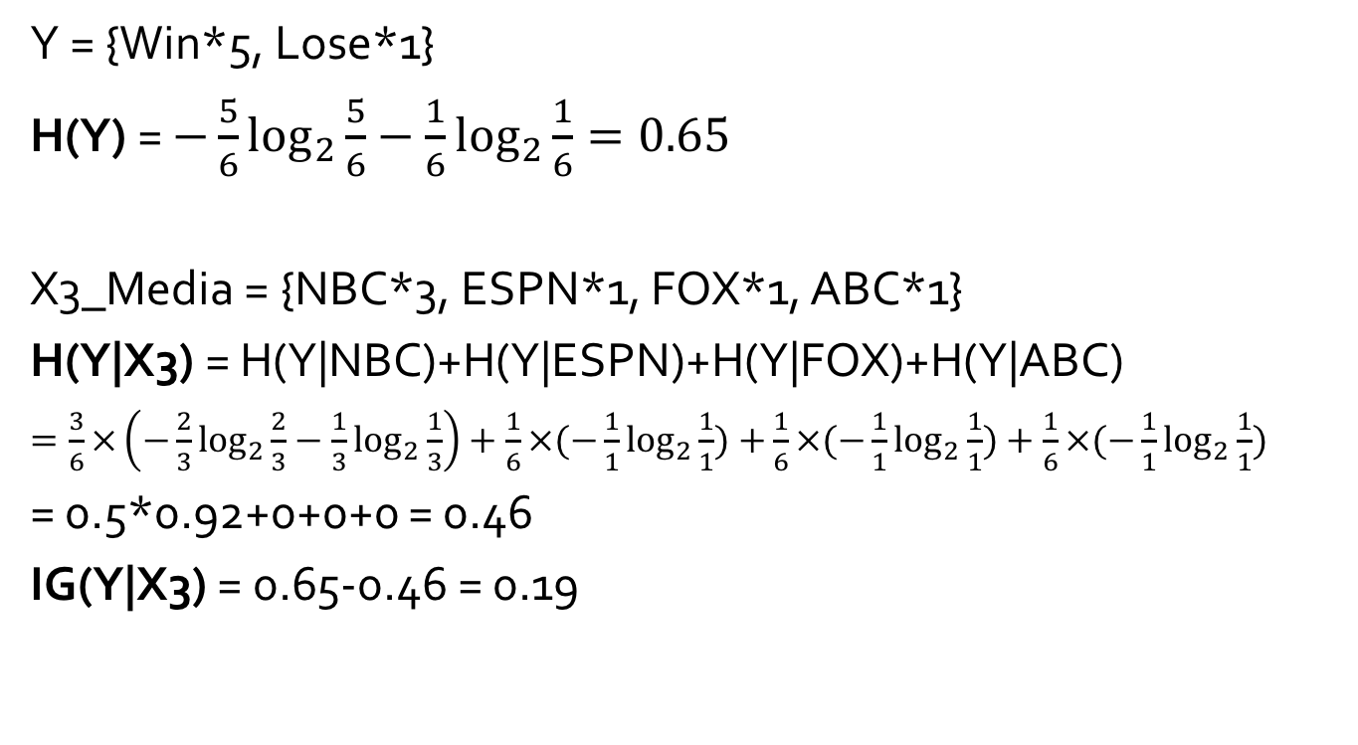
Information Gain Calculation
Y = {Win*5, Lose*1}
H(Y) = $−\frac{5}{6}\log_{2}{\frac{5}{6}}−\frac{1}{6}\log_{2}{\frac{1}{6}}=0.65$
X3_Media = {NBC*3, ESPN*1, FOX*1, ABC*1}
H(Y|X3) = H(Y|NBC)+H(Y|ESPN)+H(Y|FOX)+H(Y|ABC)
$=\frac{3}{6}×\left(−\frac{2}{3}\log_{2}{\frac{2}{3}}−\frac{1}{3}\log_{2}{\frac{1}{3}}\right)+\frac{1}{6}×(−\frac{1}{1}\log_{2}{\frac{1}{1}})$ $+\frac{1}{6}×(−\frac{1}{1}\log_{2}{\frac{1}{1}})+\frac{1}{6}×(−\frac{1}{1}\log_{2}{\frac{1}{1}})$
= 0.5*0.92+0+0+0 = 0.46
IG(Y|X3) = 0.65-0.46 = 0.19

Slide 19
Final Decision Tree
Is Opponent …Top25?
In
Out
Lose
Win
Test:
1 | 10/21/17 | USC | Home | In | 1-NBC | Lose
2 | 10/28/17 | North Carolina State | Home | Out | 1-NBC | Win
3 | 11/4/17 | Wake Forest | Home | Out | 1-NBC | Win
4 | 11/18/17 | Navy | Home | Out | 1-NBC | Win
I don’t think this is a good classifier…
(overfitting)
I bet 4 straight wins so the accuracy is 75%!

Slide 20
Quinlan’s Example (1986): Playing Tennis
 | Outlook | Temperature | Humidity | Windy | Label: Play?
1 | Sunny | Hot | High | "False" | No
2 | Sunny | Hot | High | "True" | No
3 | Overcast | Hot | High | "False" | Yes
4 | Rainy | Mild | High | "False" | Yes
5 | Rainy | Cool | Normal | "False" | Yes
6 | Rainy | Cool | Normal | "True" | No
7 | Overcast | Cool | Normal | "True" | Yes
8 | Sunny | Mild | High | "False" | No
9 | Sunny | Cool | Normal | "False" | Yes
10 | Rainy | Mild | Normal | "False" | Yes
11 | Sunny | Mild | Normal | "True" | Yes
12 | Overcast | Mild | High | "True" | Yes
13 | Overcast | Hot | Normal | "False" | Yes
14 | Rainy | Mild | High | "True" | No
1 | Rainy | Hot | High | "False" | ?

Slide 21
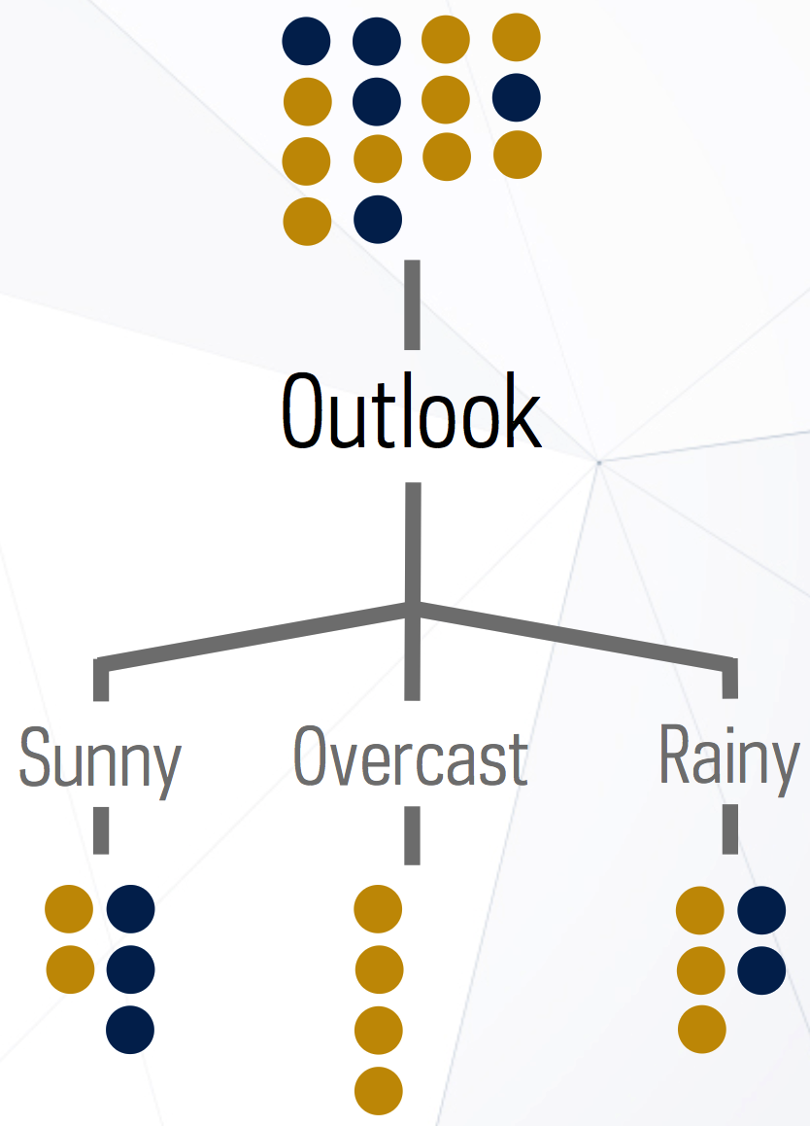
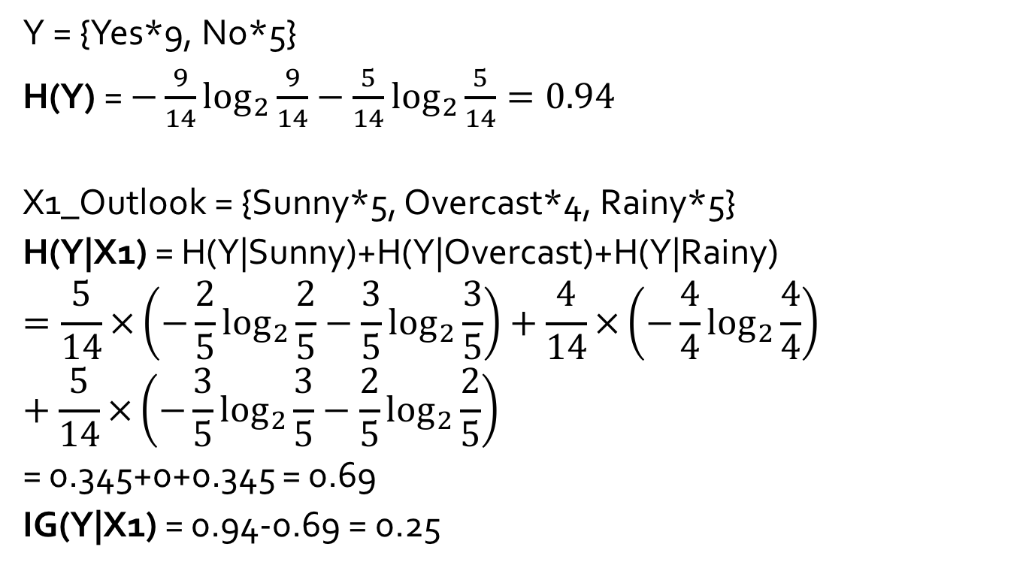
Information Gain Calculation
Y = {Yes*9, No*5}
H(Y) = $−\frac{9}{14}\log_{2}{\frac{9}{14}}−\frac{5}{14}\log_{2}{\frac{5}{14}}=0.94$
X1_Outlook = {Sunny*5, Overcast*4, Rainy*5}
H(Y|X1) = H(Y|Sunny)+H(Y|Overcast)+H(Y|Rainy)
$$=\frac{5}{14}×\left(−\frac{2}{5}\log_{2}{\frac{2}{5}}−\frac{3}{5}\log_{2}{\frac{3}{5}}\right)+\frac{4}{14}×\left(−\frac{4}{4}\log_{2}{\frac{4}{4}}\right)+\frac{5}{14}×\left(−\frac{3}{5}\log_{2}{\frac{3}{5}}−\frac{2}{5}\log_{2}{\frac{2}{5}}\right)$$
= 0.345+0+0.345 = 0.69
IG(Y|X1) = 0.94-0.69 = 0.25
“No”
“Yes”
14
5
4
5

Slide 22
Information Gain Calculation
IG(Y|X1_Outlook) = 0.25
IG(Y|X2_Temperature) = 0.03
IG(Y|X3_Humidity) = 0.15
IG(Y|X4_Windy) = 0.05
So the best feature is Outlook.
What’s next step?
14
5
4
5

Slide 23
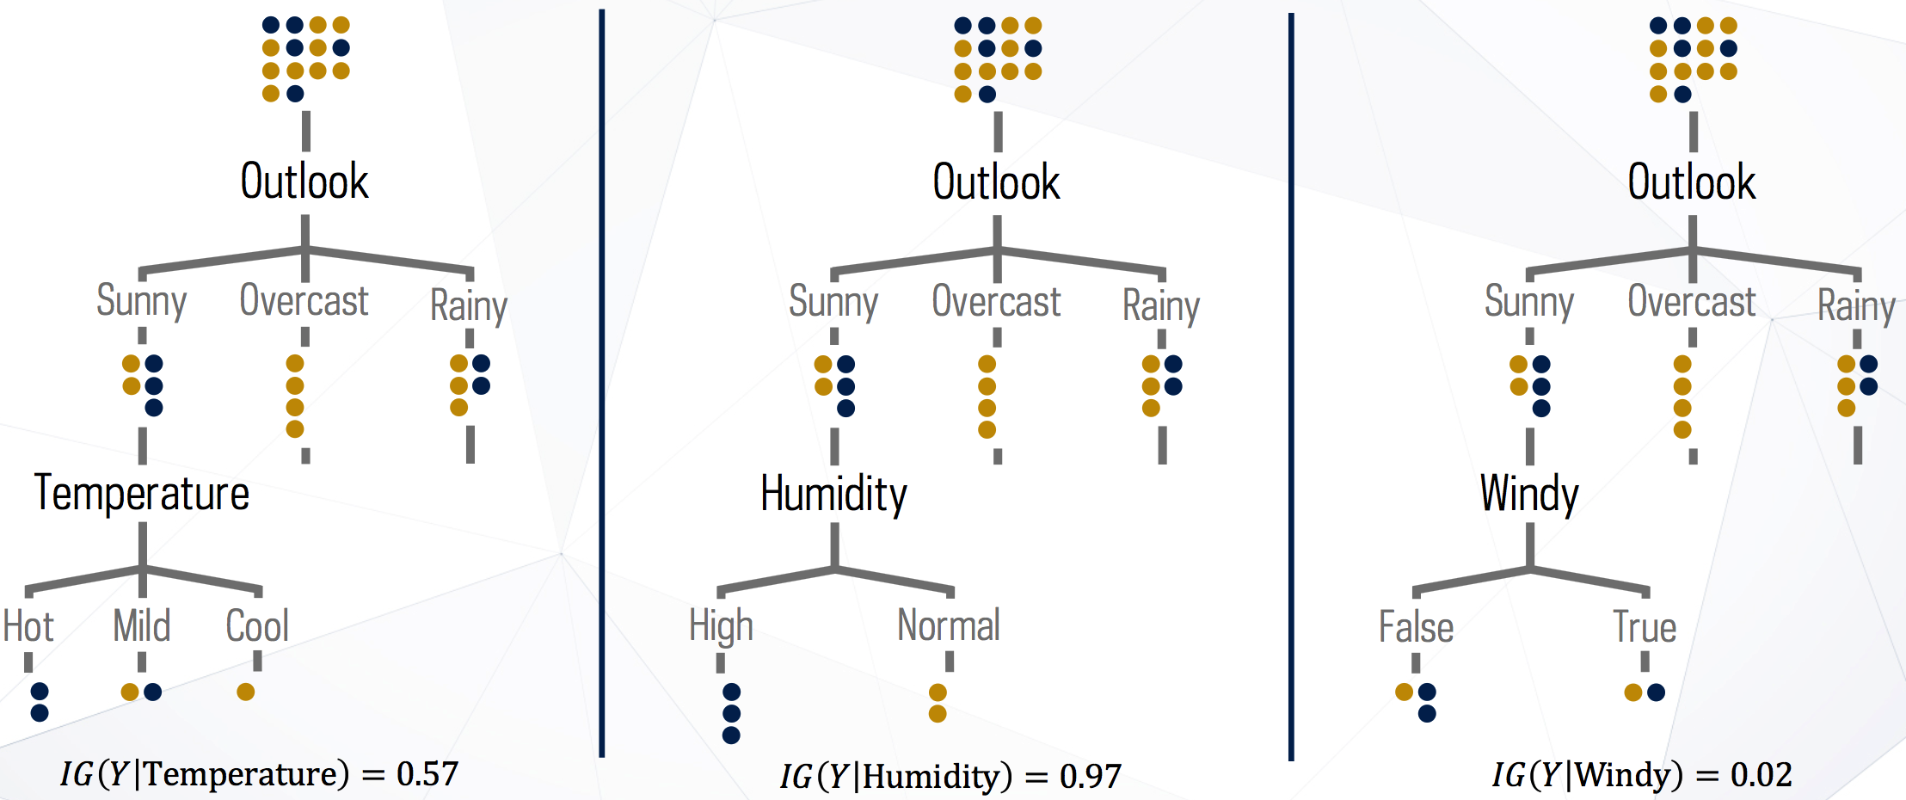
Next Step
Good!

Slide 24
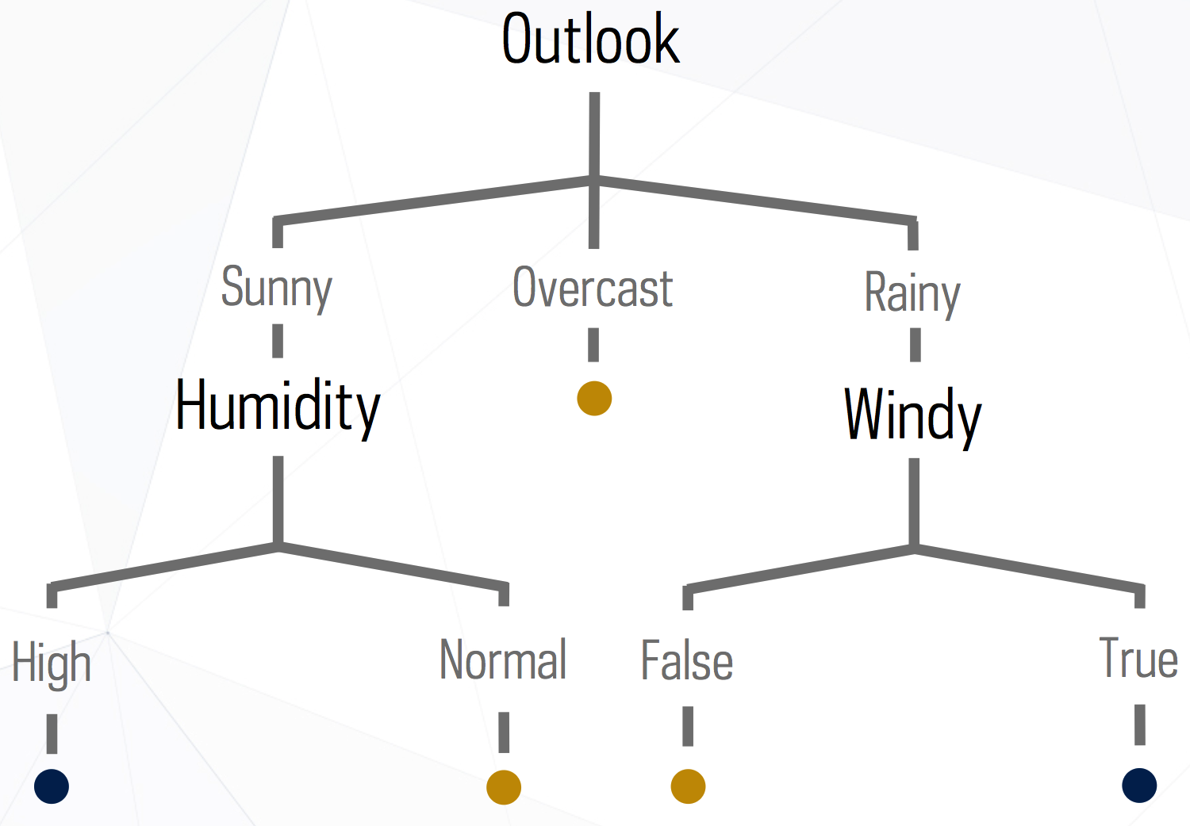
Final Decision Tree

Slide 25
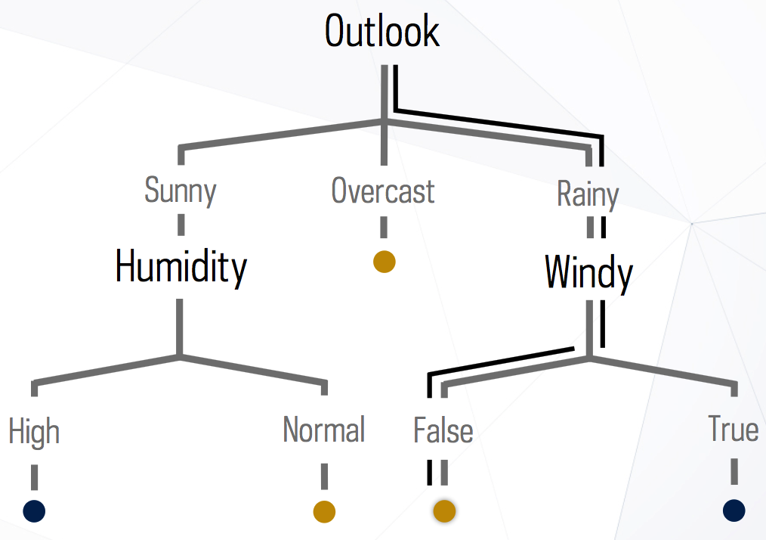
Prediction
1 | Rainy | Hot | High | "False" | ?
“Yes”

Slide 26
Splitting Criterion
Information Gain (used in ID3)
Iterative Dichotomiser 3 invented by Ross Quinlan in 1986
Gain Ratio (used in C4.5)
C4.5 is an extension of Quinlan‘s earlier ID3 algorithm, developed by Ross Quinlan
It became quite popular after ranking #1 in the Top 10 Algorithms in Data Mining pre-eminent paper published by Springer LNCS in 2008
Gini Measure (used in CART)
Classification And Regression Trees by Breiman et al. in 1984

Slide 27
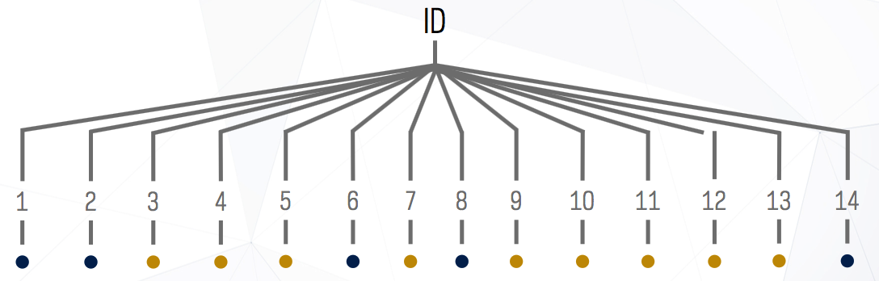
Gain Ratio (C4.5)
Information gain measure is biased towards highly-branching attributes = with a large number of values
Entropy of splitting on “ID” is 0. IG for “ID” is maximal.

Slide 28
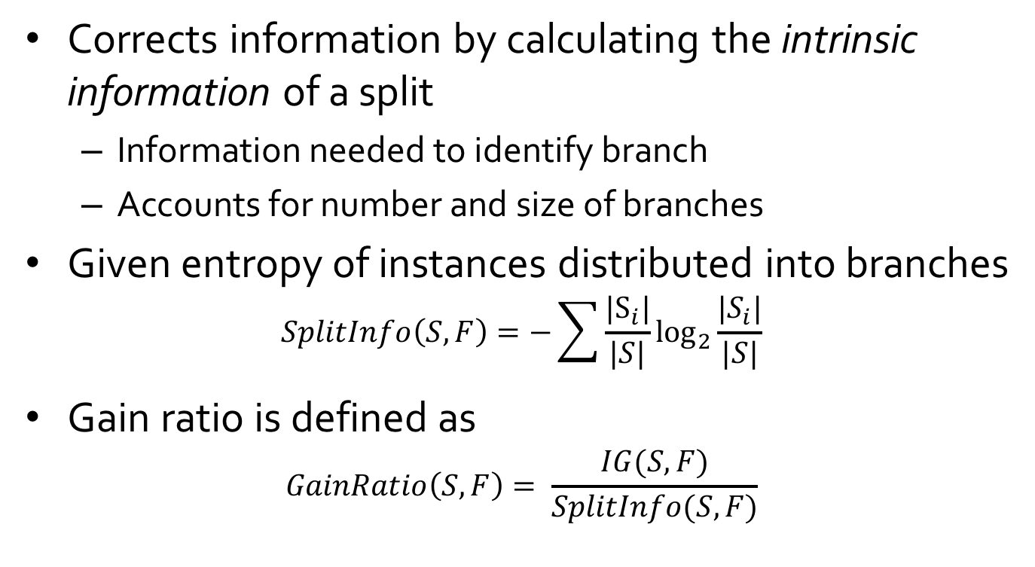
Gain Ratio (C4.5)
Corrects information by calculating the intrinsic information of a split
Information needed to identify branch
Accounts for number and size of branches
Given entropy of instances distributed into branches
$$SplitInfo\left(S, F\right)=−\sum{\frac{|S_{i}|}{|S|}\log_{2}{\frac{|S_{i}|}{|S|}}}$$
Gain ratio is defined as
$$GainRatio\left(S,F\right)= \frac{IG(S,F)}{SplitInfo(S,F)}$$
S: “samples”
F: feature

Slide 29
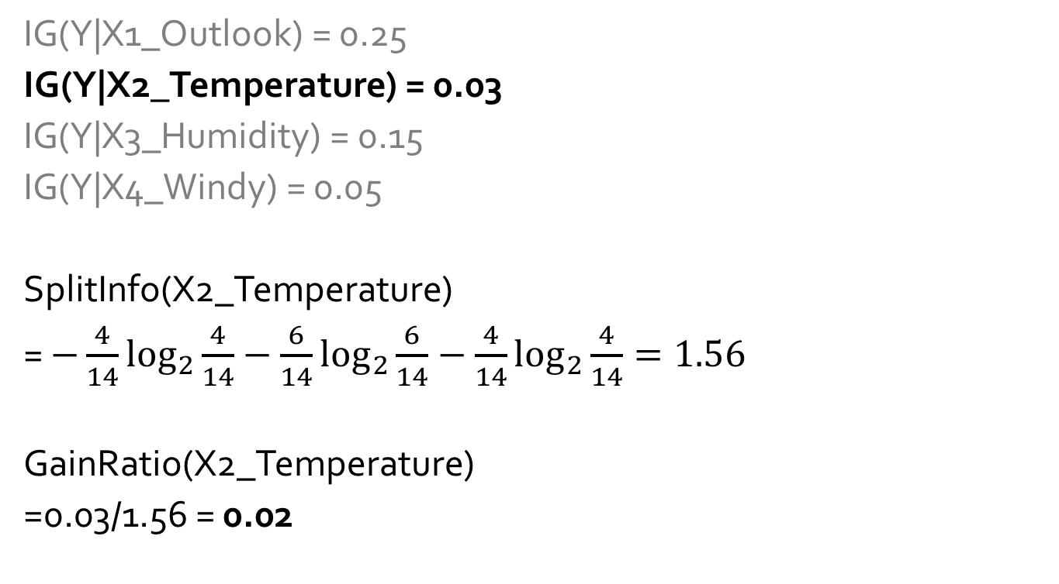
Gain Ratio Calculation
IG(Y|X1_Outlook) = 0.25
IG(Y|X2_Temperature) = 0.03
IG(Y|X3_Humidity) = 0.15
IG(Y|X4_Windy) = 0.05
SplitInfo(X2_Temperature)
= $−\frac{4}{14}\log_{2}{\frac{4}{14}}−\frac{6}{14}\log_{2}{\frac{6}{14}}−\frac{4}{14}\log_{2}{\frac{4}{14}}=1.56$
GainRatio(X2_Temperature)
=0.03/1.56 = 0.02
Temperature
Hot
Hot
Hot
Mild
Cool
Cool
Cool
Mild
Cool
Mild
Mild
Mild
Hot
Mild

Slide 30
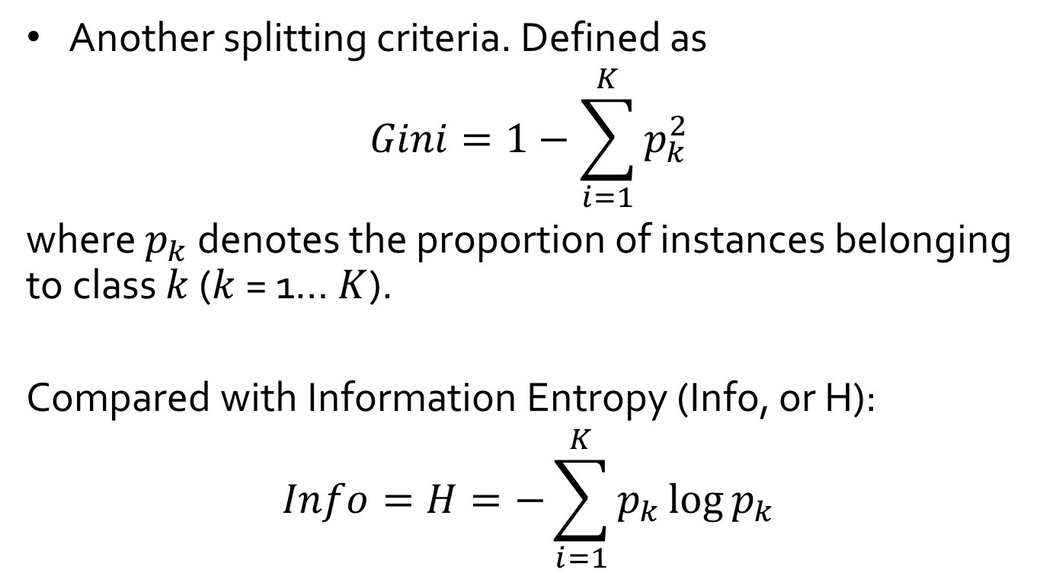
Gini Index (CART)
Another splitting criteria. Defined as
$$Gini=1−\sum_{i=1}^{K}{p_{k}^{2}}$$
where $p_{k}$ denotes the proportion of instances belonging to class $k$ ($k$ = 1… $K$).
Compared with Information Entropy (Info, or H):
$$Info=H=−\sum_{i=1}^{K}{p_{k}\log{p_{k}}}$$

Slide 31
IG vs Gini
Maximize

Slide 32
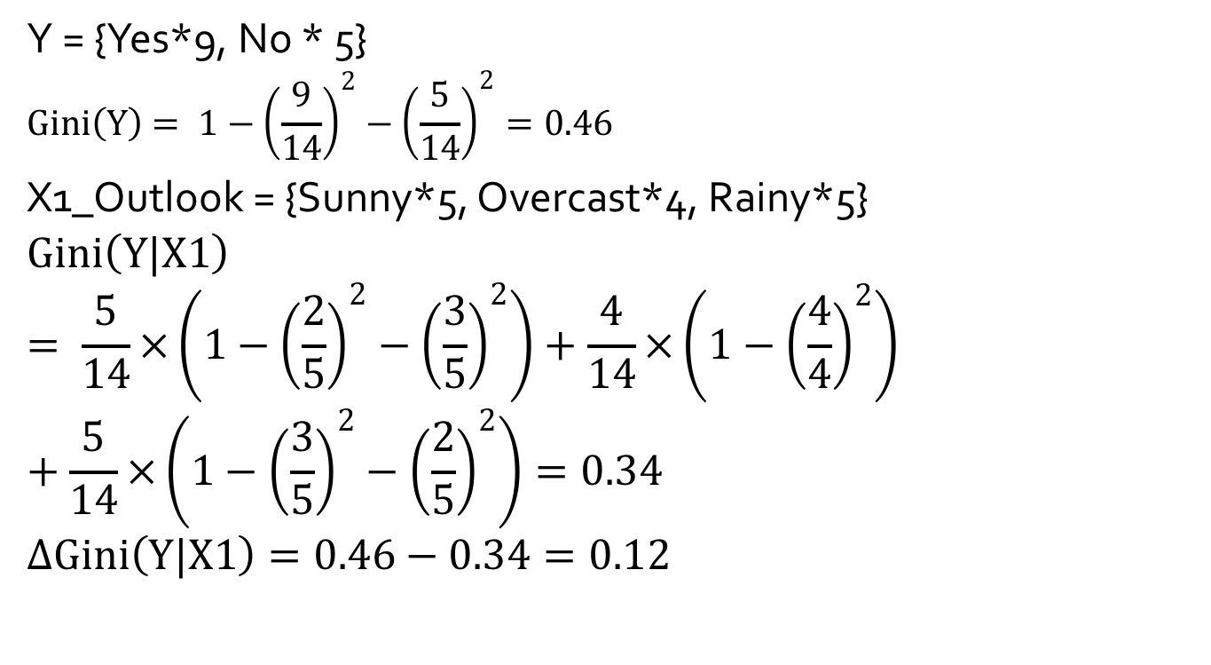
Gini Index Calculation
Y = {Yes*9, No * 5}
$$Gini\left(Y\right)= 1−{\left(\frac{9}{14}\right)}^{2}−{\left(\frac{5}{14}\right)}^{2}=0.46$$
X1_Outlook = {Sunny*5, Overcast*4, Rainy*5}
$$Gini\left(Y|X1\right)= \frac{5}{14}×\left(1−{\left(\frac{2}{5}\right)}^{2}−{\left(\frac{3}{5}\right)}^{2}\right)+\frac{4}{14}×\left(1−{\left(\frac{4}{4}\right)}^{2}\right)+\frac{5}{14}×\left(1−{\left(\frac{3}{5}\right)}^{2}−{\left(\frac{2}{5}\right)}^{2}\right)=0.34$$
$$∆Gini\left(Y|X1\right)=0.46−0.34=0.12$$
“No”
“Yes”
14
5
4
5

Slide 33
Gini Index Calculation
𝞓gini (Y|X1_Outlook) = 0.12
𝞓gini(Y|X2_Temperature) = 0.02
𝞓gini(Y|X3_Humidity) = 0.09
𝞓gini(Y|X4_Windy) = 0.03
So the best feature is Outlook.
14
5
4
5

Slide 34
Decision Tree Demo
http://www.meng-jiang.com/teaching/DecisionTreeDemo.zip
This is for Question 1 in your exercise ☺

Slide 35
References
C. Apte and S. Weiss. Data mining with decision trees and decision rules. Future Generation Computer Systems, 13, 1997
P. K. Chan and S. J. Stolfo. Learning arbiter and combiner trees from partitioned data for scaling machine learning. KDD'95
A. J. Dobson. An Introduction to Generalized Linear Models. Chapman & Hall, 1990.
R. O. Duda, P. E. Hart, and D. G. Stork. Pattern Classification, 2ed. John Wiley, 2001
U. M. Fayyad. Branching on attribute values in decision tree generation. AAAI’94.
Y. Freund and R. E. Schapire. A decision-theoretic generalization of on-line learning and an application to boosting. J. Computer and System Sciences, 1997.
J. Gehrke, R. Ramakrishnan, and V. Ganti. Rainforest: A framework for fast decision tree construction of large datasets. VLDB’98.
J. Gehrke, V. Gant, R. Ramakrishnan, and W.-Y. Loh, BOAT -- Optimistic Decision Tree Construction. SIGMOD'99.
T. Hastie, R. Tibshirani, and J. Friedman. The Elements of Statistical Learning: Data Mining, Inference, and Prediction. Springer-Verlag, 2001.
T.-S. Lim, W.-Y. Loh, and Y.-S. Shih. A comparison of prediction accuracy, complexity, and training time of thirty-three old and new classification algorithms. Machine Learning, 2000

Slide 36
References (cont.)
J. Magidson. The Chaid approach to segmentation modeling: Chi-squared automatic interaction detection. In R. P. Bagozzi, editor, Advanced Methods of Marketing Research, Blackwell Business, 1994
M. Mehta, R. Agrawal, and J. Rissanen. SLIQ : A fast scalable classifier for data mining. EDBT'96
T. M. Mitchell. Machine Learning. McGraw Hill, 1997
S. K. Murthy, Automatic Construction of Decision Trees from Data: A Multi-Disciplinary Survey, Data Mining and Knowledge Discovery 2(4): 345-389, 1998
J. R. Quinlan. Induction of decision trees. Machine Learning, 1:81-106, 1986.
J. R. Quinlan. C4.5: Programs for Machine Learning. Morgan Kaufmann, 1993.
J. R. Quinlan. Bagging, boosting, and c4.5. AAAI‘96.
R. Rastogi and K. Shim. Public: A decision tree classifier that integrates building and pruning. VLDB’98
J. Shafer, R. Agrawal, and M. Mehta. SPRINT : A scalable parallel classifier for data mining. VLDB’96
J. W. Shavlik and T. G. Dietterich. Readings in Machine Learning. Morgan Kaufmann, 1990
P. Tan, M. Steinbach, and V. Kumar. Introduction to Data Mining. Addison Wesley, 2005
S. M. Weiss and C. A. Kulikowski. Computer Systems that Learn: Classification and Prediction Methods from Statistics, Neural Nets, Machine Learning, and Expert Systems. Morgan Kaufman, 1991
S. M. Weiss and N. Indurkhya. Predictive Data Mining. Morgan Kaufmann, 1997
I. H. Witten and E. Frank. Data Mining: Practical Machine Learning Tools and Techniques, 2ed. Morgan Kaufmann, 2005

