Slide 1


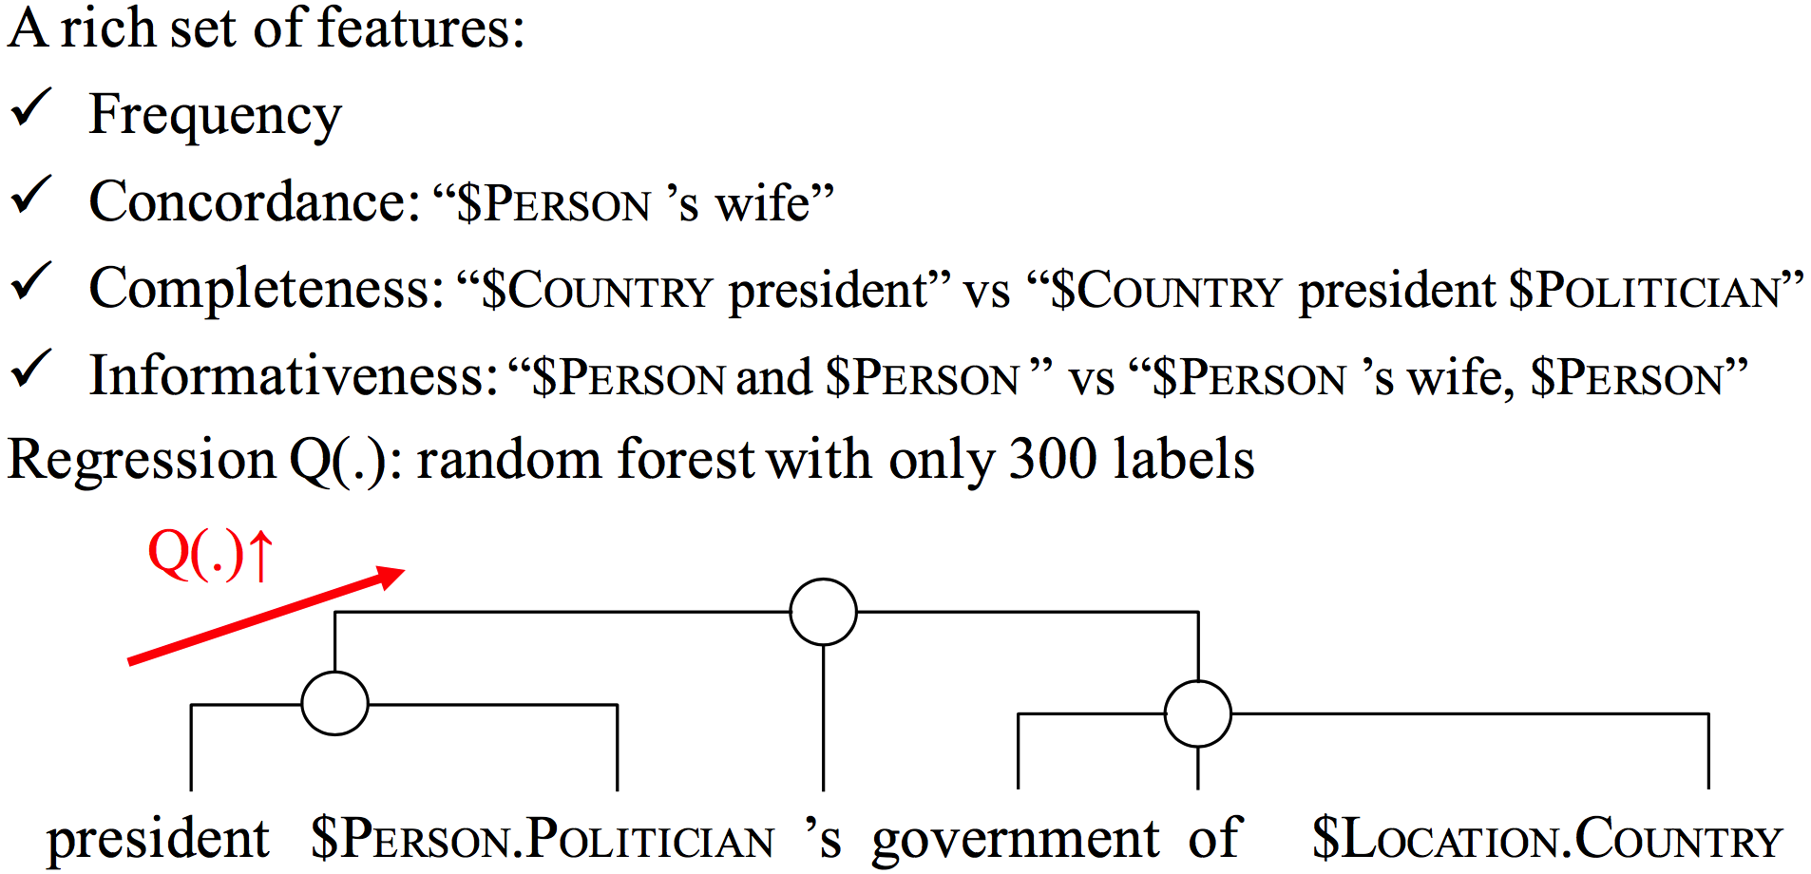
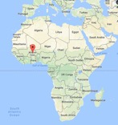
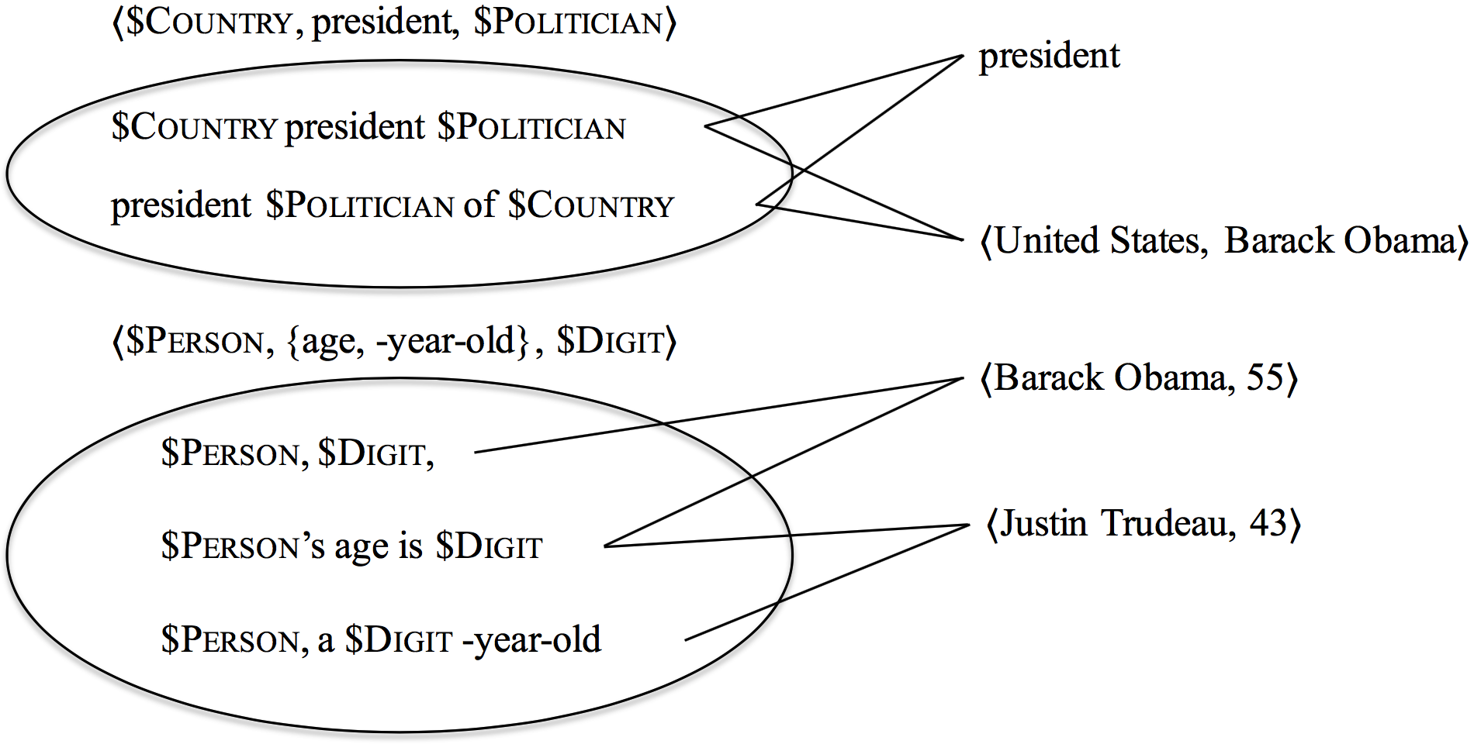
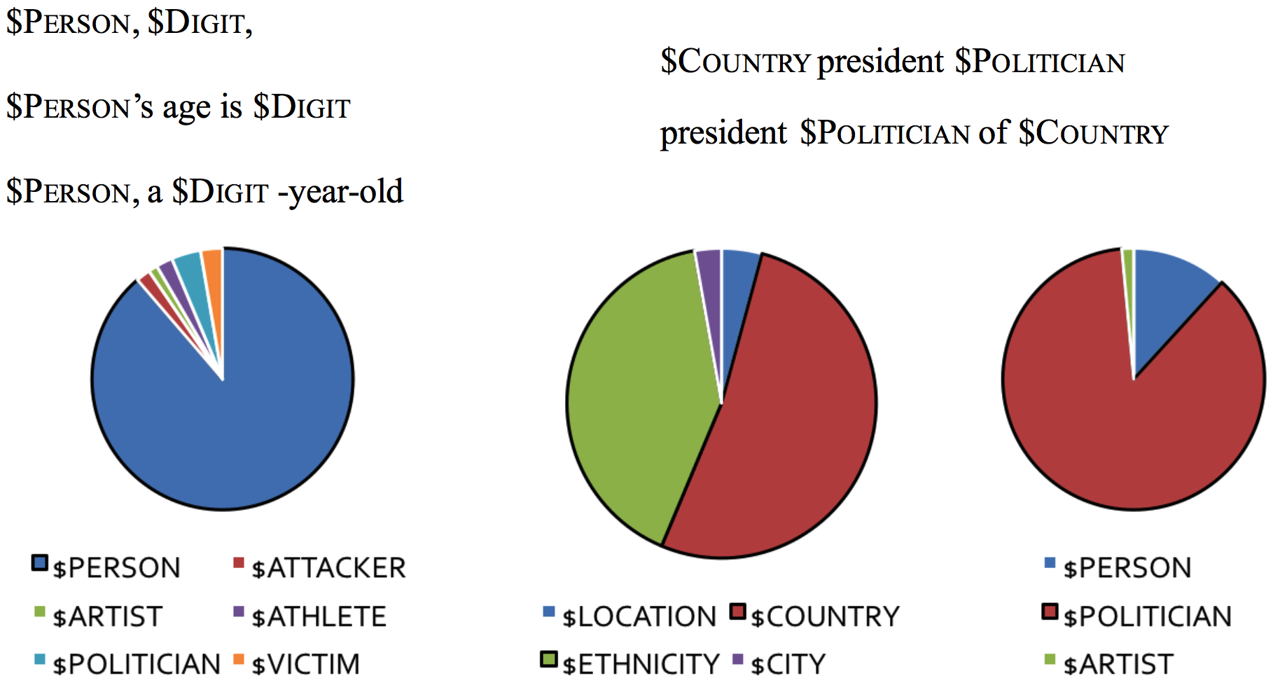
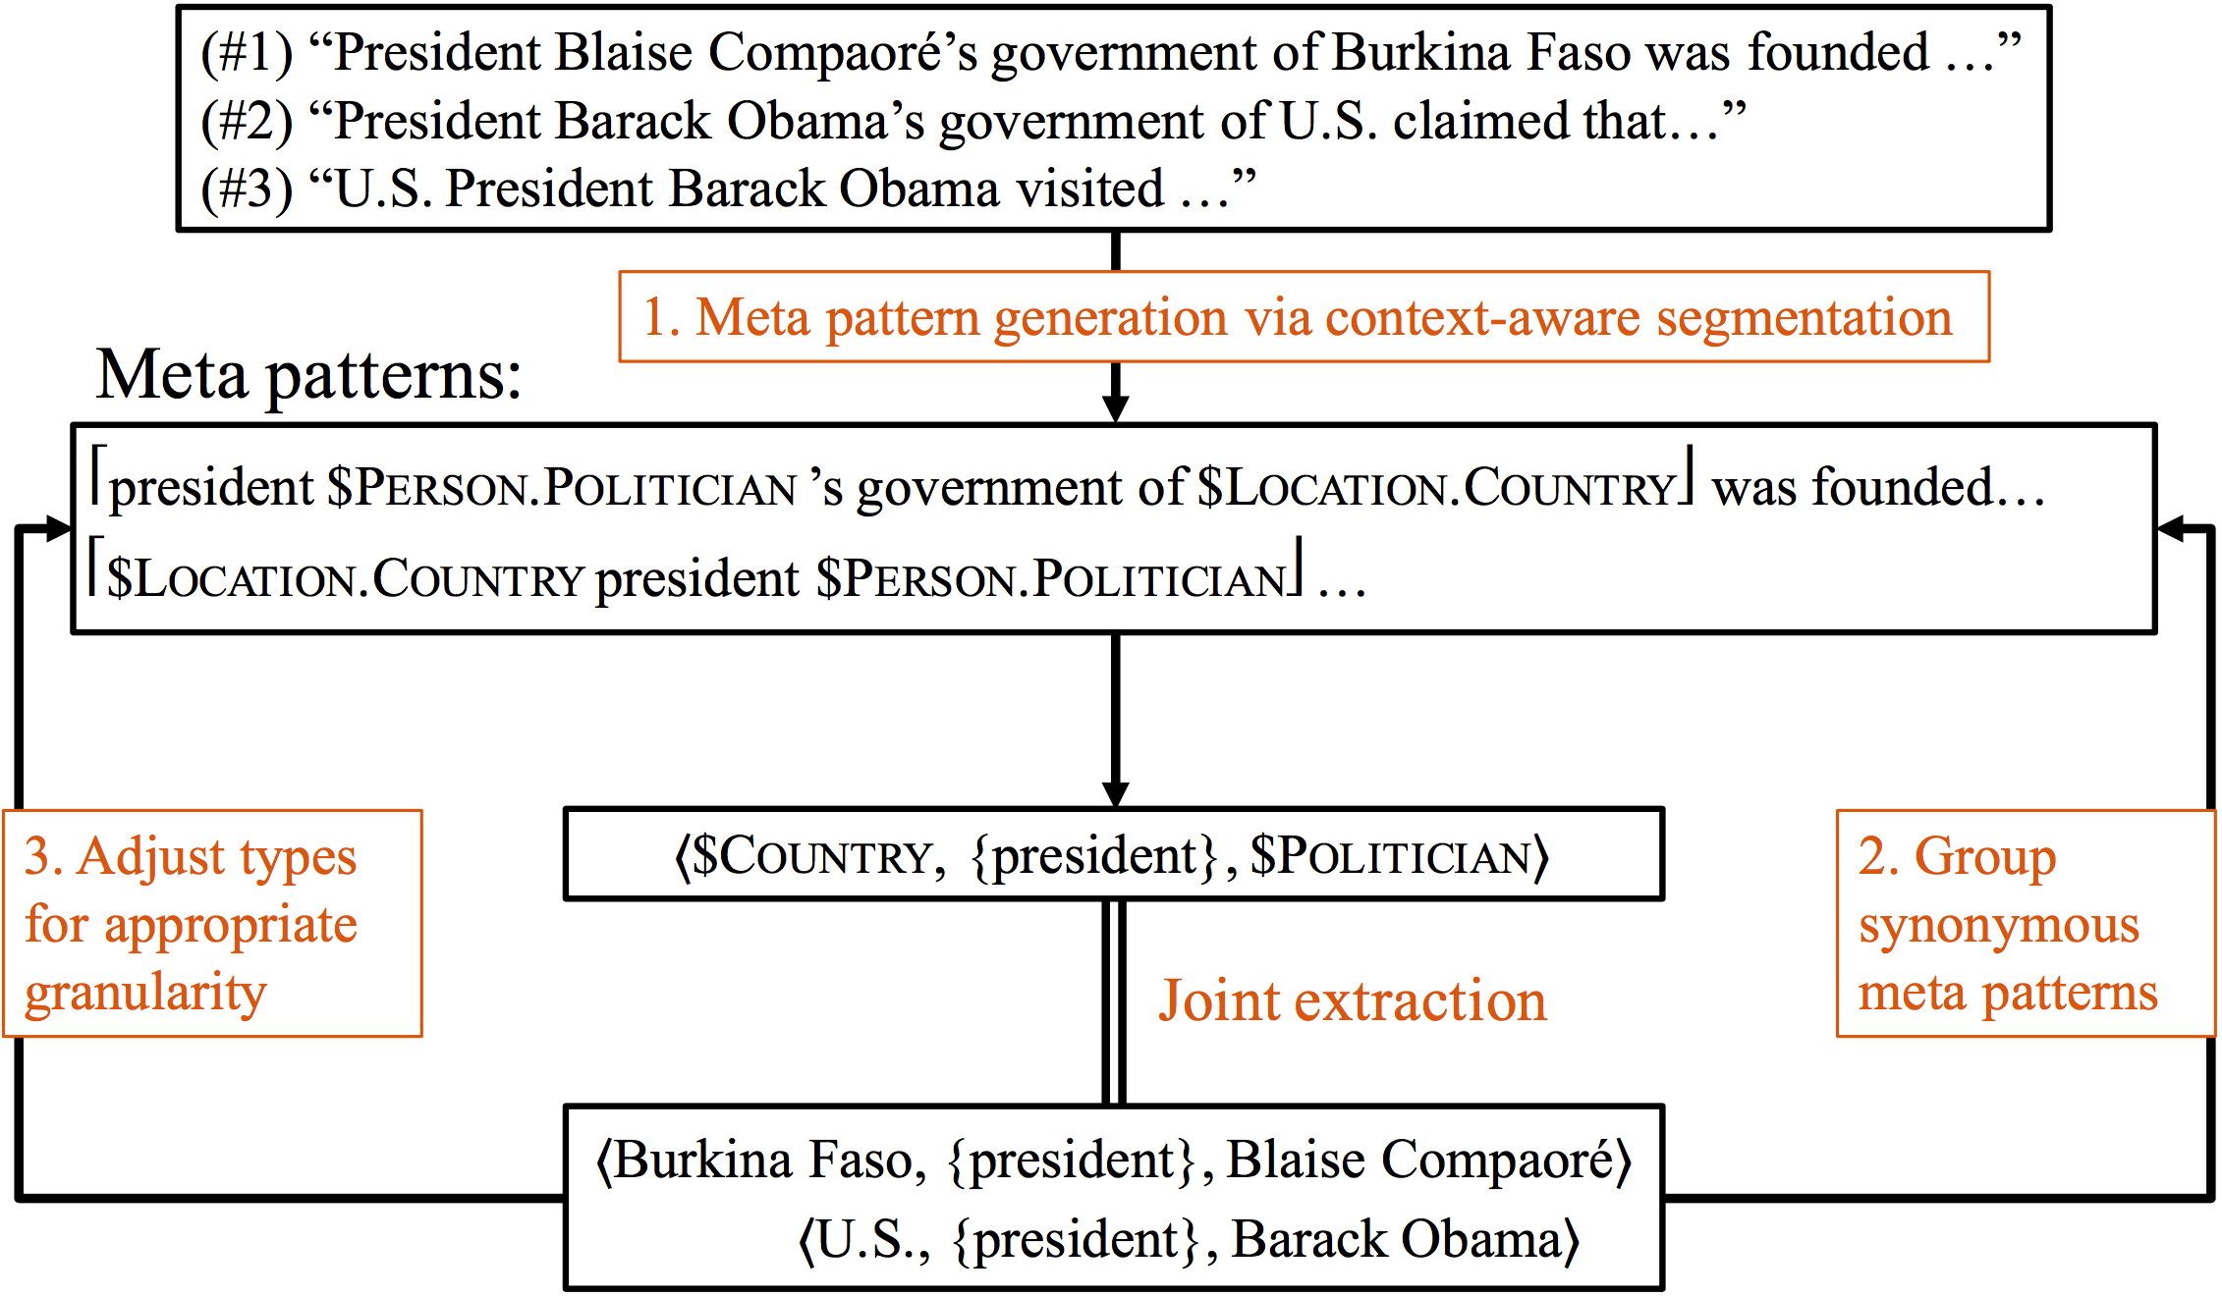
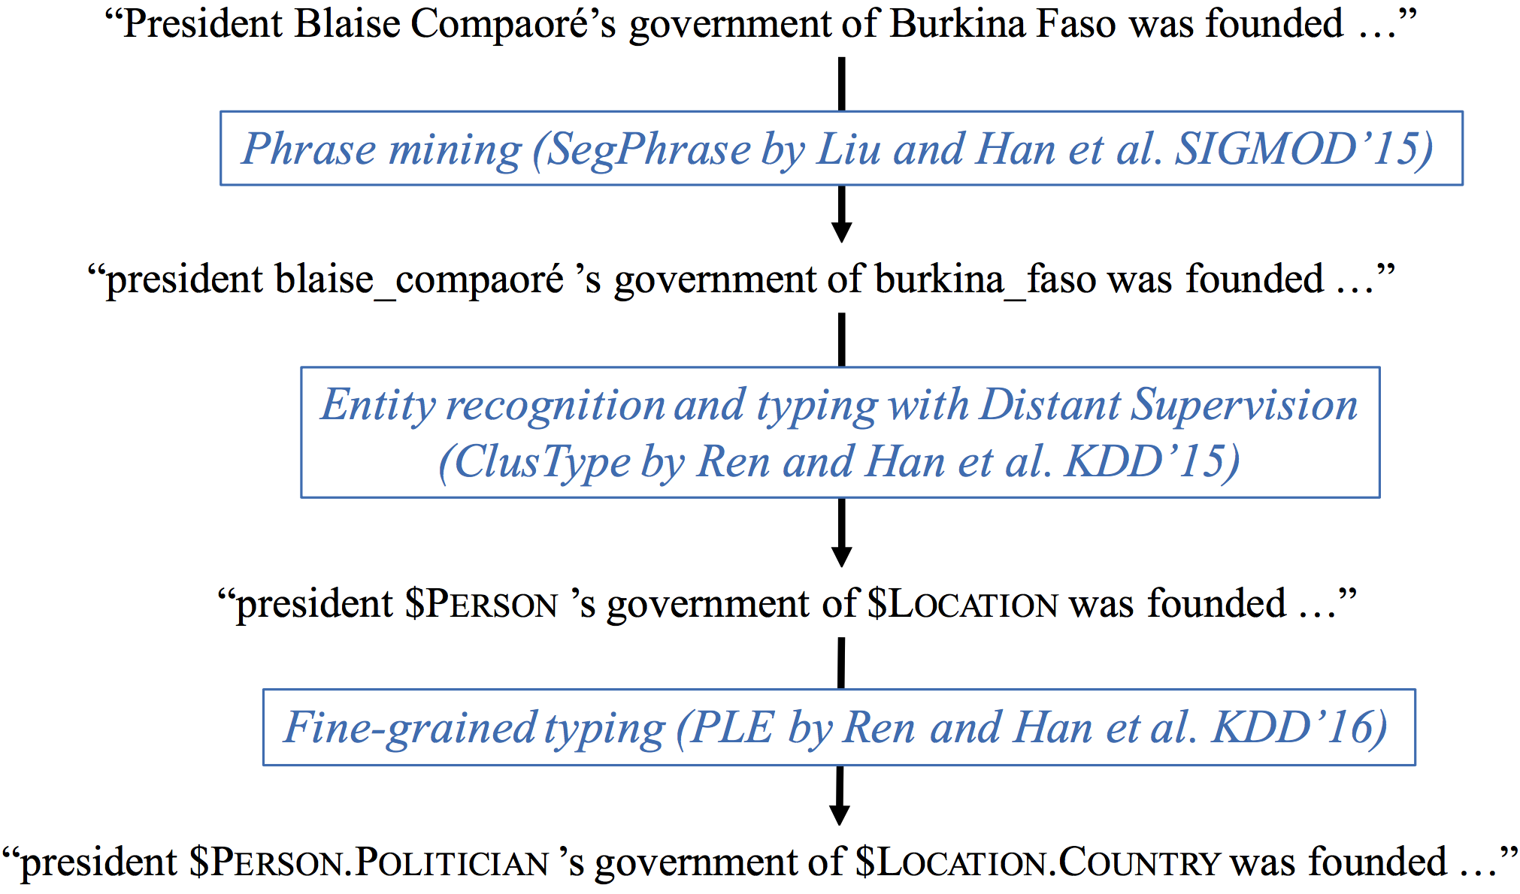
Meng Jiang¹, Jingbo Shang¹, Talyor Cassidy², Xiang Ren¹, Lance M. Kaplan², Timothy P. Hanratty², Jiawei Han¹ ¹ Department of Computer Science, University of Illinois at Urbana-Champaign, IL, USA ² Computational & Information Sciences Directorate, Army Research Laboratory, Adelphi, MD, USA
MetaPAD: Meta Pattern Discovery from Massive Text Corpora
The 23rd ACM SIGKDD Conference on Knowledge Discovery and Data Mining (KDD), Halifax, Canada, 2017.
Motivation
Task: Fact extraction from massive corpora (e.g., news, tweets, papers) to facilitate heterogeneous information network construction
Task 1: (entity, attribute name, attribute value)-tuple extraction
(Burkina Faso, president, Blaise Compaoré)
(Burkina Faso, population, 17 million)
(Blaise Compaoré, age, 65)
Task 2: (entity type, attribute name, value type)-tuple extraction
($LOCATION.COUNTRY, president, $PERSON.POLITICIAN)
($LOCATION, population, $DIGIT $DIGITUNIT)
($PERSON, age, $DIGIT)
Idea: Discovering a group of synonymous “meta patterns” to find facts.
Step 1: Meta pattern quality assessment and segmentation
Step 2: Grouping synonymous meta patterns
Step 3: Adjusting types for appropriate granularity
Given a sentence “President Blaise Compaoré’s government of Burkina Faso was founded…”, …
was,13897
president,2769
…
government,1886
…
blaise,42
compaore,15
…
 | M
T | E | X | T |  |  | N
 | S |  |  |  |  | E
 | S | T | R | U | C | T | U | R | E
 |  |  |  |  |  | W
 |  |  |  |  |  | O
 |  |  |  |  |  | R
 |  |  |  |  |  | K
age:65
Blaise Compaoré: $PERSON.POLITICIAN
Burkina Faso: $COUNTRY
president
population: 17 million
president $POLITICIAN’s government of $COUNTRY
(e.g., President Blaise Compaoré’s government of Burkina Faso)
$COUNTRY president $POLITICIAN
$COUNTRY ’s president $POLITICIAN
president $POLITICIAN of $COUNTRY
…
(Burkina Faso, president, Blaise Compaoré)
(U.S., president, Barack Obama)
…
The MetaPAD Framework
mutual enhancement: Generating meta patterns: c(pattern) >> c(tuple)_
Grouping synonymous meta patterns: #(patterns) ↑ → #(tuples)↑_
Step 0: Preprocessing
Meta patterns | Entity | Attribute value
$COUNTRY president $POLITICIAN $COUNTRY’s president $POLITICIAN president $POLITICIAN of $COUNTRY … president $POLITICIAN’s government of $COUNTRY | United States | Barack Obama
 | Russia | Vladimir Putin
 | France | Francois Hollande
 | … | …
 | Burkina Faso | Blaise Compaoré
Meta patterns | Entity | Attribute value
$COMPANY CEO $PERSON $COMPANY chief executive $PERSON $PERSON, the $COMPANY CEO, … $COMPANY former CEO $PERSON $PERSON, the $COMPANY former CEO, | Apple | Tim Cook
 | Facebook | Mark Zuckerberg
 | Hewlett-Packard | Carly Fiorina
 | … | …
 | Infor | Charles Phillips
 | Afghan Citadel | Roya Mahboob
Meta patterns | Entity | Attribute value
$BACTERIA was resistant to $ANTIBIOTICS $BACTERIA are resistant to $ANTIBIOTICS $BACTERIA is the most resistant to $ANTIBIOTICS … $BACTERIA, particularly those resistant to $ANTIBIOTICS | corynebacterium striatum BM4687 | gentamicin
 | methicillin-susceptible S aureus | vancomycin
 | multidrug-resistant enterobacteriaceae | gentamicin
Meta patterns | Entity | Attribute value
$TREATMENT was used to treat $DISEASE $DISEASE using the $TREATMENT $TREATMENT has been used to treat $DISEASE $TREATMENT of patients with $DISEASE … | zoledronic acid therapy | Paget’s disease of bone
 | bisphosphonates | osteoporosis
 | calcitonin | Paget’s disease of bone

