Slide 1
Chapter 9. Advanced Classification: Support Vector Machines (SVMs)
V
V
V
V
V
V
S
S
M
S
S
M
S
M
M
M
M
Meng Jiang
CSE 40647/60647 Data Science Fall 2017

Slide 2
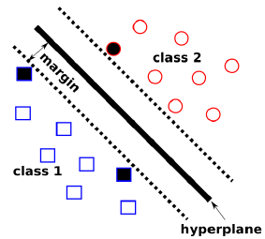
Concepts
Support Vector
Support Vector
Quick start:
Hyperplane
Supper Vector
Margin
SVMs
Maximize Margin Width
Non-linear SVMs: Kernel Function
Support Vector

Slide 3
A Classification Problem
Dataset
Suppose data science course instructors have observed that students get the most out of the course if they are good at Math or Stats.
Over time, they have recorded the scores of the enrolled students in these subjects.
Also, for each of these students, they have a label depicting their performance in the data science course: “Good” or “Bad”.

Slide 4
A Classification Problem (cont.)
Research problem
Now they want to determine the relationship between Math and Stats scores and the performance (label) in the ML course.
Application
Perhaps, based on what they find, they want to specify a prerequisite for enrolling in the course.

Slide 5
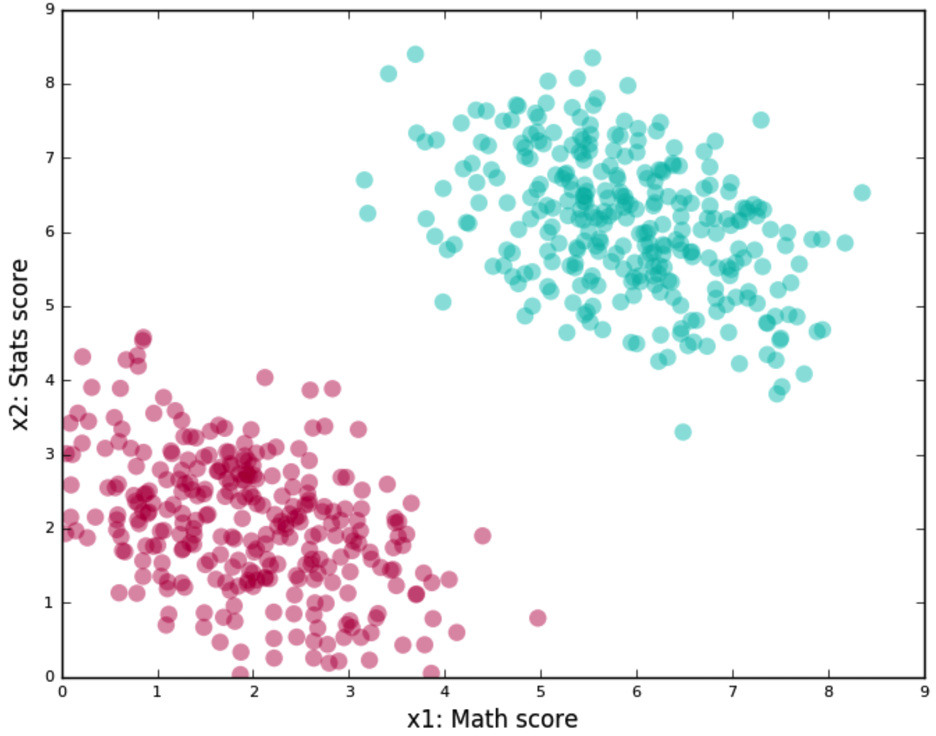
A Classification Problem (cont.)
Data Preprocessing + Visualization
Draw a two-dimensional scatter plot, where one axis represents scores in Math, while the other represents scores in Stats.
A student with certain scores is shown as a point on the graph.
The color of the point – green or red – represents how he/she did on the data science course: “Good” or “Bad” respectively.
Training data

Slide 6
A Classification Problem (cont.)
Goal
Finding a line that passes between the red and green clusters, and then determining which side of this line a score tuple lies on, is a good algorithm.

Slide 7
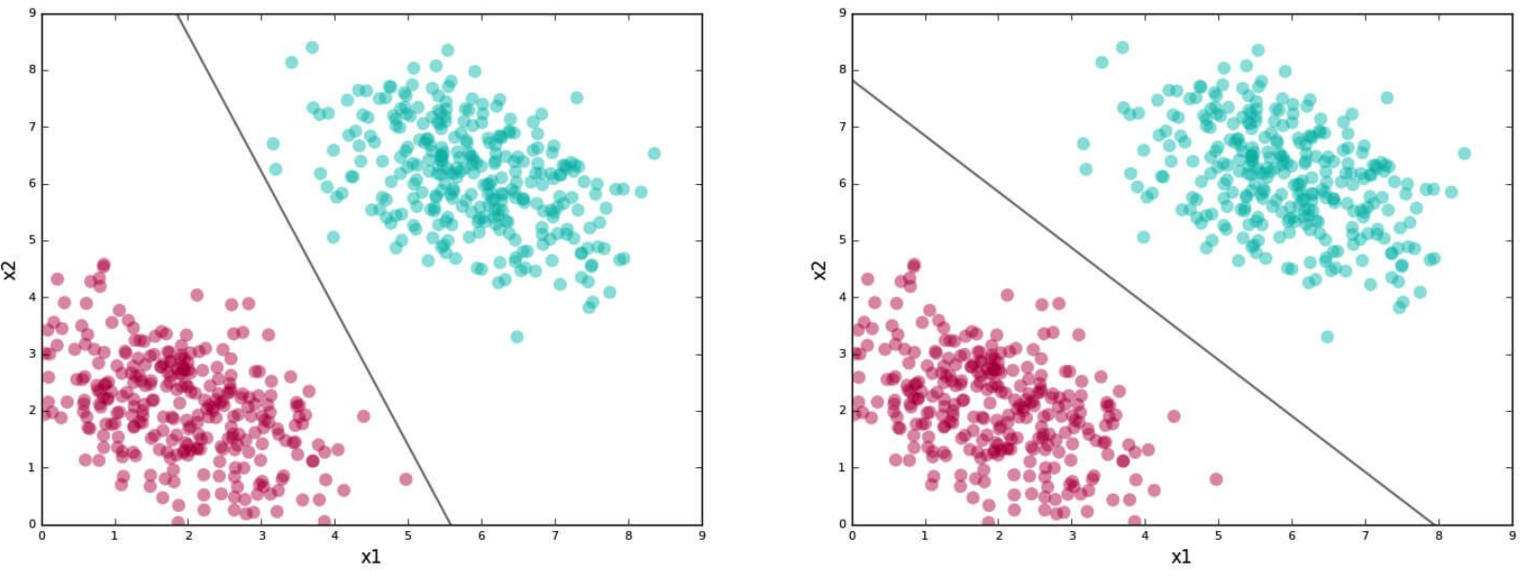
A Classification Problem (cont.)
The line is our separating boundary (because it separates out the labels) or classifier (we use it classify points).
Two classifiers:

Slide 8
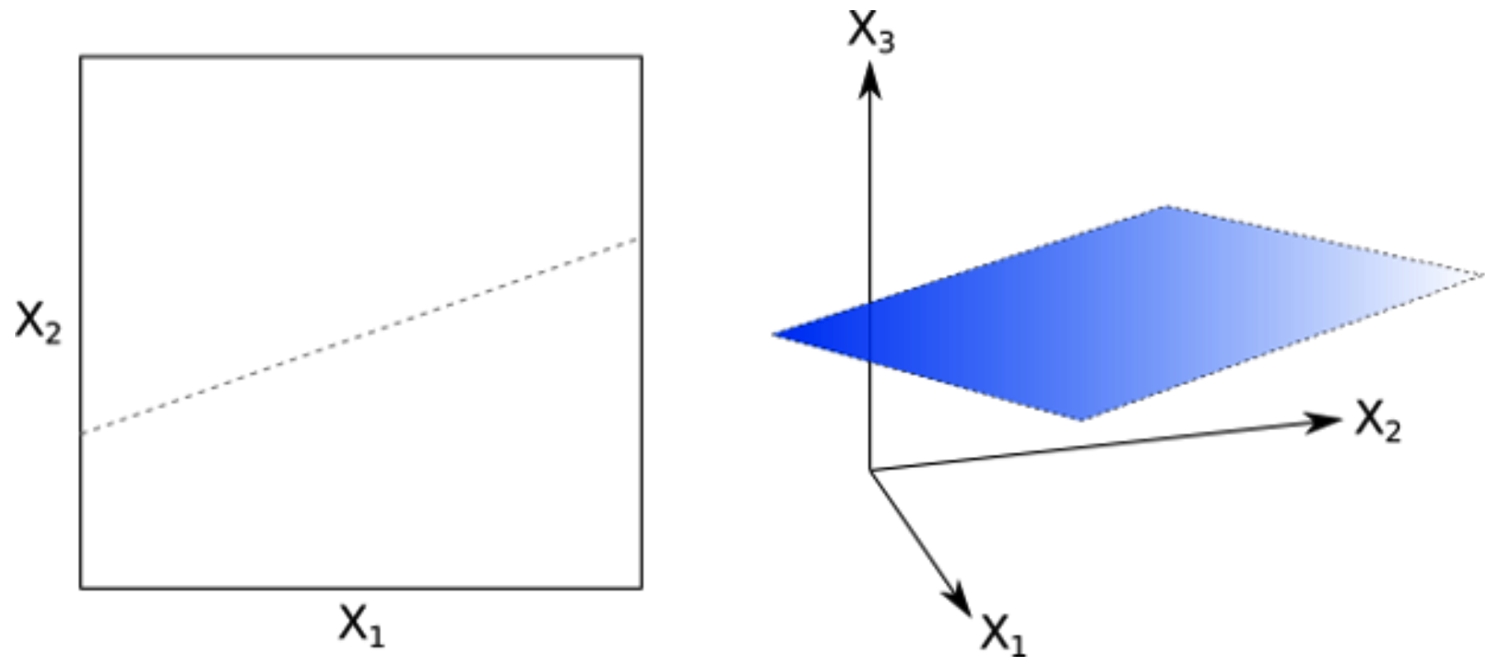
Concept 1: Hyperplane
In two dimensions we find a line.
In three dimensions we find a plane.
In high dimensions we find a hyperplane – a generalization of the two-dimensional line and three-dimensional plane to an arbitrary number of dimensions.
Data that can be separated by a hyperplane is known as linearly separable data.
The hyperplane acts as a linear classifier.

Slide 9
Concepts
Support Vector
Support Vector
Quick start:
Hyperplane
Supper Vector
Margin
SVMs
Maximize Margin Width
Non-linear SVMs: Kernel Function
Support Vector

Slide 10
Good vs Bad Classifiers
Q: Both lines separate the red and green clusters. Is there a good reason to choose one over another?

Slide 11
Good vs Bad Classifiers
Q: Both lines separate the red and green clusters. Is there a good reason to choose one over another?

Slide 12
Good vs Bad Classifiers
A: We try to find the second kind of line.
Q’: Define underlying philosophy in the general case.

Slide 13
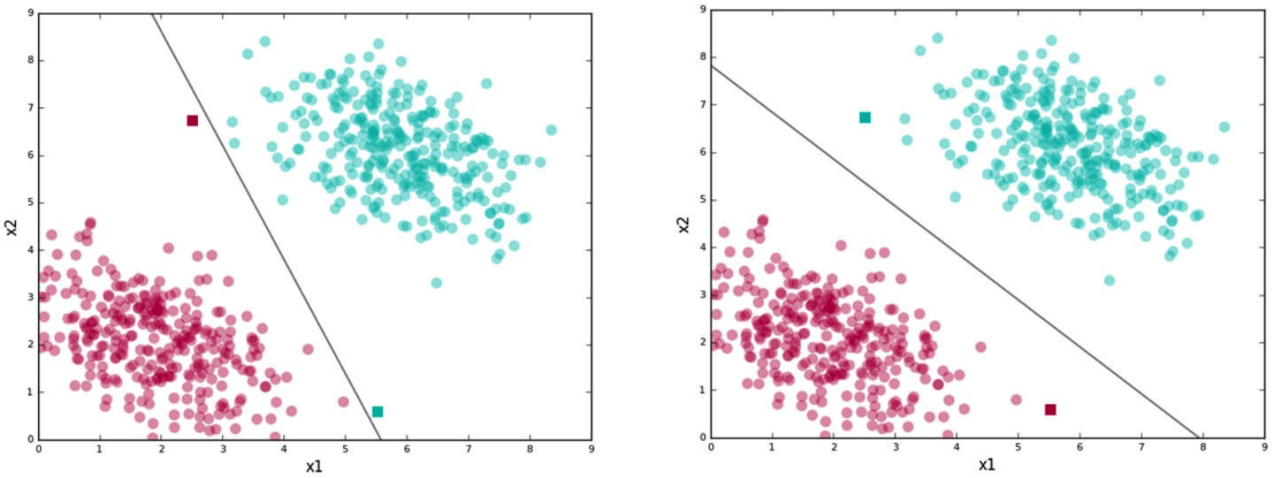
Good vs Bad Classifiers
Philosophy
Find lines that correctly classify the training data
Among all such lines, pick the one that has the greatest distance to the points closest to it

Slide 14
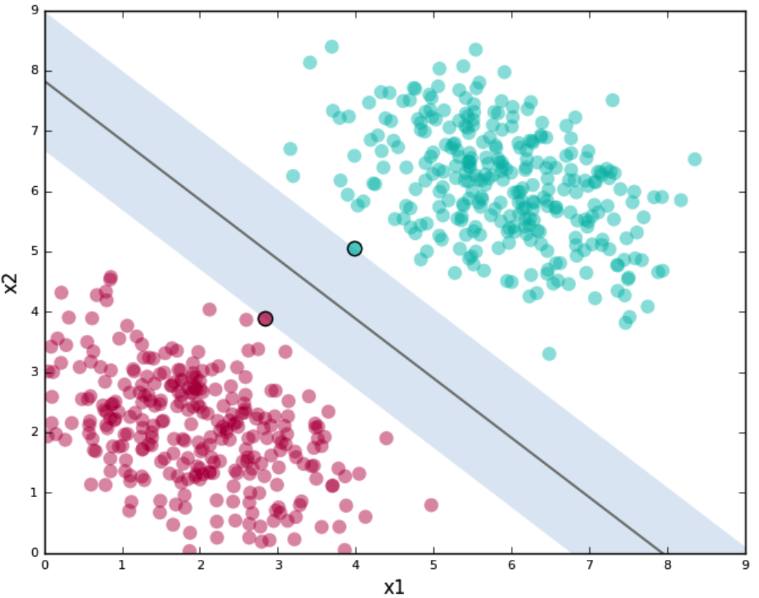
Concept 2: Support Vector
The closest points that identify this line are known as support vectors.

Slide 15
Concept 3: Margin
The (shaded) region support vectors define around the line is known as the margin.

Slide 16
Concepts
Support Vector
Support Vector
Quick start:
Hyperplane
Supper Vector
Margin
SVMs
Maximize Margin Width
Non-linear SVMs: Kernel Function
Support Vector

Slide 17
Support Vector Machines
Definition (Wikipedia)
A SVM is a discriminative classifier formally defined by a separating hyperplane. In other words, given labeled training data, the algorithm outputs an optimal hyperplane which categorizes new examples.
A data point is viewed as a p-dimensional vector, and we want to know whether we can separate such points with a (p-1)-dimensional hyperplane.
Use
SVMs give you a way to pick between many possible classifiers in a way that guarantees a higher chance of correctly labeling your test data.

Slide 18
SVM: General Philosophy
Small Margin
Large Margin
Support Vectors

Slide 19
Concepts
Support Vector
Support Vector
Quick start:
Hyperplane
Supper Vector
Margin
SVMs
Maximize Margin Width
Non-linear SVMs: Kernel Function
Support Vector

Slide 20
Formally Define the Problem
Binary Classification
E.g., course performance classification
x_{i} = (x₁, x₂, x₃, …): Subject scores
y_{i} = +1 or –1: “Good” or “Bad”
x₁ : score of subject Math
x₂ : score of subject Stats
Mathematically, x ∈ ℜ^{n}, y ∈ {+1, –1},
We want to derive a function f: X → Y

Slide 21
Optimization
Support vectors:
x⁺
x⁻
x⁺
“Predict Class = +1” zone
Hyperplane:
wx+b=0
x⁻
What we know:
w . x⁺ + b = +1
w . x⁻ + b = -1
wx+b=1
wx+b=0
“Predict Class = -1” zone
wx+b=-1
A separating hyperplane can be written as
w . x + b = 0,
where w={w₁, w₂, …, w_{n}} is a weight vector and b a scalar (bias).

Slide 22
Optimization
Support vectors:
x⁺
x⁻
x⁺
M=Margin Width
“Predict Class = +1” zone
Hyperplane:
wx+b=0
x⁻
What we know:
w . x⁺ + b = +1
w . x⁻ + b = -1
wx+b=1
wx+b=0
“Predict Class = -1” zone
wx+b=-1
How to calculate the Margin Width?
Distance between two parallel lines.

Slide 23
Optimization: Maximize Margin Width
Support vectors:
x⁺
x⁻
x⁺
M=Margin Width
“Predict Class = +1” zone
Hyperplane:
wx+b=0
x⁻
What we know:
w . x⁺ + b = +1
w . x⁻ + b = -1
wx+b=1
wx+b=0
“Predict Class = -1” zone
wx+b=-1
max
Any constraints?
Correctly categorize…
same as min

Slide 24
Optimization: Maximize Margin Width
Support vectors:
x⁺
x⁻
x⁺
M=Margin Width
“Predict Class = +1” zone
Hyperplane:
wx+b=0
x⁻
What we know:
w . x⁺ + b = +1
w . x⁻ + b = -1
wx+b=1
wx+b=0
“Predict Class = -1” zone
wx+b=-1
H₁: wx_{i} + b ≥ 1 for y_{i} = +1
H₂: wx_{i} + b ≤ -1 for y_{i} = -1
→ y_{i} (wx_{i} + b) ≥ 1 for all i
max
same as min

Slide 25
The MMW Problem
min
s.t.
for all i
It’s a Constrained (Convex) Quadratic Optimization Problem!
Quadratic optimization problems are a well-known class of mathematical programming problems, and many (rather intricate) algorithms exist for solving them.

Slide 26
Solving the MMW Problem
Need to optimize a quadratic function subject to linear constraints.
Quadratic objective function and linear constraints → Quadratic Programming (QP) → Lagrangian multipliers
The solution involves constructing a dual problem where a Lagrange multiplier α_{i} is associated with every constraint in the primary problem:
Find w and b such that
Φ(w) =½ w^{T}w is minimized;
and for all {(x_{i} ,y_{i})}: y_{i} (w^{T}x_{i} + b) ≥ 1
Find α₁…α_{N} such that
Q(α) =Σα_{i} - ½ΣΣα_{i}α_{j}y_{i}y_{j}x_{i}^{T}x_{j}
is maximized and
(1) Σα_{i}y_{i} = 0
(2) α_{i} ≥ 0 for all α_{i}

Slide 27
Concepts
Support Vector
Support Vector
Quick start:
Hyperplane
Supper Vector
Margin
SVMs
Maximize Margin Width
Non-linear SVMs: Kernel Function
Support Vector

Slide 28
LinearSVM: Summary
The classifier is a separating hyperplane.
Linearly separable data points
Most “important” training points are support vectors; they define the hyperplane.
Quadratic optimization algorithms can identify which training points x_{i} are support vectors with non-zero Lagrangian multipliers α_{i}.
maximum marginal hyperplane
Find α₁…α_{N} such that
Q(α) = Σα_{i} - ½ΣΣα_{i}α_{j}y_{i}y_{j}x_{i}^{T}x_{j} is maximized and
(1) Σα_{i}y_{i} = 0
(2) 0 ≤ α_{i} ≤ C for all α_{i}

Slide 29
Why is SVM Effective on High Dimensional Data?
The complexity of trained classifier is characterized by the # of support vectors rather than the dimensionality of the data.
The support vectors are the essential or critical training examples — they lie closest to the decision boundary.
If all other training examples are removed and the training is repeated, the same separating hyperplane would be found.

Slide 30
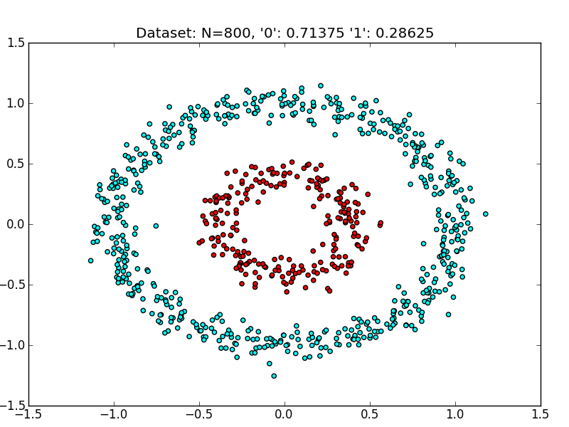
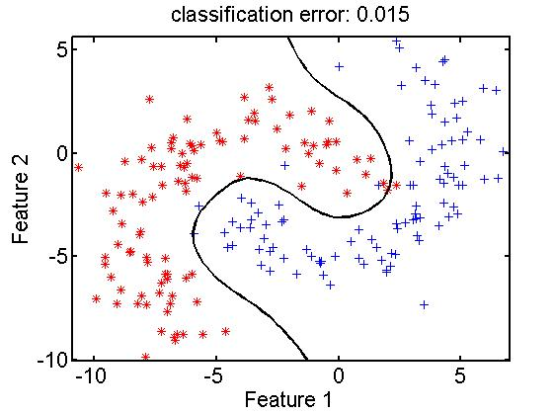
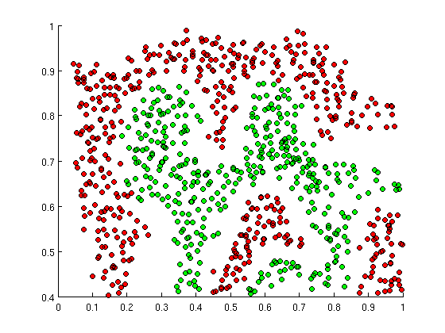
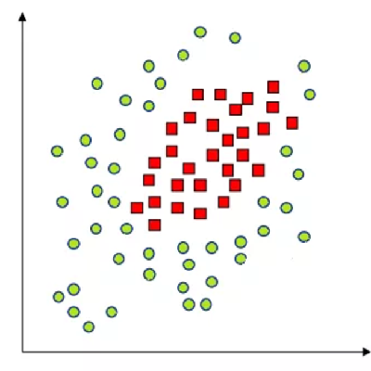
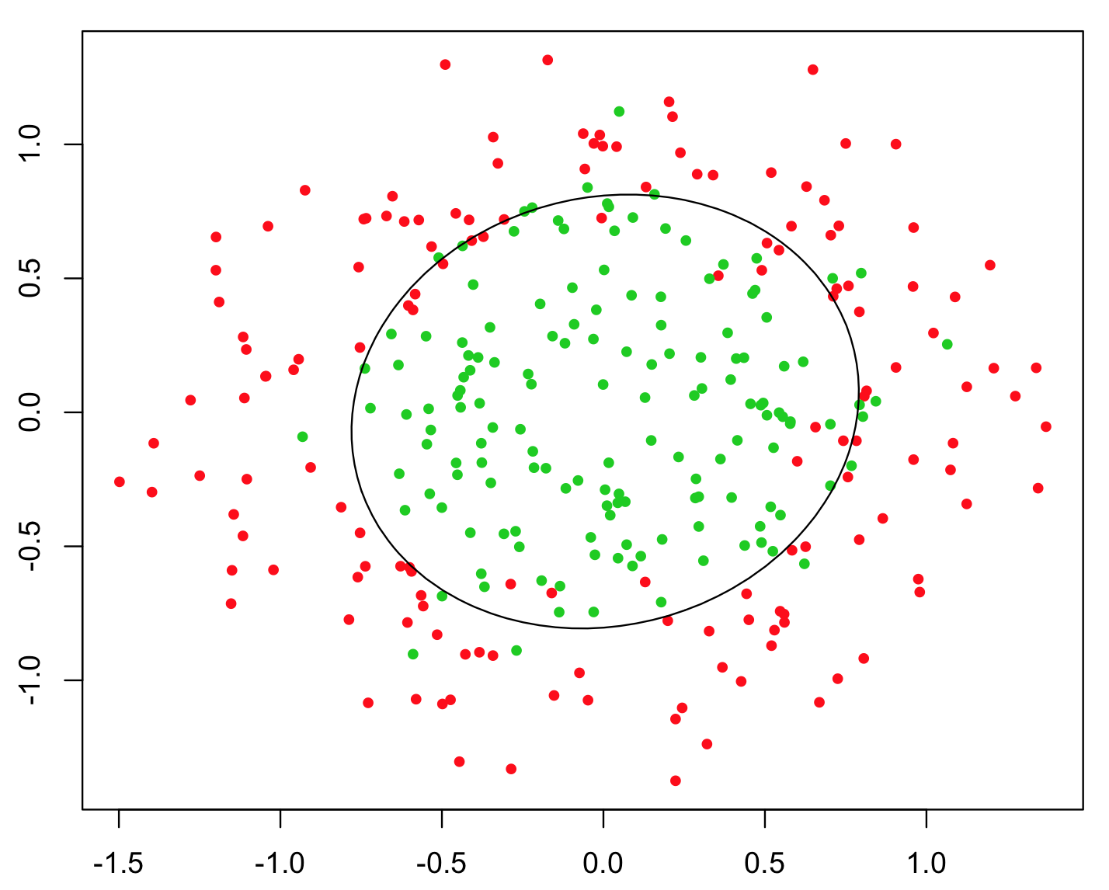
Non-Linear Data Points

Slide 31
Non-linear SVMs: Feature Spaces
General idea: The original input space can always be mapped to some higher-dimensional feature space where the training set is separable:
Φ: x → φ(x)

Slide 32
The “Kernel Trick”
The classifier relies on dot product between vectors
K(x_{i},x_{j})=x_{i}^{T}x_{j}
If every data point is mapped into high-dimensional space via some transformation Φ: x → φ(x), the dot product becomes:
K(x_{i},x_{j})= φ(x_{i}) ^{T}φ(x_{j})
A kernel function is some function that corresponds to an inner product in some expanded feature space.

Slide 33
What Functions are Kernels?
For some functions K(x_{i},x_{j}) checking that
K(x_{i},x_{j})= φ(x_{i}) ^{T}φ(x_{j}) can be cumbersome.
Mercer’s theorem:
Every semi-positive definite symmetric function is a kernel
Semi-positive definite symmetric functions correspond to a semi-positive definite symmetric Gram matrix:
K(x₁,x₁) | K(x₁,x₂) | K(x₁,x₃) | … | K(x₁,x_{N})
K(x₂,x₁) | K(x₂,x₂) | K(x₂,x₃) |  | K(x₂,x_{N})
… | … | … | … | …
K(x_{N},x₁) | K(x_{N},x₂) | K(x_{N},x₃) | … | K(x_{N},x_{N})
K =

Slide 34
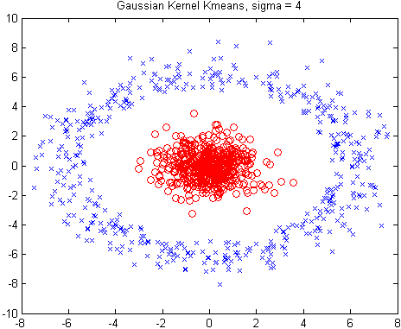
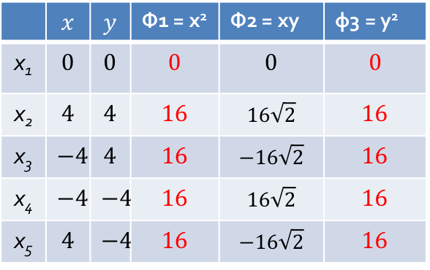

Example: A Kernel Function
Polynomial kernel of degree h=2: K(X_{i}, X_{j}) = X_{i}∙X_{j} ² → φ(x, y) = (x², $\sqrt{2}$xy, y²)
Suppose there are 5 original 2-dimensional points:
x₁(0, 0), x₂(4, 4), x₃(-4, 4), x₄(-4, -4), x₅(4, -4)
 | $$x$$ | $$y$$ | Φ1 = x² | Φ2 = xy | φ3 = y²
x₁ | $$0$$ | $$0$$ | $$0$$ | $$0$$ | $$0$$
x₂ | $$4$$ | $$4$$ | $$16$$ | $$16\sqrt{2}$$ | $$16$$
x₃ | $$−4$$ | $$4$$ | $$16$$ | $$−16\sqrt{2}$$ | $$16$$
x₄ | $$−4$$ | $$−4$$ | $$16$$ | $$16\sqrt{2}$$ | $$16$$
x₅ | $$4$$ | $$−4$$ | $$16$$ | $$−16\sqrt{2}$$ | $$16$$
x₃
x₂
x₄
x₅

Slide 35
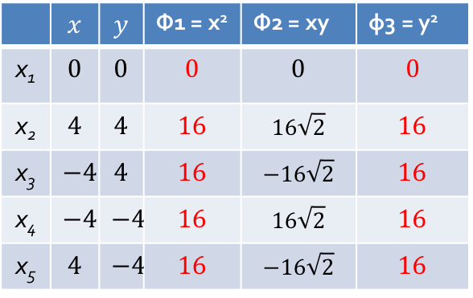

Example: A Kernel Function
Polynomial kernel of degree h=2: K(X_{i}, X_{j}) = X_{i}∙X_{j} ² → φ(x, y) = (x², $\sqrt{2}$xy, y²)
Suppose there are 5 original 2-dimensional points:
x₁(0, 0), x₂(4, 4), x₃(-4, 4), x₄(-4, -4), x₅(4, -4)
Φ3
x₂
Now linearly separable!!!
x₃
Φ2
x₂
x₄
x₃
x₅
x₅
Φ1
x₄
 | $$x$$ | $$y$$ | Φ1 = x² | Φ2 = xy | φ3 = y²
x₁ | $$0$$ | $$0$$ | $$0$$ | $$0$$ | $$0$$
x₂ | $$4$$ | $$4$$ | $$16$$ | $$16\sqrt{2}$$ | $$16$$
x₃ | $$−4$$ | $$4$$ | $$16$$ | $$−16\sqrt{2}$$ | $$16$$
x₄ | $$−4$$ | $$−4$$ | $$16$$ | $$16\sqrt{2}$$ | $$16$$
x₅ | $$4$$ | $$−4$$ | $$16$$ | $$−16\sqrt{2}$$ | $$16$$
$$K(x_{i},x_{1})$$ | $$K(x_{i},x_{2})$$ | $$K(x_{i},x_{3})$$ | $$K(x_{i},x_{4})$$ | $$K(x_{i},x_{5})$$
$$0$$ | $$0$$ | $$0$$ | $$0$$ | $$0$$
$$0$$ | $$322$$ | $$0$$ | $$322$$ | $$0$$
$$0$$ | $$0$$ | $$322$$ | $$0$$ | $$322$$
$$0$$ | $$322$$ | $$0$$ | $$322$$ | $$0$$
$$0$$ | $$0$$ | $$322$$ | $$0$$ | $$322$$

Slide 36
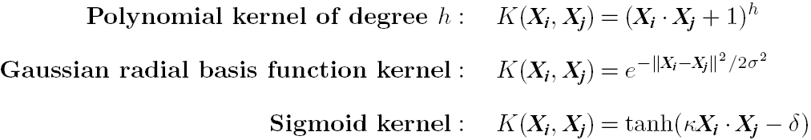
Kernel Functions for Nonlinear Classification
Instead of computing the dot product on the transformed data, it is mathematically equivalent to applying a kernel function K(X_{i}, X_{j}) to the original data, i.e., K(X_{i}, X_{j}) = Φ(X_{i}) Φ(X_{j}).
Typical Kernel Functions

Slide 37
Non-linear SVMs: Optimization
Dual problem formulation:
The solution is:
Optimization techniques for finding α_{i}’s remain the same!
Find α₁…α_{N} such that
Q(α) =Σα_{i} - ½ΣΣα_{i}α_{j}y_{i}y_{j}K(x_{i}, x_{j}) is maximized and
(1) Σα_{i}y_{i} = 0
(2) α_{i} ≥ 0 for all α_{i}
f(x) = Σα_{i}y_{i}K(x_{i}, x_{j})+ b

Slide 38
Concepts
Support Vector
Support Vector
Quick start:
Hyperplane
Supper Vector
Margin
SVMs
Maximize Margin Width
Non-linear SVMs: Kernel Function
Support Vector

Slide 39
SVM: History and Applications
Vapnik and colleagues (1992)—groundwork from Vapnik & Chervonenkis’ statistical learning theory in 1960s
Features: training can be slow but accuracy is high owing to their ability to model complex nonlinear decision boundaries (margin maximization)
Applications:
Text categorization
Image classification
Hand-written digit/character recognition
Object recognition
Bioinformatics (Protein classification, Cancer classification…)

Slide 40
SVM Related Links
SVM Website: http://www.kernel-machines.org/
Representative implementations
LIBSVM: an efficient implementation of SVM, multi-class classifications, nu-SVM, one-class SVM, including also various interfaces with java, python, etc.
SVM-light: simpler but performance is not better than LIBSVM, support only binary classification and only in C
SVM-torch: another recent implementation also written in C
http://www.meng-jiang.com/teaching/SVMDemo.zip

Slide 41
References
C. M. Bishop, Neural Networks for Pattern Recognition. Oxford University Press, 1995
L. Breiman, J. Friedman, R. Olshen, and C. Stone. Classification and Regression Trees. Wadsworth International Group, 1984
C. J. C. Burges. A Tutorial on Support Vector Machines for Pattern Recognition. Data Mining and Knowledge Discovery, 2(2): 121-168, 1998
N. Cristianini and J. Shawe-Taylor, Introduction to Support Vector Machines and Other Kernel-Based Learning Methods, Cambridge University Press, 2000
H. Yu, J. Yang, and J. Han. Classifying large data sets using SVM with hierarchical clusters. KDD'03
A. J. Dobson. An Introduction to Generalized Linear Models. Chapman & Hall, 1990
R. O. Duda, P. E. Hart, and D. G. Stork. Pattern Classification, 2ed. John Wiley, 2001
T. Hastie, R. Tibshirani, and J. Friedman. The Elements of Statistical Learning: Data Mining, Inference, and Prediction. Springer-Verlag, 2001
S. Haykin, Neural Networks and Learning Machines, Prentice Hall, 2008
D. Heckerman, D. Geiger, and D. M. Chickering. Learning Bayesian networks: The combination of knowledge and statistical data. Machine Learning, 1995
H. Cheng, X. Yan, J. Han & C.-W. Hsu, Discriminative Frequent Pattern Analysis for Effective Classification, ICDE‘07
W. Cohen. Fast effective rule induction. ICML'95

Slide 42
References (cont.)
H. Cheng, X. Yan, J. Han & P. S. Yu, Direct Discriminative Pattern Mining for Effective Classification, ICDE’08
G. Cong, K. Tan, A. Tung & X. Xu. Mining Top-k Covering Rule Groups for Gene Expression Data, SIGMOD’05
M. Deshpande, M. Kuramochi, N. Wale & G. Karypis. Frequent Substructure-based Approaches for Classifying Chemical Compounds, TKDE’05
G. Dong & J. Li. Efficient Mining of Emerging Patterns: Discovering Trends and Differences, KDD’99
W. Fan, K. Zhang, H. Cheng, J. Gao, X. Yan, J. Han, P. S. Yu & O. Verscheure. Direct Mining of Discriminative and Essential Graphical and Itemset Features via Model-based Search Tree, KDD’08
W. Li, J. Han & J. Pei. CMAR: Accurate and Efficient Classification based on Multiple Class-association Rules, ICDM’01
B. Liu, W. Hsu & Y. Ma. Integrating Classification and Association Rule Mining, KDD’98
J. R. Quinlan and R. M. Cameron-Jones. FOIL: A midterm report. ECML’93
Jingbo Shang, Wenzhu Tong, Jian Peng, and Jiawei Han, "DPClass: An Effective but Concise Discriminative Patterns-Based Classification Framework", SDM’16
J. Wang and G. Karypis. HARMONY: Efficiently Mining the Best Rules for Classification, SDM’05
X. Yin & J. Han. CPAR: Classification Based on Predictive Association Rules, SDM’03

