Slide 1

Meng Jiang
Postdoctoral Researcher in UIUC since Aug 2015 (Office 2130)
Ph. D. from Tsinghua University, Beijing (2010-2015)
Research topic: Data-driven Behavioral Analytics with Networks
Different from Experience-driven: Observation, Representation, Model
Applications: recommender system, fraud/spam detection, etc.
Given behavioral data (user-information interaction), I study
Mining user-item behavior network w/ social, spatiotemporal contexts
Structuring information network from unstructured items’ content
Integrating behavior network and information network for applications
www.meng-jiang.com
Notes:
Experience-driven: governor of a world of plants and zombies, look beautiful/strange, bitter melon
We have data of their interactions, bipartite graph between plants and zombies, bipartite core detection/propagation
How to predict what the users want to retweet? Popularity, personal preference, interpersonal influence…
How to detect fake accounts? Many followees, many hashtags/urls in their tweets…
User-item bipartite network – friendship, location, time
Item: $Person, $Location, $Organization, attributes, relationships
How to incorporate the information network for accurate prediction/detection?

Slide 2
Chapter 4: Data Warehousing and On-line Analytical Processing
Data Warehouse: Basic Concepts
Data Warehouse Modeling: Data Cube and OLAP
Data Warehouse Design and Usage
Data Warehouse Implementation
Summary
Notes:
What is DW. Four keywords.
The role of DW … (to be introduced)

Slide 3
Data Warehouse: A Multi-Tiered Architecture
Top Tier: Front-End Tools
Middle Tier: OLAP Server
Bottom Tier: Data Warehouse Server
Data
Notes:
1. Data Warehousing. Prepare the lecture: YouTube, 2002, JH in Peking U. Slides: over 80% of the slides are the same.
2002: high school… eight-year-old. Out-of-Date?
2. Data mining? Reading and sharing files, importing data into database and sharing database, sharing data via cloud platforms
3. Working/doing data analysis for yourself, or for a few customers. When the company is huge, thousands of people, how about working for the managers? The managers are not coding but making decisions every day. Their duty is not to make any mistake.
4. How to use data to improve their performance, make right decisions, and keep the company well run? There must be some fundamental philosophy, principles, methodology and even techniques.
5. This is important when you are looking for jobs in big companies. Example: When I was an undergraduate, my roommate/classname – Shanghai citizen, working for Baidu Shanghai immediately after graduation. Has been a project manager when I attended his wedding years ago. He told me he worked on data warehousing since he joined Baidu. His bookshelf has Han’s books, Data warehousing. He also watched Han’s YouTube talk in 2002. He directed his team of 12 people to improve a part of Baidu’s huge data warehouse for years.
DW bridges the data from operational databases and the query, report and analysis (front-end tools) of decision makers.
Bottom, data, database, to warehouse server, OLAP server, to front.

Slide 4
Three Data Warehouse Models
Enterprise warehouse
Collects all of the information about subjects spanning the entire organization
Data Mart
A subset of corporate-wide data that is of value to a specific groups of users
Its scope is confined to specific, selected groups, such as marketing data mart
Independent vs. dependent (directly from warehouse) data mart
Virtual warehouse
A set of views over operational databases
Only some of the possible summary views may be materialized
Notes:
Bottom tier.
From the view of enterprise.
DW: for Holiday Inn.
Data marts: Champaign’s Holiday Inn; Advertisement and promotions of Holiday Inn.
Data marts are usually implemented on low-cost departmental servers.
Virtual warehouse: when you just have the operational DBs, but you want summary views as DW.
How to build the bottom tier for departments?
S1: First build DW. Then split DW into data marts. (projection)
S2: First build data marts independently and then merge them.

Slide 5
Extraction, Transformation, and Loading (ETL)
Data extraction
get data from multiple, heterogeneous, and external sources
Data cleaning
detect errors in the data and rectify them when possible
Data transformation
convert data from legacy or host format to warehouse format
Load
sort, summarize, consolidate, compute views, check integrity, and build indicies and partitions
Refresh
propagate the updates from the data sources to the warehouse
Notes:
MK 08.11.09 Former title: Data Warehouse Back-End Tools and Utilities
Point by point.
From operational databases to data warehouse.

Slide 6
Metadata Repository
Meta data is the data defining warehouse objects. It stores:
Description of the structure of the data warehouse
schema, view, dimensions, hierarchies, derived data defn, data mart locations and contents
Operational meta-data
data lineage (history of migrated data and transformation path), currency of data (active, archived, or purged), monitoring information (warehouse usage statistics, error reports, audit trails)
The algorithms used for summarization
The mapping from operational environment to the data warehouse
Data related to system performance
warehouse schema, view and derived data definitions
Business data
business terms and definitions, ownership of data, charging policies
Notes:
Point by point.
The algorithms used for summarization: I4, CaseOLAP.

Slide 7
Chapter 4: Data Warehousing and On-line Analytical Processing
Data Warehouse: Basic Concepts
Data Warehouse Modeling: Data Cube and OLAP
Data Warehouse Design and Usage
Data Warehouse Implementation
Summary

Slide 8
From Tables and Spreadsheets to Data Cubes
A data warehouse is based on a multidimensional data model which views data in the form of a data cube
A data cube, such as sales, allows data to be modeled and viewed in multiple dimensions
Dimension tables, such as item (item_name, brand, type), or time(day, week, month, quarter, year)
Fact table contains measures (such as dollars_sold) and keys to each of the related dimension tables
Data cube: A lattice of cuboids
In data warehousing literature, an n-D base cube is called a base cuboid
The top most 0-D cuboid, which holds the highest-level of summarization, is called the apex cuboid
The lattice of cuboids forms a data cube.
Notes:
Spreadsheets: Excel files
Dimension tables
Fact tables (measure tables)
Key to value: a set of keys in selected dimensions; result of a measure
Next page supplies details about Data Cube and Cuboids.

Slide 9
Data Cube: A Lattice of Cuboids
all
0-D (apex) cuboid
time
item
location
supplier
1-D cuboids
time,location
item,location
location,supplier
time,item
2-D cuboids
time,supplier
item,supplier
time,location,supplier
3-D cuboids
time,item,location
time,item,supplier
item,location,supplier
4-D (base) cuboid
time, item, location, supplier
Notes:
Every dimension still has multiple levels (time: year, month, week, day, hour).
Every cuboid is a cube. We call a lattice of cuboids (all the cubes) as data cube.

Slide 10
Conceptual Modeling of Data Warehouses
Modeling data warehouses: dimensions & measures
Star schema: A fact table in the middle connected to a set of dimension tables
Snowflake schema: A refinement of star schema where some dimensional hierarchy is normalized into a set of smaller dimension tables, forming a shape similar to snowflake
Fact constellations: Multiple fact tables share dimension tables, viewed as a collection of stars, therefore called galaxy schema or fact constellation
Notes:
Star, Snowflake, Galaxy (constellation – collection of stars)

Slide 11
Star Schema: An Example
time
time_key
day
day_of_the_week
month
quarter
year
item
item_key
item_name
brand
type
supplier_type
Sales Fact Table
time_key
item_key
branch_key
branch
location
location_key
branch_key
branch_name
branch_type
location_key
street
city
state_or_province
country
units_sold
dollars_sold
avg_sales
Measures
Notes:
3 measures
4 dimensional keys: every dimension has different levels
Top-to-bottom (often big to small, high-level to low-level, few to many, sometimes there is no hierarchy) but “time/location” in this figure reversed the hierarchy.
Roll up (summarize the data): climb the hierarchy → going down in the figure
Drill down (from the top to the bottom, from few to many, from big to small)

Slide 12
Snowflake Schema: An Example
time
item
time_key
day
day_of_the_week
month
quarter
year
item_key
item_name
brand
type
supplier_key
supplier
Sales Fact Table
supplier_key
supplier_type
time_key
item_key
branch_key
branch
location
location_key
location_key
street
city_key
branch_key
branch_name
branch_type
units_sold
dollars_sold
city
city_key
city
state_or_province
country
avg_sales
Measures
Notes:
Example: (1) 4th Street, Champaign, Illinois, US
(2) 6th Street, Champaign, Illinois, US
(3) Green Street, Champaign, Illinois, US
…Street, Champaign; (another table) Champaign, Illinois, US
Which one is better?
Snowflake schema: save storage cost (you have to link the tables/relations when you compute)
Star schema: save computing cost (some companies still use star schema, not snowflake schema)

Slide 13
Fact Constellation: An Example
time
time_key
day
day_of_the_week
month
quarter
year
item
Shipping Fact Table
item_key
item_name
brand
type
supplier_type
Sales Fact Table
time_key
time_key
item_key
shipper_key
item_key
branch_key
from_location
branch
location_key
location
to_location
branch_key
branch_name
branch_type
units_sold
location_key
street
city
province_or_state
country
dollars_cost
dollars_sold
units_shipped
avg_sales
shipper
Measures
shipper_key
shipper_name
location_key
shipper_type
Notes:
Sales and Shipping tables can share items, locations, time tables.

Slide 14
A Concept Hierarchy for a Dimension (location)
all
all
region
Europe
...
North_America
country
Germany
...
Spain
Canada
...
Mexico
city
Frankfurt
...
Vancouver
...
Toronto
office
L. Chan
...
M. Wind
Notes:
Levels and values of a dimension
Q1: How to construct the concept hierarchy from structured data (Web Tables)?
Q2: How to … from (unstructured) text data?
Many terms: cube, cuboid (1) dimension, level, concept; (2) measure, fact
“value”: concept, fact

Slide 15
Data Cube Measures: Three Categories
Distributive: if the result derived by applying the function to n aggregate values is the same as that derived by applying the function on all the data without partitioning
E.g., count(), sum(), min(), max()
Algebraic: if it can be computed by an algebraic function with M arguments (where M is a bounded integer), each of which is obtained by applying a distributive aggregate function
avg(x) = sum(x) / count(x)
Is min_N() an algebraic measure? How about standard_deviation()?
Holistic: if there is no constant bound on the storage size needed to describe a subaggregate.
E.g., median(), mode(), rank()
Notes:
We want to distribute tasks to multiple machines according to different levels of the hierarchy – fast!
1. Distributive: like MapReduce. If the measure operation allows you to split the cube into pieces and calculate, and then aggregate the results to derive the final results…
Ex: the total sales in US from 2010-2015? – dividing into states/years and then putting together
2. Average? Avg_Illinois + Avg_California +Avg_Oklahoma? Wrong. You have to take the counts into consideration. If you want to do it distributively, you have to communite two values (sum and count), not just one (avg).
Min_N: the N minimal values?
Std?
3. Holistic: you send 1, 2, 8, 10 values? No way! You have to get all the data. Median… if we want exact value, not approximated value.

Slide 16
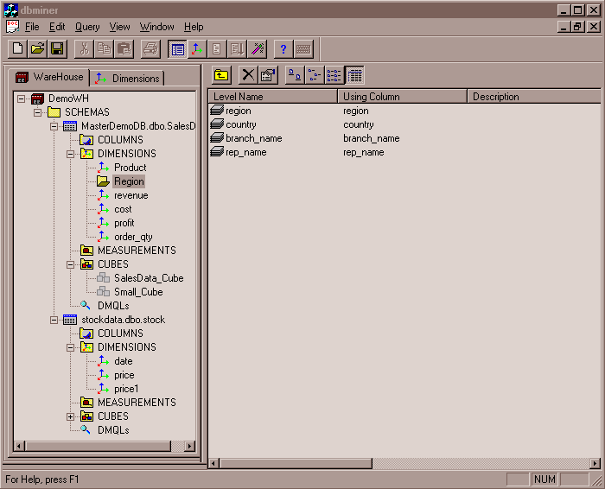
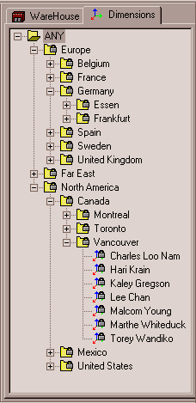
View of Warehouses and Hierarchies
Specification of hierarchies
Schema hierarchy
day < {month < quarter; week} < year
Set_grouping hierarchy
{1..10} < inexpensive
Notes:
Microsoft…

Slide 17
Multidimensional Data
Sales volume as a function of product, month, and region
Dimensions: Product, Location, Time
Hierarchical summarization paths
Region
Industry Region Year
Category Country Quarter
Product City Month Week
Office Day
Product
Month
Notes:
The dimension sometimes does not have a strict hierarchy, but a network/graph.

Slide 18
A Sample Data Cube
Date
Total annual sales
of TVs in U.S.A.
1Qtr
2Qtr
3Qtr
4Qtr
sum
Product
TV
PC
U.S.A
VCR
sum
Canada
Country
Mexico
sum
All, All, All
Notes:
Orange cuboid, green cuboid, dark blue cuboid (the apex cuboid).

Slide 19
Cuboids Corresponding to the Cube
all
0-D (apex) cuboid
product
date
country
1-D cuboids
product,date
product,country
date, country
2-D cuboids
3-D (base) cuboid
product, date, country

Slide 20
Typical OLAP Operations
Roll up (drill-up): summarize data
by climbing up hierarchy or by dimension reduction
Drill down (roll down): reverse of roll-up
from higher level summary to lower level summary or detailed data, or introducing new dimensions
Slice and dice: project and select
Pivot (rotate):
reorient the cube, visualization, 3D to series of 2D planes
Other operations
Drill across: involving (across) more than one fact table
Drill through: through the bottom level of the cube to its back-end relational tables (using SQL)
Notes:
For details, see next page
Drill across: A-B-C to A-B-D
Drill through: you cannot find details from the data when you generate the cube. You have to go to back-end relational tables. (not cube operations but SQL operations)

Slide 21
Typical OLAP Operations
Notes:
Right, bottom: drill down on time, from quarters to months (Q1-Q4 to Jan-Dec)
Right, top: roll up from cities to countries (Vancouver, Toronto, NY, Chicago to Canada, USA)
Left, top: dice (select Q1 and Q2 on time dimension, Toronto and Vancouver on location dimension)
Left, bottom: slice (project to time = Q1, 3D to 2D), pivot (rotate)

Slide 22
A Star-Net Query Model
Customer Orders
Shipping Method
Customer
CONTRACTS
AIR-EXPRESS
ORDER
TRUCK
PRODUCT LINE
Time
Product
ANNUALY
QTRLY
DAILY
PRODUCT ITEM
PRODUCT GROUP
CITY
SALES PERSON
COUNTRY
DISTRICT
REGION
DIVISION
Location
Each circle is called a footprint
Promotion
Organization
Notes:
Every black line from the original is a dimension.
Every circle on the line/axis is a level, called footprint.
Walking across 5 footprints/circles: query the 5 levels of the 5 dimensions from the star net.

Slide 23
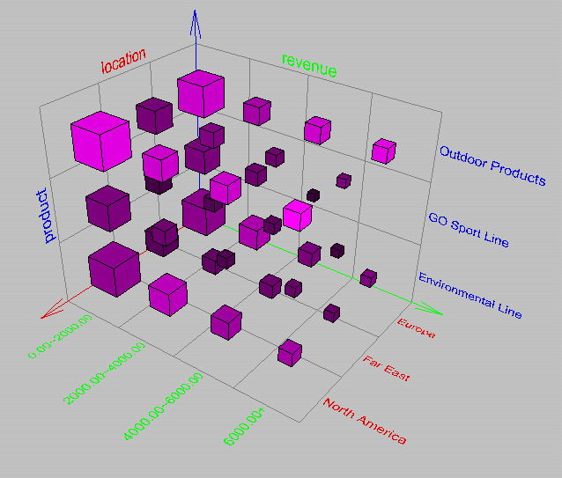
Browsing a Data Cube
Visualization
OLAP capabilities
Interactive manipulation
Notes:
Dimensions, size, brightness, density…for different measures (visualization)

Slide 24
Chapter 4: Data Warehousing and On-line Analytical Processing
Data Warehouse: Basic Concepts
Data Warehouse Modeling: Data Cube and OLAP
Data Warehouse Design and Usage
Data Warehouse Implementation
Summary

Slide 25
Design of Data Warehouse: A Business Analysis Framework
Four views regarding the design of a data warehouse
Top-down view
allows selection of the relevant information necessary for the data warehouse
Data source view
exposes the information being captured, stored, and managed by operational systems
Data warehouse view
consists of fact tables and dimension tables
Business query view
sees the perspectives of data in the warehouse from the view of end-user
Notes:
Top-down: who operates DW
Data source: who imports data into DW
DW: who builds and manages DW
Business query: who uses DW for data analysis/decision making

Slide 26
Data Warehouse Design Process
Top-down, bottom-up approaches or a combination of both
Top-down: Starts with overall design and planning (mature)
Bottom-up: Starts with experiments and prototypes (rapid)
From software engineering point of view
Waterfall: structured and systematic analysis at each step before proceeding to the next
Spiral: rapid generation of increasingly functional systems, short turn around time, quick turn around
Typical data warehouse design process
Choose a business process to model, e.g., orders, invoices, etc.
Choose the grain (atomic level of data) of the business process
Choose the dimensions that will apply to each fact table record
Choose the measure that will populate each fact table record
Notes:
How to design a DW: approach, engineering, elements

Slide 27
Data Warehouse Usage
Three kinds of data warehouse applications
Information processing
supports querying, basic statistical analysis, and reporting using crosstabs, tables, charts and graphs
Analytical processing
multidimensional analysis of data warehouse data
supports basic OLAP operations, slice-dice, drilling, pivoting
Data mining
knowledge discovery from hidden patterns
supports associations, constructing analytical models, performing classification and prediction, and presenting the mining results using visualization tools
Notes:
Do you want to use DW to analyze your data? (data mining)
If you are a member of a big company, you cannot avoid it. You have to learn this tool.

Slide 28
From On-Line Analytical Processing (OLAP) to On Line Analytical Mining (OLAM)
Why online analytical mining?
High quality of data in data warehouses
DW contains integrated, consistent, cleaned data
Available information processing structure surrounding data warehouses
ODBC, OLEDB, Web accessing, service facilities, reporting and OLAP tools
OLAP-based exploratory data analysis
Mining with drilling, dicing, pivoting, etc.
On-line selection of data mining functions
Integration and swapping of multiple mining functions, algorithms, and tasks
Notes:
Save lots of your time in preprocessing, and finally you realize that it’s easy to use.

Slide 29
Chapter 4: Data Warehousing and On-line Analytical Processing
Data Warehouse: Basic Concepts
Data Warehouse Modeling: Data Cube and OLAP
Data Warehouse Design and Usage
Data Warehouse Implementation
Summary

Slide 30
Efficient Data Cube Computation
Data cube can be viewed as a lattice of cuboids
The bottom-most cuboid is the base cuboid
The top-most cuboid (apex) contains only one cell
How many cuboids in an n-dimensional cube with L levels?
Materialization of data cube
Full materialization: Materialize every (cuboid)
No materialization: Materialize none (cuboid)
Partial materialization: Materialize some cuboids
Which cuboids to materialize?
Selection based on size, sharing, access frequency, etc.
Why this formula?
Industry Region Year
Category Country Quarter
Product City Month Week
Office Day
Notes:
i: dimension
Cumulative product
Why +1: There is an invisible level: “all”.
The number of cuboids: 4 dimensions, 4 levels each dimension -> 5*5*5*5 = 625 cuboids
Which cuboid to materialize?
Size: as small as possible - Year
Sharing: Month – lots of months but easy to compute for Quarter, Year…
Trade-off: size vs. sharing.

Slide 31
The “Compute Cube” Operator
Cube definition and computation in DMQL
define cube sales [item, city, year]: sum (sales_in_dollars)
compute cube sales
Transform it into a SQL-like language (with a new operator cube by, introduced by Gray et al.’96)
SELECT item, city, year, SUM (amount)
FROM SALES
CUBE BY item, city, year
Need compute the following Group-Bys
(date, product, customer),
(date, product),(date, customer), (product, customer),
(date), (product), (customer)
()
http://research.microsoft.com/en-us/um/people/gray/
()
(city)
(item)
(year)
(city, item)
(city, year)
(item, year)
(city, item, year)
Notes:
James Nicholas “Jim” Gray (born January 12, 1944; presumed lost at sea January 28, 2007 – 63-year-old; declared deceased May 16, 2012) was an American computer scientist who received the Turing Award in 1998 “for seminal contributions to database and transaction processing research and technical leadership in system implementation.”
“Gone missing” http://research.microsoft.com/en-us/um/people/gray/
Gray pursued his career primarily working as a researcher and software designer at a number of industrial companies, including IBM, Tandem Computers, and DEC. He joined Microsoft in 1995 and was a Technical Fellow for the company.
Jim Gray ICDE’96, DMKD’97 (cited by 2808)
Data cube: A relational aggregation operator generalizing group-by, cross-tab, and sub-totals
“Cube by”: (many) group-bys (+ cross-table + sub-totals)

Slide 32
Indexing OLAP Data: Bitmap Index
Index on a particular column
Each value in the column has a bit vector: bit-op is fast
The length of the bit vector: # of records in the base table
The i-th bit is set if the i-th row of the base table has the value for the indexed column
not suitable for high cardinality domains
A recent bit compression technique, Word-Aligned Hybrid (WAH), makes it work for high cardinality domain as well [Wu, et al. TODS’06]
Base table
Index on Region
Index on Type
Notes:
Bit-map index compression methods should be introduced –JH
Indexing for SQL: group by…
Value (base table) to column name (index table)
P1: if #cells = #Rec * #Value is too big: too large 0/1 bit sequences
P2: if #Value (Asia, Europe…) is too big: ? (only when the values are not that many)
The most popular for indexing is B+ tree.

Slide 33
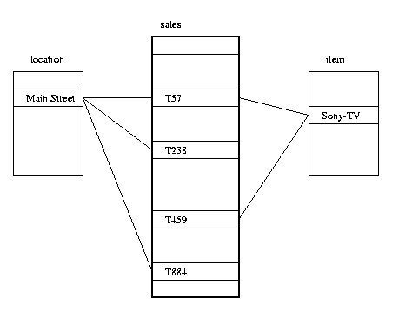
Indexing OLAP Data: Join Indices
Join index: JI(R-id, S-id) where R (R-id, …)  S (S-id, …)
Traditional indices map the values to a list of record ids
It materializes relational join in JI file and speeds up relational join
In data warehouses, join index relates the values of the dimensions of a star schema to rows in the fact table.
E.g., fact table: Sales and two dimensions city and product
A join index on city maintains for each distinct city a list of R-IDs of the tuples recording the Sales in the city
Join indices can span multiple dimensions
Notes:
Indexing for “join” operation results
Popular in relational tables.

Slide 34
Efficient Processing OLAP Queries
Determine which operations should be performed on the available cuboids
Transform drill, roll, etc. into corresponding SQL and/or OLAP operations, e.g., dice = selection + projection
Determine which materialized cuboid(s) should be selected for OLAP op.
Let the query to be processed be on {brand, province_or_state} with the condition “year = 2004”, and there are 4 materialized cuboids available:
1) {year, item_name, city}
2) {year, brand, country}
3) {year, brand, province_or_state}
4) {item_name, province_or_state} where year = 2004
Which should be selected to process the query?
Explore indexing structures and compressed vs. dense array structs in MOLAP

Slide 35
OLAP Server Architectures
Relational OLAP (ROLAP)
Use relational or extended-relational DBMS to store and manage warehouse data and OLAP middle ware
Include optimization of DBMS backend, implementation of aggregation navigation logic, and additional tools and services
Greater scalability
Multidimensional OLAP (MOLAP)
Sparse array-based multidimensional storage engine
Fast indexing to pre-computed summarized data
Hybrid OLAP (HOLAP) (e.g., Microsoft SQLServer)
Flexibility, e.g., low level: relational, high-level: array
Specialized SQL servers (e.g., Redbricks)
Specialized support for SQL queries over star/snowflake schemas
Notes:
MJ:
ROLAP: use DBMS to store and manage DW, OLAP
MOLAP: array-based
HOLAP: SQL Server (Relational + Multidimensional array; user-guided)
Redbricks bought by IBM:
http://www-03.ibm.com/software/products/en/redbrick (not sure if still exists)
ROLAP:
ROLAP-based cubing algorithms (Agarwal et al. ‘96)
Array-based cubing algorithms (Zhao et al. ‘97)
Bottom-up computation method (Beyer & Ramarkrishman ‘99)
H-cubing technique (Han, Jian Pei, Guozhu Dong & Ke Wang, SIGMOD’01)
Dong: Wright State Univ
Pei, Wang: Simon Fraser (Georgia Tech)

Slide 36
Chapter 4: Data Warehousing and On-line Analytical Processing
Data Warehouse: Basic Concepts
Data Warehouse Modeling: Data Cube and OLAP
Data Warehouse Design and Usage
Data Warehouse Implementation
Summary

Slide 37
Summary
Data warehousing: A multi-dimensional model of a data warehouse
A data cube consists of dimensions & measures
Star schema, snowflake schema, fact constellations
OLAP operations: drilling, rolling, slicing, dicing and pivoting
Data Warehouse Architecture, Design, and Usage
Multi-tiered architecture
Business analysis design framework
Information processing, analytical processing, data mining, OLAM
Implementation: Efficient computation of data cubes
Partial vs. full vs. no materialization
Indexing OALP data: Bitmap index and join index
OLAP query processing
OLAP servers: ROLAP, MOLAP, HOLAP

Slide 38
References (I)
S. Agarwal, R. Agrawal, P. M. Deshpande, A. Gupta, J. F. Naughton, R. Ramakrishnan, and S. Sarawagi. On the computation of multidimensional aggregates. VLDB’96
D. Agrawal, A. E. Abbadi, A. Singh, and T. Yurek. Efficient view maintenance in data warehouses. SIGMOD’97
R. Agrawal, A. Gupta, and S. Sarawagi. Modeling multidimensional databases. ICDE’97
S. Chaudhuri and U. Dayal. An overview of data warehousing and OLAP technology. ACM SIGMOD Record, 26:65-74, 1997
J. Gray, et al. Data cube: A relational aggregation operator generalizing group-by, cross-tab and sub-totals. Data Mining and Knowledge Discovery, 1:29-54, 1997.
A. Gupta and I. S. Mumick. Materialized Views: Techniques, Implementations, and Applications. MIT Press, 1999
J. Han. Towards on-line analytical mining in large databases. SIGMOD Record, 1998
V. Harinarayan, A. Rajaraman, and J. D. Ullman. Implementing data cubes efficiently. SIGMOD’96

Slide 39
References (II)
C. Imhoff, N. Galemmo, and J. G. Geiger. Mastering Data Warehouse Design: Relational and Dimensional Techniques. John Wiley, 2003
W. H. Inmon. Building the Data Warehouse. John Wiley, 1996
R. Kimball and M. Ross. The Data Warehouse Toolkit: The Complete Guide to Dimensional Modeling. 2ed. John Wiley, 2002
P. O'Neil and D. Quass. Improved query performance with variant indexes. SIGMOD'97
S. Sarawagi and M. Stonebraker. Efficient organization of large multidimensional arrays. ICDE'94
P. Valduriez. Join indices. ACM Trans. Database Systems, 12:218-246, 1987.
J. Widom. Research problems in data warehousing. CIKM’95.
K. Wu, E. Otoo, and A. Shoshani, Optimal Bitmap Indices with Efficient Compression, ACM Trans. on Database Systems (TODS), 31(1), 2006, pp. 1-38.

