Slide 1
Announcement
HW2 due is tonight 11:59pm. NO extension!
NetID-HW2.PDF
HW3 is out!
Questions on Task 1-2 of Course Project “SciBot”
You can draw FP-trees by hand and screenshot. Please make your submission a PDF (Tex, MS Word)!
Mid-term exam on Oct. 5
Let me know early if you will be off campus: Coordinate with TA to find a date before and TA will proctor you.

Slide 2
Announcement (cont.)
FP-Growth YouTube Video (Prof. Jiawei Han at UIUC): https://www.youtube.com/watch?v=LXx1xKF9oDg
Top 10 data mining algorithms: http://home.etf.rs/~vm/os/dmsw/Top10DMAlgorithms.pdf
Discussions: Find a (Computer/Data) (Scientist/Engineer) job
Principle; C.V./Resume
BS, MS, PHD?
Industry, Academia?
Programming languages?
…

Slide 3

Chapter 6. Frequent Pattern Mining: Pattern Evaluation
Meng Jiang
CSE 40647/60647 Data Science Fall 2017
Introduction to Data Mining

Slide 4
How to Judge if a Rule/Pattern Is Interesting?
Pattern-mining will generate a large set of patterns/rules
Not all the generated patterns/rules are interesting
Interestingness measures: Objective vs. Subjective
Objective interestingness measures
Support, confidence, correlation, …
Subjective interestingness measures: One person’s trash could be another person’s treasure
Query-based: Relevant to a user’s particular request
Against one’s knowledge-base: unexpected, freshness, timeliness
Visualization tools: Multi-dimensional, interactive examination

Slide 5
Limitation of the Support-Confidence Framework
Are s and c interesting in association rules: “A ⇒ B” [s, c]?
Example: Suppose one school may have the following statistics on # of students who may play basketball and/or eat cereal:
Association rule mining may generate the following:
play-basketball ⇒ eat-cereal [40%, 66.7%] (higher s & c)
But this strong association rule is misleading: The overall % of students eating cereal is 75% > 66.7%, a more telling rule:
¬ play-basketball ⇒ eat-cereal [35%, 87.5%] (high s & higher c)
Be careful!
2-way contingency table
 | play-basketball | not play-basketball | sum (row)
eat-cereal | 400 | 350 | 750
not eat-cereal | 200 | 50 | 250
sum(col.) | 600 | 400 | 1000

Slide 6
Interestingness Measure: Lift
Measure of dependent/correlated events: lift
Lift(B, C) may tell how B and C are correlated
Lift(B, C) = 1: B and C are independent
> 1: positively correlated
< 1: negatively correlated
For our example,
Thus, B and C are negatively correlated since lift(B, C) < 1;
B and ¬C are positively correlated since lift(B, ¬C) > 1
C and ¬B are positively correlated since lift(C, ¬B) > 1
Symmetric?
 | B | ¬B | ∑_{row}
C | 400 | 350 | 750
¬C | 200 | 50 | 250
∑_{col.} | 600 | 400 | 1000
lift(¬B, C) = 0.35/0.4/0.75 = 1.17
Notes:
Lift(not B, C) = 0.35/0.4/0.75 = 1.17

Slide 7
Interestingness Measure: χ²
Observed value
Expected value
Another measure to test correlated events: χ²
General rules
χ² = 0: independent
χ² > 0: correlated, either positive or negative, so it needs additional test
Now,
χ² shows B and C are negatively correlated since the expected value is 450 but the observed is only 400
 | B | ¬B | ∑_{row}
C | 400 (450) | 350 (300) | 750
¬C | 200 (150) | 50 (100) | 250
∑_{col} | 600 | 400 | 1000

Slide 8
Lift and χ² : Are They Always Good Measures?
Null transactions: Transactions that contain neither B nor C
Let’s examine the dataset D
BC (100) is much rarer than B¬C (1000) and ¬BC (1000), but there are many ¬B¬C (100000)
Unlikely B & C will happen together!
But, lift(B, C) = 8.44 >> 1 (Lift shows B and C are strongly positively correlated!)
χ² = 670: Observed(BC) >> expected value (11.85)
Too many null transactions may “spoil the soup”!
 | B | ¬B | ∑_{row}
C | 100 | 1000 | 1100
¬C | 1000 | 100000 | 101000
∑_{col.} | 1100 | 101000 | 102100
null transactions
Contingency table with expected values added
 | B | ¬B | ∑_{row}
C | 100 (11.85) | 1000 | 1100
¬C | 1000 (988.15) | 100000 | 101000
∑_{col.} | 1100 | 101000 | 102100

Slide 9
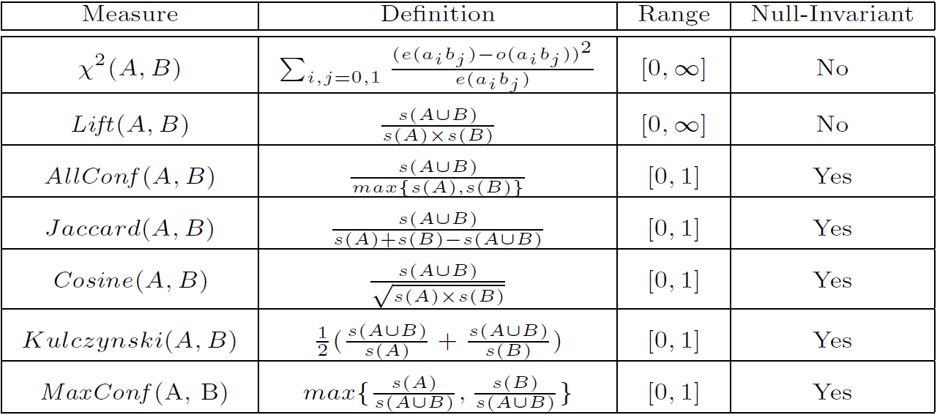
Interestingness Measures & Null-Invariance
Null invariance: Value does not change with the # of null-transactions
A few interestingness measures: Some are null invariant
Χ² and lift are not null-invariant
Jaccard, consine, AllConf, MaxConf, and Kulczynski are null-invariant measures
×
max{ s(A∪B) / s(A) , s(A∪B) / s(B) }

Slide 10
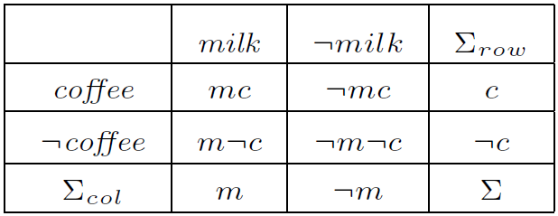
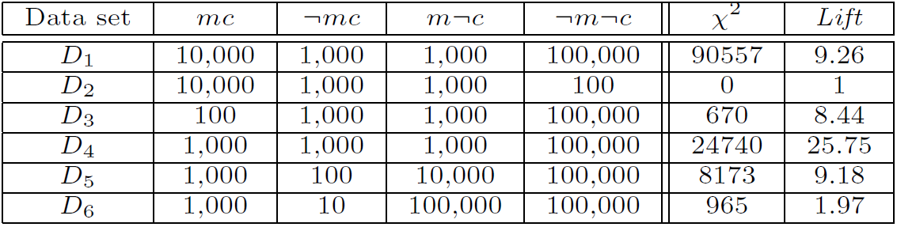
Null Invariance: An Important Property
Why is null invariance crucial for the analysis of massive transaction data?
Many transactions may contain neither milk nor coffee!
milk vs. coffee contingency table
Lift and χ² are not null-invariant: not good to evaluate data that contain too many or too few null transactions!
Many measures are not null-invariant!
Null-transactions
w.r.t. m and c

Slide 11
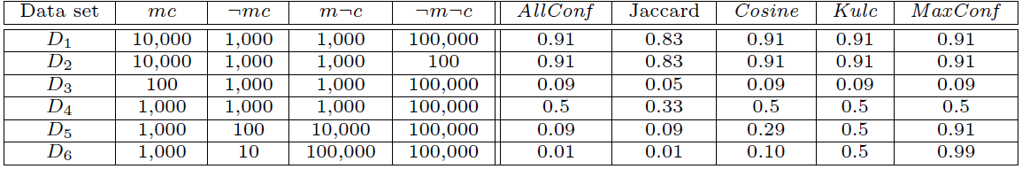
Comparison of Null-Invariant Measures
Not all null-invariant measures are created equal
Which one is better?
D₄—D₆ differentiate the null-invariant measures
Kulc (Kulczynski 1927) holds firm and is in balance of both directional implications
2-variable contingency table
All 5 are null-invariant
Subtle: They disagree on those cases

Slide 12
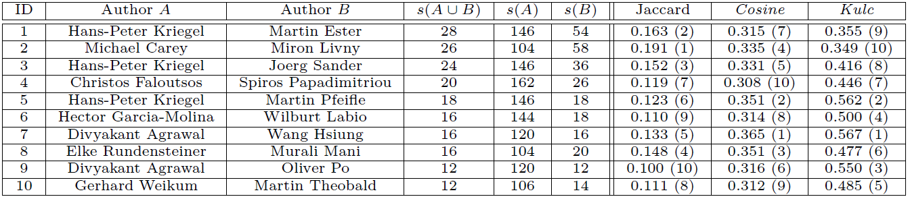
Analysis of DBLP Coauthor Relationships
Recent DB conferences, removing balanced associations, low sup, etc.
Which pairs of authors are strongly related?
Use Kulc to find Advisor-advisee, close collaborators
Advisor-advisee relations

Slide 13

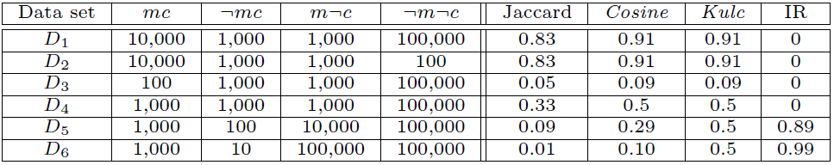
Imbalance Ratio with Kulczynski Measure
IR (Imbalance Ratio): measure the imbalance of two itemsets A and B in rule implications:
Kulczynski and Imbalance Ratio (IR) together present a clear picture for all the three datasets D₄ through D₆
D₄ is neutral & balanced; D₅ is neutral but imbalanced
D₆ is neutral but very imbalanced

Slide 14
What Measures to Choose for Effective Pattern Evaluation?
Null value cases are predominant in many large datasets
Neither milk nor coffee is in most of the baskets; neither Mike nor Jim is an author in most of the papers; ……
Null-invariance is an important property
Lift and χ² are good measures if null transactions are not predominant
Otherwise, Kulczynski + Imbalance Ratio should be used to judge the interestingness of a pattern
AllConf, Jaccard, Cosine, MaxConf…

Slide 15
Discussion
Where do you want to use them?
max{ s(A∪B) / s(A) , s(A∪B) / s(B) }

Slide 16
Summary
Basic Concepts:
Frequent Patterns, Association Rules, Closed Patterns and Max-Patterns
Frequent Itemset Mining Methods
The Downward Closure Property and The Apriori Algorithm
Extensions or Improvements of Apriori
Mining Frequent Patterns by Exploring Vertical Data Format
FPGrowth: A Frequent Pattern-Growth Approach
Mining Closed Patterns
Which Patterns Are Interesting?—Pattern Evaluation Methods
Interestingness Measures: Lift and χ2
Null-Invariant Measures
Comparison of Interestingness Measures

Slide 17
References
R. Agrawal, T. Imielinski, and A. Swami, “Mining association rules between sets of items in large databases”, in Proc. of SIGMOD'93
R. J. Bayardo, “Efficiently mining long patterns from databases”, in Proc. of SIGMOD'98
N. Pasquier, Y. Bastide, R. Taouil, and L. Lakhal, “Discovering frequent closed itemsets for association rules”, in Proc. of ICDT'99
J. Han, H. Cheng, D. Xin, and X. Yan, “Frequent Pattern Mining: Current Status and Future Directions”, Data Mining and Knowledge Discovery, 15(1): 55-86, 2007
R. Agrawal and R. Srikant, “Fast algorithms for mining association rules”, VLDB'94
A. Savasere, E. Omiecinski, and S. Navathe, “An efficient algorithm for mining association rules in large databases”, VLDB'95
J. S. Park, M. S. Chen, and P. S. Yu, “An effective hash-based algorithm for mining association rules”, SIGMOD'95
S. Sarawagi, S. Thomas, and R. Agrawal, “Integrating association rule mining with relational database systems: Alternatives and implications”, SIGMOD'98
M. J. Zaki, S. Parthasarathy, M. Ogihara, and W. Li, “Parallel algorithm for discovery of association rules”, Data Mining and Knowledge Discovery, 1997
J. Han, J. Pei, and Y. Yin, “Mining frequent patterns without candidate generation”, SIGMOD’00

Slide 18
References (cont.)
M. J. Zaki and Hsiao, “CHARM: An Efficient Algorithm for Closed Itemset Mining”, SDM'02
J. Wang, J. Han, and J. Pei, “CLOSET+: Searching for the Best Strategies for Mining Frequent Closed Itemsets”, KDD'03
C. C. Aggarwal, M.A., Bhuiyan, M. A. Hasan, “Frequent Pattern Mining Algorithms: A Survey”, in Aggarwal and Han (eds.): Frequent Pattern Mining, Springer, 2014
C. C. Aggarwal and P. S. Yu. A New Framework for Itemset Generation. PODS’98
S. Brin, R. Motwani, and C. Silverstein. Beyond market basket: Generalizing association rules to correlations. SIGMOD'97
M. Klemettinen, H. Mannila, P. Ronkainen, H. Toivonen, and A. I. Verkamo. Finding interesting rules from large sets of discovered association rules. CIKM'94
E. Omiecinski. Alternative Interest Measures for Mining Associations. TKDE’03
P.-N. Tan, V. Kumar, and J. Srivastava. Selecting the Right Interestingness Measure for Association Patterns. KDD'02
T. Wu, Y. Chen and J. Han, Re-Examination of Interestingness Measures in Pattern Mining: A Unified Framework, Data Mining and Knowledge Discovery, 21(3):371-397, 2010

Slide 19
Discussion
Find a (Computer/Data) (Scientist/Engineer) job?
Principle
C.V./Resume
BS, MS, PHD?
Industry, Academia?
Programming languages?
…

