Slide 1

BY : ABDELMAJID ELOUSSE

Slide 2
PLAN :
Jakarta EE
UML (Diagramme de Class)
Servlet
Java Presistence Pages (JSP)
Java Presistence API (JPA)
Hibernate
TomCat
Maven

Slide 3
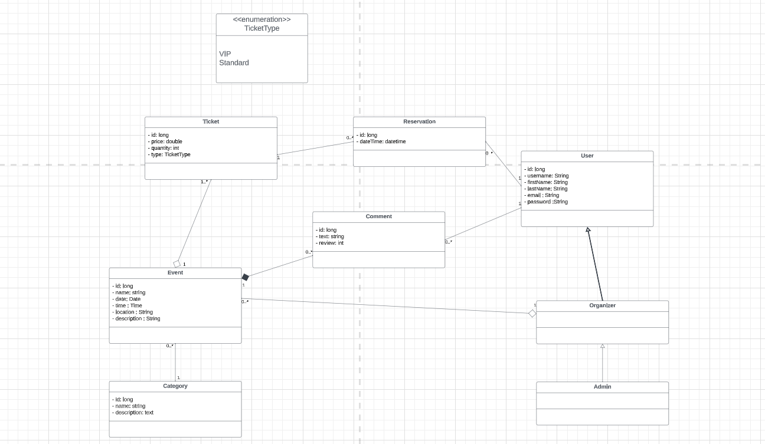

Slide 4

Jakarta EE
Version: 9

Slide 5

Servlet
Version: 6.0.0
Jakarta Servlet

Slide 6

Java Server Pages

Slide 7

Java Presistence Api
Version: 1.0.2 Final
Hibernate JPA

Slide 8

Hibernate
Version: 6.2.7 Final
Hibernate-Core

Slide 9

TOMCAT
Version: 10.1.13

Slide 10

MAVEN
Version: 3.9.5

