Slide 1

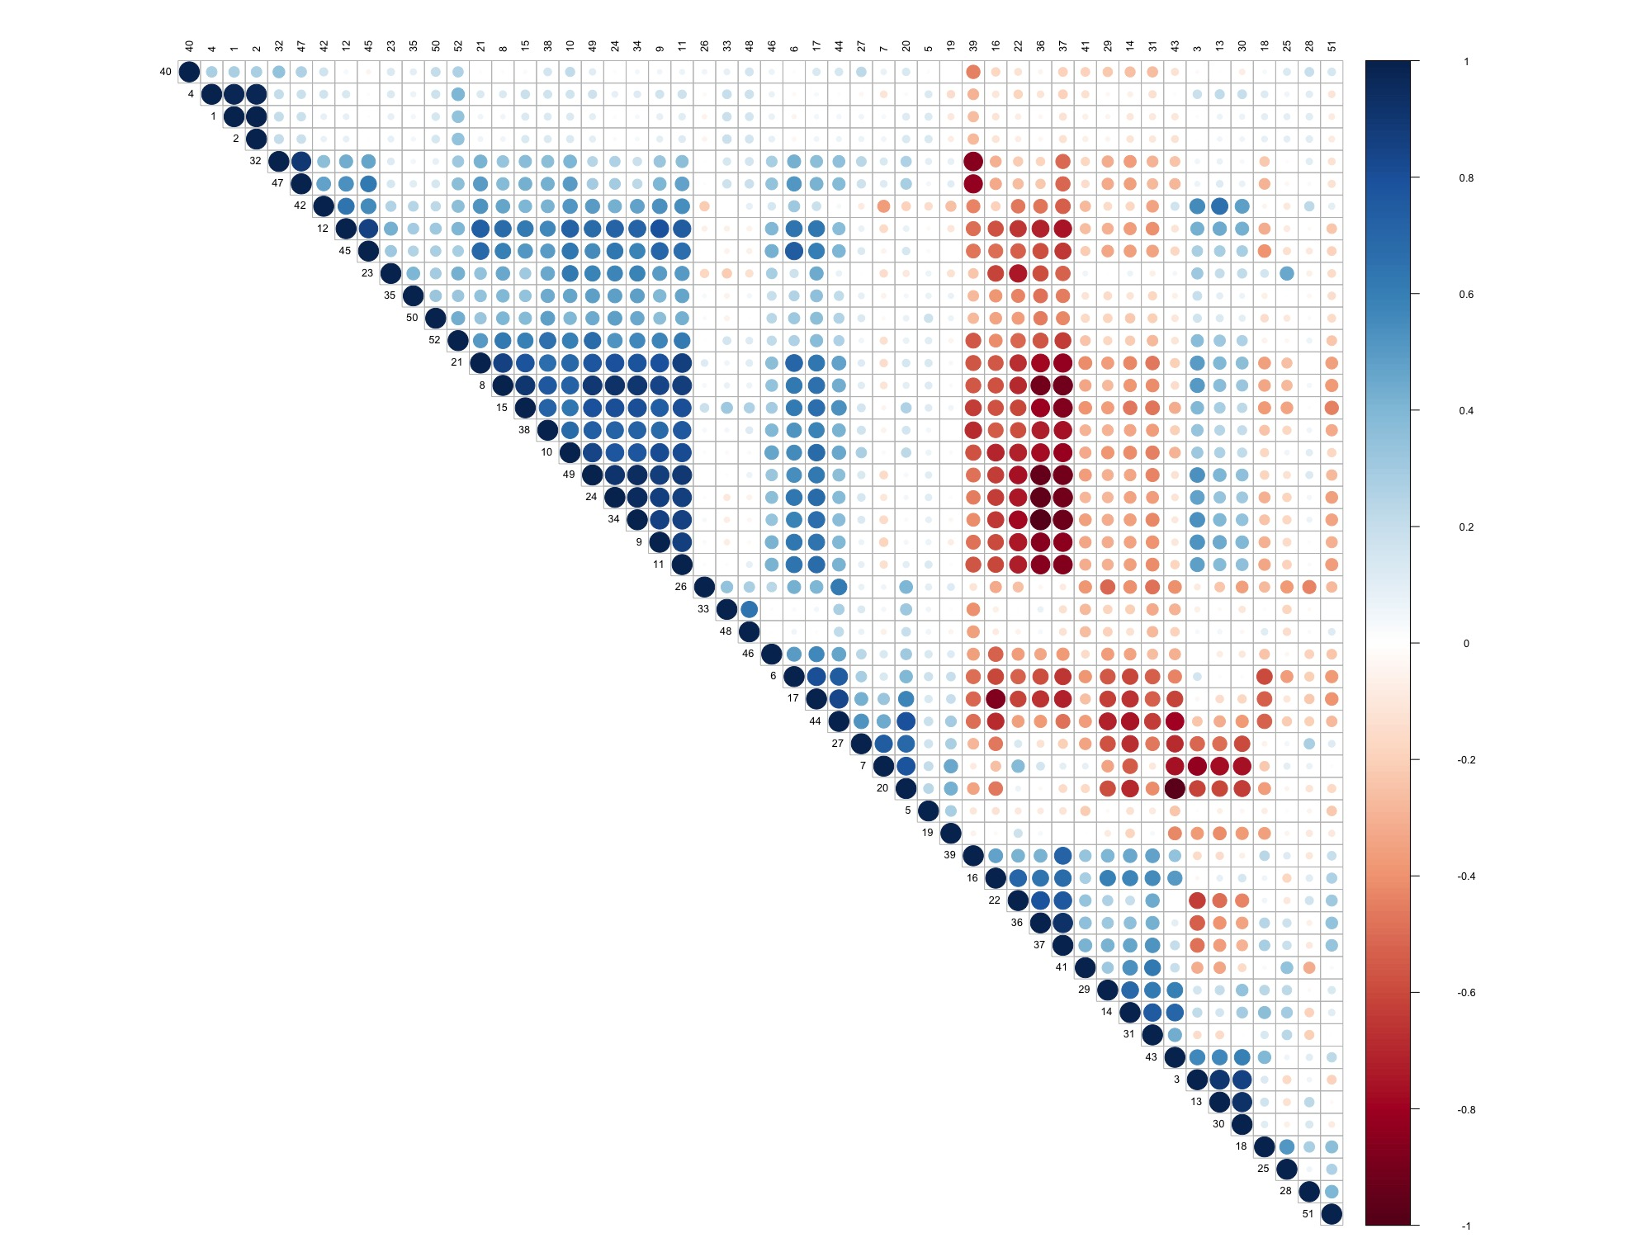
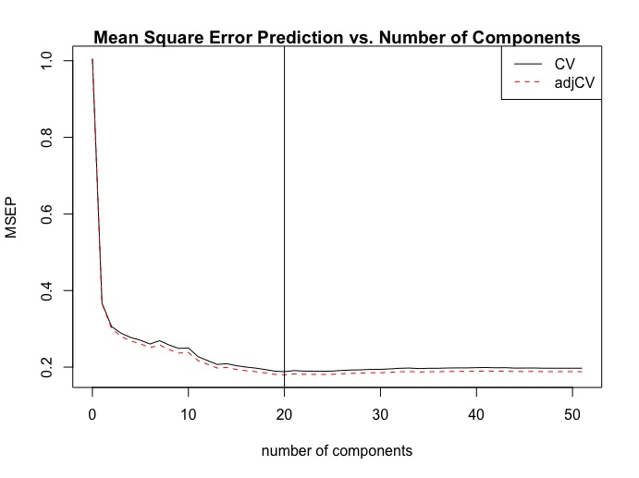
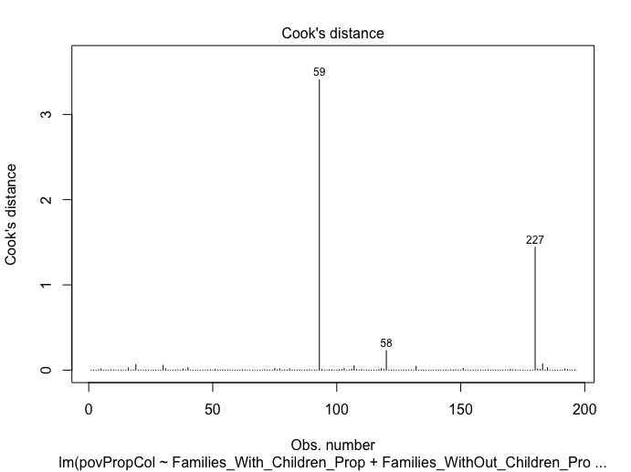
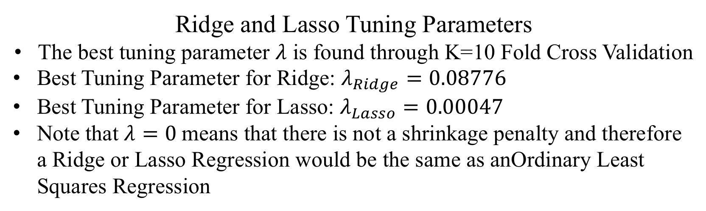
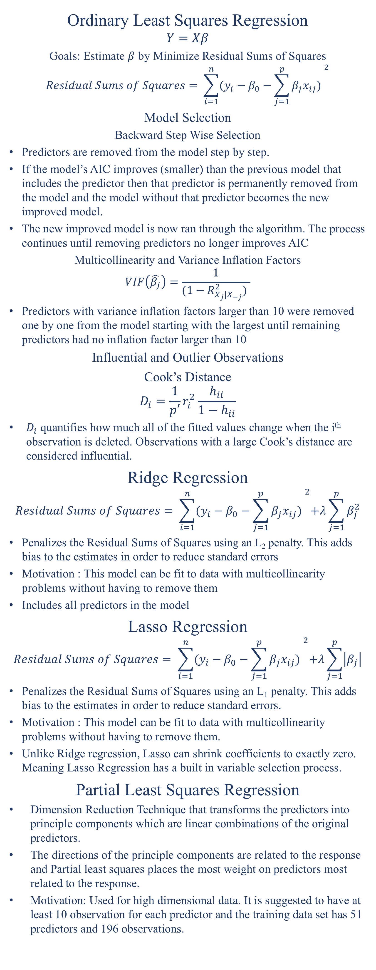
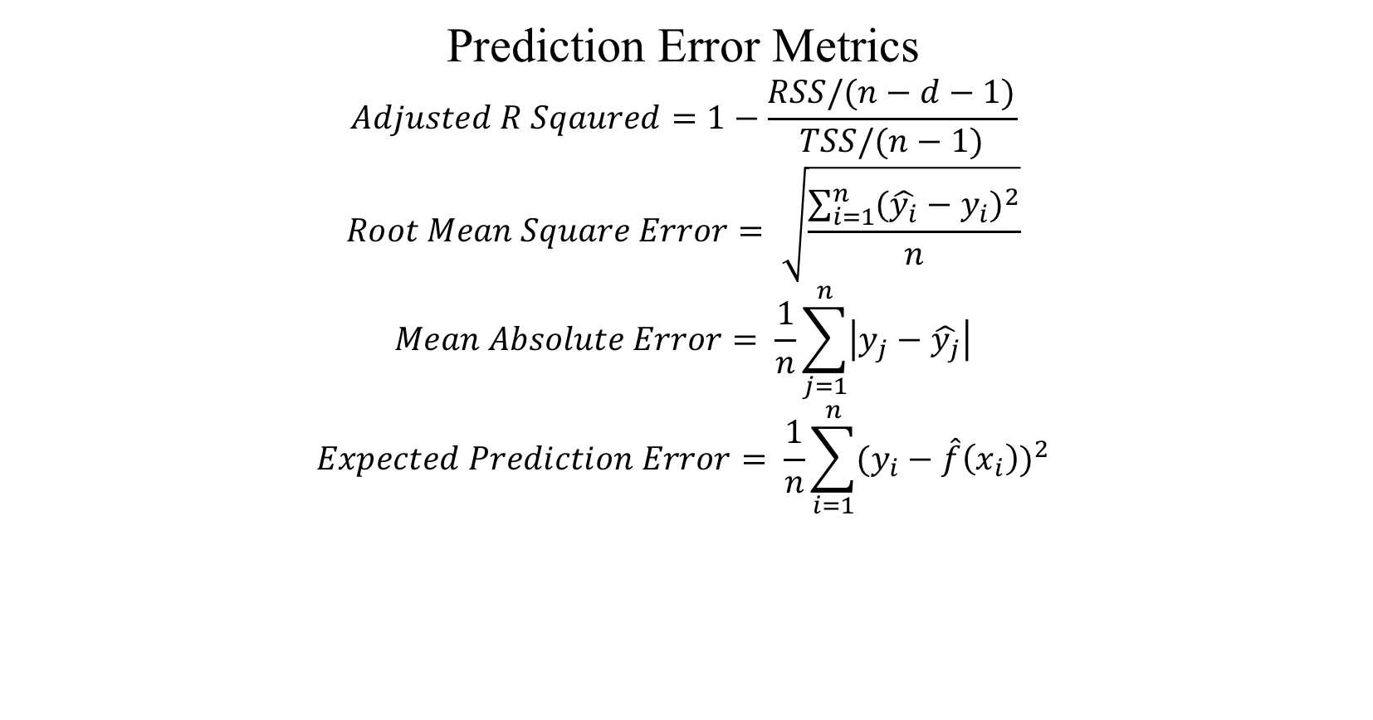
Predicting Proportion of People in Poverty by Neighborhood using Housing and Crime Demographics
Michael Ingram
Introduction
Methods
Results
Predictor Variables Not Shrunk to Zero in Lasso Regression
3. Persons per Household | 16. Households with Income less than 60k | 23. People Over 25 with less than 12th Grade Education | 39. Population of 2 or More Races | 46. Births African American
4. Total Population | 17. Households with Income between 60k and 125k | 24. People Over 25 with Some College No Degree | 40. Population over 65 | 47. Births Asian per Pacific Islander
5. Crime Incidents | 18. Housing Vacancy | 25. Population 18-24 | 41. Population under 5 | 49. Births Native American
12. Families with Children | 19. Multifamily Units | 32. Population Asian and Pacific Islander | 43. Renters Spending More Than 30% of Income on Housing | 50. Births Non Latino White
13. Families without Children | 22. People Over 25 with High School Only | 34. Population Native American | 44. Single Mothers with Children in Poverty
Predicting the poverty levels by neighborhood is important information for Denver policy makers. With Denver growing at an unprecedented rate, new neighborhoods are being constructed or rezoned. Being able to accurately predict the poverty levels of neighborhoods would be able to help with a multitude of policy making decisions.
My project looks at 51 different housing and crime demographics from the Denver area.
Ordinary Least Squares Regression
$$Y=Xβ$$
Goals: Estimate $β$ by Minimize Residual Sums of Squares
$$Residual Sums of Squares= \sum_{i=1}^{n}{{(y_{i}−β_{0}−\sum_{j=1}^{p}{β_{j}x_{ij}) }}^{2}}$$
Model Selection
Backward Step Wise Selection
Predictors are removed from the model step by step.
If the model’s AIC improves (smaller) than the previous model that includes the predictor then that predictor is permanently removed from the model and the model without that predictor becomes the new improved model.
The new improved model is now ran through the algorithm. The process continues until removing predictors no longer improves AIC
Multicollinearity and Variance Inflation Factors
$$VIF\left(\hat{β_{j}}\right)=\frac{1}{(1−R_{X_{j}|X_{−j}}^{2}) }$$
Predictors with variance inflation factors larger than 10 were removed one by one from the model starting with the largest until remaining predictors had no inflation factor larger than 10
Influential and Outlier Observations
Cook’s Distance
$$D_{i}=\frac{1}{p′}r_{i}^{2}\frac{h_{ii}}{1−h_{ii}}$$
$D_{i}$ quantifies how much all of the fitted values change when the i^{th} observation is deleted. Observations with a large Cook’s distance are considered influential.
Ridge Regression
$$Residual Sums of Squares= \sum_{i=1}^{n}{{(y_{i}−β_{0}−\sum_{j=1}^{p}{β_{j}x_{ij}) }}^{2}+λ\sum_{j=1}^{p}{β_{j}^{2}}}$$
Penalizes the Residual Sums of Squares using an L₂ penalty. This adds bias to the estimates in order to reduce standard errors
Motivation : This model can be fit to data with multicollinearity problems without having to remove them
Includes all predictors in the model
Lasso Regression
$$Residual Sums of Squares= \sum_{i=1}^{n}{{(y_{i}−β_{0}−\sum_{j=1}^{p}{β_{j}x_{ij}) }}^{2}+λ\sum_{j=1}^{p}{\left|β_{j}\right|}}$$
Penalizes the Residual Sums of Squares using an L₁ penalty. This adds bias to the estimates in order to reduce standard errors.
Motivation : This model can be fit to data with multicollinearity problems without having to remove them.
Unlike Ridge regression, Lasso can shrink coefficients to exactly zero. Meaning Lasso Regression has a built in variable selection process.
Partial Least Squares Regression
Dimension Reduction Technique that transforms the predictors into principle components which are linear combinations of the original predictors.
The directions of the principle components are related to the response and Partial least squares places the most weight on predictors most related to the response.
Motivation: Used for high dimensional data. It is suggested to have at least 10 observation for each predictor and the training data set has 51 predictors and 196 observations.
Prediction Error Metrics
$$Adjusted R Sqaured=1−\frac{RSS/(n−d−1)}{TSS/(n−1)}$$
$$Root Mean Square Error= \sqrt{\frac{\sum_{i=1}^{n}{{(\hat{y_{i}}−y_{i})}^{2}}}{n}}$$
$$Mean Absolute Error= \frac{1}{n}\sum_{j=1}^{n}{\left|y_{j}−\hat{y_{j}}\right|}$$
$$Expected Prediction Error= \frac{1}{n}\sum_{i=1}^{n}{{(y_{i}−\hat{f}\left(x_{i}\right))}^{2}}$$
Objectives
Using machine learning techniques including ordinary least squares linear regression, ridge regression, lasso regression and partial least squares I look to see how accurately we can predict the proportion of people in poverty in a neighborhood.
I also look at which demographics are significant to each of the different prediction models.
Data Set
Partial Least Squares Component Plot
Determining the best number of components to use by plotting the number of components vs. Mean Square Error
Housing data set contained mostly count variables. These were transformed to proportions by dividing by either Total Population, Total Households, or Total Housing Unites
From the crime data set, total number of crimes per neighborhood was totaled
All variables were standardized before model
Data set was split into a 75% Training Data Set with 196 observations and 25% Test Data Set with 66 Observations
Response Variable: Proportion of People in Poverty
Correlation Plot
Dark blue spaces indicate large positive correlation and red indicates large negative correlation.
Gives a visual view of the high correlation problem many of the predictors
Predictor Variables
1. Households | 18. Housing Vacancy | 35. Population Non Latino
2. Housing Units | 19. Multifamily Units | 36. Population Non Latino White
3. Persons per Household | 20. Overcrowded Housing Units | 37. Population Other Race, Single Race Selected
4. Total Population | 21. People Over 25 with College Associates or Better | 38. Population White
5. Crime Incidents | 22. People Over 25 with High School Only | 39. Population of 2 or More Races
6. One Person Housing | 23. People Over 25 with less than 12th Grade Education | 40. Population over 65
7. Adults Non English Speaking | 24. People Over 25 with Some College No Degree | 41. Population under 5
8. Births to Teen Mothers | 25. Population 18-24 | 42. Single Family Units
9. Births to Unwed Mothers | 26. Population 25-34 | 43. Renters Spending More Than 30% of Income on Housing
10. Births to Women Less with than a 12th Grade Education | 27. Population 35-44 | 44. Single Mothers with Children in Poverty
11. Children Living With Single Parents | 28. Population 45-54 | 45. Unemployed in Civilian Labor Force
12. Families with Children | 29. Population 5-17 | 46. Births African American
13. Families without Children | 30. Population 55-64 | 47. Births Asian per Pacific Islander
14. Foreign Born | 31. Population African American | 48. Births Latino
15. Households with Income more than 125k | 32. Population Asian and Pacific Islander | 49. Births Native American
16. Households with Income less than 60k | 33. Population Latino | 50. Births Non Latino White
17. Households with Income between 60k and 125k | 34. Population Native American | 51. Births Other Races
Prediction Results
 | Adjusted R Squared | Root Mean Square Error | Mean Absolute Error | Expected Prediction Error
Ordinary Least Squares | 0.699 | 0.555 | 0.374 | 0.308
Ridge | 0.781 | 0.465 | 0.317 | 0.216
Lasso | 0.797 | 0.447 | 0.310 | 0.200
Partial Least Squares | 0.800 | 0.444 | 0.316 | 0.197
Cook’s Distance Plot
Neighborhoods 59 and 227 were removed for being largely influential points.
Ordinary Least Squares Final Model Coefficients
Predictor | Coefficient | Standard Error | P-Value
Families with Children | -0.158 | 0.036 | 1.89e-05
Families without Children | -0.085 | 0.040 | 0.035
Overcrowded Housing Units | 0.233 | 0.040 | 1.83e-08
People Over 25 with some College and No Degree | -0.107 | 0.026 | 5.89e-05
Population 18-24 | 0.244 | 0.046 | 3.04e-07
Single Family Units | 0.143 | 0.052 | 0.006
Renters Spending more than 30% of Income on Housing | 0.267 | 0.059 | 1.20e-05
Single Mothers with Children in Poverty | 0.481 | 0.032 | < 2e-16
Births Non Latino White | -0.079 | 0.026 | 0.003
Conclusions
The model with the best prediction accuracy is Partial Least Squares Regression. Partial Least Squares had best Adjusted R Squared, RMSE, and Expected Prediction Error. This is most likely due to the large number of predictors and small number of observations.
The predictors significant to the prediction of poverty proportions in the ordinary least squares model seem to point to the lifestyle many 18-24 year old's live.
Lasso removed many of the same predictors as Ordinary Least Squares except for Overcrowded Housing and Single Family Units
Ridge and Lasso Tuning Parameters
The best tuning parameter $λ$ is found through K=10 Fold Cross Validation
Best Tuning Parameter for Ridge: $λ_{Ridge}=0.08776$
Best Tuning Parameter for Lasso: $λ_{Lasso}=0.00047$
Note that $λ=0$means that there is not a shrinkage penalty and therefore a Ridge or Lasso Regression would be the same as anOrdinary Least Squares Regression
References
Weisberg, S. (2014). Applied linear regression (4th ed.). Hoboken, NJ: Wiley.
Gareth James, Daniela Witten, Trevor Hastie, Robert Tibshirani. (2013). An introduction to statistical learning : with applications in R. New York :Springer,
Faraway, J. J. (2014). Linear models with R (2nd ed.). Boca Raton ; London ; New York: CRC Press.

