Slide 1

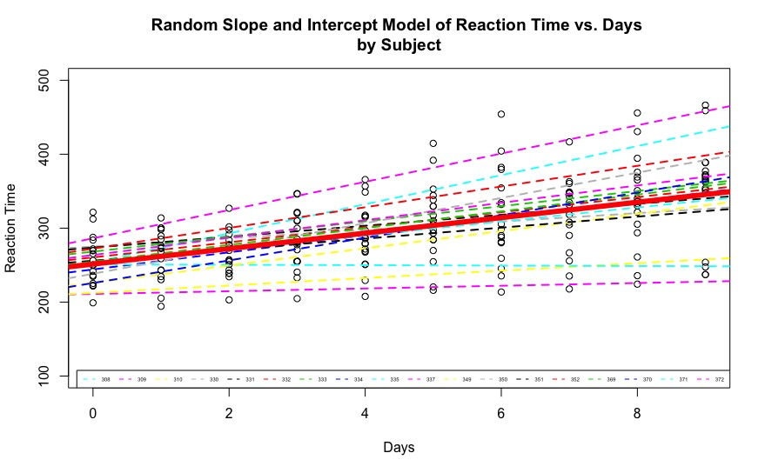
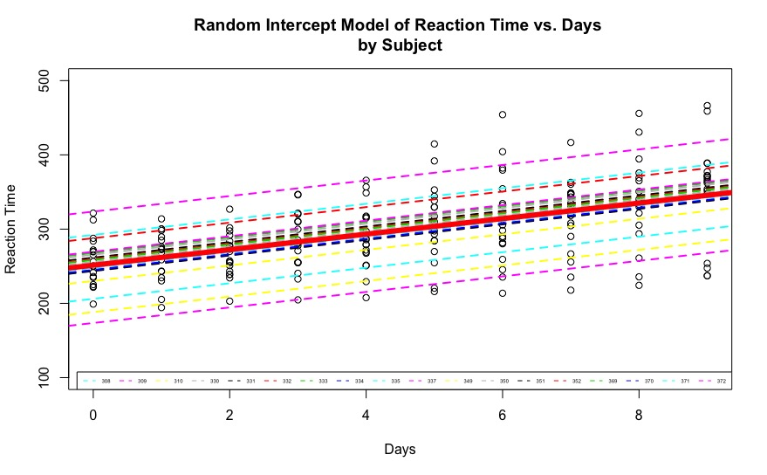
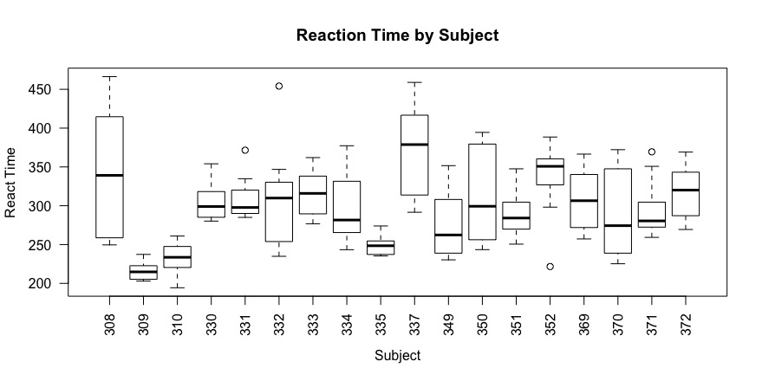
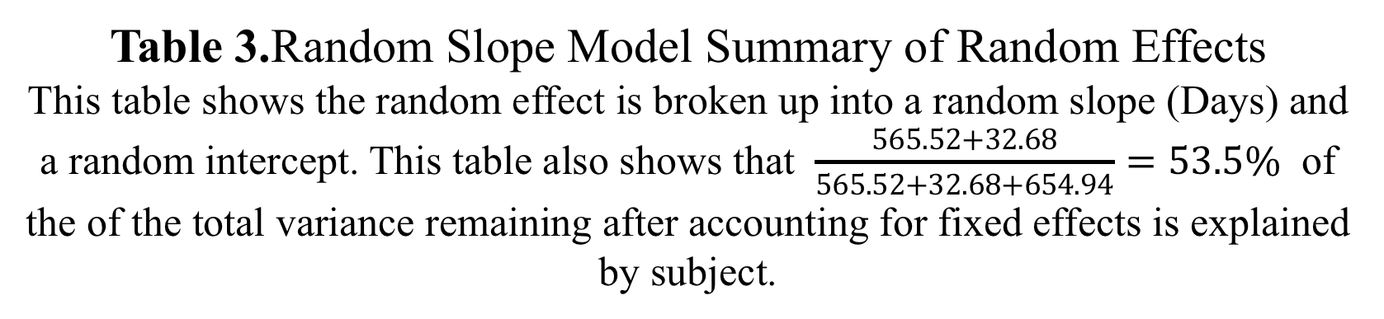
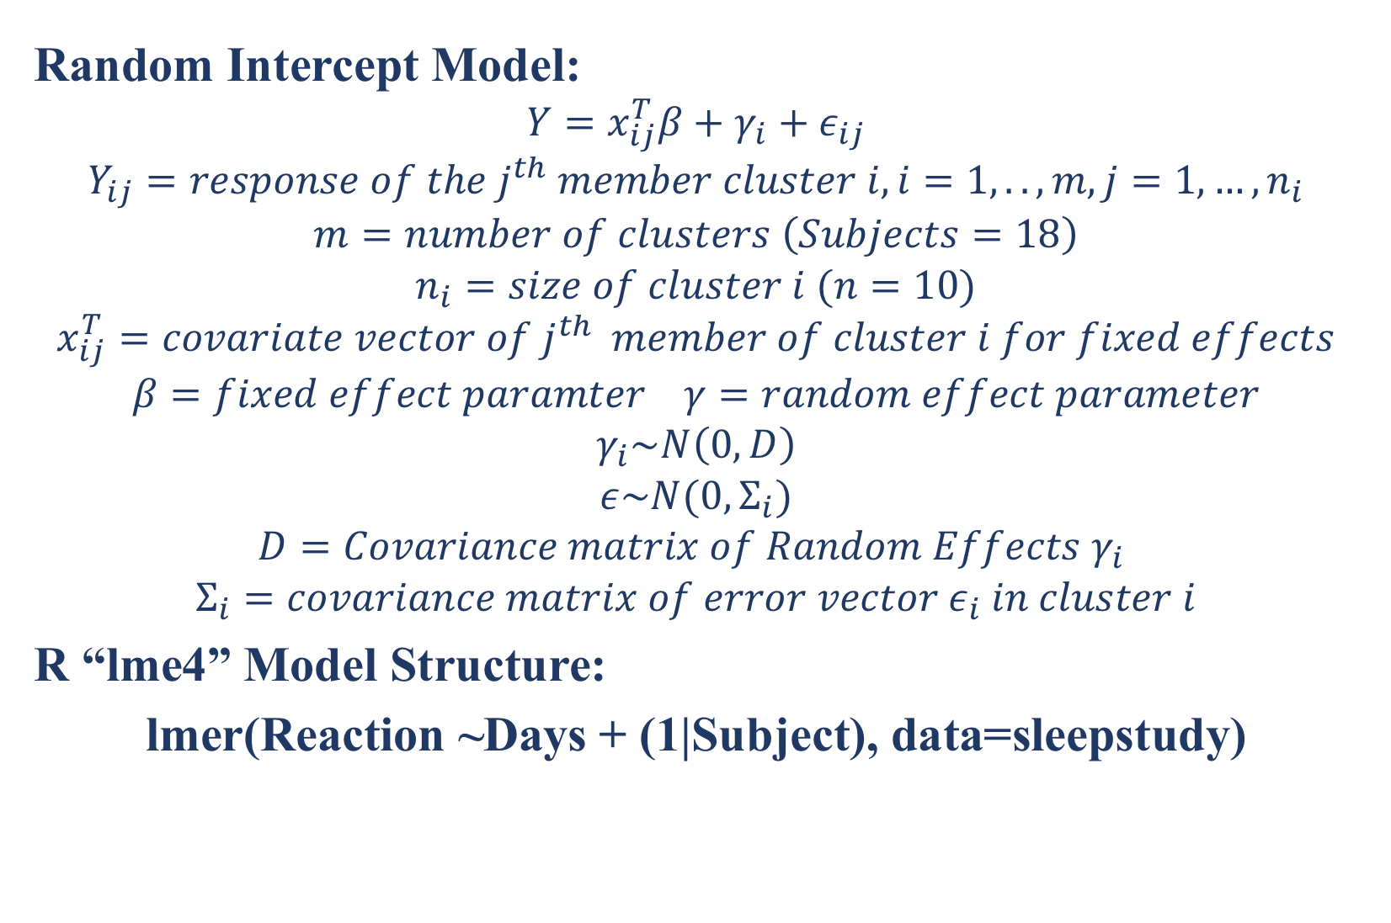
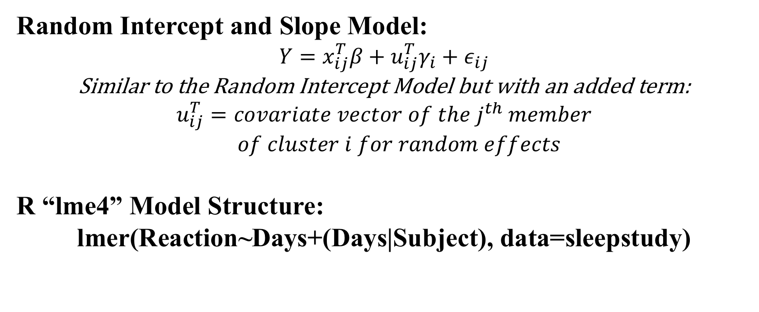
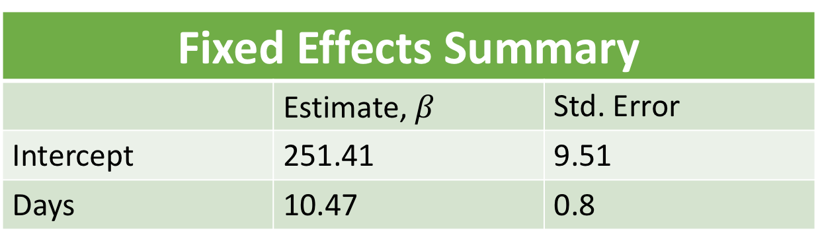
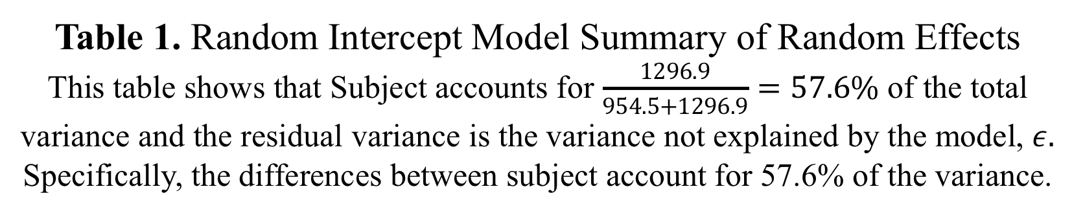
Linear Mixed Models in R:
A Sleep Deprivation Study
Michael Ingram
Introduction
Methods and Results
Random Intercept and Slope Model:
$$Y=x_{ij}^{T}β+{u_{ij}^{T}γ}_{i}+ε_{ij}$$
Similar to the Random Intercept Model but with an added term:
$$u_{ij}^{T}=covariate vector of the j^{th} member$$
$of cluster i for random effects$
R “lme4” Model Structure:
lmer(Reaction~Days+(Days|Subject), data=sleepstudy)
Likelihood Ratio Test for Statistical Significance of Fixed Effects
Model | Test Statistic | P-Value
Random Intercept | 116.46 | <2.2e-16
Random Slope | 23.537 | 1.226e-6
The Study:
The average reaction time per day for 18 subjects was tested and recorded.
Study lasted for 10 total days including day 0.
The subject’s reaction time for a series of tests given each day was averaged.
Day 0 the subject was allowed there normal sleeping hours and then reaction time was recorded
On Days 1-9 the subject was only allowed three hours of sleep
Study was published in Gregory Belenky, Nancy J. Wesensten, David R. Thorne, Maria L. Thomas, Helen C. Sing, Daniel P. Redmond, Michael B. Russo and Thomas J. Balkin (2003) Patterns of performance degradation and restoration during sleep restriction and subsequent recovery: a sleep dose-response study. Journal of Sleep Research 12, 1–12.
Random Intercept Model:
$$Y=x_{ij}^{T}β+γ_{i}+ε_{ij}$$
$$Y_{ij}=response of the j^{th} member cluster i, i=1,..,m, j=1,…,n_{i}$$
$$m=number of clusters \left(Subjects=18\right)$$
$$n_{i}=size of cluster i (n=10)$$
$$x_{ij}^{T}=covariate vector of j^{th} member of cluster i for fixed effects$$
$$β=fixed effect paramter γ=random effect parameter$$
$$γ_{i}\sim N\left(0,D\right)$$
$$ε\sim N(0, Σ_{i})$$
$$D=Covariance matrix of Random Effects γ_{i}$$
$$Σ_{i}=covariance matrix of error vector ε_{i} in cluster i$$
R “lme4” Model Structure:
lmer(Reaction ~Days + (1|Subject), data=sleepstudy)
Table 4. Likelihood Ratio Test for H_{o}: Fixed Effect Days=0.
The table shows the results from a likelihood ratio test where the model with the fixed effect was compared to a null model without the fixed effect. Both tests found evidence in support of the alternative hypothesis that the fixed effect differs from zero.
Random Effects Summary
Groups | Name | Variance | Std. Deviation
Subject | Intercept | 565.52 | 23.78
 | Days | 32.68 | 5.72
Residual |  | 654.94 | 25.59
Restricted Likelihood Ratio Test for Statistical Significance of Random Effects
Model | RLRT Test Statistic | P-Value
Random Intercept | 107.2 | <2.2e-16
Random Slope | 47.796 | <2.2e-16
Data Set
Random Effects Summary
Groups | Name | Variance | Std. Deviation
Subject | (Intercept) | 1296.9 | 36.01
Residual |  | 954.5 | 30.90
Response: Reaction Time (ms)
Random Effect Predictor: Subject (18 subject with numbers: 308, 309, 310, 330, 331, 332, 333, 334 ,335, 337, 349, 350, 351, 352, 369, 370, 371, 372)
Fixed Effect Predictor: Days (0-9)
10 observations per subject
180 total observations
Table 3.Random Slope Model Summary of Random Effects
This table shows the random effect is broken up into a random slope (Days) and a random intercept. This table also shows that $\frac{565.52+32.68}{565.52+32.68+654.94}=53.5\%$ of the of the total variance remaining after accounting for fixed effects is explained by subject.
Table 5. Restricted Likelihood Ratio Test for Testing the Addition of the Random Effect
For the random intercept slope we are testing if the addition of the random slope for subject is significant. The p-value gives evidence in favor of the alternative hypothesis that the inclusion of the random intercept differs from zero.
For the random slope model we are testing if the addition of the random slope to the random intercept model is significant. The p-value gives evidence in support of the alternative hypothesis that the inclusion of the random slope is significant.
Table 1. Random Intercept Model Summary of Random Effects
This table shows that Subject accounts for $\frac{1296.9}{954.5+1296.9}=57.6\%$ of the total variance and the residual variance is the variance not explained by the model, $ε.$ Specifically, the differences between subject account for 57.6% of the variance.
When to use Linear Mixed Model
Random Slope Model Fixed Effects:
Problem: Observations are not independent due to grouping or nesting (hierarchical)
Why is this a problem: Violates the Ordinary Least Squares Regression assumption of the independence of error terms
Solution: Multiple Linear Regression Models or Linear Mixed Model
Why Linear Mixed Models Preferred: Using Multiple Linear Regression models would decrease your number of observations, Increase the chance of a type I error and increase the number of parameters to estimate
Why Linear Mixed Models for the sleep deprivation study: There are 10 observations (1 for each day) taken for each patient.
Fixed Effects Summary
 | Estimate, $β$ | Std. Error
Intercept | 251.41 | 9.51
Days | 10.47 | 0.8
For the Random Slope Model Fixed Effects Summary the Coefficients have not changed from from the Random Intercept model since the only change has been made to the random effect in the model. Defer to Table 2. for the Random Slope Model’s fixed effects summary
Conclusions
The Random Intercept model shows that each subject has a different starting reaction time but all subjects reaction time increases as the number of days of sleep deprivation increases
The Random Slope model shows that each subject has a different starting reaction time but all but 1 subject has an increase in reaction time with an increase in the number of days with sleep deprivation. Furthermore, the rate at which each subjects reaction time increases (or decreases) is different between subjects
Which Model to Choose? In this case, the random slope model makes more sense since it captures the different increases or decreases in reaction time where as the random intercept does not. This is further supported by the results of the Restricted Likelihood Ratio Test which show support for the inclusion of the random slope.
Table 2. Random Intercept Model Summary of Fixed Effects
This table shows the coefficients and standard error for the random intercept model and that as days increases so does reaction time
References
University of Bristol. "Centre for Multilevel Modelling." A Short Biography of Elizabeth Blackwell | Elizabeth Blackwell Institute for Health Research | University of Bristol. November 12, 2014. Accessed December 08, 2018. http://www.bristol.ac.uk/cmm/learning/videos/random-slopes.html.
Legal Studies Program. Accessed December 08, 2018. https://www.ssc.wisc.edu/sscc/pubs/MM/MM_TestEffects.html.
Introduction to Linear Mixed Models. Accessed December 08, 2018. https://ourcodingclub.github.io/2017/03/15/mixed-models.html
Packages:
Douglas Bates, Martin Maechler, Ben Bolker, Steve Walker (2015). Fitting Linear Mixed-Effects Models Using lme4. Journal of Statistical Software, 67(1), 1-48. doi:10.18637/jss.v067.i01.
Scheipl, F., Greven, S. and Kuechenhoff, H. (2008) Size and power of tests for a zero random effect variance or polynomial regression in additive and linear mixed models. Computational Statistics & Data Analysis, 52(7):3283--3299.
Figure 1. Reaction Time by Subject.
Figure 1 shows how multiple observations per subject means the range and mean reaction differs for each subject. This would be a problem for an ordinary least squares model and is the motivation for a linear mixed model
Figure 3. Random Slope Model of Reaction Time vs. Days by Subject.
The Dark Red solid line indicates the fixed effects model while the different colored dashed lines indicate the model by subject. Here each subject has its own random intercept and slope.
Figure 2. Random Intercept Model of Reaction Time vs. Days by Subject.
The Dark Red solid line indicates the fixed effects model while the different colored dashed lines indicate the model by subject. Notice that all subject share the same slope but a different intercept.

