Slide 1
Yummy Crummy
Melissa Jenkins, Cassidy Lamm, Nico Wood

Slide 2
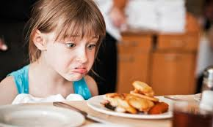
The Problem
Kids are picky
It’s easy for parents to mix up what each kid (and themselves) likes and doesn’t like
Also hard to keep track of allergens
Physical lists just aren’t practical!

Slide 3
Our Solution – Yummy Crummy
Provide parents with a convenient, user-friendly interface
Keep track of which dishes their family members like and dislike
Easy rating system and storage within app
INSERT MOCKUP HERRRRRR

Slide 4
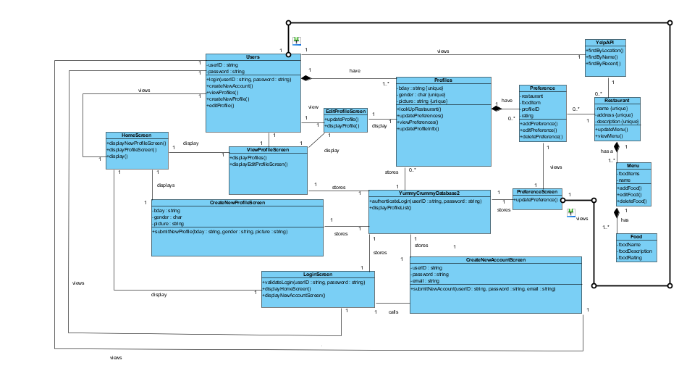

Slide 5
PUT COLLABORATION DIAGRAM HERR

Slide 6
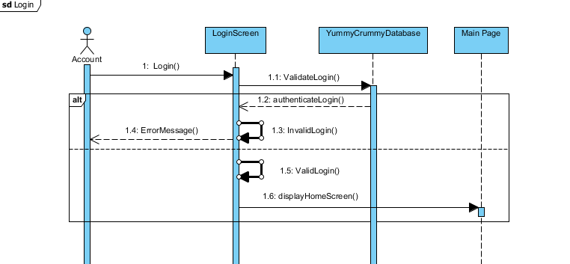
Login

Slide 7
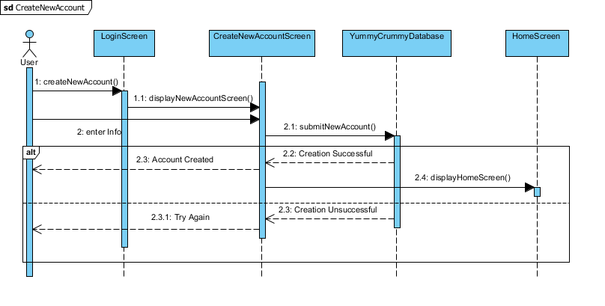
Create New Account

Slide 8
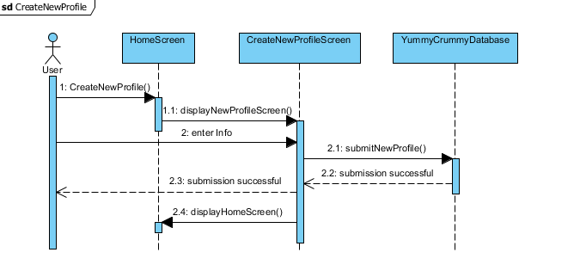
Create New Profile

Slide 9
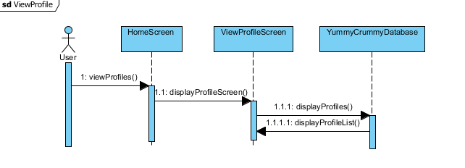
View Profile

Slide 10
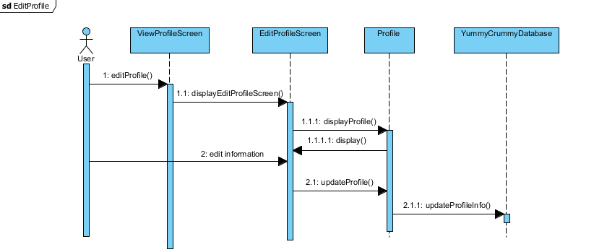
Edit Profile

Slide 11
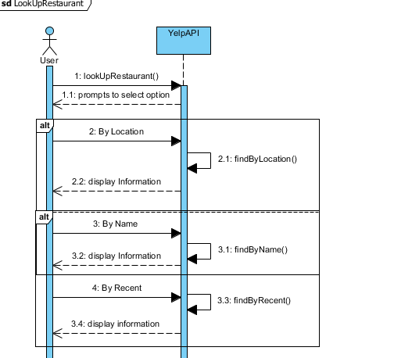
Lookup Restaurant

Slide 12
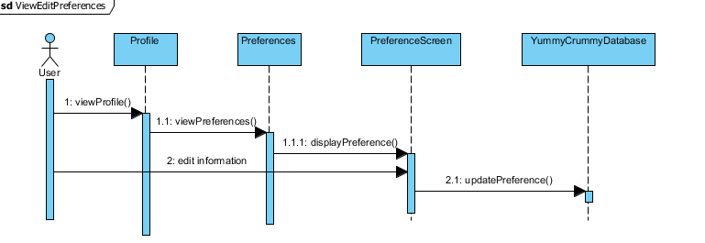
View/Edit Preferences

Slide 13

Changes to Project
Reorganized how users and profiles are represented
User has many profiles (either child or adult)
GOT ACCESS TO YELP API
Anything else?

Slide 14
Summary Discussion
What was difficult this past assignment
What we see as being difficult in the future
Reach goals

