Slide 1
MSCA 37014 Python for Analytics
Winter 2020

Slide 2

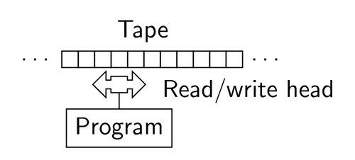
Let’s first talk about
Who was this character in the movie?
Alan Turing
Turing Machine, 1936

Slide 3
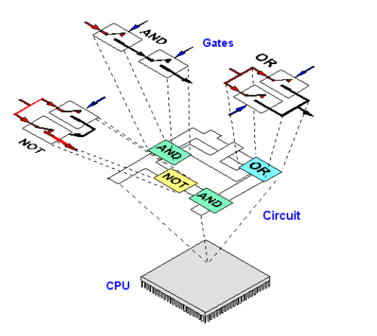
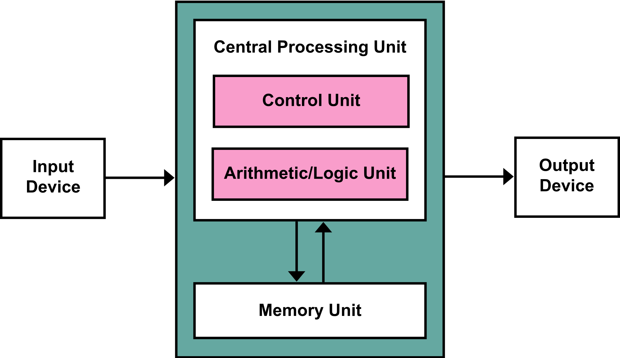
Just after: Von Neumann architecture

Slide 4
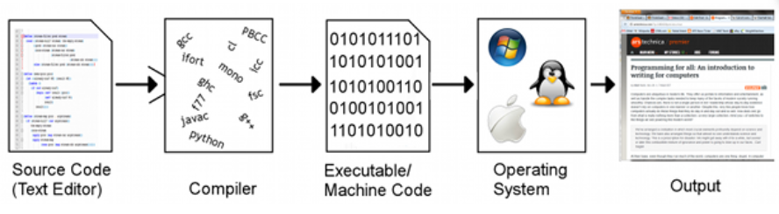
Compilation Chain

Slide 5
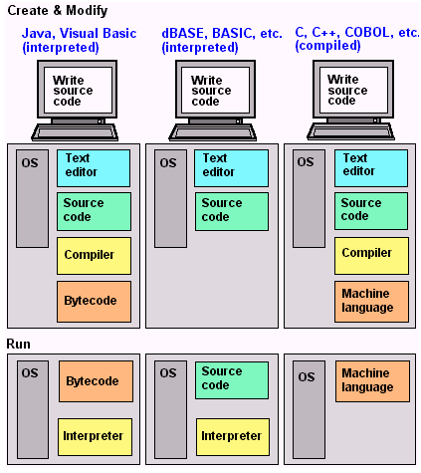
Where is Python in the programming language?

Slide 6
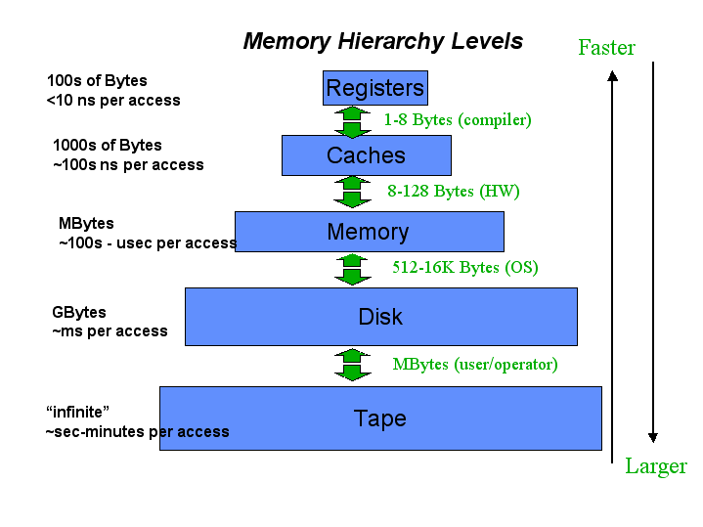
Memory Hierarchy

Slide 7
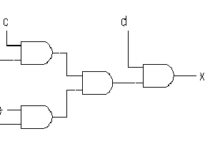
Where are We Going??
Arithmetic
Single/multicycle
Datapaths
1000
CPU
µProc
60%/yr.
(2X/1.5yr)
“Moore’s Law”
100
Processor-Memory
Performance Gap: (grows 50% / year)
Performance
10
DRAM
9%/yr.
(2X/10 yrs)
IFetch
Dcd
Exec
Mem
WB
1
DRAM
1980
1981
1982
1983
1984
1985
1986
1987
1988
1989
1990
1991
1992
1993
1994
1995
1996
1997
1998
1999
IFetch
Dcd
Exec
Mem
WB
2000
IFetch
Dcd
Exec
Mem
WB
Time
IFetch
Dcd
Exec
Mem
WB
Pipelining
ℵ
I/O
Memory Systems

Slide 8
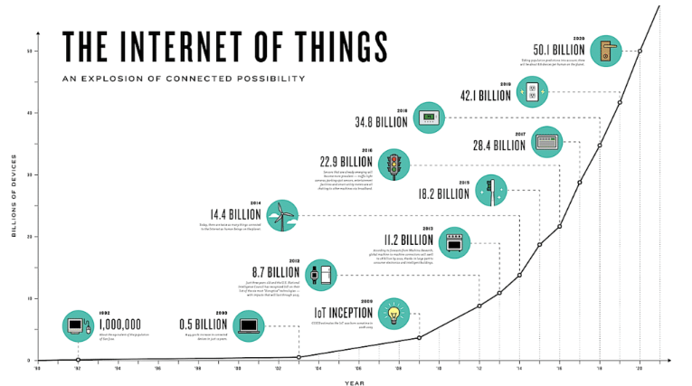
Moore’s law

Slide 9

Python
Python is:
Widely used
High-level (vs low-level: assembly code, C,…)
General-purpose (vs DSL: HTML, Erlang,…)
Interpreted (vs compiled)
Dynamic programming language (vs static)
Important paradigm:
Object-oriented
Functional/procedural
Dynamic type
Large set of libraries

Slide 10
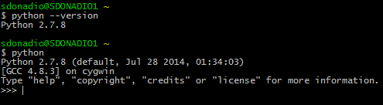
Python installation
I advise to use PyCharm as a IDE (Integrated Development Environment)
Python is pre-installed with Mac OS and Linux
For Windows, you need to install it http://python.org

Slide 11
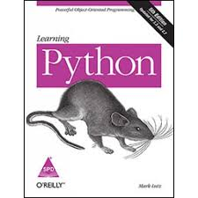
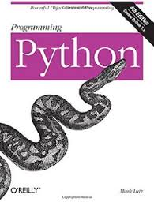
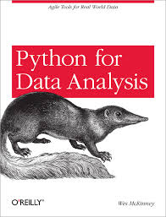
Books

Slide 12
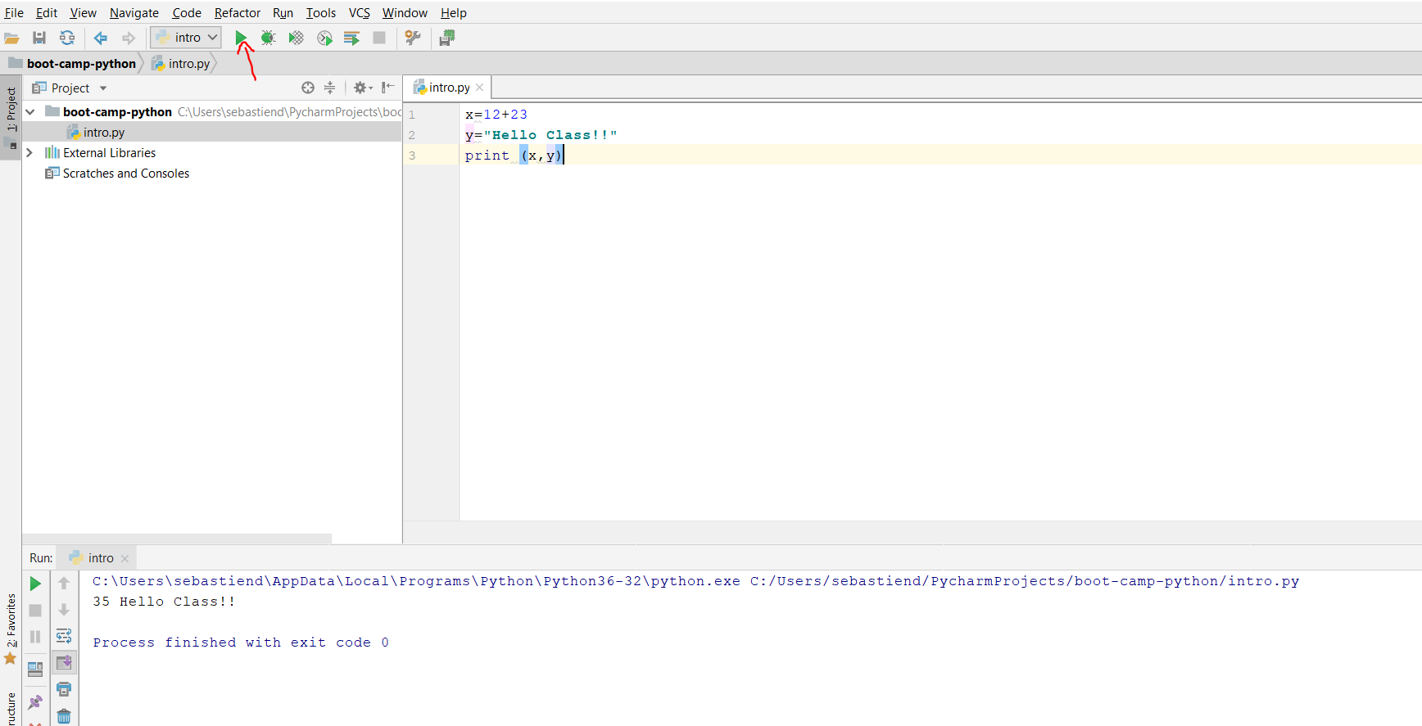
Running a Python program

Slide 13
Indentation
The indentation in python is not optional.
It replaces the curly braces {}
Use a newline to end a line of code (use \ when you want to continue the line)
example
if (cond == True)
{
print “something”
}
if cond == True:
____print “something”

Slide 14
The basics
Assignment: =
Comparison: ==
Operations: +-*/% for numbers
Logical operators: and, or, not
Variables:
No declaration needed
No need to specify the type

Slide 15
Basic Data types
Integers
1 2 3 4 5
Float
1.23 343.43 43.242
Strings
“foo”

Slide 16
Comments
Start comments with # – the rest of line is ignored.
You can also use
”””
This is a comment on many lines
”””

Slide 17
Assignment
The assignment is done using =
Binding a name in Python means setting a name to hold a reference to some object
No intrinsic type
We create a name the first time, it appears
foo = 4
A reference will be deleted via garbage collection after any names bound to it have passed out of scope

Slide 18
Using a variable
If you try to access a variable without creating the variable first, we will get an error
>>> a
Traceback (most recent call last):
File "<stdin>", line 1, in <module>
NameError: name 'a' is not defined

Slide 19
Multiple Assignment
>>> x,y=1,2
>>> print x
1
>>> print y
2

Slide 20
Naming rules
Case sensitive
Don’t start with a number
Reserved words:
and
assert
break
class
continue
def
del
elif
else
except
exec
finally
for
from
global
if
import
in
is
lambda
not
or
pass
print
raise
return
try
while

Slide 21
Understanding Reference Semantics
Assignment manipulates references
x = y (assign a reference to x)
Assignment example:
x = 3
integer 3 is created and stored in memory
a variable x is created
a reference to the memory location storing the 3 is then assigned to the name x

Slide 22
Understanding Reference Semantics
Assignment manipulates references
x = y (assign a reference to x)
Assignment example:
x = 3
integer 3 is created and stored in memory
a variable x is created
a reference to the memory location storing the 3 is then assigned to the name x

Slide 23
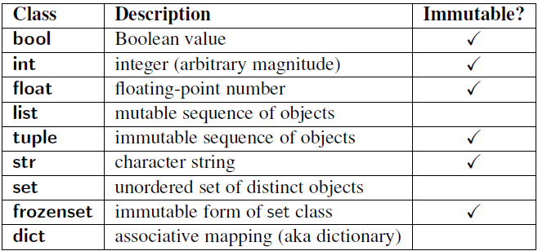
Mutable vs Immutable

Slide 24
Built-in types
Tuples
Sequence of immutable Python objects
a=(1,2,3)
Dictionary
Each key is separated from its value by a colon (:), the items are separated by commas, and the whole thing is enclosed in curly braces.
b={‘name’ : ‘foo’, ‘firstname’ : ‘las’}
List
most versatile datatype available in Python which can be written as a list of comma-separated values (items) between square brackets. Important thing about a list is that items in a list need not be of the same type.
c=[1,23,4]

Slide 25
List introduction
List is surrounded by square brackets
A=[1,2,4]
List element can be any Python object
A list can be empty
A=[]
Remember:
for i in [1,2,3,4]:
List are mutable

Slide 26
List (some new functions)
We already saw:
len(list)
range(…) returning a list
We can slice a list
t=[1,2,3,4,5,6,7]
t[1:3] → [2,3]
type(t) → <class 'list'>

Slide 27
List (some new functions)
append adding a new element
Operator in
>>> 1 in [1,2,3]
True
>>> 0 in [1,2,3]
False
>>> foo
['a', 'd', 'AA']
>>> foo.sort()
>>> foo
['AA', 'a', 'd']

Slide 28
Create a list from string
>>> foo
['AA', 'a', 'd']
>>> line='I am going to split this line'
>>> line.split()
['I', 'am', 'going', 'to', 'split', 'this', 'line']
Adding many objects at the same time
>>> foo.extend([1,2,3])
>>> print (foo)
['AA', 'a', 'd', 1, 2, 3]

Slide 29
List and Tuples
List:
Mutable
l1 = [1,2]
l1[0]=3 # ok
id(l1) # 12345
l1+= [4]
Id(l1) # 12345
C={l1: 1} # error
Tuple:
Immutable
t1 = (1,2)
t1[0]=3 #error
Id(t1) # 14345
t1+= (4,)
Id(t1) # 14355
C={t1: 1} # ok

Slide 30
List and Dictionary
Dictionaries are like Lists except that they use keys instead of numbers to look up values
>>> ddd = dict()
>>> ddd['age'] = 21
>>> ddd['course'] = 182
>>> print ddd
{'course': 182, 'age': 21}
>>> ddd['age'] = 23
>>> print ddd
{'course': 182, 'age': 23}
>>> lst = list()
>>> lst.append(21)
>>> lst.append(183)
>>> print lst[21, 183]
>>> lst[0] = 23
>>> print lst[23, 183]

Slide 31
Dictionary functions
>>> car={'tyre':4, 'wheel':1, 'antenna':1}
>>> print (car)
{'tyre': 4, 'wheel': 1, 'antenna': 1}
>>> car['tyre']=2
print (car)
{'tyre': 2, 'wheel': 1, 'antenna': 1}
>>> car.get('wheel')
1
>>> car.values()
dict_values([2, 1, 1])
car.keys()
dict_keys(['tyre', 'wheel', 'antenna'])

Slide 32
Dictionary functions
>>> for k,v in car.items():
... print (k,v)
...
tyre 2
wheel 1
antenna 1
>>> [key for (key, value) in car.items() if value == 1]
['wheel', 'antenna']
➔
keys = []
for k,v in car.items():
if(v == 1): keys+=[k]
print keys

Slide 33
Dictionary functions
>>> for k,v in car.items():
... print (k,v)
...
tyre 2
wheel 1
antenna 1
>>> [key for (key, value) in car.items() if value == 1]
['wheel', 'antenna']
>>> del car['antenna']
>>> print (car)
{'tyre': 2, 'wheel': 1}

Slide 34
Object Oriented Programming

Slide 35
Object Oriented Programming in Python
Why?
Better program design
Better modularization
Inspired by Richard P. Muller, California Institute of Technology presentation

Slide 36
What is an Object?
A software item that contains variables and methods
Object Oriented Design focuses on
Encapsulation:
dividing the code into a public interface, and a private implementation of that interface
Polymorphism:
the ability to overload standard operators so that they have appropriate behavior based on their context
Inheritance:
the ability to create subclasses that contain specializations of their parents
Inspired by Richard P. Muller, California Institute of Technology presentation

Slide 37
Python Classes
Python contains classes that define objects
Objects are instances of classes
class FinancialProduct:
def __init__(self,description,product_code,type):
self.description = description
self.product_code = product_code
self.type = type
__init__ is the default constructor
self refers to the object itself,
like this in Java.
Inspired by Richard P. Muller, California Institute of Technology presentation

Slide 38
Example: Point class
class FinancialProduct:
def __init__(self,description,product_code,type):
self.description = description
self.product_code = product_code
self.type = type
det change_description(self,description): self.description = description
def __repr__(self):
return self.description + " " + self.product_code
>>> fp1 = FinancialProduct('APPLE','AAPL','Stock’)
>>> print(fp1)
APPLE AAPL
Inspired by Richard P. Muller, California Institute of Technology presentation

Slide 39
FinancialProduct class
Overloaded the default constructor
Defined class variables (color, location) that are persistent and local to the atom object
Good way to manage shared memory:
instead of passing long lists of arguments, encapsulate some of this data into an object, and pass the object.
much cleaner programs result
Overloaded the print operator
We now want to use the point class to build a shape...
Inspired by Richard P. Muller, California Institute of Technology presentation

Slide 40
Derived Class - Inheritance
class Stock(FinancialProduct):
def __init__(self,description,product_code):
super().__init__(self,product_code,'Stock')
class Derivative(FinancialProduct):
def __init__(self,description,product_code):
super().__init__(self,product_code, 'Derivative')
__init__, __repr__, and change_description are taken from the parent class (FinancialProduct)
Another example of code reuse
Basic functions don't have to be retyped, just inherited
Less to rewrite when specifications change

Slide 41
Overloading parent functions
class Stock(FinancialProduct):
def __init__(self,description,product_code):
super().__init__(self,product_code,'Stock’)
def __repr__(self):
return ‘something specific to stock’
Now we only inherit __init__ and change_description from the parent
We define a new version of __repr__ specially for line
Inspired by Richard P. Muller, California Institute of Technology presentation

Slide 42
Adding to parent functions
Sometimes you want to extend, rather than replace, the parent functions.
class Stock(FinancialProduct):
def __init__(self,description="000",product_code="000"):
super().__init__(self,product_code,'Stock')
call the constructor
for the parent function
add additional functionality
to the constructor
Inspired by Richard P. Muller, California Institute of Technology presentation

Slide 43
Public and Private Data
Currently everything in FinancialProduct is public, thus we could do:
>>> p1 = FinancialProduct('APPLE','AAPL','Stock')
>>> p1.description = ’foo'
that would break any function that used p1.description
We therefore need to protect the p1.description and provide accessors to this data
Encapsulation or Data Hiding
accessors are "gettors" and "settors"
Encapsulation is particularly important when other people use your class
Inspired by Richard P. Muller, California Institute of Technology presentation

Slide 44
Public and Private Data, Cont.
In Python anything with two leading underscores is private
__a, __my_variable
Anything with one leading underscore is semi-private, and you should feel guilty accessing this data directly.
_b
Sometimes useful as an intermediate step to making data private
Inspired by Richard P. Muller, California Institute of Technology presentation

Slide 45
Encapsulated Point
class FinancialProduct:
def __init__(self,description,product_code):
self.description = color
self.__product_code =product_code #position is private
def product_code(self):
return self.__product_code
Inspired by Richard P. Muller, California Institute of Technology presentation

Slide 46
Why Encapsulate?
By defining a specific interface you can keep other modules from doing anything incorrect to your data
By limiting the functions you are going to support, you leave yourself free to change the internal data without messing up your users
Write to the Interface, not the the Implementation
Makes code more modular, since you can change large parts of your classes without affecting other parts of the program, so long as they only use your public functions
Inspired by Richard P. Muller, California Institute of Technology presentation

Slide 47
Classes that look like arrays
Overload __getitem__(self,index) to make a class act like an array
class shape:
def __getitem__(self,index):
return self.pointlist[index]
>>> l1 = shape(’Line') #defined as before
>>> for p in l1: #use like a list!
print p
>>> l1[0].translate(1.,1.,1.)
Inspired by Richard P. Muller, California Institute of Technology presentation

Slide 48
Classes that look like functions
Overload __call__(self,arg) to make a class behave like a function
class gaussian:
def __init__(self,exponent):
self.exponent = exponent
def __call__(self,arg):
return math.exp(-self.exponent*arg*arg)
>>> func = gaussian(1.)
>>> func(3.)
0.0001234
Inspired by Richard P. Muller, California Institute of Technology presentation

Slide 49
More overload
__setitem__(self,index,value)
Another function for making a class look like an array/dictionary
a[index] = value
__add__(self,other)
Overload the "+" operator
p1= p1+ p2
__mul__(self,number)
Overload the "*" operator
zeros = 3*[0]
__getattr__(self,name)
Overload attribute calls
Inspired by Richard P. Muller, California Institute of Technology presentation

Slide 50
Other things to overload, cont.
__del__(self)
Overload the default destructor
del p1
__len__(self)
Overload the len() command
p1_l= len(p1)
__getslice__(self,low,high)
Overload slicing
p1_s= p1[0:9]
__cmp__(self,other):
On comparisons (<, ==, etc.) returns -1, 0, or 1, like C's strcmp
Inspired by Richard P. Muller, California Institute of Technology presentation

Slide 51
Modules
from book import Book
from book import *
import math
>>> dir(math)
['__doc__', '__file__', '__loader__', '__name__', '__package__', '__spec__', 'acos', 'acosh', 'asin', 'asinh', 'atan', 'atan2', 'atanh', 'ceil', 'copysign', 'cos', 'cosh', 'degrees', 'e', 'erf', 'erfc', 'exp', 'expm1', 'fabs', 'factorial', 'floor', 'fmod', 'frexp', 'fsum', 'gamma', 'gcd', 'hypot', 'inf', 'isclose', 'isfinite', 'isinf', 'isnan', 'ldexp', 'lgamma', 'log', 'log10', 'log1p', 'log2', 'modf', 'nan', 'pi', 'pow', 'radians', 'sin', 'sinh', 'sqrt', 'tan', 'tanh', 'trunc']

Slide 52
Packages
import sound.effects.echo
from sound.effects import echo
from sound.effects.echo import echofilter
sound/ Top-level package
__init__.py Initialize the sound package
formats/ Subpackage for file format conversions
__init__.py
wavread.py
wavwrite.py
aiffread.py
aiffwrite.py
auread.py
auwrite.py
...
effects/ Subpackage for sound effects
__init__.py
echo.py
surround.py
reverse.py
...
filters/ Subpackage for filters
__init__.py
equalizer.py
vocoder.py
karaoke.py
...

Slide 53
Exceptions

Slide 54
Exceptions
>>> 10 * (1/0)
Traceback (most recent call last):
File "<stdin>", line 1, in <module>
ZeroDivisionError: division by zero
>>> 4 + spam*3
Traceback (most recent call last):
File "<stdin>", line 1, in <module>
NameError: name 'spam' is not defined
>>> '2' + 2
Traceback (most recent call last):
File "<stdin>", line 1, in <module>
TypeError: Can't convert 'int' object to str implicitly

Slide 55
Exception list
EnvironmentError
IOError IOError
SyntaxError IndentationError
SystemError SystemExit
ValueError
RuntimeError NotImplementedError
Exception StopIteration
SystemExit StandardError
ArithmeticError OverflowError
FloatingPointError ZeroDivisonError
AssertionError AttributeError
EOFError
ImportError KeyboardInterrupt
LookupError
IndexError KeyError
NameError UnboundLocalError

Slide 56
How to handle exceptions
try:
# code raising an exception or not
except {NameOfError}:
# code pick to resolve the exception or not
The block ‘try’ is executed until an exception occurs
If an exception occurs the rest of the code is skipped
If an exception occurs not matching the exception named in the except clause, it is passed on to outer try statements
If no handler is found, it is an unhandled exception and execution stops

Slide 57
try…except...else
try:
# code raising an exception or not
except {NameOfError}:
# code pick to resolve the exception or note
else:
# it is useful when the code must be executed if the try clause does not raise an exception

Slide 58
Raising Exceptions
raise statement allow the programmer to force a specified exception to occur:
raise NameError(‘Hello’)
You can have the raise statement allowing one to re-raise the exception if we don’t want to handle the exception
try:
# code raising an exception or not
except {NameOfError}:
# code pick to resolve the exception or note

Slide 59
User defined exceptions
class MyError(Exception):
def __init__(self, value):
self.value = value
def __str__(self):
return repr(self.value)
My exception occurred, value: 4
>>> raise MyError(‘Arg!’)
Traceback (most recent call last):
__main__.MyError: ‘Arg!’

Slide 60
Defining cleanup actions
>>> try:
... raise KeyboardInterrupt
... finally:
... print 'Goodbye, world!'
...
Goodbye, world!
KeyboardInterrupt
Traceback (most recent call last):
File "<stdin>", line 2, in <module>
Finally will be called in any circumstances
Let’s code the function divide(x,y)

Slide 61
Agenda – Session 2
Type Casting
Date / Time
Regular Expression
Input/Output
Threads

Slide 62
Type Casting

Slide 63
Type-casting - Observations
>>> print 2/3
0
>>> print float(2/3)
0.0
>>> print float(2)/3
0.666666666667
>>> print 'add one ' + 3
Traceback (most recent call last):
File "<stdin>", line 1, in <module>
TypeError: cannot concatenate 'str' and 'int' objects
>>> print 'add one ' + str(3)
add one 3

Slide 64
Reminder – type command
>>> type(int(123))
<type 'int'>
>>> type(float(123))
<type 'float'>
>>> type(list('Test'))
<type 'list'>
>>> a=12.12
>>> type(a)
<type 'float'>

Slide 65
Casting
string, floating point → integer
>>> int('2014')
2014
>>> int(3.141592)
3
string, integer → integer
>>> float('1.99')
1.99
>>> float(5)
5.0

Slide 66
Casting
integer, float, list, tuple, dictionary → string
>>> str(3.141592)
'3.141592'
>>> str([1,2,3,4])
'[1, 2, 3, 4]‘
string, tuple, dictionary → list
>>> list(Home') # list of characters in Home‘
[‘H', ‘o', ‘m', ‘e']
>>> list((1,2,3,4)) # (1,2,3,4) is a tuple
[1, 2, 3, 4]

Slide 67
Date/Time

Slide 68
Date / Time
The datetime module contains a class called date that holds information about a particular day
DateTime and DateTimeDelate are immutable
http://www.egenix.com/products/python/mxBase/mxDateTime/mxDateTime.pdf
To create a date object:
import datetime
today = datetime.date(2016,10,18)
Check functions associated to this object
>>> dir(today)
['__add__', '__class__', '__delattr__', '__doc__', '__eq__', '__format__', '__ge__', '__getattribute__', '__gt__', '__hash__', '__init__', '__le__', '__lt__', '__ne__', '__new__', '__radd__', '__reduce__', '__reduce_ex__', '__repr__', '__rsub__', '__setattr__', '__sizeof__', '__str__', '__sub__', '__subclasshook__', 'ctime', 'day', 'fromordinal', 'fromtimestamp', 'isocalendar', 'isoformat', 'isoweekday', 'max', 'min', 'month', 'replace', 'resolution', 'strftime', 'timetuple', 'today', 'toordinal', 'weekday', 'year']

Slide 69
Access methods example
today.strftime(“%B %d, %Y”)
>>> print today.strftime("%D")
10/18/16
>>> print today.strftime("%B %d, %Y")
October 18, 2016
>>> today.timetuple()
time.struct_time(tm_year=2016, tm_mon=10, tm_mday=18, tm_hour=0, tm_min=0, tm_sec=0, tm_wday=1, tm_yday=292, tm_isdst=-1)

Slide 70
Properties
The date object has the properties year, month, and day which can also be accessed using the dot operator
today.day
today.year
Unix Timestamp:
The Unix time (or Unix epoch or POSIX time or Unix timestamp) is a system for describing points in time, defined as the number of seconds elapsed since midnight proleptic Coordinated Universal Time (UTC) of January 1, 1970, not counting leap seconds. --wiki

Slide 71
Associated operations
Mathematical operators:
Addition:
>>> today+yesterday
Traceback (most recent call last):
File "<stdin>", line 1, in <module>
TypeError: unsupported operand type(s) for +: 'datetime.date' and 'datetime.date'
Subtraction:
>>> today-yesterday
datetime.timedelta(1)
>>> str(today-yesterday)
'1 day, 0:00:00'

Slide 72
Associated operations
Condition:
>>> today<yesterday
False
>>> today>yesterday
True
>>> today==yesterday
False
>>> today!=yesterday
True

Slide 73
Convert a string to datetime object
>>> date_object = datetime.strptime('2016/10/18 18:33:00', '%Y/%m/%d %H:%M:%S')
>>> print date_object
2016-10-18 18:33:00

Slide 74
Workshop - datetime
# Give the current date and time (use the function now() associated to datetime
str(datetime.datetime.now())
# Give the current year
str(datetime.datetime.now().strftime('%Y'))
# Give the current week number of the year
str(datetime.datetime.now().strftime('%W'))
# Give day of the week
str(datetime.datetime.now().strftime('%A'))

Slide 75
Workshop - datetime
# Convert a string to datetime 'Oct 18 2016 6:43PM’
>>> date_object = datetime.strptime('Oct 18 2016 6:43PM', '%b %d %Y %I:%M%p')
>>> print(date_object)
2016-10-18 18:43:00
# Subtract 5 days from current date
timedeltadt = date.today() - timedelta(5)
print('Current Date :',date.today())
print('5 days before Current Date :',dt)

Slide 76
Workshop - datetime
# Convert a UNIX timestamp into a readable date
>>> print(datetime.fromtimestamp( int("1344205682") ).strftime('%Y-%m-%d %H:%M:%S'))
# Give dates between two dates
from datetime import timedelta, date
def daterange(date1, date2):
for n in range(int ((date2 - date1).days)+1):
yield date1 + timedelta(n)
start_dt = date(2015, 12, 20)
end_dt = date(2016, 1, 11)
for dt in daterange(start_dt, end_dt):
print(dt.strftime("%Y-%m-%d"))

Slide 77
Regular expression

Slide 78
Regular expressions
String manipulation tool
REX are in all modern languages
Use regular expressions to:
Search a string (search and match)
Replace parts of a string (sub)
Break strings into smaller pieces (split)

Slide 79
REX Syntax
Simple case:
Characters matching themselves
“foo” will match “foo” and only that string
[x] matching any one character of a list of characters
“[abc] matches ‘a’, ‘b’ or ‘c’
[^x] matching any one character not in the x
“[^abc] matches anything but ‘a’, ‘b’ or ‘c’
“.” matches any single character
Parentheses groups “(abc)+” mathes ‘abc’, ‘abcabc’,…
x|y matches x or y

Slide 80
REX Syntax
More complex:
x* matche zero or more x
x+ matches one or more x
x? match zero or one x
x{2,3} match 2 or 3 x
\d any digit
\s any whitespaces
\w any alphanumeric
\W any non-alphanumeric
^ matches the beginning of a string

Slide 81
Python function: Search and Match
The two basic functions are re.search and re.match
Search looks for a pattern anywhere in a string
Match looks for a match staring at the beginning
Both return None (logical false) if the pattern isn’t found and a “match object” instance if it is
>>> import re
>>> pattern='test'
>>> re.search(pattern,'aaaaatestbbbbb')
<_sre.SRE_Match object at 0x7f3eb2b3c920>
>>> re.search(pattern,'aaaaatetbbbbb')
>>>

Slide 82
More examples
>>> matched_string=re.search(pattern,'aaaaatestbbbbb')
>>> matched_string.group() #group returns string matched
'test'
>>> matched_string.start() # match start offset
5
>>> matched_string.end() # match end offset
9
>>> matched_string.span() # return tuple
(5, 9)

Slide 83
Workshop – Pattern Matching
Write the pattern to match any email addresses finishing by .edu,.com,.org,.net:
Test your code on the following address:
finmath@uchicago.edu
finmath@uchicago.ed
>>> pattern="\w+@(\w+\.)+(com|org|net|edu)"
>>> a=re.match(pattern,“finmath@uchicago.edu")
>>> a.group()
'finmath@uchicago.edu'

Slide 84
Workshop – Pattern Matching
We can put parentheses around groups we want to be able to reference
Give the code to return the login and the domain of an email address
Note that the ‘groups’ are numbered in a preorder traversal of the forest
>>> pattern2 = "(\w+)@((\w+\.)+(com|org|net|edu))"
>>> a = re.match(patter,"finmath@uchicago.edu")
>>> a.group(1)
finmath'
>>> a.group(2)
'uchicago.edu'
>>> r2.groups()
r2.groups()
('finin', 'cs.umbc.edu', 'umbc.', 'edu’)

Slide 85
Workshop – Pattern Matching
Label on matched group can be labelled by:
(?P<label>[pattern_to_match])
Example: (?P<name>\w+) can be called by .group(‘name’)
Apply that to the example with the email using the label login and the label domain.
>>> pattern3 = "(?P<login>\w+)@(?P<domain>(\w+\.)+(com|org|net|edu))"
>>> a = re.match(pattern3,"finmath@uchicago.edu")
>>> print a.group('login')
finmath
>>> print a.group('domain')
uchicago.edu

Slide 86
Workshop – Split
You already know the method split associated to strings:
>>> a="I am so glad to be in class today"
>>> a.split(" ")
['I', 'am', 'so', 'glad', 'to', 'be', 'in', 'class', 'today']
Use re.split({pattern}) to find the same result
>>> >>> re.split("\W+",a)
['I', 'am', 'so', 'glad', 'to', 'be', 'in', 'class', 'today']

Slide 87
Speeding up pattern matching
Reuse pattern more than once → Compile the pattern
pattern3 = "(?P<login>\w+)@(?P<domain>(\w+\.)+(com|org|net|edu))“
>>> compiled_pattern = re.compile(pattern3)
>>> compiled_pattern
<_sre.SRE_Pattern object at 0x9422e0>
Use the compiled pattern
>>> a=compiled_pattern.search("finmatch@uchicago.edu")
>>> a.groups()
('finmatch', 'uchicago.edu', 'uchicago.', 'edu')

Slide 88
Reading a file

Slide 89
Input/Output – Opening a file
Format:
<file variable> = open(<file name>, "r")
Example:
(Constant file name)
inputFile = open("data.txt", "r")
OR
(Variable file name: entered by user at runtime)
filename = input("Enter name of input file: ")
inputFile = open(filename, "r")

Slide 90
Input/Output – Reading a file
Typically reading is done within the body of a loop
Each execution of the loop will read a line from the file into a string
Format:
for <variable to store a string> in <name of file variable>:
<Do something with the string read from file>
Example:
for line in inputFile:
print(line) # Echo file contents back onscreen

Slide 91
Input/Output – Closing a file
Automatically closed once program terminates
Good practice to close a file (just in case of unexpected interruption)
Format:
<name of file variable>.close()
Example:
inputFile.close()

Slide 92
Writing a file

Slide 93
Input/Output – Opening a file
Format:
<name of file variable> = open(<file name>, "w")
Example:
(Constant file name)
outputFile = open("gpa.txt", "w")
(Variable file name: entered by user at runtime)
outputFileName = input("Enter the name of the output file
to record the GPA's to: ")
outputFile = open(outputFileName, "w")

Slide 94
Input/Output – Writing a file
You can use the ‘write()’ function in conjunction with a file variable.
Note however that this function will ONLY take a string parameter (everything else must be converted to this type first).
Format:
outputFile.write(temp)
Example:
# Assume that temp contains a string of characters.
outputFile.write (temp)

Slide 95
Reading From Files: Commonly Used Algorithm
Pseudo-code:
Read a line from a file as a string
While (string is not empty)
process the line
Read another line from the file

Slide 96
File Input: Alternate Implementation
Name of the online example: grades3.py
inputFileName = input ("Enter name of input file: ")
inputFile = open(inputFileName, "r")
print("Opening file", inputFileName, " for reading.")
line = inputFile.readline()
while (line != ""):
sys.stdout.write(line)
line = inputFile.readline()
inputFile.close()
print("Completed reading of file", inputFileName)
Notes:
* Trace with a simple input file e.g., gpa.txt

Slide 97
Data Processing: Files
Files can be used to store complex data given that there exists a predefined format.
Format of the example input file: ‘employees.txt’
<Last name><SP><First Name>,<Occupation>,<Income>

Slide 98
Example Program: data_processing.py
inputFile = open ("employees.txt", "r")
print ("Reading from file input.txt")
for line in inputFile:
name,job,income = line.split(',')
last,first = name.split()
income = int(income)
income = income + (income * BONUS)
print("Name: %s, %s\t\t\tJob: %s\t\tIncome $%.2f"
%(first,last,job,income))
print ("Completed reading of file input.txt")
inputFile.close()
# EMPLOYEES.TXT
Adama Lee,CAG,30000
Morris Heather,Heroine,0
Lee Bruce,JKD master,100000

Slide 99
Error Handling With Exceptions
Exceptions are used to deal with extraordinary errors (‘exceptional ones’).
Typically these are fatal runtime errors (“crashes” program)
Example: trying to open a non-existent file
Basic structure of handling exceptions
try:
Attempt something where exception error may happen
except <exception type>:
React to the error
else: # Not always needed
What to do if no error is encountered
finally: # Not always needed
Actions that must always be performed

Slide 100
Exceptions: File Example
Name of the online example: file_exception.py
Input file name: Most of the previous input files can be used e.g. “input1.txt”
inputFileOK = False
while (inputFileOK == False):
try:
inputFileName = input("Enter name of input file: ")
inputFile = open(inputFileName, "r")
except IOError:
print("File", inputFileName, "could not be opened")
else:
print("Opening file", inputFileName, " for reading.")
inputFileOK = True
for line in inputFile:
sys.stdout.write(line)
print ("Completed reading of file", inputFileName)
inputFile.close()
print ("Closed file", inputFileName)

Slide 101
Workshop: Create my_cp and my_grep
## Open the file with read only permit
f = open('myTextFile.txt')
## Read the first line
line = f.readline()
## If the file is not empty keep reading line one at a time
## till the file is empty
while line:
print line
line = f.readline()
f.close()
import re def grep(pattern,fileObj): r=[] linenumber=0 for line in fileObj: linenumber +=1 if re.search(pattern,line): r.append((linenumber,line)) return r

Slide 102
Threading - Concurrency
Acknowledgment: David Beazley http://www.dabeaz.com

Slide 103
Introduction
•Programming with threads is hard
•Really hard
Question:
Why did the multithreaded chicken cross the road?
Answer:
to To other side. get the
-- Jason Whittington
Acknowledgment: David Beazley http://www.dabeaz.com

Slide 104
Concurrency
Definition: Doing more than one thing at a time
Example: client/server – Amazon accepting many customers at the same time – Chase accepting many withdraw from different customers at the same time
https://docs.python.org/2/library/threading.html
https://docs.python.org/3.5/library/threading.html
Acknowledgment: David Beazley http://www.dabeaz.com

Slide 105
Multitasking
Sequential
Multitasking
Task A
Task B
Task A
Task A
Task A
Task B
Task B
Task B

Slide 106
Parallel Processing
Task A
CPU 1
Task B
CPU 2
Number of tasks > number of CPU => CPU multitasks

Slide 107
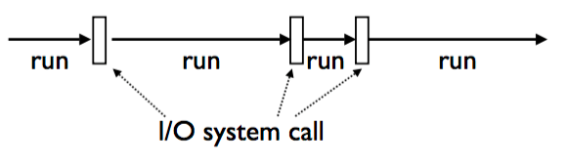
Task Execution
All tasks execute by alternating between CPU processing and I/O handling

Slide 108
Processes / Threads
Processes:
Not share memory
File descriptors not shared
Not the same context (file system, signal)
Threads
Share memory
Share file descriptors
Share same context (file system, signal)

Slide 109
Threads
Independent task running inside a program
Shares resources with the main program (memory, files, network connections,…)
Own independent flow of execution
Python threads are real system threads
POSIX threads (pthreads)
Windows threads
Fully managed by the host operating system
Possible because of the General Interpreter Lock

Slide 110
Naive thread
Python loads a program and starts executing the code
$ python code.py
code
code
code
Main thread

Slide 111
Naive thread – Thread Creation
$ python code.py
code
code
code
Creation of a thread – Launches a function
Create thread (thread_function1)
def thread_function1():
Main thread
Thread 1

Slide 112
Naive thread – Thread Execution
$ python code.py
code
code
code
Create thread (thread_function1)
def thread_function1():
code
code
Concurrent execution of statements
Main thread
Thread 1

Slide 113
Naive thread – Thread Exit
$ python code.py
code
code
code
code
code
code
Create thread (thread_function1)
def thread_function1():
code
code
Main thread
Thread terminates on return or exit
Return or exit

Slide 114
Threading module
Python threads are defined by a class
import threading
Inherit from Thread and redefine run()
OR
Functions as threads

Slide 115
First Method: Define a class and Redefine Run function
import time import threading class CountdownThread(threading.Thread): def __init__(self,count): threading.Thread.__init__(self) self.count = count def run(self): while self.count > 0: print ("Counting down", self.count) self.count -= 1 time.sleep(1) return t1 = CountdownThread(10) t1.start() t2 = CountdownThread(20) t2.start()

Slide 116
Function as threads
import time import threading def countdown(count): while count > 0: print ("Counting down", count) count -= 1 time.sleep(1) t1 = threading.Thread(target=countdown,args=(10,)) t1.start()

Slide 117
Joining a thread
A thread runs independently
The main thread can wait for a thread to exit using the function join
Example:
t.start()
…
t.join()

Slide 118
Workshop
Create a variable ‘balance’ representing the balance of a checking account
Create two customers:
customer1 will make 100000000 deposits of $1
customer2 will withdraw 100000000 deposits of $1
They will do these operations in parallel
First question: what should you expect for the balance knowing that the initial balance is 0 to start?

Slide 119
Access to shared data
import threading x = balance # Balance bank account def client1(): global balance for i in range(100000000): balance += 1 def client2(): global balance for i in range(100000000): balance -= 1 c1 = threading.Thread(target=client1) c2 = threading.Thread(target=client2) c1.start(); c2.start() c1.join(); c2.join() # Wait for completion print(balance) # Expected result is 0

Slide 120
Access to Shared Data
• Threads share all of the data in your program
• Thread scheduling is non-deterministic
• Operations often take several steps and might
be interrupted mid-stream (non-atomic)
• Thus, access to any kind of shared data is also
non-deterministic (remember the Chicken joke)

Slide 121
What happens to your customers?
Consider a shared object
balance = 0
And two threads that modify it
Thread-1
--------
...
balance = balance + 1
...
Thread-2
--------
...
balance = balance - 1
...
•It's possible that the resulting value will be unpredictably corrupted

Slide 122
What happens to your customers?
The two threads
Thread-1
--------
...
balance = balance + 1
...
Thread-2
--------
...
balance = balance - 1
...
Low level interpreter execution
Thread-1
--------
LOAD_GLOBAL 1 (balance)
LOAD_CONST 2 (1)
BINARY_ADD
STORE_GLOBAL 1 (balance)
Thread-2
--------
LOAD_GLOBAL 1 (balance)
LOAD_CONST 2 (1)
BINARY_SUB
STORE_GLOBAL 1 (balance)
thread switch
thread switch

Slide 123
What happens to your customers?
The two threads
Thread-1
--------
...
balance = balance + 1
...
Thread-2
--------
...
balance = balance - 1
...
Low level interpreter execution
Thread-1
--------
LOAD_GLOBAL 1 (balance)
LOAD_CONST 2 (1)
BINARY_ADD
STORE_GLOBAL 1 (balance)
Thread-2
--------
LOAD_GLOBAL 1 (balance)
LOAD_CONST 2 (1)
BINARY_SUB
STORE_GLOBAL 1 (balance)
thread switch
Problem: using stale value of balance
thread switch

Slide 124
Race Conditions
• The corruption of shared data due to thread scheduling is often known as a “race condition”.
To fix that, we need to use thread synchronization

Slide 125
Synchronization options
The threading library defines the following objects for synchronizing threads
Lock
Rlock
Semaphore
Bounded
Semaphore
Event
Condition

Slide 126
Mutex Locks
Mutual Exclusion Lock
m = threading.Lock()
Commonly used
Primarily used to synchronize threads so that only one thread can make modifications to shared data at any given time

Slide 127
Mutex Locks
There are two basic operations:
m.acquire() # Acquire the lock
m.release() # Release the lock
Only one thread can successfully acquire the lock at any given time
If another thread tries to acquire the lock when its already in use, it gets blocked until the lock is released

Slide 128
Critical Section
The two threads
x_lock = threading.Lock()
Thread-1
--------
...
x_lock.acquire()
balance = balance + 1
x_lock.release()
...
Thread-2
--------
...
x_lock.acquire()
balance = balance – 1
x_lock.release()
...
If you remove the lock here?
Does it still work?
Critical Section: only one thread can run this part of the code
NO !

Slide 129
Bank code example
import threading
balance_lock = threading.Lock()
balance = 0 # A shared value
def client1():
global balance
for i in xrange(100000000):
balance_lock.acquire()
balance += 1
balance_lock.release()
def client2():
global balance
for i in xrange(100000000):
balance_lock.acquire()
balance -= 1
balance_lock.release()
t1 = threading.Thread(target=client1)
t2 = threading.Thread(target=client2)
t1.start(); t2.start()
t1.join(); t2.join() # Wait for completion
print balance # Expected result is 0

Slide 130
Lock Management
Acquired locks must always be released
However, it gets evil with exceptions and
other non-linear forms of control-flow
Always try to follow this prototype:
x = 0
x_lock = threading.Lock()
# Example critical section
x_lock.acquire()
try:
statements using x
finally:
x_lock.release()
x = 0
x_lock = threading.Lock()
# Critical section
with x_lock:
statements using x

Slide 131
Deadlock
Don't write code that acquires more than one mutex lock at a time
x = 0
y = 0
x_lock = threading.Lock()
y_lock = threading.Lock()
It will stuck your code

Slide 132
Semaphores
A counter-based synchronization primitive
m = threading.Semaphore(n) # Create a semaphore
m.acquire() # Acquire
m.release() # Release
acquire() - Waits if the count is 0, otherwise decrements the count and continues
release() - Increments the count and signals waiting threads (if any)
Unlike locks, acquire()/release() can be called in any order and by any thread

Slide 133
Semaphores
Using a semaphore to limit resources in the bank examples
import threading
import time
balance_lock = threading.Lock()
balance = 0 # A shared value
def client1():
global balance
for i in xrange(1000000):
balance_lock.acquire()
balance += 1
balance_lock.release()
def client2():
global balance
for i in xrange(1000000):
balance_lock.acquire()
balance -= 1
balance_lock.release()
def observer1(x):
print x
global balance
for i in xrange(1000):
print 'observer ' + str(x) + ': ' + str(balance)
time.sleep(x)
t1 = threading.Thread(target=client1)
t2 = threading.Thread(target=client2)
t3 = threading.Thread(target=observer1, kwargs={'x' : 1})
t4 = threading.Thread(target=observer1, kwargs={'x' : 2})
t5 = threading.Thread(target=observer1, kwargs={'x' : 3})
t1.start(); t2.start() ; t3.start(); t4.start(); t5.start()
t1.join(); t2.join() ; t3.join(); t4.join() ; t5.join() # Wait for completion
print balance

Slide 134
Add semaphore to bank example
import threading
import time
balance_lock = threading.Lock()
sema = threading.Semaphore(2)
balance = 0 # A shared value
def client1():
global balance
for i in xrange(1000000):
balance_lock.acquire()
balance += 1
balance_lock.release()
def client2():
global balance
for i in xrange(1000000):
balance_lock.acquire()
balance -= 1
balance_lock.release()
def observer1(x):
print x
global balance
sema.acquire()
try:
for i in xrange(1000):
print 'observer ' + str(x) + ': ' + str(balance)
time.sleep(x)
finally:
sema.release()
t1 = threading.Thread(target=client1)
t2 = threading.Thread(target=client2)
t3 = threading.Thread(target=observer1, kwargs={'x' : 1})
t4 = threading.Thread(target=observer1, kwargs={'x' : 2})
t5 = threading.Thread(target=observer1, kwargs={'x' : 3})
t1.start(); t2.start() ; t3.start(); t4.start(); t5.start()
t1.join(); t2.join() ; t3.join(); t4.join() ; t5.join() # Wait for completion
print balance

Slide 135
Daemon
You can make it independent from a terminal
t.daemon=True
t.setDaemon(True)

