Slide 1







<Capstone-SpaceX>
<JIAN KUN MAO>
<MAY 13TH 2022>
Link to github

Slide 2



PROJECT_OUTLINE
Executive Summary
Introduction
Methodology
Results
Conclusion

Slide 3

Executive Summary(Process)
Data collection
Data wrangling
EDA with data visualization
EDA with SQL
Building an interactive map with Folium
Building a Dashboard with Plotly Dash
Predictive analysis BY machine learning

Slide 4
Results
Data analysis result
Predictive result

Slide 5

INTRODUCTION
Background
Base on the information that post on the Wikipedia, tony of the info would be found including cost of the Falcon, success Rate etc. Which help us to find the difference between Space X and other project(company).
Question need to solve
Influence of the Success Rate
What is the advantage make of the SpaceX have highest Success Rate with lower cost.

Slide 6

METHODOLOGY
Data collection & wrangling
-data mining(beautiful Soup)
-data transfer to DF
-cleaning(organize and keep the variable data)
Visualization
-SQL(query the data w/ condition)
-Plot(Show the relationship between variables)
-Folium and Dash
Classification model

Slide 7
Data collection
1 get response from API
2 Covert response to j.son
3 cleaning the data
4 transfer the data to DF format
5 export to CSV file
Link to github

Slide 8
Data Scraping & Wrangling
1 get response from API
2 create BeautifulSoup Object
3 find the Target table
4 extract the data from table
5 get the variable data
6 export to CSV file
Link to github for
scraping
Link to github for Wrangling

Slide 9
Data visualization
Link to github
1 Plot
2 SQL
3 Interactive map
Link to github
Link to github

Slide 10
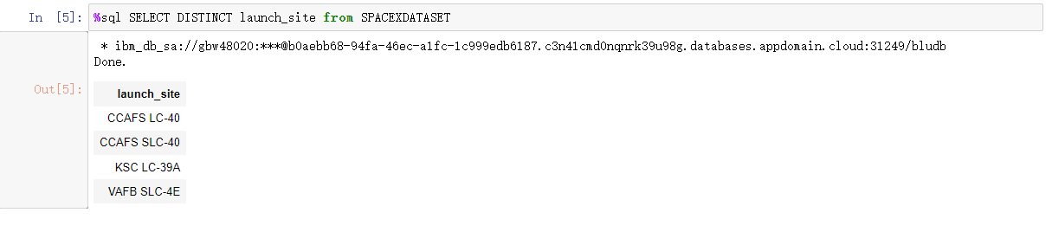
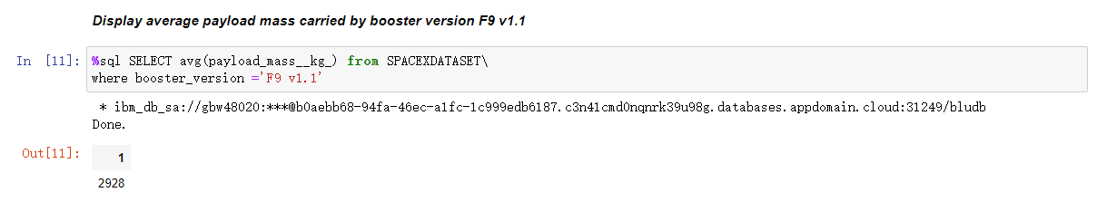
SQL（key information）

Slide 11
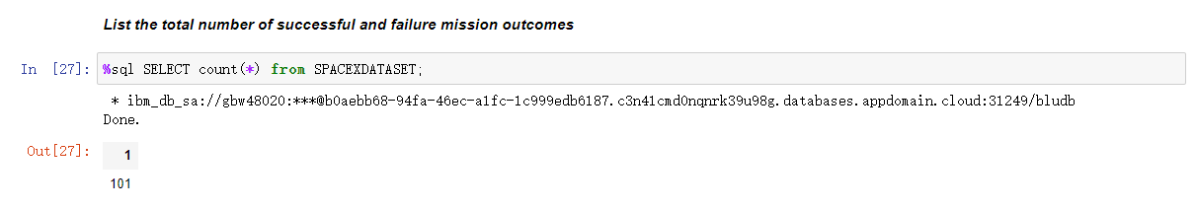
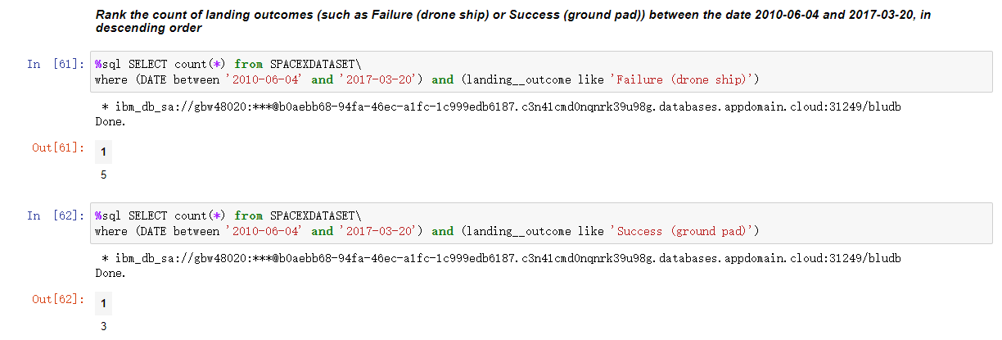

Slide 12
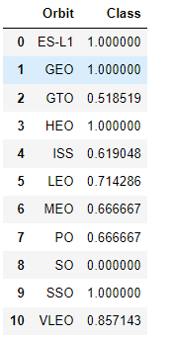
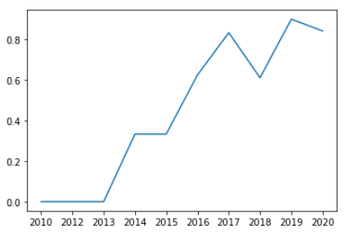
Key information in Plot
Success Rate of
Each Orbit
In 2010-2020

Slide 13
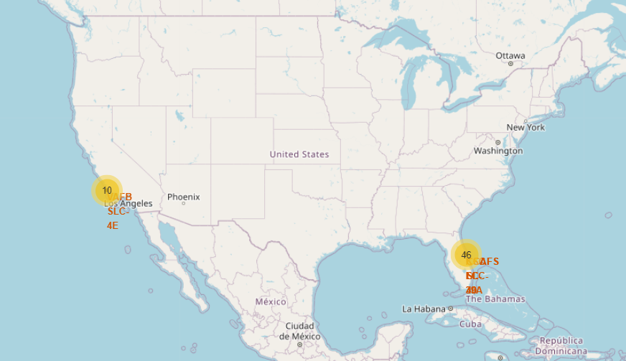
Interactive map by folium(key Information)
Clear to show the launch number and location
in the East and west coast of U.S.

Slide 14
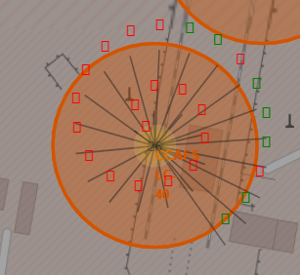
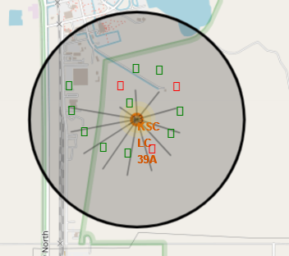
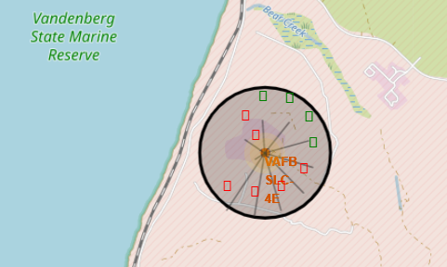
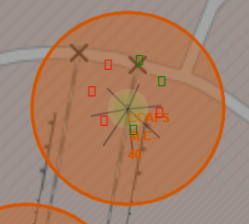
The successful launch (green) and fail(red)
EAST
WEST

Slide 15
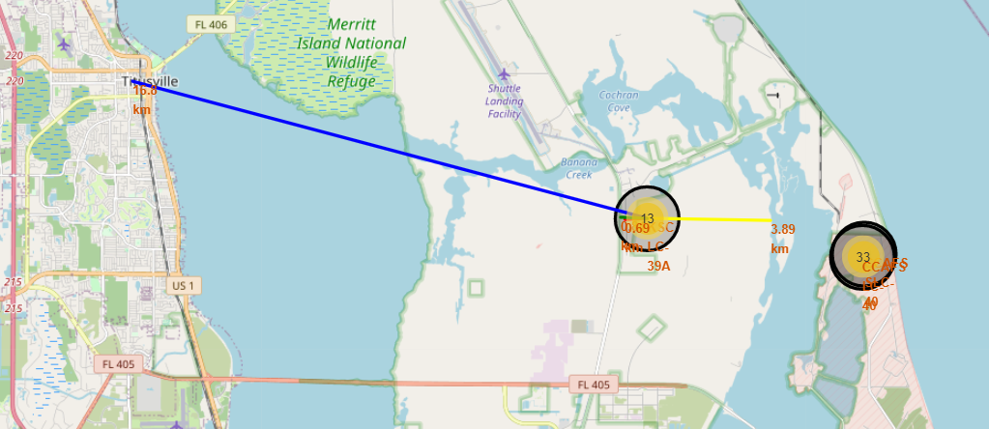
Launch site Traffic Condition

Slide 16

DASHBOARD
Link to github

Slide 17
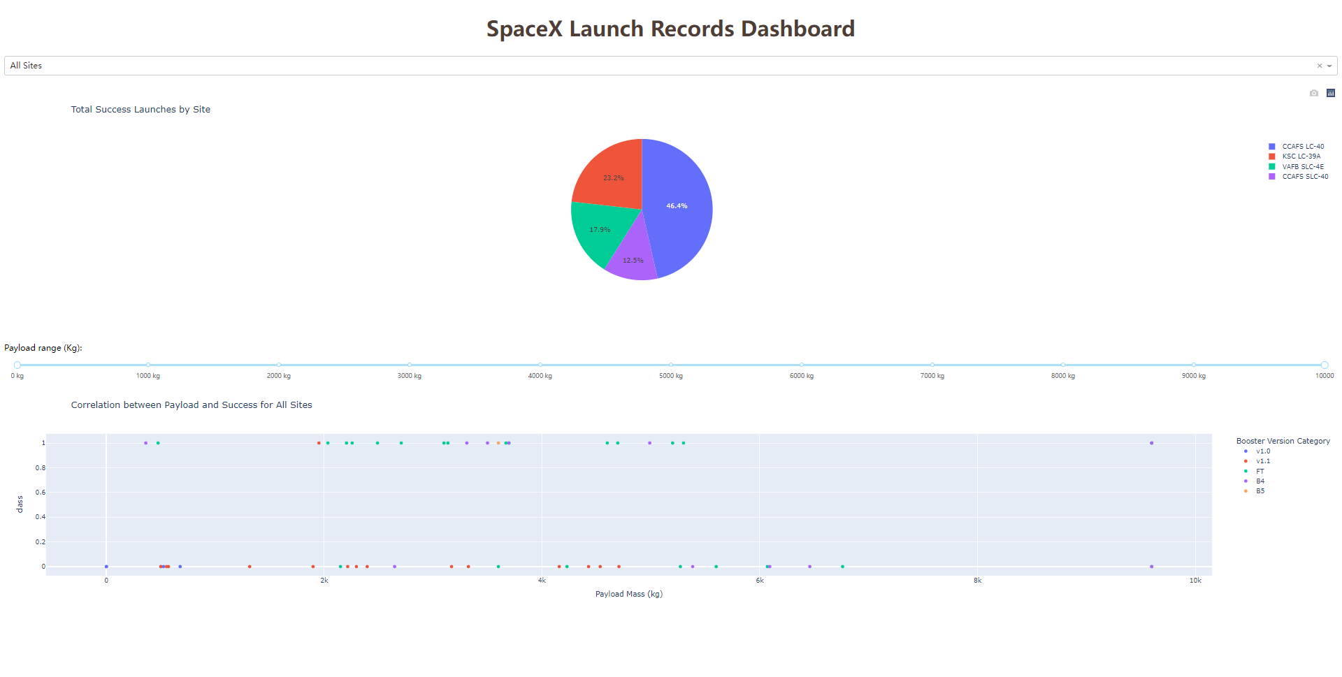
Overall

Slide 18
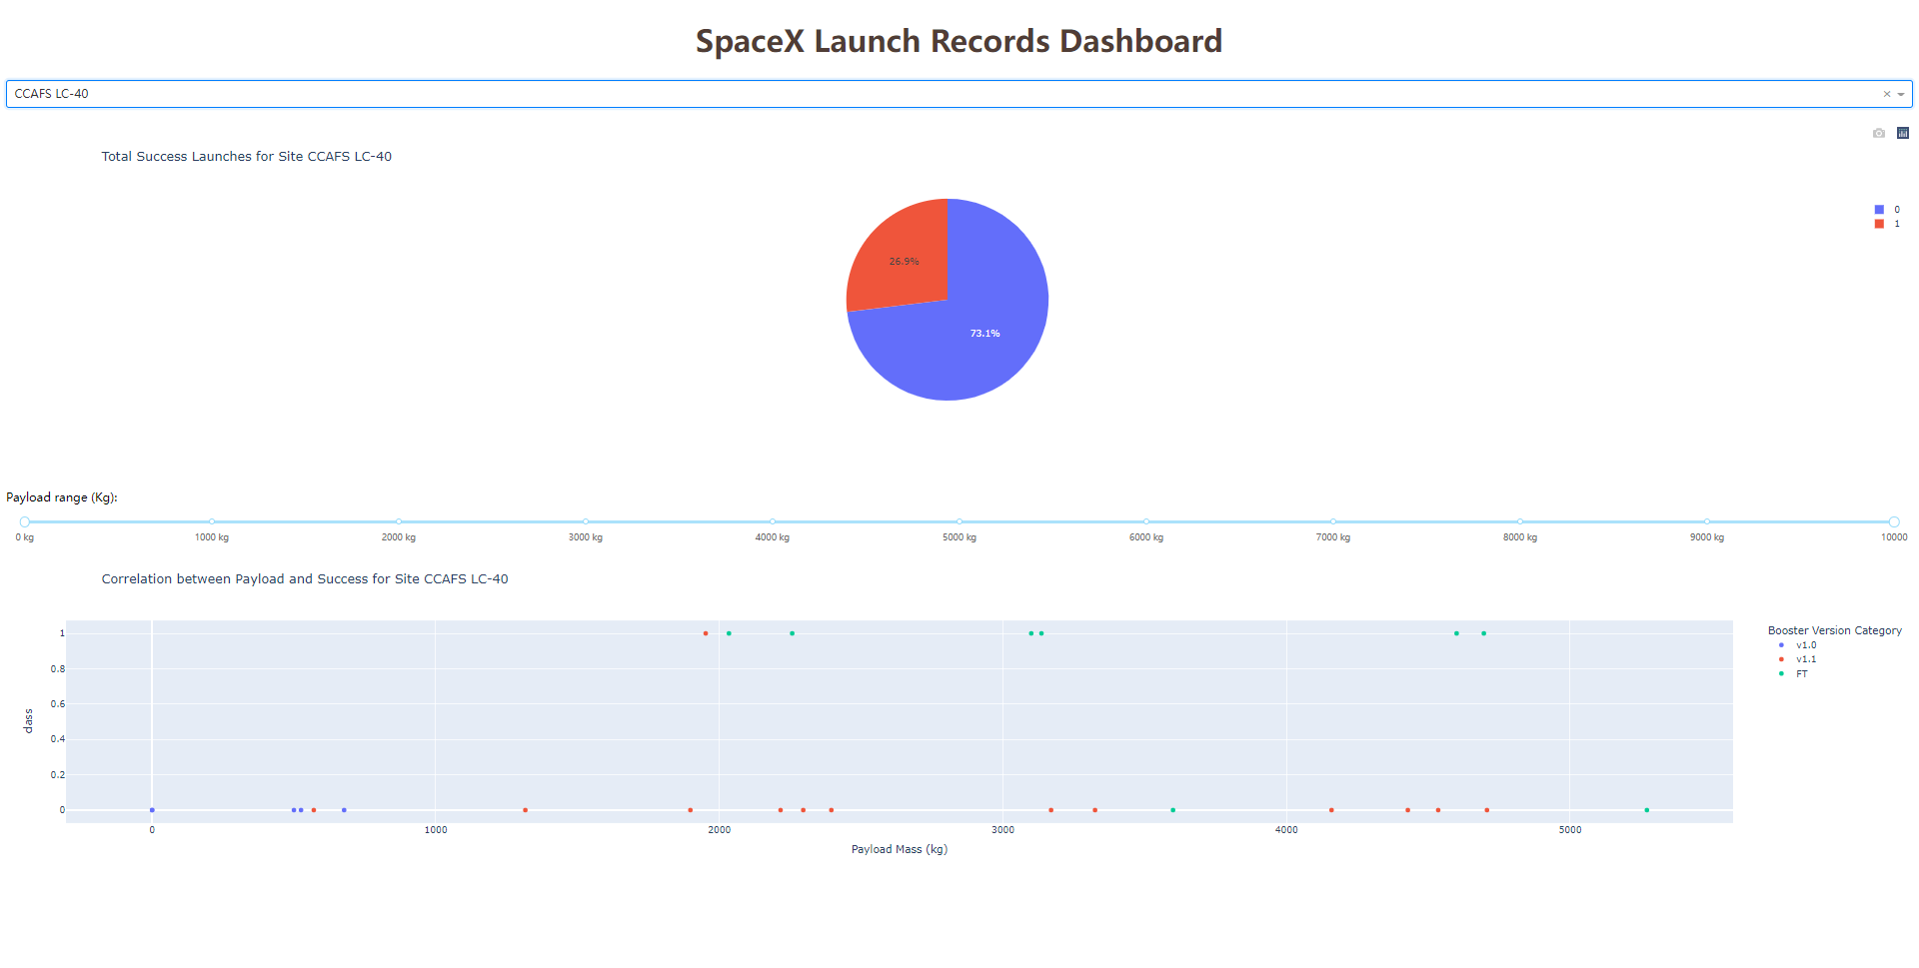
CCAFS LC-40

Slide 19
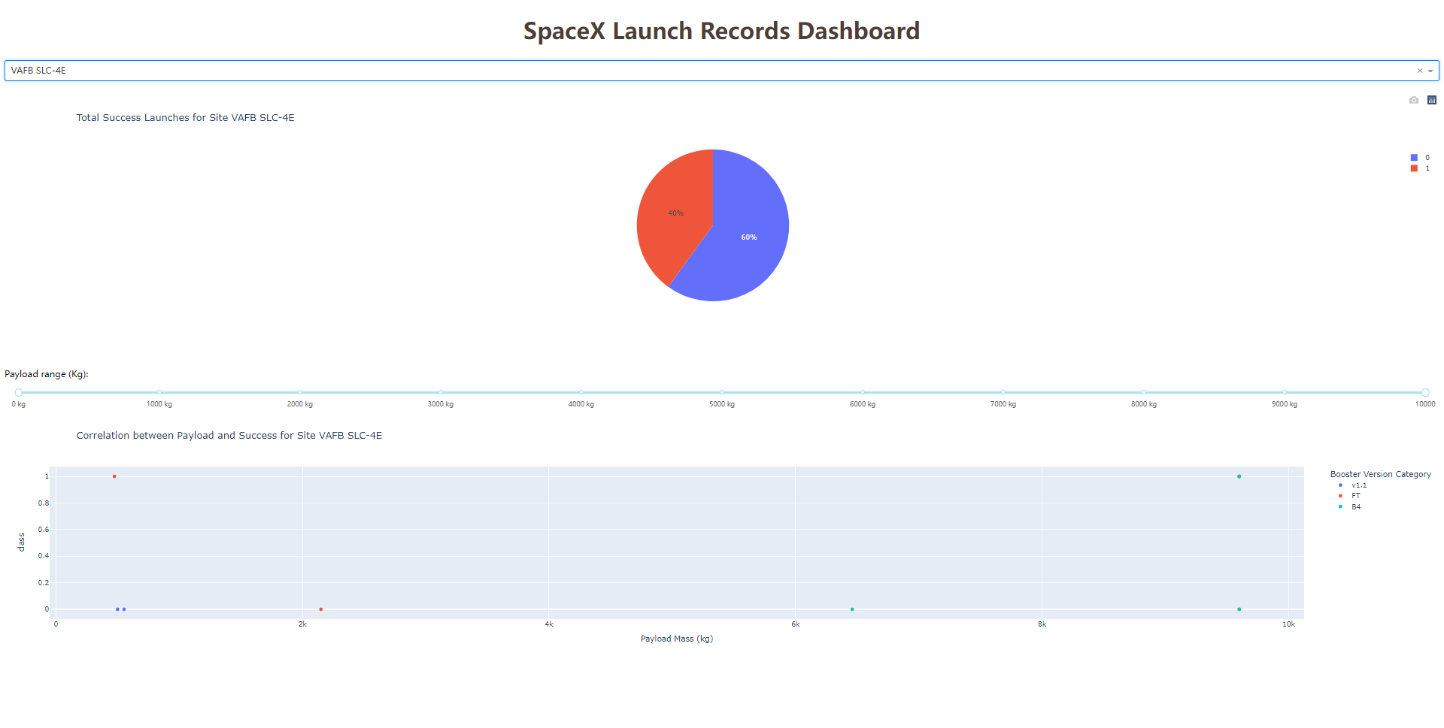
VAFB SLC-4E

Slide 20
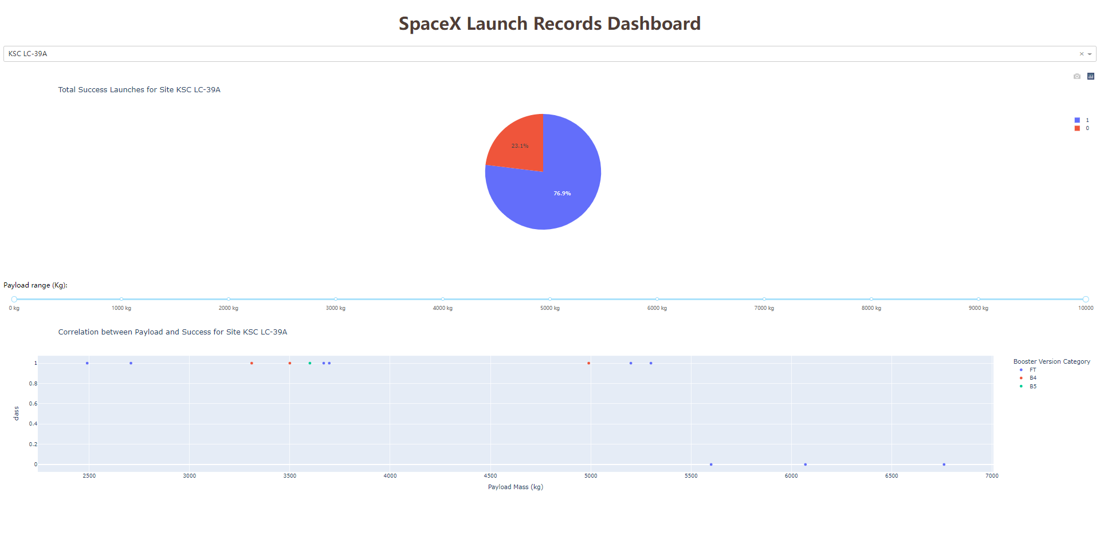
KSC LC-39A(Highest Success Rate)

Slide 21
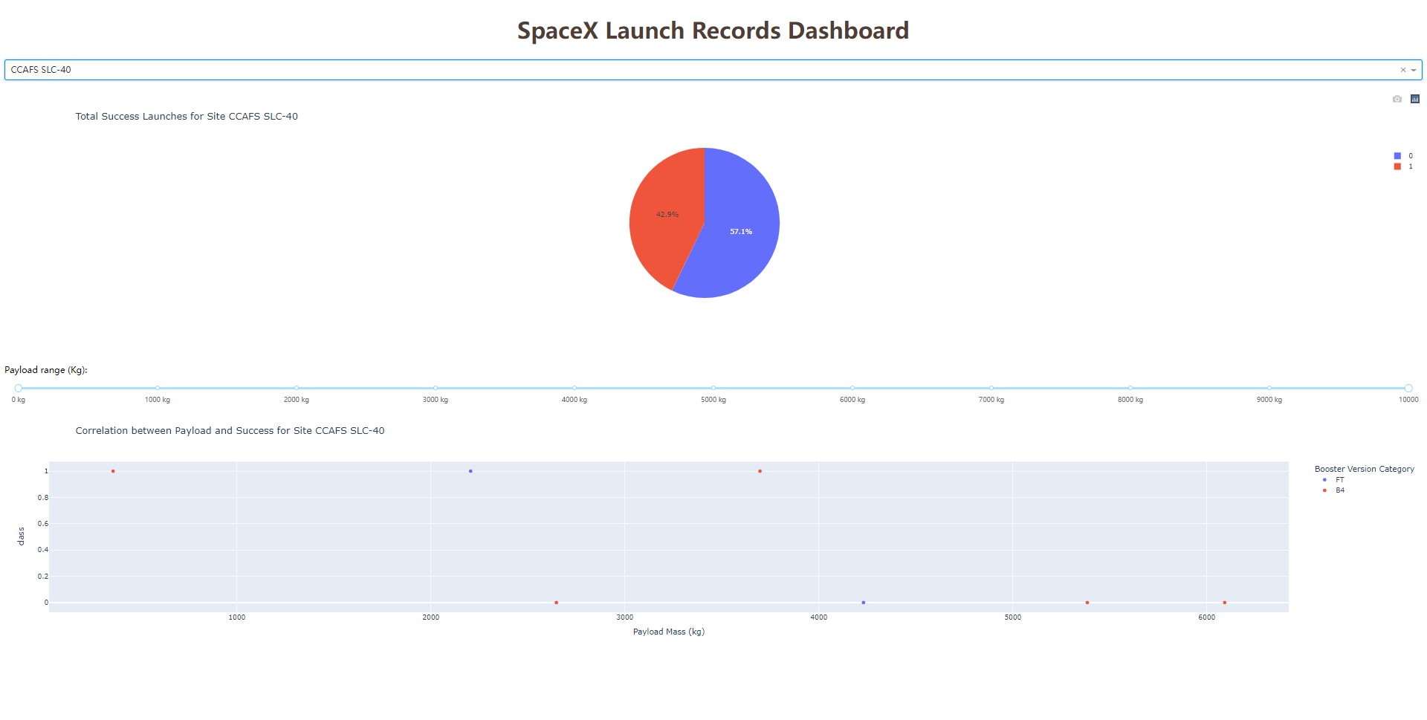
CCAFS SLC-40

Slide 22
Classification model by machine learning

Slide 23
Model Choosing Accuracy of 4 different models
Link to github
MODEL | Accuracy
LogisticRegression | 0.84642857
SVN | 0.84821429
TREE | 0.87678571
KNN | 0.84821429
Obviously Tree has the highest score in the table

Slide 24
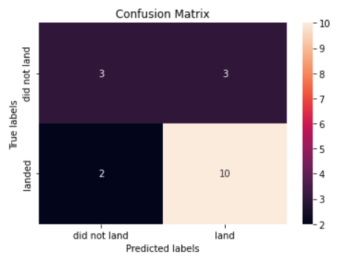
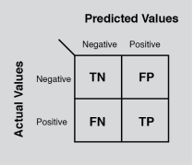
Result
In here, we can see the predictive result which base on the tree algorithm, for more convivence I put a guide figure to help audiences have understand the Confusion Matrix

Slide 25
DISCUSSION
In this case
we found
Orbit GEO,HEO,SSO,ES-L1 have the best Success Rate
Success Rate is generally increasing in 2010-2020
KSC LC-39A has the most successful launches
Tree Classifier algorithm is the best predictor.

