Slide 1
오차역전파 - mnist
2021.08.04 AAI Lab. 세미나
김민준

Slide 2
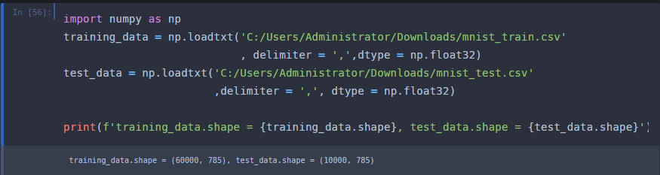
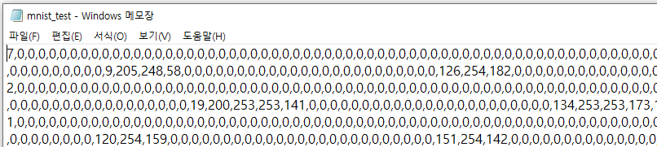
Load Data

Slide 3
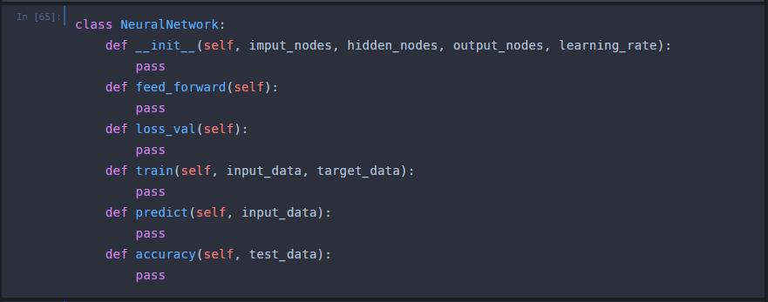
NeuralNetwork class

Slide 4
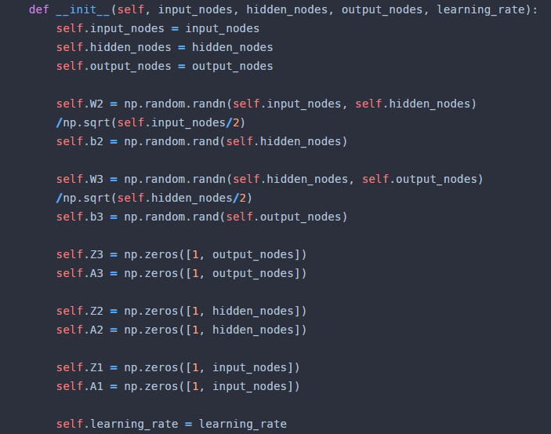


__init__
#$He initialization$
#$He initialization$

Slide 5
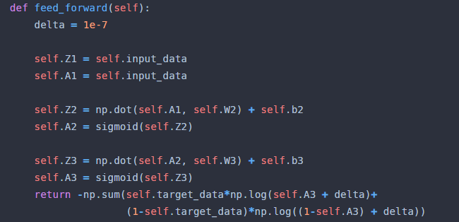


feed_forward
입력층
은닉층
출력층
#$Z_{2}=A_{1}W_{2}+b_{2}$
#$A_{2}=sigmoid\left(Z_{2}\right)$
#$Z_{3}=A_{2}W_{3}+b_{3}$
#$A_{3}=sigmoid(Z_{3})$
$$cross enrtopy=$$

Slide 6
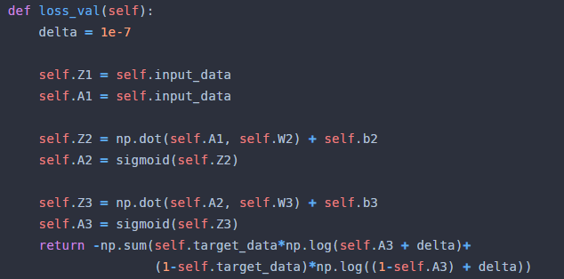
loss_val

Slide 7
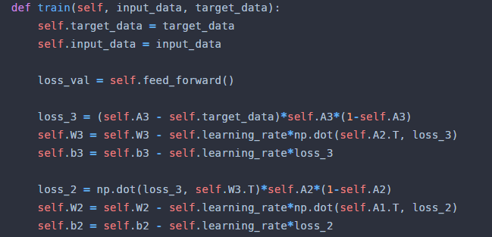
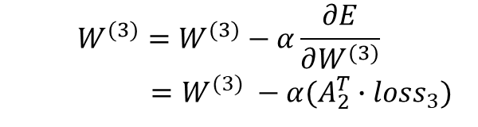
train
$$W^{(3)}=W^{(3)}−α\frac{∂E}{∂W^{(3)}}$$
$$=W^{(3)} −α(A_{2}^{T}∙loss_{3})$$

Slide 8
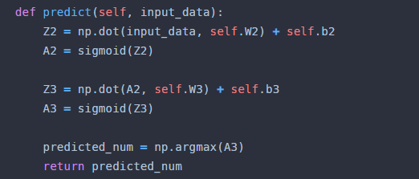
predict

Slide 9
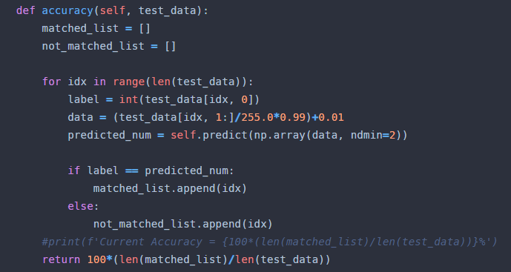
accuracy

Slide 10
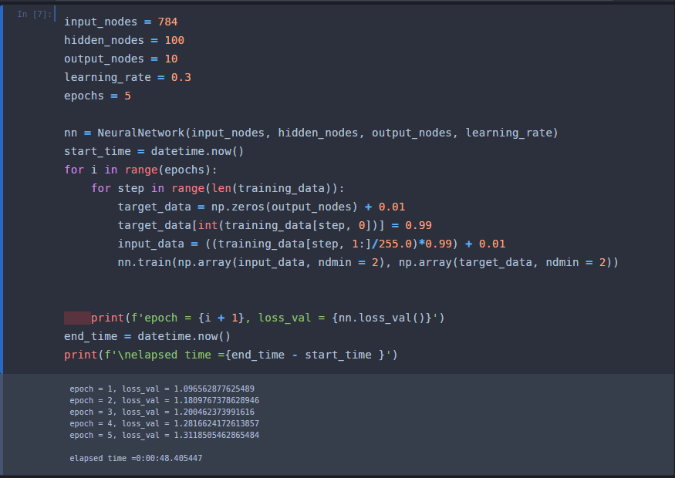
학습

Slide 11

결과

