Slide 1
공업수학
20181796 김민준

Slide 2




#1 $z가$ 다음과 같을 때 $e^{z}$를 $u+iv$형태로 쓰시오.
$z=2+πi$
$e^{z}=e^{2+πi}=e^{2}e^{πi}=e^{2}\left(\cos{π}+i\sin{π}\right)=e^{2}\cos{π}+ie^{2}\sin{π}$
$$u$$
$$v$$

Slide 3

#2 다음 방정식의 모든 해를 구하시오.
$e^{z}=−2$
$e^{z}=e^{x+yi}=e^{x}\left(\cos{y}+i\sin{y}\right)=−2$
$\left|e^{z}\right|=2=e^{x}$ → $x=\ln{2}$
$\cos{y}=−1,\sin{y}=0$ → $y=π+2nπ$
$∴z=\ln{2}+\left((2n+1)π\right)i$

Slide 4
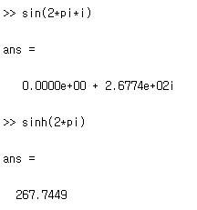


#3 다음 값을 $u+iv$형태로 구하시오.
$\sin{2πi}=\frac{1}{2i}\left(e^{i\left(2πi\right)}−e^{−i\left(2πi\right)}\right)=\frac{1}{2i}\left(e^{−2π}−e^{2π}\right)=i\left(\frac{e^{2π}−e^{−2π}}{2}\right)$
$u=0, v=\left(\frac{e^{2π}−e^{−2π}}{2}\right)$
$\sin{2πi}=\sin{0}\cosh{2π}+i\cos{0}\sinh{2π}$
$=i\sinh{2π}=i\left(\frac{e^{2π}−e^{−2π}}{2}\right)$

Slide 5
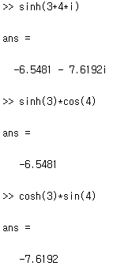
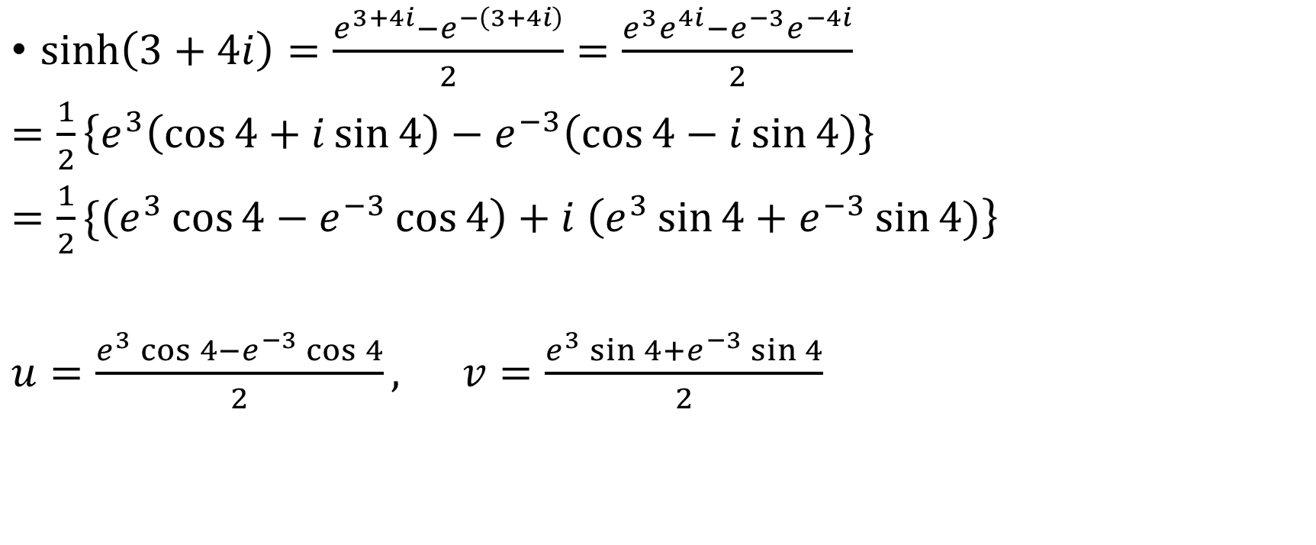

#4 다음 값을 $u+iv$형태로 구하시오.
$\sinh\left(3+4i\right)=\frac{e^{3+4i}−e^{−\left(3+4i\right)}}{2}=\frac{e^{3}e^{4i}−e^{−3}e^{−4i}}{2}$
$=\frac{1}{2}\left\{e^{3}\left(\cos{4}+i\sin{4}\right)−e^{−3}\left(\cos{4}−i\sin{4}\right)\right\}$
$=\frac{1}{2}\{\left(e^{3}\cos{4}−e^{−3}\cos{4}\right)+i \left(e^{3}\sin{4}+e^{−3}\sin{4})\right\}$
$u=\frac{e^{3}\cos{4}−e^{−3}\cos{4}}{2}, v=\frac{e^{3}\sin{4}+e^{−3}\sin{4}}{2}$

Slide 6
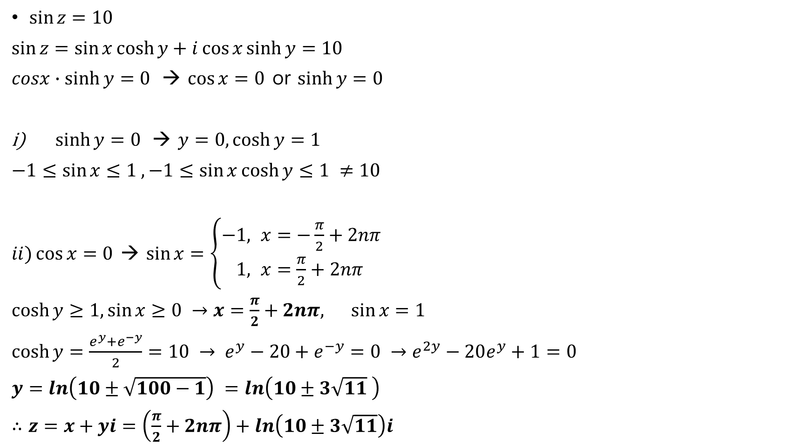
#5 다음 방정식의 모든 해를 구하시오.
$\sin{z}=10$
$\sin{z}=\sin{x}\cosh{y}+i\cos{x}\sinh{y}=10$
$cosx∙\sinh{y}=0$ → $\cos{x}=0$ or $\sinh{y}=0$
$\sinh{y}=0$ → $y=0,\cosh{y}=1$
$−1≤\sin{x}≤1 , −1≤\sin{x}\cosh{y}≤1 ≠10$
$ii)\cos{x}=0$ → $\sin{x}=\left\{\begin{aligned}−&1, x=−\frac{π}{2}+2nπ \\ &1, x=\frac{π}{2}+2nπ\end{aligned}\right.$
$\cosh{y}≥1,\sin{x}≥0 →x=\frac{π}{2}+2nπ, \sin{x}=1$
$\cosh{y}=\frac{e^{y}+e^{−y}}{2}=10 → e^{y}−20+e^{−y}=0 →e^{2y}−20e^{y}+1=0$
$y=ln\left(10±\sqrt{100−1}\right) =ln\left(10±3\sqrt{11} \right)$
$∴z=x+yi=\left(\frac{π}{2}+2nπ\right)+ln\left(10±3\sqrt{11}\right)i$

Slide 7
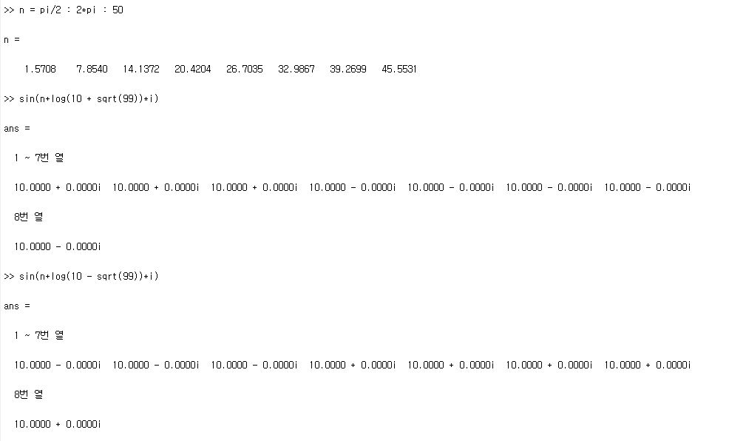
#5 - MATLAB

Slide 8
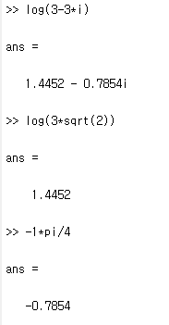


#6 다음 값을 $u+iv$형태로 구하시오.
$Ln\left(3−3i\right)=\ln{|z|}+iArg\left(z\right)$
$\left|z\right|=\sqrt{3^{2}+3^{2}}=3\sqrt{2}$
$Arg\left(z\right)=\arctan\left(−\frac{3}{3}\right)=−\frac{π}{4}$
$∴Ln\left(3−3i\right)=\ln\left(3\sqrt{2}\right)−\frac{π}{4}i$

Slide 9
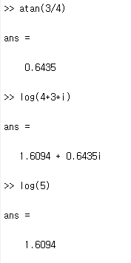


#7 다음 값을 $u+iv$형태로 구하시오.
$\ln\left(4+3i\right)=\ln\left|z\right|+\arg{(z)}$
$\left|z\right|=\sqrt{4^{2}+3^{2}}=5$
$\arg\left(z\right)=\arctan\left(\frac{3}{4}\right)±2nπ ≈0.6435±2nπ$
$∴\ln\left(4+3i\right)=\ln\left(5\right)+\left(0.6435±2nπ\right)i$

Slide 10
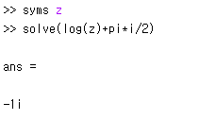

#8 다음 방정식의 해를 구하시오.
$\ln\left(z\right)=−\frac{πi}{2}$
$z=e^{−\frac{πi}{2}}=\cos\left(−\frac{π}{2}\right)+i\sin\left(−\frac{π}{2}\right)=\cos\left(\frac{π}{2}\right)−i\sin\left(\frac{π}{2}\right)=−i$

Slide 11
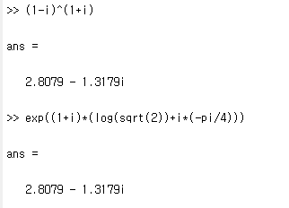

#9 다음 값을 구하시오.
${\left(1−i\right)}^{1+i}=k$
$\ln{{\left(1−i\right)}^{1+i}}=\left(1+i\right)\ln{(1−i)}=\ln{k}$
$\ln\left(1−i\right)=\ln\left(\sqrt{2}\right)+i\left(−\frac{π}{4}±2nπ\right)$
$\ln{k}=\left(1+i\right)\left(\ln{\sqrt{2}}+i\left(−\frac{π}{4}±2nπ\right)\right)$
$∴k=e^{\left(1+i\right)\left(\ln{\sqrt{2}}+i\left(−\frac{π}{4}±2nπ\right)\right)}$

