Slide 1
공업수학
20181796 김민준

Slide 2
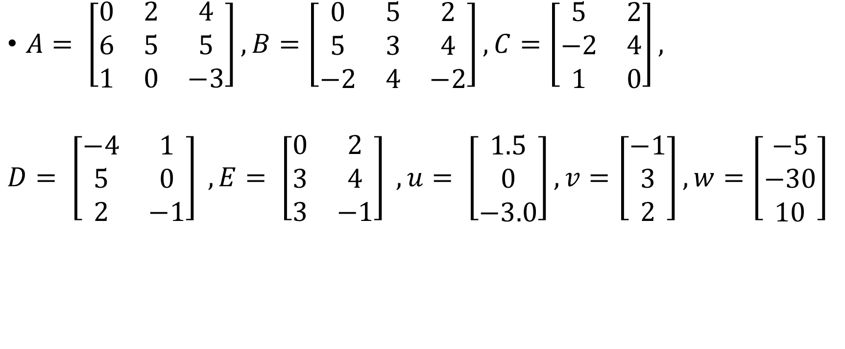
#1 Let
$A= \left[\begin{matrix}0 & 2 & 4 \\ 6 & 5 & 5 \\ 1 & 0 & −3\end{matrix}\right], B=\left[\begin{matrix}0 & 5 & 2 \\ 5 & 3 & 4 \\ −2 & 4 & −2\end{matrix}\right], C=\left[\begin{matrix}5 & 2 \\ −2 & 4 \\ 1 & 0\end{matrix}\right],$
$D= \left[\begin{matrix}−4 & 1 \\ 5 & 0 \\ 2 & −1\end{matrix}\right] , E= \left[\begin{matrix}0 & 2 \\ 3 & 4 \\ 3 & −1\end{matrix}\right] , u= \left[\begin{matrix}1.5 \\ 0 \\ −3.0\end{matrix}\right], v=\left[\begin{matrix}−1 \\ 3 \\ 2\end{matrix}\right], w=\left[\begin{matrix}−5 \\ −30 \\ 10\end{matrix}\right]$

Slide 3
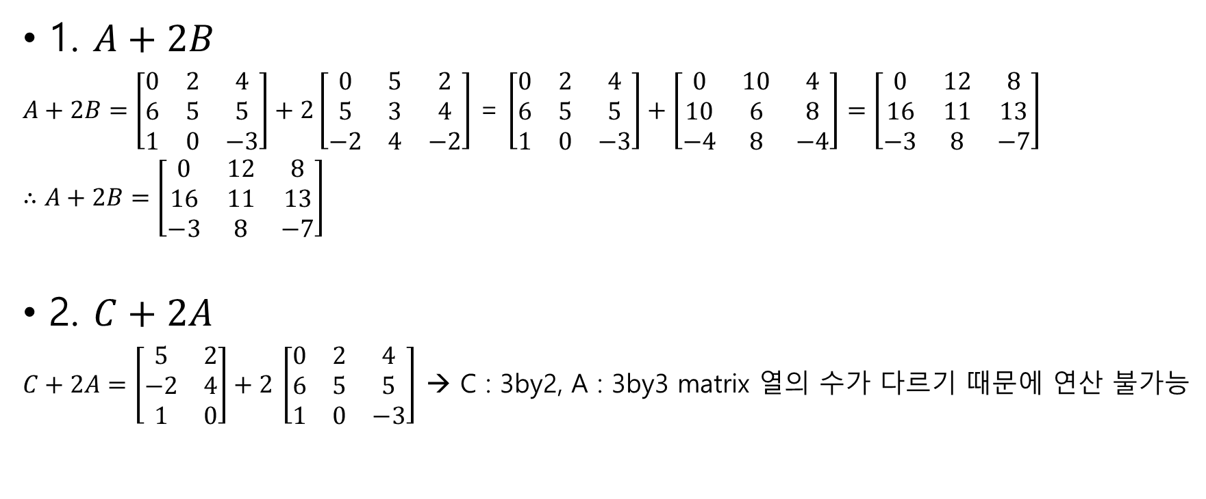
#1
1. $A+2B$
$A+2B=\left[\begin{matrix}0 & 2 & 4 \\ 6 & 5 & 5 \\ 1 & 0 & −3\end{matrix}\right]+2\left[\begin{matrix}0 & 5 & 2 \\ 5 & 3 & 4 \\ −2 & 4 & −2\end{matrix}\right]$ = $\left[\begin{matrix}0 & 2 & 4 \\ 6 & 5 & 5 \\ 1 & 0 & −3\end{matrix}\right]+\left[\begin{matrix}0 & 10 & 4 \\ 10 & 6 & 8 \\ −4 & 8 & −4\end{matrix}\right]=\left[\begin{matrix}0 & 12 & 8 \\ 16 & 11 & 13 \\ −3 & 8 & −7\end{matrix}\right]$
$∴A+2B=\left[\begin{matrix}0 & 12 & 8 \\ 16 & 11 & 13 \\ −3 & 8 & −7\end{matrix}\right]$
2. $C+2A$
$C+2A=\left[\begin{matrix}5 & 2 \\ −2 & 4 \\ 1 & 0\end{matrix}\right]+2$ $\left[\begin{matrix}0 & 2 & 4 \\ 6 & 5 & 5 \\ 1 & 0 & −3\end{matrix}\right]$ → C : 3by2, A : 3by3 matrix 열의 수가 다르기 때문에 연산 불가능

Slide 4
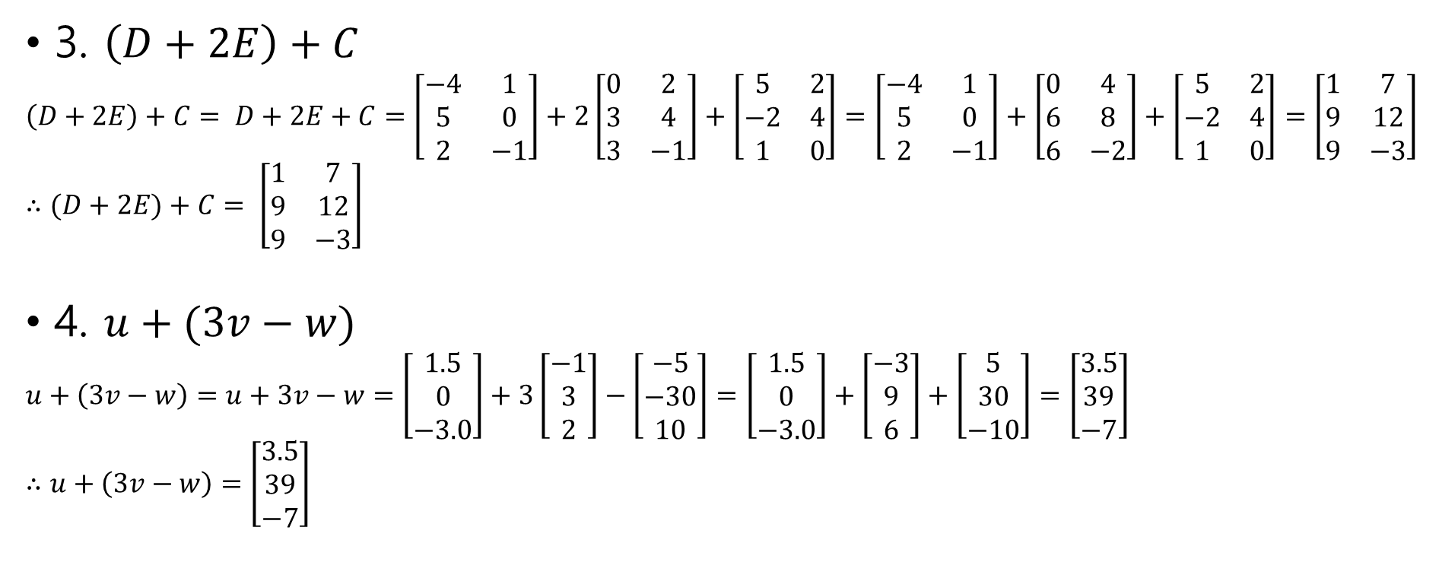
#1
3. $\left(D+2E\right)+C$
$\left(D+2E\right)+C= D+2E+C=\left[\begin{matrix}−4 & 1 \\ 5 & 0 \\ 2 & −1\end{matrix}\right]+2\left[\begin{matrix}0 & 2 \\ 3 & 4 \\ 3 & −1\end{matrix}\right]+\left[\begin{matrix}5 & 2 \\ −2 & 4 \\ 1 & 0\end{matrix}\right]=\left[\begin{matrix}−4 & 1 \\ 5 & 0 \\ 2 & −1\end{matrix}\right]+\left[\begin{matrix}0 & 4 \\ 6 & 8 \\ 6 & −2\end{matrix}\right]+\left[\begin{matrix}5 & 2 \\ −2 & 4 \\ 1 & 0\end{matrix}\right]=\left[\begin{matrix}1 & 7 \\ 9 & 12 \\ 9 & −3\end{matrix}\right]$
$∴(D+2E)+C= \left[\begin{matrix}1 & 7 \\ 9 & 12 \\ 9 & −3\end{matrix}\right]$
4. $u+(3v−w)$
$u+\left(3v−w\right)=u+3v−w=\left[\begin{matrix}1.5 \\ 0 \\ −3.0\end{matrix}\right]+3\left[\begin{matrix}−1 \\ 3 \\ 2\end{matrix}\right]−\left[\begin{matrix}−5 \\ −30 \\ 10\end{matrix}\right]=\left[\begin{matrix}1.5 \\ 0 \\ −3.0\end{matrix}\right]+\left[\begin{matrix}−3 \\ 9 \\ 6\end{matrix}\right]+\left[\begin{matrix}5 \\ 30 \\ −10\end{matrix}\right]=\left[\begin{matrix}3.5 \\ 39 \\ −7\end{matrix}\right]$
$∴u+\left(3v−w\right)=\left[\begin{matrix}3.5 \\ 39 \\ −7\end{matrix}\right]$

Slide 5

#2~5 Let
$A= \left[\begin{matrix}4 & −2 & 3 \\ −2 & 1 & 6 \\ 1 & 2 & 2\end{matrix}\right] , B= \left[\begin{matrix}1 & −3 & 0 \\ −3 & 1 & 0 \\ 0 & 0 & 2\end{matrix}\right], C=\left[\begin{matrix}0 & 1 \\ 3 & 2 \\ −2 & 0\end{matrix}\right]$
$a=\left[\begin{matrix}1 & −2 & 0\end{matrix}\right], b= \left[\begin{matrix}3 \\ 1 \\ −1\end{matrix}\right]$

Slide 6
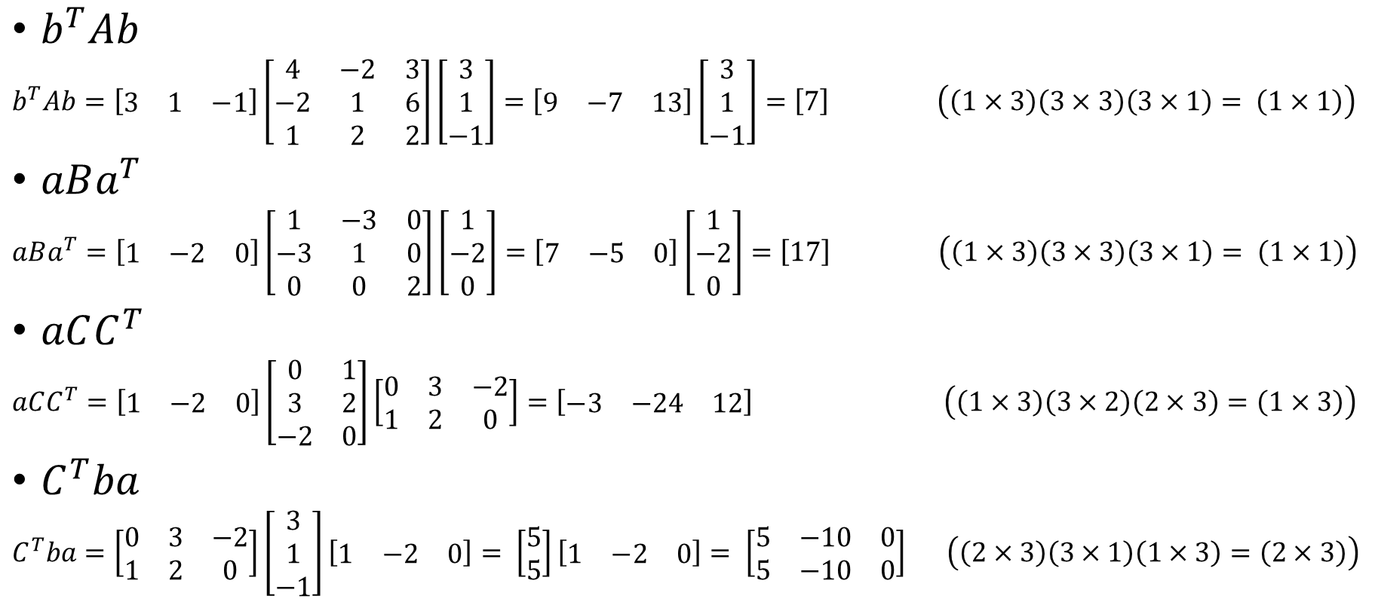
#2
$b^{T}Ab$
$b^{T}Ab=\left[\begin{matrix}3 & 1 & −1\end{matrix}\right]\left[\begin{matrix}4 & −2 & 3 \\ −2 & 1 & 6 \\ 1 & 2 & 2\end{matrix}\right]\left[\begin{matrix}3 \\ 1 \\ −1\end{matrix}\right]=\left[\begin{matrix}9 & −7 & 13\end{matrix}\right]\left[\begin{matrix}3 \\ 1 \\ −1\end{matrix}\right]=\left[7\right]$ $\left(\left(1×3\right)\left(3×3\right)\left(3×1\right)= \left(1×1\right)\right)$
$aBa^{T}$
$aBa^{T}=\left[\begin{matrix}1 & −2 & 0\end{matrix}\right]\left[\begin{matrix}1 & −3 & 0 \\ −3 & 1 & 0 \\ 0 & 0 & 2\end{matrix}\right]\left[\begin{matrix}1 \\ −2 \\ 0\end{matrix}\right]=\left[\begin{matrix}7 & −5 & 0\end{matrix}\right]\left[\begin{matrix}1 \\ −2 \\ 0\end{matrix}\right]=\left[17\right] \left(\left(1×3\right)\left(3×3\right)\left(3×1\right)= \left(1×1\right)\right)$
$aCC^{T}$
$aCC^{T}=\left[\begin{matrix}1 & −2 & 0\end{matrix}\right]\left[\begin{matrix}0 & 1 \\ 3 & 2 \\ −2 & 0\end{matrix}\right]\left[\begin{matrix}0 & 3 & −2 \\ 1 & 2 & 0\end{matrix}\right]=\left[\begin{matrix}−3 & −24 & 12\end{matrix}\right]$ $\left(\left(1×3\right)\left(3×2\right)\left(2×3\right)=\left(1×3\right)\right)$
$C^{T}ba$
$C^{T}ba=\left[\begin{matrix}0 & 3 & −2 \\ 1 & 2 & 0\end{matrix}\right]\left[\begin{matrix}3 \\ 1 \\ −1\end{matrix}\right]\left[\begin{matrix}1 & −2 & 0\end{matrix}\right]= \left[\begin{matrix}5 \\ 5\end{matrix}\right]\left[\begin{matrix}1 & −2 & 0\end{matrix}\right]= \left[\begin{matrix}5 & −10 & 0 \\ 5 & −10 & 0\end{matrix}\right]$ $\left(\left(2×3\right)\left(3×1\right)\left(1×3\right)=\left(2×3\right)\right)$

Slide 7
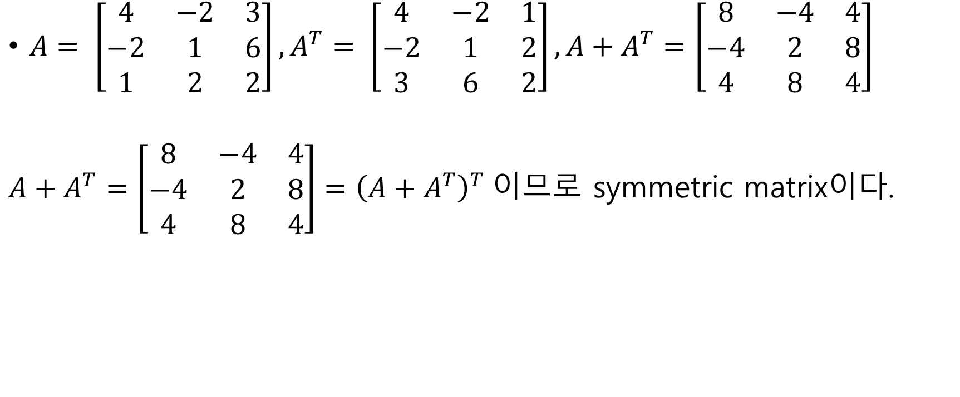
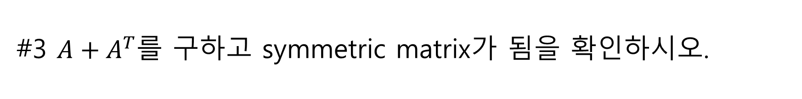
#3 $A+A^{T}$를 구하고 symmetric matrix가 됨을 확인하시오.
$A= \left[\begin{matrix}4 & −2 & 3 \\ −2 & 1 & 6 \\ 1 & 2 & 2\end{matrix}\right], A^{T}= \left[\begin{matrix}4 & −2 & 1 \\ −2 & 1 & 2 \\ 3 & 6 & 2\end{matrix}\right], A+A^{T}=\left[\begin{matrix}8 & −4 & 4 \\ −4 & 2 & 8 \\ 4 & 8 & 4\end{matrix}\right]$
$A+A^{T}=\left[\begin{matrix}8 & −4 & 4 \\ −4 & 2 & 8 \\ 4 & 8 & 4\end{matrix}\right]={\left(A+A^{T}\right)}^{T}$이므로 symmetric matrix이다.

Slide 8
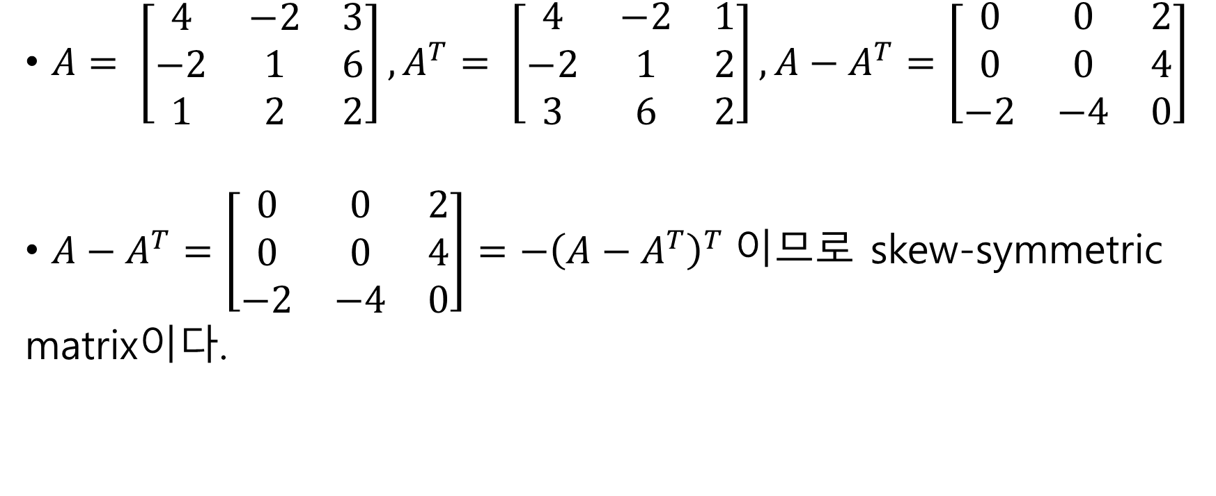
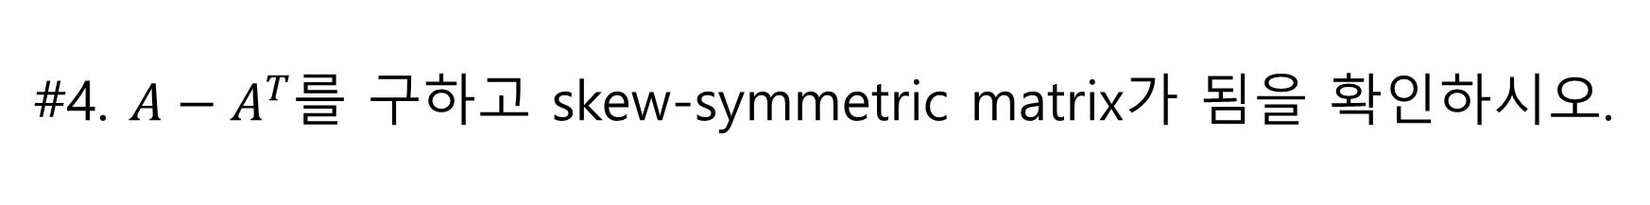
#4. $A−A^{T}$를 구하고 skew-symmetric matrix가 됨을 확인하시오.
$A= \left[\begin{matrix}4 & −2 & 3 \\ −2 & 1 & 6 \\ 1 & 2 & 2\end{matrix}\right], A^{T}= \left[\begin{matrix}4 & −2 & 1 \\ −2 & 1 & 2 \\ 3 & 6 & 2\end{matrix}\right], A−A^{T}=\left[\begin{matrix}0 & 0 & 2 \\ 0 & 0 & 4 \\ −2 & −4 & 0\end{matrix}\right]$
$A−A^{T}=\left[\begin{matrix}0 & 0 & 2 \\ 0 & 0 & 4 \\ −2 & −4 & 0\end{matrix}\right]=−{\left(A−A^{T}\right)}^{T}$이므로 skew-symmetric
matrix이다.

Slide 9
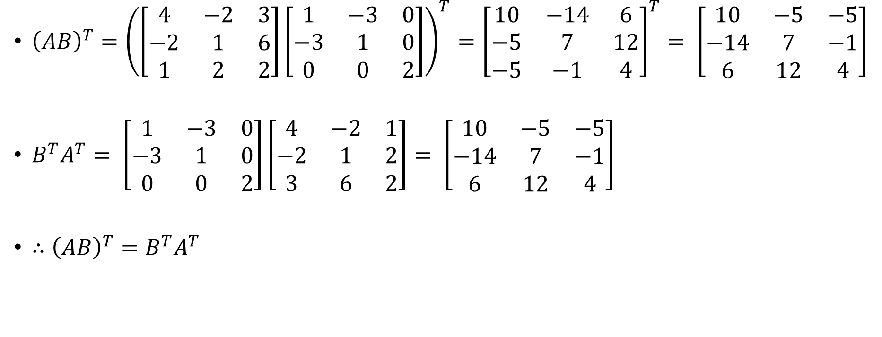
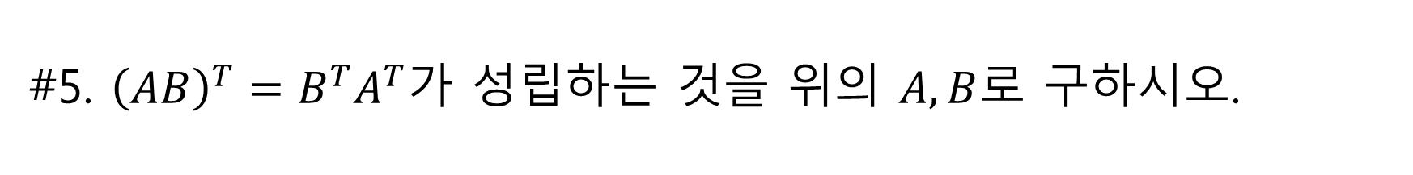
#5. ${\left(AB\right)}^{T}=B^{T}A^{T}가$ 성립하는 것을 위의 $A, B$로 구하시오.
${\left(AB\right)}^{T}={\left(\left[\begin{matrix}4 & −2 & 3 \\ −2 & 1 & 6 \\ 1 & 2 & 2\end{matrix}\right]\left[\begin{matrix}1 & −3 & 0 \\ −3 & 1 & 0 \\ 0 & 0 & 2\end{matrix}\right]\right)}^{T}={\left[\begin{matrix}10 & −14 & 6 \\ −5 & 7 & 12 \\ −5 & −1 & 4\end{matrix}\right]}^{T}= \left[\begin{matrix}10 & −5 & −5 \\ −14 & 7 & −1 \\ 6 & 12 & 4\end{matrix}\right]$
$B^{T}A^{T}= \left[\begin{matrix}1 & −3 & 0 \\ −3 & 1 & 0 \\ 0 & 0 & 2\end{matrix}\right]\left[\begin{matrix}4 & −2 & 1 \\ −2 & 1 & 2 \\ 3 & 6 & 2\end{matrix}\right]= \left[\begin{matrix}10 & −5 & −5 \\ −14 & 7 & −1 \\ 6 & 12 & 4\end{matrix}\right]$
$∴{\left(AB\right)}^{T}=B^{T}A^{T}$

Slide 10
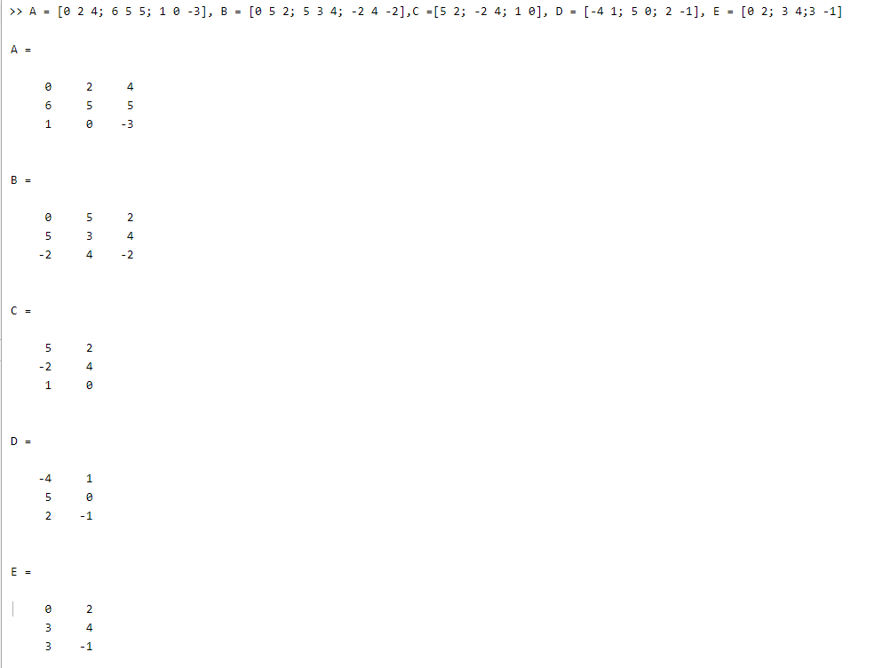
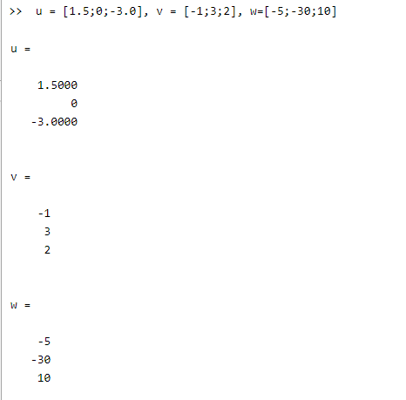
#6. MATLAB - #1

Slide 11
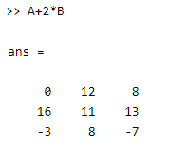
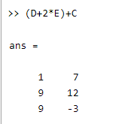

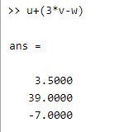
#6. MATLAB - #1
#1-1
#1-3
#1-2
#1-4

Slide 12
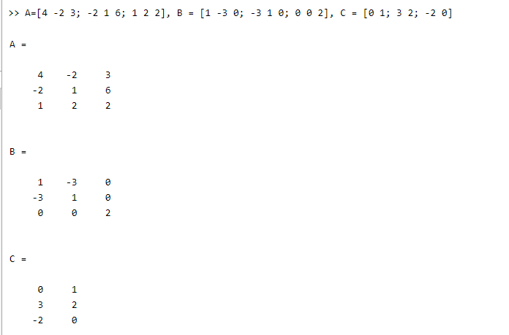
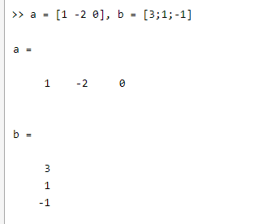
#6. MATLAB - #2~5

Slide 13
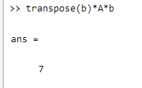
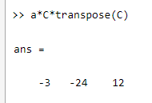
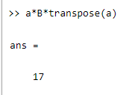
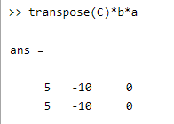




#6. MATLAB - #2
$$b^{T}Ab$$
$$aCC^{T}$$
$$aBa^{T}$$
$$C^{T}ba$$

Slide 14
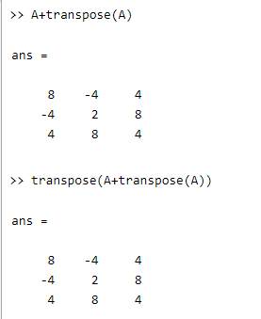
#6. MATLAB - #3

Slide 15
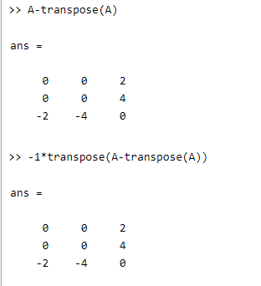
#6. MATLAB - #4

Slide 16
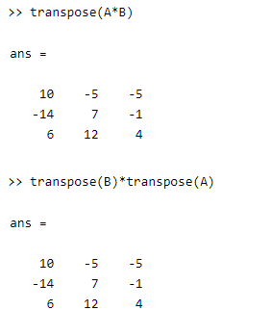
#6. MATLAB - #5

