Slide 1
공업수학
20181796 김민준

Slide 2

1. 다음 행렬의 행렬식을 구하시오.
1-1
$A=\left[\begin{matrix}4 & −1 & 8 \\ 0 & 2 & 3 \\ 0 & 0 & 5\end{matrix}\right] ,\det\left(A\right)= \left|\begin{matrix}4 & −1 & 8 \\ 0 & 2 & 3 \\ 0 & 0 & 5\end{matrix}\right|=4×2×5=40$ (triangular matrix)

Slide 3

1. 다음 행렬의 행렬식을 구하시오.
1-2
$A=\left[\begin{matrix}1 & 2 & 0 & 0 \\ 2 & 4 & 2 & 0 \\ 0 & 2 & 9 & 2 \\ 0 & 0 & 2 & 16\end{matrix}\right]={\left(−1\right)}^{1+1}×1×\left|\begin{matrix}4 & 2 & 0 \\ 2 & 9 & 2 \\ 0 & 2 & 16\end{matrix}\right|+{\left(−1\right)}^{1+2}×2×\left|\begin{matrix}2 & 2 & 0 \\ 0 & 9 & 2 \\ 0 & 2 & 16\end{matrix}\right|+0+0$
$=4\left|\begin{matrix}9 & 2 \\ 2 & 16\end{matrix}\right|−2\left|\begin{matrix}2 & 2 \\ 0 & 16\end{matrix}\right|−2\left\{2\left|\begin{matrix}9 & 2 \\ 2 & 16\end{matrix}\right|−2\left|\begin{matrix}0 & 2 \\ 0 & 16\end{matrix}\right|\right\}$
$=−64$

Slide 4

2. Cramer’s rule을 이용하여 다음 연립방정식의 해를 구하시오.
$$3x −2y +z= 13$$
$$−2x + y +4z= 11$$
$$x +4y−5z=−31$$
$$A=\left[\begin{matrix}3 & −2 & 1 \\ −2 & 1 & 4 \\ 1 & 4 & −5\end{matrix}\right]$$
$$\det\left(A\right)=3\left|\begin{matrix}1 & 4 \\ 4 & −5\end{matrix}\right|−\left(−2\right)\left|\begin{matrix}−2 & 4 \\ 1 & −5\end{matrix}\right|+1\left|\begin{matrix}−2 & 1 \\ 1 & 4\end{matrix}\right|=−60$$
$$x=\frac{\left|\begin{matrix}13 & −2 & 1 \\ 11 & 1 & 4 \\ −31 & 4 & −5\end{matrix}\right|}{\det\left(A\right)} , y=\frac{\left|\begin{matrix}3 & 13 & 1 \\ −2 & 11 & 4 \\ 1 & −31 & −5\end{matrix}\right|}{\det\left(A\right)}, z=\frac{\left|\begin{matrix}3 & −2 & 13 \\ −2 & 1 & 11 \\ 1 & 4 & −31\end{matrix}\right|}{\det\left(A\right)}$$

Slide 5
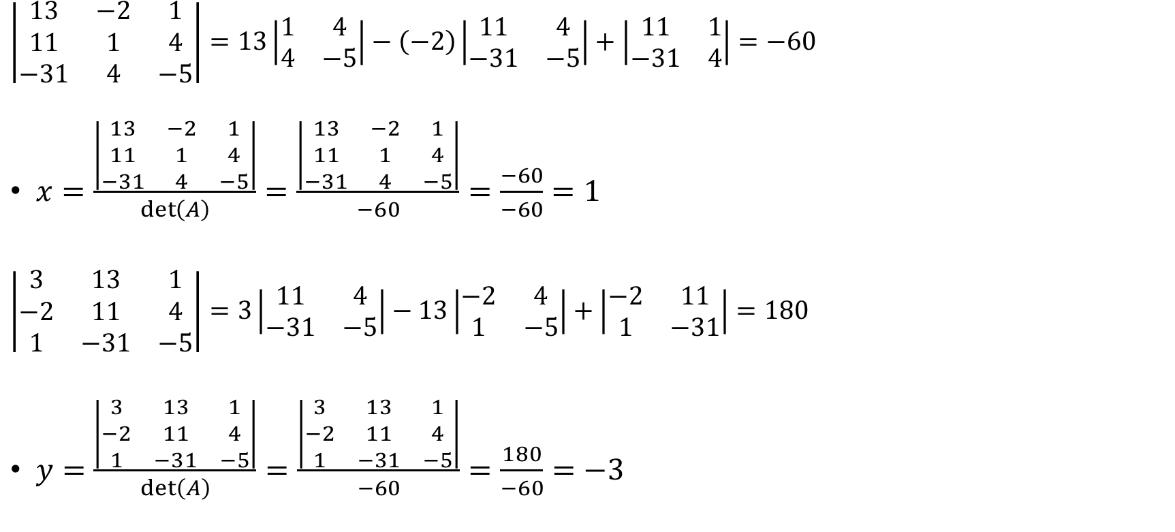
2. Cramer’s rule을 이용하여 다음 연립방정식의 해를 구하시오.
$\left|\begin{matrix}13 & −2 & 1 \\ 11 & 1 & 4 \\ −31 & 4 & −5\end{matrix}\right|=13\left|\begin{matrix}1 & 4 \\ 4 & −5\end{matrix}\right|−\left(−2\right)\left|\begin{matrix}11 & 4 \\ −31 & −5\end{matrix}\right|+\left|\begin{matrix}11 & 1 \\ −31 & 4\end{matrix}\right|=−60$
$x=\frac{\left|\begin{matrix}13 & −2 & 1 \\ 11 & 1 & 4 \\ −31 & 4 & −5\end{matrix}\right|}{\det\left(A\right)}=\frac{\left|\begin{matrix}13 & −2 & 1 \\ 11 & 1 & 4 \\ −31 & 4 & −5\end{matrix}\right|}{−60}=\frac{−60}{−60}=1$
$\left|\begin{matrix}3 & 13 & 1 \\ −2 & 11 & 4 \\ 1 & −31 & −5\end{matrix}\right|=3\left|\begin{matrix}11 & 4 \\ −31 & −5\end{matrix}\right|−13\left|\begin{matrix}−2 & 4 \\ 1 & −5\end{matrix}\right|+\left|\begin{matrix}−2 & 11 \\ 1 & −31\end{matrix}\right|=180$
$y=\frac{\left|\begin{matrix}3 & 13 & 1 \\ −2 & 11 & 4 \\ 1 & −31 & −5\end{matrix}\right|}{\det\left(A\right)}=\frac{\left|\begin{matrix}3 & 13 & 1 \\ −2 & 11 & 4 \\ 1 & −31 & −5\end{matrix}\right|}{−60}=\frac{180}{−60}=−3$

Slide 6

2. Cramer’s rule을 이용하여 다음 연립방정식의 해를 구하시오.
$\left|\begin{matrix}3 & −2 & 13 \\ −2 & 1 & 11 \\ 1 & 4 & −31\end{matrix}\right|=3\left|\begin{matrix}1 & 11 \\ 4 & −31\end{matrix}\right|−\left(−2\right)\left|\begin{matrix}−2 & 11 \\ 1 & −31\end{matrix}\right|+13\left|\begin{matrix}−2 & 1 \\ 1 & 4\end{matrix}\right|=−240$
$z=\frac{\left|\begin{matrix}3 & −2 & 13 \\ −2 & 1 & 11 \\ 1 & 4 & −31\end{matrix}\right|}{\det\left(A\right)}=\frac{\left|\begin{matrix}3 & −2 & 13 \\ −2 & 1 & 11 \\ 1 & 4 & −31\end{matrix}\right|}{−60}=\frac{−240}{−60}=4$
$$∴x=1, y=−3, z=4$$

Slide 7

3. 다음 행렬의 inverse matrix를 구하시오.
$A= \left[\begin{matrix}1 & 2 & 3 \\ 4 & 5 & 6 \\ 7 & 8 & 9\end{matrix}\right] ,\det\left(A\right)=1\left(45−48\right)−2\left(36−42\right)+3\left(32−35\right)=0$
$\det\left(A\right)=0 이$므로 Singular matrix이다. → 역행렬 존재하지 않음

Slide 8

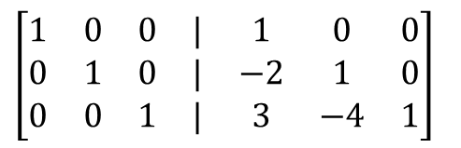


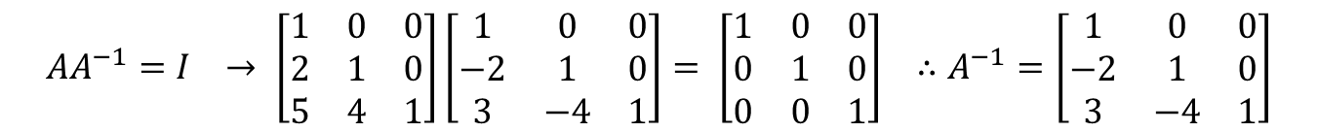
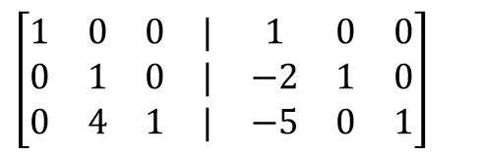
3. 다음 행렬의 inverse matrix를 구하시오.
$A= \left[\begin{matrix}1 & 0 & 0 \\ 2 & 1 & 0 \\ 5 & 4 & 1\end{matrix}\right],\det\left(A\right)=1 이$므로 invertible 이다.
$\left[A | I\right] = \left[\begin{matrix}1 & 0 & 0 & | & 1 & 0 & 0 \\ 2 & 1 & 0 & | & 0 & 1 & 0 \\ 5 & 4 & 1 & | & 0 & 0 & 1\end{matrix}\right]$ 을 $[I|A^{−1}]$로 변형하면 $A^{−1}$를 구할 수 있다.
$\left[\begin{matrix}1 & 0 & 0 & | & 1 & 0 & 0 \\ 2 & 1 & 0 & | & 0 & 1 & 0 \\ 5 & 4 & 1 & | & 0 & 0 & 1\end{matrix}\right]$
$$−2R_{1}+R_{2}→R_{2}$$
$$−5R_{1}+R_{3}→R_{3}$$
$$\left[\begin{matrix}1 & 0 & 0 & | & 1 & 0 & 0 \\ 0 & 1 & 0 & | & −2 & 1 & 0 \\ 0 & 4 & 1 & | & −5 & 0 & 1\end{matrix}\right]$$
$$−4R_{2}+R_{3}→R_{3}$$
$$\left[\begin{matrix}1 & 0 & 0 & | & 1 & 0 & 0 \\ 0 & 1 & 0 & | & −2 & 1 & 0 \\ 0 & 0 & 1 & | & 3 & −4 & 1\end{matrix}\right]$$
$$AA^{−1}=I → \left[\begin{matrix}1 & 0 & 0 \\ 2 & 1 & 0 \\ 5 & 4 & 1\end{matrix}\right]\left[\begin{matrix}1 & 0 & 0 \\ −2 & 1 & 0 \\ 3 & −4 & 1\end{matrix}\right]= \left[\begin{matrix}1 & 0 & 0 \\ 0 & 1 & 0 \\ 0 & 0 & 1\end{matrix}\right] ∴A^{−1}=\left[\begin{matrix}1 & 0 & 0 \\ −2 & 1 & 0 \\ 3 & −4 & 1\end{matrix}\right]$$

Slide 9
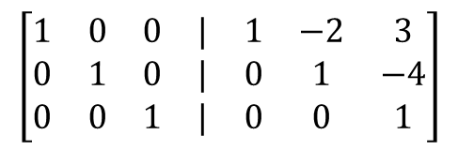
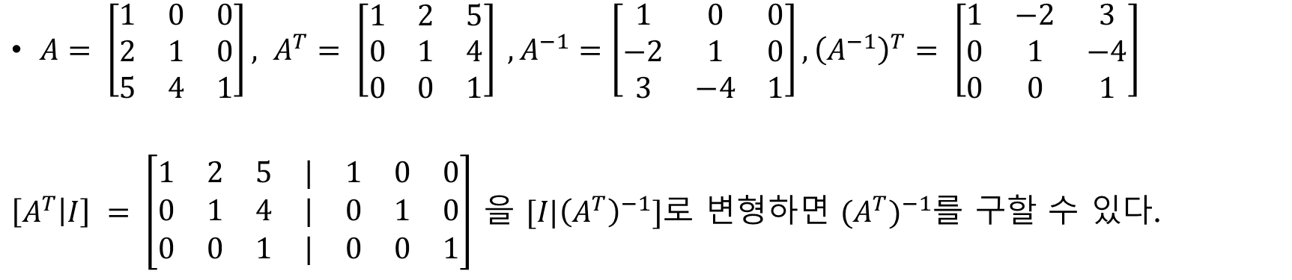
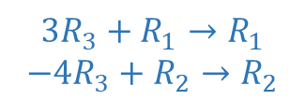
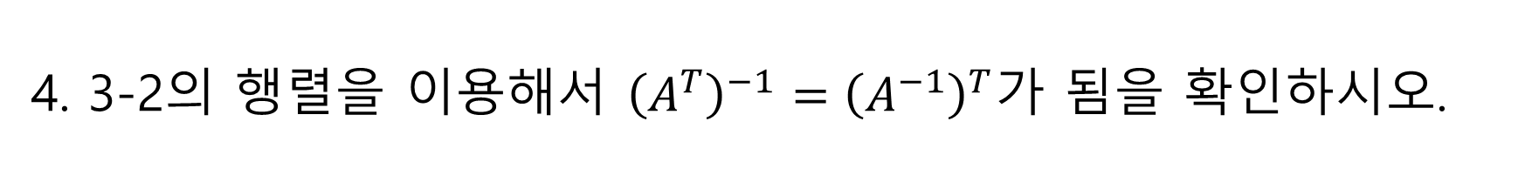
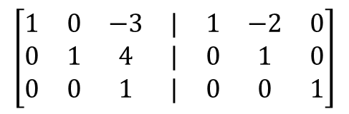

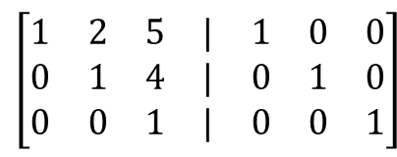

4. 3-2의 행렬을 이용해서 ${\left(A^{T}\right)}^{−1}={\left(A^{−1}\right)}^{T}$가 됨을 확인하시오.
$A= \left[\begin{matrix}1 & 0 & 0 \\ 2 & 1 & 0 \\ 5 & 4 & 1\end{matrix}\right], A^{T}= \left[\begin{matrix}1 & 2 & 5 \\ 0 & 1 & 4 \\ 0 & 0 & 1\end{matrix}\right] , A^{−1}=\left[\begin{matrix}1 & 0 & 0 \\ −2 & 1 & 0 \\ 3 & −4 & 1\end{matrix}\right], {\left(A^{−1}\right)}^{T}= \left[\begin{matrix}1 & −2 & 3 \\ 0 & 1 & −4 \\ 0 & 0 & 1\end{matrix}\right]$
$\left[A^{T} | I\right] = \left[\begin{matrix}1 & 2 & 5 & | & 1 & 0 & 0 \\ 0 & 1 & 4 & | & 0 & 1 & 0 \\ 0 & 0 & 1 & | & 0 & 0 & 1\end{matrix}\right]$ 을 $[I|{\left(A^{T}\right)}^{−1}]$로 변형하면 $({A^{T})}^{−1}$를 구할 수 있다.
$$3R_{3}+R_{1}→R_{1}$$
$$−4R_{3}+R_{2}→R_{2}$$
$$\left[\begin{matrix}1 & 0 & 0 & | & 1 & −2 & 3 \\ 0 & 1 & 0 & | & 0 & 1 & −4 \\ 0 & 0 & 1 & | & 0 & 0 & 1\end{matrix}\right]$$
$$\left[\begin{matrix}1 & 2 & 5 & | & 1 & 0 & 0 \\ 0 & 1 & 4 & | & 0 & 1 & 0 \\ 0 & 0 & 1 & | & 0 & 0 & 1\end{matrix}\right]$$
$$−2R_{2}+R_{1}→R_{1}$$
$$\left[\begin{matrix}1 & 0 & −3 & | & 1 & −2 & 0 \\ 0 & 1 & 4 & | & 0 & 1 & 0 \\ 0 & 0 & 1 & | & 0 & 0 & 1\end{matrix}\right]$$
$$∴{\left(A^{T}\right)}^{−1}=\left[\begin{matrix}1 & −2 & 3 \\ 0 & 1 & −4 \\ 0 & 0 & 1\end{matrix}\right]={\left(A^{−1}\right)}^{T}$$

Slide 10
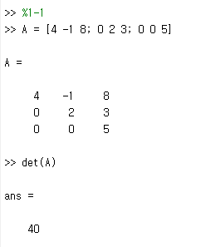
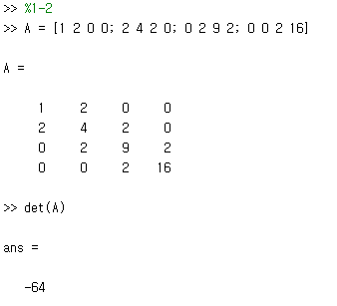
#5. MATLAB
#1-1
#1-2

Slide 11
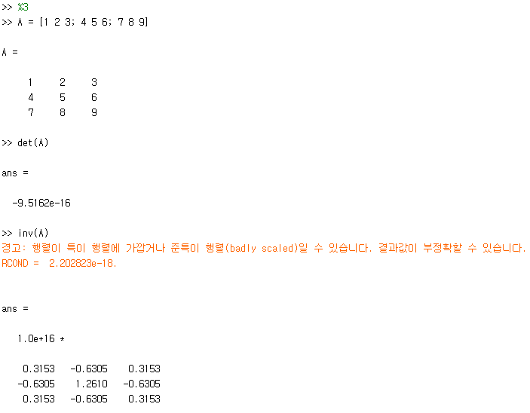
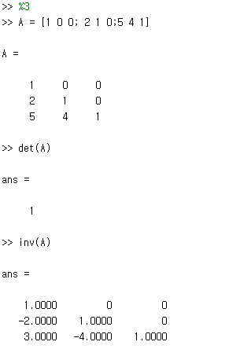
#5. MATLAB
#3-1
#3-2

Slide 12
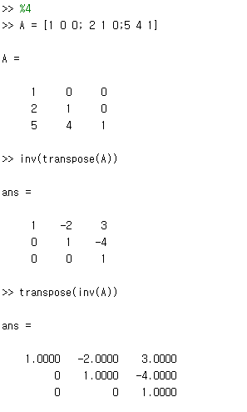
#5. MATLAB
#4

