Slide 1
공업수학
20181796 김민준

Slide 2

#1-1 다음 행렬의 eigenvalues와 eigenvectors를 구하시오.
$A= \left[\begin{matrix}a & b \\ −b & a\end{matrix}\right], Av=λv,v= \left[\begin{matrix}x_{1} \\ x_{2}\end{matrix}\right]$
$\det\left(A−λI_{2}\right)= \left|\begin{matrix}a−λ & b \\ −b & a−λ\end{matrix}\right|={\left(a−λ\right)}^{2}+b^{2}=0$
Eigenvalues : $λ=a+bi, a−bi$

Slide 3


#1-1 다음 행렬의 eigenvalues와 eigenvectors를 구하시오.
i) $λ_{1}=a+bi$
$A −λ_{1}I_{2}= \left[\begin{matrix}−bi & b \\ −b & −bi\end{matrix}\right]$
$\left(A−λI\right)v=0$ →$\left[\begin{matrix}−bi & b \\ −b & −bi\end{matrix}\right]\left[\begin{matrix}x_{1} \\ x_{2}\end{matrix}\right]=0$
$\left[\begin{matrix}−bi & b & | & 0 \\ −b & −bi & | & 0\end{matrix}\right]$ $\left[\begin{matrix}−bi & b & | & 0 \\ 0 & 0 & | & 0\end{matrix}\right]$
$−bix_{1}+bx_{2}=0$ → $x_{2}=ix_{1}$ $∴v=\left[\begin{matrix}x_{1} \\ x_{2}\end{matrix}\right]= \left[\begin{matrix}x_{1} \\ ix_{1}\end{matrix}\right]=x_{1}\left[\begin{matrix}1 \\ i\end{matrix}\right]$
$∴eigen vector v_{1}=\left[\begin{matrix}1 \\ i\end{matrix}\right]$
$$iR_{1}+R_{2}→R_{2}$$

Slide 4


#1-1 다음 행렬의 eigenvalues와 eigenvectors를 구하시오.
ii)$λ_{2}=a−bi$
$A −λ_{2}I_{2}= \left[\begin{matrix}bi & b \\ −b & bi\end{matrix}\right]$
$\left(A−λI_{2}\right)v=0$ → $\left[\begin{matrix}bi & b \\ −b & bi\end{matrix}\right]\left[\begin{matrix}x_{1} \\ x_{2}\end{matrix}\right]=0$
$\left[\begin{matrix}bi & b & | & 0 \\ −b & bi & | & 0\end{matrix}\right] \left[\begin{matrix}bi & b & | & 0 \\ 0 & 0 & | & 0\end{matrix}\right]$
$bix_{1}+bx_{2}=0$ → $x_{2}=−ix_{1}$ $∴v=\left[\begin{matrix}x_{1} \\ x_{2}\end{matrix}\right]= \left[\begin{matrix}x_{1} \\ −ix_{1}\end{matrix}\right]=x_{1}\left[\begin{matrix}1 \\ −i\end{matrix}\right]$
$∴eigen vector v_{2}=\left[\begin{matrix}1 \\ −i\end{matrix}\right]$
$$iR_{1}−R_{2}→R_{2}$$

Slide 5
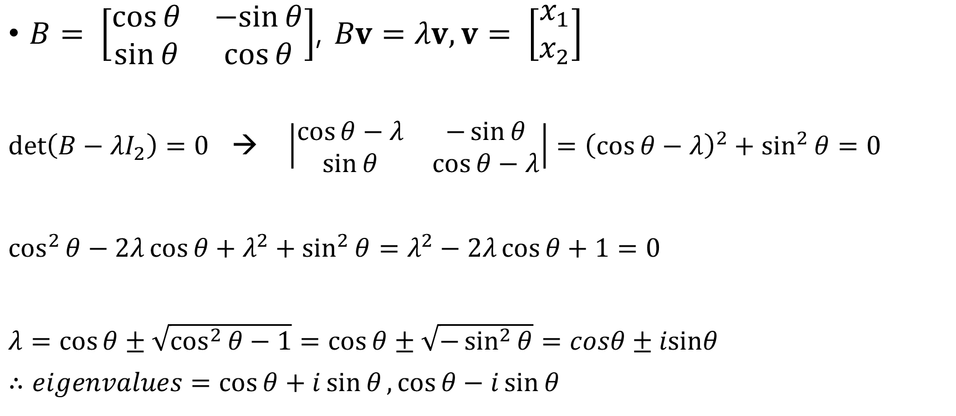
#1-2 다음 행렬의 eigenvalues와 eigenvectors를 구하시오.
$B= \left[\begin{matrix}\cos{θ} & −sin{θ} \\ \sin{θ} & \cos{θ}\end{matrix}\right]$, $Bv=λv,v= \left[\begin{matrix}x_{1} \\ x_{2}\end{matrix}\right]$
$\det\left(B−λI_{2}\right)=0$ → $\left|\begin{matrix}\cos{θ−λ} & −\sin{θ} \\ \sin{θ} & \cos{θ−λ}\end{matrix}\right|={\left(\cos{θ}−λ\right)}^{2}+\sin^{2}{θ}=0$
$\cos^{2}{θ}−2λ\cos{θ}+λ^{2}+\sin^{2}{θ}=λ^{2}−2λ\cos{θ}+1=0$
$λ=\cos{θ}±\sqrt{\cos^{2}{θ}−1}=\cos{θ}±\sqrt{−\sin^{2}{θ}}=cosθ±isinθ$
$∴eigenvalues=\cos{θ}+i\sin{θ},\cos{θ}−i\sin{θ}$

Slide 6


#1-2 다음 행렬의 eigenvalues와 eigenvectors를 구하시오.
i)$λ_{1}=\cos{θ}+i\sin{θ}$
$B−λ_{1}I_{2}= \left[\begin{matrix}−i\sin{θ} & −\sin{θ} \\ \sin{θ} & −i\sin{θ}\end{matrix}\right]$
$\left(B−λ_{1}I_{2}\right)v=0$ → $\left[\begin{matrix}−i\sin{θ} & −\sin{θ} \\ \sin{θ} & −i\sin{θ}\end{matrix}\right]\left[\begin{matrix}x_{1} \\ x_{2}\end{matrix}\right]= \left[\begin{matrix}0 \\ 0\end{matrix}\right]$
$\left[\begin{matrix}−i\sin{θ} & −\sin{θ} & | & 0 \\ \sin{θ} & −i\sin{θ} & | & 0\end{matrix}\right]$ $\left[\begin{matrix}−i\sin{θ} & −\sin{θ} & | & 0 \\ 0 & 0 & | & 0\end{matrix}\right]$
$−i\sin{θ}x_{1}−\sin{θ}x_{2}=0$ → $x_{2}=−ix_{1} ∴v= \left[\begin{matrix}x_{1} \\ −ix_{1}\end{matrix}\right]=x_{1}\left[\begin{matrix}1 \\ −i\end{matrix}\right]$
$∴eigenvector v_{1}=\left[\begin{matrix}1 \\ −i\end{matrix}\right]$
$$iR_{1}−R_{2}→R_{2}$$

Slide 7


#1-2 다음 행렬의 eigenvalues와 eigenvectors를 구하시오.
ii)$λ_{2}= \cos{θ}−i\sin{θ}$
$B−λ_{2}I_{2}= \left[\begin{matrix}i\sin{θ} & −\sin{θ} \\ \sin{θ} & i\sin{θ }\end{matrix}\right]$
$\left(B−λ_{2}I_{2}\right)v=0$ → $\left[\begin{matrix}i\sin{θ} & −\sin{θ} \\ \sin{θ} & i\sin{θ}\end{matrix}\right]\left[\begin{matrix}x_{1} \\ x_{2}\end{matrix}\right]= \left[\begin{matrix}0 \\ 0\end{matrix}\right]$
$\left[\begin{matrix}i\sin{θ} & −\sin{θ} & | & 0 \\ \sin{θ} & i\sin{θ} & | & 0\end{matrix}\right]$ $\left[\begin{matrix}i\sin{θ} & −\sin{θ} & | & 0 \\ 0 & 0 & | & 0\end{matrix}\right]$
$i\sin{θ}x_{1}−\sin{θ}x_{2}=0$ → $x_{2}=ix_{1} ∴v= \left[\begin{matrix}x_{1} \\ ix_{1}\end{matrix}\right]=x_{1}\left[\begin{matrix}1 \\ i\end{matrix}\right]$
$∴eigenvector v_{2}=\left[\begin{matrix}1 \\ i\end{matrix}\right]$
$$iR_{1}+R_{2}→R_{2}$$

Slide 8

#1-3 다음 행렬의 eigenvalues와 eigenvectors를 구하시오.
$C= \left[\begin{matrix}3 & 5 & 3 \\ 0 & 4 & 6 \\ 0 & 0 & 1\end{matrix}\right], Cv=λv, v= \left[\begin{matrix}x_{1} \\ x_{2} \\ x_{3}\end{matrix}\right]$
$C−λI_{3}=\left[\begin{matrix}3−λ & 5 & 3 \\ 0 & 4−λ & 6 \\ 0 & 0 & 1−λ\end{matrix}\right]$
$\det\left(C−λI_{3}\right)=\left(3−λ\right)\left(4−λ\right)\left(1−λ\right)=0$ (triangular matrix)
→ Eigenvalues = 1, 3, 4

Slide 9
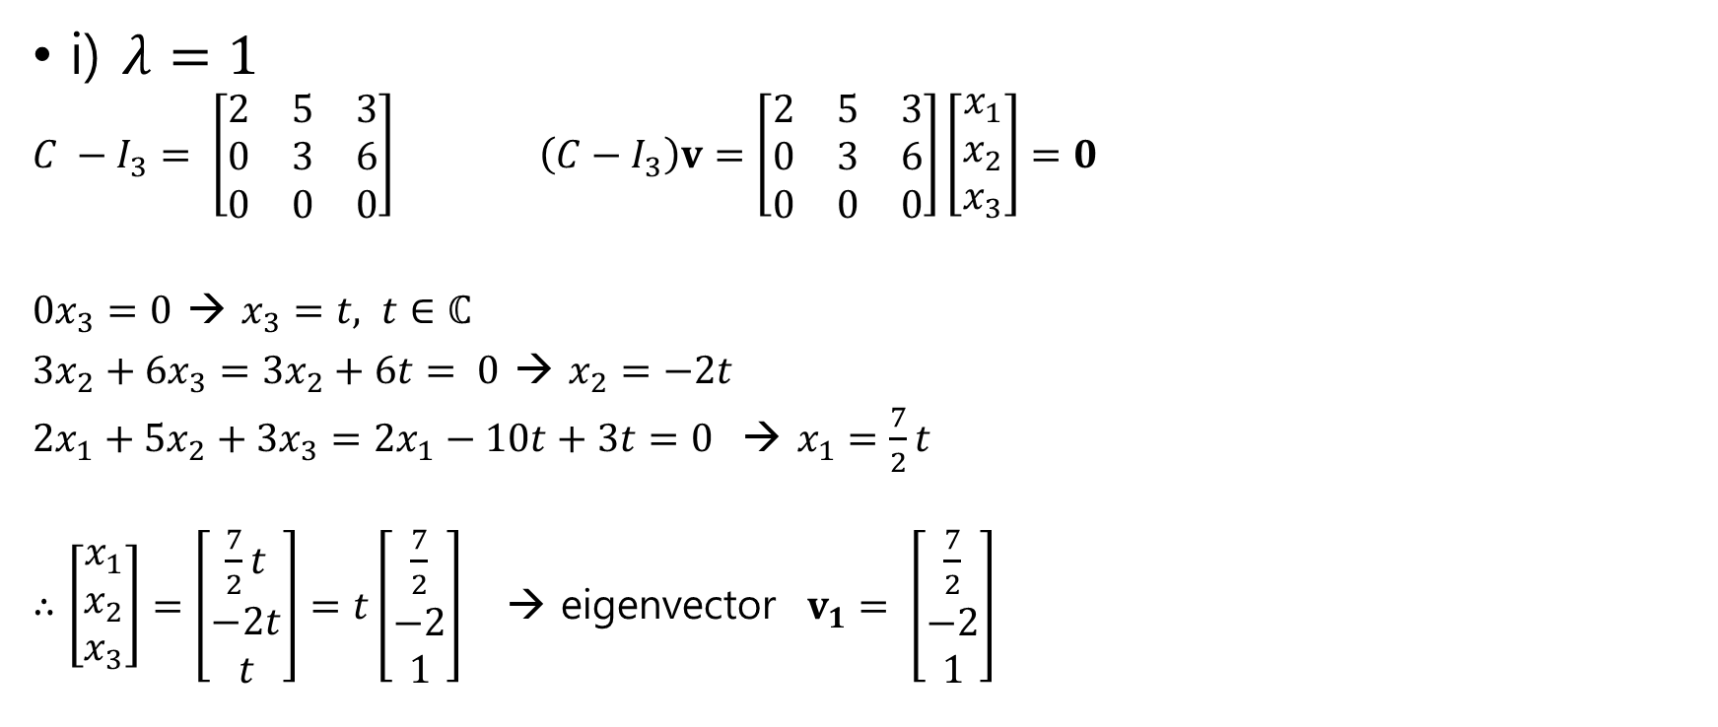
#1-3 다음 행렬의 eigenvalues와 eigenvectors를 구하시오.
i) $λ=1$
$C −I_{3}= \left[\begin{matrix}2 & 5 & 3 \\ 0 & 3 & 6 \\ 0 & 0 & 0\end{matrix}\right]$ $\left(C−I_{3}\right)v=\left[\begin{matrix}2 & 5 & 3 \\ 0 & 3 & 6 \\ 0 & 0 & 0\end{matrix}\right]\left[\begin{matrix}x_{1} \\ x_{2} \\ x_{3}\end{matrix}\right]=0$
$0x_{3}=0$ → $x_{3}=t, t∈ℂ$
$3x_{2}+6x_{3}=3x_{2}+6t= 0$ → $x_{2}=−2t$
$2x_{1}+5x_{2}+3x_{3}=2x_{1}−10t+3t=0$ → $x_{1}=\frac{7}{2}t$
$∴\left[\begin{matrix}x_{1} \\ x_{2} \\ x_{3}\end{matrix}\right]=\left[\begin{matrix}\frac{7}{2}t \\ −2t \\ t\end{matrix}\right]=t\left[\begin{matrix}\frac{7}{2} \\ −2 \\ 1\end{matrix}\right]$ → eigenvector $v_{1}= \left[\begin{matrix}\frac{7}{2} \\ −2 \\ 1\end{matrix}\right]$

Slide 10

#1-3 다음 행렬의 eigenvalues와 eigenvectors를 구하시오.
i) $λ=$ 3
$C −{3I}_{3}= \left[\begin{matrix}0 & 5 & 3 \\ 0 & 1 & 6 \\ 0 & 0 & −2\end{matrix}\right]$ $\left(C−3I_{3}\right)v=\left[\begin{matrix}0 & 5 & 3 \\ 0 & 1 & 6 \\ 0 & 0 & −2\end{matrix}\right]\left[\begin{matrix}x_{1} \\ x_{2} \\ x_{3}\end{matrix}\right]=0$
$−2x_{3}=0$→ $x_{3}=0$
$x_{2}+6x_{3}=x_{2}+0=0$ → $x_{2}= 0$
$x_{1}=t, t∈ℂ$
$∴\left[\begin{matrix}x_{1} \\ x_{2} \\ x_{3}\end{matrix}\right]=\left[\begin{matrix}t \\ 0 \\ 0\end{matrix}\right]=t\left[\begin{matrix}1 \\ 0 \\ 0\end{matrix}\right]$ → eigenvector $v_{2}= \left[\begin{matrix}1 \\ 0 \\ 0\end{matrix}\right]$

Slide 11

#1-3 다음 행렬의 eigenvalues와 eigenvectors를 구하시오.
i) $λ=$4
$C −4I_{3}= \left[\begin{matrix}−1 & 5 & 3 \\ 0 & 0 & 6 \\ 0 & 0 & −3\end{matrix}\right]$ $\left(C−4I_{3}\right)v=\left[\begin{matrix}−1 & 5 & 3 \\ 0 & 0 & 6 \\ 0 & 0 & −3\end{matrix}\right]\left[\begin{matrix}x_{1} \\ x_{2} \\ x_{3}\end{matrix}\right]=0$
$−3x_{3}=0$ → $x_{3}=0$
$−x_{1}+5x_{2}+3x_{3}=−x_{1}+5x_{2}=0$ → $x_{1}=5x_{2}$
$∴\left[\begin{matrix}x_{1} \\ x_{2} \\ x_{3}\end{matrix}\right]=\left[\begin{matrix}5x_{2} \\ x_{2} \\ 0\end{matrix}\right]=x_{2}\left[\begin{matrix}5 \\ 1 \\ 0\end{matrix}\right]$ → eigenvector $v_{3}= \left[\begin{matrix}5 \\ 1 \\ 0\end{matrix}\right]$

Slide 12
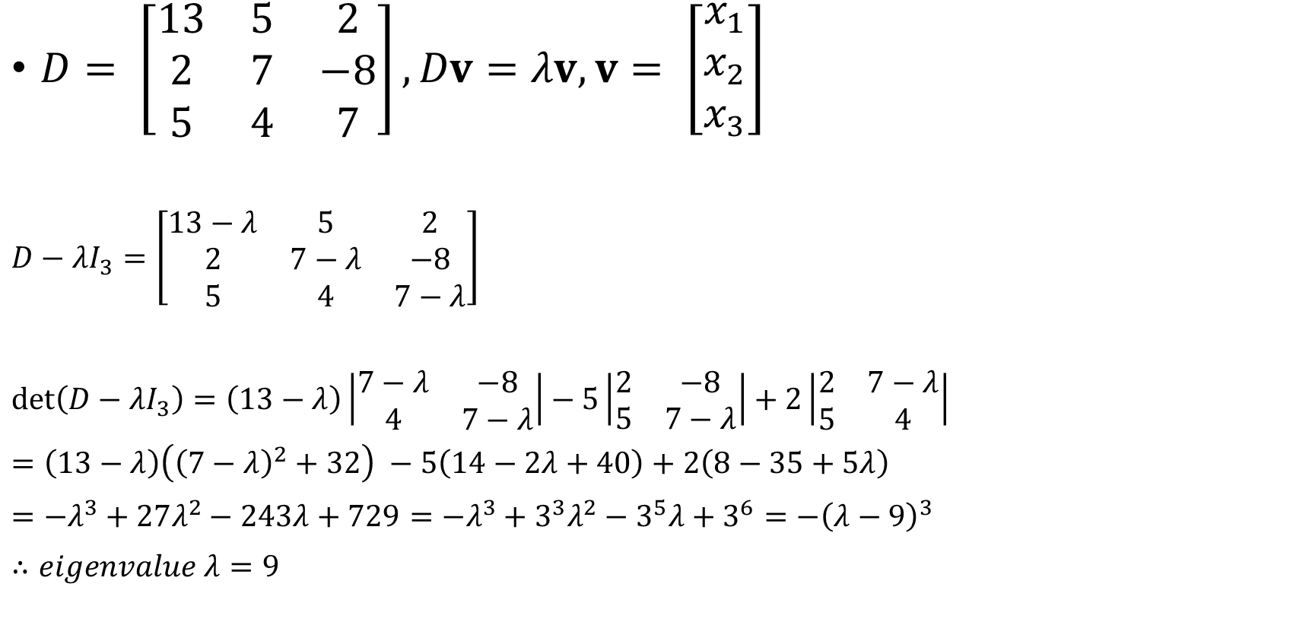
#1-4 다음 행렬의 eigenvalues와 eigenvectors를 구하시오.
$D= \left[\begin{matrix}13 & 5 & 2 \\ 2 & 7 & −8 \\ 5 & 4 & 7\end{matrix}\right], Dv=λv, v= \left[\begin{matrix}x_{1} \\ x_{2} \\ x_{3}\end{matrix}\right]$
$D−λI_{3}=\left[\begin{matrix}13−λ & 5 & 2 \\ 2 & 7−λ & −8 \\ 5 & 4 & 7−λ\end{matrix}\right]$
$\det\left(D−λI_{3}\right)=\left(13−λ\right)\left|\begin{matrix}7−λ & −8 \\ 4 & 7−λ\end{matrix}\right|−5\left|\begin{matrix}2 & −8 \\ 5 & 7−λ\end{matrix}\right|+2\left|\begin{matrix}2 & 7−λ \\ 5 & 4\end{matrix}\right|$
$=\left(13−λ\right)\left({\left(7−λ\right)}^{2}+32\right) −5\left(14−2λ+40\right)+2\left(8−35+5λ\right)$
$=−λ^{3}+27λ^{2}−243λ+729=−λ^{3}+3^{3}λ^{2}−3^{5}λ+3^{6}=−{\left(λ−9\right)}^{3}$
$∴eigenvalue λ=9$

Slide 13


#1-4 다음 행렬의 eigenvalues와 eigenvectors를 구하시오.
$λ=9$
$D−9I_{3}= \left[\begin{matrix}4 & 5 & 2 \\ 2 & −2 & −8 \\ 5 & 4 & −2\end{matrix}\right]$
$\left(D−9I_{3}\right)v=0$ → $\left[\begin{matrix}4 & 5 & 2 & | & 0 \\ 2 & −2 & −8 & | & 0 \\ 5 & 4 & −2 & | & 0\end{matrix}\right]$ $\left[\begin{matrix}4 & 5 & 2 & | & 0 \\ 0 & −\frac{9}{2} & −9 & | & 0 \\ 0 & −\frac{9}{4} & −\frac{9}{2} & | & 0\end{matrix}\right] \left[\begin{matrix}4 & 5 & 2 & | & 0 \\ 0 & 1 & 2 & | & 0 \\ 0 & 0 & 0 & | & 0\end{matrix}\right]$
$x_{3}=t, t∈ℂ$
$x_{2}+2x_{3}=0$ → $x_{2}=−2t$
$4x_{1}+5x_{2}+2x_{3}=0$ → $4x_{1}−10t+2t=4\left(x_{1}−2t\right)=0$ → $x_{1}=2t$
$∴v= \left[\begin{matrix}x_{1} \\ x_{2} \\ x_{3}\end{matrix}\right]= \left[\begin{matrix}2t \\ −2t \\ t\end{matrix}\right]=t\left[\begin{matrix}2 \\ −2 \\ 1\end{matrix}\right]$ $∴eigenvector v=\left[\begin{matrix}2 \\ −2 \\ 1\end{matrix}\right]$
$$−\frac{1}{2}R_{1}+R_{2}→R_{2}$$
$$−\frac{5}{4}R_{1}+R_{3}→R_{3}$$

Slide 14
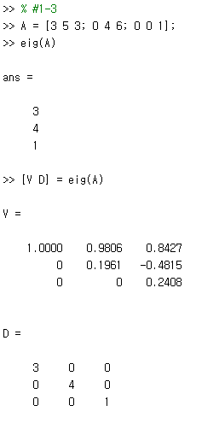
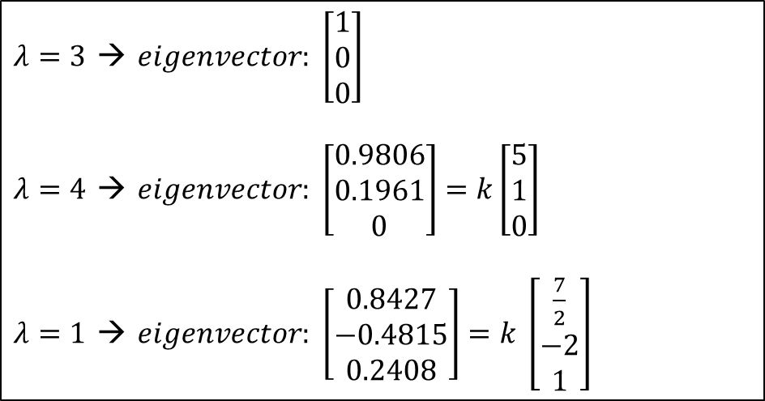
MATLAB
$λ=3$ → $eigenvector: \left[\begin{matrix}1 \\ 0 \\ 0\end{matrix}\right]$
$λ=4$ → $eigenvector: \left[\begin{matrix}0.9806 \\ 0.1961 \\ 0\end{matrix}\right]=k\left[\begin{matrix}5 \\ 1 \\ 0\end{matrix}\right]$
$λ=1$ → $eigenvector: \left[\begin{matrix}0.8427 \\ −0.4815 \\ 0.2408\end{matrix}\right]=k$ $\left[\begin{matrix}\frac{7}{2} \\ −2 \\ 1\end{matrix}\right]$
Eigenvalues : 3, 4, 1

Slide 15
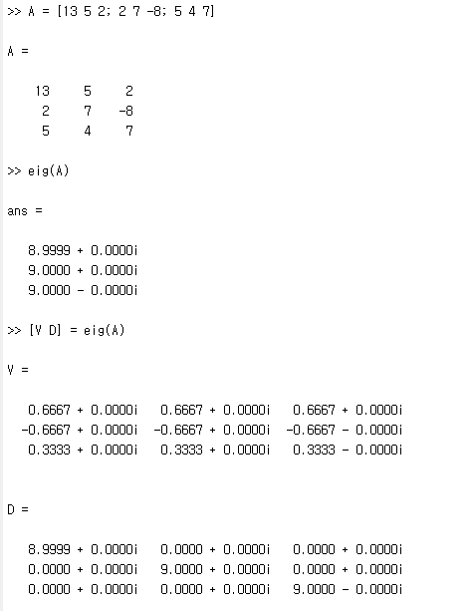
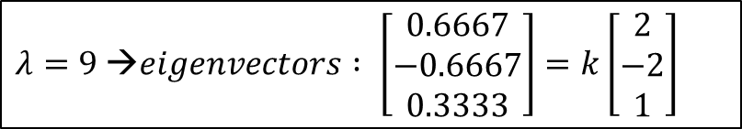
MATLAB
$λ=9$→$eigenvectors : \left[\begin{matrix}0.6667 \\ −0.6667 \\ 0.3333\end{matrix}\right]=k\left[\begin{matrix}2 \\ −2 \\ 1\end{matrix}\right]$
Eigenvalues : 9, 9, 9 (3중근)

