Slide 1
공업수학
20181796 김민준

Slide 2


1. Eigenbasis를 구하고, 대각화를 통하여 각 행렬의 10제곱을 구하시오.
$$A= \left[\begin{matrix}4 & 3 & 3 \\ 3 & 6 & 1 \\ 3 & 1 & 6\end{matrix}\right]$$
1. Eigenvalue 구하기
$A−λI= \left[\begin{matrix}4−λ & 3 & 3 \\ 3 & 6−λ & 1 \\ 3 & 1 & 6−λ\end{matrix}\right]$
$\det\left(A−λI\right)=\left(4−λ\right)\left({\left(6−λ\right)}^{2}−1\right)−3\left(3\left(6−λ\right)−3\right)+3\left(3−3\left(6−λ\right)\right)=−λ^{3}+16λ^{2}−65λ+50$
$=−\left(λ−10\right)\left(λ−5\right)\left(λ−1\right)=0$
→ $λ=1, 5, 10$

Slide 3

1. Eigenbasis를 구하고, 대각화를 통하여 각 행렬의 10제곱을 구하시오.
$$A= \left[\begin{matrix}4 & 3 & 3 \\ 3 & 6 & 1 \\ 3 & 1 & 6\end{matrix}\right]$$
2. Eigenvector 구하기
$λ=1$
$A−I=\left[\begin{matrix}3 & 3 & 3 \\ 3 & 5 & 1 \\ 3 & 1 & 5\end{matrix}\right], \left[A−I | 0\right]=\left[\begin{matrix}3 & 3 & 3 & | & 0 \\ 3 & 5 & 1 & | & 0 \\ 3 & 1 & 5 & | & 0\end{matrix}\right]$
$REF :\left[\begin{matrix}1 & 1 & 1 & | & 0 \\ 0 & 1 & −1 & | & 0 \\ 0 & 0 & 0 & | & 0\end{matrix}\right]$ → eigenvector $v_{1}$= $\left[\begin{matrix}−2 \\ 1 \\ 1\end{matrix}\right]$

Slide 4

1. Eigenbasis를 구하고, 대각화를 통하여 각 행렬의 10제곱을 구하시오.
$$A= \left[\begin{matrix}4 & 3 & 3 \\ 3 & 6 & 1 \\ 3 & 1 & 6\end{matrix}\right]$$
ii) $λ=5$
$A−5I=\left[\begin{matrix}−1 & 3 & 3 \\ 3 & 1 & 1 \\ 3 & 1 & 1\end{matrix}\right], \left[A−5I | 0\right]=\left[\begin{matrix}−1 & 3 & 3 & | & 0 \\ 3 & 1 & 1 & | & 0 \\ 3 & 1 & 1 & | & 0\end{matrix}\right]$
$REF :\left[\begin{matrix}−1 & 3 & 3 & | & 0 \\ 0 & 1 & 1 & | & 0 \\ 0 & 0 & 0 & | & 0\end{matrix}\right]$ → eigenvector $v_{2}$= $\left[\begin{matrix}0 \\ −1 \\ 1\end{matrix}\right]$

Slide 5

1. Eigenbasis를 구하고, 대각화를 통하여 각 행렬의 10제곱을 구하시오.
$$A= \left[\begin{matrix}4 & 3 & 3 \\ 3 & 6 & 1 \\ 3 & 1 & 6\end{matrix}\right]$$
iii) $λ=10$
$A−10I=\left[\begin{matrix}−6 & 3 & 3 \\ 3 & −4 & 1 \\ 3 & 1 & −4\end{matrix}\right], \left[A−10I | 0\right]=\left[\begin{matrix}−6 & 3 & 3 & | & 0 \\ 3 & −4 & 1 & | & 0 \\ 3 & 1 & −4 & | & 0\end{matrix}\right]$
$REF :\left[\begin{matrix}2 & −1 & −1 & | & 0 \\ 0 & 1 & −1 & | & 0 \\ 0 & 0 & 0 & | & 0\end{matrix}\right]$ → eigenvector $v_{3}$= $\left[\begin{matrix}1 \\ 1 \\ 1\end{matrix}\right]$
Eigenvectors $v_{1},v_{2},v_{3}=\left[\begin{matrix}−2 \\ 1 \\ 1\end{matrix}\right], \left[\begin{matrix}0 \\ −1 \\ 1\end{matrix}\right], \left[\begin{matrix}1 \\ 1 \\ 1\end{matrix}\right]$
(eigenvalues가 모두 다르므로 독립이 보장됨)
→ eigen basis = $\left\{\left[\begin{matrix}−2 \\ 1 \\ 1\end{matrix}\right], \left[\begin{matrix}0 \\ −1 \\ 1\end{matrix}\right], \left[\begin{matrix}1 \\ 1 \\ 1\end{matrix}\right]\right\}$

Slide 6

1. Eigenbasis를 구하고, 대각화를 통하여 각 행렬의 10제곱을 구하시오.
$$A= \left[\begin{matrix}4 & 3 & 3 \\ 3 & 6 & 1 \\ 3 & 1 & 6\end{matrix}\right]$$
3. 대각화
$\hat{A}=P^{−1}AP$
$P= \left[\begin{matrix}−2 & 0 & 1 \\ 1 & −1 & 1 \\ 1 & 1 & 1\end{matrix}\right]$
$\left[P|I\right]=\left[\begin{matrix}−2 & 0 & 1 & | & \begin{matrix}1 & 0 & 0\end{matrix} \\ 1 & −1 & 1 & | & \begin{matrix}0 & 1 & 0\end{matrix} \\ 1 & 1 & 1 & | & \begin{matrix}0 & 0 & 1\end{matrix}\end{matrix}\right]→\left[\begin{matrix}1 & 0 & 0 & | & −\frac{1}{3} & \frac{1}{6} & \frac{1}{6} \\ 0 & 1 & 0 & | & 0 & −\frac{1}{2} & \frac{1}{2} \\ 0 & 0 & 1 & | & \frac{1}{3} & \frac{1}{3} & \frac{1}{3}\end{matrix}\right]=\text{[}\text{I}\text{|}P^{−1}]$
$P^{−1} = \left[\begin{matrix}−\frac{1}{3} & \frac{1}{6} & \frac{1}{6} \\ 0 & −\frac{1}{2} & \frac{1}{2} \\ \frac{1}{3} & \frac{1}{3} & \frac{1}{3}\end{matrix}\right]$ ,$\hat{A}= \left[\begin{matrix}1 & 0 & 0 \\ 0 & 5 & 0 \\ 0 & 0 & 10\end{matrix}\right]$ → $\left[\begin{matrix}1 & 0 & 0 \\ 0 & 5 & 0 \\ 0 & 0 & 10\end{matrix}\right]=\left[\begin{matrix}−\frac{1}{3} & \frac{1}{6} & \frac{1}{6} \\ 0 & −\frac{1}{2} & \frac{1}{2} \\ \frac{1}{3} & \frac{1}{3} & \frac{1}{3}\end{matrix}\right]\left[\begin{matrix}4 & 3 & 3 \\ 3 & 6 & 1 \\ 3 & 1 & 6\end{matrix}\right]\left[\begin{matrix}−2 & 0 & 1 \\ 1 & −1 & 1 \\ 1 & 1 & 1\end{matrix}\right]$

Slide 7
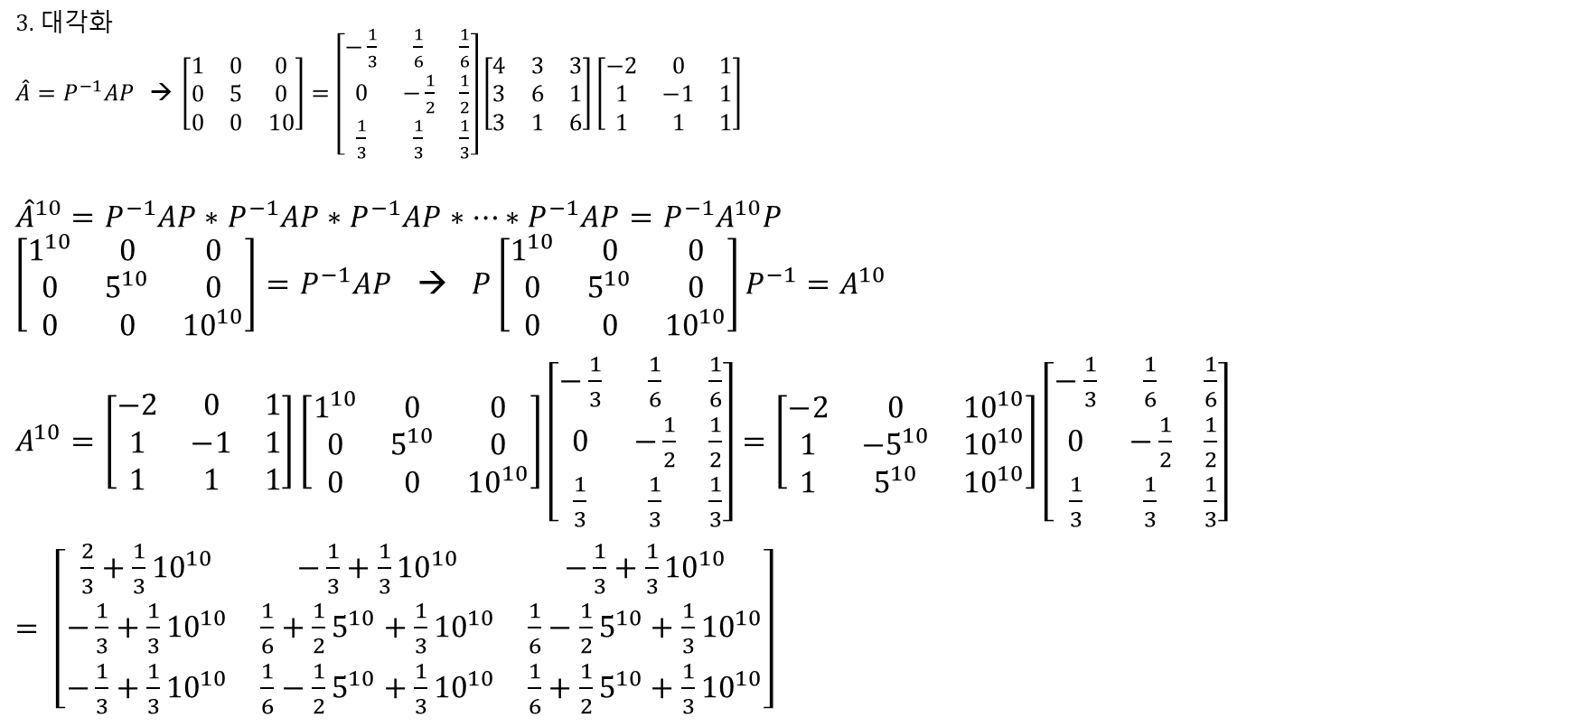
1. Eigenbasis를 구하고, 대각화를 통하여 각 행렬의 10제곱을 구하시오.
$$A= \left[\begin{matrix}4 & 3 & 3 \\ 3 & 6 & 1 \\ 3 & 1 & 6\end{matrix}\right]$$
3. 대각화
$\hat{A}=P^{−1}AP$ → $\left[\begin{matrix}1 & 0 & 0 \\ 0 & 5 & 0 \\ 0 & 0 & 10\end{matrix}\right]=\left[\begin{matrix}−\frac{1}{3} & \frac{1}{6} & \frac{1}{6} \\ 0 & −\frac{1}{2} & \frac{1}{2} \\ \frac{1}{3} & \frac{1}{3} & \frac{1}{3}\end{matrix}\right]\left[\begin{matrix}4 & 3 & 3 \\ 3 & 6 & 1 \\ 3 & 1 & 6\end{matrix}\right]\left[\begin{matrix}−2 & 0 & 1 \\ 1 & −1 & 1 \\ 1 & 1 & 1\end{matrix}\right]$
${\hat{A}}^{10}=P^{−1}AP∗P^{−1}AP∗P^{−1}AP∗⋯∗P^{−1}AP=P^{−1}A^{10}P$
$\left[\begin{matrix}1^{10} & 0 & 0 \\ 0 & 5^{10} & 0 \\ 0 & 0 & {10}^{10}\end{matrix}\right]=P^{−1}AP$ → $P\left[\begin{matrix}1^{10} & 0 & 0 \\ 0 & 5^{10} & 0 \\ 0 & 0 & {10}^{10}\end{matrix}\right]P^{−1}=A^{10}$
$A^{10}=\left[\begin{matrix}−2 & 0 & 1 \\ 1 & −1 & 1 \\ 1 & 1 & 1\end{matrix}\right]\left[\begin{matrix}1^{10} & 0 & 0 \\ 0 & 5^{10} & 0 \\ 0 & 0 & {10}^{10}\end{matrix}\right]\left[\begin{matrix}−\frac{1}{3} & \frac{1}{6} & \frac{1}{6} \\ 0 & −\frac{1}{2} & \frac{1}{2} \\ \frac{1}{3} & \frac{1}{3} & \frac{1}{3}\end{matrix}\right]=\left[\begin{matrix}−2 & 0 & {10}^{10} \\ 1 & {−5}^{10} & {10}^{10} \\ 1 & 5^{10} & {10}^{10}\end{matrix}\right]\left[\begin{matrix}−\frac{1}{3} & \frac{1}{6} & \frac{1}{6} \\ 0 & −\frac{1}{2} & \frac{1}{2} \\ \frac{1}{3} & \frac{1}{3} & \frac{1}{3}\end{matrix}\right]$
$= \left[\begin{matrix}\frac{2}{3}+\frac{1}{3}{10}^{10} & −\frac{1}{3}+\frac{1}{3}{10}^{10} & −\frac{1}{3}+\frac{1}{3}{10}^{10} \\ −\frac{1}{3}+\frac{1}{3}{10}^{10} & \frac{1}{6}+\frac{1}{2}5^{10}+\frac{1}{3}{10}^{10} & \frac{1}{6}−\frac{1}{2}5^{10}+\frac{1}{3}{10}^{10} \\ −\frac{1}{3}+\frac{1}{3}{10}^{10} & \frac{1}{6}−\frac{1}{2}5^{10}+\frac{1}{3}{10}^{10} & \frac{1}{6}+\frac{1}{2}5^{10}+\frac{1}{3}{10}^{10}\end{matrix}\right]$

Slide 8


1. Eigenbasis를 구하고, 대각화를 통하여 각 행렬의 10제곱을 구하시오.
$$B= \left[\begin{matrix}1 & 1 & 0 \\ 1 & 1 & 0 \\ 0 & 0 & −4\end{matrix}\right]$$
1. Eigenvalue 구하기
$B−λI= \left[\begin{matrix}1−λ & 1 & 0 \\ 1 & 1−λ & 0 \\ 0 & 0 & −4−λ\end{matrix}\right]$
$\det\left(B−λI\right)=\left(−4−λ\right)\left({\left(1−λ\right)}^{2}−1\right)=−\left(λ+4\right)λ\left(λ−2\right)=0$→ $λ=−4, 0, 2$

Slide 9

1. Eigenbasis를 구하고, 대각화를 통하여 각 행렬의 10제곱을 구하시오.
$$B= \left[\begin{matrix}1 & 1 & 0 \\ 1 & 1 & 0 \\ 0 & 0 & −4\end{matrix}\right]$$
2. Eigenvector 구하기
$λ=−4$
$B−\left(−4I\right)=\left[\begin{matrix}5 & 1 & 0 \\ 1 & 5 & 0 \\ 0 & 0 & 0\end{matrix}\right], \left[B−(−4I) | 0\right]=\left[\begin{matrix}5 & 1 & 0 & | & 0 \\ 1 & 5 & 0 & | & 0 \\ 0 & 0 & 0 & | & 0\end{matrix}\right]$
$REF :\left[\begin{matrix}5 & 1 & 0 & | & 0 \\ 0 & 1 & 0 & | & 0 \\ 0 & 0 & 0 & | & 0\end{matrix}\right]$ → eigenvector $v_{1}$= $\left[\begin{matrix}0 \\ 0 \\ 1\end{matrix}\right]$

Slide 10

1. Eigenbasis를 구하고, 대각화를 통하여 각 행렬의 10제곱을 구하시오.
$$B= \left[\begin{matrix}1 & 1 & 0 \\ 1 & 1 & 0 \\ 0 & 0 & −4\end{matrix}\right]$$
ii) $λ=$ 0
$B−0I=\left[\begin{matrix}1 & 1 & 0 \\ 1 & 1 & 0 \\ 0 & 0 & −4\end{matrix}\right], \left[B−0I | 0\right]=\left[\begin{matrix}1 & 1 & 0 & | & 0 \\ 1 & 1 & 0 & | & 0 \\ 0 & 0 & −4 & | & 0\end{matrix}\right]$
$REF :\left[\begin{matrix}1 & 1 & 0 & | & 0 \\ 0 & 0 & 0 & | & 0 \\ 0 & 0 & −4 & | & 0\end{matrix}\right]$ → eigenvector $v_{2}$= $\left[\begin{matrix}−1 \\ 1 \\ 0\end{matrix}\right]$

Slide 11

1. Eigenbasis를 구하고, 대각화를 통하여 각 행렬의 10제곱을 구하시오.
$$B= \left[\begin{matrix}1 & 1 & 0 \\ 1 & 1 & 0 \\ 0 & 0 & −4\end{matrix}\right]$$
iii) $λ=2$
$B−2I=\left[\begin{matrix}−1 & 1 & 0 \\ 1 & −1 & 0 \\ 0 & 0 & −6\end{matrix}\right], \left[B−2I | 0\right]=\left[\begin{matrix}−1 & 1 & 0 & | & 0 \\ 1 & −1 & 0 & | & 0 \\ 0 & 0 & −6 & | & 0\end{matrix}\right]$
$REF :\left[\begin{matrix}−1 & 1 & 0 & | & 0 \\ 0 & 0 & 0 & | & 0 \\ 0 & 0 & −6 & | & 0\end{matrix}\right]$ → eigenvector $v_{3}$= $\left[\begin{matrix}1 \\ 1 \\ 0\end{matrix}\right]$
Eigenvectors $v_{1},v_{2},v_{3}=\left[\begin{matrix}0 \\ 0 \\ 1\end{matrix}\right], \left[\begin{matrix}−1 \\ 1 \\ 0\end{matrix}\right], \left[\begin{matrix}1 \\ 1 \\ 0\end{matrix}\right]$
(eigenvalues가 모두 다르므로 독립이 보장됨)
→ eigen basis = $\left\{\left[\begin{matrix}0 \\ 0 \\ 1\end{matrix}\right], \left[\begin{matrix}−1 \\ 1 \\ 0\end{matrix}\right], \left[\begin{matrix}1 \\ 1 \\ 0\end{matrix}\right]\right\}$

Slide 12

1. Eigenbasis를 구하고, 대각화를 통하여 각 행렬의 10제곱을 구하시오.
$$B= \left[\begin{matrix}1 & 1 & 0 \\ 1 & 1 & 0 \\ 0 & 0 & −4\end{matrix}\right]$$
3. 대각화
$\hat{B}=P^{−1}BP$
$P= \left[\begin{matrix}0 & −1 & 1 \\ 0 & 1 & 1 \\ 1 & 0 & 0\end{matrix}\right]$
$\left[P|I\right]=\left[\begin{matrix}0 & −1 & 1 & | & \begin{matrix}1 & 0 & 0\end{matrix} \\ 0 & 1 & 1 & | & \begin{matrix}0 & 1 & 0\end{matrix} \\ 1 & 0 & 0 & | & \begin{matrix}0 & 0 & 1\end{matrix}\end{matrix}\right]→\left[\begin{matrix}1 & 0 & 0 & | & 0 & 0 & 1 \\ 0 & 1 & 0 & | & −\frac{1}{2} & \frac{1}{2} & 0 \\ 0 & 0 & 1 & | & \frac{1}{2} & \frac{1}{2} & 0\end{matrix}\right]=\text{[}\text{I}\text{|}P^{−1}]$
$P^{−1} = \left[\begin{matrix}0 & 0 & 1 \\ −\frac{1}{2} & \frac{1}{2} & 0 \\ \frac{1}{2} & \frac{1}{2} & 0\end{matrix}\right]$ ,$\hat{B}= \left[\begin{matrix}−4 & 0 & 0 \\ 0 & 0 & 0 \\ 0 & 0 & 2\end{matrix}\right]$ → $\left[\begin{matrix}−4 & 0 & 0 \\ 0 & 0 & 0 \\ 0 & 0 & 2\end{matrix}\right]=\left[\begin{matrix}0 & 0 & 1 \\ −\frac{1}{2} & \frac{1}{2} & 0 \\ \frac{1}{2} & \frac{1}{2} & 0\end{matrix}\right]\left[\begin{matrix}1 & 1 & 0 \\ 1 & 1 & 0 \\ 0 & 0 & −4\end{matrix}\right]\left[\begin{matrix}0 & −1 & 1 \\ 0 & 1 & 1 \\ 1 & 0 & 0\end{matrix}\right]$

Slide 13
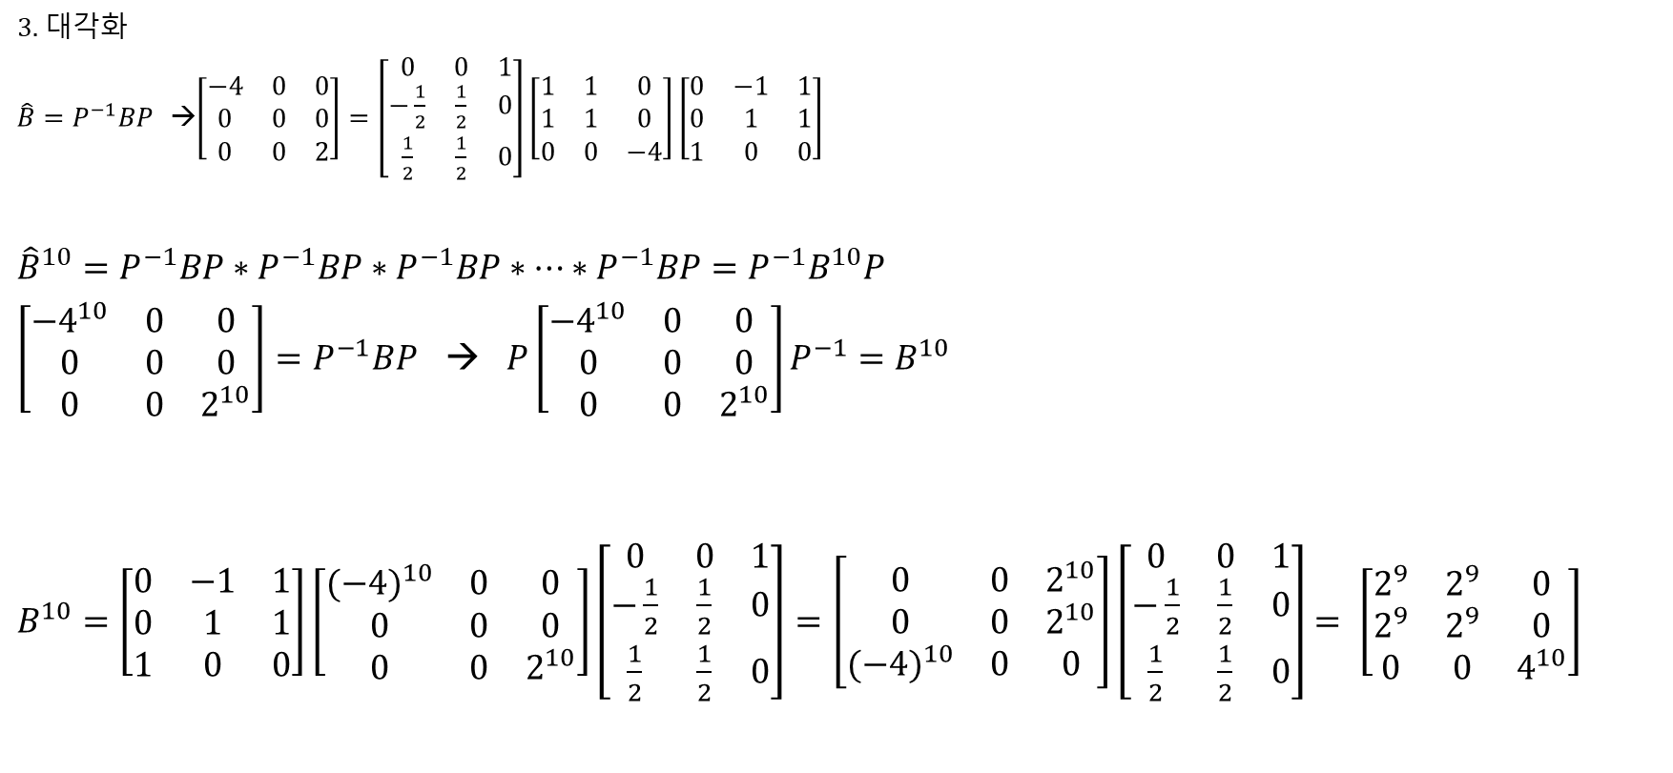
1. Eigenbasis를 구하고, 대각화를 통하여 각 행렬의 10제곱을 구하시오.
$$B= \left[\begin{matrix}1 & 1 & 0 \\ 1 & 1 & 0 \\ 0 & 0 & −4\end{matrix}\right]$$
3. 대각화
$\hat{B}=P^{−1}BP$ →$\left[\begin{matrix}−4 & 0 & 0 \\ 0 & 0 & 0 \\ 0 & 0 & 2\end{matrix}\right]=\left[\begin{matrix}0 & 0 & 1 \\ −\frac{1}{2} & \frac{1}{2} & 0 \\ \frac{1}{2} & \frac{1}{2} & 0\end{matrix}\right]\left[\begin{matrix}1 & 1 & 0 \\ 1 & 1 & 0 \\ 0 & 0 & −4\end{matrix}\right]\left[\begin{matrix}0 & −1 & 1 \\ 0 & 1 & 1 \\ 1 & 0 & 0\end{matrix}\right]$
${\hat{B}}^{10}=P^{−1}BP∗P^{−1}BP∗P^{−1}BP∗⋯∗P^{−1}BP=P^{−1}B^{10}P$
$\left[\begin{matrix}−4^{10} & 0 & 0 \\ 0 & 0 & 0 \\ 0 & 0 & 2^{10}\end{matrix}\right]=P^{−1}BP$ → $P\left[\begin{matrix}−4^{10} & 0 & 0 \\ 0 & 0 & 0 \\ 0 & 0 & 2^{10}\end{matrix}\right]P^{−1}=B^{10}$
$B^{10}=\left[\begin{matrix}0 & −1 & 1 \\ 0 & 1 & 1 \\ 1 & 0 & 0\end{matrix}\right]\left[\begin{matrix}(−{4)}^{10} & 0 & 0 \\ 0 & 0 & 0 \\ 0 & 0 & 2^{10}\end{matrix}\right]\left[\begin{matrix}0 & 0 & 1 \\ −\frac{1}{2} & \frac{1}{2} & 0 \\ \frac{1}{2} & \frac{1}{2} & 0\end{matrix}\right]=\left[\begin{matrix}0 & 0 & 2^{10} \\ 0 & 0 & 2^{10} \\ (−{4)}^{10} & 0 & 0\end{matrix}\right]\left[\begin{matrix}0 & 0 & 1 \\ −\frac{1}{2} & \frac{1}{2} & 0 \\ \frac{1}{2} & \frac{1}{2} & 0\end{matrix}\right]$ $= \left[\begin{matrix}2^{9} & 2^{9} & 0 \\ 2^{9} & 2^{9} & 0 \\ 0 & 0 & 4^{10}\end{matrix}\right]$

Slide 14

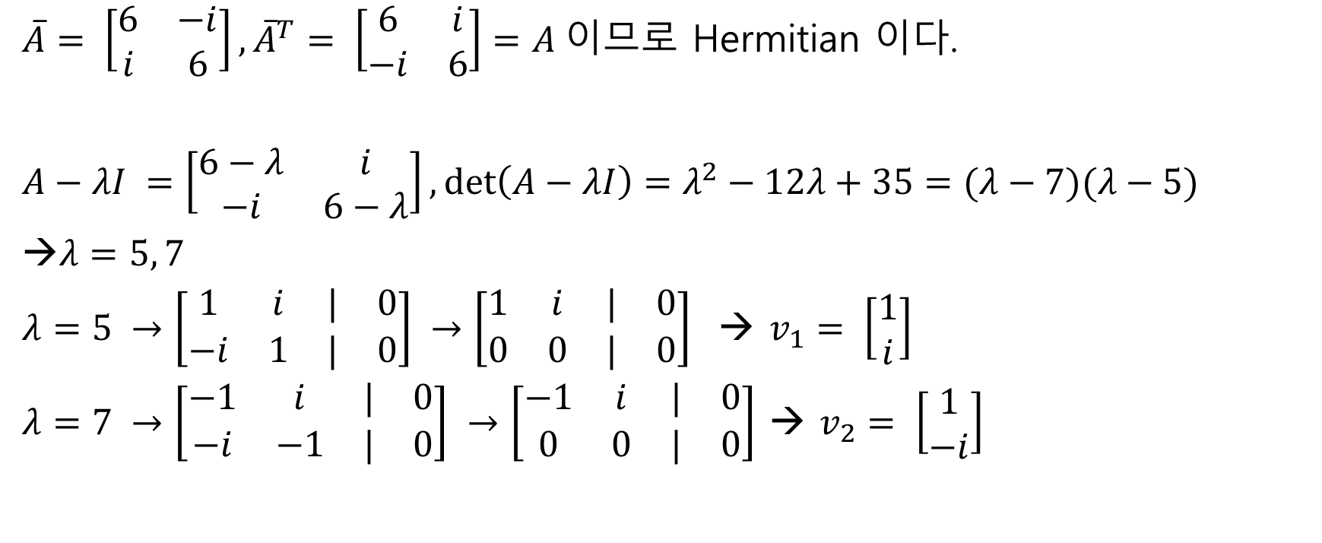
2. 다음 행렬은 Hermitian, skew-Hermitian, Unitary 행렬 중 어떤 것인가? 행렬의 고유값과 고유벡터를 구한 후 매트랩으로 확인하시오.
$$A= \left[\begin{matrix}6 & i \\ −i & 6\end{matrix}\right]$$
$\overline{A}= \left[\begin{matrix}6 & −i \\ i & 6\end{matrix}\right],{\overline{A}}^{T}= \left[\begin{matrix}6 & i \\ −i & 6\end{matrix}\right]=A$이므로 Hermitian 이다.
$A−λI =\left[\begin{matrix}6−λ & i \\ −i & 6−λ\end{matrix}\right],\det\left(A−λI\right)=λ^{2}−12λ+35=(λ−7)(λ−5)$
$λ=5, 7$
$λ=5 →\left[\begin{matrix}1 & i & | & 0 \\ −i & 1 & | & 0\end{matrix}\right] →\left[\begin{matrix}1 & i & | & 0 \\ 0 & 0 & | & 0\end{matrix}\right]$ → $v_{1}= \left[\begin{matrix}1 \\ i\end{matrix}\right]$
$λ=7 →\left[\begin{matrix}−1 & i & | & 0 \\ −i & −1 & | & 0\end{matrix}\right] →\left[\begin{matrix}−1 & i & | & 0 \\ 0 & 0 & | & 0\end{matrix}\right]$ → $v_{2}= \left[\begin{matrix}1 \\ −i\end{matrix}\right]$

Slide 15
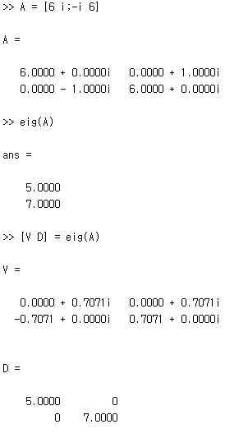
2. 다음 행렬은 Hermitian, skew-Hermitian, Unitary 행렬 중 어떤 것인가? 행렬의 고유값과 고유벡터를 구한 후 매트랩으로 확인하시오.
$$A= \left[\begin{matrix}6 & i \\ −i & 6\end{matrix}\right]$$

Slide 16

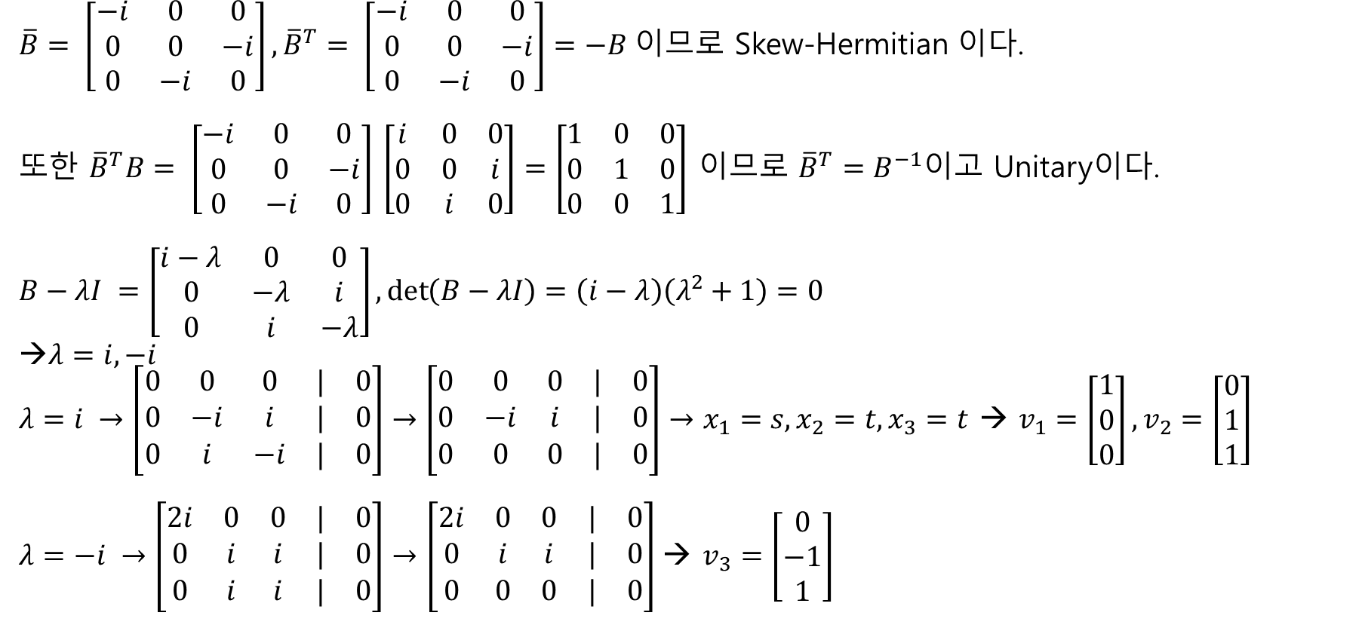

2. 다음 행렬은 Hermitian, skew-Hermitian, Unitary 행렬 중 어떤 것인가? 행렬의 고유값과 고유벡터를 구한 후 매트랩으로 확인하시오.
$$B= \left[\begin{matrix}i & 0 & 0 \\ 0 & 0 & i \\ 0 & i & 0\end{matrix}\right]$$
$\overline{B}= \left[\begin{matrix}−i & 0 & 0 \\ 0 & 0 & −i \\ 0 & −i & 0\end{matrix}\right], {\overline{B}}^{T}= \left[\begin{matrix}−i & 0 & 0 \\ 0 & 0 & −i \\ 0 & −i & 0\end{matrix}\right]=−B$이므로 Skew-Hermitian 이다.
또한 ${\overline{B}}^{T}B= \left[\begin{matrix}−i & 0 & 0 \\ 0 & 0 & −i \\ 0 & −i & 0\end{matrix}\right]$ $\left[\begin{matrix}i & 0 & 0 \\ 0 & 0 & i \\ 0 & i & 0\end{matrix}\right]=\left[\begin{matrix}1 & 0 & 0 \\ 0 & 1 & 0 \\ 0 & 0 & 1\end{matrix}\right]$ 이므로 ${\overline{B}}^{T}=B^{−1}$이고 Unitary이다.
$B−λI =\left[\begin{matrix}i−λ & 0 & 0 \\ 0 & −λ & i \\ 0 & i & −λ\end{matrix}\right],\det\left(B−λI\right)=\left(i−λ\right)\left(λ^{2}+1\right)=0$
$λ=i, −i$
$λ=i →\left[\begin{matrix}0 & 0 & 0 & | & 0 \\ 0 & −i & i & | & 0 \\ 0 & i & −i & | & 0\end{matrix}\right]→\left[\begin{matrix}0 & 0 & 0 & | & 0 \\ 0 & −i & i & | & 0 \\ 0 & 0 & 0 & | & 0\end{matrix}\right]→x_{1}=s, x_{2}=t, x_{3}=t$ → $v_{1}=\left[\begin{matrix}1 \\ 0 \\ 0\end{matrix}\right], v_{2}=\left[\begin{matrix}0 \\ 1 \\ 1\end{matrix}\right]$
$λ=−i →\left[\begin{matrix}2i & 0 & 0 & | & 0 \\ 0 & i & i & | & 0 \\ 0 & i & i & | & 0\end{matrix}\right]→\left[\begin{matrix}2i & 0 & 0 & | & 0 \\ 0 & i & i & | & 0 \\ 0 & 0 & 0 & | & 0\end{matrix}\right]$→ $v_{3}=\left[\begin{matrix}0 \\ −1 \\ 1\end{matrix}\right]$
$$v= \left[\begin{matrix}s \\ t \\ t\end{matrix}\right]=s\left[\begin{matrix}1 \\ 0 \\ 0\end{matrix}\right]+t\left[\begin{matrix}0 \\ 1 \\ 1\end{matrix}\right]$$

Slide 17
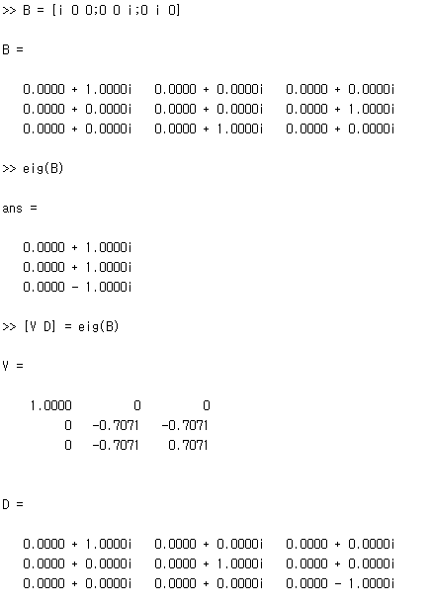
2. 다음 행렬은 Hermitian, skew-Hermitian, Unitary 행렬 중 어떤 것인가? 행렬의 고유값과 고유벡터를 구한 후 매트랩으로 확인하시오.
$$B= \left[\begin{matrix}i & 0 & 0 \\ 0 & 0 & i \\ 0 & i & 0\end{matrix}\right]$$

Slide 18
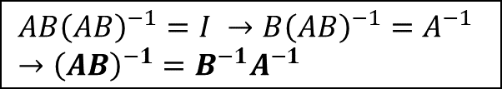
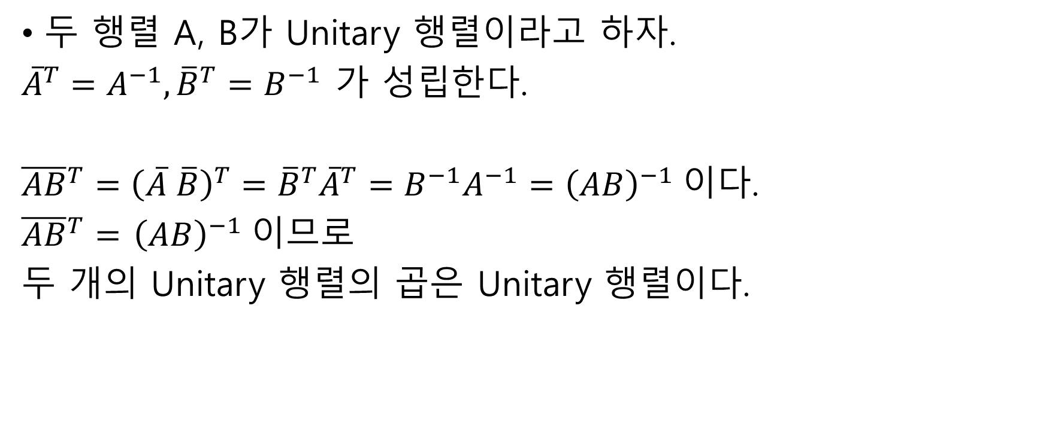
3. 두 개의 Unitary행렬의 곱도 Unitary임을 증명하고 MATLAB으로 3x3 Unitary 행렬의 예를 들어 확인하시오.
두 행렬 A, B가 Unitary 행렬이라고 하자.
${\overline{A}}^{T}=A^{−1}, {\overline{B}}^{T}=B^{−1}$ 가 성립한다.
${\overline{AB}}^{T}={\left(\overline{A} \overline{B}\right)}^{T}={\overline{B}}^{T}{\overline{A}}^{T}=B^{−1}A^{−1}={\left(AB\right)}^{−1}$이다.
${\overline{AB}}^{T}=$ ${\left(AB\right)}^{−1}$이므로
두 개의 Unitary 행렬의 곱은 Unitary 행렬이다.
$$AB{\left(AB\right)}^{−1}=I →B{\left(AB\right)}^{−1}=A^{−1} →{\left(AB\right)}^{−1}=B^{−1}A^{−1}$$

Slide 19
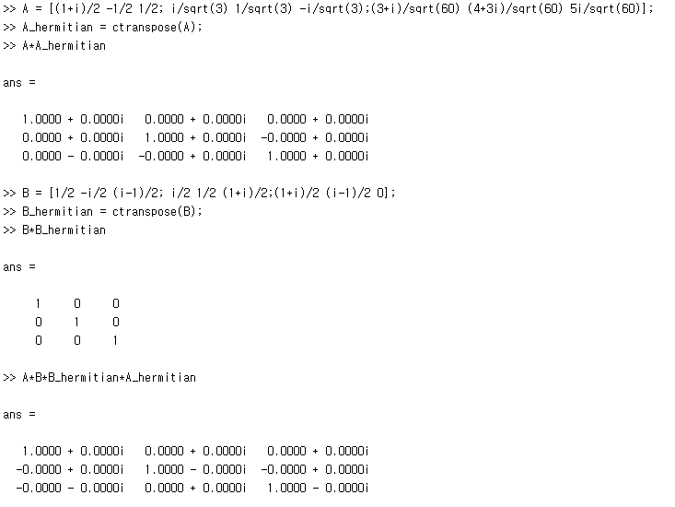

3. 두 개의 Unitary행렬의 곱도 Unitary임을 증명하고 MATLAB으로 3x3 Unitary 행렬의 예를 들어 확인하시오.
$$\left(AB\right){\left(AB\right)}^{∗}=\left(AB\right)B^{∗}A^{∗}$$

