Slide 1
공업수학
20181796 김민준

Slide 2
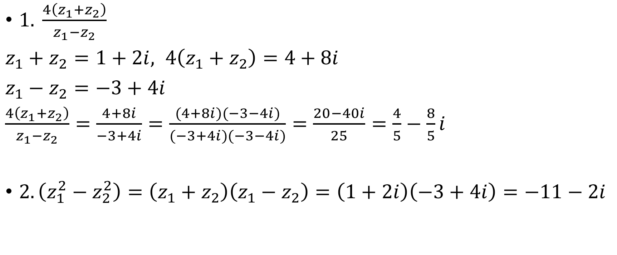

1, 2 .$z_{1}=−1+3i, z_{2}=2−i$ 일 때 다음을 구하시오.
$1. \frac{4\left(z_{1}+z_{2}\right)}{z_{1}−z_{2}}$
$z_{1}+z_{2}=1+2i, 4\left(z_{1}+z_{2}\right)=4+8i$
$z_{1}−z_{2}=−3+4i$
$\frac{4\left(z_{1}+z_{2}\right)}{z_{1}−z_{2}}=\frac{4+8i}{−3+4i}=\frac{(4+8i)(−3−4i)}{(−3+4i)(−3−4i)}=\frac{20−40i}{25}=\frac{4}{5}−\frac{8}{5}i$
$2. \left(z_{1}^{2}−z_{2}^{2}\right)=\left(z_{1}+z_{2}\right)\left(z_{1}−z_{2}\right)=\left(1+2i\right)\left(−3+4i\right)=−11−2i$

Slide 3

3. 다음을 polar form으로 표현하시오.
3. $z=−3$
$z=x+yi=−3+0i → \left(x=−3, y=0\right)$
$x=r\cos{θ}, y=r\sin{θ}, r=\sqrt{x^{2}+y^{2}}=\sqrt{{\left(−3\right)}^{2}}=3$
$−3=3\cos{θ}, 0=3\sin{θ}$ → $θ=π$
$∴z=−3=3(\cos{π}+i\sin{π})$

Slide 4

4. 다음을 polar form으로 표현하시오.
4. $z=1+\frac{π}{2}i$
$z=x+yi=1+\frac{π}{2}i →\left(x=1, y=\frac{π}{2}\right)$
$x=r\cos{θ}, y=r\sin{θ}, r=\sqrt{x^{2}+y^{2}}=\sqrt{\frac{4+π^{2}}{4}}$
$1=\sqrt{\frac{4+π^{2}}{4}}\cos{θ} ,\frac{π}{2}=\sqrt{\frac{4+π^{2}}{4}}\sin{θ}$ → $θ=\arccos\left(\sqrt{\frac{4}{4+π^{2}}}\right)=\arcsin\left(\sqrt{\frac{π^{2}}{4+π^{2}}}\right) ≈57.5184$
$∴z=1+\frac{π}{2}i=\sqrt{\frac{4+π^{2}}{4}}\left(\cos{θ}+i\sin{θ}\right)=\sqrt{\frac{4+π^{2}}{4}} \left(\sqrt{\frac{4}{4+π^{2}}}+i\sqrt{\frac{π^{2}}{4+π^{2}}}\right)=\sqrt{\frac{4+π^{2}}{4}}(\cos{57.5184}+i\sin{57.5184})$

Slide 5
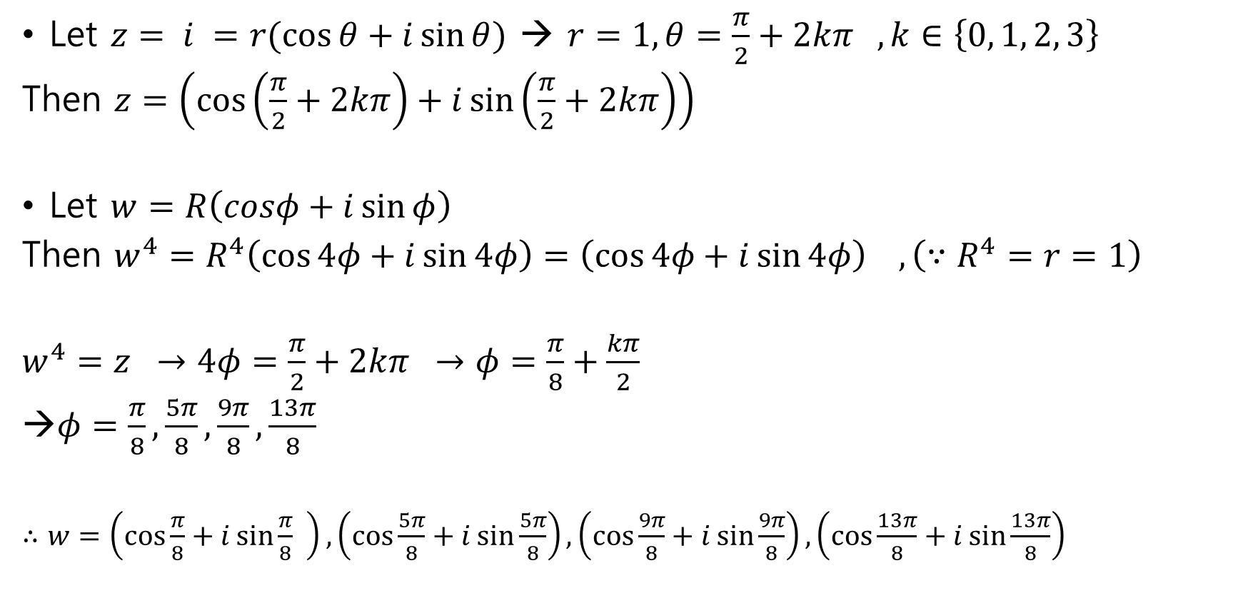

5. $w^{4}=i$를 만족하는 모든 $w$를 구하시오.
Let $z= i =r(\cos{θ}+i\sin{θ})$ → $r=1, θ=\frac{π}{2}+2kπ , k∈\left\{0, 1, 2, 3\right\}$
Then $z=\left(\cos\left(\frac{π}{2}+2kπ\right)+i\sin\left(\frac{π}{2}+2kπ\right)\right)$
Let $w=R\left(cosφ+i\sin{φ}\right)$
Then $w^{4}=R^{4}\left(\cos{4φ}+i\sin{4φ}\right)=\left(\cos{4φ}+i\sin{4φ}\right) , \left(∵R^{4}=r=1\right)$
$w^{4}=z →4φ=\frac{π}{2}+2kπ →φ=\frac{π}{8}+\frac{kπ}{2}$
$φ=\frac{π}{8},\frac{5π}{8},\frac{9π}{8},\frac{13π}{8}$
$∴w=\left(\cos{\frac{π}{8}}+i\sin{\frac{π}{8}} \right), \left(\cos{\frac{5π}{8}}+i\sin{\frac{5π}{8}}\right), \left(\cos{\frac{9π}{8}}+i\sin{\frac{9π}{8}}\right),\left(\cos{\frac{13π}{8}}+i\sin{\frac{13π}{8}}\right)$

Slide 6

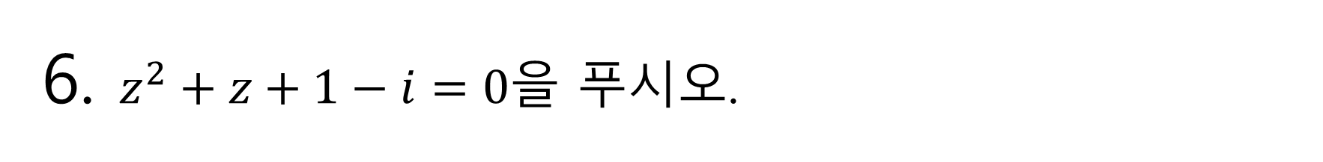
6. $z^{2}+z+1−i=0$을 푸시오.
$z^{2}+z+1−i=0$
$z^{2}+1=−\left(z−i\right)$
$\left(z+i\right)\left(z−i\right)=−\left(z−i\right)$
$i) \left(z−i\right)=0$ → $z=i$
$ii) \left(z−i\right)≠0$ → $\left(z+i\right)=−1, z=−i−1$
$∴z=i, −i−1$

Slide 7
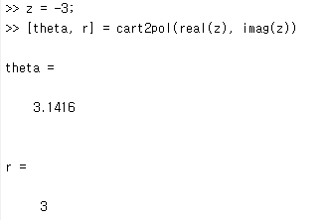
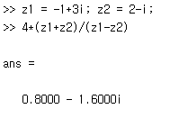
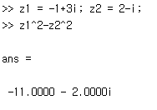
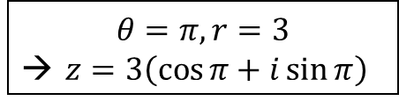
7. MATLAB
#3
#1
#2
$$θ=π, r=3$$
→ $z=3\left(\cos{π}+i\sin{π}\right)$

Slide 8
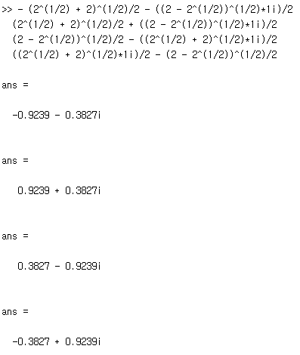
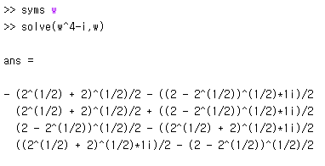
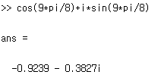
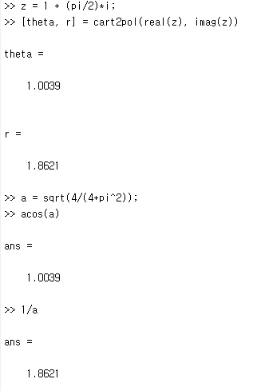
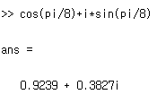
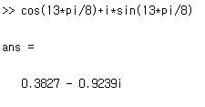
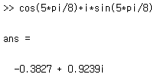
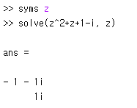


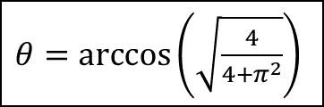
7. MATLAB
#5
#4
$a= \sqrt{\frac{4}{4+π^{2}}}$
$θ=\arccos\left(\sqrt{\frac{4}{4+π^{2}}}\right)$
#6
$r=\sqrt{\frac{4+π^{2}}{4}}=\frac{1}{a}$

