Slide 1
공업수학
20181796 김민준

Slide 2
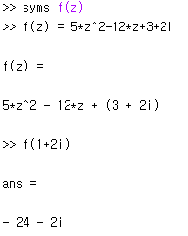
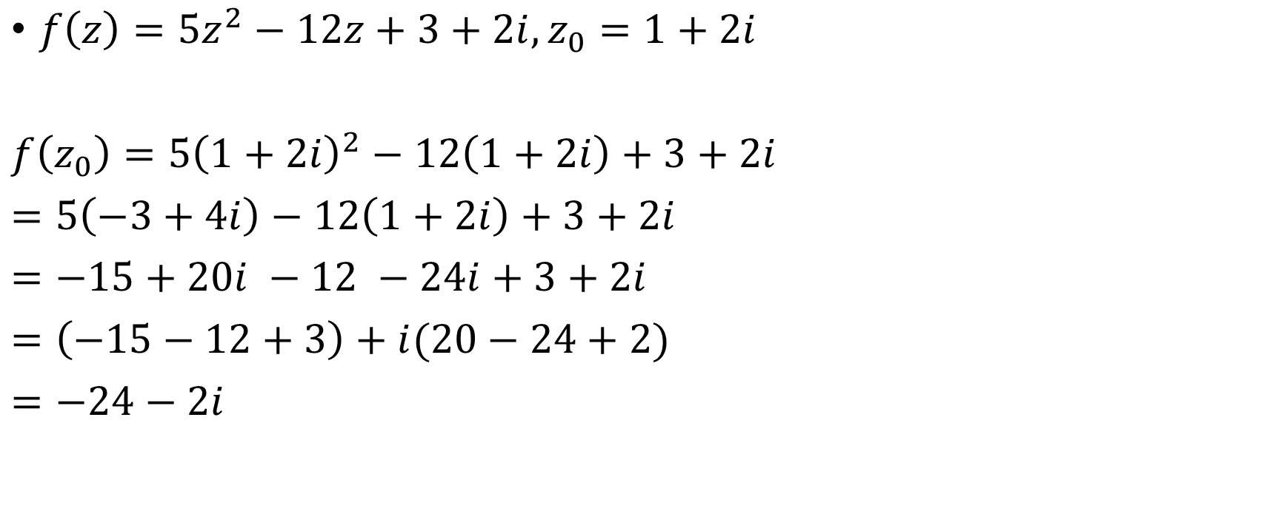

1. 다음 주어진 $z_{0}$에서 함수 $f(z_{0})$의 값을 구하시오.
$f\left(z\right)=5z^{2}−12z+3+2i, z_{0}=1+2i$
$f\left(z_{0}\right)=5{\left(1+2i\right)}^{2}−12\left(1+2i\right)+3+2i$
$=5\left(−3+4i\right)−12\left(1+2i\right)+3+2i$
$=−15+20i −12 −24i+3+2i$
$=\left(−15−12+3\right)+i(20−24+2)$
$=−24−2i$

Slide 3
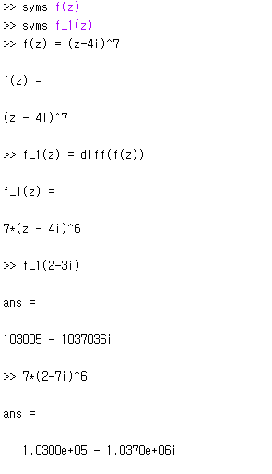


2. 다음 $z$에서 derivative값을 구하시오.
$f\left(z\right)={\left(z−4i\right)}^{7}, z_{0}=2−3i$
$f^{′}\left(z\right)=7{\left(z−4i\right)}^{6}$
$f^{′}\left(z_{0}\right)=7{\left(2−7i\right)}^{6}$

Slide 4


3. 다음 functions은 analytic인가?
$f\left(z\right)=iz\overline{z}$
$z=x+iy, \overline{z}=x−iy$
$iz\overline{z}=i\left(x+iy\right)\left(x−iy\right)=i\left(x^{2}+y^{2}\right)=u\left(x,y\right)+iv\left(x,y\right)$
$u\left(x,y\right)=0, v\left(x,y\right)=x^{2}+y^{2}$
$u_{x}=v_{y}, u_{y}=−v_{x}$ 이면 analytic
$u_{x}=0, v_{y}=2y$ → $u_{x}≠v_{y}$
$u_{y}=0, −v_{x}=−2x$ → $u_{y}≠−v_{x}$
$∴$ 해석적이지 않다.
$f$가 해석적이면 $∇^{2}u=0, ∇^{2}v=0$ 이다.
iif
$∇^{2}u≠0 or ∇^{2}v≠0$ 이면 $f$는 해석적이지 않다.
$∇^{2}v=v_{xx}+v_{yy}=2+2=4≠0$
$∴$해석적이지 않다.

Slide 5
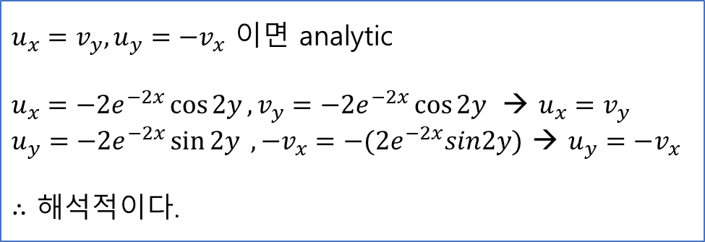
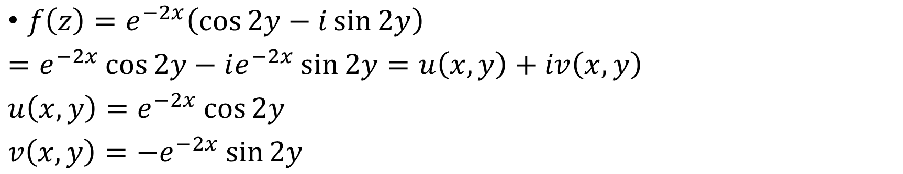
4. 다음 functions은 analytic인가?
$f\left(z\right)=e^{−2x}\left(\cos{2y}−i\sin{2y}\right)$
$=e^{−2x}\cos{2y}−ie^{−2x}\sin{2y}=u\left(x,y\right)+iv\left(x,y\right)$
$u\left(x,y\right)=e^{−2x}\cos{2y}$
$v\left(x,y\right)=−e^{−2x}\sin{2y}$
$u_{x}=v_{y}, u_{y}=−v_{x}$ 이면 analytic
$u_{x}=−2e^{−2x}\cos{2y}, v_{y}=−2e^{−2x}\cos{2y}$ → $u_{x}=v_{y}$
$u_{y}=−2e^{−2x}\sin{2y} ,−v_{x}=−(2e^{−2x}sin2y)$ → $u_{y}=−v_{x}$
$∴$ 해석적이다.

Slide 6

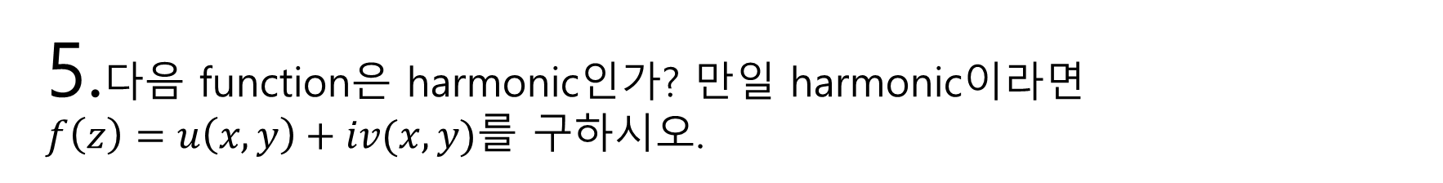
5.다음 function은 harmonic인가? 만일 harmonic이라면 $f\left(z\right)=u\left(x,y\right)+iv(x,y)$를 구하시오.
$u=x^{2}+y^{2}$
$∇^{2}u=u_{xx}+u_{yy}=2+2=4≠0$
Harmonic 아님.

Slide 7
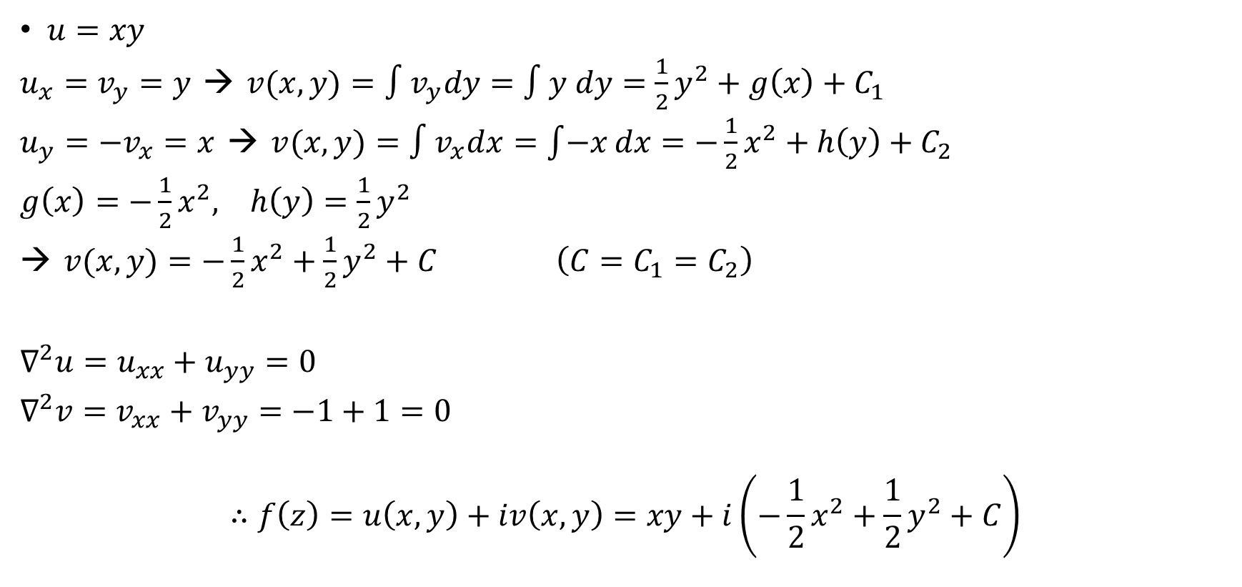
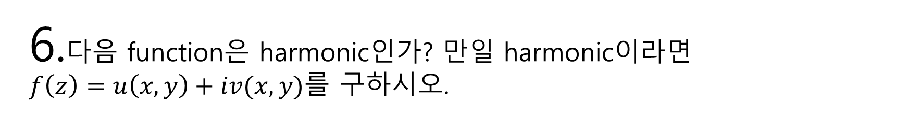
6.다음 function은 harmonic인가? 만일 harmonic이라면 $f\left(z\right)=u\left(x,y\right)+iv(x,y)$를 구하시오.
$u=xy$
$u_{x}=v_{y}=y$ → $v(x,y)=∫v_{y}dy=∫y dy=\frac{1}{2}y^{2}+g\left(x\right)+C_{1}$
$u_{y}=−v_{x}=x$ → $v(x,y)=∫v_{x}dx=\int{−x}dx=−\frac{1}{2}x^{2}+h\left(y\right)+C_{2}$
$g\left(x\right)=−\frac{1}{2}x^{2}, h\left(y\right)=\frac{1}{2}y^{2}$
→ $v(x,y)=−\frac{1}{2}x^{2}+\frac{1}{2}y^{2}+C$ $\left(C=C_{1}=C_{2}\right)$
$∇^{2}u=u_{xx}+u_{yy}=0$
$∇^{2}v=v_{xx}+v_{yy}=−1+1=0$
$$∴f\left(z\right)=u\left(x,y\right)+iv\left(x,y\right)=xy+i\left(−\frac{1}{2}x^{2}+\frac{1}{2}y^{2}+C\right)$$
→ harmonic

