Slide 2
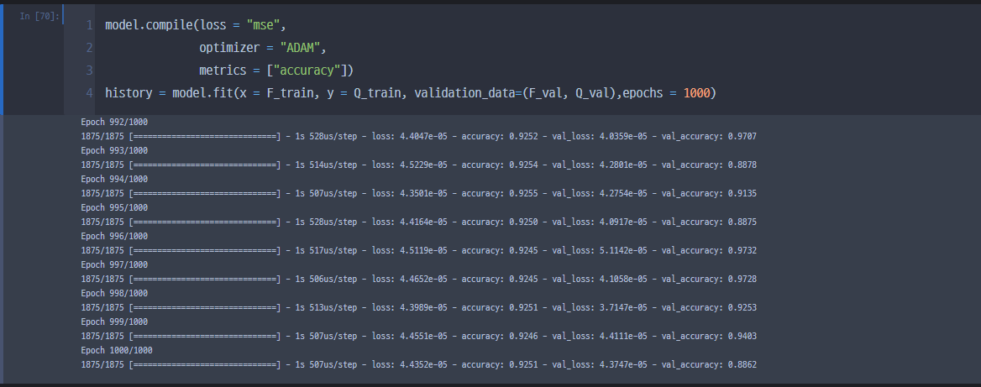
hatQ N = 5, M = 100000

