Slide 1
Thing Definition Language
One Data Model Liaison Group
Michael Koster
March 26, 2019

Slide 2
Thing Definition Language
context http://onedm.org#tdl uses [odm js] scope st define [ Switch { extends Capability hasProperty Switch.value hasAction [Switch.on Switch.off] } Switch.value { extends Property hasDataItem Switch.valueData } Switch.on {extends Action} Switch.off {extends Action} Switch.valueData { extends DataItem type string enum [on off] } ]
context http://onedm.org#tdl uses [odm js] scope st define DimmableLight { extends Thing hasCapability [
st:Switch st:SwitchLevel
]
}

Slide 3
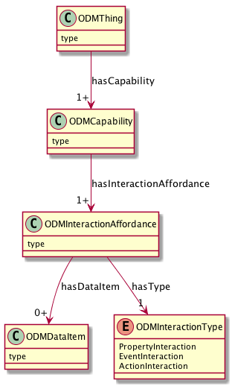
UML Model
Device Type and Constraints e.g. Thermostat, Light
Composable Capabilities e.g. onoff, level, temperature
Events, Actions, Properties
Data Types, Enums

Slide 4
Thing Definition Language
A high level language using a few simple patterns
Developers can create and augment definitions in this high level language
Automatic feature extraction can output this language
The JSON Definition Format can be produced automatically, and protocol bindings generated

Slide 5
Keywords
context - works like JSON-LD context to define namespaces and terms
uses - specifies one or more default source namespaces, evaluated in order
scope - specifies default namespace that definitions are added to
define - creates a definition in some namespace, args are a new term and a definition block
extends - specifies a class template to use in the definition block

Slide 6
Structure
keywords
[ list ] items determined by keyword, use where multiple items are allowed
{ block } contains key-value pairs, whitespace delimited, according to the class template defined by extends
Basic Definition Format
define <new term> {extends <class> key1 value1 key2 value2 … }
key-value pairs add constraints to the definition

Slide 7
Namespace Resolution
0. keywords
1. local block
2. enclosing block
3. namespace declared with scope keyword
4. namespaces declared with uses keyword, in declared order

Slide 8
Example Definition
context http://onedm.org#tdl uses [odm js] scope st define [ Switch { extends Capability hasProperty Switch.value hasAction [Switch.on Switch.off] } Switch.value { extends Property hasDataItem Switch.valueData } Switch.on {extends Action} Switch.off {extends Action} Switch.valueData { extends DataItem type string enum [on off] } ]

Slide 9
Example Generated JSON
{
"@id": "st:Switch",
"rdfs:subClassOf": "odm:Capability",
"odm:hasInteractionAffordance": [
"st:Switch.value",
"st:Switch.on",
"st:Switch.off"
]
},
{
"@id": "st:Switch.value",
"@type": "odm.PropertyInteraction",
"rdfs:subClassOf": "odm:InteractionAffordance",
"odm:hasDataItem": "st:Switch.valueData"
},
{
"@id": "st:Switch.valueData",
"rdfs:subClassOf": "odm:DataItem",
"js:type": "js:string",
"js:enum": ["on", "off"]
},

Slide 10
Defining a Device Type
context http://onedm.org#tdl uses [odm js] scope st define DimmableLight { extends Thing hasCapability [
st:Switch st:SwitchLevel
]
}

