Slide 1
ObjectFlow for Microcontrollers
Simple and Reliable Data Flow Graph programming for embedded applications

Slide 2
ObjectFlow
Data-driven programming for tiny microcontrollers
Arduino Uno class (2KB/32KB) and larger
Small library, no central executive, timer- and communication event-driven
Similar to IEC61499, Node-RED, etc. based on Data Flow Graphs (DFG)
Uses the LWM2M data model and semantics with an event-driven communication protocol
Communication is implemented in the application layer using a set of well-known LWM2M types

Slide 3
ObjectFlow - Digital Twin for Embedded Code
On-device code is simple, minimal, and reliable
A small set of primitives implemented as static C++ wrapper classes for Object and Resource
Graphs are build from a standardized JSON format that models Object and Resource Instances on the embedded device – a digital twin of the device code
Tools construct a C++ header file template that is built with the device code application handler bundle using the standard IDE (e.g. Arduino IDE), and downloaded to the device in the usual way.

Slide 4
High Level Process
Models
Models
C++ Code
JSON Models
Build

Slide 5
ObjectFlow – DFG wrapper
A small set of Resource types for communication
Time types for Current, Interval, and LastActivation
Input and Output link types based on LWM2M Objlink
Value subtypes for Input, Output, and Current Value
DFG - communication is event driven and initiated according to application logic
Bound methods implement application handlers
InputSync (data pull) and OutputSync (data push)
onValueUpdate, onValueSync, onInterval handlers

Slide 6
ObjectFlow – DFG and Reactive Communication
LWM2M Object
LWM2M Object
InputLink
OutputLink
InputLink
OutputLink
InputValue
OutputValue
InputValue
OutputValue
outputSync
onValueUpdate
CurrentValue
CurrentValue
handler
handler
handler
handler
handler
handler
handler
handler

Slide 7
Complex Functions
Function Object
(Trigger)
Timer
Input Objects
In Link 1
In Value 1
Value
In Link 2
Output Objects
In Value 2
Out Link
Value
Value
Out Value

Slide 8
ObjectFlow – DFG architecture
An ObjectFlow application is a Data Flow Graph
DFG Nodes are implemented as LWM2M Objects
A DFG Node is a collection of one or more Objects
LWM2M Object Links (Objlink) are used to group Objects into a DFG Node and to implement the data flow connections between Nodes (arcs, edges)

Slide 9
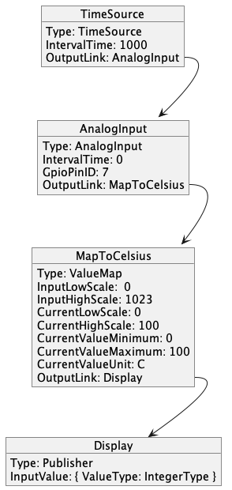
Example graph
TimeSource: Type: TimeSource IntervalTime: 1000 TimerOutputLink: AnalogInput AnalogInput: Type: AnalogInput GpioPinID: 7 IntervalTime: 0 OutputLink: MapToCelsius MapToCelsius: Type: ValueMap InputLowScale: 0 InputHighScale: 1023 CurrentLowScale: 0 CurrentHighScale: 100 CurrentValueMinimum: 0 CurrentValueMaximum: 100 CurrentValueUnit: C OutputLink: Display Display: Type: Publisher InputValue: { ValueType: IntegerType }

Slide 10
ObjectFlow - Tools
The DFG model tools do all of the heavy lifting so the embedded code can be extremely simple and lightweight, e.g. type checking is done in the model
Code generation involves serialization of the objects and resources into a C++ header file, and packaging of the implementation code for the application objects (time and data event handlers)
The result is a standard C++ package that can be built by any C++ toolchain (Arduino, etc.)

Slide 11
High Level Process
SDF Models
SDF Models
UML Doc
Model Build
C++ Header
C++ Classes
FLow JSON
Target Build

Slide 12
Build Process
SDF
Models
SDF
SDF
SDF
Merge
Fully Resolved Instances
Embedded Code
Select + Copy
SDF
Serialize
Flow JSON
Code Gen
C++ Header
Build SDF Instances
Configure
Render
DSL
Flow JSON
Merge
Flow JSON
Render
Flow UML
Documents
YAML
UML
WoT TD
YAML UML
TD

Slide 13
Making a New Flow Graph
UML Doc
UML Doc
Flow JSON
Build
Target

Slide 14
Making a New Object
New SDF Model
SDF Models
SDF Models
types.h
SDF Models
Build
SDF Models
Co-develop
C++ Classes
New C++ Class
C++ Classes
C++ Classes
C++ Classes

Slide 15
Example SDF Model
defaultnamespace: objectflow sdfData: # add this ObjectType ID to the TypeID registry TypeID: ObjectType: Publisher: { const: 43008 } sdfThing: # Publisher Object Publisher: sdfRef: /#/sdfThing/ObjectFlowObject sdfData: TypeID: sdfRef: /#/sdfData/TypeID/ObjectType/Publisher # Publisher Object Resources sdfRequired: - /#/sdfThing/Publisher/sdfThing/InputValue sdfThing: InputValue: sdfRef: /#/sdfThing/ObjectFlowObject/sdfThing/InputValue ValueType: sdfChoice: default: { sdfRef: /#/sdfData/ValueType/sdfChoice/IntegerType } sdfAction: OnDefaultValueUpdate: Publish the data to the endpoint
=> TypeID: { const: 43008 }

Slide 16
Example SDF Instance
defaultnamespace: objectflow sdfThing: # Instance Graph InstanceGraph: sdfRef: /#/sdfThing/ObjectList # Objects in the graph sdfThing: TimeSource: sdfRef: /#/sdfThing/TimeSource sdfThing: IntervalTime: sdfProperty: Value: sdfChoice: IntegerType: { const: 1000 } OutputLink: sdfData: SdfLink: { InstancePointer: /#/sdfThing/InstanceGraph/sdfThing/AnalogInput } AnalogInput: sdfRef: /#/sdfThing/AnalogInput sdfThing: GpioPinID: sdfProperty: Value: sdfChoice: IntegerType: { const: 7 } OutputLink: sdfData: SdfLink: { InstancePointer: /#/sdfThing/InstanceGraph/sdfThing/ScaleMapper }

Slide 17
Simplified DSL
defaultnamespace: objectflow sdfThing: # Instance Graph InstanceGraph: sdfRef: /#/sdfThing/ObjectList # Objects in the graph sdfThing: TimeSource: sdfRef: /#/sdfThing/TimeSource sdfThing: IntervalTime: sdfProperty: Value: sdfChoice: IntegerType: { const: 1000 } TimerOutputLink: sdfData: SdfLink: { InstancePointer: /#/sdfThing/InstanceGraph/sdfThing/AnalogInput } AnalogInput: sdfRef: /#/sdfThing/AnalogInput sdfThing: GpioPinID: sdfProperty: Value: sdfChoice: IntegerType: { const: 7 } OutputLink: sdfData: SdfLink: { InstancePointer: /#/sdfThing/InstanceGraph/sdfThing/MapToCelsius }
TimeSource: Type: TimeSource IntervalTime: 1000 TimerOutputLink: AnalogInput AnalogInput: Type: AnalogInput GpioPinID: 7 OutputLink: MapToCelsius

Slide 18
Reserved LWM2M Types
TypeID: ResourceType: ValueType: { const: 27000 }
InputLinkType: { const: 27001 } OutputLinkType: { const: 27002 } InputValueType: { const: 27003 } CurrentValueType: { const: 27004 } OutputValueType: { const: 27005 } CurrentTimeType: { const: 27006 } IntervalTimeType: { const: 27007 } LastActivationTimeType: { const: 27008 }
SDF Definition
#define InputLinkType 27000
#define InputLinkType 27001 #define OutputLinkType 27002 #define InputValueType 27003 #define CurrentValueType 27004 #define OutputValueType 27005 #define CurrentTimeType 27006 #define IntervalTimeType 27007 #define LastActivationTimeType 27008
Generated C++ Header

Slide 19
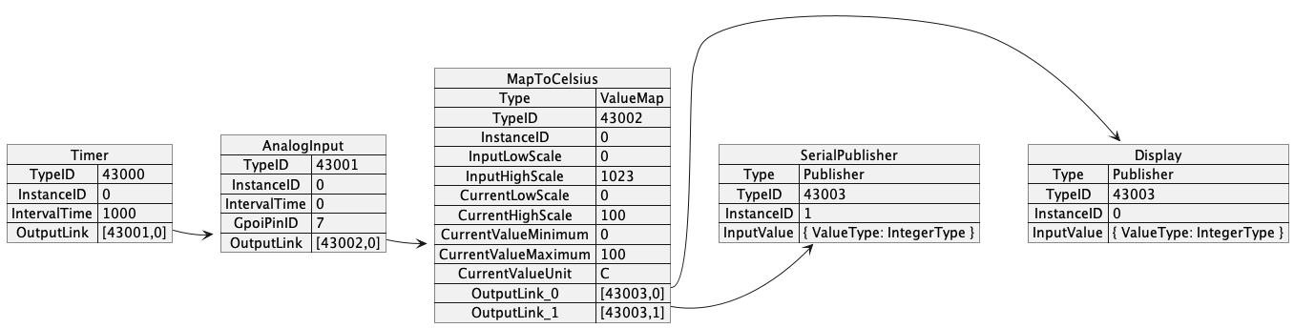
Resolved Instance Graph

