Slide 1
Lit Silicon: A Case Where Thermal Imbalance Couples Concurrent Execution in Multiple GPUs
Marco Kurzynski, Shaizeen Aga* and Di Wu
University of Central Florida, AMD*
July 1st, 2026
ISCA 2026

Slide 2
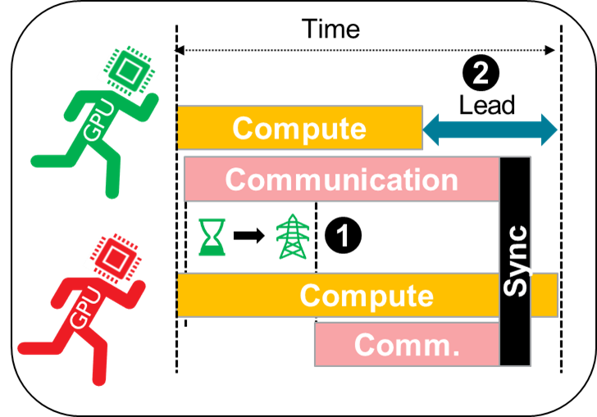



Tackle Lit Silicon → Superior ML Performance And Power
Leaders (cooler, faster)
Stragglers (hotter, slower)
1
2
3
Benefits of Tackling Lit Silicon
Lit Silicon
Effect
Variation-aware Power Sloshing
Tackling Lit Silicon delivers 6% increased throughput
Tackling Lit Silicon delivers 4% power reduction

Slide 3
ML Is Increasingly Distributed → ML Communication
1
<<
HBM capacity
Model memory
Shard model across GPUs
Network
GPU-N
2
GPU-0
→
Inter & intra node communication
Increasing training datasets
3
Shard computation across GPUs
Need for performance

Slide 4
Distributed ML Suffers Thermal Imbalance Induced Variation
Inter-GPU execution variation = Leader (faster) & straggler (slower) GPUs
(e.g., load imbalance, memory allocation differences, etc.)
Key observation: thermal imbalance is a key cause for execution variation in distributed ML
Leaders (cooler, faster)
Stragglers (hotter, slower)
Distributed ML
Inter-GPU Variation
Time
Lead
….
….
GPU
Compute
GPUs
GPUs
Compute
….
….
GPU

Slide 5
Lit Silicon = Variation x Concurrent Compute-Communication
ML trend: Concurrent compute and communication to hide communication overheads
Effect-1: leaders wait for stragglers at sync. points, extending communication on leaders
Effect-2: extended communication on leaders causes more contention, slowing them down
Key observation: stragglers extend communication and burn power on leaders, coined the Lit Silicon effect
Time
Time
2
Lead
Lead
GPU
Compute
GPU
Compute
Leaders (cooler, faster)
Communication
1
Stragglers (hotter, slower)
Sync
Compute
Compute
GPU
GPU
Comm.

Slide 6
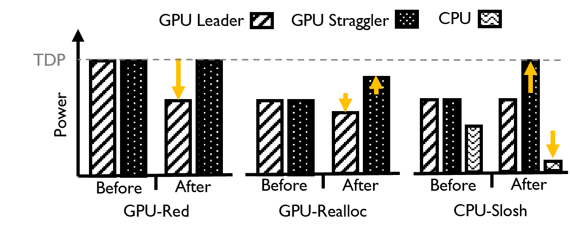
Variation-driven Power Sloshing Can Tackle Lit Silicon
Execution variation provides key guidance on power re-balancing (sloshing)
Leaders can be capped without loss of performance
Power can be sloshed to stragglers for superior performance
Key observation: detect execution variation & harness it to guide power sloshing decisions
Leaders (cooler, faster)
Power Sloshing Mechanisms
Stragglers (hotter, slower)
Inter-GPU Variation
….
GPUs
….

Slide 7
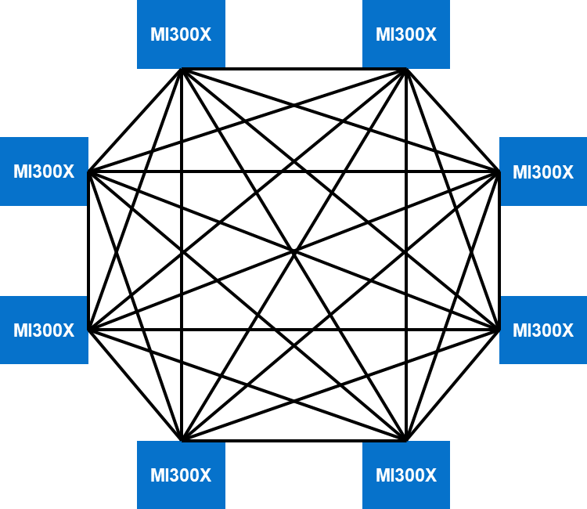
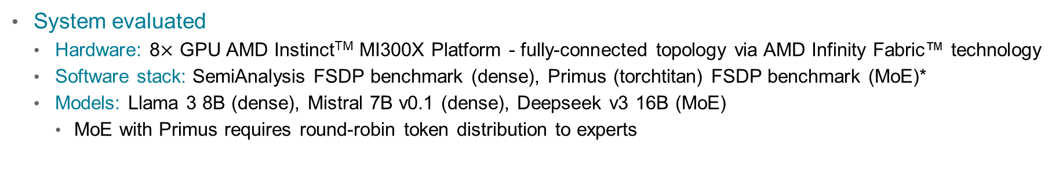
Experimental Setup
System evaluated
Hardware: 8$×$ GPU AMD InstinctTM MI300X Platform - fully-connected topology via AMD Infinity Fabric™ technology
Software stack: SemiAnalysis FSDP benchmark (dense), Primus (torchtitan) FSDP benchmark (MoE)*
Models: Llama 3 8B (dense), Mistral 7B v0.1 (dense), Deepseek v3 16B (MoE)
MoE with Primus requires round-robin token distribution to experts
Single node with 8$×$ AMD InstinctTM MI300X GPUs
128GB/s bidirectional per link
Communication

Slide 8
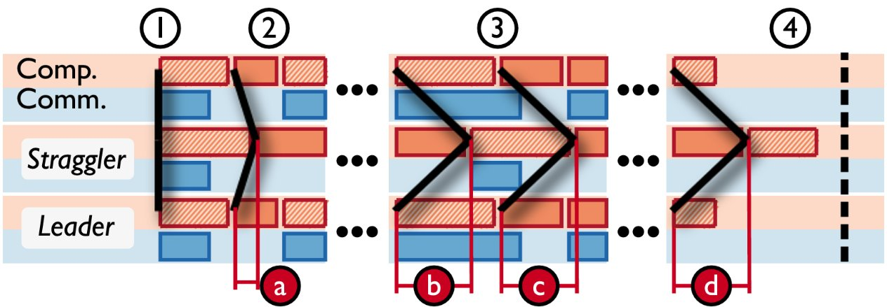
Negative Feedback Loop Of Lit Silicon Over Time
A “straggler wave” forms by tracking difference in kernel start time (the lead) across GPUs
GPUs start together
Leaders run faster and gain a lead (a)
Leaders suffer from extended communication, wait for stragglers, and reach an equilibrium where lead (b) = (c) = (d)
Leaders wait for the straggler to finish
Key observation-1: macro execution view (iteration time) fails to convey impact of the Lit Silicon effect
Key observation-2: fine-grained tracking of "lead" is necessary to tackle the Lit Silicon effect

Slide 9
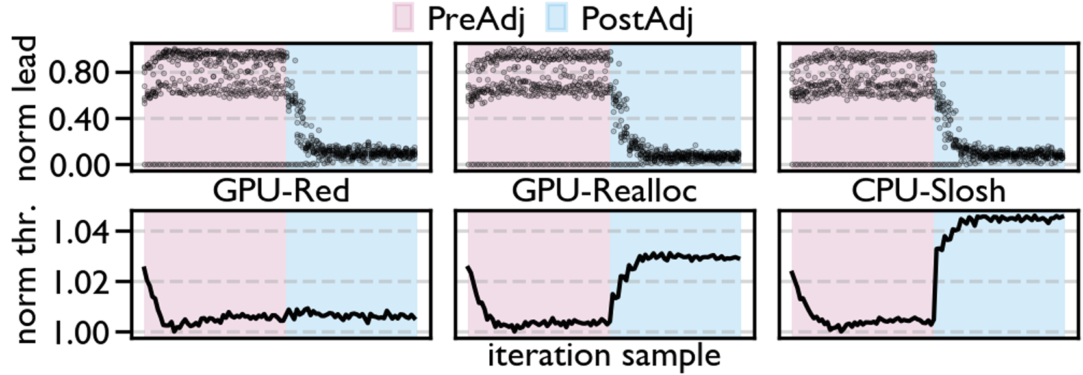
Superior Throughput from Aligning Lead Values
Impact of power sloshing on lead and throughput
GPU-Red maintains throughput ✅
GPU-Realloc improves throughput by 3%
CPU-Slosh improves throughput by 4%
Key observation: lead-aware power sloshing delivers throughput improvements
+

Slide 10
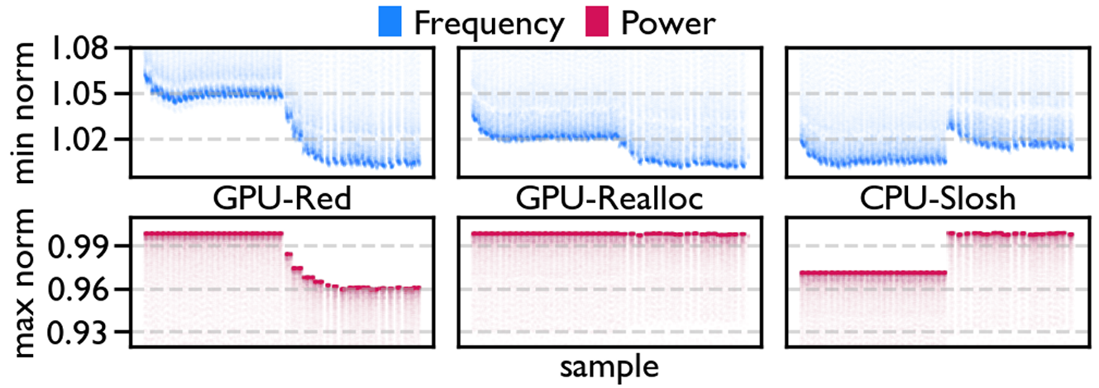
Power Savings from Aligning Lead Values
Impact of power sloshing on average GPU frequency and power
GPU-Red saves 4% power
GPU-Realloc maintains power ✅
CPU-Slosh sloshes 3% more power to GPUs
Key observation: frequency drops across GPUs, but increases where it matters (straggler)

Slide 11
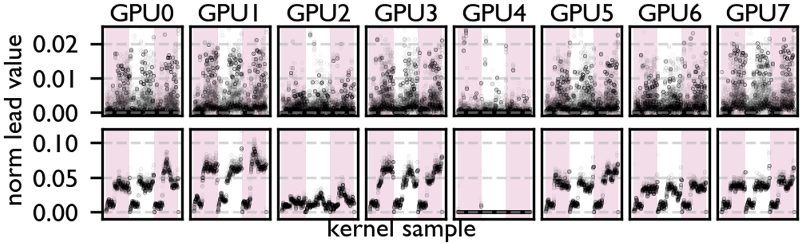
Lit Silicon Prevalent Across ML Models & Algorithms
Frequent all-to-all communication synchronizes GPUs every layer
Smaller lead values with more variation from frequent synchronization makes tuning converge slower
Straggler is consistent for MoE and dense workloads
Key observation: Lit Silicon manifests in both MoE and dense workloads with the same stragglers & leaders
DeepSeek
Llama
leader
straggler

Slide 12
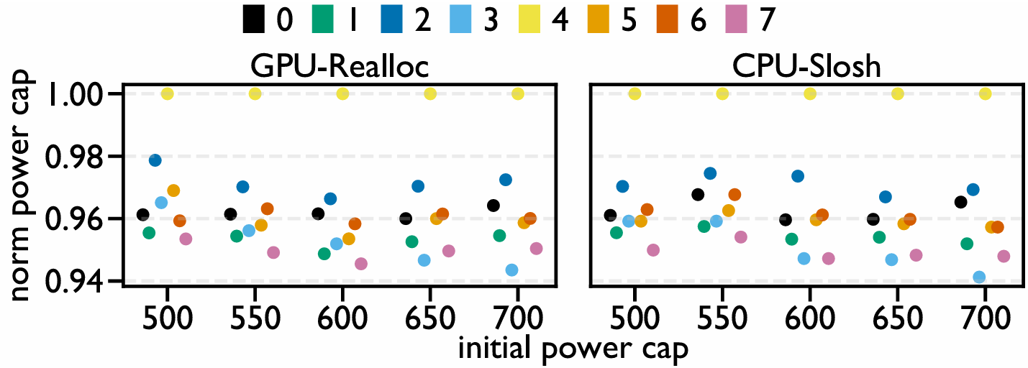
Final Power Caps Are Stable And Reusable
Node-level power caps can vary, so a power sloshing strategy must be flexible
The relative power distribution across GPUs is consistent at different uniform node-level power caps
Key observation: once a power distribution is found, it can be reused for any scenario or model (e.g., MoE)

Slide 13
Production-grade Power Sloshing – Online Tuning
Cons of tuning with lead values:
Relies on administrator privileges to set power caps
Need to dump and process traces for detecting lead values
Recommendation: firmware solution which synchronizes frequencies in the background
Sync frequency
Power cap
Frequency
Time

Slide 14
Production-grade Power Sloshing – Offline Tuning
Curated benchmarks can obtain a power distribution to be re-used
Deployable today
Not as efficient or flexible as online tuning
Our contribution: a curated benchmark for detecting Lit Silicon
Recommendation: use our curated benchmark to periodically obtain reusable power distributions
Admin-curated
benchmark
Alloc
Idle
Alloc
Tune
Alloc
….
….

Slide 15
Tackle Lit Silicon → Superior ML Performance And Power
Leaders (cooler, faster)
Stragglers (hotter, slower)
1
2
3
Benefits of Tackling Lit Silicon
Lit Silicon
Effect
Variation-aware Power Sloshing
Tackling Lit Silicon delivers 6% increased throughput
Tackling Lit Silicon delivers 4% power reduction

Slide 16
Lit Silicon: A Case Where Thermal Imbalance Couples Concurrent Execution in Multiple GPUs
Marco Kurzynski, Shaizeen Aga* and Di Wu
University of Central Florida, AMD*
July 1st, 2026
ISCA 2026

Slide 17
Copyright and disclaimer
The information presented in this document is for informational purposes only and may contain technical inaccuracies, omissions, and typographical errors. The information contained herein is subject to change and may be rendered inaccurate releases, for many reasons, including but not limited to product and roadmap changes, component and motherboard version changes, new model and/or product differences between differing manufacturers, software changes, BIOS flashes, firmware upgrades, or the like. Any computer system has risks of security vulnerabilities that cannot be completely prevented or mitigated. AMD assumes no obligation to update or otherwise correct or revise this information. However, AMD reserves the right to revise this information and to make changes from time to time to the content hereof without obligation of AMD to notify any person of such revisions or changes.
THIS INFORMATION IS PROVIDED “AS IS”. AMD MAKES NO REPRESENTATIONS OR WARRANTIES WITH RESPECT TO THE CONTENTS HEREOF AND ASSUMES NO RESPONSIBILITY FOR ANY INACCURACIES, ERRORS, OR OMISSIONS THAT MAY APPEAR IN THIS INFORMATION. AMD SPECIFICALLY DISCLAIMS ANY IMPLIED WARRANTIES OF NON-INFRINGEMENT, MERCHANTABILITY, OR FITNESS FOR ANY PARTICULAR PURPOSE. IN NO EVENT WILL AMD BE LIABLE TO ANY PERSON FOR ANY RELIANCE, DIRECT, INDIRECT, SPECIAL, OR OTHER CONSEQUENTIAL DAMAGES ARISING FROM THE USE OF ANY INFORMATION CONTAINED HEREIN, EVEN IF AMD IS EXPRESSLY ADVISED OF THE POSSIBILITY OF SUCH DAMAGES.
AMD, the AMD Arrow logo, Instinct, Infinity Fabric, ROCm, and combinations thereof are trademarks of Advanced Micro Devices, Inc. Other product names used in this publication are for identification purposes only and may be trademarks of their respective companies.
© 2026 Advanced Micro Devices, Inc. All rights reserved.

