Slide 1

DESIGN PORTFOLIO
Michael Murray
Sr. Mechanical Design Engineer
2009-2025
+1 919 824 1597 (m)
mjm.murray@gmail.com
https://linktr.ee/michaeljohnmurray

Slide 2
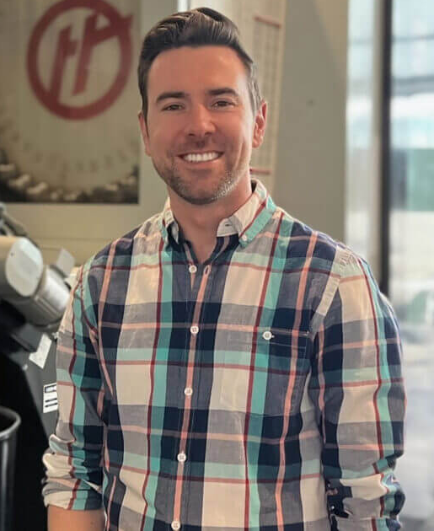
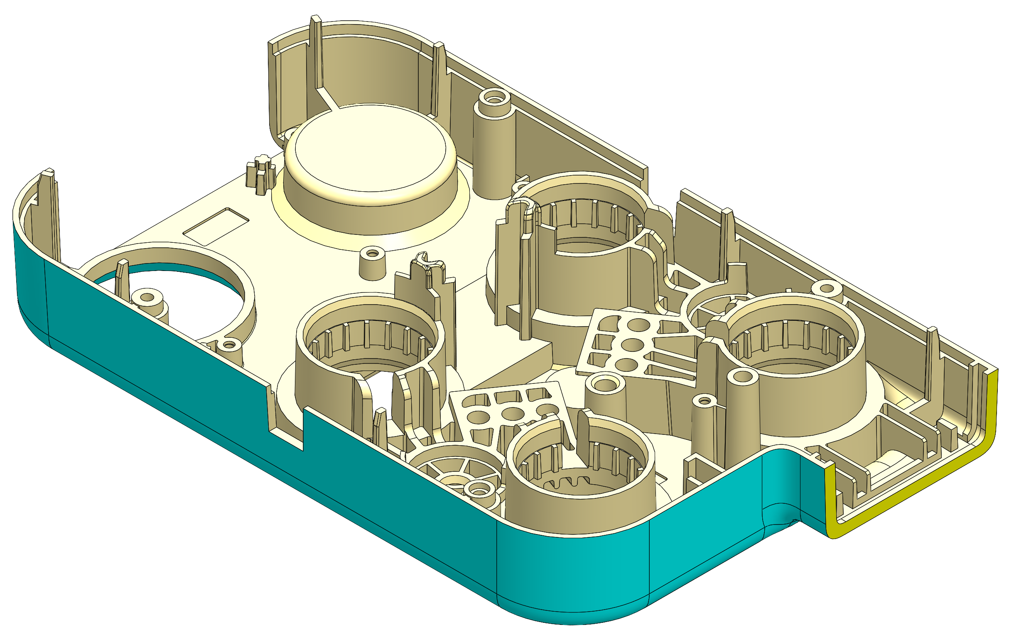
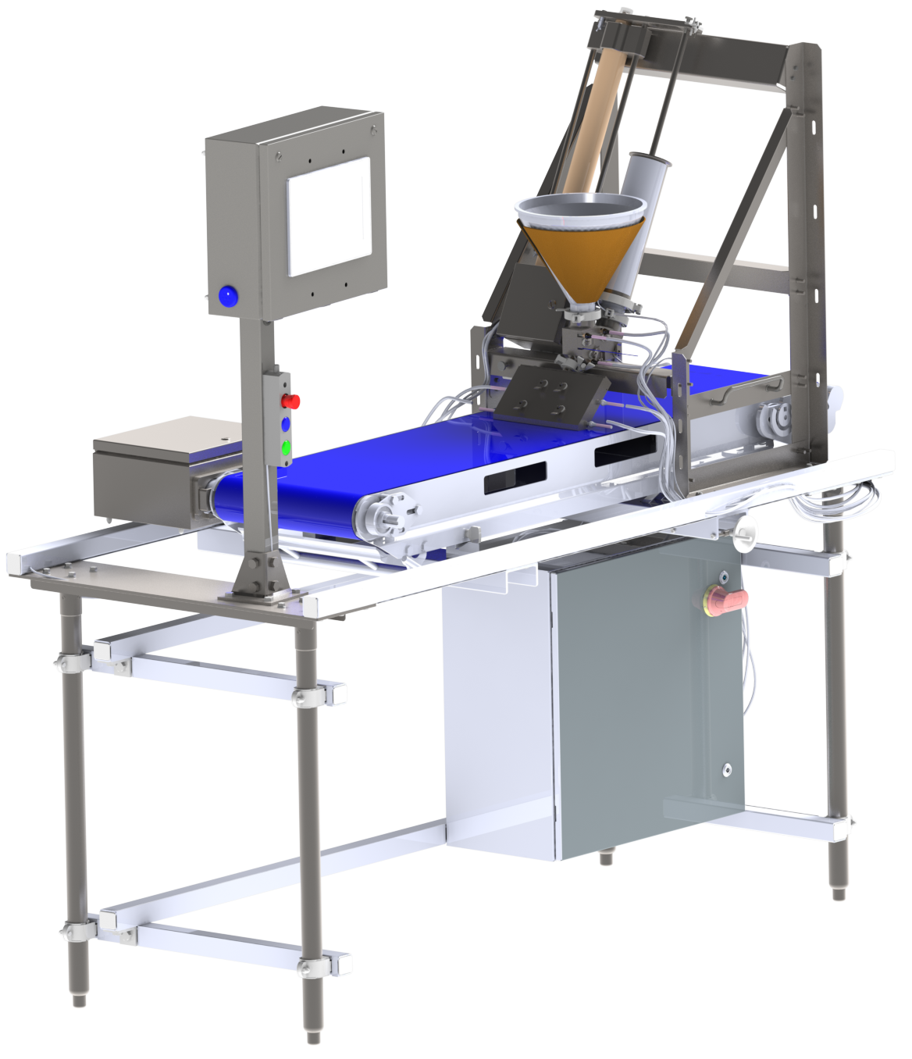
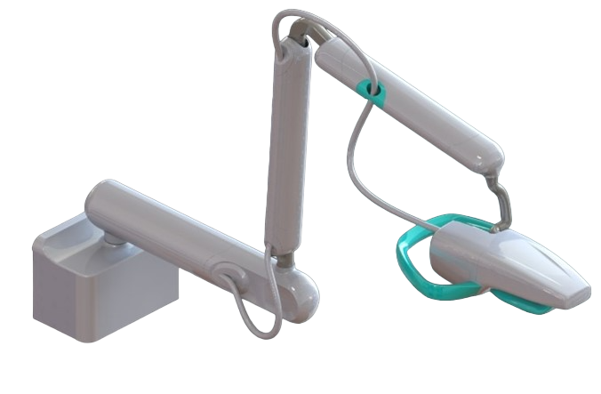
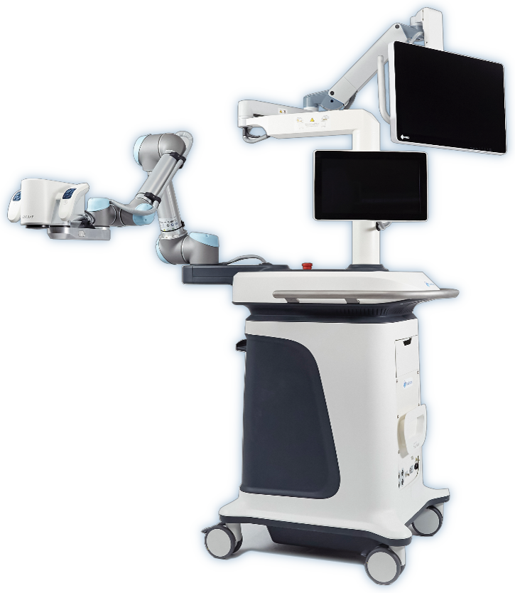
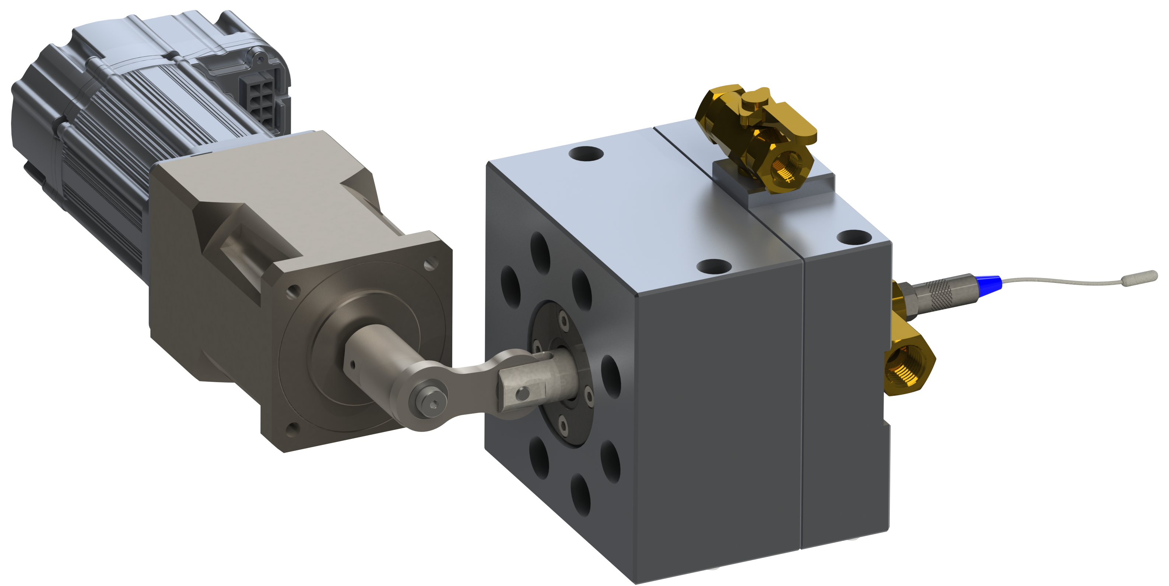
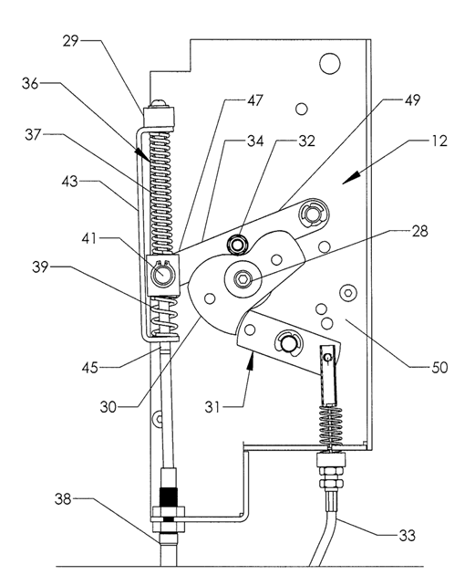
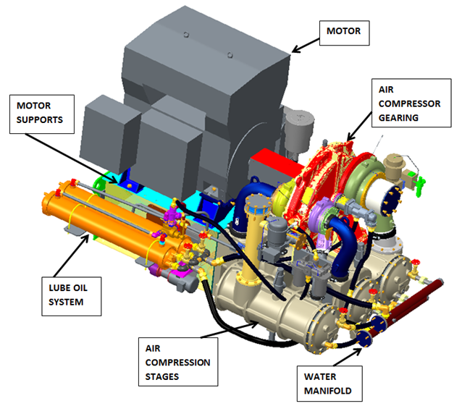
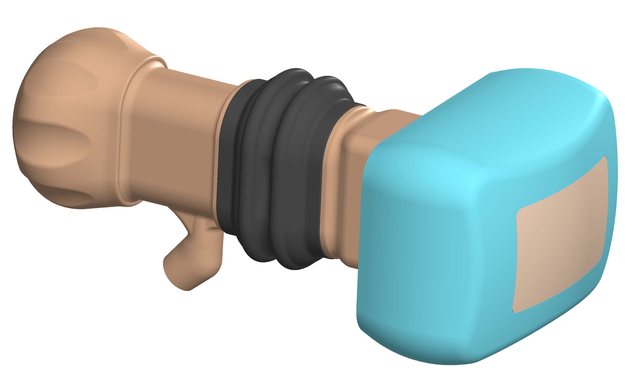
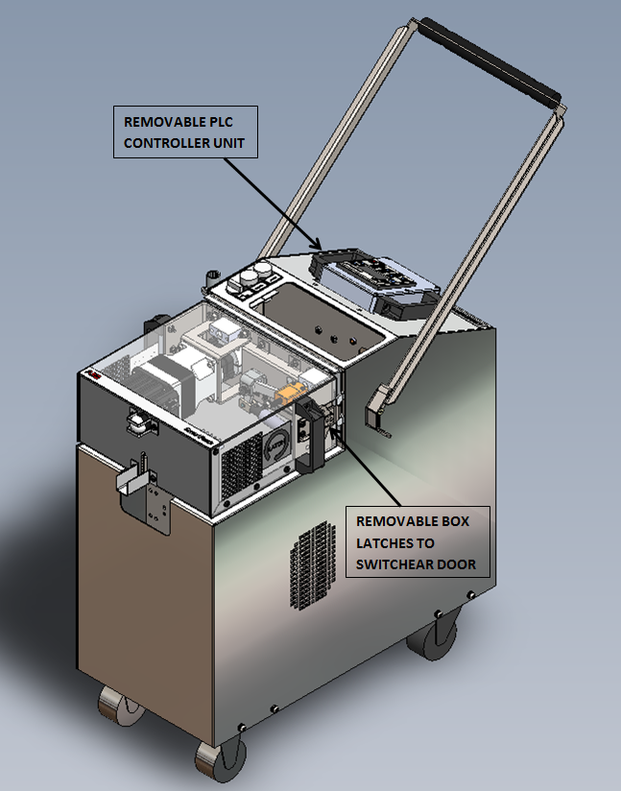
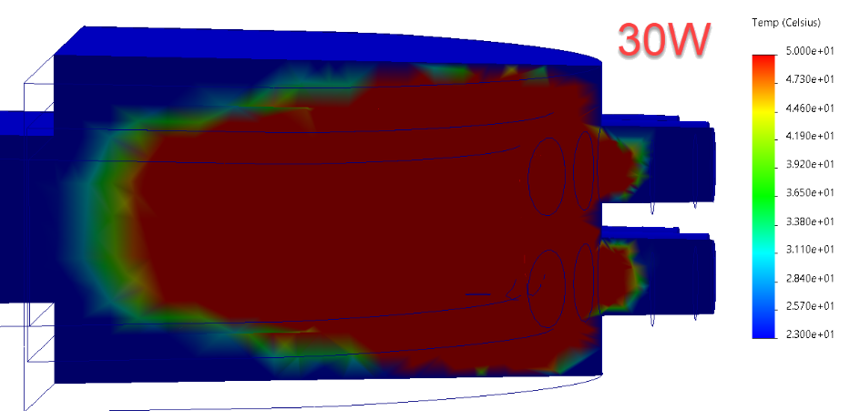
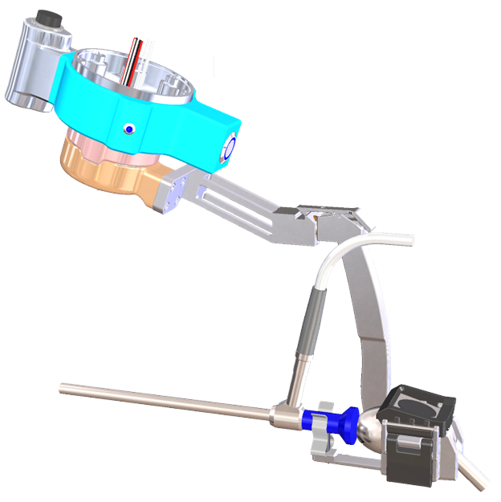
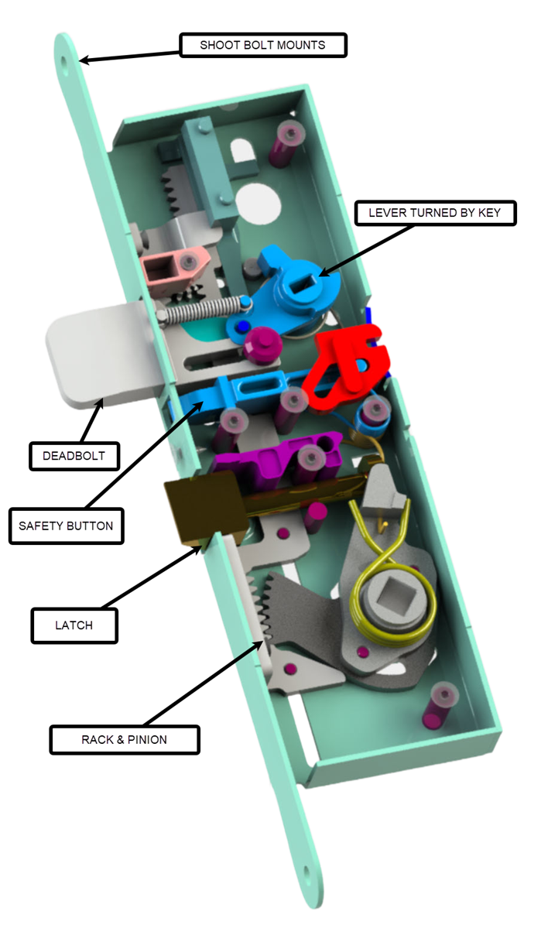
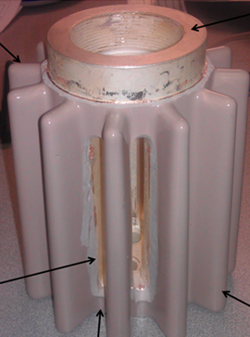
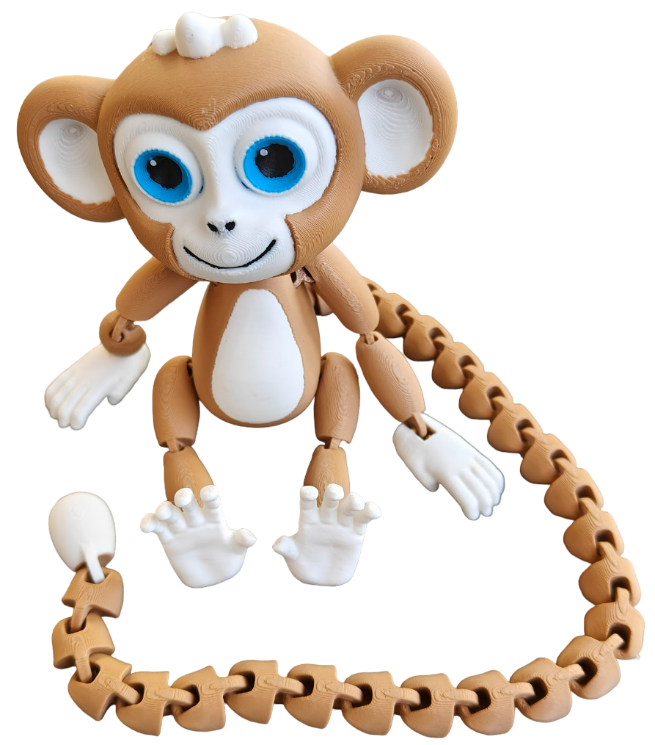
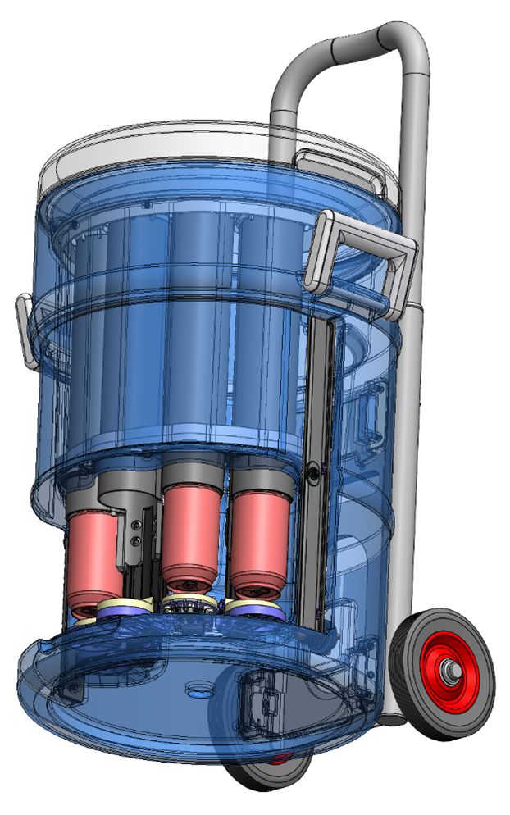
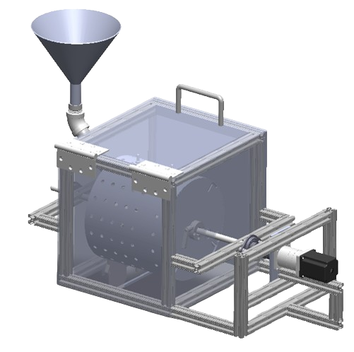
TABLE OF CONTENTS
ABOUT ME
3D X-RAY DEVICE
SURGICAL ROBOTIC 3D MICROSCOPE
DIAPHRAGM PUMP CATHETER DEVICE
DFM, INJECTION MOLDED PARTS
AUTOMATED FOOD PROCESSING DEVICE
SPRING-LOADED LOCKING MECH
SWITCHGEAR REMOTE RACKING DEVICE
PORTABLE MECH OPERATED CELL
TEAR-INDUCING HEATER
CENTRIFUGAL AIR COMPRESSOR
ENDOSCOPIC VISION SYSTEM
NARROW LOCK
EPOXY COATED “ARM”
CAN DISPENSER
COFFEE ROASTER
PERSONAL PROJECTS

Slide 3
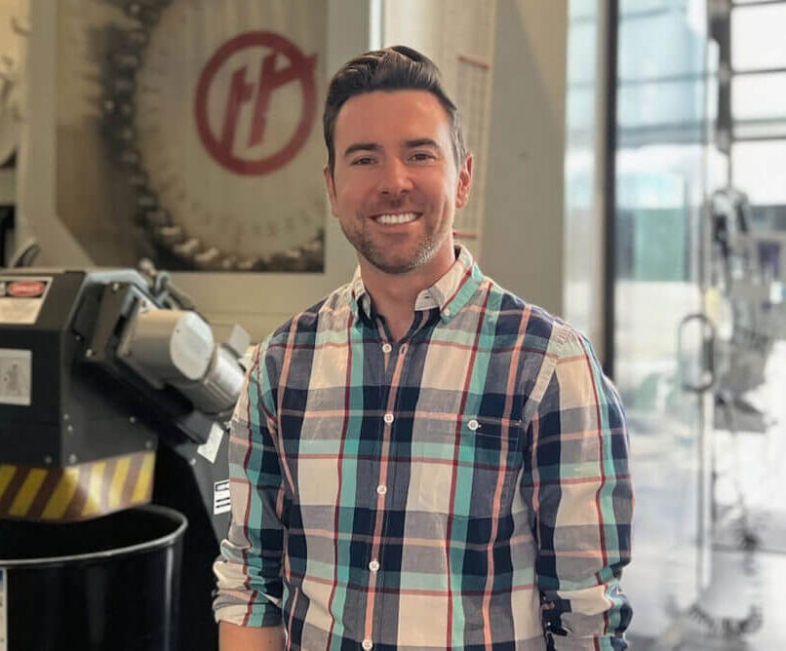
ABOUT ME
BASICS & BACKGROUND
Hometown: Durham, NC
Current City: San Francisco, CA, Mission District
BSME, North Carolina State University, 2009
14 years experience as Mechanical Engineer
Owned a handyman business at age 15
INDUSTRY EXPERIENCE
Power products
Medical devices
Air compressors
Metal-cutting tools
Consumer products
HOBBIES & PASSIONS
Maker & 3D Printer, tinkerer to a fault
Musician (vocals and production)
Hiking, soccer, basketball
Stand-up comedy enthusiast
GOALS FOR NEXT ROLE
Get back into technical leadership and mentoring
Drive innovation
Work on an exciting technology
Make use of my creativity

Slide 4
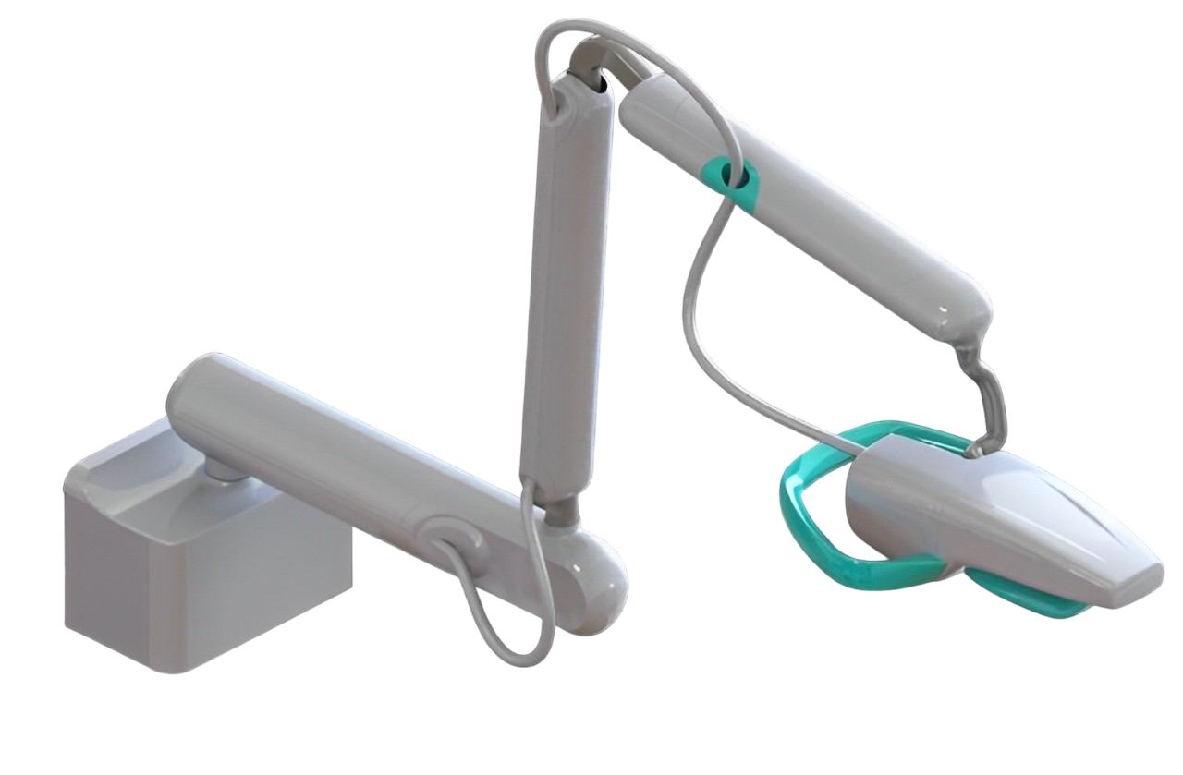
3D X-RAY DEVICE
SUMMARY
The 3D x-ray machine is designed to provide both a clearer and more comprehensive image to healthcare providers, the first of which being dentists. The technology uses multiple beams to create an image similar to that of a Computed Tomography scan (CT). It was then adapted for Tomosynthesis.
REQUIREMENTS
Product specs
  Reach and position
  Force/torque required to position
  CT image quality
FDA/IEC requirements
ROLE
Mechanical lead and sole Design Engineer
Prototyping and testing, including test protocols
Chemical compatibility studies
Working with software and electrical engineering
Working with international suppliers

Slide 5
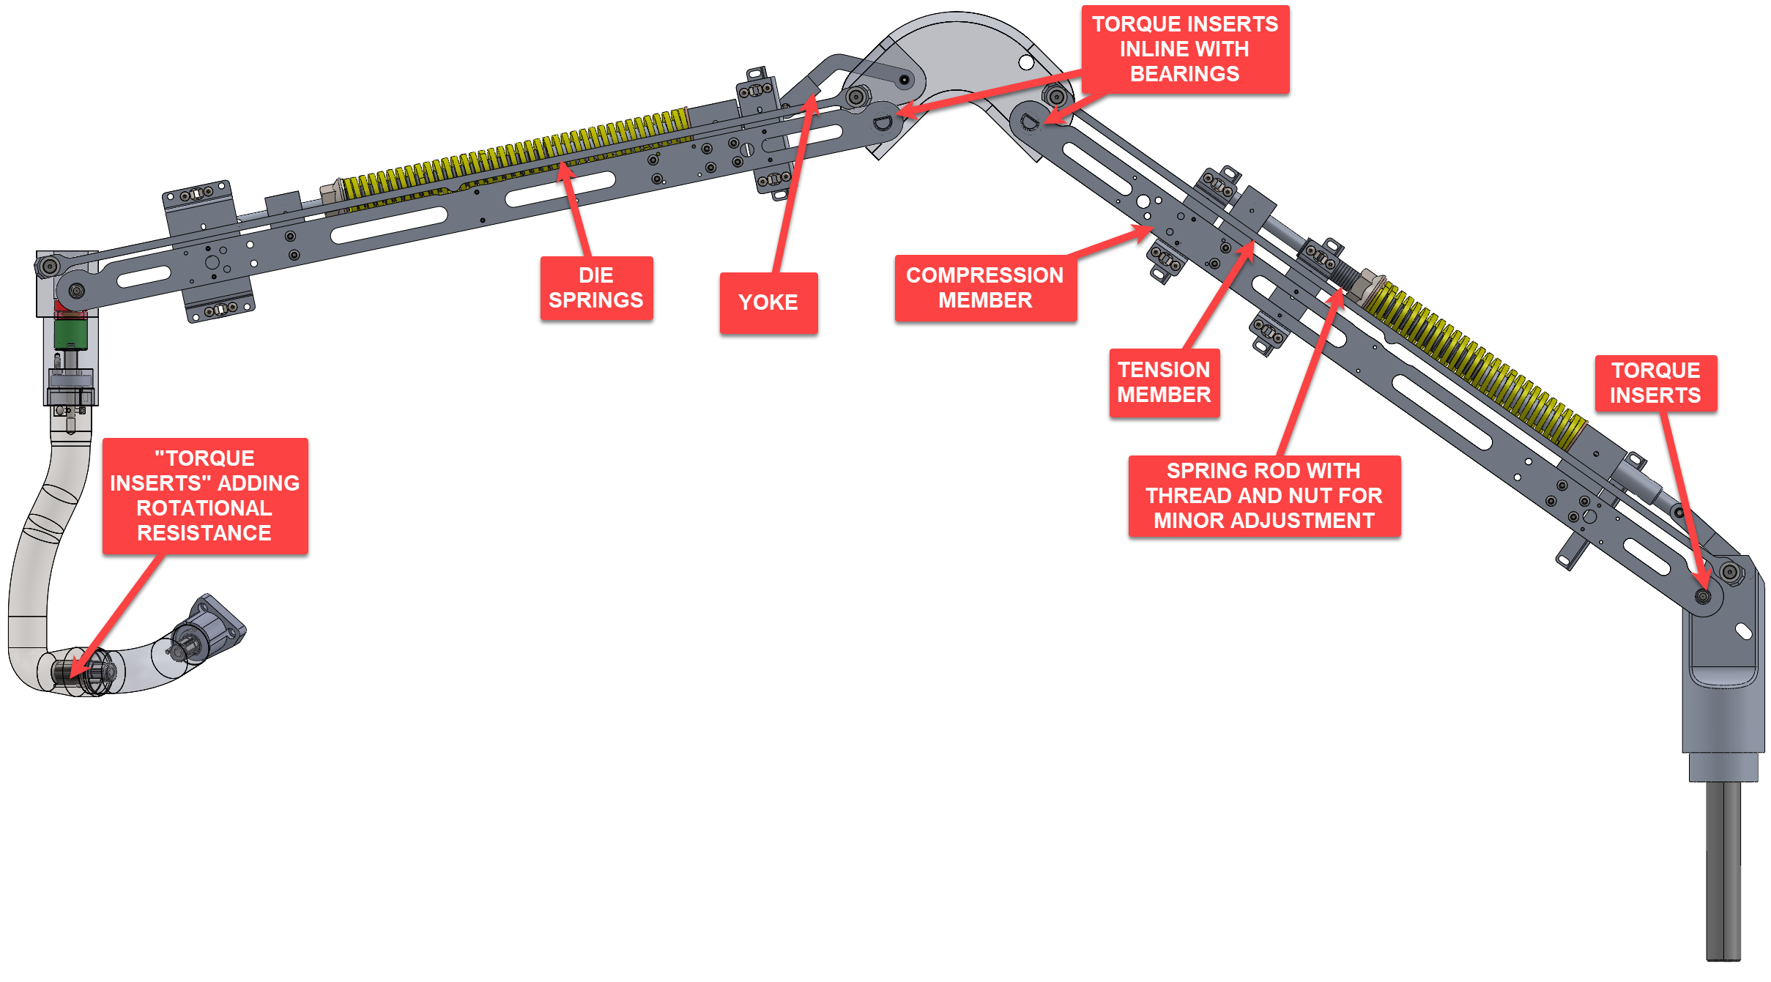
3D X-RAY DEVICE (CONT’D)
POSITIONING
Without a brake, and many degrees of freedom, great accuracy is needed
  Arm must move under low load, and fully static under no load, at all angles
Die springs act as a suspension system of sorts (tuned per assembly)
Built a calculator to predict the force required to move the arm at any angle, and compared that to the forces acting upon the system

Slide 6
SURGICAL 3D ROBOTIC MICROSCOPE
SUMMARY
The 3D microscope allows neurosurgeons performing microsurgery to get a clear, three-dimensional, “zoomed in”, visual representation of the patient as they perform surgery. The robot allows for ease of motion.
REQUIREMENTS
FDA and IEC regulations (510K submission), myriad product specs
ROLE
Design and analysis (finite element and modal in SOLIDWORKS Simulation) of functional and aesthetic parts.

Slide 7
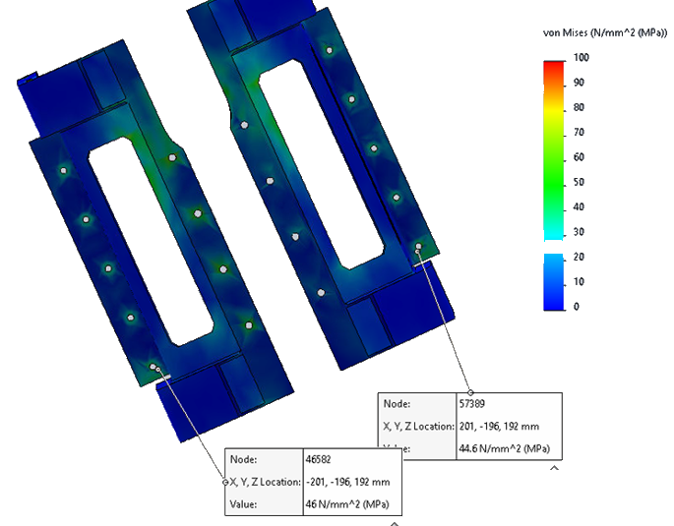
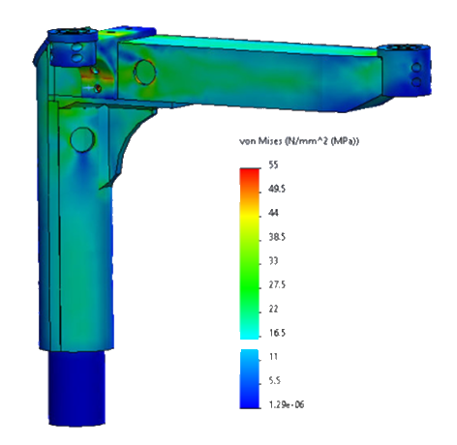
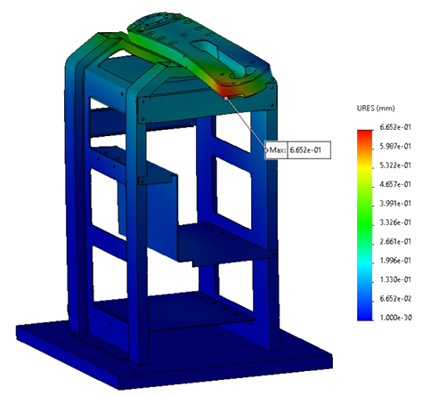
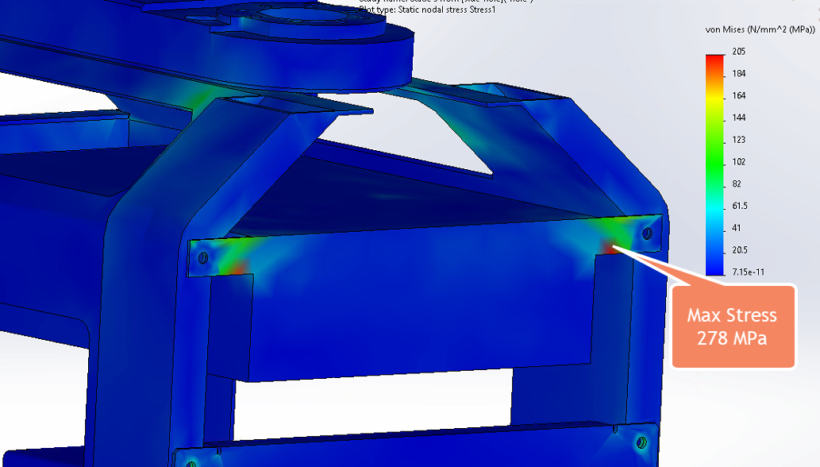
SIMULATION (3D MICROSCOPE)
SUMMARY
Static analysis of fully assembled frame, including fasteners to determine highest points of stress and verify safety factors in accordance with IEC 60601.
Fastener pull-out force verified
Modal analysis performed on cantilevered screen arm

Slide 8
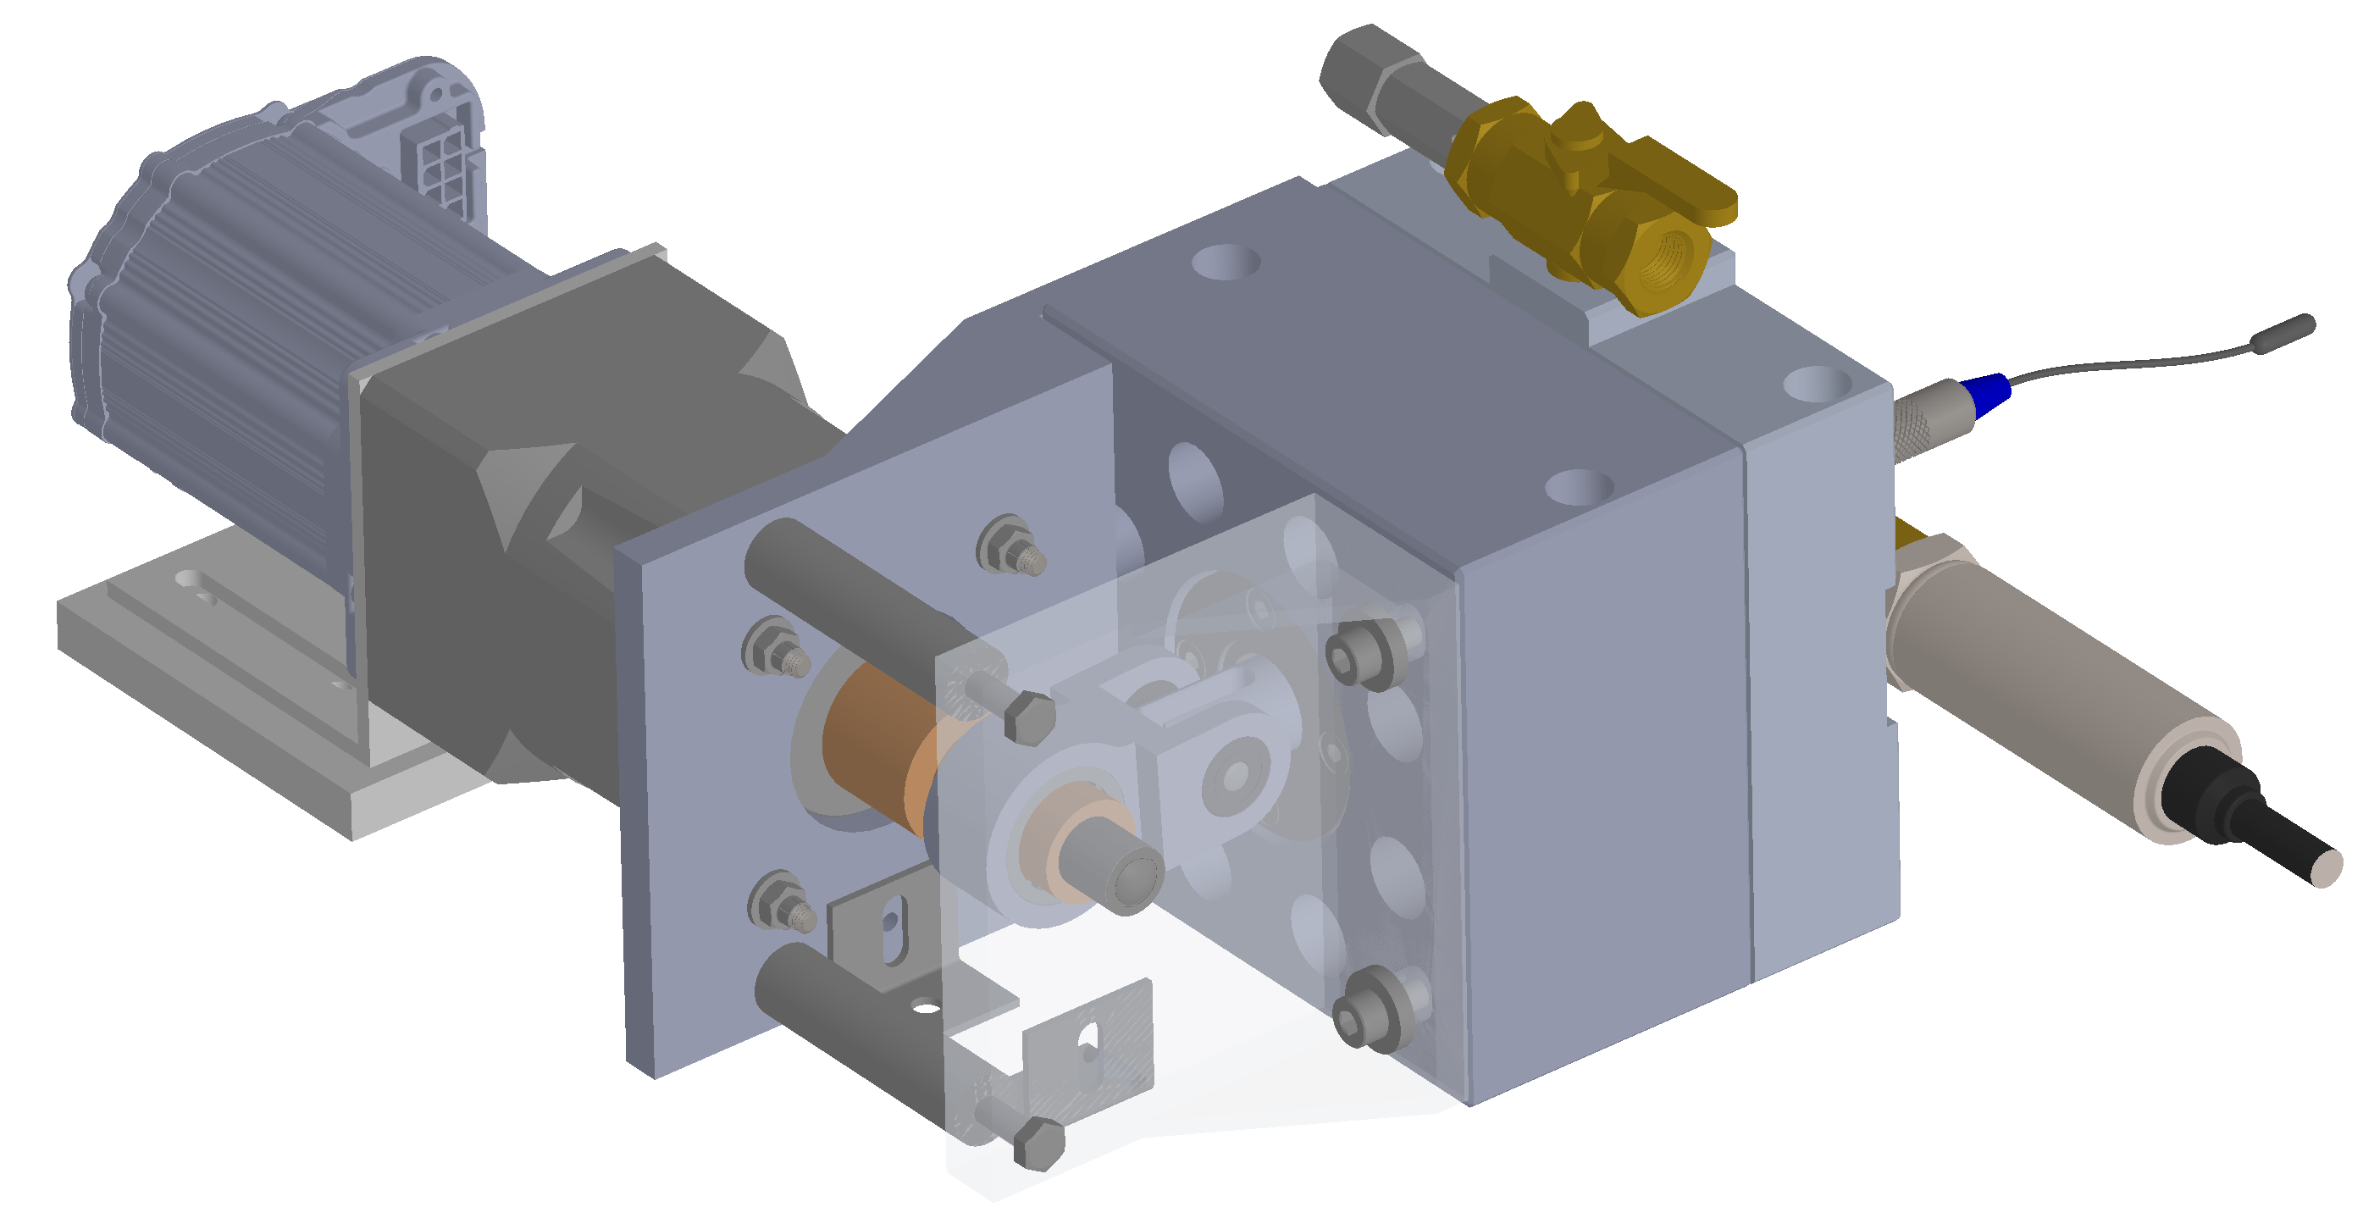
DIAPHRAGM PUMP CATHETER DEVICE
SUMMARY
A balloon catheter is used to remove intravascular calcified lesions. The balloon pulsates with force driven by a diaphragm pump, controlled by a servo motor / Arduino controller.
REQUIREMENTS
Product specs
  Frequency, balloon pressure
  Catheter/balloon size
FDA/IEC requirements
Low budget relative to complexity
~1Nm of torque required for 5.5kN force from chamber pressure
ROLE
Initial proof of concept
Research, design, and simulation
Testing and design iterations
Prototyping using manual machining, silicone molding, 3D printing
Project management
CAM and CNC machining parts

Slide 9
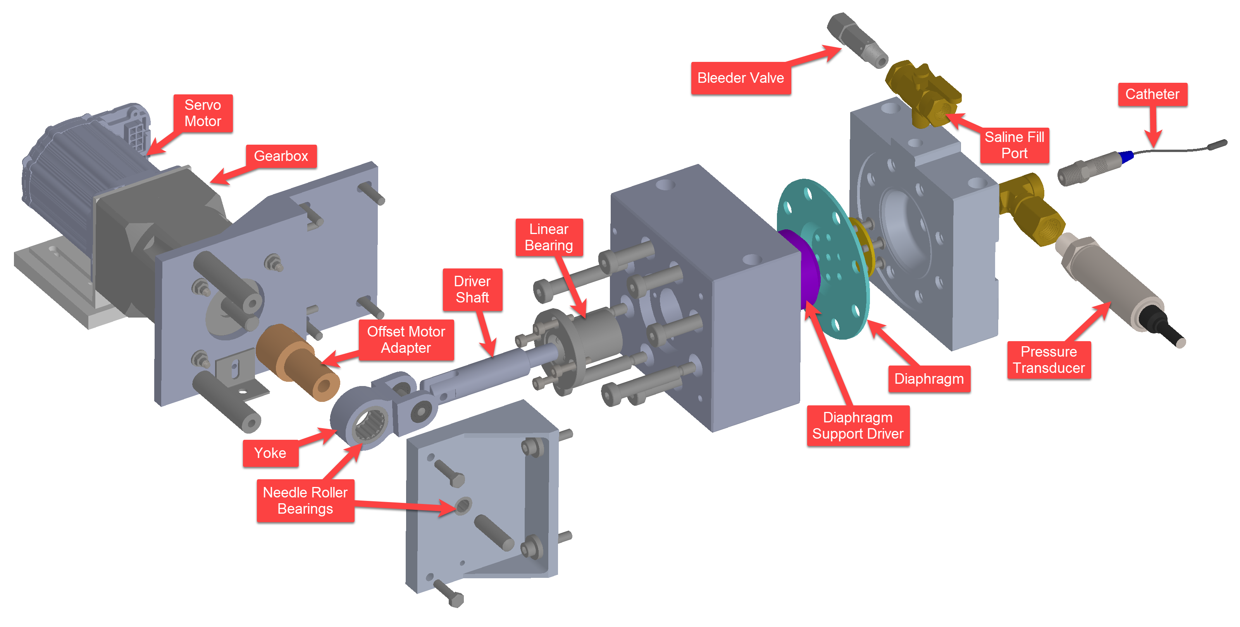
DIAPHRAGM PUMP EXPLODED

Slide 10
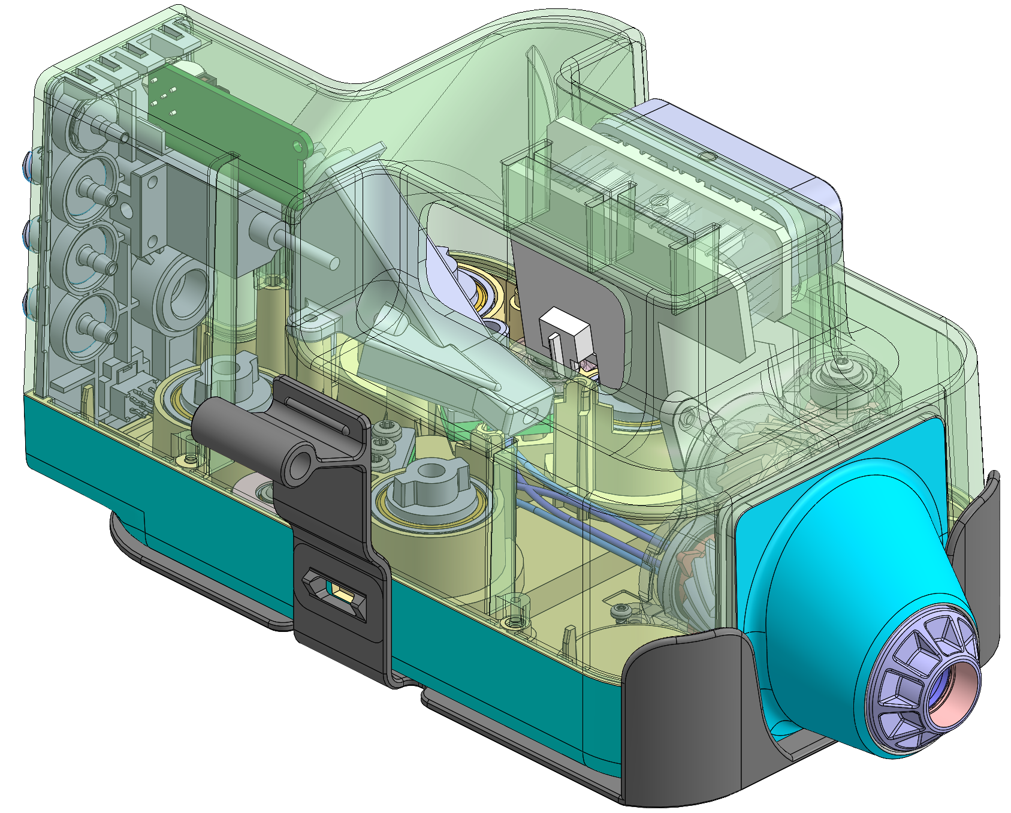
ROBOTIC ENDOSCOPE, INJECTION MOLDED PARTS
SUMMARY
A surgical device used sterilized plastic parts as part of a pulley driven push-pull cable system. The parts in the system were designed for 3D printing in a prototype. They needed to be redesigned for injection molding and redesigned in accordance with direction from industrial design.
REQUIREMENTS
Industrial design directions, molding best practices.
ROLE
Mechanical Design Engineer, functional and aesthetic parts. Worked with overseas CM to ensure moldability and quality.

Slide 11
AUTOMATED FOOD PROCESSING DEVICE
SUMMARY
A gelatinous material is poured into the temperature-controlled hopper. A piston uses negative pressure to pull the material into the cylinder, and then pushes it out through a nozzle into the desired form onto trays on a conveyer belt.
REQUIREMENTS
FDA and NSF regulations, product specs
ROLE
Designed framework, linear rail/actuator systems, conveyer motor system, modal analysis. Prototyping using CNC and manual machining, 3D printing, assembly, wiring.

Slide 12
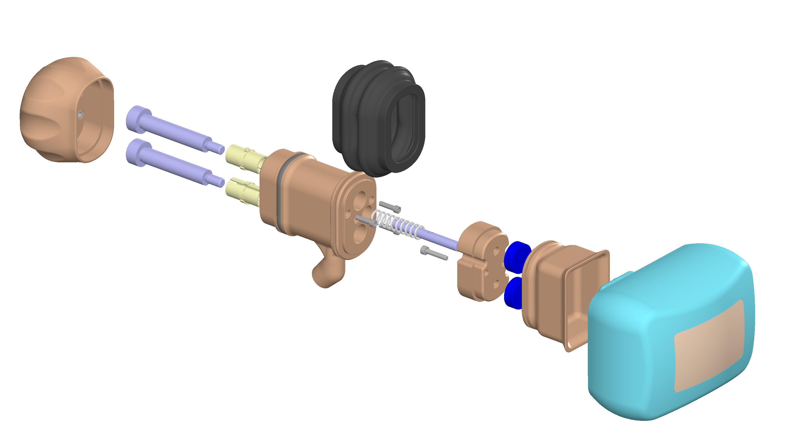
SPRING-LOADED LOCKING SYSTEM, MED DEVICE
SUMMARY
The surgeon places the device against the patient’s skin and had to hold it still for upwards of 30 min. The new device allows the surgeon to use an off-the-shelf armature and the spring-loaded mechanism to secure the device for the length of the procedure.
REQUIREMENTS
FDA/IEC requirements
Holding force of 25N
Stroke of 20mm
Sealing with a custom elastomeric seal
ROLE
Mechanical lead and sole Design Engineer
Prototyping and testing, including designing a mold for and molding the elastomeric seal
Defining materials
Identifying and managing vendors

Slide 13
SWITCHGEAR REMOTELY OPERATED RACKING DEVICE
Patents 9,876,335 and US8654513B2
SUMMARY
The electric remote racking device is intended to assist technicians with the process of racking medium voltage circuit breakers and associated equipment. The main function of the device is to perform the racking operation with minimal manual interaction. If the operator is nearby and the circuit breaker is charged when it disconnects, there can be a deadly explosion.
REQUIREMENTS
Move from connect to disconnect in 2 minutes, operate interlock, control all three positions, operator to lift no more than 45 pounds, cost under $3,000 to manufacture in small quantities.
ROLE
Design, motor and PLC programming, prototype construction, testing, supplier identification, project management, presentations to all parties including upper management, manufacturing support.

Slide 14
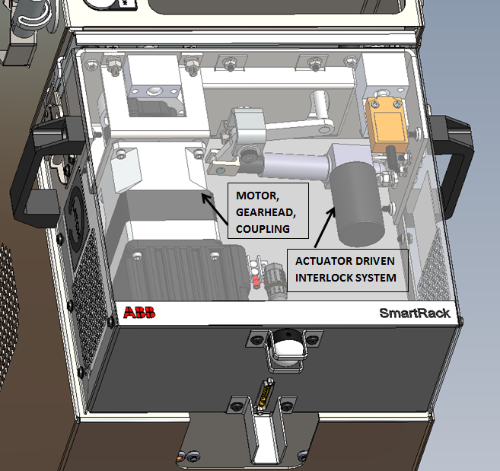
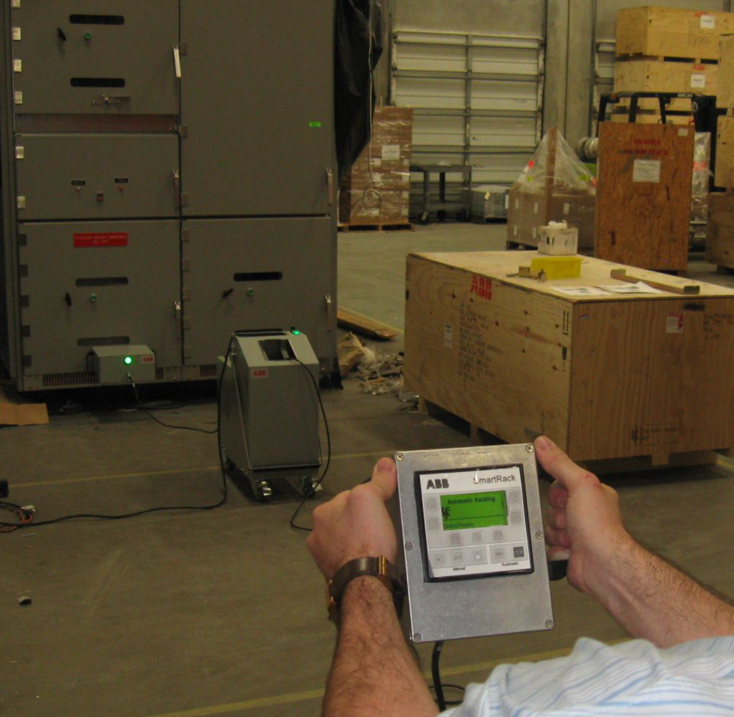
RACKING DEVICE CONT’D

Slide 15
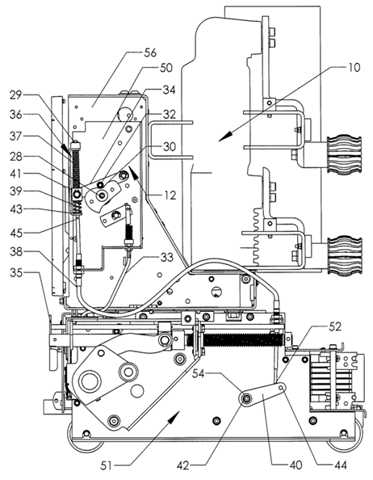
PORTABLE MECHANISM OPERATED CELL
SUMMARY
Circuit breakers retrofitted to existing breaker compartments or switchgear operated by rolling in or out have mechanical and electromechanical interlocks. The methods of interlocking often vary. A centralized, universal solution was desired.
REQUIREMENTS
Internal standards, IEEE, ANSI, ISO, and UL
ROLE
Adapt proposed solution to a wide range of circuit breakers, changing the proposed solution as needed.

Slide 16
ENDOSCOPIC VISION SYSTEM
SUMMARY
An endoscopic camera must be held in place to s specific tolerance. A magnetic coupling is held by a “quick-release” system, in a position held to a tolerance with respect to the camera/endoscope.
REQUIREMENTS
FDA and IEC regulations, product specs
ROLE
Mechanical Design Engineer, many functional and aesthetic parts, and analysis and redesign of existing systems. Prototyping using CNC and manual machining, 3D printing, assembly.

Slide 17
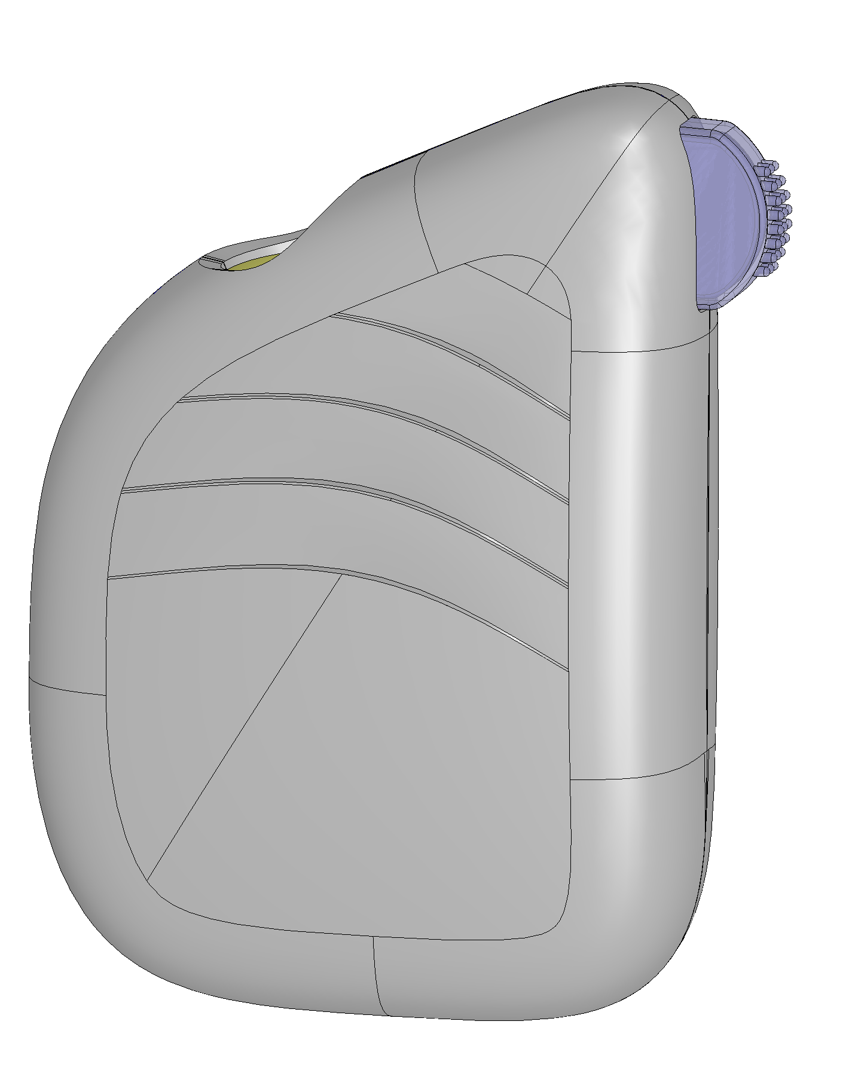
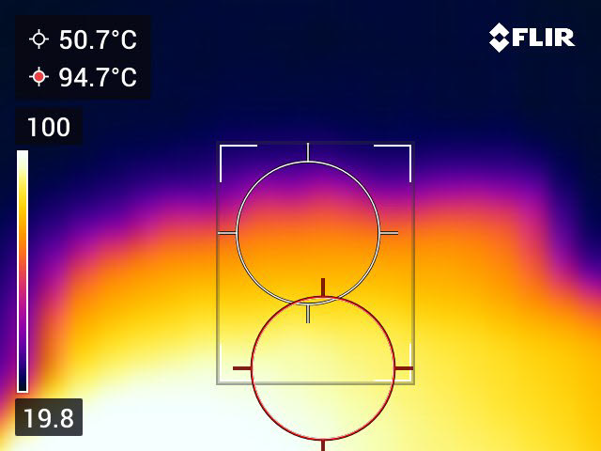
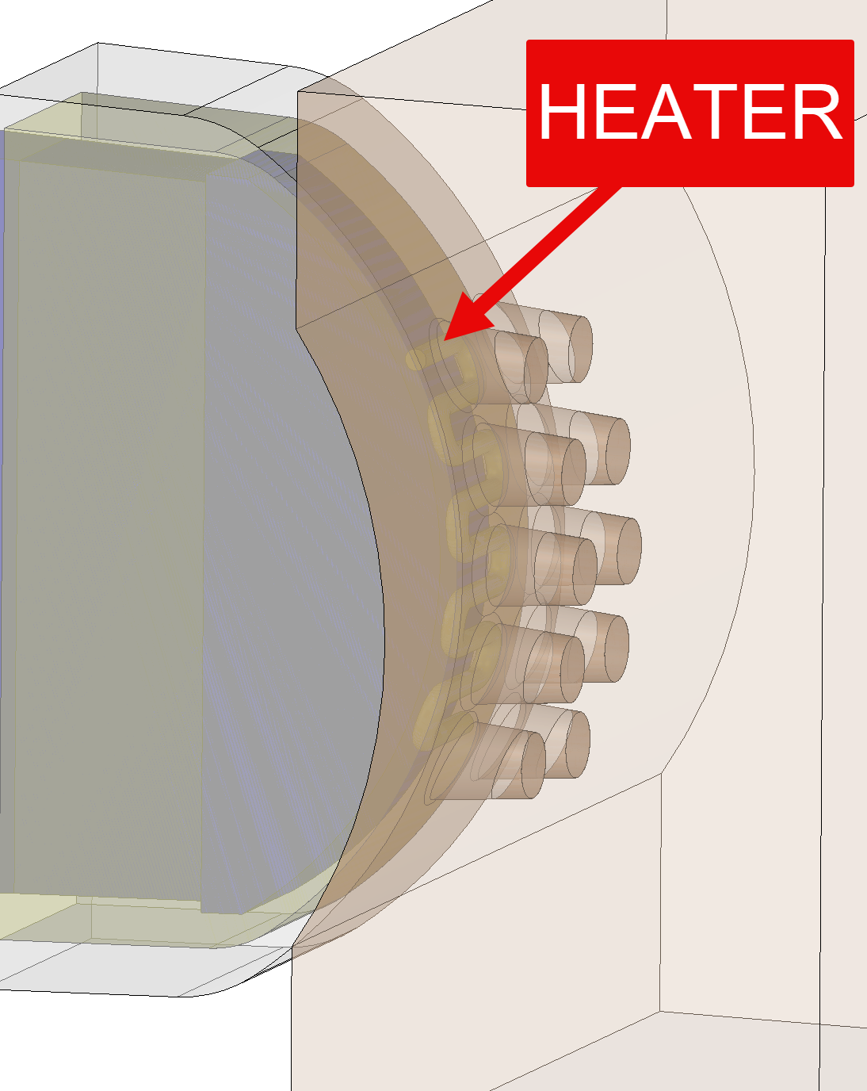
TEAR-INDUCING HEATER
SUMMARY
Device used to induce tears in a patient by vibrating against nose or by stroking across eyelid. Designed a silicone cover and a microheater to achieve optimal temperature.
REQUIREMENTS
Achieve specified temper
FDA regulations
Prevent overheating (used PTC)
ROLE
Design of cover and heater
Thermal analysis
Benchtop testing and iteration
Customer-facing project manager

Slide 18
NARROW LOCK
SUMMARY
The narrow lock was developed to meet market demand for a door that had less material on the frame and more glass. The lock has the same functionality of the standard lock but is designed to fit in a much smaller space.
REQUIREMENTS
Keep all functionality of standard lock, meet functional requirements of torque and force needed to operate mechanisms, maintain manufacturing cost, cycle test 20,000, and deadbolt load drop test.
ROLE
Design, testing, and manufacturing support.

Slide 19
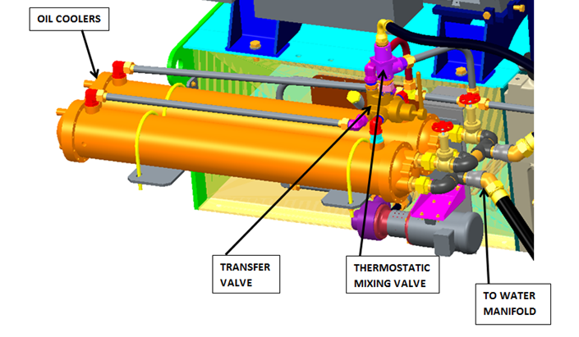
CENTRIFUGAL AIR COMPRESSOR DUAL OIL COOLER
SUMMARY
The oil cooler on an air compressor keeps the air and system components running at the desired temperature, but the cooler occasionally requires service. The dual oil cooler system allows the operator to transfer the switch to a second cooler and keep the machine running during service of the other cooler.
ROLE
Role: Identify cooler, valves, and hardware, layout full compressor model, design tubes, brackets, and incorporate oil pumps and water manifold, manufacturing support.

Slide 20
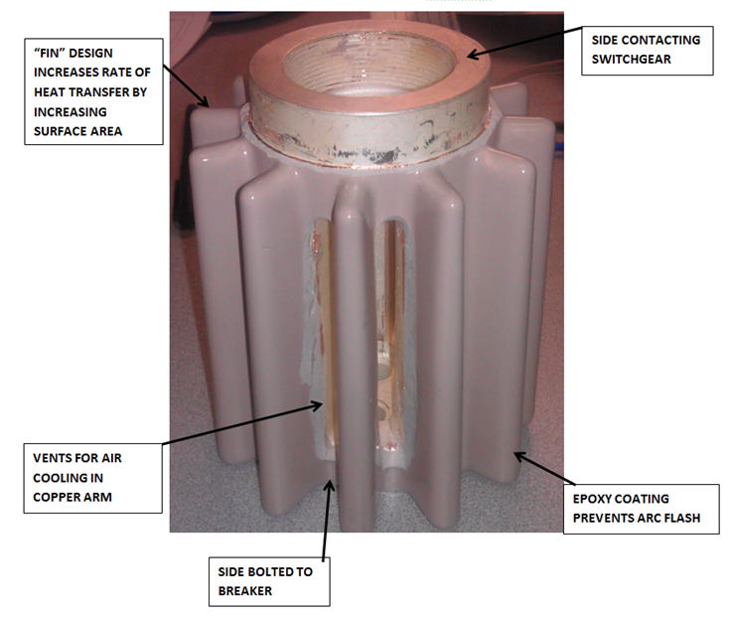
EPOXY COATED “ARM”
SUMMARY
The “arm” connects the circuit breaker and switchgear. Heat can reach a point that causes copper to braze and components to fail. The epoxy-coated, finned arm promotes heat transfer away from the arm, uses air to cool the arm, and is insulated from arc flash through coating.
ROLE
Redesign and optimize arm, fins, and select coating material to reduce heat at contact point. Run thermal simulation in SOLIDWORKS Simulation.

Slide 21
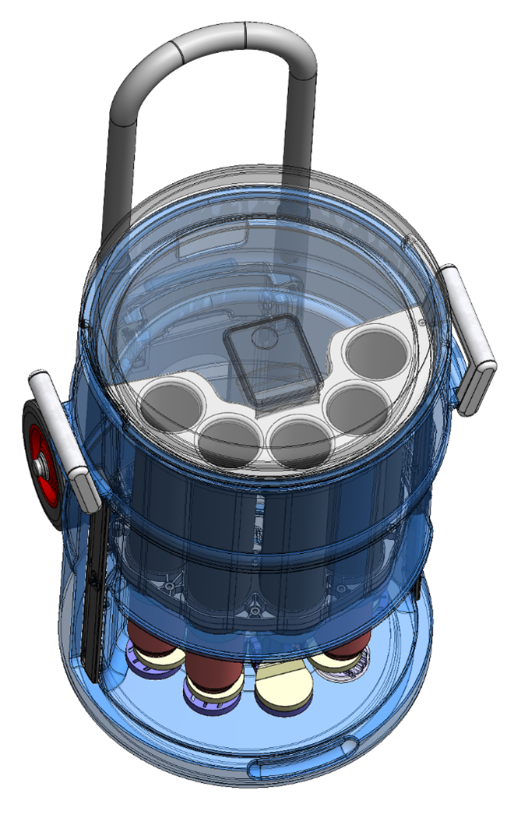
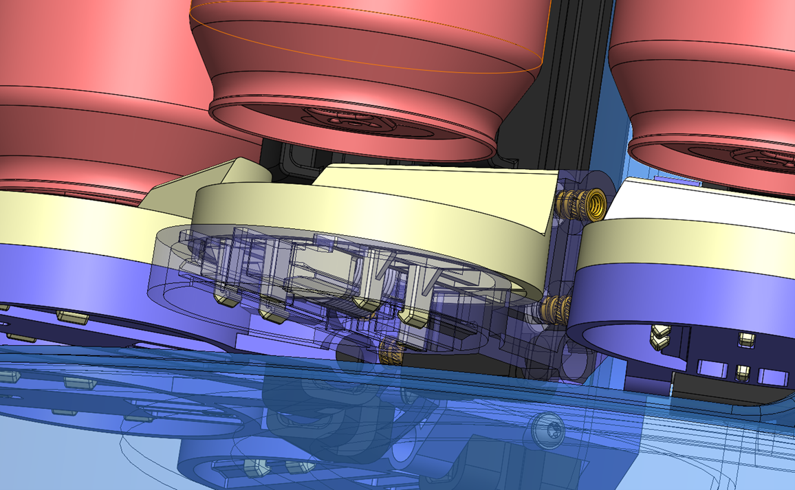
CAN DISPENSER
SUMMARY
Cooler and dispenser for multiple cans. User slides out one can at a time from the bottom window. Injection molded, overmolded, and machined parts.
REQUIREMENTS
Easily operable with one hand, max can temperature
ROLE
Mechanical Design Engineer, functional and aesthetic parts.

Slide 22
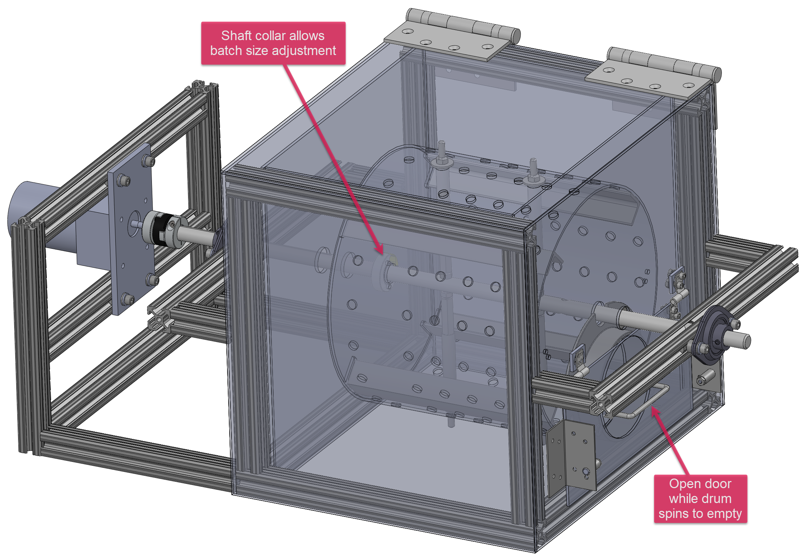
COFFEE ROASTER
SUMMARY
Designed a low-cost coffee roaster using a closed-loop stepper to obtain data and operate the rotary motion. The novelty of the invention lies in its ability to adjust the capacity, eliminating the need for companies to have multiple roasters for different sized loads.
REQUIREMENTS
Adjustable batch sizes, thermal and electrical requirements, rotating speed and motor power based on weight and volume of rotating coffee beans.
ROLE
Sole Mechanical and Electrical Design Engineer

Slide 23
PERSONAL PROJECTS

Slide 24
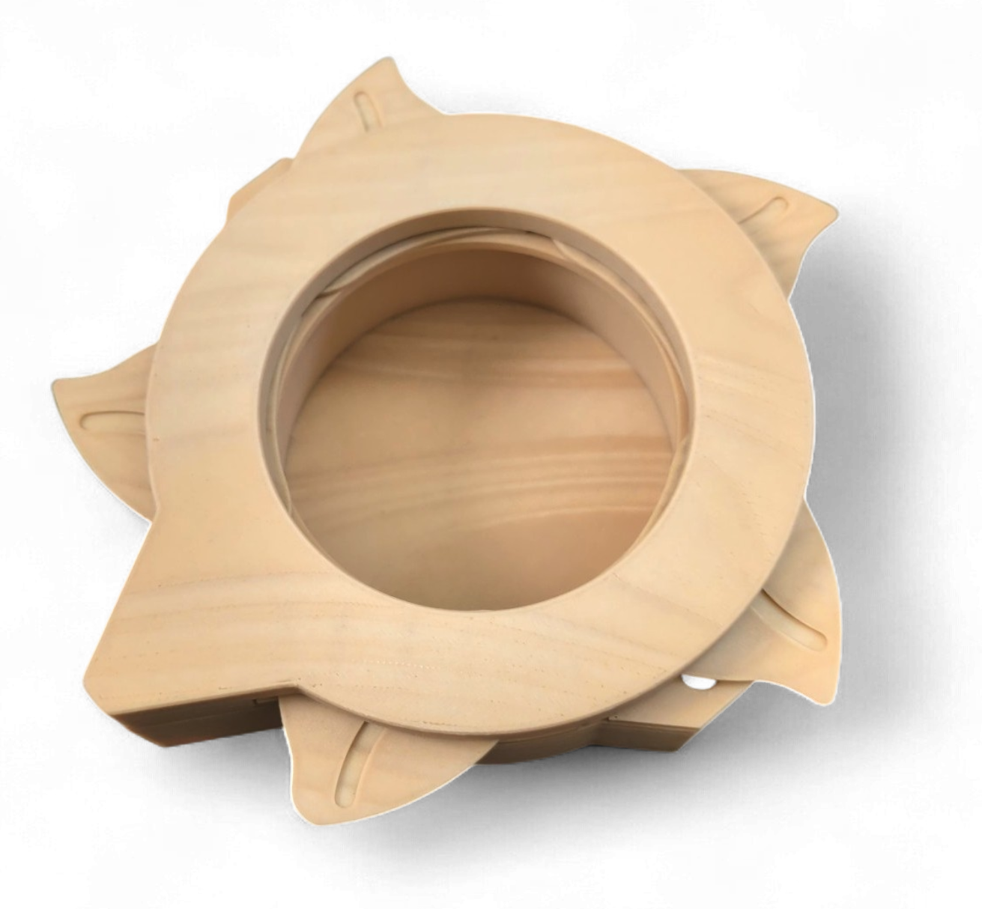
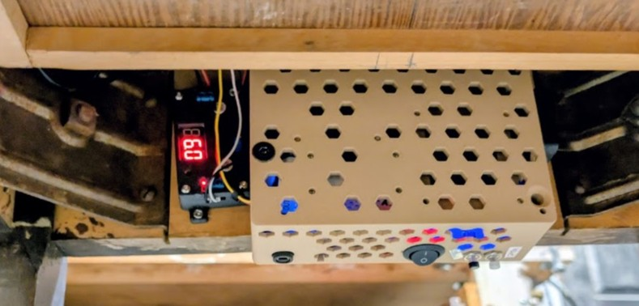
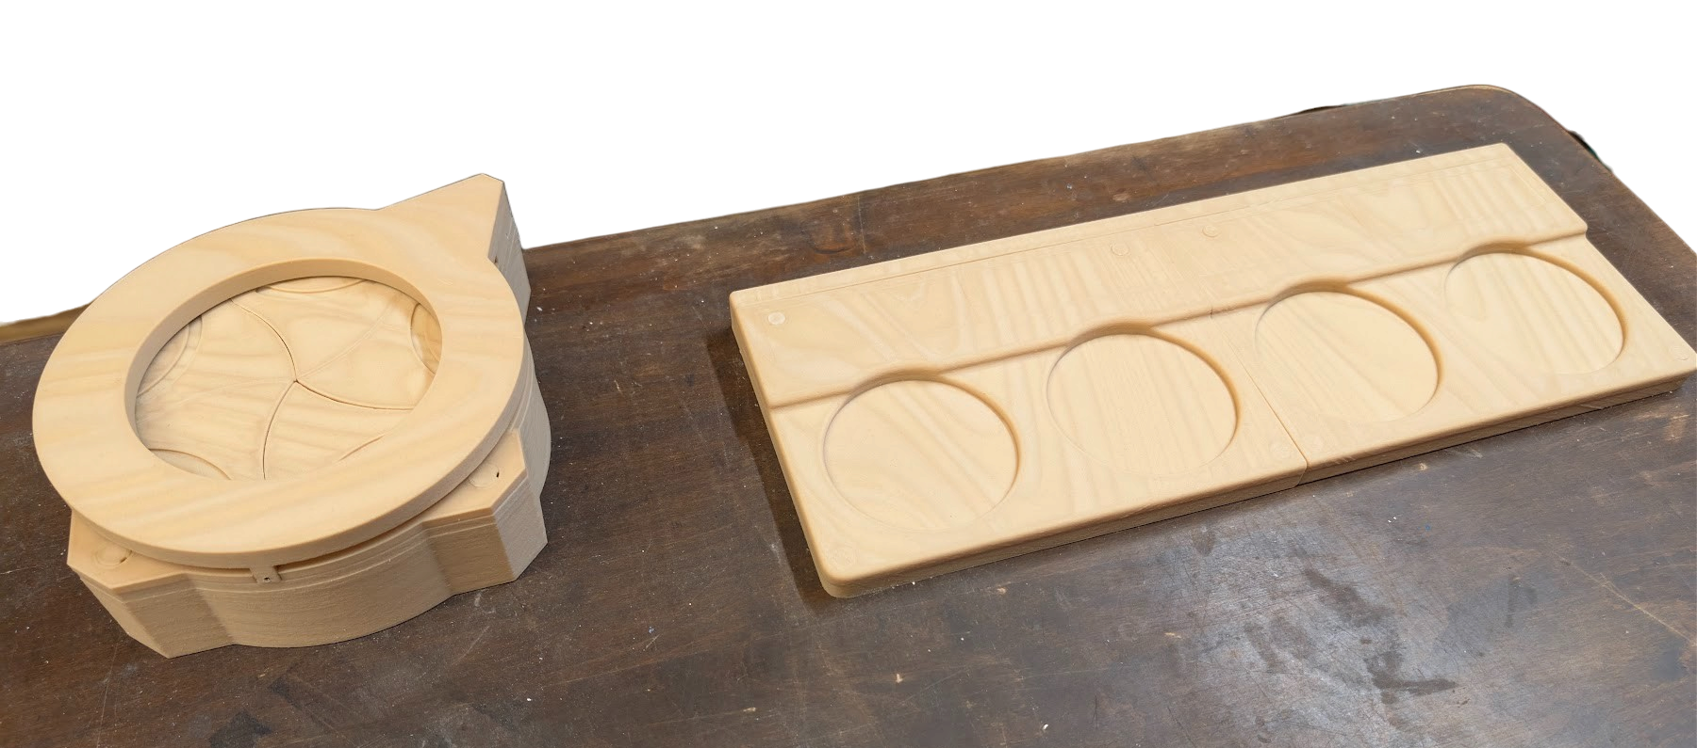
RFID ESCAPE ROOM PUZZLE
SUMMARY
Players place 4 bottles, each with a hidden RFID tag, on a pad in the correct order. When the order is right, a 3D-printed iris box opens to reveal a hidden key. Controlled by a Raspberry Pi and powered by a 12V LiFePO4 pack. Built for my sister’s neighborhood escape room.
REQUIREMENTS
Detect and identify 4 tagged bottles by RFID, open the key box only when all 4 bottles are in the correct order, operator can manually open or close the box and reset the puzzle, self-powered by a rechargeable battery, with all wiring and electronics hidden from players.
ROLE
Designed and built entire system, wired, coded in Python on Raspberry Pi, debugged.

Slide 25
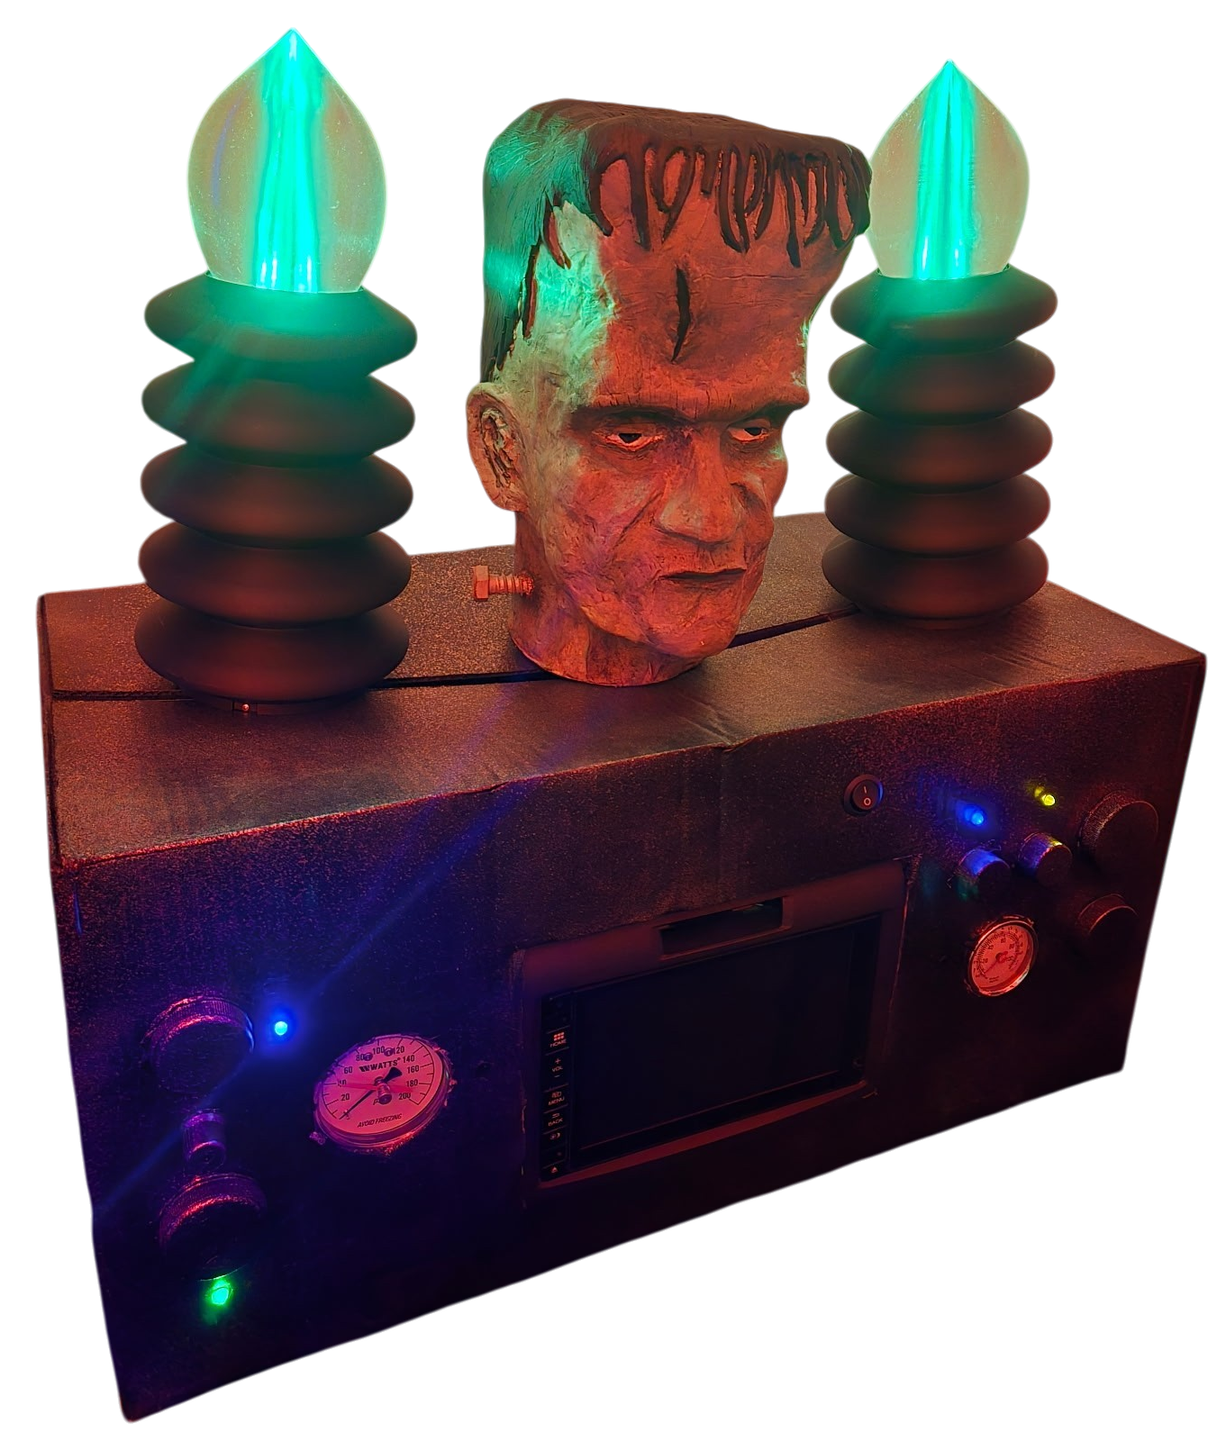
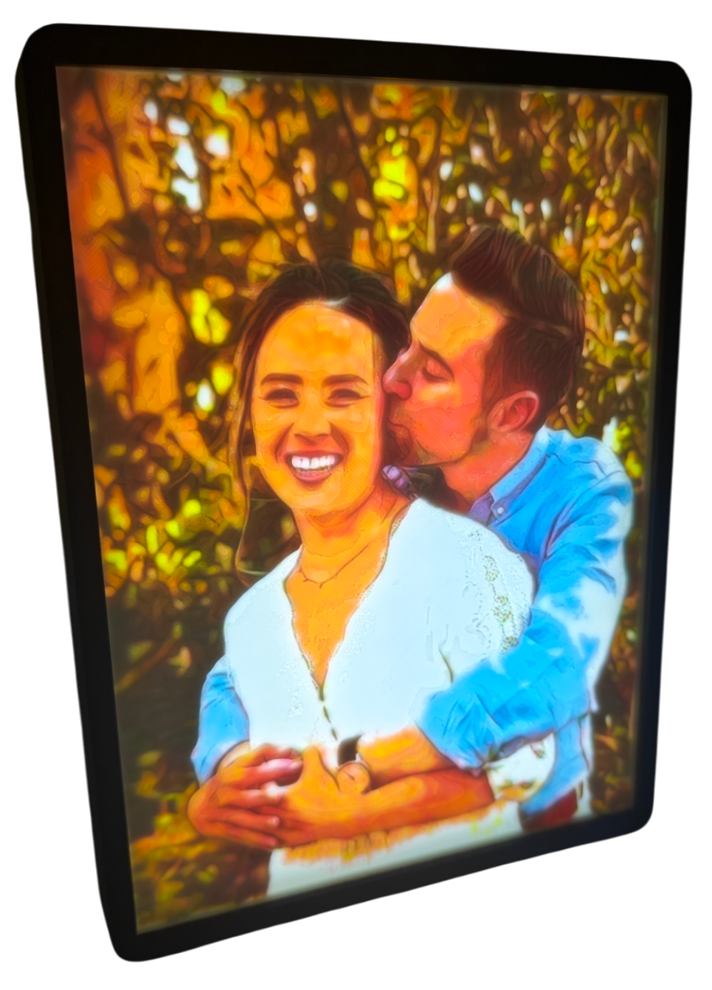
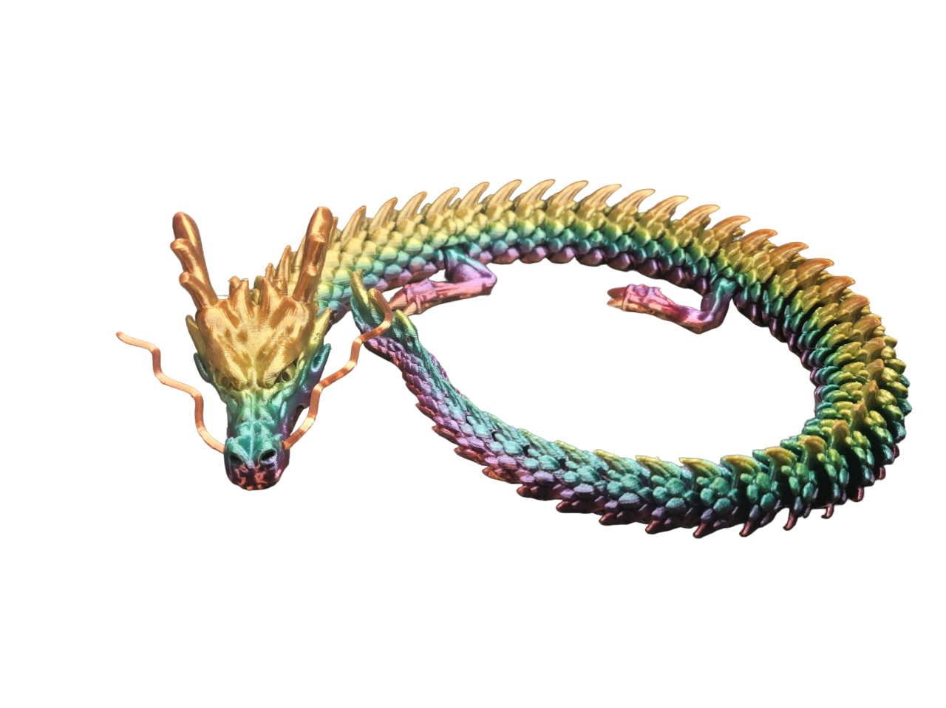
3D PRINTS & MAKES
LED Backed 3D Printed Lithophane

Slide 26
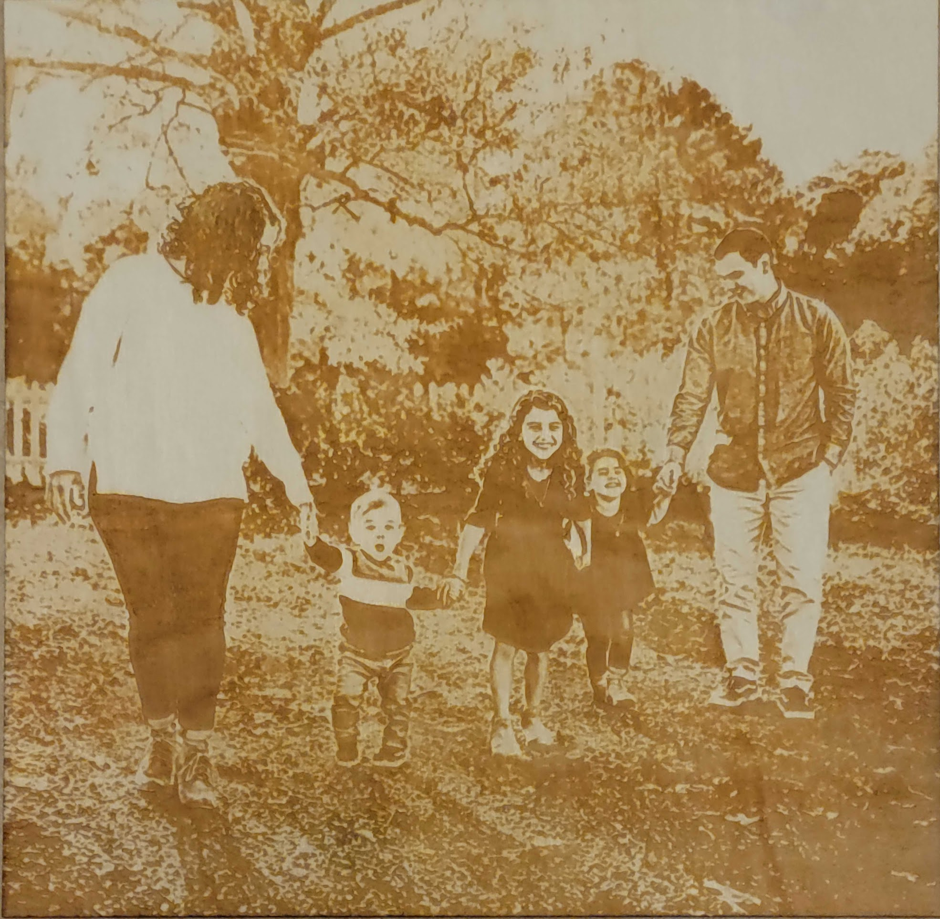
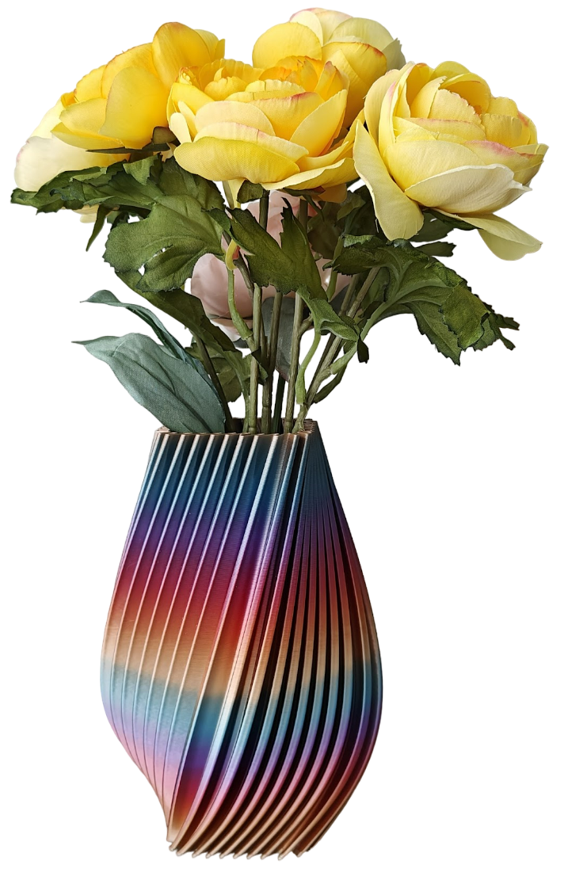
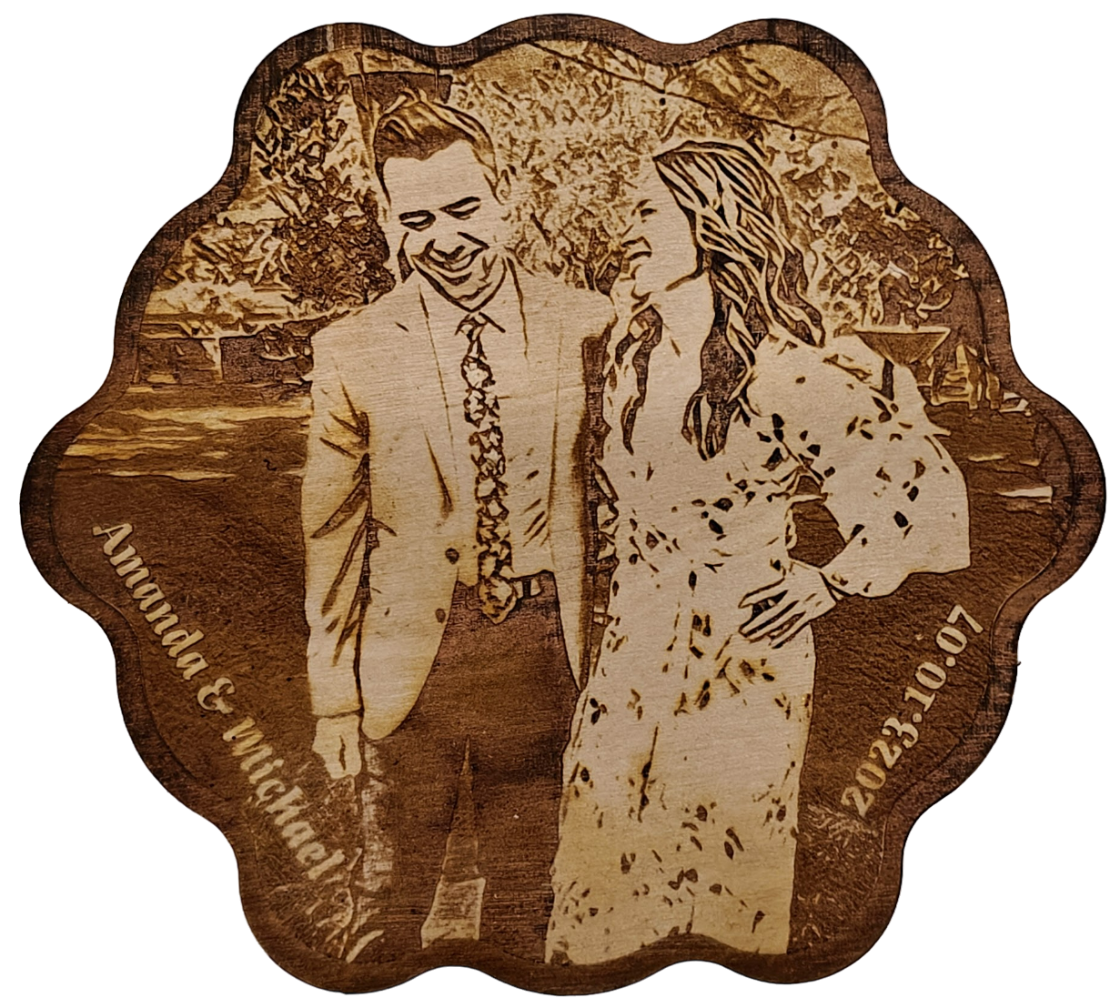
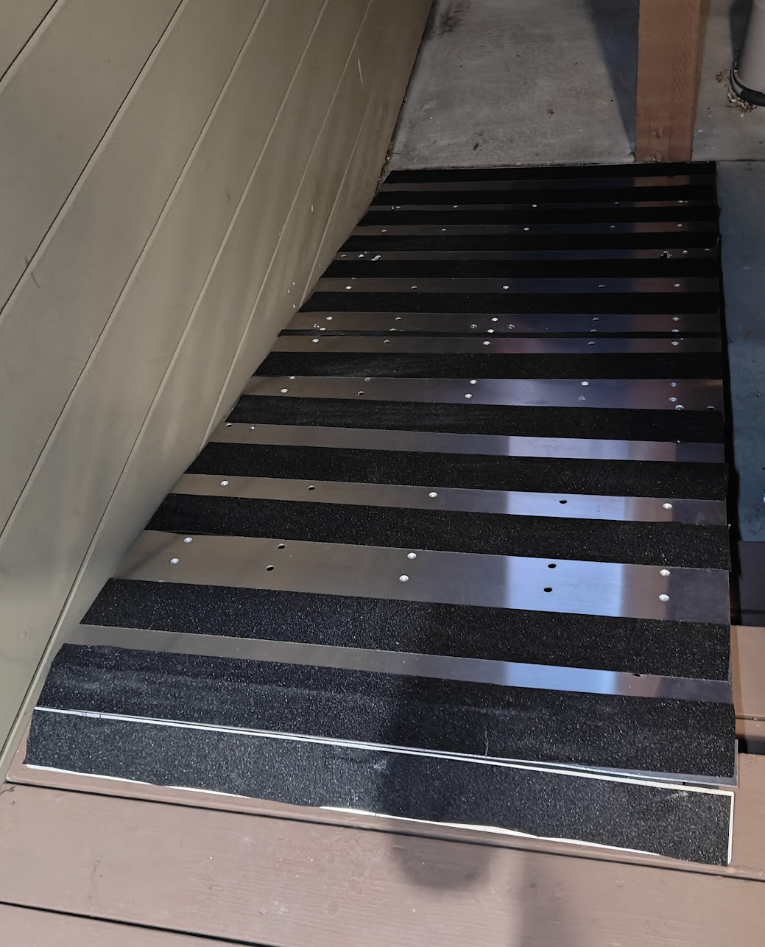
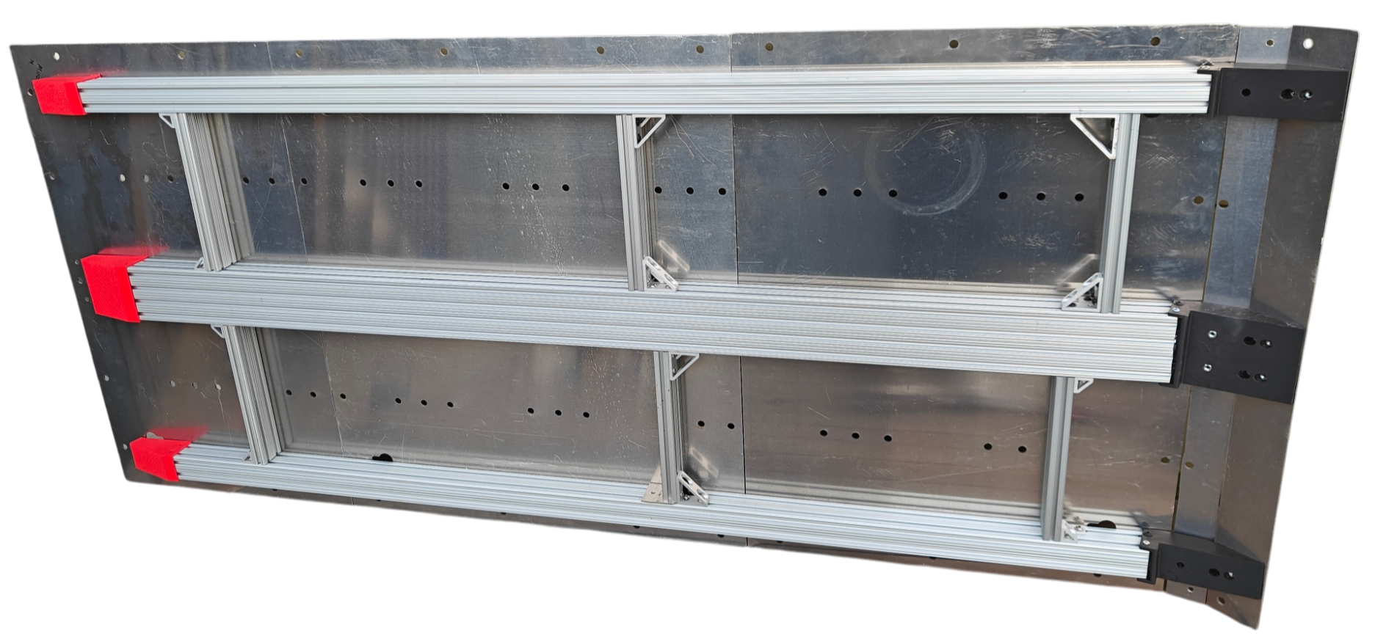
3D PRINTS & MAKES (CONT’D)
Laser cut and Etched Wedding Coasters
Ramp for Steps (made from scrap metal)

