Slide 1
Excel at Excel

Slide 2
Topics
Anatomy of Excel
Navigating in a spreadsheet
Entering values and applying cell styles and conditional formatting
Performing calculations & Using built-in functions to perform calculations
Autofilling Series and Formulae
Using relative and absolute references
Shortcuts for working more efficiently
Introductory Tables and Pivot Tables
Working with graphs and charts

Slide 3
First things first
Please download our materials from:
https://github.com/mjmacarty/excel-at-excel
Before we get going let’s spend a couple of minutes talking about anything specific that you want to see.
Please write down anything you wanted to see when you signed up for this workshop
I will do my best to make sure you see it!

Slide 4
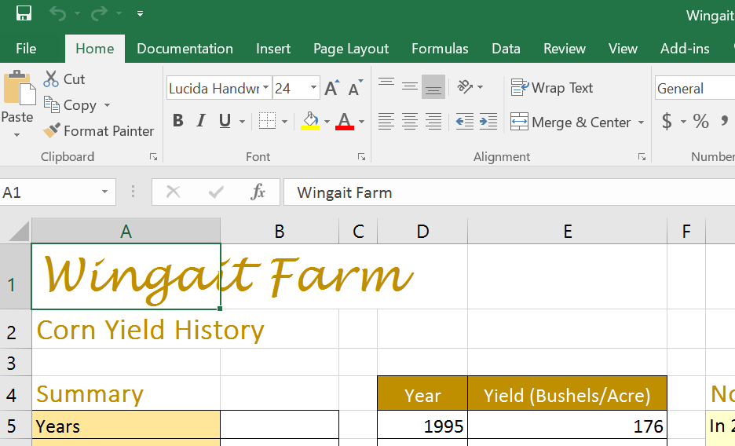
Anatomy of Excel
Ribbon tabs: organized by activity
Quick access
toolbar
The ribbon
Formula Bar
Commands are
organized into
related groups
Column identifier
and selector
Row number and selector

Slide 5

Using the quick access toolbar
Click the drop down menu on the right side of the quick access toolbar
Select desired command
Repeat as needed to customize your menu
Click More commands… near the bottom if what you want isn’t listed by default

Slide 6
Entering values and navigating a worksheet
We are going to start by using some common techniques to model a problem, in our case the problem is how much revenue can be generated by growing a lot of soybeans: Open the file: Beans.xlsx
We are told that the farm has 150 acres available to plant
They will estimate a full 150 acre crop using a test field with the following dimensions:
6 rows, each one 300 feet long
3 feet wide and 3 feet between rows
Test plot yielded 655 pounds of beans
Moisture content was 16.5%
Enter these values in the appropriate cells

Slide 7
Using coloration and other visual cues
Spreadsheets are dynamic communication tools
You may not be the end user of your work
Ease of understanding and use should be one of the goals
We will use cell references in our calculations to promote ease of use and “advertised” correctness
We will use cell colors and other formatting to signal to the spreadsheet consumer where it is “OK” to change values and which cells contain calculations

Slide 8
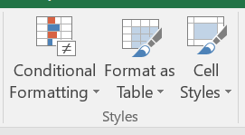
Cell styles
Excel has a number pre-defined cell styles
Cell styles can be accessed from the Styles group on the Home tab
In addition to pre-defined styles, you can create custom styles
New Cell Style… (near the bottom of the pop up)
Click format to make desired changes
Click OK to close the Format Cells dialog
Then click OK again to save the style

Slide 9
Applying a style to multiple cells
Cells can be selected singly, in a range or over several ranges
Click on click B4 to select it
Hold the Ctrl or Command key
Click and drag cells B7:B9
Click and drag B13:B14
Click B19, then Click and drag E7:E10
Click the Cell styles button and select Input
Repeat the selection procedure for B10, B15:B16, B20:B21, B23
Use Cell styles to format these cells as Calculation

Slide 10
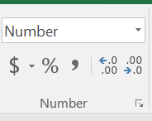
Calculations in Excel
Excel uses the following symbols to perform calculations
+ (addition)
- (subtraction)
* (multiplication)
/ (division)
^ (exponent)
We will use some of these to complete the necessary calculations
To calculate the test plot in acres, in B10 enter the following:
=2*B7*B8*B9/E7
We have far more decimals displayed than necessary
Adjust using decrease decimals from the number group

Slide 11
Completing other calculations
Our bean weight will need to be adjusted for the standardized moisture content expected
The following formula should be entered in B15:
=B13*(1-B14)
Then to calculate the weight we will be paid for in B16 enter:
=B15/(1-E8)
Click in B19 and decrease the decimals so only the number 11 appears in the cell
Calculate Bushels per acre as B19/B10
Calculate Total Yield as B20*B4
Calculate Estimated Revenue as B21*E10
NOTE: Even though we have decreased decimals in some cases, Excel calculates results using actual values

Slide 12
What-if analysis
Suppose the roughly $66,000 we estimated just isn’t enough and you wanted to find out what kind of yield would be needed to get to say $80,000
Since we set up our sheet to be flexible we could simply click in B13 and test different values there until we hit the right one
This is a form of What-if analysis, but it isn’t terribly efficient
Fortunately Excel has a tool we can use to get there quickly…

Slide 13
Goal Seek
Goal seek is a built-in tool that basically does what was described on the previous slide
Click on cell B23
Click on the data tab
Locate the What-if Analysis button and click, and select Goal Seek…
Be sure B23 appears in the Set cell: box
Click in the To value: box and type 80000
Click in the By changing cell: box
Click B13, then click OK

Slide 14
Using some built-in functions
Excel has automated many of the longer calculations that are common and includes many reference and logical functions
While the results of these functions is highly varied, they share a common syntax
General syntax of all Excel functions:
function_name(argument1, argument2, …)
Square brackets indicate optional arguments:
function_name(argument1, [argument2], …)

Slide 15
Common statistical functions
Function name | Output
SUM() | Adds the values in cells or ranges
AVERAGE() | Calculates the average of a collection of numbers
MIN(), MAX() | Finds the smallest or biggest value from a collection of cells
COUNT() | Counts the number of cells with numeric values in them
COUNTA() | Counts the number of cells “non-empty cells in a range”
COUNTBLANK() | Counts the number of blank cells in a range
MEDIAN() | Middle value from a range of numbers
ROUND() | Truncates a number at the specified number of digits

Slide 16
Using the function wizard
Switch to the Yield History sheet by clicking its tab near the bottom of the Excel window
Click in B5
Click the Formulas tab above the ribbon
Click More Functions, then select Statistical
Locate Count and click it, the function wizard opens
In the spreadsheet point at E5, then Click and drag down to E27
Click Ok and the number of years growing history appears in B5

Slide 17
Entering functions more efficiently
The function wizard has its uses, but it tends to be slower than just typing the formula right in the cell
Click in B6
Type =AVERAGE(E5:E27)
Notice the answer presents with many decimals
Instead of reducing the decimals we are going physically round the answer
Move into B6 and press F2 or Ctrl + U on a MAC to edit the formula
Place your cursor to immediately to the right of the = and type: ROUND(
Move your cursor to the right of the closing parentheses and type ,0)
The result is a rounded version of the average with no decimals
The finished formula should look like this: =ROUND(AVERAGE(E5:E27),0)
Notice that you can use functions as arguments for other functions

Slide 18
Other commonly statistical functions
To further summarize the growing history, we will calculate the minimum, maximum and median yields
In B7 enter =MIN(E5:E27)
In B8 enter =MAX(E5:E27)
In B9 enter =MEDIAN(E5:E27)
We could also find out how much data we are missing using the COUNTBLANK() function on the range E5:27
Obviously, this is much more useful when you can’t visually check how much data is missing

Slide 19
Working with dates
Excel has many functions that deal with dates
The include DAY([date]), MONTH([date]), YEAR([date]) to easily peel off different components of a date
The TODAY() function returns today’s date
You can also add and subtract integers to dates to return days in the future or past

Slide 20
Dates in action
Switch to the Growth sheet and move to cell B4
Type =TODAY() to display todays date
Move to B7 and type 4/15/2017
Move to cell =B7
The value in B7 is displayed in L5 → changes in B7 automatically get passed to L5
In cell L6 enter =L5+1
We will now copy the formula down to fill in dates
All dates are now able to be updated by changed the value in B7

Slide 21
Auto-filling lists of Dates, Numbers, etc.
Excel has features that make repetitive tasks more efficient
Ranges of dates, numbers, months and days can automatically be filled in using the fill handle or Fill Series tools
In D5 Type January, move out of the cell, then select D5 again and click and drag on the fill handle → the months are automatically copied down in sequential order
This same thing can be dome with days of the week and dates, i.e. enter one then copy it down or across to get a series
With numbers you have to start a pattern first to use the fill handle
Auto fill is more efficient when you have a long list

Slide 22
Cell referencing in formulas
By default copying a formula from one cell to another behaves similarly to the other examples of: Excel updates cell references as you copy a formula
This is called relative referencing
Sometimes we want to override this default so the cell references do not update → called absolute referencing
Let’s see it in action to calculate stage dates
Reference values for the various stages can be found in a table N12:O16

Slide 23
Examples of relative and absolute references
Select cell B8 and enter =B7+O12
Press enter to complete the calculation
Move back into B8 and double click on the fill handle
The quickest way I know of to copy a formula down a column
Notice that the harvest date is in January, which seems a tad late in the season
The problem is that the growing dates are all relative to the planting date not the date above them
Check the formulas to verify that the cell reference in each row updated

Slide 24
Fixing the formulas and calculating
Double click in B8 to edit the formula
Navigate to the B7 part of the formula and press F4
The formula should now be =$B$7+O12
The dollar signs indicate that the cell reference to B7 should remain constant; the cell reference to O12 will update as the formula is copied
4. Double click the fill handle to copy the formula down and the harvest date should be 7/30/2017

Slide 25
More formulas with absolute and mixed references
To calculate growing days, starting in G5 we need the maximum of E5 and O6: =MAX(E5,$O$7)
In H5 we need the minimum of F5 and O7: =MIN(F5,$O$8)
In I5 use the following formula: =(G5+F5)/2-$O$6
Once complete verify the value in I5 = 1
Select G5:I5, then double click the fill handle to copy the formula down
Calculate a cumulative(running) sum beginning in J5 with the following: =SUM($I$5:I5)
Once the formula is complete double click the fill handle to copy it down

Slide 26
VLOOKUP
VLOOKUP is one of Excel’s reference function used to find values in a table
Syntax:
Specify formula should work for exact or approximate matches*
VLOOKUP(lookup_value, table_array, col_index_num, [range_lookup])
Cell to look in
Table address to look in for row that starts with lookup_value
Column number to return if the lookup_value is found
*Note: in general when looking up non-numerical values you will use the EXACT match version of the function

Slide 27
Using VLOOKUP
In B16 we want a formula that looks for the value in B15 and tries to find it in the table from N20:Q27
If found we want the formula to return the value in the second column of the table
Type the following in B16: =VLOOKUP(B16,N20:Q27,2,FALSE)
We will repeat this formula two more times in B17 & B18, incrementing the col_index_num

Slide 28
Logical functions and using IF
Logical functions perform a test that can evaluate to True or False, and return the result of the test
Some of the logical functions simply return TRUE or FALSE, but others like IF can do other things based on the outcome of the test
General syntax:
IF(logical_test, [value_if_true], [value_if_false])

Slide 29
Using IF to flag when crop is ready to harvest and VLOOKUP to pick off the date
In K5 enter: =IF(J5>=$B$18, “YES”, “NO”)
Flags all dates on and after the crop is ready the word YES
The result of the first formula should be NO
Double click the fill handle to copy the formula down
Now we can use VLOOKUP to find the first instance of YES and return the harvest date, in B21:
=VLOOKUP(B18, K5:L163,2,FALSE)

Slide 30
Text Functions
Facilitate working with text strings
Common operations include splitting, combining and appending data
Open addresses.xlsx
In L2 enter =CONCATENTATE(A2, “ “, B2)
First and Last names are combined
In M2 enter =LEN(K2)
Displays string length
Edit the formula in M2 to =RIGHT(K2, LEN(K2)-7)
Removes http:// from the URL

Slide 31
Text Functions
Other Text functions
LEFT() displays desired number of characters from left of string
SEARCH() returns starting position of substring within a string
Typically text functions are used together
For example suppose you want to display email provider
We will do this in stages
Enter =RIGHT(J2,SEARCH(“@”,J2)-1) in N2
Enter =LEFT(N2,SEARCH(“.”,N2)-1)
This can be copied down and now you can conduct analysis of email providers

Slide 32
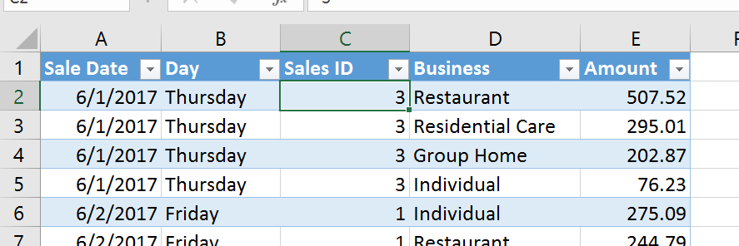
Excel Table
Excel’s table feature adds database functionality to the spreadsheet
Allows sorting and filtering of data
Lets see the table in action, open: sales.xlsx
Go to the Insert tab and click Table
Auto-filter dropdowns
to quickly find data of interest
Adds row banding
for easier reading

Slide 33
Excel Table
Collection of similar data organized in columns and rows
Each column represents a single “piece” of data
Each row represents an observation
Common table operations
Add new data
Sort data
Filter data to show only observations that meet some criteria
Calculate summary statistics with the total row
Freezing rows/columns
Create summary tables with Pivot tables

Slide 34
Pivot Table
Facilitates quick summarization of data in complex ways
Data can be aggregated and summarized across multiple dimensions
Add a pivot table sheet by selecting the target data
Go to the insert tab
Click the Pivot table button on the left side of the ribbon
Add columns to the pivot table by clicking on column names in the Pivot Table Fields pane
Data can be added to rows, columns, values and filters
Allows data to be organized as desired

Slide 35
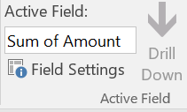
Pivot Table
Insert a pivot table for the sales data
Click Business in the fields pane (business appears in rows)
Click Amount (the total for each business segment is displayed)
Click Sales ID
Click and drag Sales ID from Values to Columns (data is now broken out by business and sales person)
Click the Field settings button on the ribbon
Click Average, then Number format
In the dialog box click Number then click OK
Click OK again and the average sale is displayed

Slide 36
Pivot Table
Click and drag Sales ID from the Columns area to Filters
Average sale for all sales people is displayed
Click the dropdown next to sales ID and click 1
Average sales for ID 1 is displayed
Uncheck the Sales ID box (overall averages are displayed)
Click and drag Day to the columns area (sales broken out by day)
Click the field settings button
Select sum

Slide 37
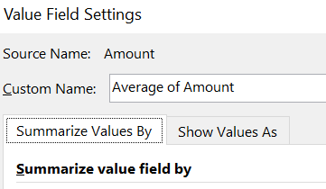
Pivot Table
Click the Show Values as Tab
Click the dropdown next to “No Calculation”
Select % of Row Total
Sales are presented by percent and day
Click Field Settings again and go to Show Values as
Select % of Grand Total, click OK
Uncheck the Day box
Business as a percent of sales is displayed

Slide 38
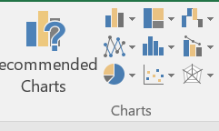
Charts
Select A4:B7
Click the insert tab and in the Charts Group click the pie icon
Right click inside the chart
Select Add Data Labels and Add Data Callouts
Click on the legend then press delete
Click on the Chart title and type:
“Sales by Segment”
The chart can now be copy/pasted into
other applications

Slide 39
Charts
Clear all of the check boxes from the Pivot Table Fields pane
Click and drag Sale Date to the Rows area
Click and drag Business to the Columns area, and add Amount to Values
Copy A5:F29 and paste the data into a new sheet
Select A1:A25 and F1:F25 on the new sheet
From the Insert tab click the line chart icon and click the first option there
Click on the chart title and type “June Sales”
Notice the “spikes” on the chart…

Slide 40
Charts
Editing the chart format
Click the chart to make it active
Notice the Design tab appears
Hover over several options in the Chart Styles group to live preview several options
Click to choose an option you like
Right click over the y-axis and select Format Axis
Change the Minimum to 500 and the Major Units to 250
Close the Format Pane

Slide 41
Thank you!
matt.macarty@gmail.com
http://youtube.com/user/mjmacarty
http://alphabench.com

