Slide 1
Virtual Machine Based Rootkit Detection
Prashanta Gyawali, Michael Malkowski, and Rachel Pekarek

Slide 2
Introduction
Rootkits
Enable continued privileged access to a computer, while actively hiding its presence from administrators
Have been around for over 20 years
Many rootkits and detectors/methods of prevention
Virtual Machine Based Rootkits (VMBRs)
Virtual Machine Monitor (VMM) used to control target OS
Difficult to detect from inside the target OS
First proof-of-concept VMBR was introduced in 2006
Few known VMBRs and VMBR detectors
Notes:
Rootkits
Enable continued privileged access to a computer, while actively hiding its presence from administrators
Have been around for over 20 years
Many rootkits and detectors/methods of prevention
Virtual Machine Based Rootkits (VMBRs)
Virtual Machine Monitor (VMM) used to control target OS
Difficult to detect from inside the target OS because the target OS can’t see outside of the VMM
First proof-of-concept VMBR was introduced in 2006 by Microsoft and the University of Michigan
There aren’t very many known VMBRs and only a few more detectors that can provide defense against them
- We are going to talk about a few of these in this presentation, but first Mike will go over a little about Virtual Machines

Slide 3
Virtual Machines
Create a completely isolated OS on one computer
Saves time and money
Two Different Types of Virtual Machines
Type I (Process) VMs
Uses same hardware as the Host OS
Single process
Faster
Generally used for servers (VMWare ESX Server)
Type II (System) VMs
Provides better separation
Simulates hardware
Significantly slower
VMWare, VirtualBox, etc…
Notes:
Mike
A virtual machine (VM) creates a completely isolated operating system on one computer that will execute programs just like a physical computer. Virtual machines were designed to satisfy the want and need to have multiple operating systems on one computer. This technology provided savings in not only money, but also time as well.
VMs can be categorized into two different types: emulated VMs and virtualized VMs. The following section will compare and contrast the two different types of virtual machines.
Emulated VMs
An emulated VM, also known as a system virtual machine, is the second of the two types of VMs. This type of VM provides a better separation between the guest OS and the host OS, which allows for multiple OSes to coexist on the same host computer. This separation provides a layer of indirection and translation that allows for the host to provide a type of chipset. Although this layer of indirection helps separate the VM from the hardware of the host, it is significantly slower than a virtualized VM.
Virtualized VMs
A virtualized VM, also known as a process virtual machine, is the faster of the two VMs. This is mainly due to the fact that the virtualized VM uses the same hardware as the host computer. There is one catch. The virtual machine’s hardware requirements must match the host’s provided set of chips.
A virtualized VM is installed as an application on the host computer that only supports a single process. Just like any other program, the process is created on start up and destroyed upon exiting the VM application.

Slide 4
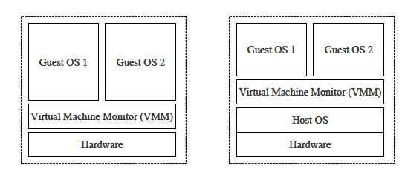
Virtual Machines Cont.
Type I
Type II
Notes:
Mike

Slide 5
Forms of Attack
No interaction with target system
Spam relays, denial of service zombies, phishing web servers, etc.
Target system observers
Logging of hardware-level data via modification of VMM’s device emulation software
Virtual machine introspection
Target system modifiers
Modifying network communication, e-mails, target applications, etc.
Virtual machine introspection
Notes:
A rootkit could technically be installed and do/cause no harm, but it is typically bundled with some sort of malware.
There are three forms of attack:
No interaction with the target system
In this case the malicious services are carried out on a separate OS and ideally the target OS sees nothing
Target system observers
- Logging of hardware-level data
Introspection:
techniques that enable VM service to understand and modify states and events within a guest
Normally used to increase security for VM users by closely monitoring the VM. But Malicious services can use it to reconstruct the data and abstractions from the target system when a VMBR is in control
Target system modifiers
Network communication, tampering with emails etc.
Introspection can also be used to modify the guest OS

Slide 6
Existing Rootkits
SubVirt
Created by Microsoft researches at University of Michigan
Traditional VMBR
Uses Type II Virtual Machines
Persistently stored upon installation
Not released to the public
Targets x86 systems
Notes:
Mike

Slide 7
EXISTING ROOTKITS Cont.
BluePill
Created by a Polish security researcher Joanna Rutkowska
Hardware-Assisted VMBR (or HVM Rootkit)
Uses Type I Virtual Machines
Installs itself on the fly
Installs the thin VMM layer beneath the OS
Does not survive system reboot
Still effective because servers are rarely restarted anyways
Code released to the public
Exploits AMD64 SVM (Secure Virtual Machine) extensions

Slide 8
VMBR Installation
Obtain root privileges/access to kernel mode
Install virtual machine rootkit on disk
Modify system boot records to ensure rootkit runs before the target OS
Done during final stages of shutdown so modifications won’t be detected by anti-malware applications
Target system’s disk space contained in virtual disk
VMM translates address to equivalent location on phys. disk
Target System no longer has access to physical disk
Rootkit has control of the system
Notes:
1. Obtain root privileges: via exploit a remote vulnerability, boot from a bad CD-ROM/DVD, malicious software installed with root privileges.
Corrupt vendors could also sell this kind of information or exploit it themselves after selling the hardware to customers.
2. Install via root privileges
3. Modify boot records in final stages of shutdown
This is done here because anti-malware applications will have already been shut down and the VMBR can bypass those protections
4. Target System hoisted into VMM
The VMBR puts the Target systems disk space in a virtual disk and translates the addresses to the actual physical disk at runtime
→Rootkit has control of the system

Slide 9
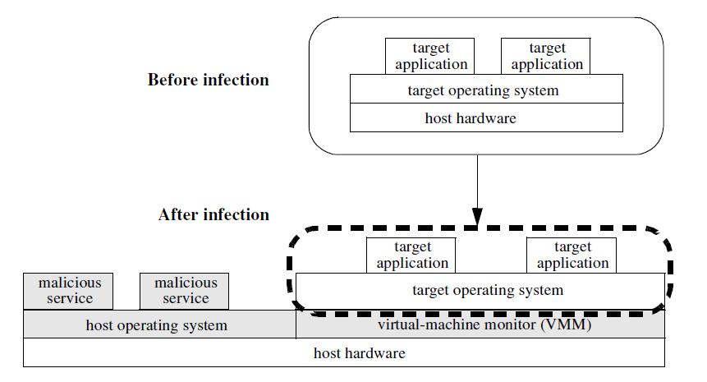
VMBR Installation
Notes:
Here there was no VM present before the installation. You can see how the VMM layer is installed directly on top of the hardware and the target OS is hoisted above it. This way the malicious services on the left are invisible to the target OS.

Slide 10
How VMBR Maintains Control
Control
Stealth
Restarting only the virtual hardware
Prevents physical hardware from restarting
Emulating system shutdowns
Low-power state
VMBR remains on the top of the system Boot Sector
Manipulate antivirus code
Deems antivirus completely useless
Running behind the scenes
Running undetected by the humans and OS alike
Notes:
Mike
Control
Restarting only the virtual hardware: This approach is successful mainly because the VMBR prevents the physical hardware from restarting, which leaves the OS, BIOS, and other low-level process to stay in the same state. This then allows for any other process run after a virtual hardware shutdown to be controlled by the VMBR.
Emulate system shutdowns: This type of mitigation occurs when the VMBR emulates what appears to be a system shutdown to a user. What really happens is the system is merely put into a low-power state, similar to a hibernate option instead of shut down. This type of power mode turns off almost all of the computer’s systems, including the hard drive disks, fans, LEDs (may vary per system), graphics cards, and other higher level systems. This allows the VMBR to live in the confinements of RAM, which still have power, where it is safe from this type of power mode. This means that the VMBR does not surrender its control of the system. When the system is then “started up”, the VMBR picks up right where it was left off. This way, any other type of process run upon boot up will run under the control of the VMBR.
Stealth
One main attributes of a rootkit is to have the ability to not be detected by either human or OS. There have been cases where a rootkit actually manipulated an antivirus’ code so that it left the antivirus useless. This is what makes a rootkit so dangerous and so persistent. By allowing the rootkit to go undetected and granting itself root access, the rootkit may do whatever it pleases. This type of control is more difficult in a virtual machine environment, but rootkits have adapted.

Slide 11
Methods of Defense
Two Ways:
Security software below the VMBR
Security software above the VMBR

Slide 12
Security software below vmbr
Can see the state of VMBR
Read physical memory or disk and look for signatures and anomalies that indicate the presence of VMBR
How to gain control below VMBR??
Use secure hardware
Boot from safe medium
Physically unplug the machine before reboot
Use secure VMM
Notes:
Detectors that run below the VMBR can see the state of the VMBR because their view of the system does not go through the VMBR’s virtualization layer.
Such detection software can read physical memory or disk and look for signatures or anomalies that indicate the presence of a VMBR, such as a modified boot sequence.
Researchers (Intel, AMD) propose hardware that can be used to develop and deploy low-layer security software that would run beneath a VMBR.
A valid way to gain control below the VMBR is to boot from a safe medium such as CD-ROM, USB drive or network boot server. This boot code can run on the system before the VMBR loads and can view the VMBR’s quiescent disk state.
VMBRs can avoid booting from safe medium by emulating system shutdowns and reboots, thus it’s a good practice to physically unplug the machine before attempting to boot from safe medium.
Using a secure VMM, king et al. implemented an enhanced version of secure boot which can prevent VMBR installations. The goal of the secure boot system is to provide attestation for existing boot components, such as disk’s master boot record, the file system’s boot sector and the OS’s boot loader and also to allow the legitimate updates of these components.

Slide 13
Security software above VMBr
Can software running above the VMBR detect its presence?????
CPU time
- compare the running time of benchmark against wall-clock time
Memory and Disk space
- run a program that requires entire machines memory
Variety of I/O devices
- not all I/O device are virtualized. Target OS can directly access physical memory using DMA.
Imperfect virtualization of x86 processors
- ‘sidt’ instruction (redpill) for detecting on the fly VMBR
Notes:
1. A VMBR adds CPU overhead to trap and emulate privileged instructions, as well as to run any malicious services. These timing differences can be noticed by software running in the virtual machine by comparing the running time of benchmarks against wall-clock time.
2. An approach used was a program that required the entire machines memory of disk space. VMBR was able to hide its space overhead in several ways and this method didn’t prove to be that good (paging some data to disk for memory and bad sector trick for disk).
3. A VMBR can simplify the task of emulating all devices by choosing to virtualize only those devices that are required to protect its state(eg the boot disk) or to carry out malicious activity(eg. Network card). The VMBR allows the target OS to access remaining devices directly. But on x86 processor target OS can directly access all physical memory using DMA. This can expose the state of the rootkit.

Slide 14
Existing Detectors
Hooksafe
Provides a hook indirection layer to regulate write access hooks in the kernel
SecVisor
Prevents unauthorized modification to the code in OS kernels using user specified approval policy
NICKLE
Any instruction executed in the shadow space must be fetched from the shadow memory
Red Pill
‘sidt’ instruction is not virtualized in x86 architecture
Paladin
Notes:
Hooks are blocks of code that intercept events, function calls, or messages. Hooking is employed by rootkits to evade detection. Hooking modifies the flow of control and hides the presence of modification.
Hooksafe provides a hypervisor based system to protect kernel hooks from being attacked by rootkits. Hooksafe monitors the possible hooks(write access) for modifications. It provides a hook indirection layer to regulate access to hooks in kernel.
2. SecVisor protects the integrity of code in OS kernels by preventing unauthorized
modifications to the code via a user specified approval policy.
NICKLE uses VMM for restricting access to the Kernel space. NICKLE module lies in the VMM layer and enforces that the guest OS kernel cannot access the shadow memory. At runtime, any instruction executed in the shadow space must be fetched from the shadow memory, which contains authenticated instructions.
The redpill virtual-machine detection technique detects the presence of VMM by using the sidt insturction. The sidt instruction reads the address of the processors interrupt descriptor table. This address is different for an operating system directly above hardware than for an operating system running above a VMM. Thus user-mode code can execute the sidt instruction to detect the presence of a VMM.

Slide 15
Paladin
Approach
Prevention and Detection
Tracking
Containment

Slide 16
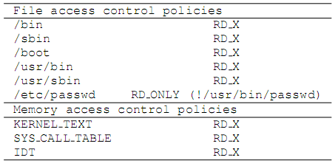
Prevention and Detection
File access control policies
Protect the system utilities from being replaced by their trojaned counterparts
Memory access control policies
Protect the kernel code and data structures from being overwritten in memrory
Notes:
File access control policies protect the system utilities from being replaced by their trojaned counterparts.
Memory access control policies protect the kernel code and data structures from being overwritten in memory.

Slide 17
TRACKING
Keeps track of file created by different processes
Generates a dependency tree by maintaining parent-child relationship between processes
Dependency tree is further used by containment algorithm

Slide 18
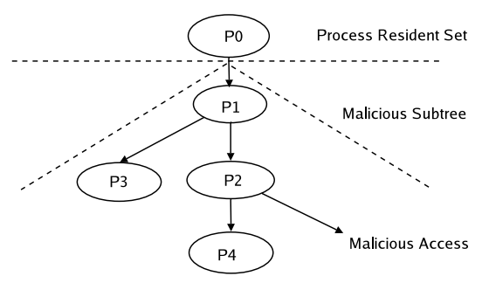
Containment
Stop immediate damage upon violation of access control policies
Tracks malicious processes by referring to information dependency tree

Slide 19
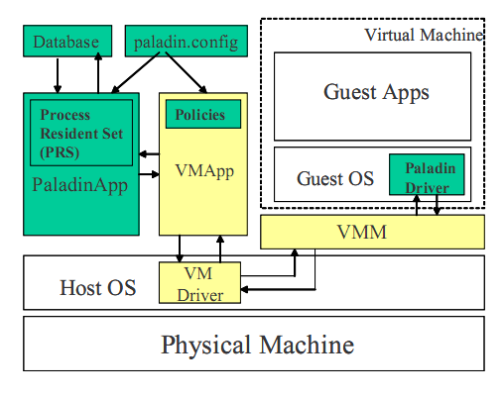
Design and Implementation (PALADIN)
Notes:
Paladin comprises of several components like the modified form of Vmware Workstation, Paladin App, the driver and the database. VMApp and the VMM are a part of the VMware Workstation software.
VMM forwards file and process related system calls to PaladinApp. These are used to update the dependency tree, stored in the database. If the violation of a given access control policy is intercepted by the VMM, it notifies the PaladinApp, which in turn initiates the containment procedure.

Slide 20
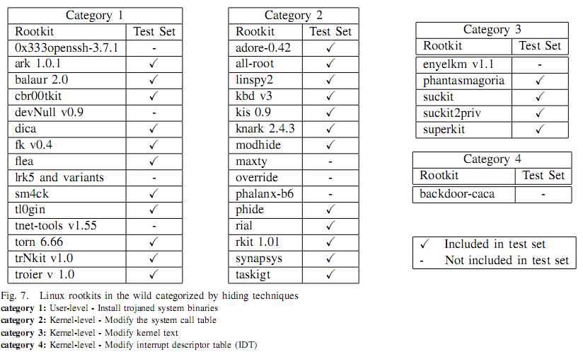
EVALUAtion (PALADIN)
Notes:
The protoype was developed for VMware Workstation. The host machine and virtual machine were running 2.4 linux kernel. Paladin was tested against 27 different rootkits. It was successfully able to detect and contain all of them.

Slide 21
Conclusion
VMBRs are a real threat and are more difficult to detect than regular rootkits
But they can be detected
Detectors like Paladin have proven to be a good solution to a VMBR threat
VMBRs may evolve in the future
And detection must evolve with it as well
Notes:
Mike

