Slide 1
Coding with AI
Python and R for people who don't code
A hands-on workshop · 3 hours · nothing to install
Notes:
Welcome. Three tabs open: your AI, Colab, Posit Cloud. Don't start until everyone's in.

Slide 2
The bottleneck was never typing.
It was knowing what to type.
AI removes the typing.
It does not remove the knowing — it just makes it possible to skip the knowing without noticing that you did.
Notes:
Say this out loud. Repeat it at the end. Everything today serves this line.

Slide 3
What you'll walk out with
An NLP pipeline
A model and a figure
A working BS detector
Turn 60 picture-description transcripts into quantitative language measures.
Predict aphasia severity from language. Make a plot you'd put in a paper.
The ability to tell when your assistant is quietly, fluently wrong.
Python · pandas · spaCy · scikit-learn
R · dplyr · lme4 · ggplot2
The part that actually matters
You will not type much code today. That is the point.
Notes:
Three things. The third is the real one.

Slide 4
Three tabs. That's the whole setup.
Your AI assistant
1
claude.ai — or ChatGPT, or whatever your institution gives you. Free tier is fine.
Google Colab
2
Python in the browser. colab.research.google.com. Nothing installs on your machine.
Posit Cloud
3
RStudio in the browser. posit.cloud. Click SAVE A PERMANENT COPY or you lose your work.
Today's data is 100% synthetic. Generated by a script. Nobody's health information is anywhere in this room.
Notes:
Setup triage. Do not proceed until every laptop is in all three.

Slide 5
What is actually happening when it writes code
What it IS doing
What it is NOT doing
Predicting the next token, given everything before it
Trained on essentially all public code and documentation
Extremely good at the shape of a correct answer
Genuinely useful, most of the time
Running your code
Looking at your data
Knowing your study design
Checking whether the answer is true
So: fast, fluent, confident — and with no idea whether it's right. Exactly like a very well-read first-year grad student who will never, ever say "I don't know."
Notes:
Not a lecture. Two minutes. But they need the mental model.

Slide 6
A bad prompt is a wish. A good prompt is a brief.
Who you are
"I'm a researcher using R in RStudio. I'm a beginner."
1
What the data is
"A CSV at data/x.csv, columns: id, group, age, wab_aq, transcript"
2
The ONE task
"Fit a linear model predicting wab_aq from age."
3
The constraints
"Use dplyr. Don't install anything new."
4
The output you want
"Just the code with short comments. No explanation."
5
Paste your REAL column names. Every hallucinated variable traces back to an AI guessing at a structure you never showed it.
Notes:
The core teaching slide of block 1. Then demo the bad prompt live.

Slide 7
The debugging loop is not failure. It's the job.
1
2
3
Paste the whole error
Paste the whole code
Say what you're running
All of it. The traceback, the line numbers, the warning you skipped. Not your summary of it.
Not the line you think is broken. The block. It cannot see your screen.
"R 4.4, tidyverse 2.0." Half of all errors are version errors.
The three-strikes rule
Three failures on the same error means it's stuck in a groove. Open a NEW chat. Describe the goal from scratch. Do not paste the failed attempts. Fresh context beats more argument.
Notes:
Normalise this hard. Beginners think an error means they broke it.

Slide 8
Live demo
1. "write me some code to analyse my data"
2. "I have 30 patients measured twice. Did they improve? Give me the R code."
Then ask it: "Are you sure? What are you assuming about independence?"
Notes:
Demo 1: it invents everything. Nobody's fault — you asked for nothing. Demo 2: watch it change its answer under questioning. THE LINE: 'It knew. It always knew. It just doesn't lead with it. That gap is where your career gets damaged.'

Slide 9
Part 1 — Python
Turning transcripts into numbers
45 minutes · 01_python_starter.ipynb
Notes:
Circulate. Most common stall: they paste code without the imports.

Slide 10
The pipeline you're about to build
Transcript
Word counts
POS tagging
Semantics
Model
raw text
n_words, TTR
content vs filler
TF-IDF similarity
classify group
"NLP" is mostly arithmetic on words.
Counting, dividing, and comparing. The heavy machinery comes out only when the arithmetic runs out. Most published discourse measures are in the first two boxes.
Notes:
This is the whole Python block on one slide.

Slide 11
The data (synthetic, and that's the point)
60 people | 30 controls · 30 with post-stroke aphasia
transcript | What they said describing a kitchen scene
wab_aq | Aphasia severity, 0–100. Higher = less impaired. Controls sit at ~99.
group, age, sex, education | The usual
transcripts_long.csv | The 30 patients again at 12 months. 60 rows — but only 30 people.
Not one word of this was said by a real person.
Every transcript came out of data/make_data.py. Which is exactly why we can paste it into a chatbot for three hours. Remember how this feels — you don't get it back with real data.
Notes:
Point at make_data.py. The honest answer to 'can I use my real data' is: make a synthetic twin of it.

Slide 12
Trap 1 — the AI will pool your controls
Variance in severity explained by how many words someone produced
Why
Controls all score ~99 on the WAB. They have no variance to explain.
Pool them in and half your "explained variance" is just the fact that patients differ from controls. Which you knew before you started.
The code runs. Nothing warns you. The number is simply twice as impressive as it deserves to be.
Notes:
Python Task 6. Native chart: same measure, two decisions.

Slide 13
Part 2 — R
Statistics, and a figure you'd actually publish
50 minutes · 02_r_starter.R
Notes:
Remind them: Save a Permanent Copy. Say it three times.

Slide 14
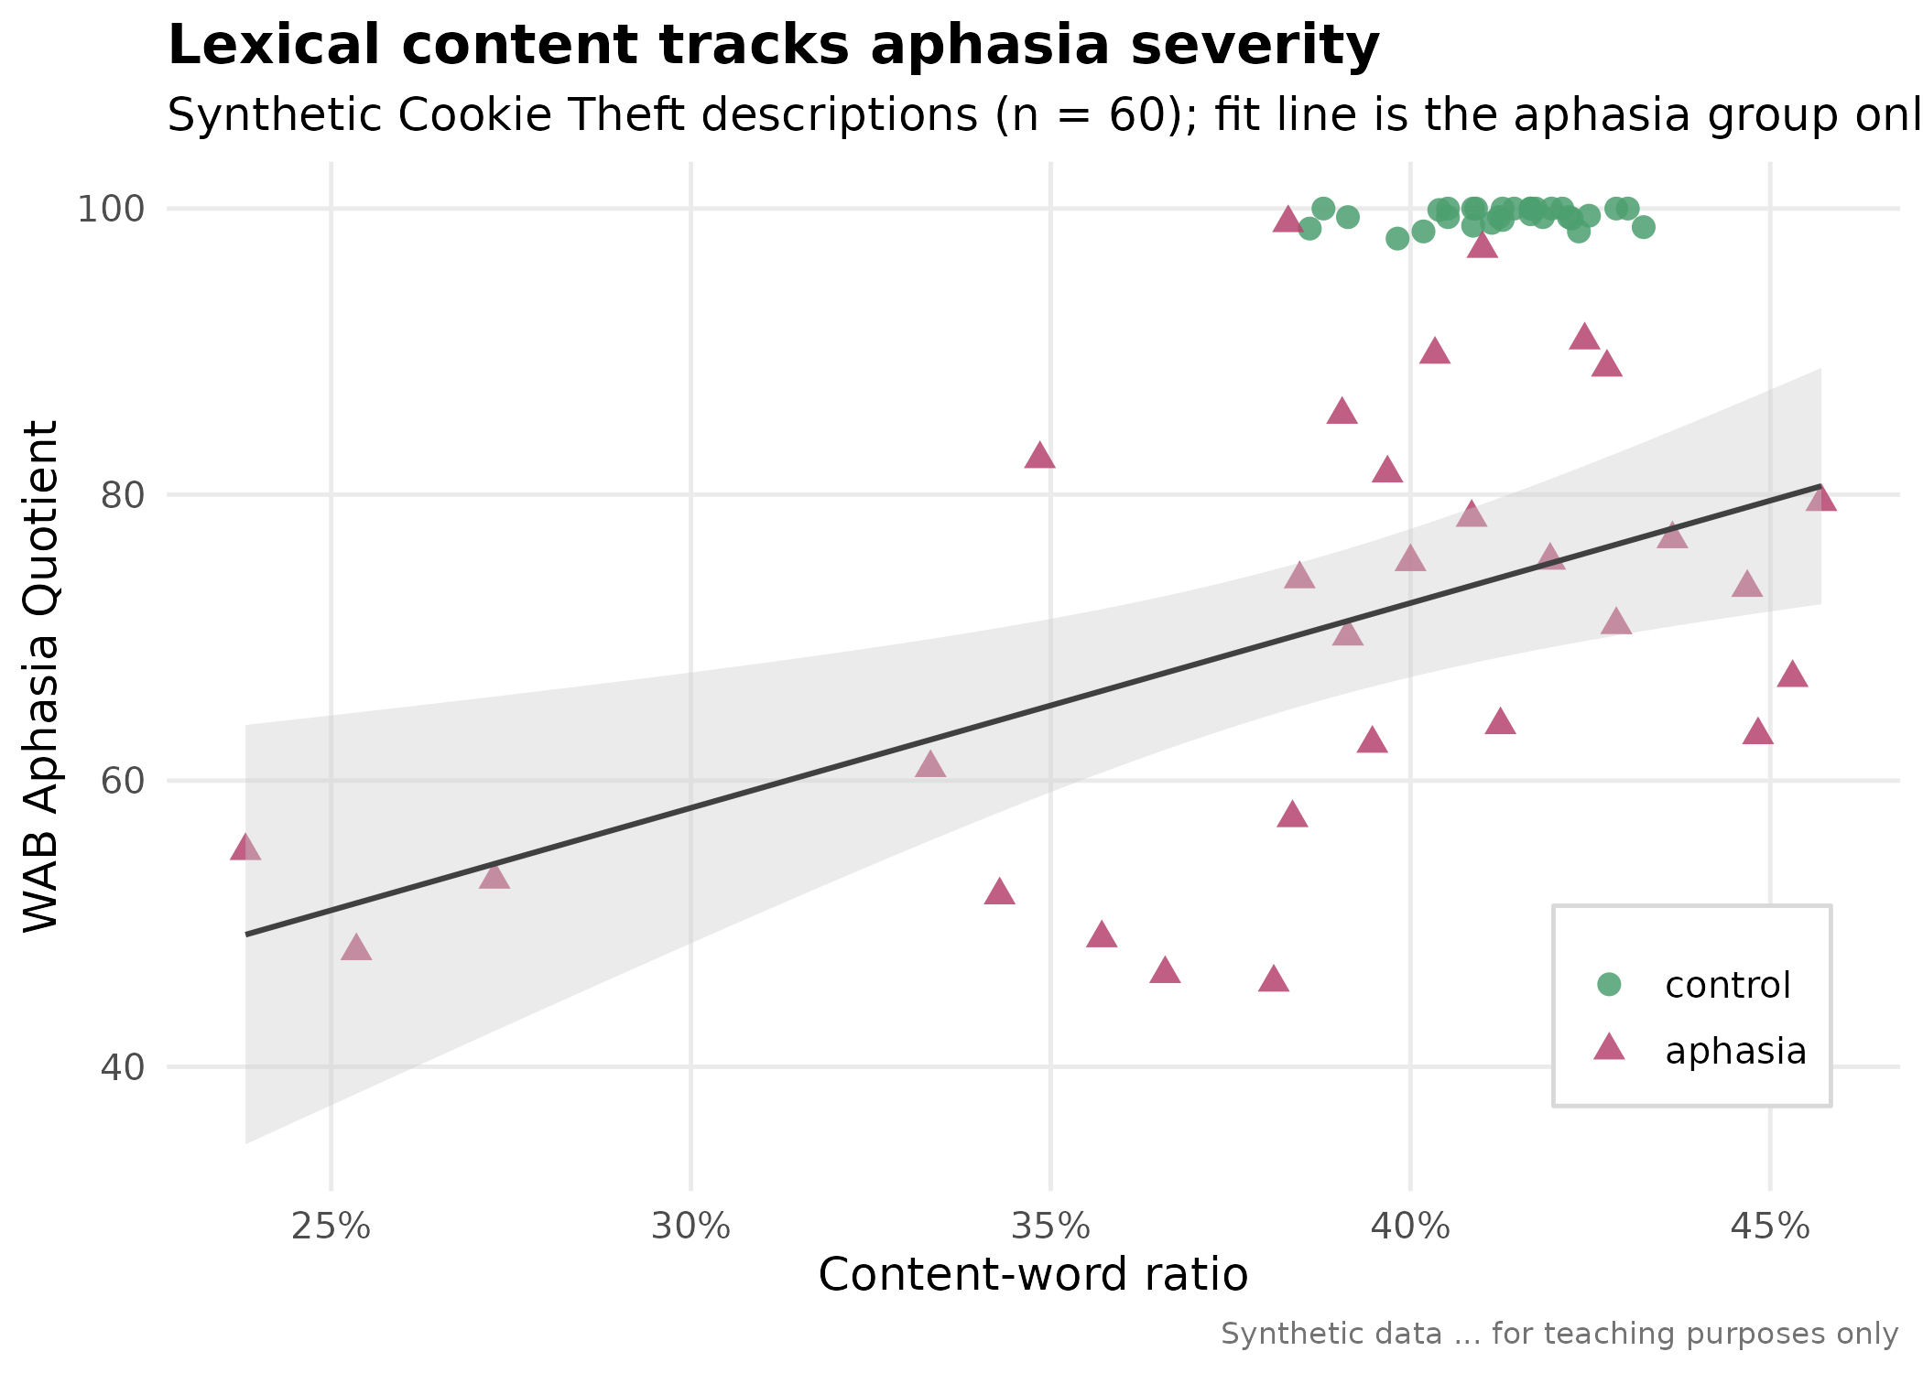
This is the best thing an AI does for you
Nobody memorises ggplot theme arguments.
Nobody should. It is pure syntax lookup — high tedium, zero insight, and you'd have spent forty minutes in Stack Overflow for this.
You describe the figure you want in English. It writes the theme() call. You look at it, you don't like the legend, you say so, it fixes it.
That loop is the whole job, and it is genuinely, permanently better than what came before.
Notes:
Be honest and enthusiastic here. This is the genuine, unambiguous win.

Slide 15
Trap 2 — the finding that quietly evaporated
On its own
With n_words in the model
lm(wab_aq ~ content_word_ratio)
+ type_token_ratio + n_words + age
p = .004
p = .055
Same data. Same variable. Same afternoon.
n_words quietly ate its variance — people who say more say more content words. Both models ran perfectly. Neither printed a warning. Your headline finding became a footnote and the only thing standing between you and reporting the first number is that you happened to look.
Ask it: "what is this model assuming about my predictors?" It gives a good answer. It just never volunteers one.
Notes:
R Task 4. Nothing errored. That's the whole horror of it.

Slide 16
Trap 3 — the wrong model HID a real effect
30 patients, measured twice. 60 rows — but 30 people.
The naive model
The correct model
lm(wab_aq ~ timepoint)
lmer(wab_aq ~ timepoint + (1|id))
p = .056
t = 5.2
"No significant improvement."
+7.1 WAB points. Clear recovery.
The wrong model didn't invent an effect. It hid one.
Throwing away the pairing threw away the power to see a real recovery. You'd have written "no significant improvement" in a grant, and you'd have been wrong — and the code would have run beautifully the entire time.
Notes:
R Task 6. This is the one that surprises people. They expect false positives.

Slide 17
The fact-check
"Write the Results paragraph for my model in APA style."
Now check every number against tidy(m1), glance(m1), nobs(m1). Line by line. Out loud.
A degrees-of-freedom value that appears nowhere in your output
A predictor called "significant" at p = .055
A coefficient reported with the sign flipped
An R² or an F statistic it never actually saw
It will write a better paragraph than you would have. And it will lie in it. Both of those are true, and you have to hold both.
Notes:
DO THIS TOGETHER ON THE PROJECTOR. It is the punchline of the day.

Slide 18
The five it gets wrong, in order of frequency
Hallucinated functions
"Is this package real? Show me the docs."
1
Confidently calls tidystats::auto_model(). No such thing exists.
Wrong test for your design
"What is this test assuming about my design?"
2
It does not know you have repeated measures. Unless you tell it.
Silent scope errors
"Print nrow() before and after every filter."
3
Models everyone when you meant a subgroup. Drops NAs without a word.
Invented numbers in prose
"Check every number against the model object."
4
Beautiful APA paragraphs containing an F it never computed.
Plausible-but-wrong stats
"Read the output yourself. Every time."
5
p = .07 described as significant. A sign flipped, reported with total serenity.
Notes:
This slide is in PROMPTS.md too. Tell them that.

Slide 19
The rules that don't bend
Never paste real patient data into a chatbot.
Not transcripts. Not MRNs. Not "de-identified" text you haven't personally checked. Share the SCHEMA, not the rows — column names and a fabricated example row are enough to get working code.
Run it. Read it. Then trust it. In that order.
Code that runs without error can still be answering a different question than the one you asked.
If you can't explain it, you can't publish it.
Not a moral point — a practical one. You are the person defending it in review, and in your own head at 2am.
And say what you did. Journals increasingly require it. One sentence in the methods. Keep the chat log.
Notes:
Slow down here. This is the part their compliance office cares about.

Slide 20
Where this goes next
Today
In-IDE
Agentic
Chat in one tab, code in another. Copy, paste, run, check.
The assistant lives inside the editor. Colab's Gemini panel. Copilot in RStudio.
Claude Code in a terminal: "read the CSV, compute the measures, fit the model, make the figure." It just does it.
Works everywhere. Free. Start here.
Same skill. Less copy-pasting.
Ninety seconds for today's ninety minutes.
The agent will do it faster than you did. The thing that changed today is that you can now read what it did and tell whether it's right. That is the entire difference between a tool and a liability.
Notes:
Show, don't teach. Demo `claude` in a terminal for 90 seconds.

Slide 21
You are now the senior author
on everything it writes for you.
Act like it.
Keep PROMPTS.md. That's the artifact.
Notes:
Final line. Land it and stop talking.

