Slide 1
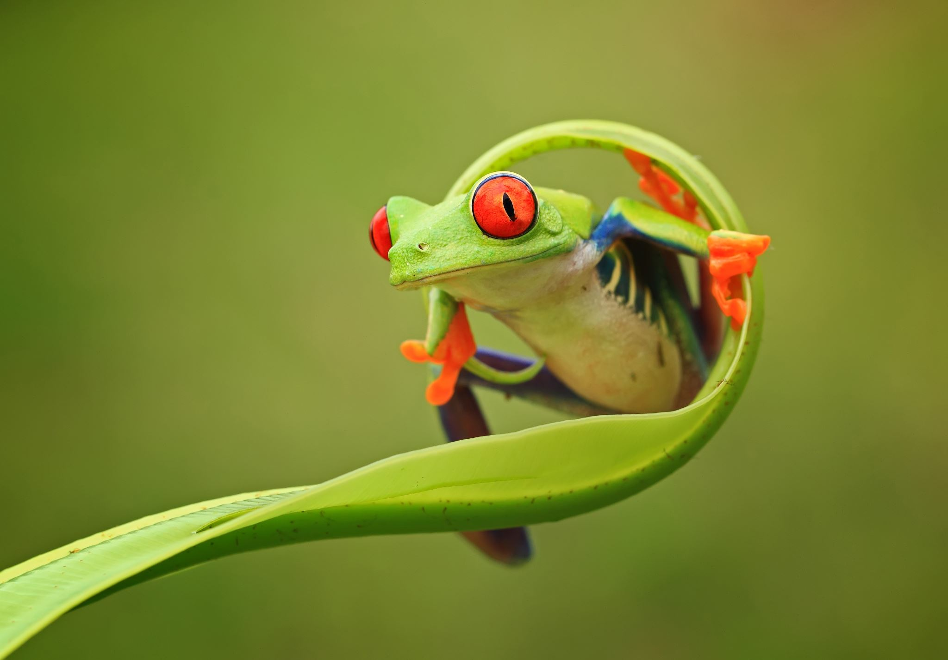
Frog-Eye Demonstration
Mickey McMahon

Slide 2
Project Introduction

Slide 3
Background & Motivation
Standard cameras
Shuttered, images are taken at a constant framerate
Each frame is an integration of data over the period of the shutter
Unable to capture objects moving appreciably faster than framerate¹
Dynamic vision sensors
Independent pixels are captured when a change in pixel’s brightness is detected²
High temporal sampling, low latency allows for more accurate object tracking³
Used in a variety of embedded systems⁴
Embodied robots
Autonomous vehicles
Drones
Visual sensor networks

Slide 4
Project Goal & Overview
Goal: To demonstrate the utility of and recreate a basic dynamic vision sensor
A user should be able to shine an infrared laser on a 4x4 array of pixels
Pixel data will be transmitted using two methods
‘Dumb’ method – all 16 pixels are read in a single ‘frame’ or ‘event’ (shutter camera)
‘Smart’ method – pixels will only be read when a change in light intensity is detected
The user will be able to further process data on the FPGA itself
Path prediction
Cluster finding

Slide 5
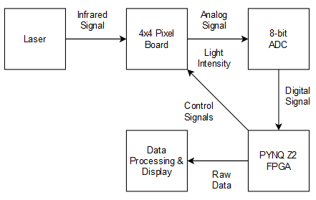
Project Outline
Circuit design
Circuit implementation
Vivado block design
High-level overview of FPGA configuration
Python API
User interface for managing data transfer between PL and computer
Data processing
Path prediction
Cluster finding
Read operations – ‘dumb’ and ‘smart’

Slide 6
Project Outline
Circuit design
Circuit implementation
Vivado block design
High-level overview of FPGA configuration
Python API
User interface for managing data transfer between PL and computer
Data processing
Path prediction
Cluster finding
Read operations – ‘dumb’ and ‘smart’

Slide 7
Component Descriptions

Slide 8
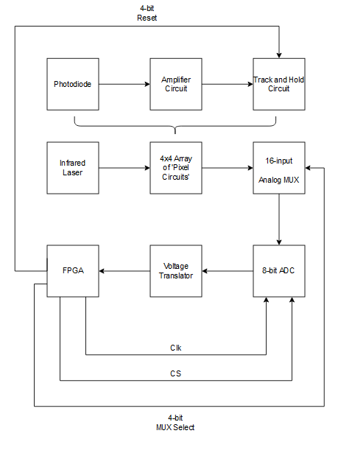
Circuit Design
FPGA Inputs
ADC Line -> Voltage Translator
FPGA Outputs
Clk
ADC clock
CS
Chip-select, controls when the ADC reads
MUX Select
Controls which pixel to read from
Reset
Dumps ‘track-and-hold’ capacitor

Slide 9
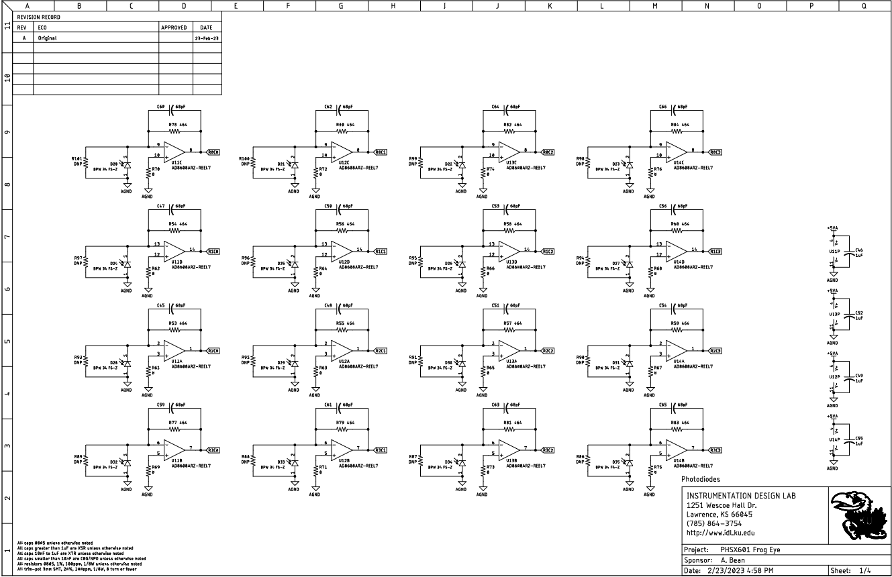

Slide 11
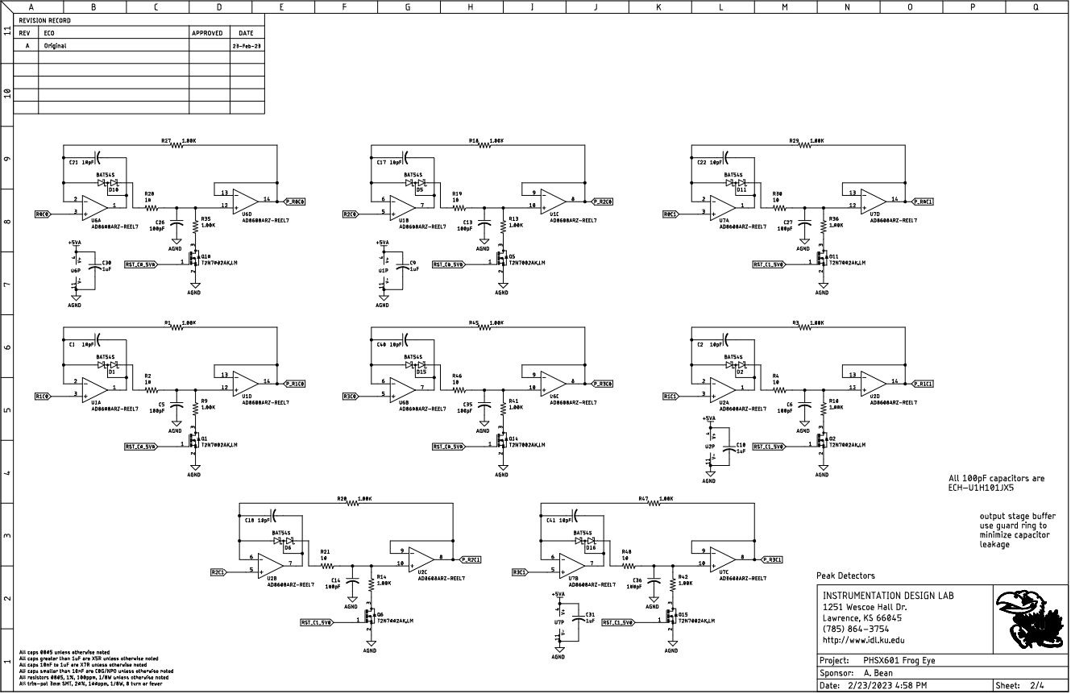

Slide 12
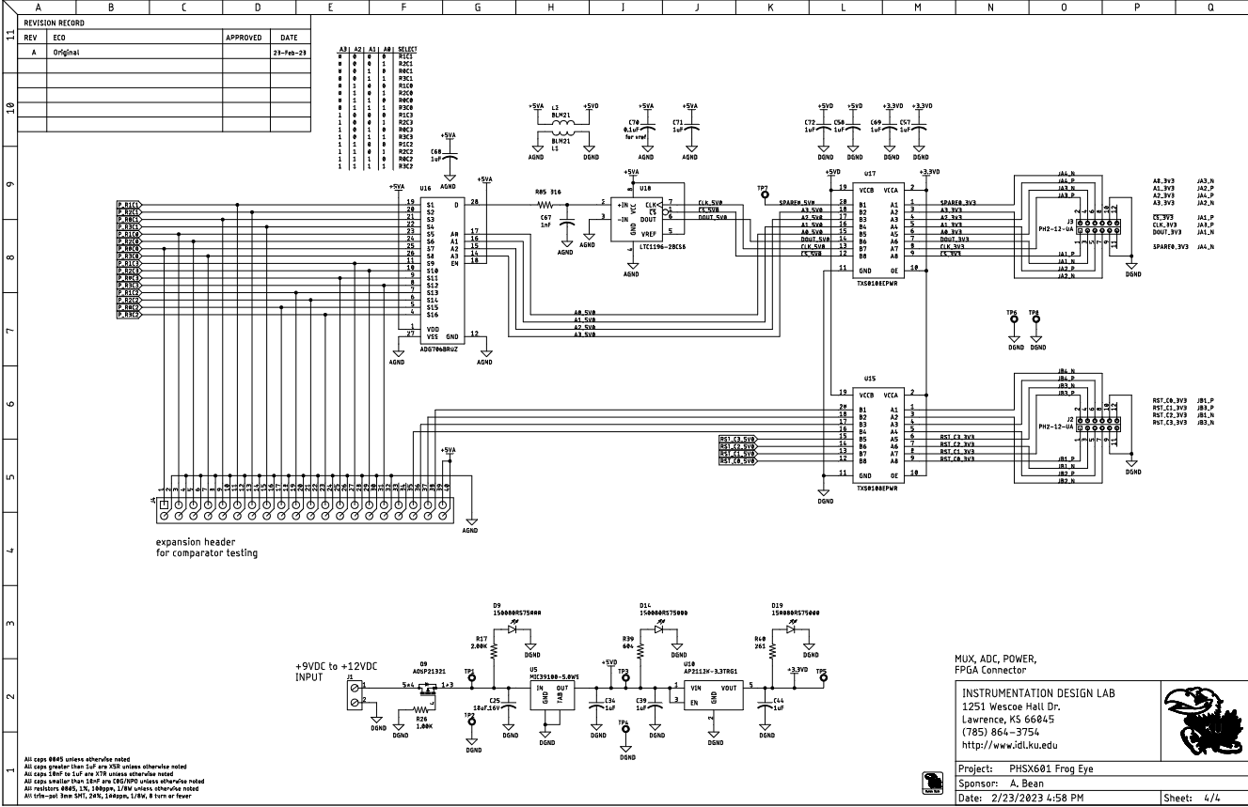

Slide 18
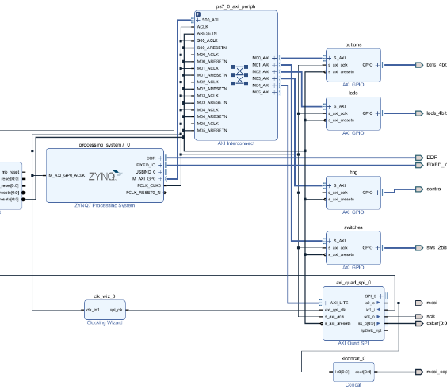
Vivado Block Design
High-level representation of the configuration between the ZYNQ processor/PL and the board’s external interfaces
Two important blocks
GPIO block ‘frog’
MUX Select and Reset Signals
AXI Quad SPI
Clk and CS

Slide 19
Vivado Block Design
High-level representation of the configuration between the ZYNQ processor/PL and the board’s external interfaces
Two important blocks
GPIO block ‘frog’
MUX Select and Reset Signals
AXI Quad SPI
Clk and CS

Slide 20
Python Overlay
Python API exposes programmability of FPGA through a wrapper that lets us interact directly with hardware IP blocks
Allows us to write data from the FPGA (control signals)
‘Frog’ GPIO
AXI Quad SPI
Allows us to access read data from the FPGA memory (ADC data)

Slide 21
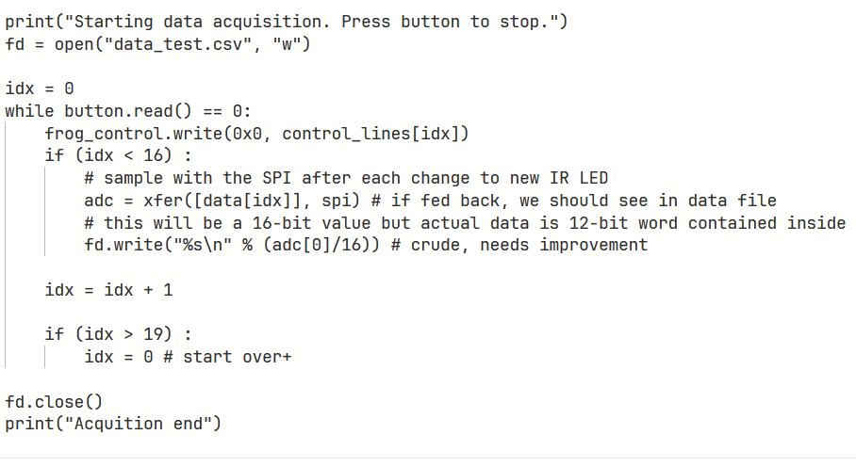
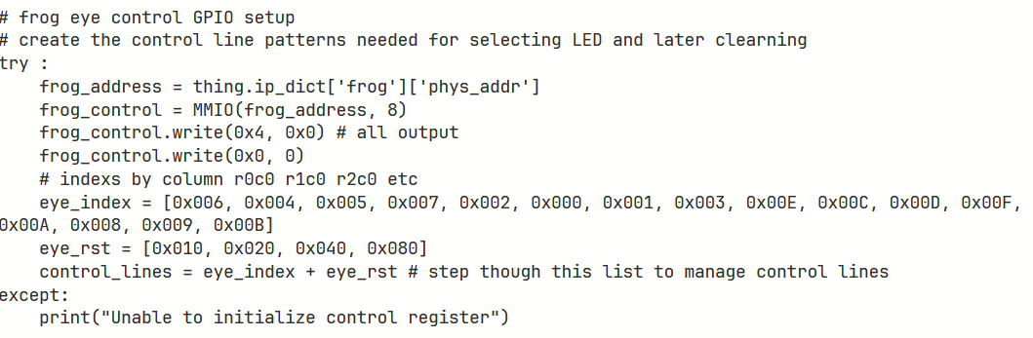
Python Overlay

Slide 22
Python Overlay

Slide 23
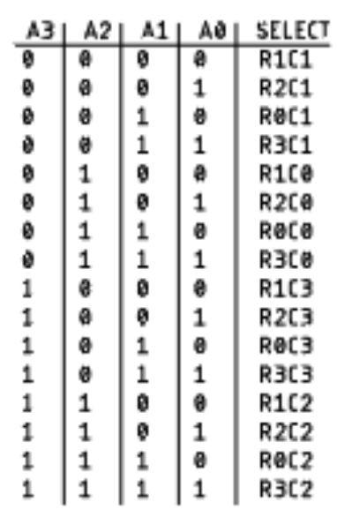
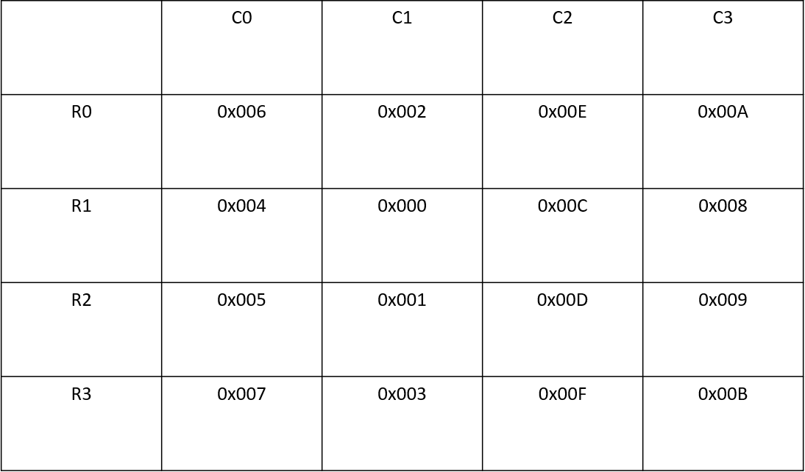
Control Signal Layout

Slide 24
Python Overlay

Slide 25
Control Signal Simulations

Slide 26
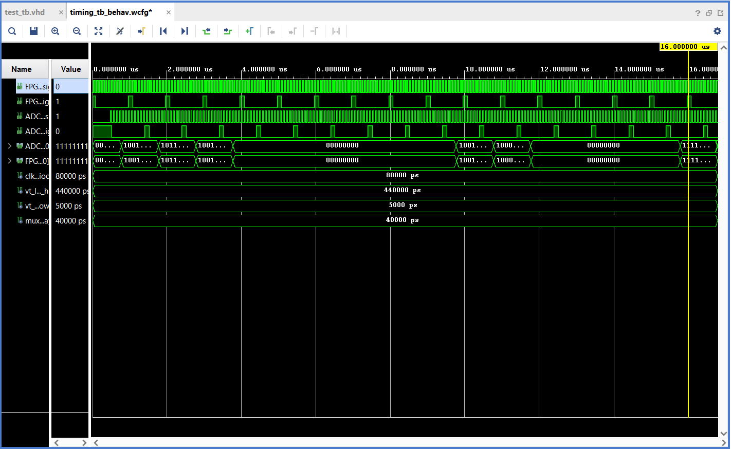
Timing diagram account for all circuit delays
Assumes fastest ADC clock and read operation
Timescale of the largest circuit delay (440ns) is orders of magnitude smaller than how fast control signals change (~3000Hz -> 330us), so circuit delays have negligible effect on output

Slide 27
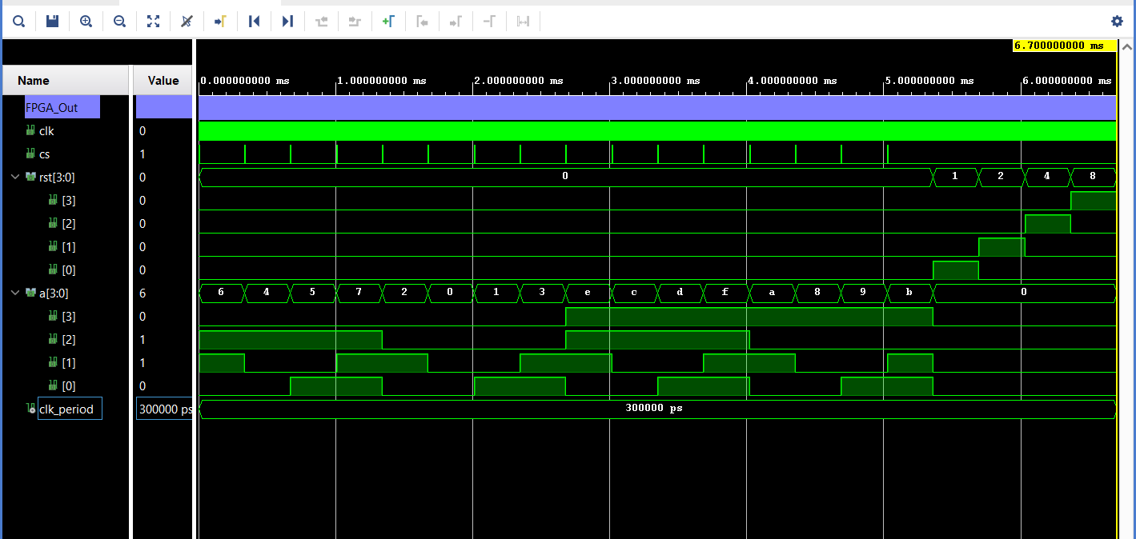
Timing diagram for outputs of FPGA at the PMOD ports
Uncertainty on writing select and reset signals of ~100us
Total time for 1 ‘event’ is ~6.7ms (150 events per second)

Slide 28
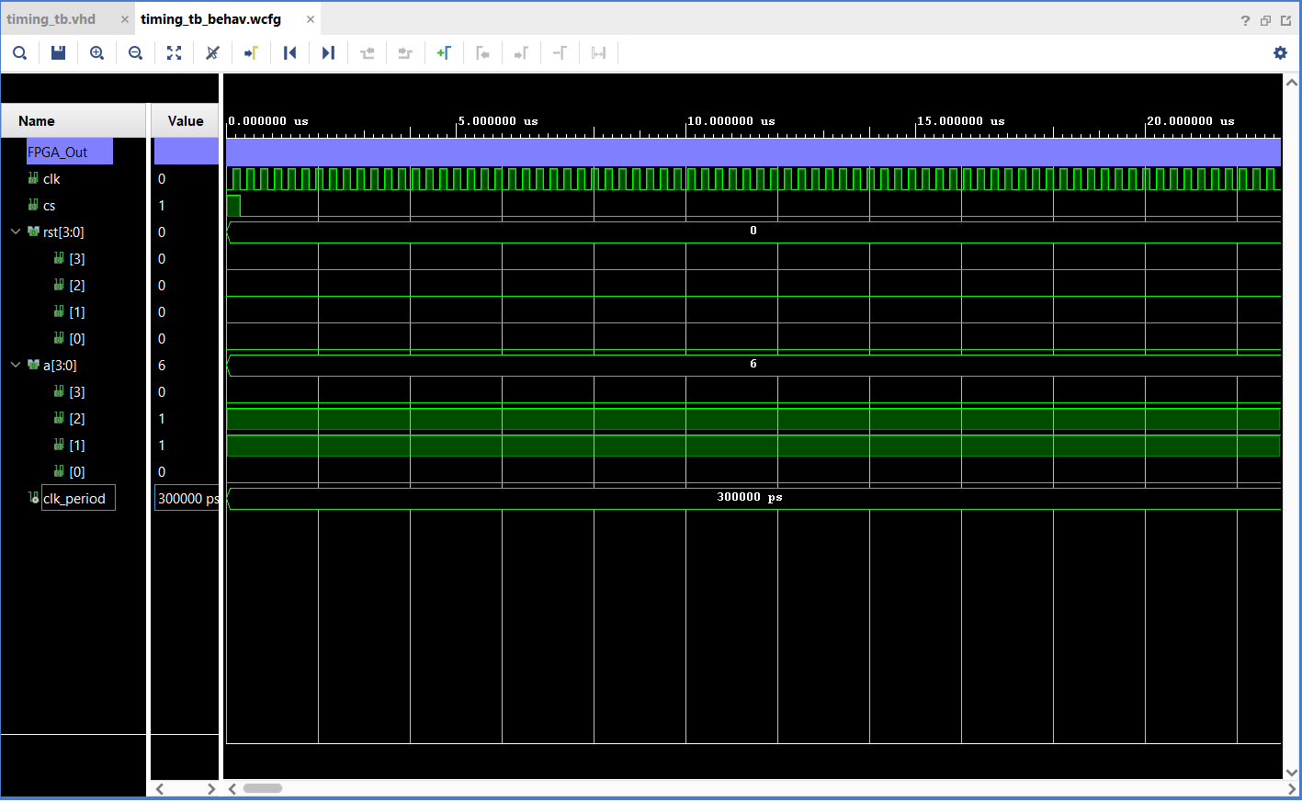

Slide 29
Tests

Slide 30
Control Signals
Used oscilloscope to verify control signal waveforms matched expected behavior from Python API
Used multimeter at circuit pins to verify all signals were being sent across lines effectively

Slide 31
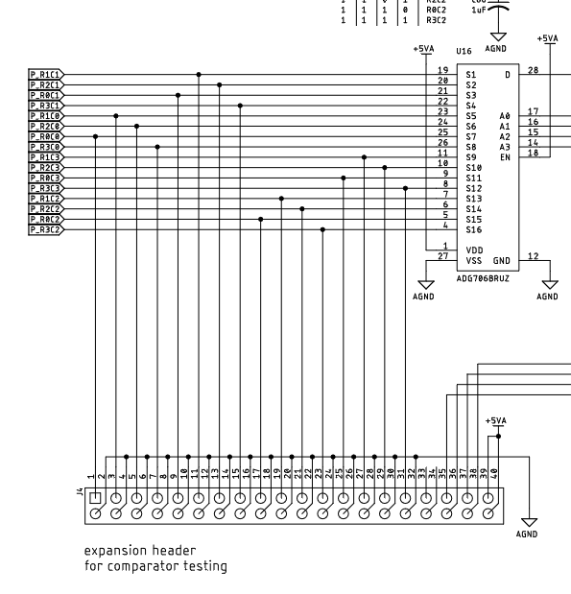
Circuit Implementation
Used multimeter to measure voltages across ‘pixel circuits’ with and without infrared laser to verify expected behavior

Slide 32
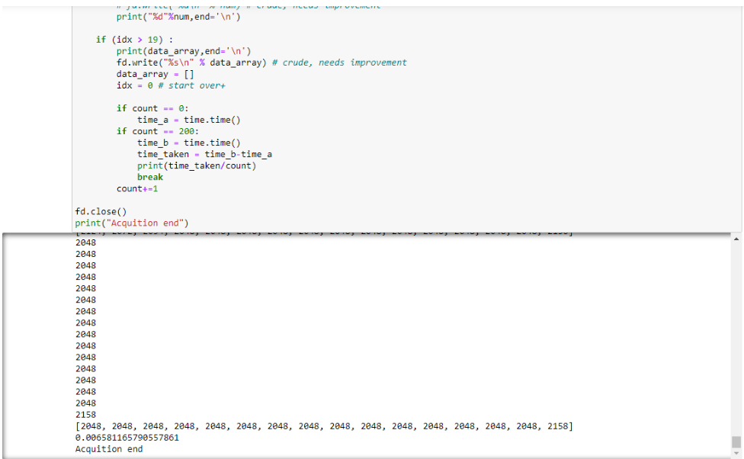
Read Timing
Calculated framerate for ‘dumb’ readout method by averaging time-per-read over 200 events
Total time for 1 ‘event’ is ~6.7ms (150 events per second)

Slide 33
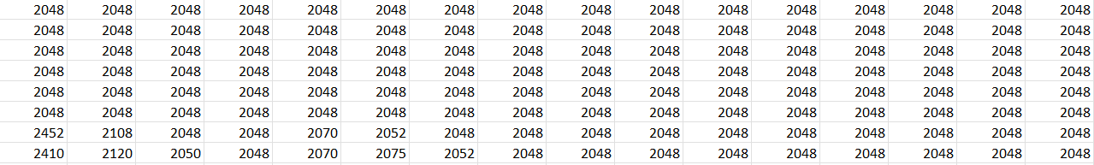
Read Data
Verified that illuminating particular pixels one-by-one or over a predetermined path yields a reasonable result
Inevitable offset errors and uncertainty due to light ‘spilling over’ to other pixels, but maximum illumination is still over correct pixels

Slide 34
Project Status
Accomplished
Designed, implemented, and tested circuit board-FPGA interface that can accurately capture light data at a constant framerate, store light data on the board’s internal memory
Working
Improving precision on data processing software to more accurately predict laser path
Other offline data processing [Eric]
Testing to see if read frequency can be improved by coding a selective read-out algorithm in the Python overlay

Slide 35
Challenges & Recommendations
Challenges
Debugging alignment issues
Precise timing
Powering the board
Improper resets
Recommendations
Analog implementation of faster read method
Uses comparator circuits to only send select signal when light intensity over pixel has changed beyond certain threshold

Slide 36
References
[1] IEEE Spectrum. https://spectrum.ieee.org/dynamic-vision-sensors-enable-high-speed-maneuvers-with-robots
[2] Tech Insights. https://www.techinsights.com/blog/image-sensor/dynamic-vision-sensors-brief-overview-image-sensor-techstream-blog
[3] Hindawi. https://www.hindawi.com/journals/complexity/2021/8973482/
[4] Key applications of the dynamic vision sensor, ResearchGate. https://www.researchgate.net/figure/Key-application-scenarios-of-the-Dynamic-Vision-Sensor-DVS_fig2_332388971

