Slide 1

New adaptive step size method for ordinary differential equations
Mike McNelis
Department of Physics, Ohio State University
https://github.com/mjmcnelis/RKM

Slide 2



Overview
Adaptive Runge–Kutta methods are useful for solving ODEs
Automatically adjust step size to improve computational efficiency and local error control
Common methods:
Step doubling
Increase accuracy of any RK scheme
Very expensive (2X more stages)
Embedded
Only a few additional stages are required
May still encounter step rejections
RKM method
Can be used with any RK scheme
No additional stages, avoids step rejections
Highly versatile and numerically efficient
ode45()
odeint()
NDSolve()

Slide 3
Prerequisites
Numerical methods for ODEs
Explicit Runge–Kutta methods like RK4
Local truncation error
Butcher tableau notation
Adaptive step size methods
Euler step doubling, Fehlberg 4(5)
Error and step size controls
Efficiency graphs
Python or similar programming language

Slide 4



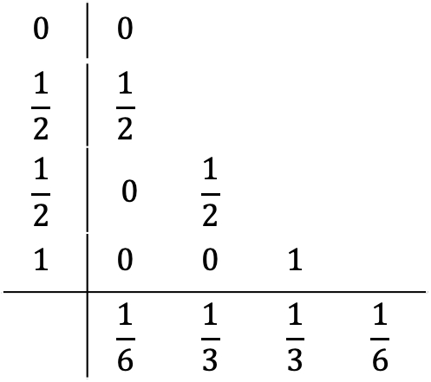






Explicit Runge–Kutta
(non-stiff ODE)
RK4 method ($Δt_{n}=const$)
$$y^{′}=f(t,y)$$
$$y\left(t_{0}\right)=y_{0}$$
$$0$$ | $$0$$
$$\frac{1}{2}$$ | $$\frac{1}{2}$$
$$\frac{1}{2}$$ | $$0$$ | $$\frac{1}{2}$$
$$1$$ | $$0$$ | $$0$$ | $$1$$
 | $$\frac{1}{6}$$ | $$\frac{1}{3}$$ | $$\frac{1}{3}$$ | $$\frac{1}{6}$$
$$k_{n,1}=f(t_{n},y_{n})$$
($s=4$ stages)
$$k_{n,2}=f\left(t_{n}+\frac{Δt_{n}}{2},y_{n}+\frac{Δt_{n}k_{n,1}}{2}\right)$$
$$k_{n,3}=f\left(t_{n}+\frac{Δt_{n}}{2},y_{n}+\frac{Δt_{n}k_{n,2}}{2}\right)$$
$$k_{n,4}=f\left(t_{n}+Δt_{n},y_{n}+Δt_{n}k_{n,3}\right)$$
$$y_{n+1}=y_{n}+Δt_{n}\left(\frac{k_{n,1}}{6}+\frac{k_{n,2}}{3}+\frac{k_{n,3}}{3}+\frac{k_{n,4}}{6}\right)$$
(RK4 update)
Butcher tableau of RK4
$$ℰ_{n+1}={C_{5,n}\left(Δt_{n}\right)}^{5}$$
(local truncation error)

Slide 5


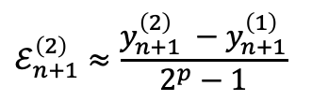





Step doubling
Take two half-steps and compare to full step (costs $3s−1$ function evaluations)
Subtract results to get local error of double-step:
Can use error estimate to extrapolate double-step:
$$y_{n+1}^{(1)}=y_{n}+{RK}_{p}(y_{n},t_{n};Δt_{n})$$
(original step)
($p=$ order of method, $s=$ stages)
$$y_{n+1}^{(2)}=y_{n+1/2}+{RK}_{p}\left(y_{n+1/2},t_{n+1/2};\frac{Δt_{n}}{2}\right)$$
(step doubling)
$$y_{n+1/2}=y_{n}+{RK}_{p}\left(y_{n},t_{n};\frac{Δt_{n}}{2}\right)$$
$$ℰ_{n+1}^{\left(2\right)}≈\frac{y_{n+1}^{\left(2\right)} −y_{n+1}^{\left(1\right)}}{2^{p}−1}$$
$$y_{n+1}^{\left(R\right)}=y_{n+1}^{\left(2\right)}+ℰ_{n+1}^{\left(2\right)}$$
(Richardson extrapolation)
$$ℰ_{n+1}^{\left(R\right)} \sim O\left({\left(Δt_{n}\right)}^{2+p}\right)$$
(increase accuracy by one order)

Slide 6
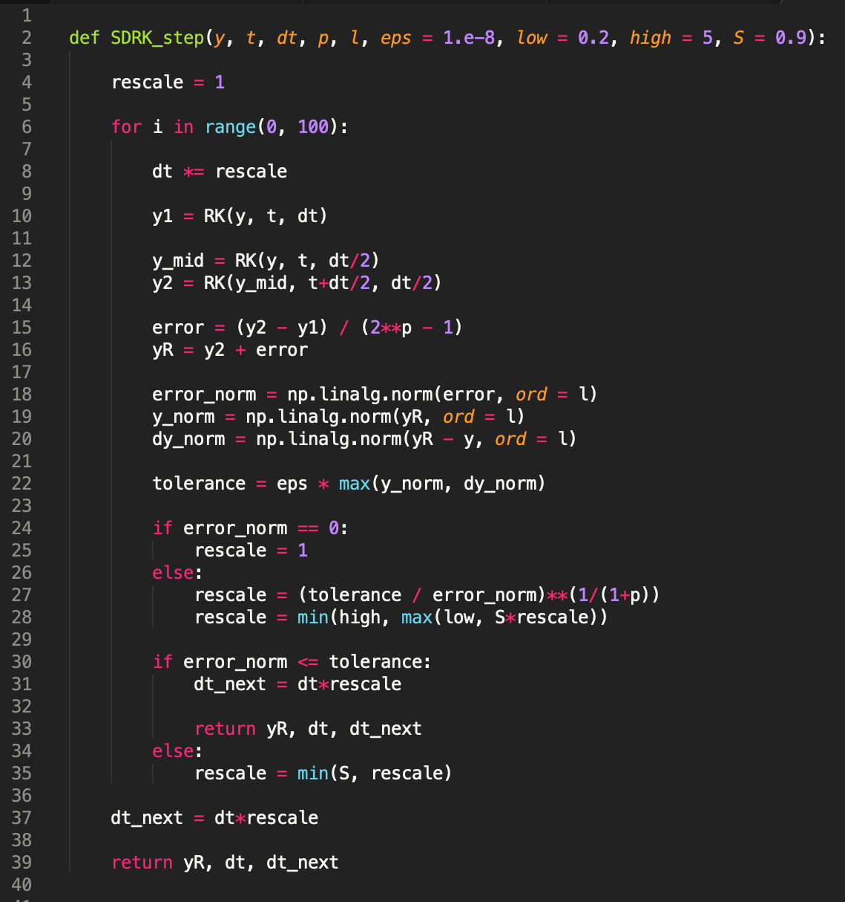
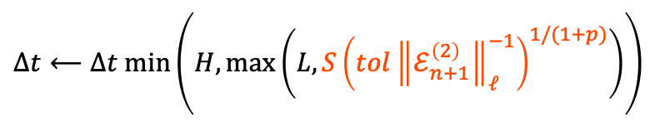



Adaptive step size
Adjust step size as
Algorithm:
Propose a step size $Δt_{n}$ and updated solution $y_{n+1}^{\left(R\right)}$
Compute local error and compare to tolerance ${∝ε}_{0}$
If $\left\|ℰ_{n+1}^{\left(2\right)}\right\|≤tol$: accept and adjust next step size $Δt_{n+1}$
Else: reject and adjust current step size $Δt_{n}$ for next attempt
($H=5$, $L=0.2$, $S=0.9$, $ℓ=$ norm)
$$Δt⟵Δt min\left(H,max⁡\left(L,S{\left(tol{\left\|ℰ_{n+1}^{\left(2\right)}\right\|}_{ℓ}^{−1}\right)}^{1/(1+p)}\right)\right)$$
$$tol=ε_{0} max\left(\left\|y_{n+1}^{\left(R\right)}\right\|,\left\|y_{n+1}^{\left(R\right)}−y_{n}\right\|\right)$$
(tolerance)

Slide 7
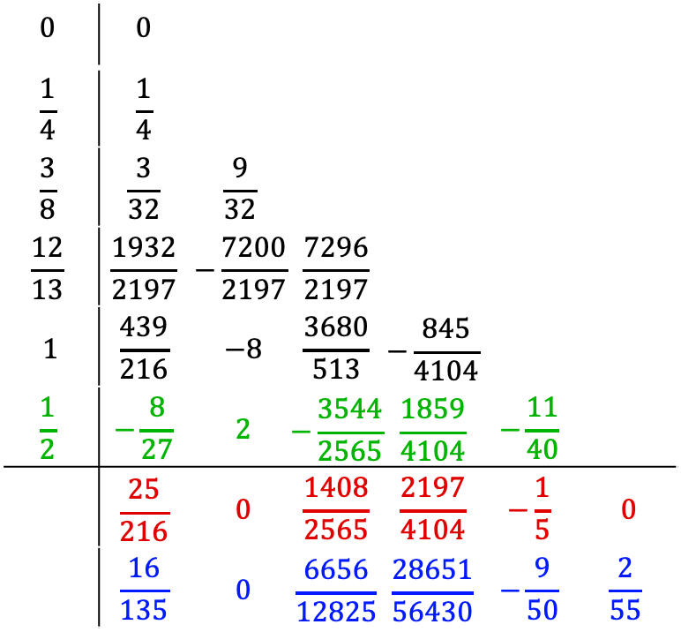


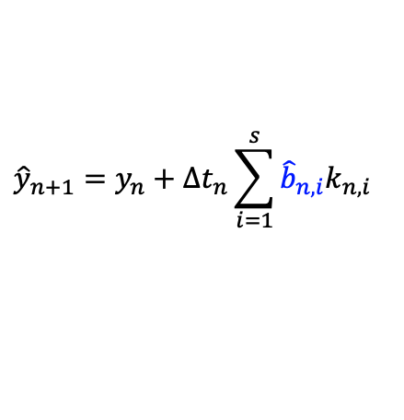
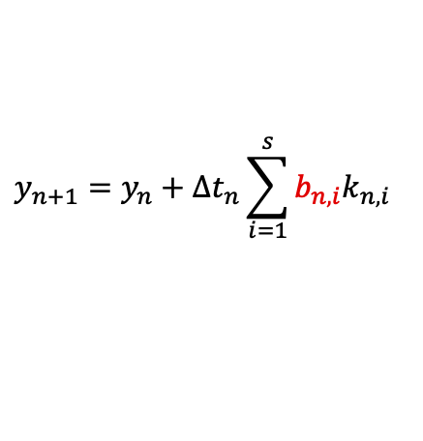
Embedded Runge–Kutta
$$0$$ | $$0$$
$$\frac{1}{4}$$ | $$\frac{1}{4}$$
$$\frac{3}{8}$$ | $$\frac{3}{32}$$ | $$\frac{9}{32}$$
$$\frac{12}{13}$$ | $$\frac{1932}{2197}$$ | $$−\frac{7200}{2197}$$ | $$\frac{7296}{2197}$$
$$1$$ | $$\frac{439}{216}$$ | $$−8$$ | $$\frac{3680}{513}$$ | $$−\frac{845}{4104}$$
$$\frac{1}{2}$$ | $$−\frac{8}{27}$$ | $$2$$ | $$−\frac{3544}{2565}$$ | $$\frac{1859}{4104}$$ | $$−\frac{11}{40}$$
 | $$\frac{25}{216}$$ | $$0$$ | $$\frac{1408}{2565}$$ | $$\frac{2197}{4104}$$ | $$−\frac{1}{5}$$ | $$0$$
 | $$\frac{16}{135}$$ | $$0$$ | $$\frac{6656}{12825}$$ | $$\frac{28651}{56430}$$ | $$−\frac{9}{50}$$ | $$\frac{2}{55}$$
Primary method comes with an embedded pair
Fehlberg 4(5) is 4th-order (embedded pair is 5th-order)
Typically need 1 or 2 additional stages
FSAL (first same as last) methods can recycle one stage
Advance with $y_{n+1}$, use $\left\|ℰ_{n+1}\right\|$ for step size control
$$y_{n+1}=y_{n}+{∆t}_{n}\sum_{i=1}^{s}{b_{n,i}k_{n,i}}$$
(primary method)
$${\hat{y}}_{n+1}=y_{n}+{∆t}_{n}\sum_{i=1}^{s}{{\hat{b}}_{n,i}k_{n,i}}$$
(embedded pair)
$$ℰ_{n+1}≈y_{n+1}−{\hat{y}}_{n+1}$$
(local error of lower-order method)
Fehlberg 4(5)

Slide 8
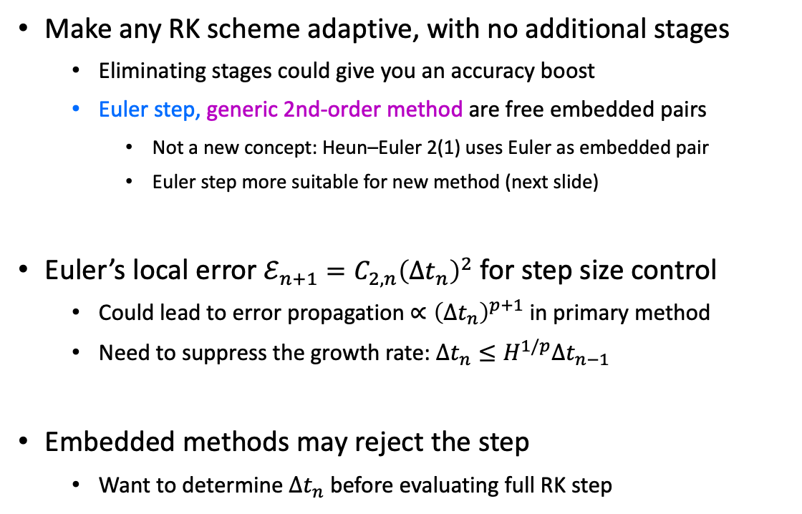
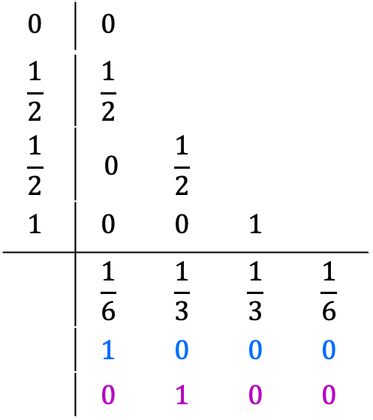
Adaptive Runge–Kutta
Make any RK scheme adaptive, with no additional stages
Eliminating stages could give you an accuracy boost
Euler step, generic 2nd-order method are free embedded pairs
Not a new concept: Heun–Euler 2(1) uses Euler as embedded pair
Euler step more suitable for new method (next slide)
Euler’s local error $ℰ_{n+1}={C_{2,n}\left(Δt_{n}\right)}^{2}$ for step size control
Could lead to error propagation $∝{\left(Δt_{n}\right)}^{p+1}$ in primary method
Need to suppress the growth rate: $Δt_{n}≤H^{1/p}Δt_{n−1}$
Embedded methods may reject the step
Want to determine $Δt_{n}$ before evaluating full RK step
$$0$$ | $$0$$
$$\frac{1}{2}$$ | $$\frac{1}{2}$$
$$\frac{1}{2}$$ | $$0$$ | $$\frac{1}{2}$$
$$1$$ | $$0$$ | $$0$$ | $$1$$
 | $$\frac{1}{6}$$ | $$\frac{1}{3}$$ | $$\frac{1}{3}$$ | $$\frac{1}{6}$$
 | $$1$$ | $$0$$ | $$0$$ | $$0$$
 | $$0$$ | $$1$$ | $$0$$ | $$0$$
Runge–Kutta 4(1,2)

Slide 9




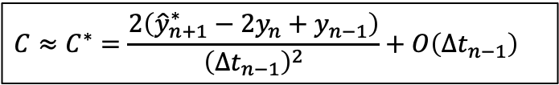




RKM algorithm
1. Compute embedded Euler step with previous step size
2. Approximate $C$ with central differences
3. Set local error to tolerance and solve for $Δt_{n}$
4. Evaluate RK step $y_{n+1}$ (can recycle first stage)
$$ℰ_{n+1}^{∗}={\frac{1}{2}C^{∗}\left(Δt_{n−1}\right)}^{2}$$
$$C_{2,n}=\frac{1}{2}C$$
$${\hat{y}}_{n+1}^{∗}=y_{n}+{∆t}_{n−1}f(t_{n},y_{n})$$
$$C≈C^{∗}=\frac{2\left({\hat{y}}_{n+1}^{∗}−2y_{n}+y_{n−1}\right)}{{\left({∆t}_{n−1}\right)}^{2}}+O\left(Δt_{n−1}\right)$$
(1st-order accurate)
$$C=y^{′′}\left(t_{n}\right)+O\left(Δt_{n}\right)$$
$$Δt_{n}=\left\{\begin{aligned}\sqrt{\frac{2ε_{0}\left\|y_{n}\right\|}{\left\|C\right\|}}, if \left\|y_{n}\right\|>\frac{2ε_{0}{\left\|f_{n}\right\|}_{}^{2}}{\left\|C\right\|} \\ \frac{{2ε}_{0}\left\|f_{n}\right\|}{\left\|C\right\|}, if \left\|y_{n}\right\|≤\frac{2ε_{0}{\left\|f_{n}\right\|}_{}^{2}}{\left\|C\right\|}\end{aligned}\right.$$
$$ℰ_{n+1}={\frac{1}{2}\left\|C\right\|\left(Δt_{n}\right)}^{2}=ε_{0} max\left(\left\|y_{n}\right\|,Δt_{n}\left\|f_{n}\right\|\right)$$
$$⟶$$
M. McNelis, D. Bazow and U. Heinz, Comput. Phys. Commun. 267 (2021) 108007

Slide 10
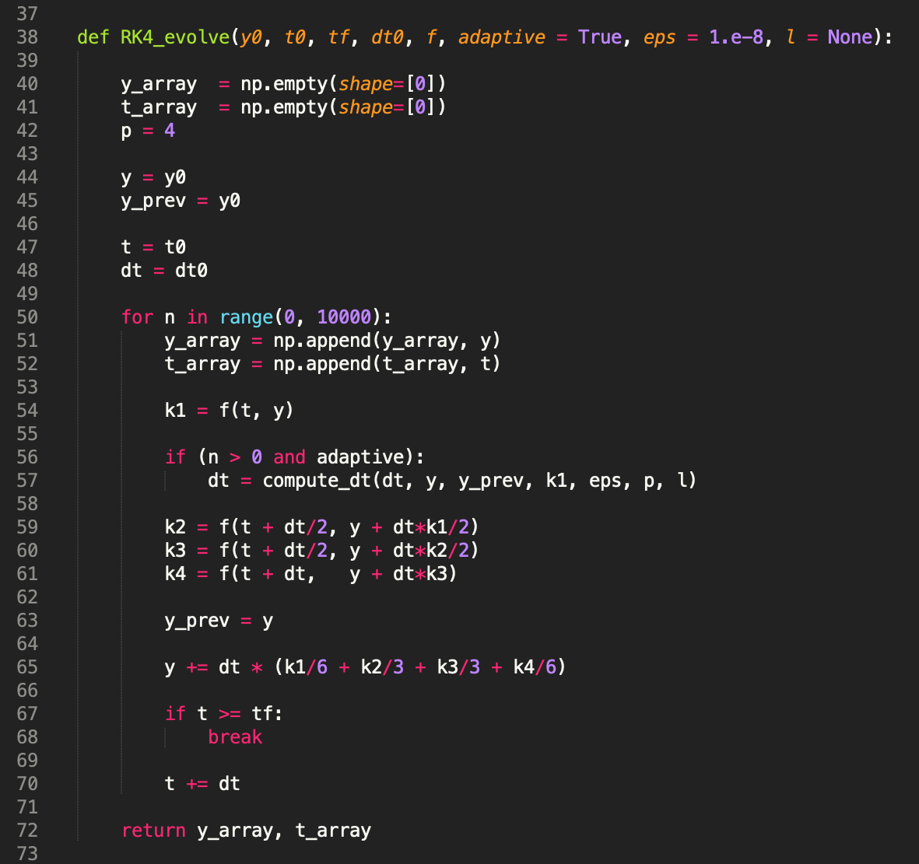
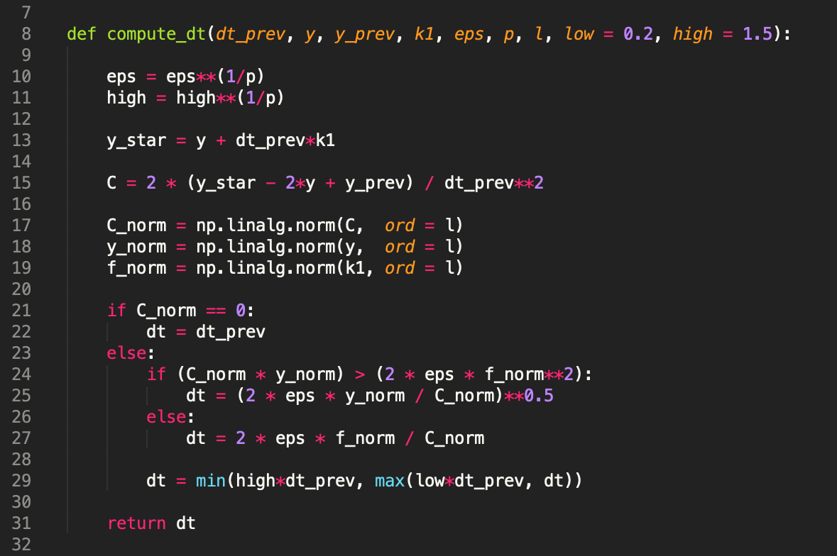

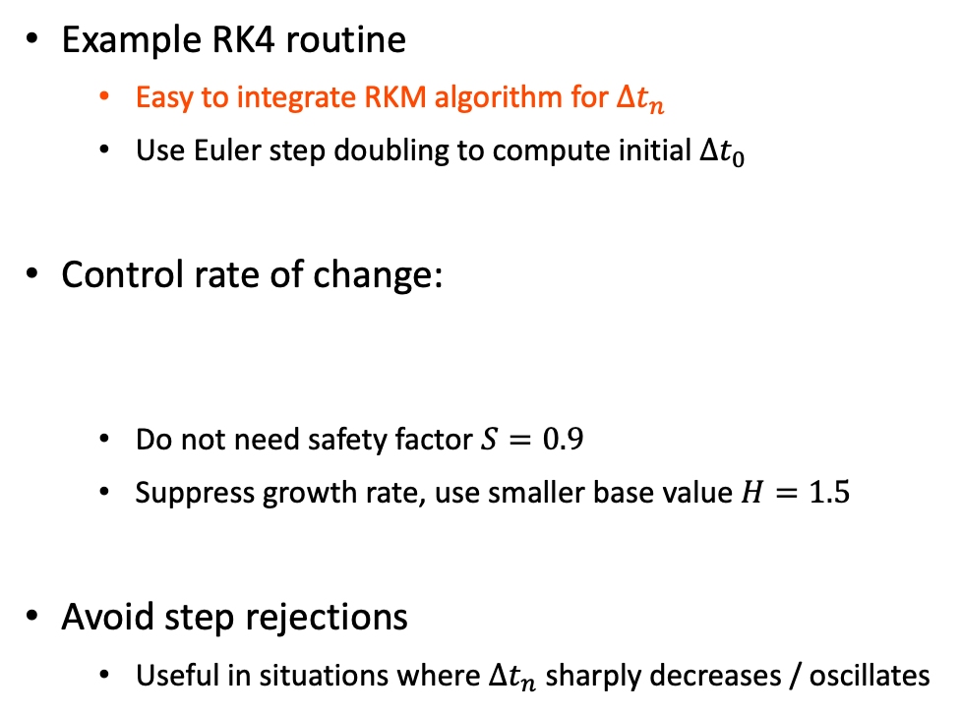
Adaptive RK4
Example RK4 routine
Easy to integrate RKM algorithm for ${∆t}_{n}$
Use Euler step doubling to compute initial ${∆t}_{0}$
Control rate of change:
Do not need safety factor $S=0.9$
Suppress growth rate, use smaller base value $H=1.5$
Avoid step rejections
Useful in situations where ${∆t}_{n}$ sharply decreases / oscillates
${∆t}_{n}$ $⟵min\left(H^{1/p}{∆t}_{n−1},max⁡\left(L{∆t}_{n−1},{∆t}_{n}\right)\right)$

Slide 11
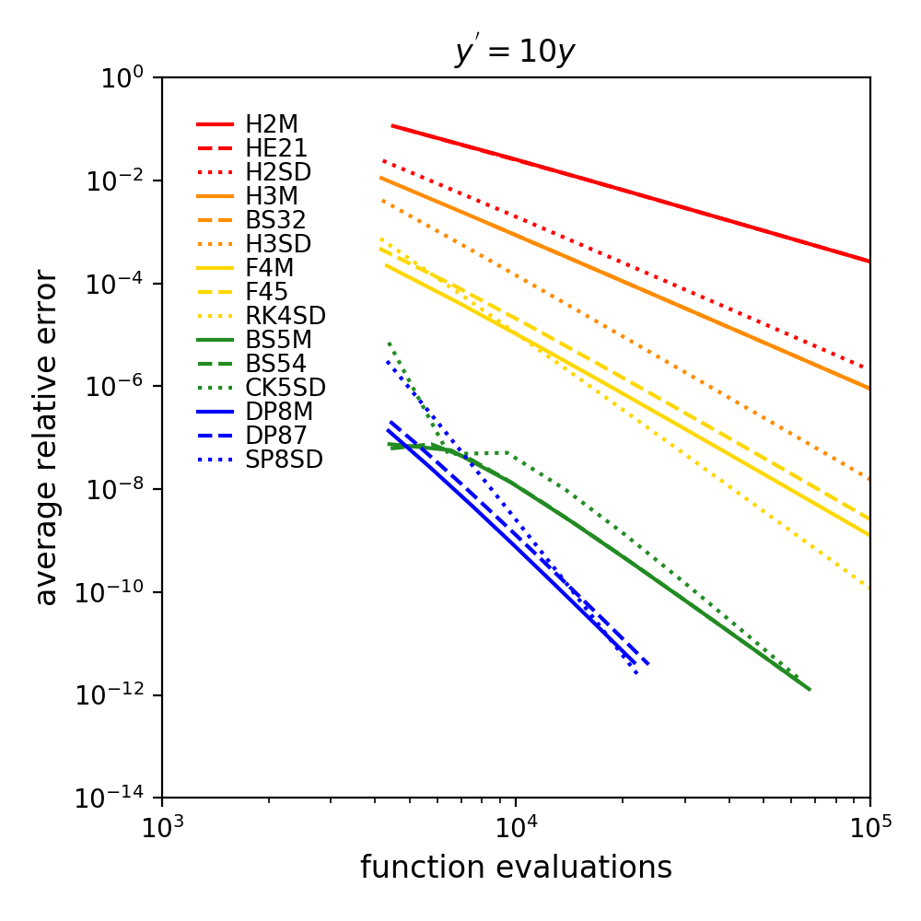
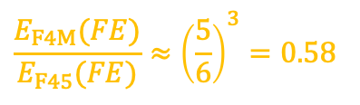

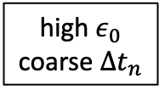
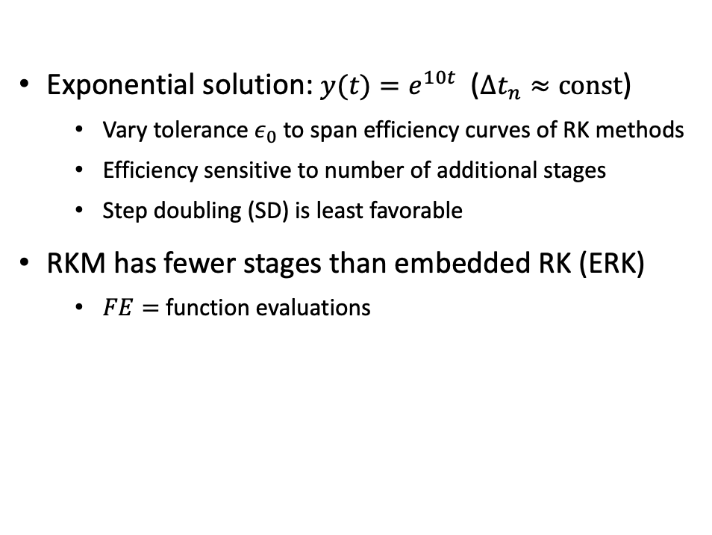

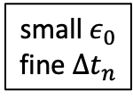

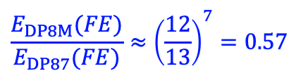

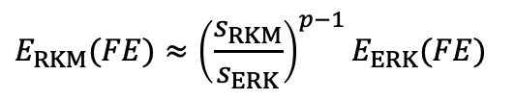
Exponential
H = Heun
BS = Bogacki–Shampine
F = Fehlberg
high $ε_{0}$ coarse $Δt_{n}$
DP = Dormand–Prince
Exponential solution: $y(t)=e^{10t}$ ($Δt_{n}≈const$)
Vary tolerance $ε_{0}$ to span efficiency curves of RK methods
Efficiency sensitive to number of additional stages
Step doubling (SD) is least favorable
RKM has fewer stages than embedded RK (ERK)
$FE=$ function evaluations
$$y^{′}=10y$$
$$y_{0}=e^{−100}$$
$$t_{0}=−10$$
$$t_{f}=10$$
$$E_{RKM}(FE)≈{\left(\frac{s_{RKM}}{s_{ERK}}\right)}^{p−1}E_{ERK}(FE)$$
small $ε_{0}$ fine $Δt_{n}$
(global error comparison)
$$\frac{E_{F4M}(FE)}{E_{F45}(FE)}≈{\left(\frac{5}{6}\right)}^{3}=0.58$$
(4th-order Fehlberg)
$$\frac{E_{DP8M}(FE)}{E_{DP87}(FE)}≈{\left(\frac{12}{13}\right)}^{7}=0.57$$
(8th-order Dormand–Prince)

Slide 12
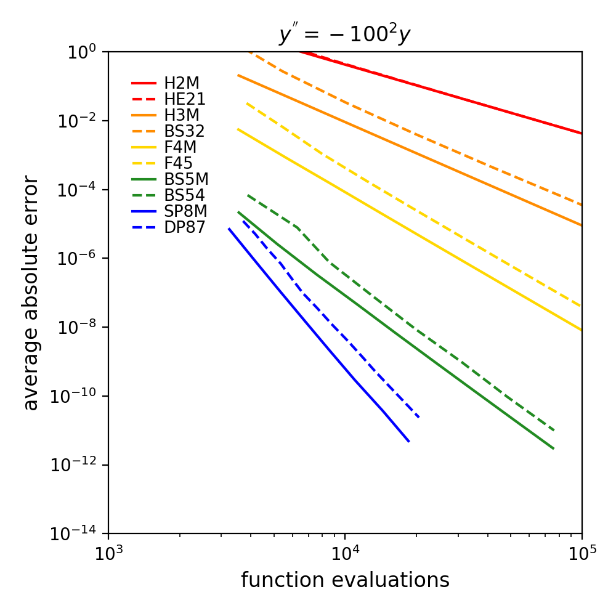
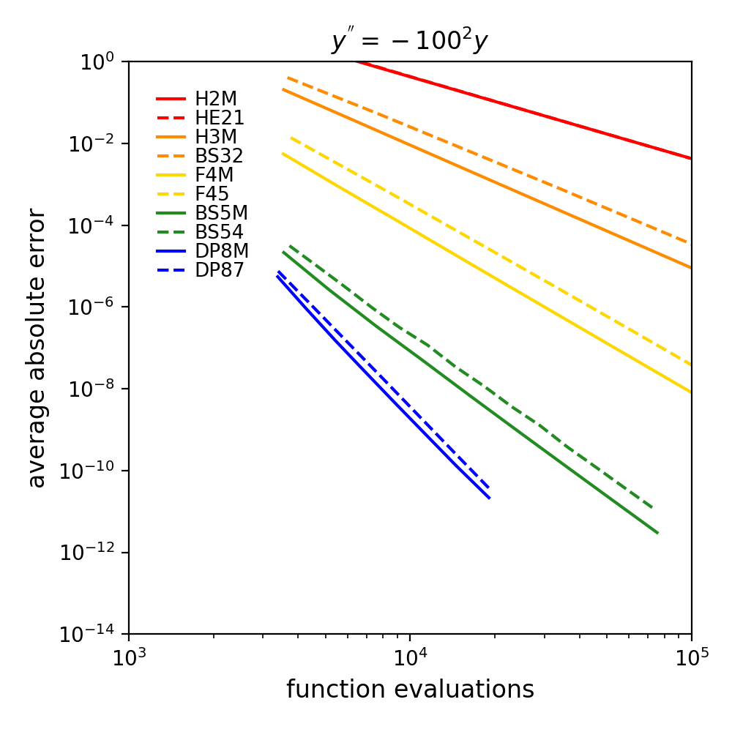






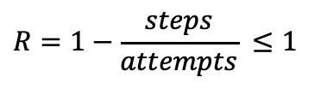
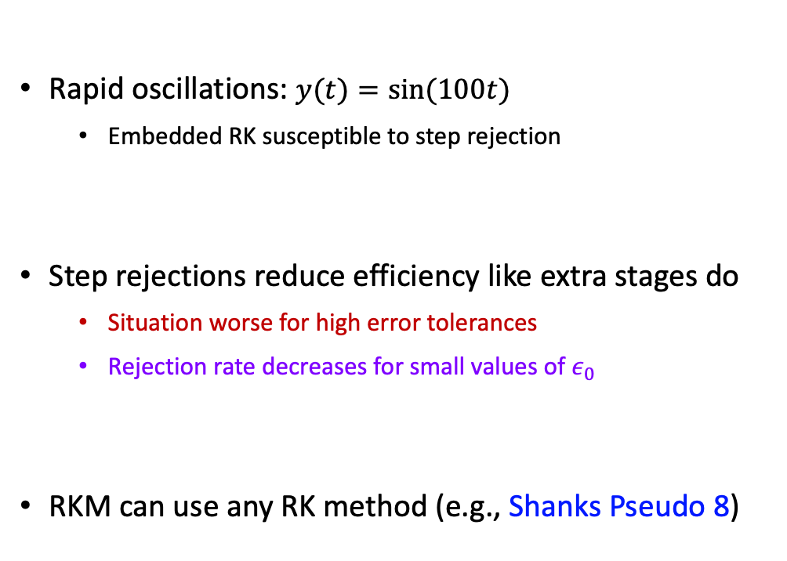


Sinusoidal
$$R=0.22$$
ignore step rejections
$$t_{f}=\frac{2π}{5}$$
Rapid oscillations: $y(t)=\sin{(100t)}$
Embedded RK susceptible to step rejection
Step rejections reduce efficiency like extra stages do
Situation worse for high error tolerances
Rejection rate decreases for small values of $ε_{0}$
RKM can use any RK method (e.g., Shanks Pseudo 8)
$$y^{′′}={100}^{2}y$$
$$y_{0}=1$$
$$t_{0}=0$$
$$R=1−\frac{steps}{attempts} ≤1$$
(step rejection rate)
$$R=0.02$$
$$E_{ERK}^{\left(ideal\right)}(FE)≈{\left(1−R\right)}^{p−1}E_{ERK}(FE)$$
(efficiency loss in ERK)

