Slide 1


Team ECE 08.5
RFID Technology for Ultrasound
Philips Healthcare
Seattle University
College of Science and Engineering
Electrical and Computer Engineering

Slide 2
Liaison Engineers
Mr. Matthew Rieger
Mr. Dale Chermak

Slide 3
Faculty Advisors
Faculty Project Advisor:
Dr. Robert Heeren
Electrical Engineering Senior Design Coordinator:
Dr. Alvin Moser

Slide 4

Team Members
Andrew Kurniadi
Robert Nguon
Min Kyeong Lee
Riley Higa
Mark John Merin

Slide 5
Philips Healthcare
Philips founded in 1896
  Manufactured the first x-ray tubes for medical applications
In 1998 acquired ATL Ultrasound of Bothell, Washington.
Design and Manufacture Ultrasound Machines
Dedicated to the advancement of Healthcare technologies.
Currently one of the top three medical device manufacturers in the world.
Notes:
Founded in 1896
Dedicated to the advancement of healthcare technology.
Design and Manufacture Ultrasound Machines

Slide 6
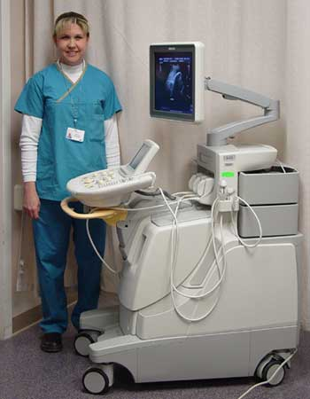
Problem
In Ultrasound exams, the sonographer must input patient data into the machine by hand
Consequences
  Time consuming
  Error prone
  Redundant

Slide 7
The Solution
RFID Technology
  Radio-frequency identification
  Method for storing and remotely retrieving data
  High-tech version of the barcode

Slide 8

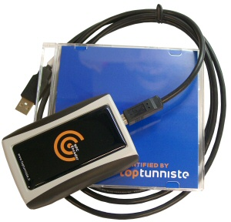
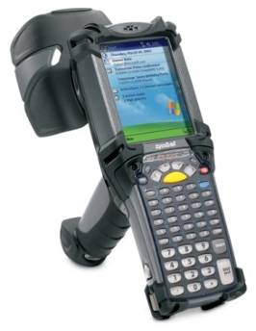
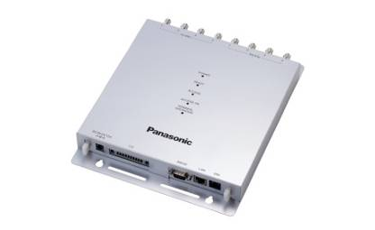
Parts of an RFID System
RFID Writer
RFID Reader
RFID tag
  Passive – no internal power supply
  Active – have own internal power source
  Storage Capacity: 256 bytes

Slide 9

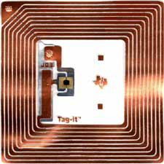
How Does RFID Work?
Information sent to and read from tags through electromagnetic waves.

Slide 10
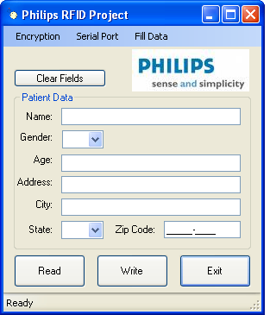
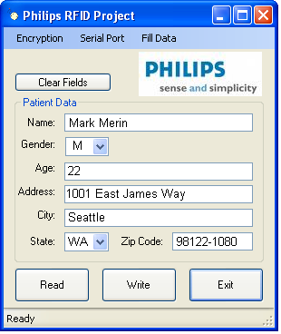
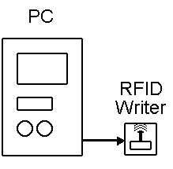
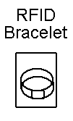
Project Overview
DATA

Slide 11
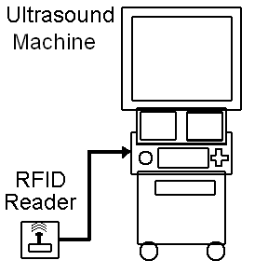
Project Overview
DATA

Slide 12
Software
Patient Data Application

Slide 13
Patient Data Form
Project Requirements
Compatible with Windows XP
Able to secure patient data
Able to store name, gender, and age
Notes:
Mention that they are project requirements

Slide 14
Security Implementation
AES (Advanced Encryption Standard)
  256 bit key
  Encrypt the data
DPAPI (Data Protection Application Programming Interface)
  Encrypt the 256 bit AES key

Slide 15

Levels of Classified Information in the United States
Unclassified
Restricted
Confidential
  Could damage national security
Secret
  Cause serious damage to national security
Top Secret
  Cause grave damage to national security

Slide 16
Security Implementation
AES (Advanced Encryption Standard)
  256 bit key
  Encrypt the data
DPAPI (Data Protection Application Programming Interface)
  Encrypt the 256 bit AES key

Slide 17


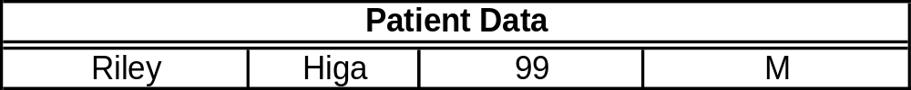
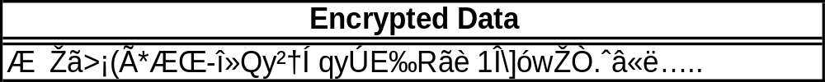
Patient Data Encryption
DPAPI
AES KEY
Encrypted Key
Data Structure

Slide 18
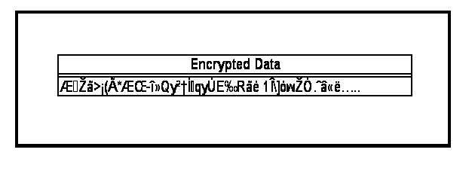
Compression Algorithm
Gzip
  Based on DEFLATE Algorithm which is a combination of:
    LZ77
    Huffman Coding
= 256 Bytes
Notes:
When we first implemented this our data waswithin the range of 284- 365 so we had to implement a compression algorithm

Slide 19
Hardware
RFID Reader/Writer

Slide 20
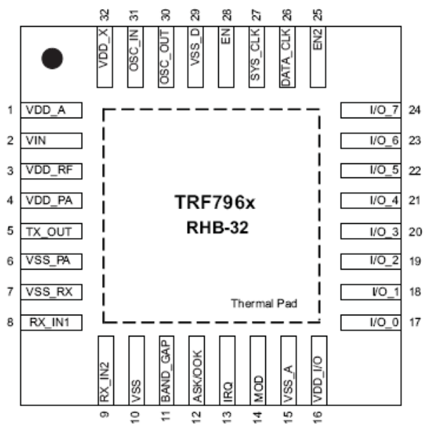
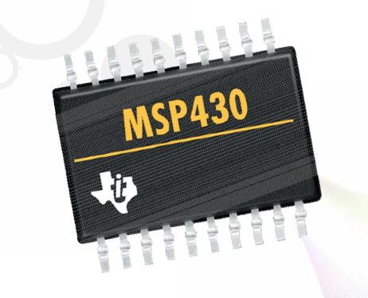
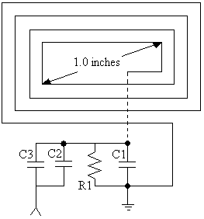
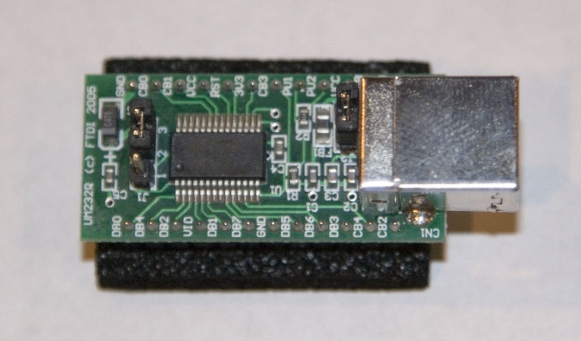
RFID Reader/Writer Components
Microcontroller
RFID Chip
Communication Interface
Antenna
Texas Instruments
MSP430
Texas Instruments
TRF7960
FTDI
UM232R
Team Designed

Slide 21
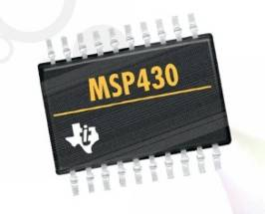
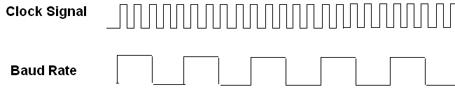
Microcontroller
Clock and Baud Rates
  Clock = at least 16 * Baud Rate
  http://mspgcc.sourceforge.net/baudrate.html
Clock: 6.78 MHz
Baud Rate: 4800 bps
Max Error: 0.04%

Slide 22
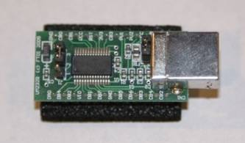
Serial Communication via RS-232
Protocol
  USART (Universal Synchronous/Asynchronous Receiver/Transmitter)
    Synchronous clock line is sent along with the data.
    Asynchronous requires the use of start and stop bits. Commonly used for RS-232 interfaces.

Slide 23
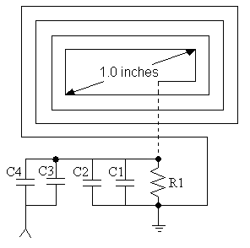
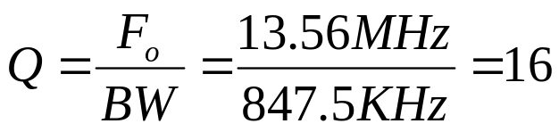
Antenna – Theoretical
Read range = 2.0 inches
  Rule of Thumb
    Antenna diagonal = 1.0 in
Q (Quality factor)
  F₀ = 13.56 MHz
  BW = 847.5 KHz

Slide 24
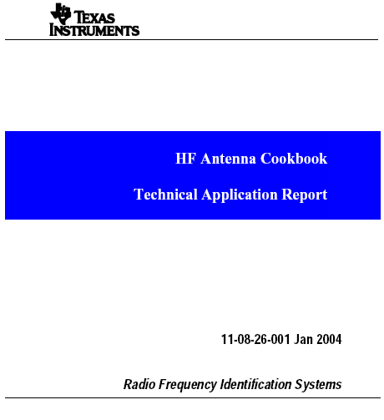
Antenna - Components
Matching
Circuit
Capacitors
  C1 = 120 pF, C3 = 10 pF, C2, C4 = 6-30 pF
  Resistor = 10K Ohms

Slide 25
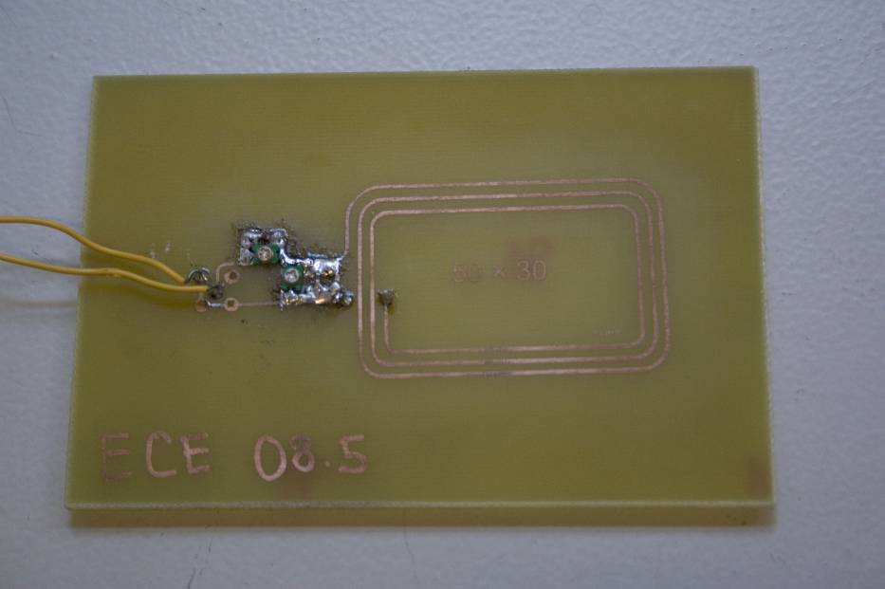

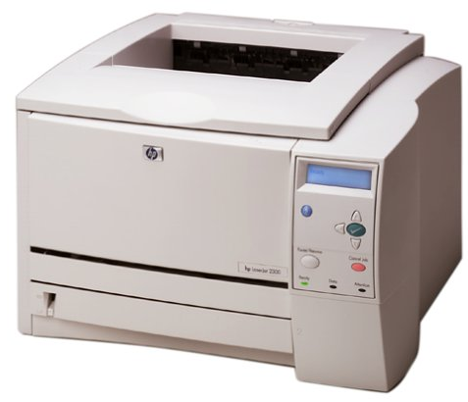
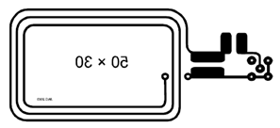

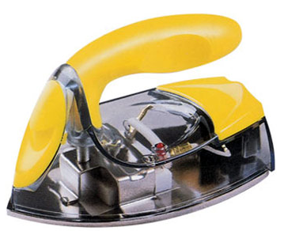
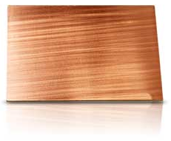
Antenna - Construction

Slide 26
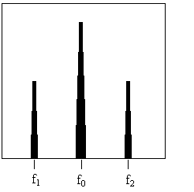
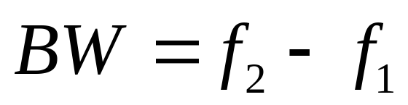
Antenna - Implementation
Signal
Generator
Spectrum
Analyzer

Slide 27


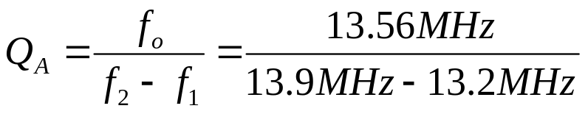
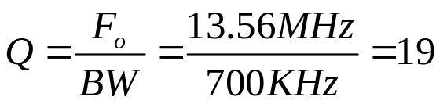
Antenna – Reality
Read Range: 58mm

Slide 28
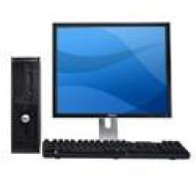
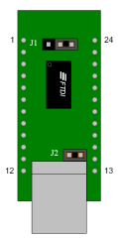
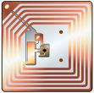
Data Flow
Front Desk Computer
RS-232 to USB Converter
Microcontroller
RFID Tag
RFID IC
Antenna

Slide 29
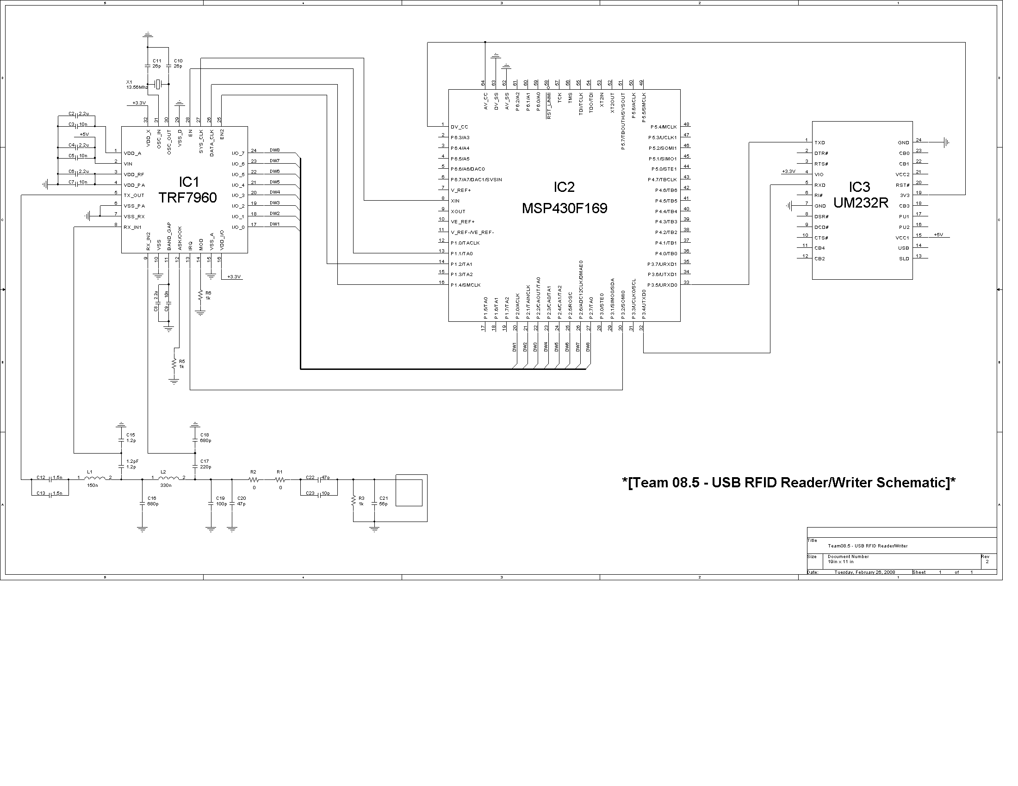
RFID Reader/Writer Schematic

Slide 30
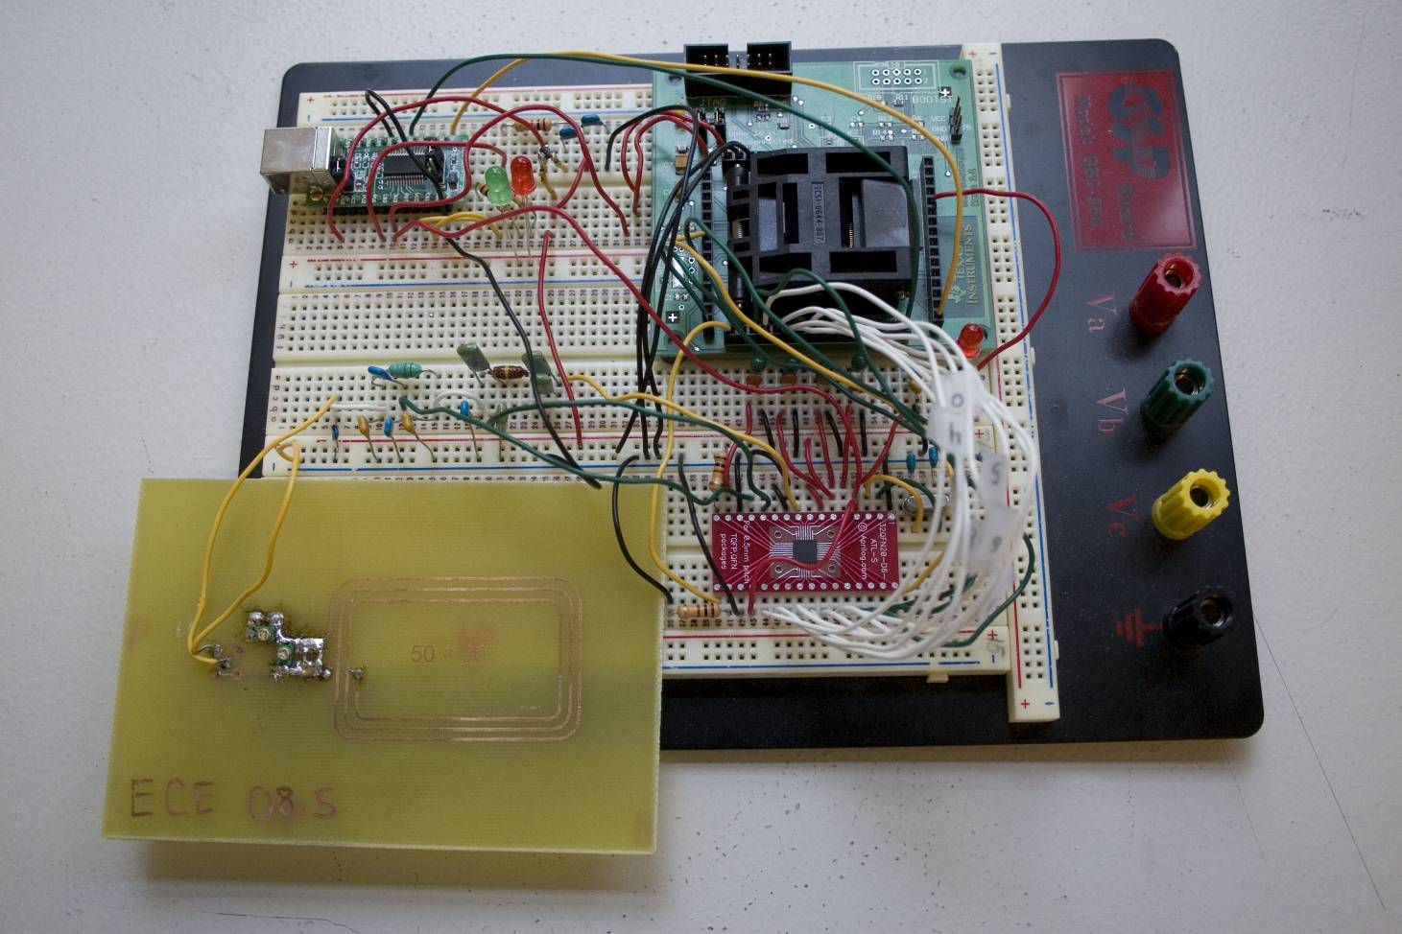
Pictures of our RFID Reader/Writer

Slide 31
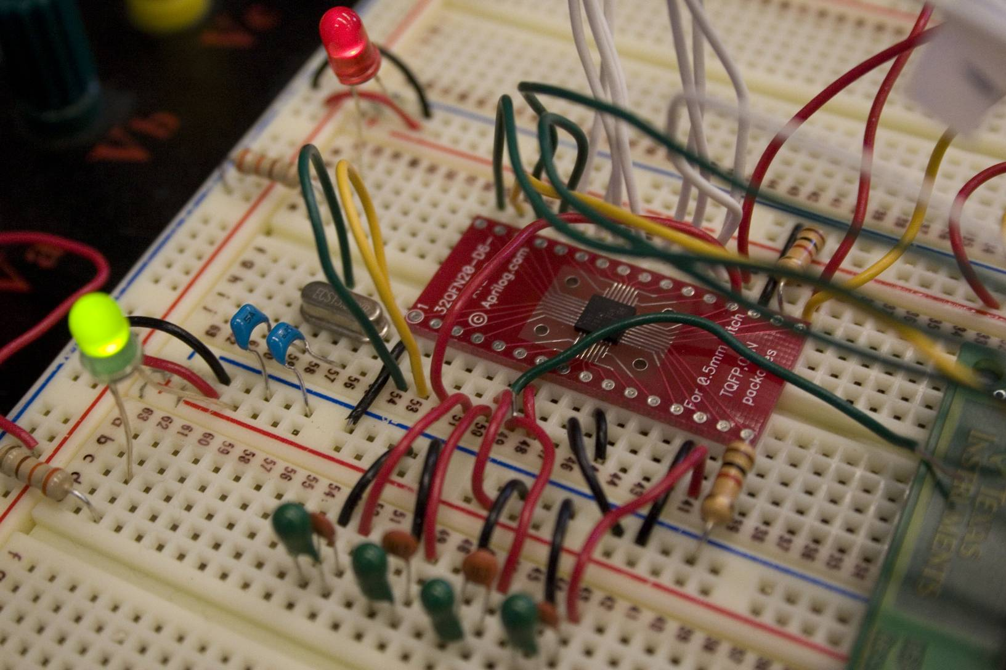
The RFID IC

Slide 32
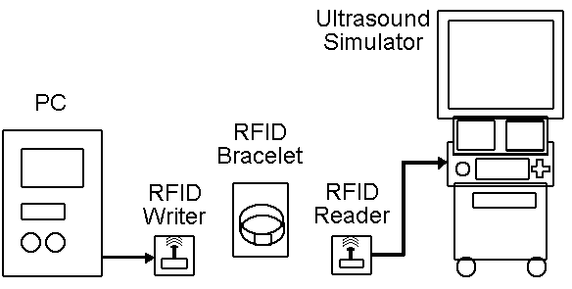
LIVE DEMO!

Slide 33
Schedule
Fall Quarter 2007
  Research and Design Phase
    Researched
      RFID technology.
      Encryption Methods.
      Compression Methods.
      Commercially Available Components.
    Wrote the Patient Data Graphical User Interface.
    Decided budget and planned schedule.

Slide 34
Schedule
Winter Quarter 2008
  Purchased prototyping/testing components.
  Implemented RS-232 Communication for the microcontroller.
  Implemented TRF7960 related functions.
  Added additional features and bug fixes for the GUI Application.
  Researched and Designed the antenna

Slide 35
Schedule
Spring Quarter 2008
  Continued working on the TRF7960 implementation
  Did more research and improved the Antenna design
  Designed the Printed Circuit Board
  Testing and Debugging Phase
  Built the final prototype.
  Prepared the Final Report

Slide 36
Budget
Approved Budget:
  $2342.68
Actual Cost
  $2235.32

Slide 37
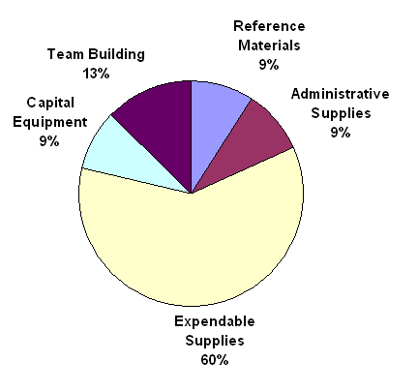
Budget Distribution
TOTAL:
$2,342.68

Slide 38
Acknowledgements
Philips Healthcare
  Matthew Rieger
  Dale Chermak
  Rob Trahms
  Greg Fissel
Seattle University
  Dr. Robert Heeren
  Gary Fernandes
  Jeff Wilhite
  Jim Howard

Slide 39
References
Philips Logo 1 from http://www.teknikmagasinet.se/prod/mellan_bild/Philips_logo.jpg
Philips Logo 2 from http://oss-in-atm.demodomain.net/20051207/images/logos/Philips-logo.gif
Seattle University Logo 1 from http://www.seattleu.edu/
Team pictures from http://www.seattleu.edu/scieng/ece/
RFID tag from http://en.wikipedia.org/wiki/Rfid_tag
RFID tag 2 from http://www.dashdave.f2s.com/images/Rfid_tag.jpg
Sonographer from http://www.arrowheadhospital.com/images/iU22-Philips-with-staff.jpg
RFID reader/writer 1 from http://www.toptunniste.fi/topshop/images/NFC_Encoder_SalesPackage_300x300.jpg
RFID reader/writer 2 from http://www.windowsfordevices.com/files/misc/MC9000G_RFID.jpg
RFID reader/writer 3 from http://panasonic.net/press-room/contents/download/products/device/hi_res/UHF-Band_RFID_Reader_Writer.jpg
Texas Instruments Antenna Cookbook from http://www.ti.com/rfid/docs/manuals/appNotes/HFAntennaCookbook.pdf
Copper board from http://www.radioshack.com/product/index.jsp?productId=2102495&cp=&sr=1&origkw=copper+board&kw=copper+board&parentPage=search

Slide 40

Questions?

