Slide 1
Python Data Analysis
Michael J. Miller
College of Engineering and Information Sciences
CEIS110 Introduction to Programming
Prof. Genevieve Sapijaszko
October 22, 2022

Slide 2
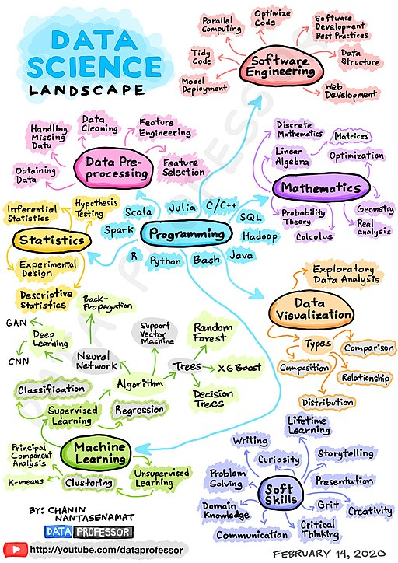
Introduction
Project Expectations
Software and Python Library Installation
Planning project
Downloading weather data
Querying database with SQL
Querying and Manipulating Data with SQL and Python
Develop Graphical Models and Interpret Results

Slide 3
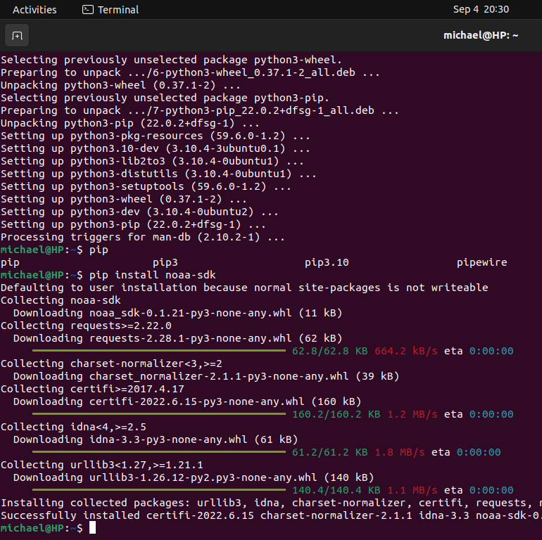
Software Installation (Ubuntu)
Python3
Check if already installed
In the terminal type: python3 –version
If no version returned or version is older than 3.x.x
sudo apt install python3
sudo apt install python3-pip
verify python3 –version, pip3 --version
Required Libraries
NOAA SDK
pip3 install noaa-sdk
Matplotlib
pip3 install matplotlib
Pandas
pip3 install pandas
Excel or equivalent spreadsheet software
Code editor of choice
VS Code https://code.visualstudio.com/download
Python Idle sudo apt install idle

Slide 4
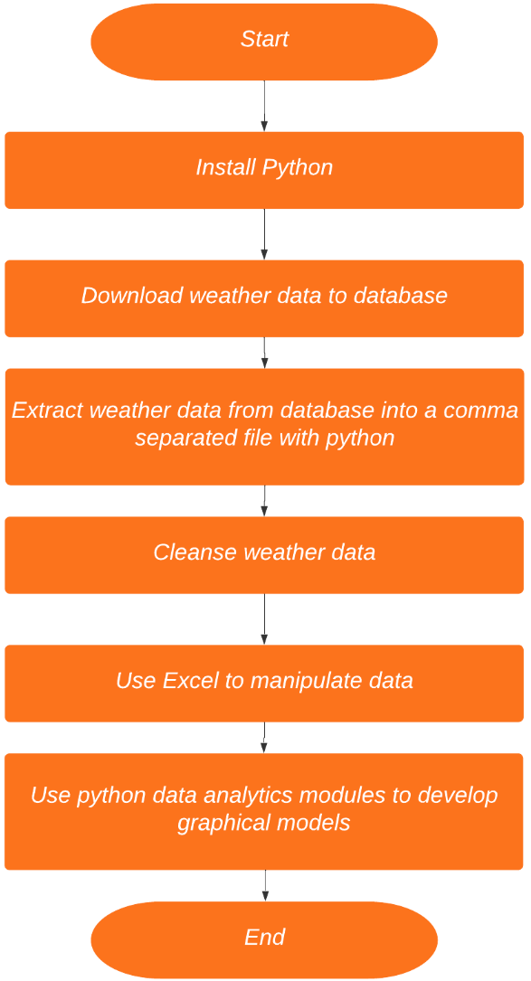
Planning Project
Include the following processes:
Install python
Download weather data to a database.
Extract weather data from database into a comma separated file with python
Cleanse weather data
Use Excel to manipulate data
Use python data analytics modules to develop graphical models

Slide 5
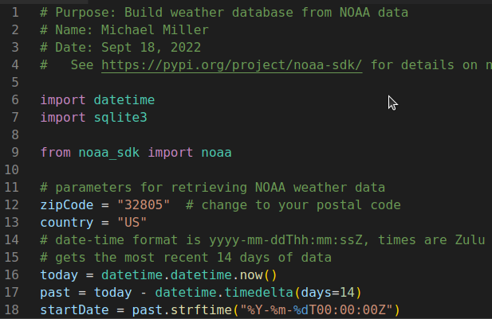
Downloading Weather Data
Open code editor
Copy and paste provided code into a new file
Change name and date
Change zip code to local zip
Save file as BuildWeatherDb.py
Executing program will:
prepare the database “weather.db”
retrieve data from NOAA database
insert the data to “weather.db”

Slide 6
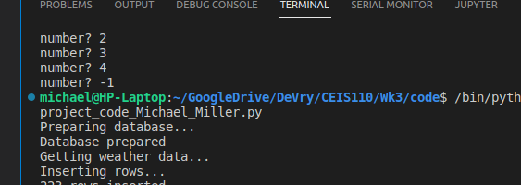
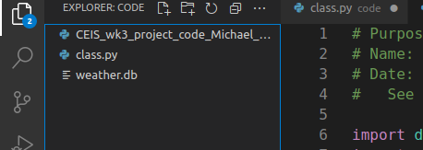
Downloading Weather Data (cont.)
Screenshot of output after running code.
Screenshot of weather.db file after running code.

Slide 7
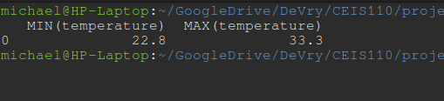
Querying database with SQL
Start new file in code editor
Name: QueryWeatherDb.py
Copy/Paste provided code
Query database for min and max temperature
SQL: " SELECT MIN(temperature), MAX(temperature) FROM observations; “
Query database for temperature, windspeed, and textDescription
SQL: = "SELECT temperature, windspeed, textDescription FROM observations where textDescription = 'Clear’; “

Slide 8
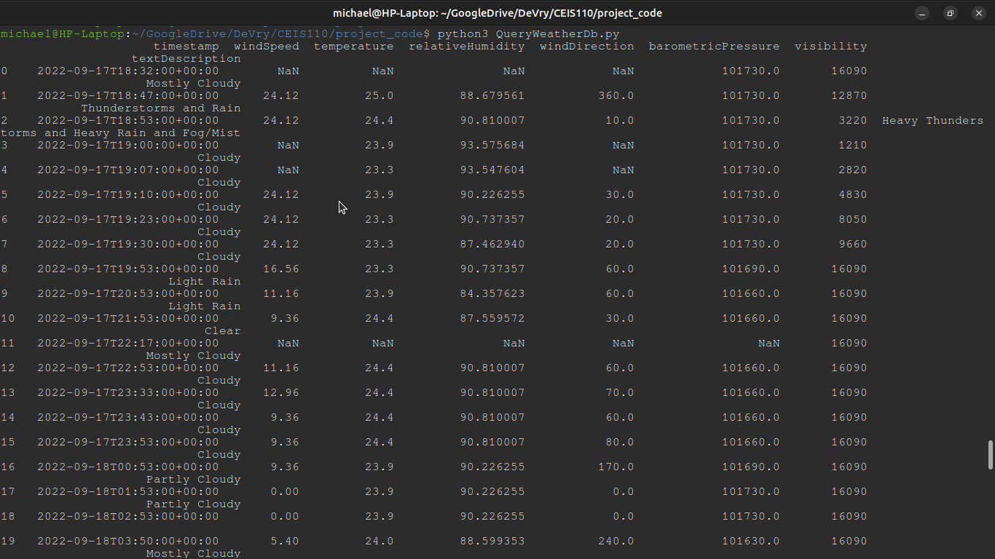
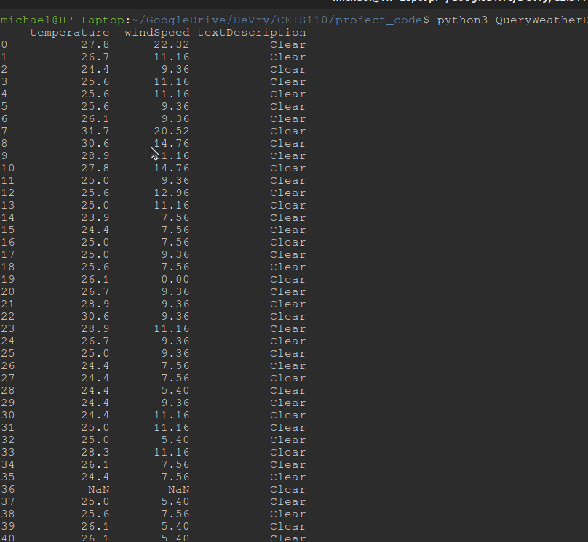
Querying database with SQL
Screenshot of SQL query command and results
Results of query including only clear days

Slide 9
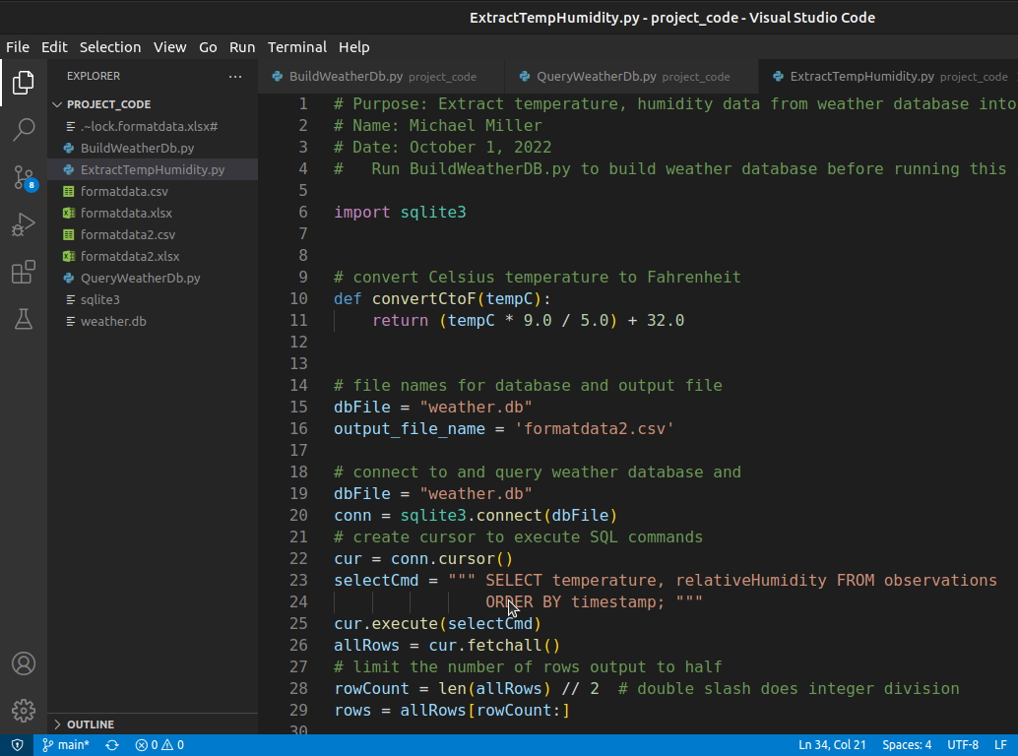
Querying and Manipulating Data
Extract temp and humidity data and output to .csv file. Copy/Paste code Save as: ExtractTempHumidity.py

Slide 10
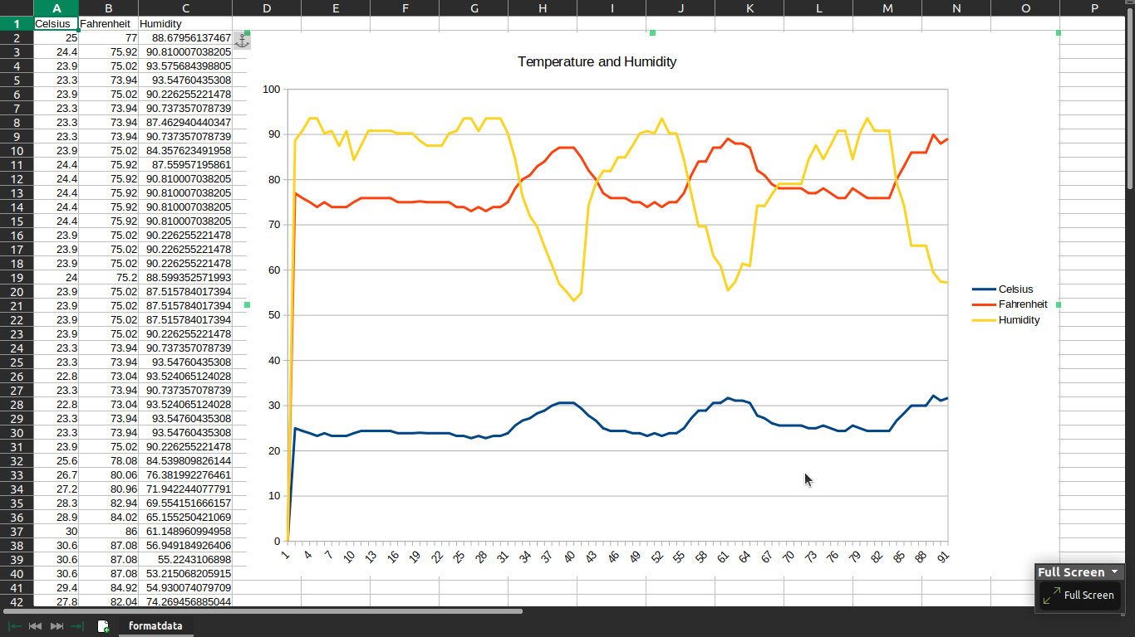
Querying and Manipulating Data
Screenshot of .csv data in Excel and line chart of data

Slide 11
Develop Graphical Models and Interpret Results
Extract temp and humidity data and output to .csv file. Copy/Paste code Save as: ExtractTempHumidity.py

Slide 12
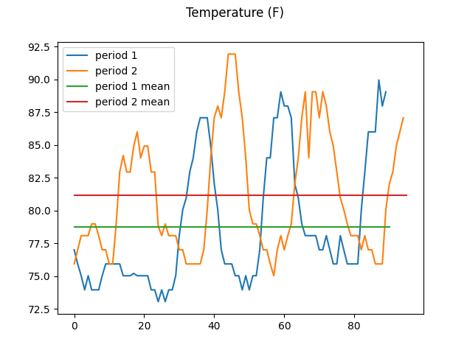
Temperature
#Purpose: Create temperature plot comparing period 1 and period 2
#Name: Michael Miller
#Date: Oct 9, 2022
import matplotlib.pyplot as plt
import pandas as pd
df1 = pd.read_csv("formatdata.csv") #baseline data is period 1 (older)
df2 = pd.read_csv("formatdata2.csv") #data for period 2 (more recent)
plt.figure()
df1_mean = df1.Fahrenheit.mean()
df2_mean = df2.Fahrenheit.mean()
df1.Fahrenheit.plot(label='period 1')
df2.Fahrenheit.plot(label='period 2')
plt.plot([0, len(df1.Fahrenheit)], [df1_mean, df1_mean], label='period 1 mean')
plt.plot([0, len(df2.Fahrenheit)], [df2_mean, df2_mean], label='period 2 mean')
plt.legend(loc='best')
plt.suptitle('Temperature (F)')
plt.show()
Period 2 shows an increase in the mean temperature.

Slide 13
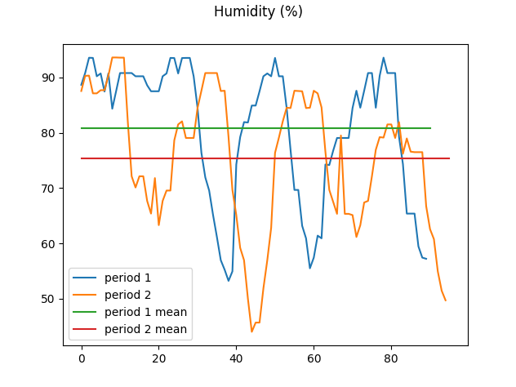
Humidity
################
#Purpose: Create humidity plot comparing period 1 and period 2
#Name: Michael Miller
#Date: Oct 9, 2022
import matplotlib.pyplot as plt
import pandas as pd
df1 = pd.read_csv("formatdata.csv") #baseline data is period 1 (older)
df2 = pd.read_csv("formatdata2.csv") #data for period 2 (more recent)
plt.figure()
df1_mean = df1.Humidity.mean()
df2_mean = df2.Humidity.mean()
df1.Humidity.plot(label='period 1')
df2.Humidity.plot(label='period 2')
plt.plot([0, len(df1.Humidity)], [df1_mean, df1_mean], label='period 1 mean')
plt.plot([0, len(df2.Humidity)], [df2_mean, df2_mean], label='period 2 mean')
plt.legend(loc='best')
plt.suptitle('Humidity (%)')
plt.show()
Period 2 shows a decrease in the mean humidity.

Slide 14
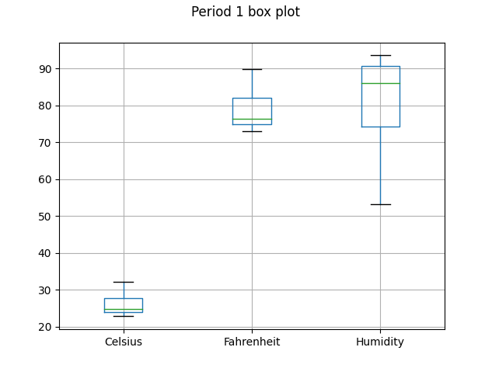
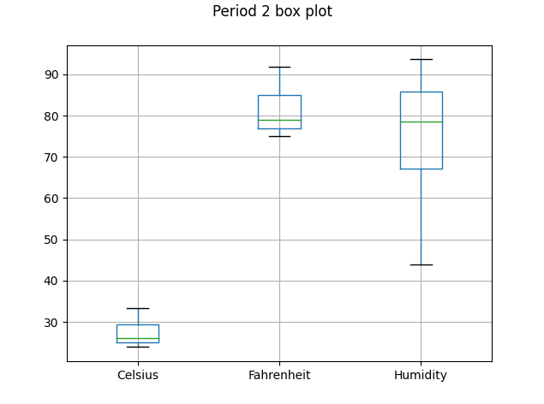
Box Plots
#Purpose: Create box plot for period 2 data
#Name: Michael Miller
#Date: Oct 9, 2022
import matplotlib.pyplot as plt
import pandas as pd
df1 = pd.read_csv("formatdata.csv")
df2 = pd.read_csv("formatdata2.csv")
df1.boxplot()
plt.suptitle('Period 1 box plot')
plt.show()
df2.boxplot()
plt.suptitle('Period 2 box plot')
plt.show()
Period 2 boxplot shows a slightly lower minimum for the humidity. All other data are too similar to be noteworthy.

Slide 15
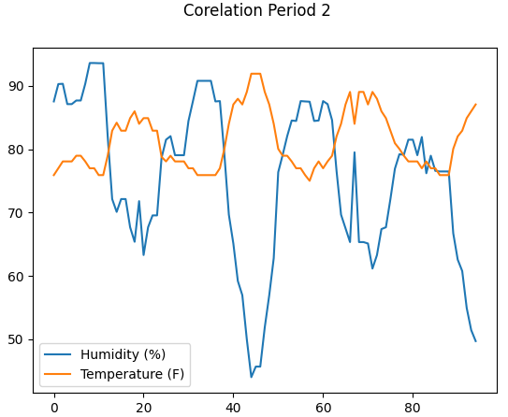
Analysis
Period 2 mean temp is higher, while mean humidity is lower than period 1.
Do the temp and humidity show any correlation in period 2?
The chart shown for period 2 shows an inverse correlation between temperature and humidity. As temperature rises humidity lowers.
The previous charts showed an increase in temperature and a decrease in humidity from period 1 to period 2.
Prediction
If this trend holds, we could expect higher temperatures and lower humidity in the days to come.

Slide 16
Challenges
PowerPoint
Learning about Master Slides and editing features
Python
Finding and installing the correct libraries
Instructions were for Anaconda I chose to work in Linux
Analyzing data and making a prediction
Difficult to see patterns in the dataset
Predicting what might happen next was just guessing

Slide 17
Skills Learned
Python
Installing, importing, and using libraries
SqLite3
Creating database with a table
Filling the data base with data
Querying the database and retrieving data
Pandas
Using pandas to read data from .csv file
Matplotlib
Plotting data and formatting chart

Slide 18
Conclusion
Data Analysis and Visualization
Exponentially growing field
~2.5 quintillion bytes are generated each day(Howarth, 2022)
Demand for skilled data analysts will only rise
Data analysis is a skill that will take time to learn, but is well worth the effort

Slide 19
References
Howarth, J., 30+ incredible big data statistics (2022). https://explodingtopics.com/blog/big-data-stats

