Slide 1
Linux Operating System An Introduction
Michael J. Miller
CEIS106
Oct 22, 2022
Professor Charlotte McKenzie

Slide 2
Introduction
What is Linux?
Operating system based on the Linux kernel
Released Sep 17, 1991 by Linus Torvalds
Free and open source
Typically packaged as “Distributions”
Includes Linux kernel plus system software and libraries
Worlds top 500 fastest computers run on Linux
Android uses the Linux kernel

Slide 3
Navigate the Linux filesystem tree
Directory Structure
Organized top down
Root at top level
Absolute pathname starts at root directory
Common commands
cd – Change directory
cd dir_name/ # relative pathname
cd /usr/bin # absolute pathname
ls – List files and folders in directory
ls -a # List all files and folders including hidden ones

Slide 4
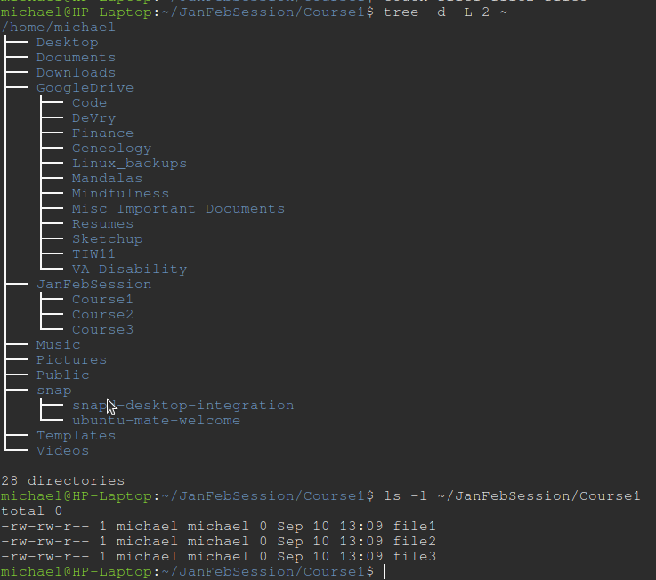
Examples
tree -d -L 2 ~
list directories in tree format
-d = directories only
-L 2 = 2 levels deep
~ = starting in user’s home directory
ls
ls -l ~/JanFebSession/Course1
ls = list files and folders
-l = print in long form
permissions
link count
ownership
date/time
file/folder name

Slide 5
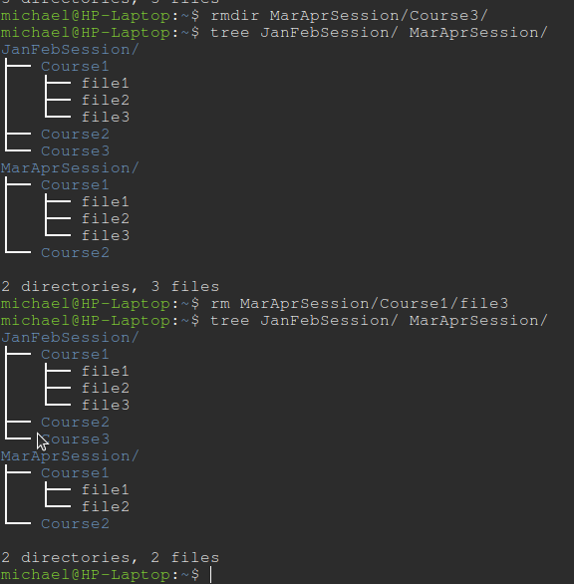
Copy and Remove Directories and Files
rmdir MarAprSession/Course3/
remove directory MarAprSession/Course3
cp source destination
copy source file to destination
-r option copies directories recursively
mv source destination
move source file to destination directory

Slide 6
Locate Directories and Files
locate -i pattern
list files in database that match pattern
file name database stores list of files
update database with updatedb
find . -iname “text”
find file with text in name
ignore case
starting in current directory

Slide 7
Creating shell scripts
Shell scripts are executable files containing bash commands
First line must be “#!/user/bin/bash”
usr/bin/bash may be different depending on distribution
Can contain
for loops
if/else statements
variables
functions
Execute permission must be given to user or group
chmod u+x filename

Slide 8
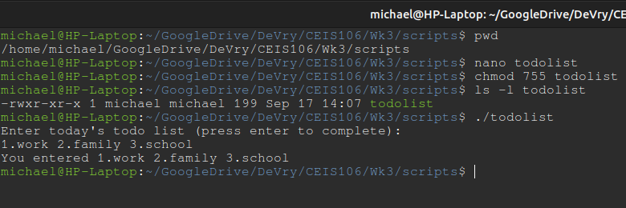
Changing Script File Permissions
chmod u+x filename
adds execute permission for current user on filename
chmod 744 filename
change files permissions
user: read, write, execute
group: read only
all others: read only

Slide 9
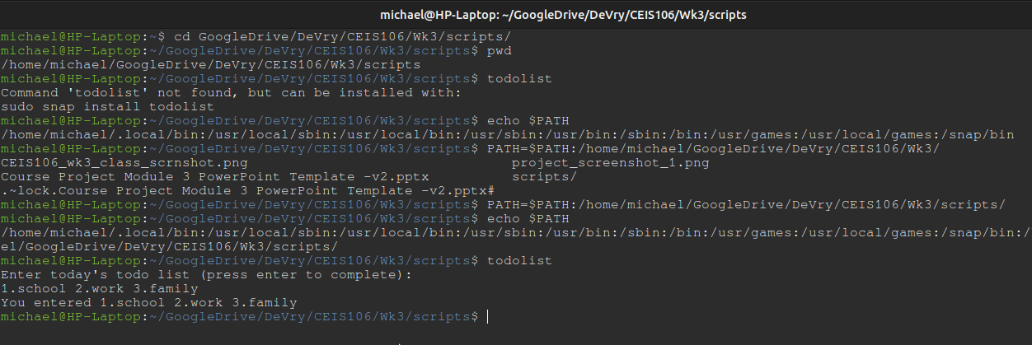
Set PATH Variable
echo $PATH
prints current PATH vale
PATH=$PATH:/home/user/
Adds “:/home/user/” to end of current PATH value

Slide 10
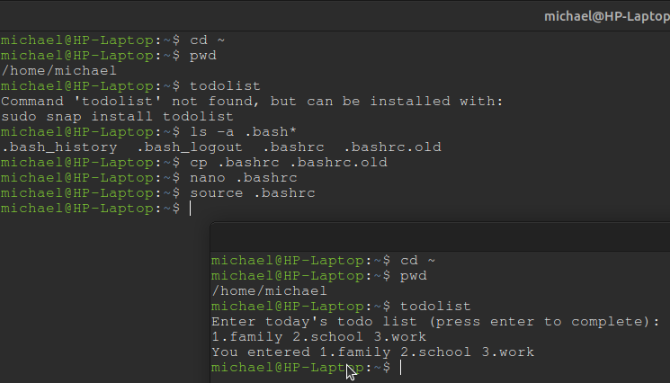
Make The PATH Value Permanent
Add desired filepath to end of .bashrc file
nano .bashrc
open .bashrc in nano editor
bashrc
file containing configuration data for shell
located in users home directory

Slide 11
Add Users and Groups in Command Line
useradd command
add new user to system
use options to configure user account specifics
uses default config settings if not specified in command
adduser command
Like useradd
Will prompt for password and user information
Typically preferred method
addgroup command
add new group to system
assigns group id (GID)

Slide 12
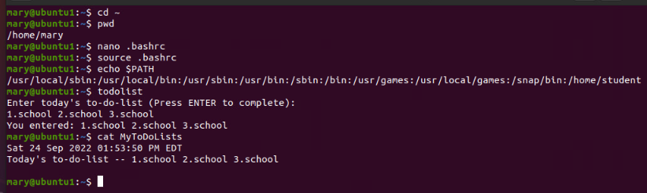
Test User and Group Settings
id username
print username’s:
userid (UID)
groupid (GID)
GID’s user belongs to
cat /etc/passwd
prints passwd file listing all users
cat /etc/shadow
prints all users with password hashed

Slide 13
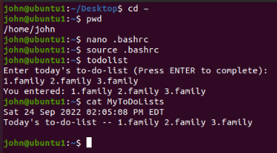
Add Users In GUI
GUI user management tools
system-config-users
Red Hat developed
RHEL/CentOS distros
yum install system-config-users
yum groupinstall “Graphical Administration Tools”
gnome-system-tools
Debian based distros
apt install gnome-statem-tools

Slide 14
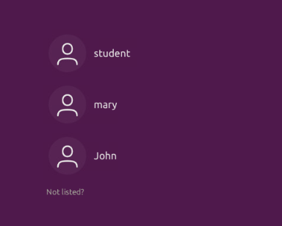
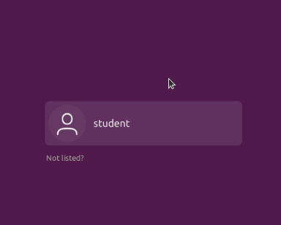
Remove Users and Groups
userdel username
Removes user from system
Deletes all entries referring to the username
groupdel group_id
Removes group from system
Deletes all entries referring to group
deluser and delgroup
friendlier than previous two commands
only removes data if command line options are used
Leaves user’s home directory and files intact by default

Slide 15
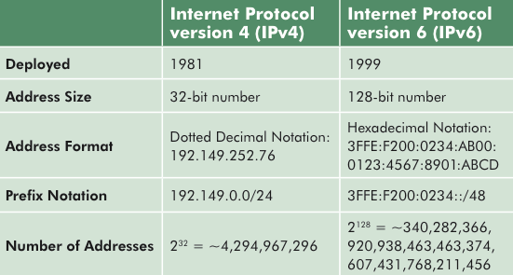
Networking
Networking
Connecting more than one computer together for sharing data
All connected computers must have an IPv4 or IPv6 address
TCP/IP
Transmission Control Protocol/Internet Protocol
Primary data transfer protocol used on the internet
IPv4 addresses
Four octets of numbers
eg. 192.168.0.1
IPv6
Eight 16bit hexadecimal numbers
eg. 2001:0db8:3c4d:0015:0000:0000:adb6:ef12
Created because IPv4 addresses will all be used up
source: wikimedia.commons.org

Slide 16
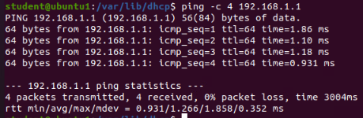
Discover Host IP Configurations
ifconfig command
lists network devices installed
Shows:
IP addresses
Current status of each device
route and netstat commands
View/modify network tables

Slide 17
Manage Network Interfaces
ifconfig command
View network configuration
Configure network interfaces/devices
DHCP - Dynamic Host Configuration Protocol Client
dhclient command
allows configuration of network interfaces with DHCP
Name Resolution
DNS (domain name space) server
FQDN – fully qualified domain name
DNS servers store mapping of host FQDN to IP address
Clients request host name from DNS server
DNS server provides matching IP for proper connection

Slide 18
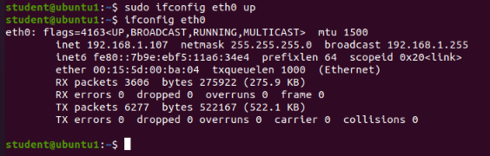
Using Network Utilities
ifconfig eth0 up
Activates eth0 eithernet device
ifconfig eth0 down
Deactivates eth0 device
ping 192.168.1.107
Requests echo response from a host
ping -c 3 hostname
Stop pinging after 3 attempts

Slide 19
Monitor Linux Processes
Performance Issues can be caused by:
Hardware improperly configured
Applications hogging resources
Too many processes running
File system excessive read/write operations
Large amounts of network traffic
Memory leaks, memory not being relinquished
Some Solutions:
Using peripheral processing devices
Adding RAM
Using SSDs, especially NVME hard drives
Run performance utilities to identify culprits

Slide 20
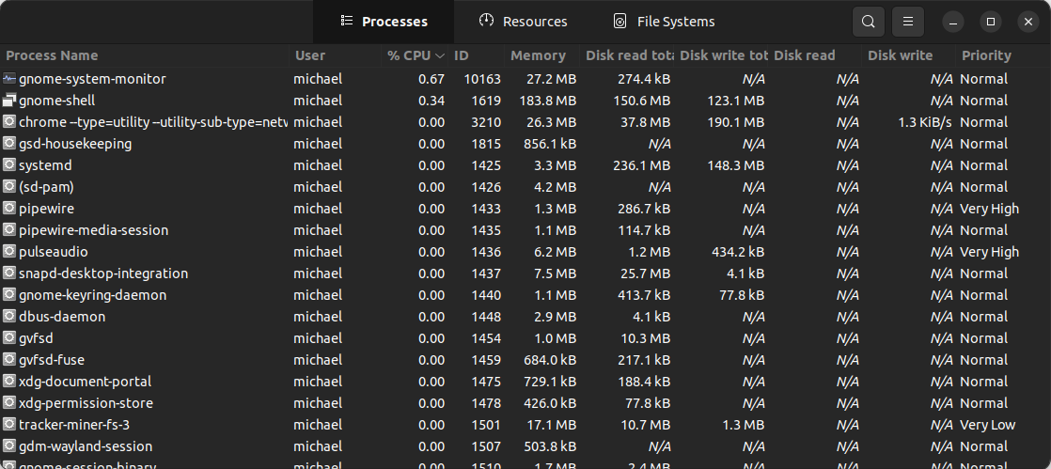
System Monitoring Utilities
HTOP
used to observe all running processes
Shows command line arguments used for process
Can be used to kill a process
System Monitor
GUI application
Similar functionality to HTOP
Can be used to kill a process

Slide 21
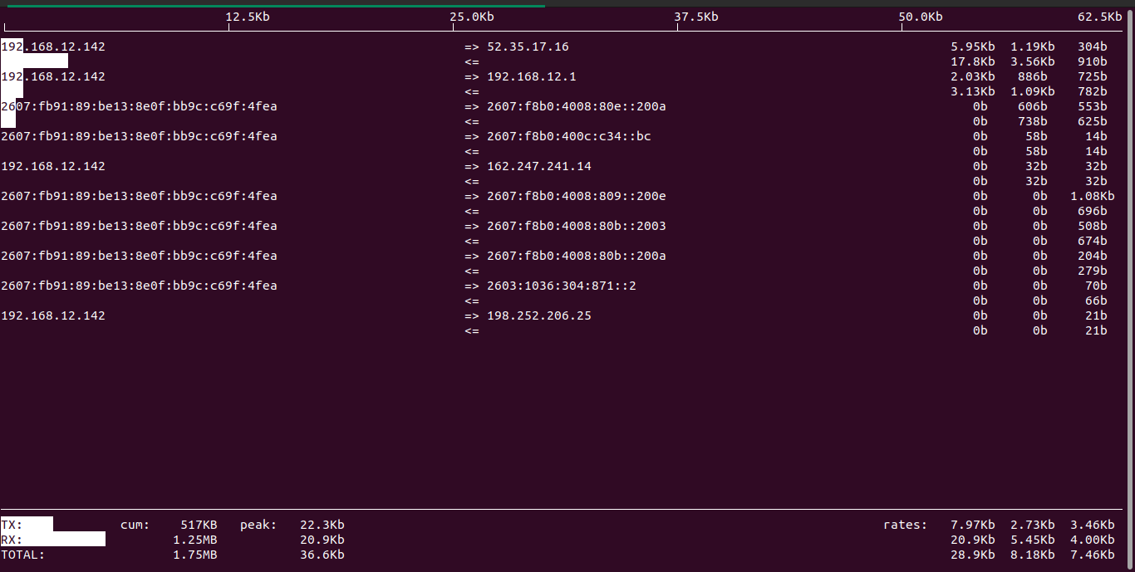
Network Bandwidth Usage
iftop utility
Listen to network traffic
Must be run as root
Counts packets that pass through set filter

Slide 22
Challenges
Virtual Machine instances used for weekly projects were complex to set-up and slow.
The lesson lab assignments on MindTap were difficult to understand. The instructions were not clear and lead to a lot of guessing before moving to the next step.
Network configuration and monitoring processes were a challenge to fully understand and remember. It will take more reading and practice to fully grasp these concepts.

Slide 23
Skills Gained
Linux command line usage
BASH scripting
Linux user/group administration
Operating Linux virtual machine instances
Organizing and presentation of lessons learned
LibreOffice Impress – Linux based PowerPoint alternative

Slide 24
Conclusion
Linux is a widely used and adaptable operating system
There is a learning curve, but it’s worth the effort
Free and Open Source software can be very effective
Linux administration as a skill is very valuable

