Slide 1
Microsoft Azure Fundamentals

Slide 2

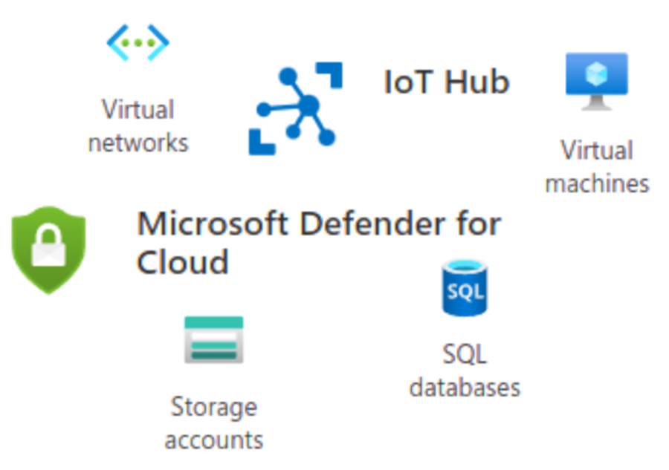

Introduction
What is Microsoft Azure?
“Azure is a cloud platform designed to simplify the process of building modern applications.” (Microsoft Azure)
Microsoft Azure offers a wide range of services across different categories including:
Virtual Machines
Cloud Storage
Virtual Networking
Databases
Security
Internet of Things (IoT)

Slide 3

Introduction
What this presentation will cover:
Deploying and connecting to VM instances
Azure VNet and Subnets
VM security
Cloud storage
Cloud monitoring

Slide 4
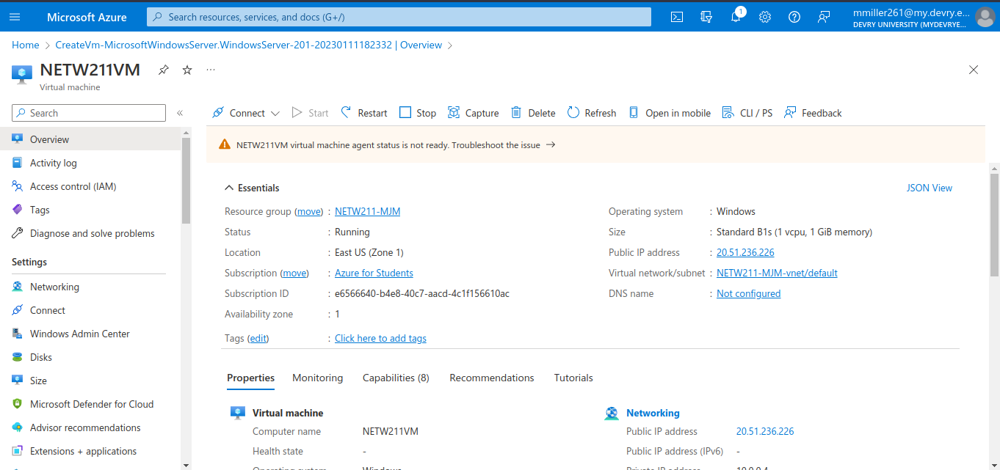
Deploying and Connecting to VM Instances
This screenshot shows the NETW211VM page with information such as the resource group name, subscription, public IP address, etc.

Slide 5
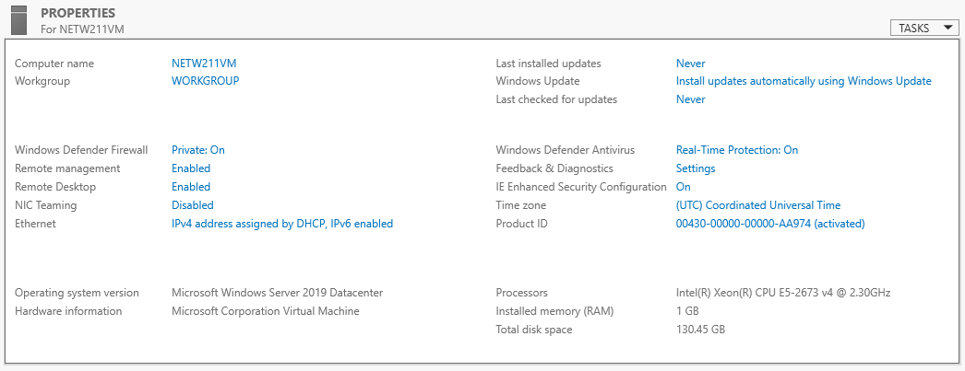
Deploying and Connecting to VM Instances
This screenshot shows the PROPERTIES for NETW211VM page, with the computer name, operating system version, hardware information, etc.

Slide 6
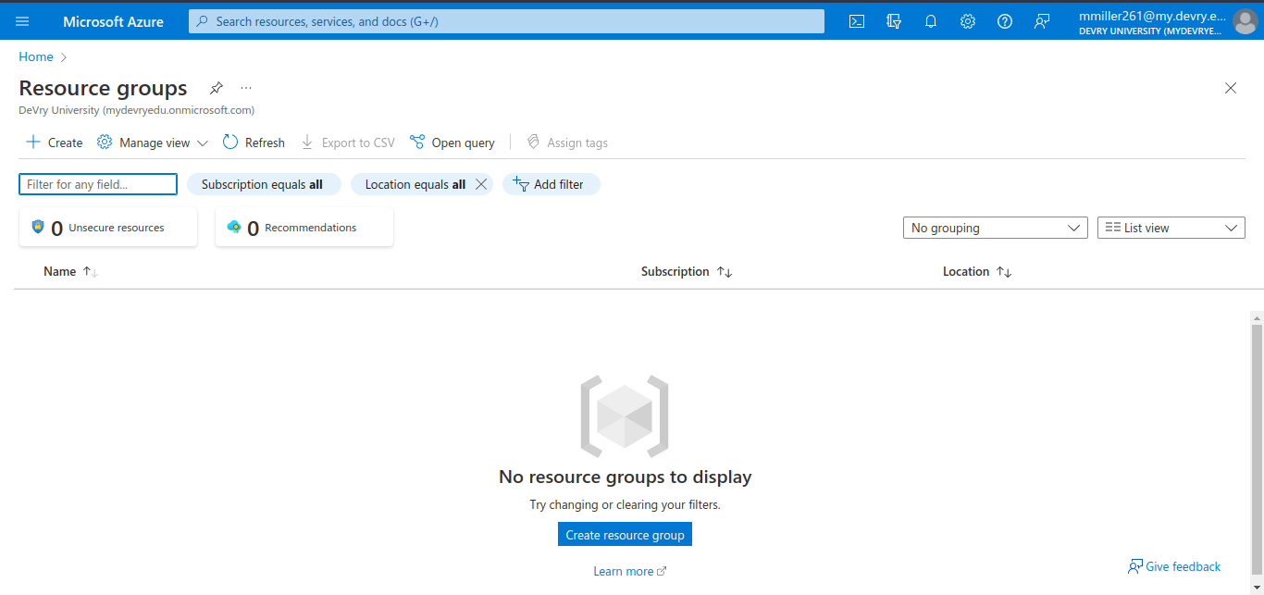
Deploying and Connecting to VM Instances
This screenshot shows the Resource groups page, with the Azure for Students subscription selection and the “No resource groups to display” message.

Slide 7
Azure VNet and Subnets
Creating a VNet with Two Subnets
1. With a /24 network prefix, how many usable IPv4 host addresses are there? [hint: you learned this in NETW191]
Answer here: Typically there are 254 usable addresses in a /24 network with the first and last addresses (x.x.x.0, x.x.x.255) being reserved.
2. Given the answer above, why is the number of available IP addresses for Subnet0 (10.0.0.0/24) or Subnet1 (10.0.1.0/24) shown as 251? [hint: where did the missing addresses go?]
Answer here: Amazon AWS reserves an additional three addresses for their use.

Slide 8
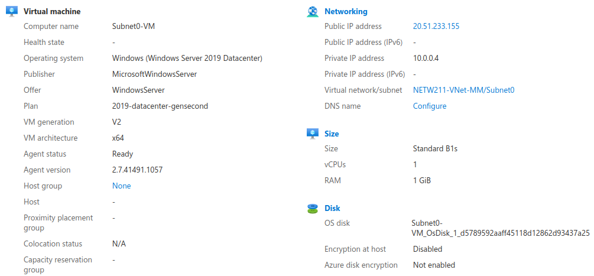
Azure VNet and Subnets
This screenshot shows the Properties section of the Subnet0-VM page, showing the networking and size information of the VM.

Slide 9
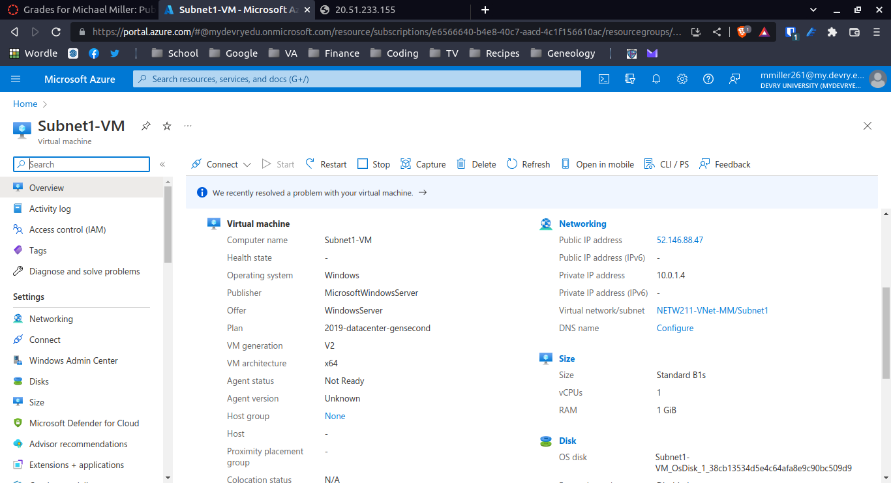
Azure VNet and Subnets
This screenshot shows the Properties section of the Subnet1-VM page, showing the networking and size information of the VM.

Slide 10
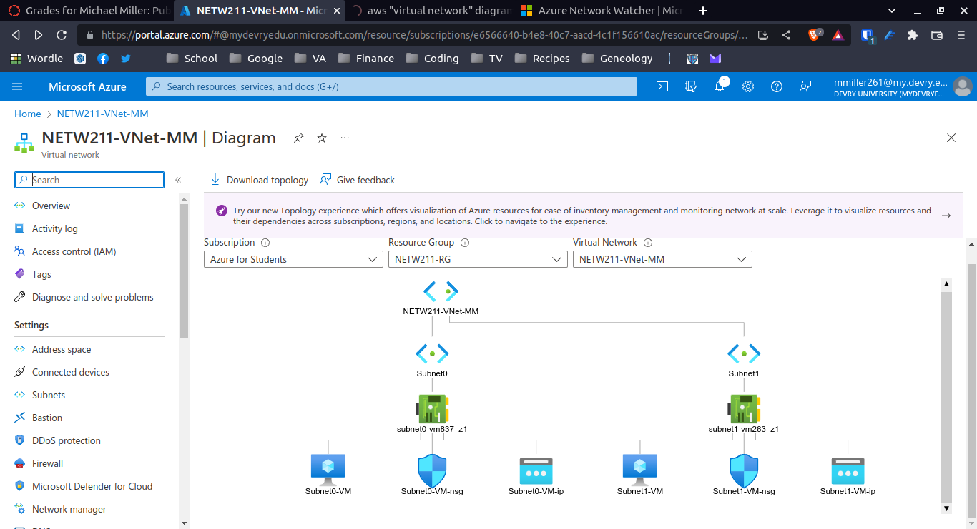
Azure VNet and Subnets
This screenshot shows the topology diagram of your VNet (NETW211-VNet-Your Initials) with two subnets (Subnet0 and Subnet1) and one VM in each subnet (Subnet0-VM and Subnet1-VM).

Slide 11
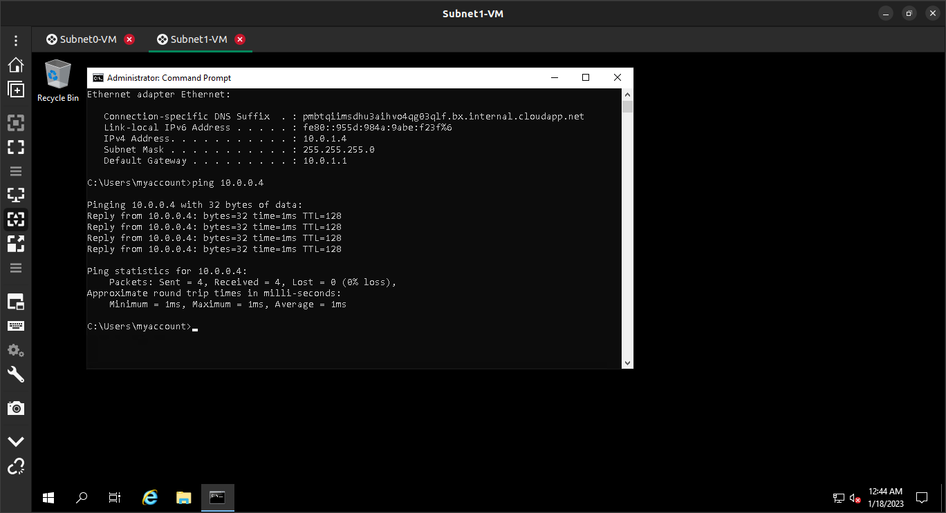
Azure VNet and Subnets
This screenshot shows the ipconfig and ping x.x.x.x results in the command prompt window, including the Subnet0-VM – x.x.x.x – Romote Desktop Connection window title.

Slide 12
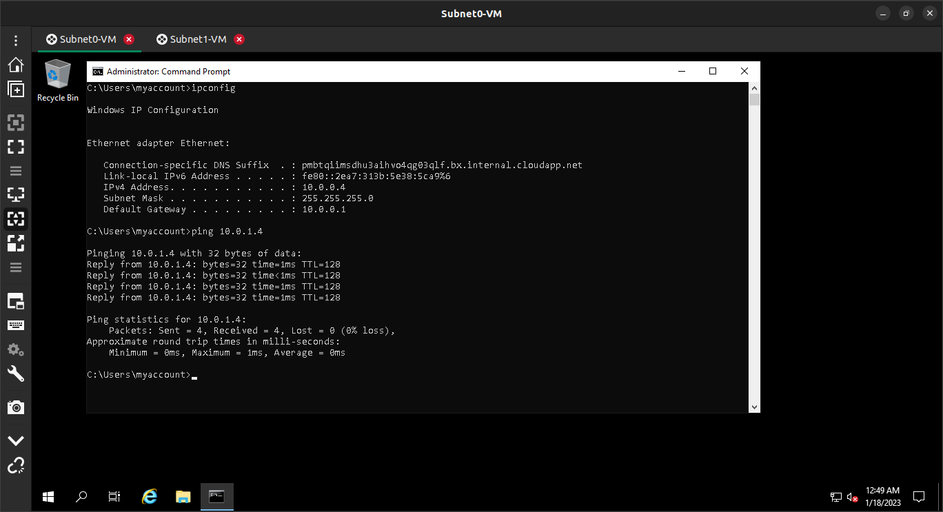
Azure VNet and Subnets
This screenshot shows the ipconfig and ping x.x.x.x results in the command prompt window, including the Subnet1-VM – x.x.x.x – Romote Desktop Connection window title.

Slide 13
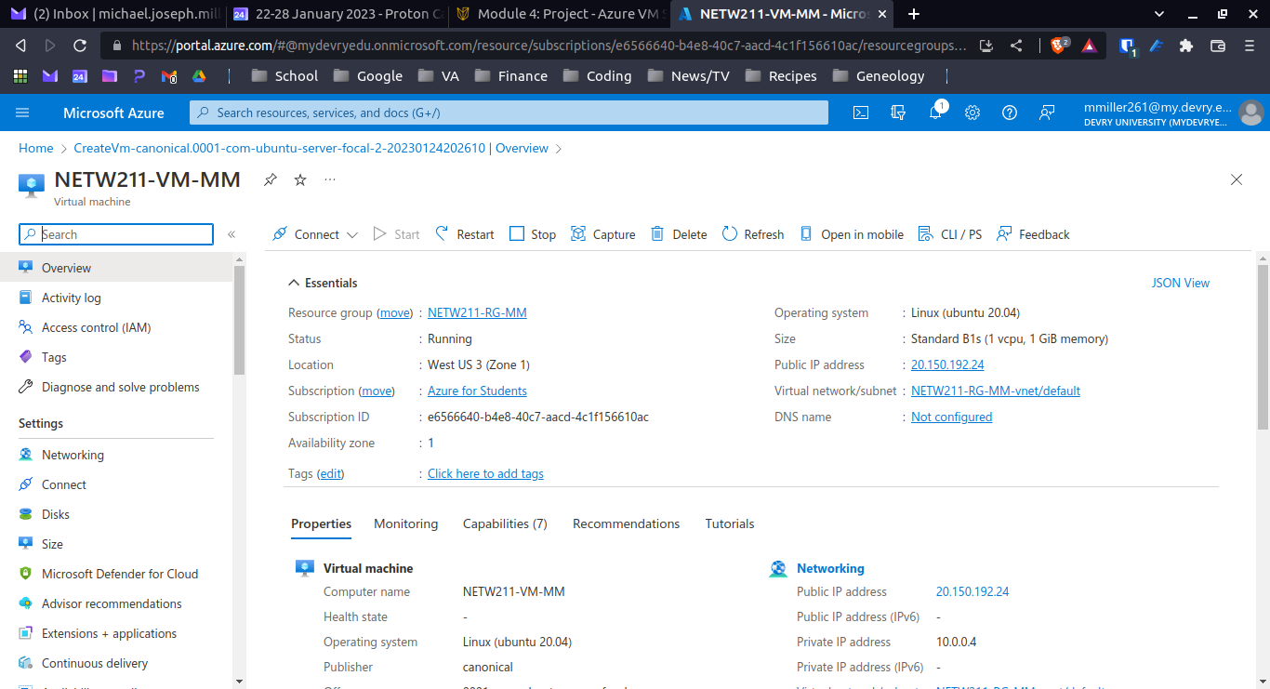
Azure VM Security
This screenshot shows the NETW211-VM-Your Initials page, with information such as the resource group name, subscription, public IP address, etc.

Slide 14
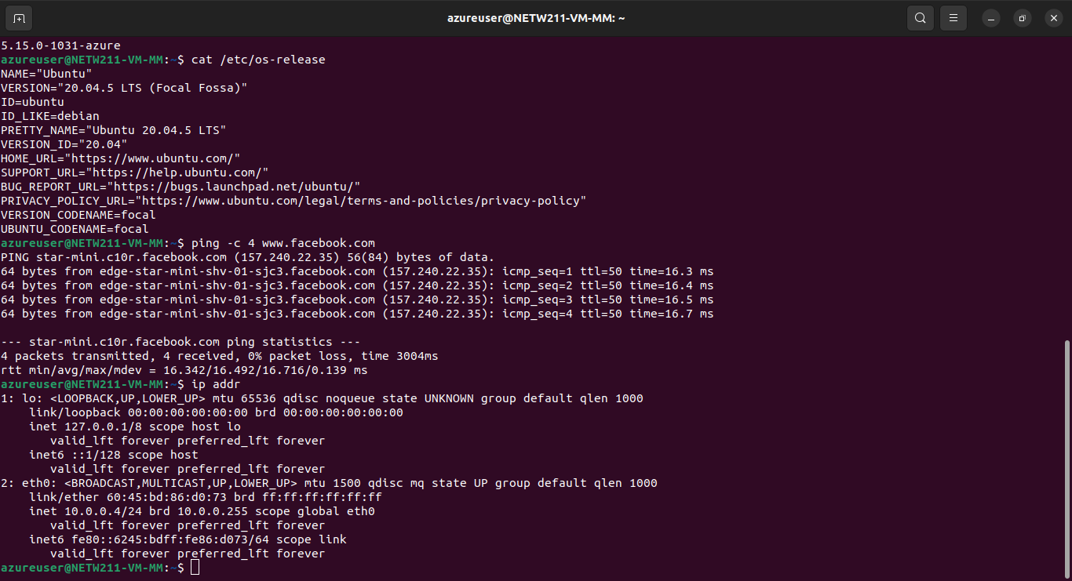
Azure VM Security
This screenshot shows the azureuser@NETW211-VM-Your Initials window showing the IPv4 address of the VM in the Azure cloud.

Slide 15
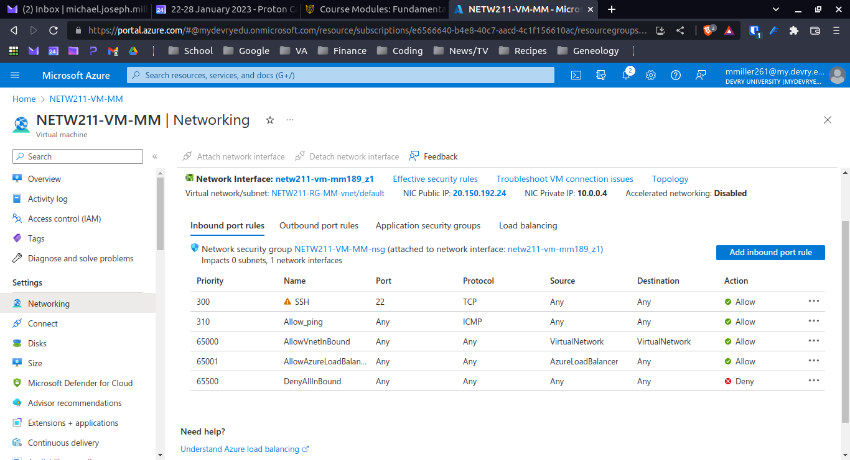
Azure VM Security
This screenshot shows the Inbound port rules section with the newly added Allow_Ping rule.

Slide 16
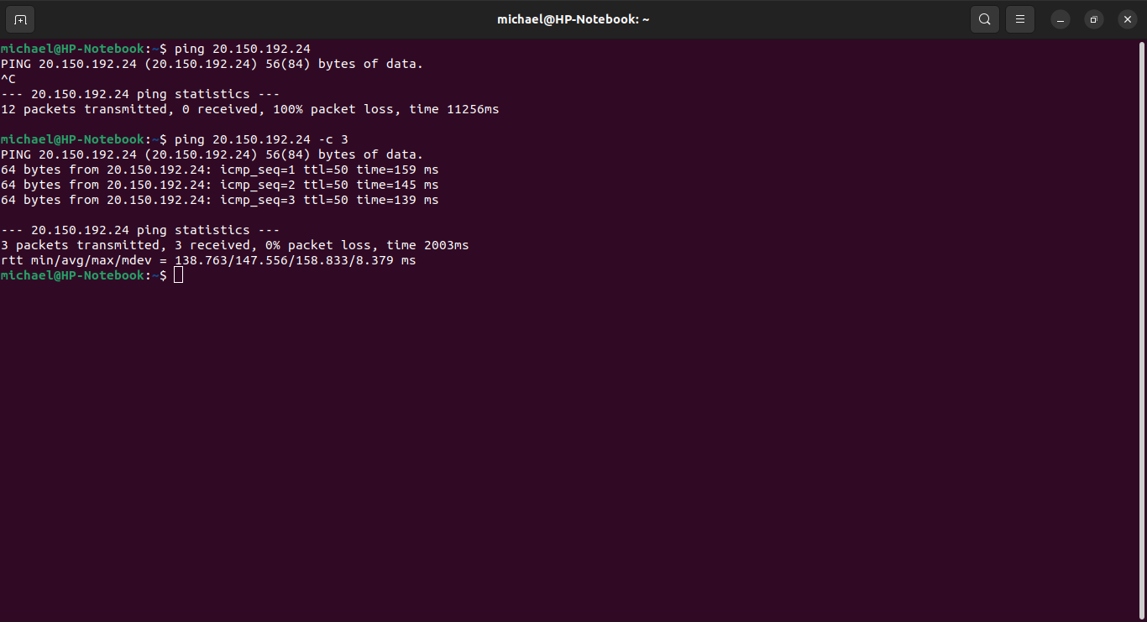
Azure VM Security
This screenshot shows the successful ping result from your local computer to the VM in the Azure cloud.

Slide 17
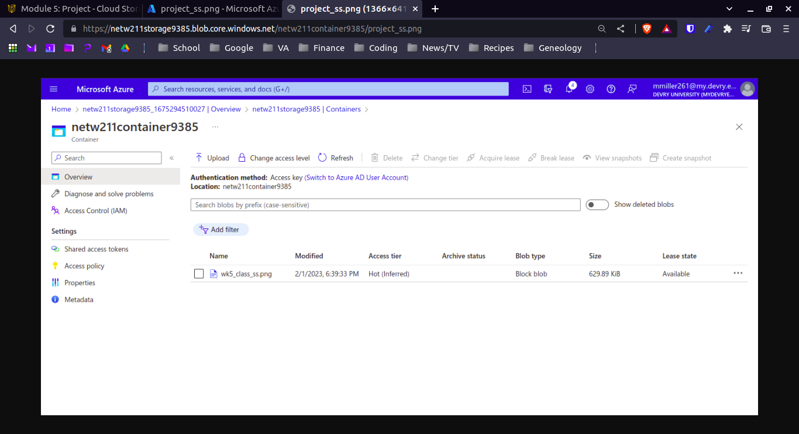
Azure Cloud Storage
This screenshot shows the browser window with the image uploaded from your local computer and the URL on top of the window.

Slide 18
Azure Cloud Storage
Question
What does the access tier setting do? What are the Azure blob storage access tiers?
[hint: in the Azure portal, on the Upload blob page, under Advanced, click the ? circle above the Access tier box.]
Answer here: The Access Tier Setting allows you to choose which type of storage access is needed for the blob. The tiers are Hot, Cold, and Archive.
Hot:
Storage for data that will be accesses frequently (less than 30-day period).
High storage $, Low access $
Cold:
Storage for data that is accessed infrequently (every 30-180 days).
Lower storage $, Higher access $ (than Hot level)
Archive:
Storage for data offline that is rarely accessed (over 180 days) and has flexible latency requirements.

Slide 19
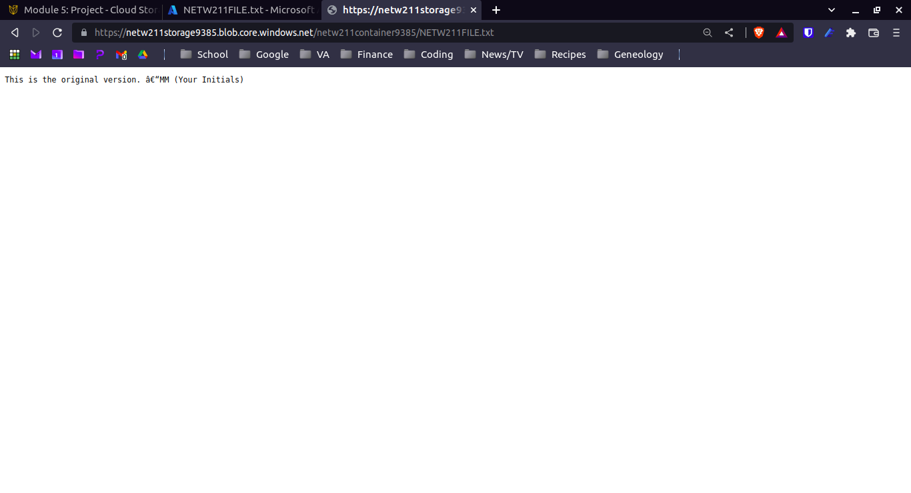
Azure Cloud Storage
Creating Blob Snapshots
This screenshot shows the browser window with the “This is the original version. –Your Initials” message and the URL on top of the window

Slide 20
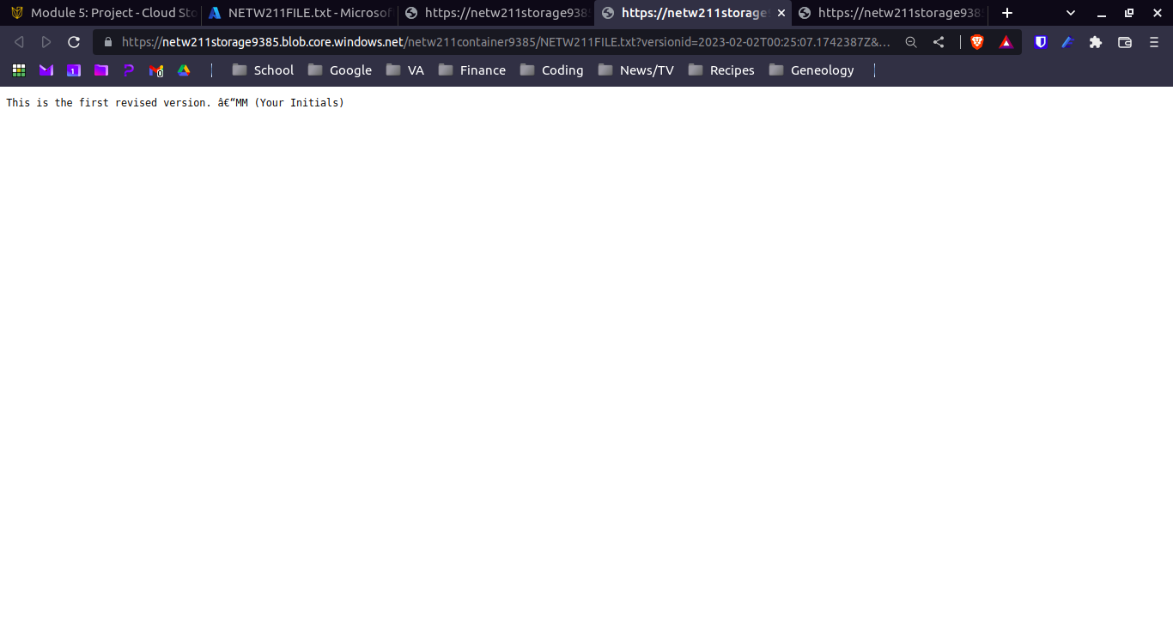
Azure Cloud Storage
Enabling Blob Versioning
This screenshot shows the browser window with the “This is the first revised version. –Your Initials” message and the URL on top of the window.

Slide 21
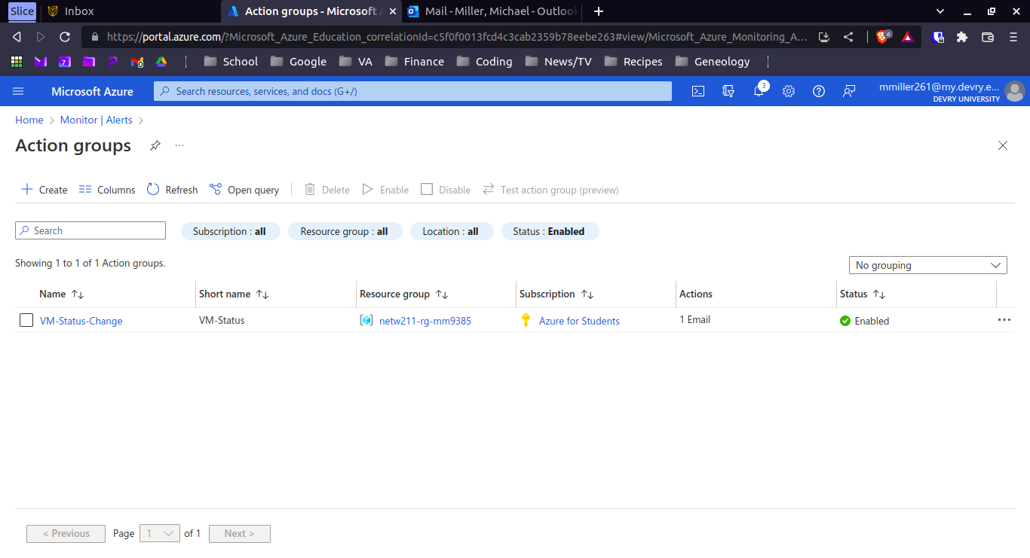
Azure Cloud Monitoring
Setting up an Action Group and Notifications
This screenshot shows the “VM-Status-Change” action group on the Manage actions page.

Slide 22
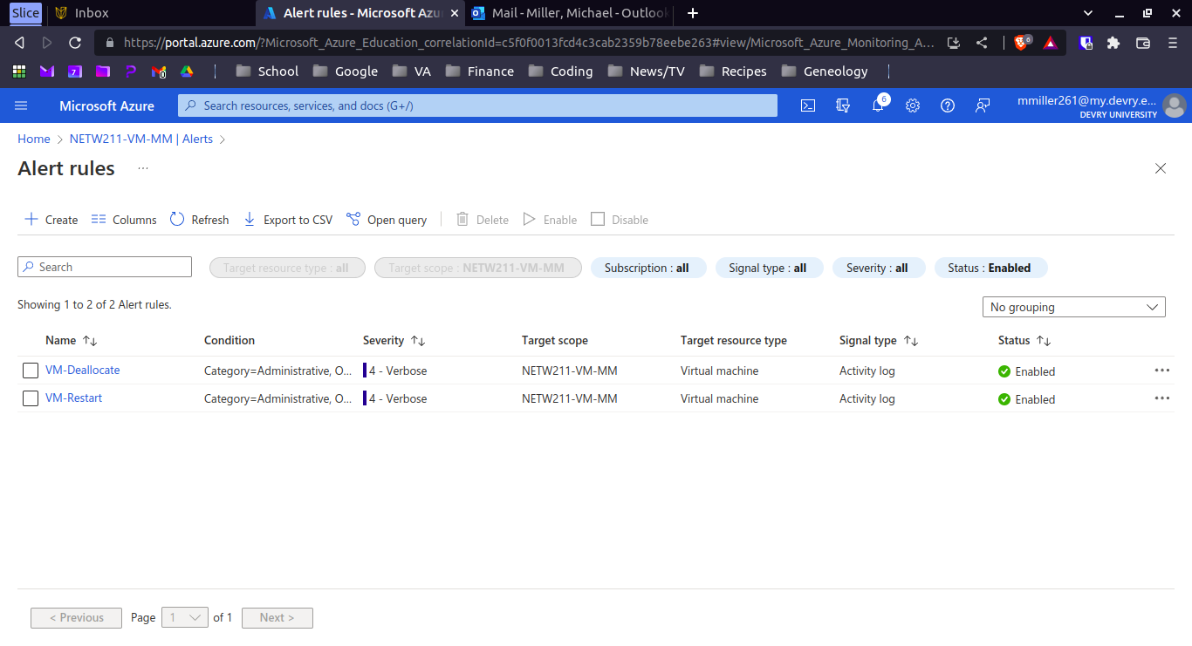
Azure Cloud Monitoring
Setting up Alert Rules
This screenshot shows the Alert rules window showing the VM-Deallocate and VM-Restart rules.

Slide 23
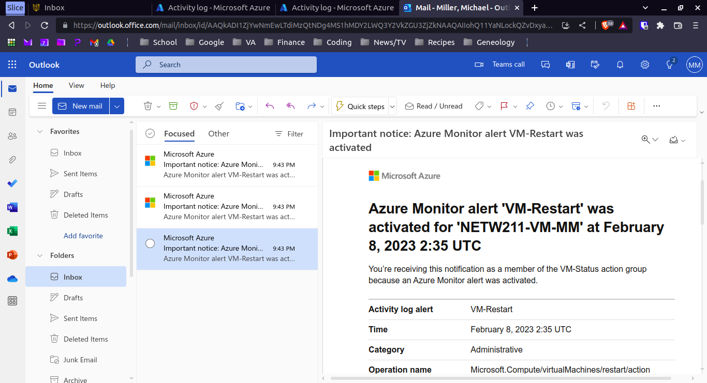
Azure Cloud Monitoring
Testing Alerts
This screenshot shows the ‘VM-Restart’ was activated email message with the date and time of the alert.

Slide 24
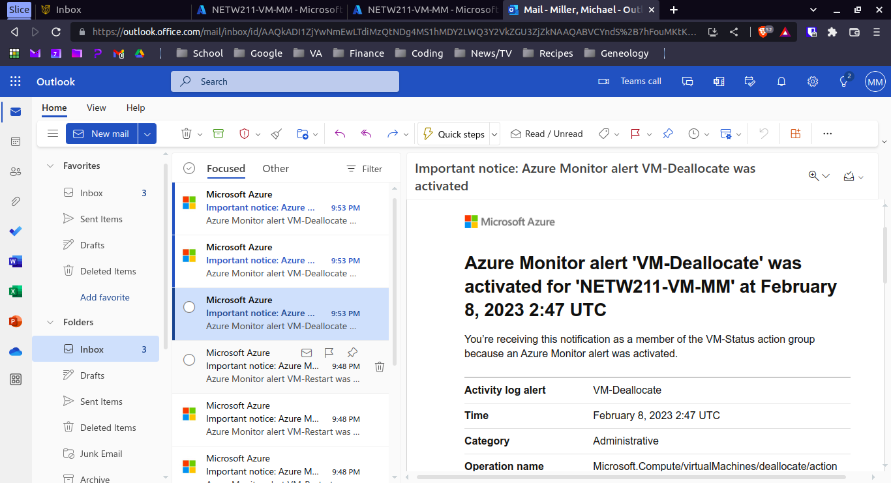
Azure Cloud Monitoring
Testing Alerts cont’d
This screenshot should show the ‘VM-Deallocate’ was activated email message with the date and time of the alert.

Slide 25
Challenges
Getting used to the Azure user interface took some time. As with anything new, it takes time to learn your way around.
Learning the Azure terminology. All cloud providers seem to have their own terminology for naming their systems and offerings.

Slide 26
Career Skills Obtained
Azure VM management
Azure VNets and subnetting
Securely connecting to a VM with SSH
Azure Network Security Groups
Azure cloud storage, blobs, and snapshots
Azure Action Groups, notifications, and alerts

Slide 27
Conclusion
Microsoft Azure is a full featured, flexible, and powerful cloud provider.
While it takes time to learn the specifics of operating in Azure, it is worth the effort.

Slide 28
References
Microsoft Azure, Azure for developers overview. https://learn.microsoft.com/en-us/azure/developer/intro/azure-developer-overview
IP Subnet Calculator, https://www.calculator.net/ip-subnet-calculator.html
Azure Virtual Network frequently asked questions, https://docs.microsoft.com/en-us/azure/virtual-network/virtual-networks-faq
Hot, Cool, and Archive access tiers for blob data, https://docs.microsoft.com/en-us/azure/storage/blobs/access-tiers-overview
Azure Blob Storage Access Tiers, https://devry.percipio.com/courses/c7ef0333-8560-403f-a004-9c5c843866b0/videos/2658bbe6-ee97-438b-a376-fbb079c3b3a0

