Slide 1
SIOP LEC 2026
THE AI PARADOX
How Optimization May Undermine Meaningful Work
A two-year field study, a governed test of AI text scoring,
and ten years of nurses’ own forum talk.
Monnot · SIOP LEC 2026
R1·C1

Slide 2
AUTHORS
Efficiency can be paid for in strain and exit
Matthew J. Monnot¹ · Isaac Thompson²
¹ Vocentive (matt@vocentive.com) ² Amazon
SIOP Leading Edge Consortium 2026
Shaping the Future of People Analytics
ONE-SENTENCE THESIS
Organizations are optimizing work with AI for efficiency. Meaning of work predicts retention and well-being. If optimization strips the meaningful parts, efficiency gains are financed by turnover and burnout.
Monnot · SIOP LEC 2026
R1·C2

Slide 3
WHY NOW
People analytics is about to inherit meaning at scale
• People analytics is about to inherit responsibility for measuring meaning at scale.
• This project tests whether that is possible, and how to govern it.
• A two-year field study, a locked test of AI text scoring, and ten years of nurses' own forum talk.
Monnot · SIOP LEC 2026
R1·C3

Slide 4

SCAN
Everything here, updated through the week
Point a phone camera here. Packet updates through the consortium week.
Digital goody bag
https://mjmonnot.github.io/lec-2026/
Poster, figures, methods, readings, and the quarter kit.
Monnot · SIOP LEC 2026
R1·C4

Slide 5
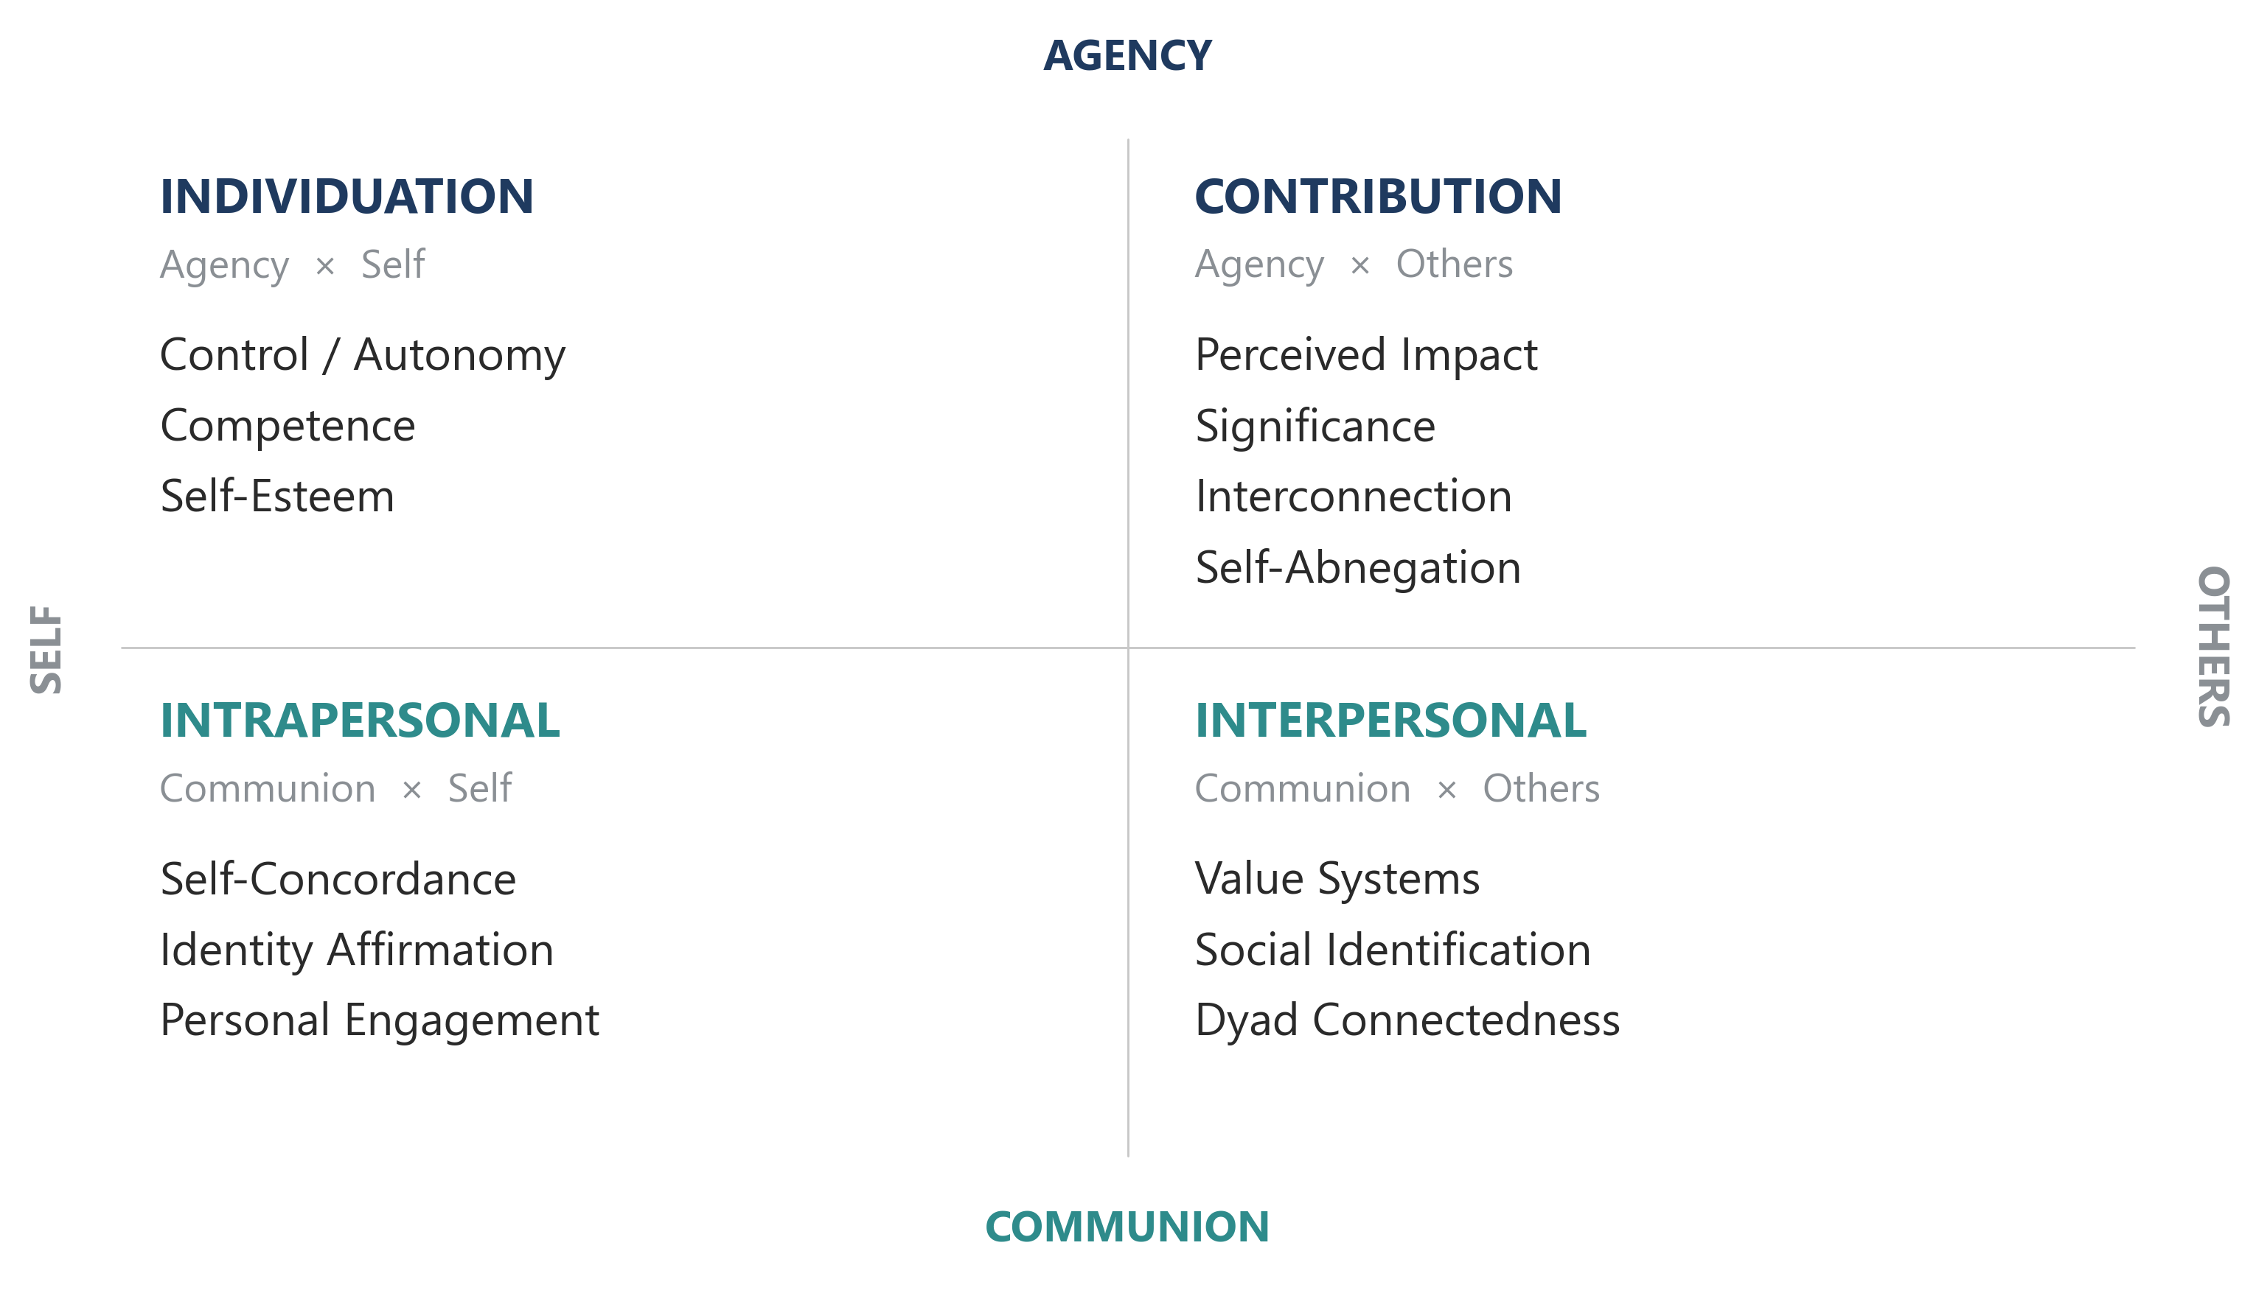
FRAMEWORK
Meaning runs on four pathways, not one score
Rosso et al. (2010): four pathways to meaningful work, 13 finer facets underneath them.
Monnot · SIOP LEC 2026
R2·C1

Slide 6
QUESTIONS
Three questions the literature left open
• Do the four pathways add up, or does one change what another does?
• Is there a ceiling: can too many active pathways exhaust rather than sustain? (Rosso et al., 2010, p. 116)
• Which pathways is AI-driven redesign most likely to strip?
Monnot · SIOP LEC 2026
R2·C2

Slide 7
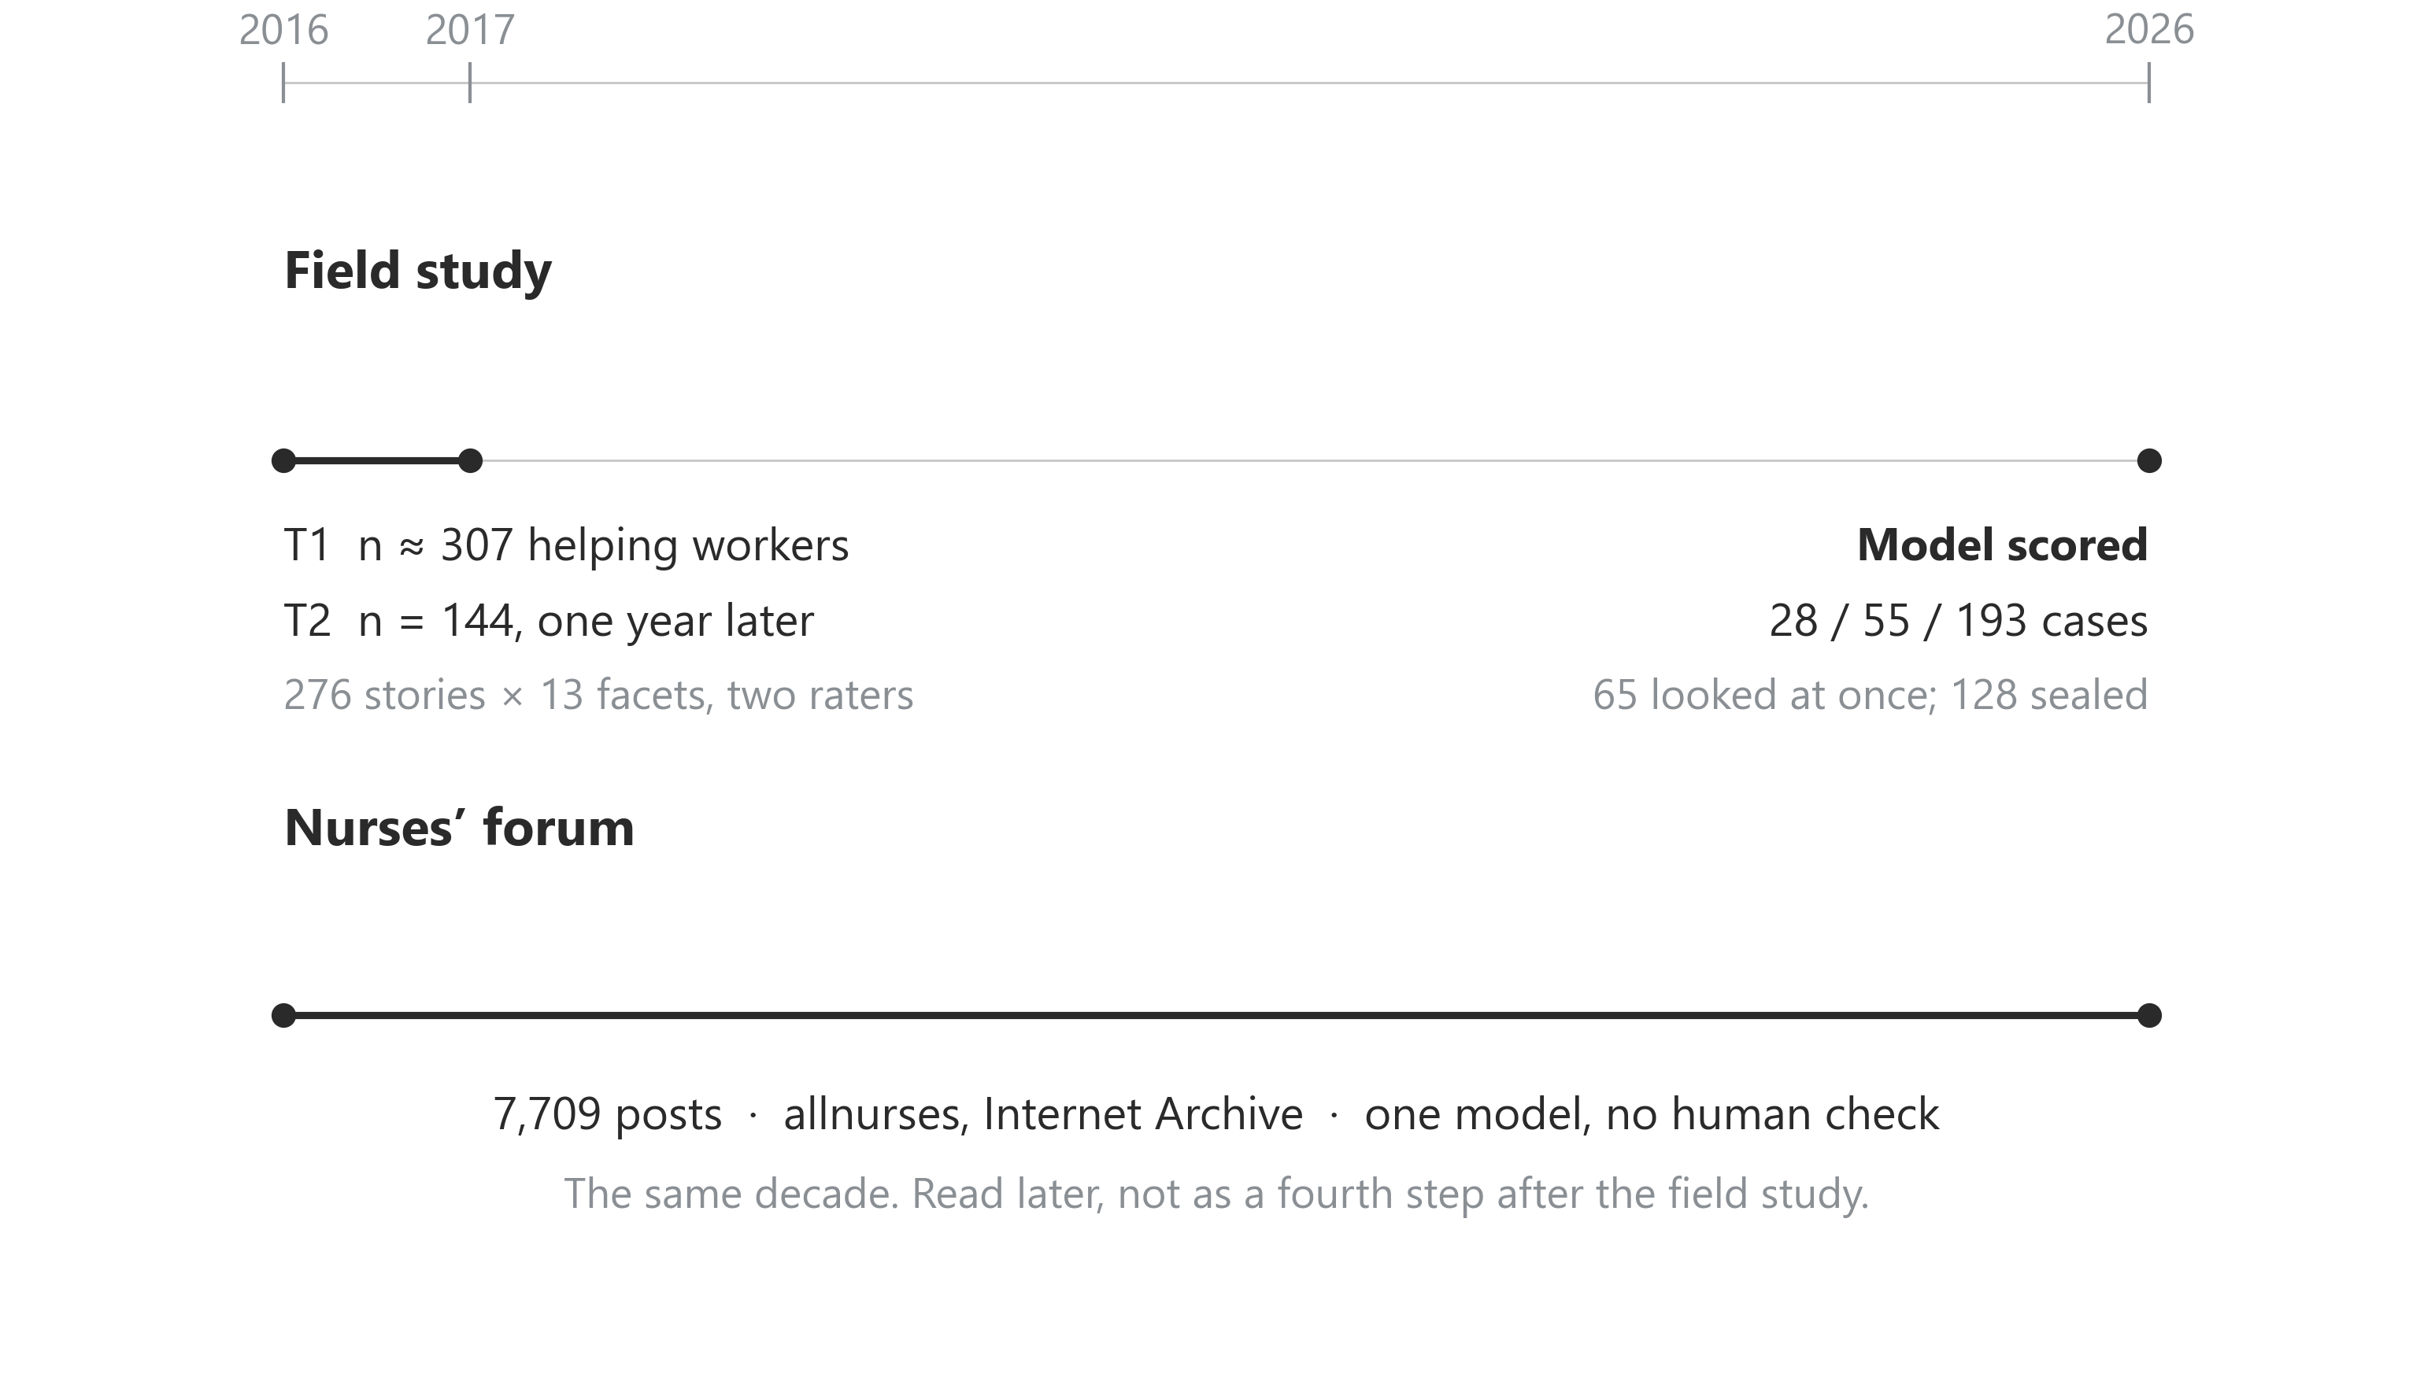
DESIGN
A two-year field study, a locked model test, and ten years of the forum
One calendar. The field study writes the pass mark first and sets cases aside. The forum is the same decade, read later: 7,709 posts from Internet Archive snapshots, labels from one model.
Monnot · SIOP LEC 2026
R2·C3

Slide 8
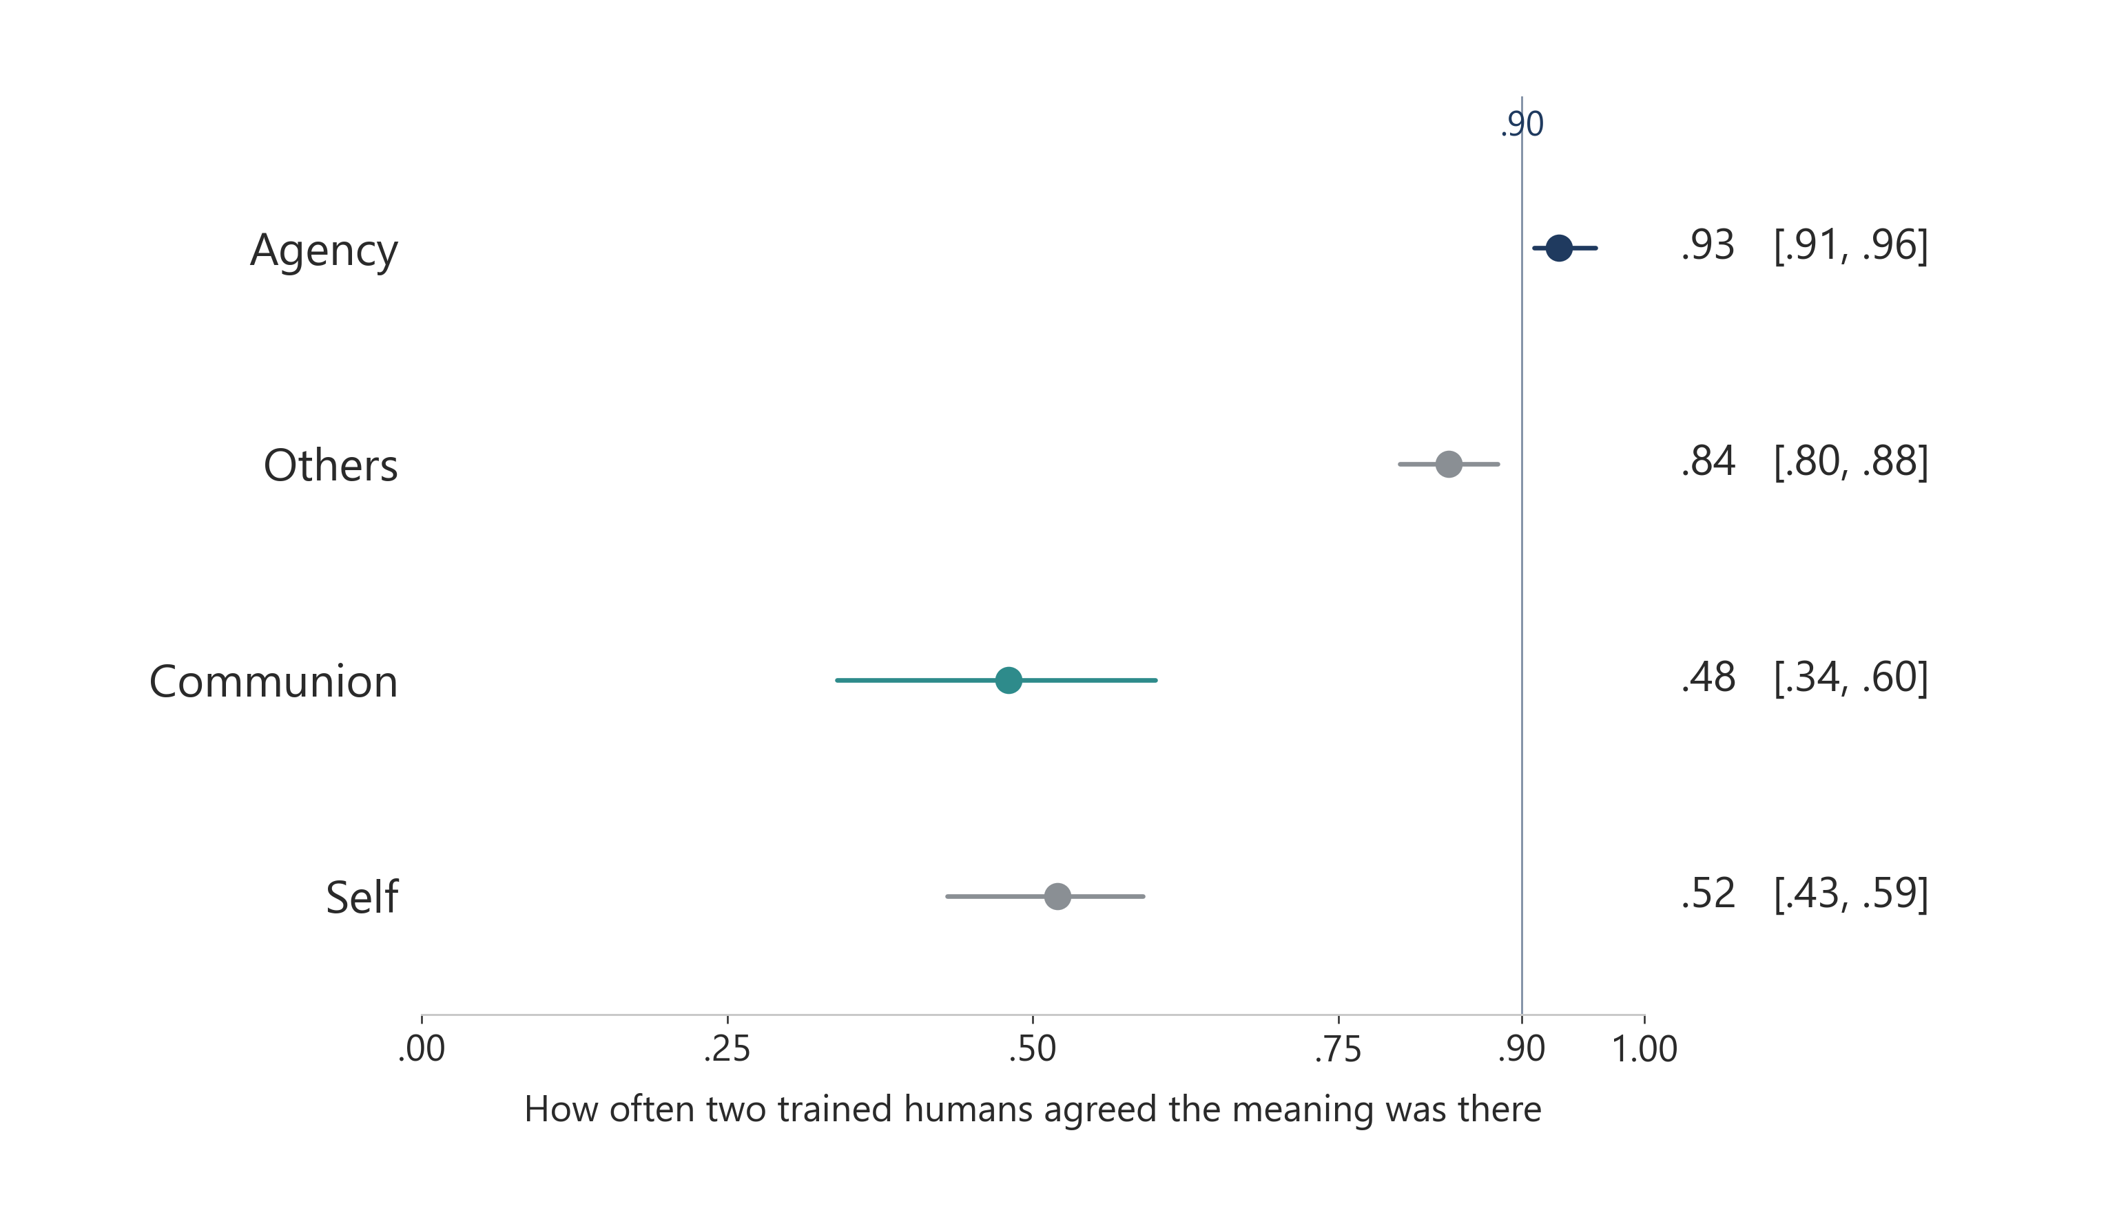
FINDING 1
Humans cannot reliably see communal meaning
How often two trained human coders agreed a kind of meaning was present, 276 stories. Agreement on agency is high; on belonging and connection it is near a coin flip.
Monnot · SIOP LEC 2026
R2·C4

Slide 9
PRACTICE
Ask which ceiling the vendor beat, on which dimension
• Any vendor claiming to measure belonging or authenticity from text should be asked: how well do two trained humans agree on it?
• For belonging and connection the answer is about .5, not .9.
• Set a separate pass mark for each kind of meaning.
• Accuracy claims with no human comparison are marketing.
Monnot · SIOP LEC 2026
R3·C1

Slide 10
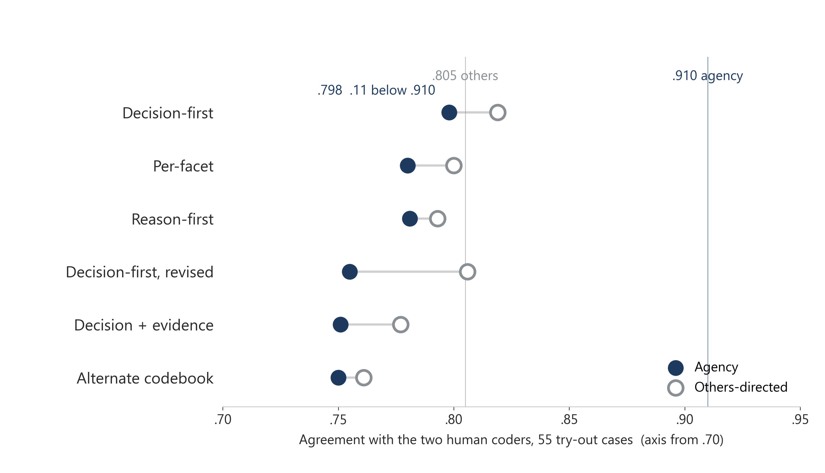
FINDING 2
None of six locked setups reached the agency bar
Six locked setups on 55 try-out cases: agency .750–.798 against a .910 bar. Highest agency .798 is .11 below the bar. Every setup also coded meaning both humans had marked absent (automatic fail). A later 65-case look stayed short on agency (.809 / .798); others-directed on the first of those dropped from .819 to .746, so the screen for the remaining 128 was not met and those cases stay sealed. Reusable: a pass mark per dimension written first, cases set aside before tuning, an automatic fail for meaning the humans did not see.
Monnot · SIOP LEC 2026
R3·C2

Slide 11
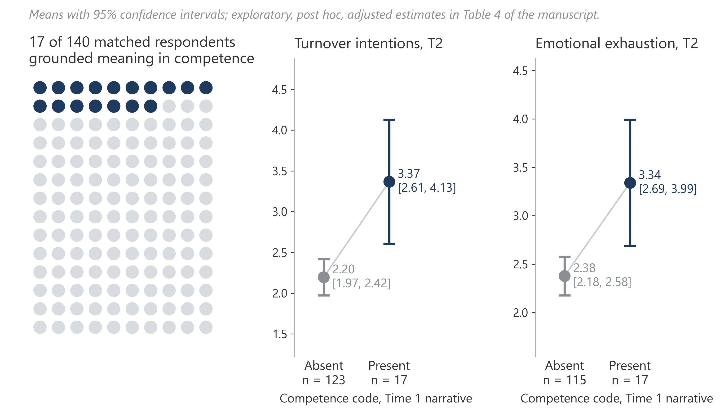
FINDING 3
Meaning narrated as competence reached next year’s strain
Competence or mastery in the Time 1 story went with higher Time 2 turnover intentions (b = 1.40) and exhaustion (b = 0.95); 17 of 140 matched cases, after adjusting for the full Time 1 survey set. The planned paths from the broad meaning dimensions sat near zero, which singles this code out. Exploratory; the lead for the next designed study.
Monnot · SIOP LEC 2026
R3·C3

Slide 12
ACTION
Three things to do this quarter
Before you score employee text: set aside a file of comments nobody scores until the model is final, and write the pass mark first from how well two trained humans agree.
1
Study 1; Törnberg (2024); Koenig et al. (2023)
Before you automate a task: map whose meaning it carries and whether the tool replaces it, leaves someone tending the machine, or amplifies the person.
2
Bankins & Formosa (2023); Parker & Grote (2022)
Pilot small with the people who do the work; keep the decision with the person; measure control and skill use, not only minutes saved.
3
Bienefeld et al. (2025); Tierney et al. (2024); Shah et al. (2025); Studies 2–3
Shaping the future of people analytics means governing it. The twelve-week plan is in the goody bag.
Monnot · SIOP LEC 2026
R3·C4

Slide 13
NEXT
The next study measures AI exposure directly
• A designed test of the competence → strain lead (17 cases so far).
• Check the forum model’s labels: a second model, reworded posts, posts that should score zero, and a human check.
• Follow the same nurse over time: ratios or metrics named in an earlier post, loss of control or quit talk later.
• A before-and-after test of AI adoption in helping work, with exposure measured directly.
Monnot · SIOP LEC 2026
R4·C1

Slide 14
TAKE IT HOME
The methods travel; the data do not
https://mjmonnot.github.io/lec-2026/
Guardrails explainer
Plain-English one-pager: set-aside cases, pass marks written first, and automatic pipeline checks.
Methods & decision records
How the cases were split, what the pass marks were, and the dated record of every run (model version, instructions, rules).
Contact
Matthew J. Monnot · Vocentive · matt@vocentive.com
Monnot · SIOP LEC 2026
R4·C2

Slide 15
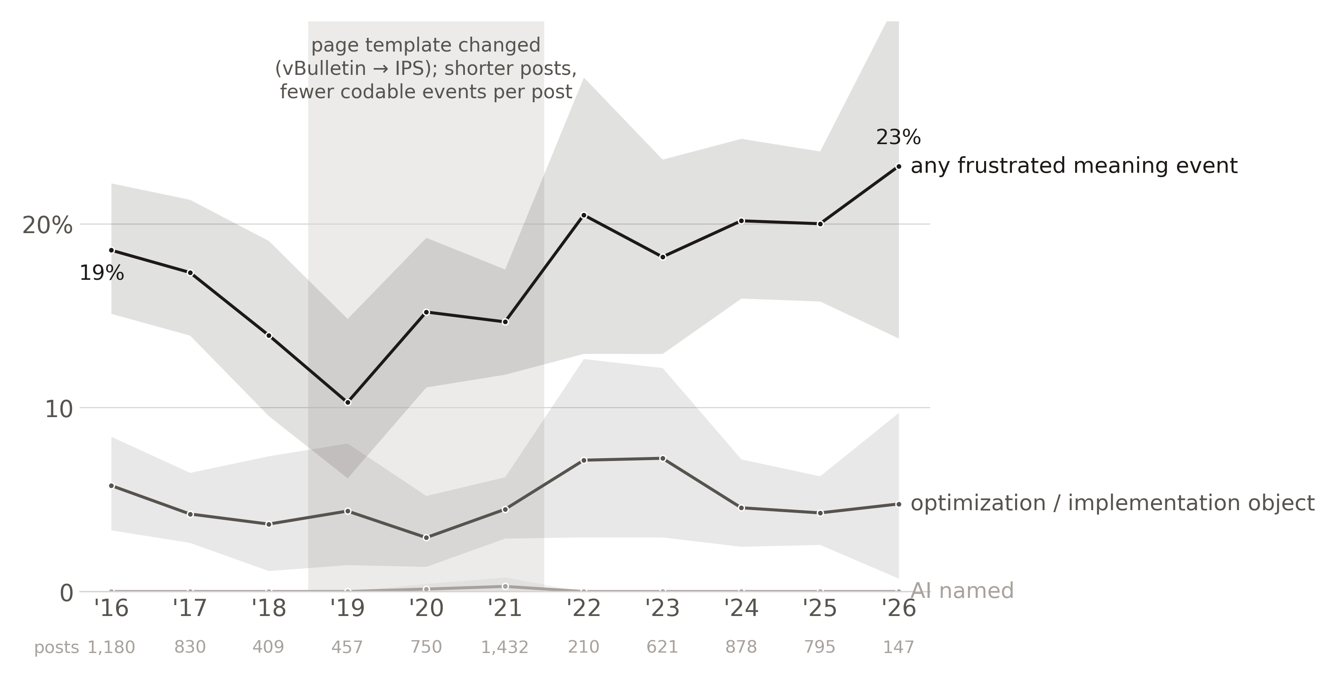
FINDING 4
Nurses named the apparatus, not AI
7,709 allnurses posts, archived 2016–2026, labels assigned by one model with no human check. Seven mentions of a named AI system, none after 2021. Ratios, metrics, charting: one post in twenty across the decade. Posts flagged for lack of control rose 4 points; a 2019–2021 site redesign sits under that rise, so hold it loosely.
Monnot · SIOP LEC 2026
R4·C3

Slide 16
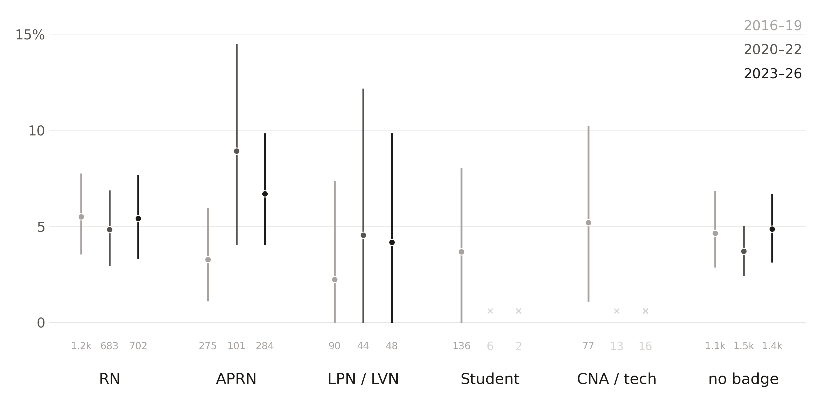
FINDING 5
What moved was control, not skill
Half of the posts naming ratios, metrics, or charting land on control over how the work is done; frustrated control is the only category that grew. Competence stays the most-expressed source of meaning. Role comes from the credential badge on the post, 48% of posts. RNs flat; advanced practice up, with an interval that includes zero.
Monnot · SIOP LEC 2026
R4·C4

Slide 17
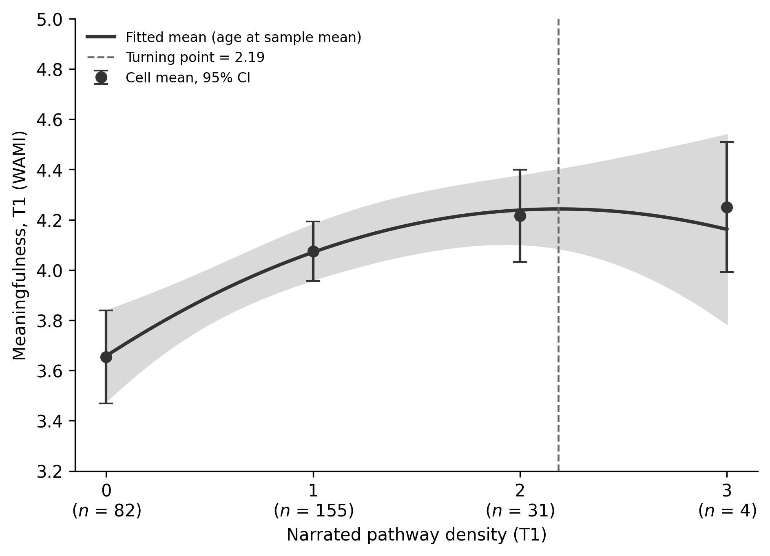
EXTRA
Survey meaning rises with the number of pathways in the story, then levels
The more meaning pathways a story carries, the higher the same person’s survey meaning score (others-directed r = .24; agency r = .20; contribution r = .23). Felt meaning rises from zero to two pathways and levels off after; exploratory.
Monnot · SIOP LEC 2026
X1

Slide 18
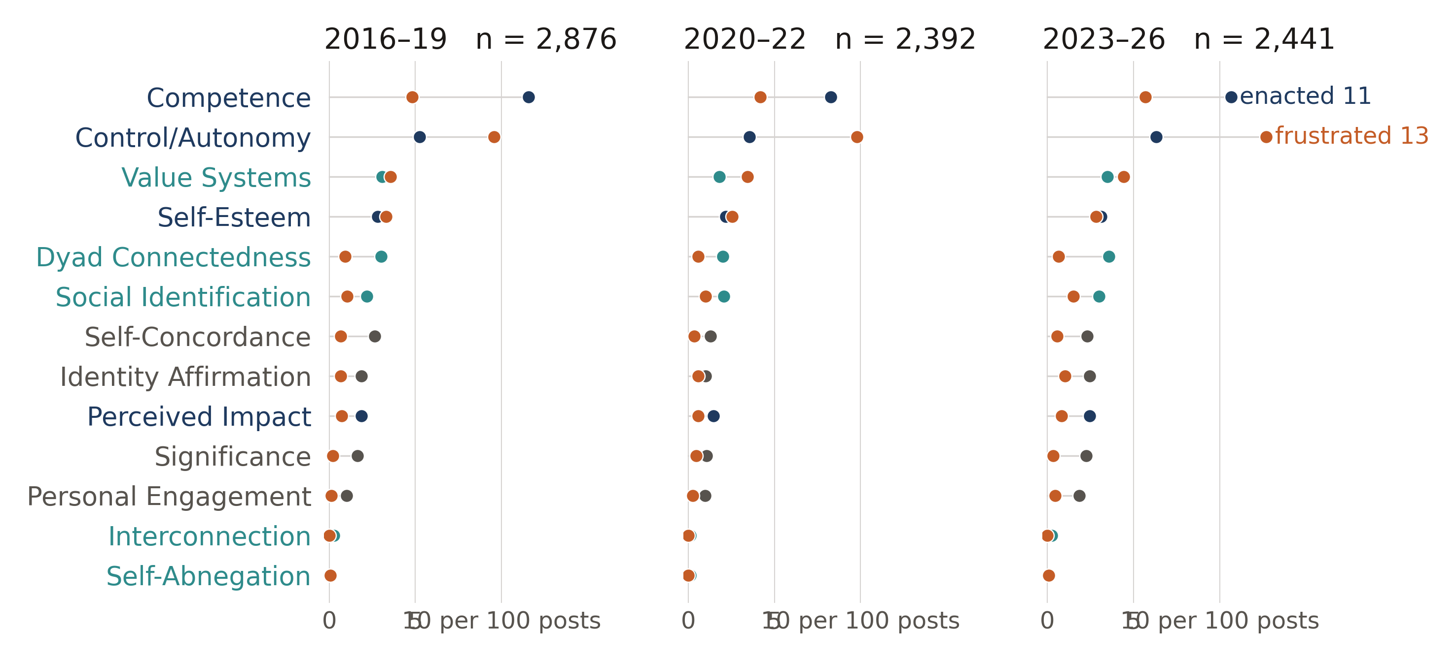
EXTRA
Frustrated control was the only forum category that grew
Events per 100 posts, labels from one model with no human check. Competence is the most-expressed source of meaning; control over means the most frustrated and the only category that grew. Belonging and connection spread across five thin, mostly positive rows. The year is when the archive copy was taken.
Monnot · SIOP LEC 2026
X2

