Slide 1
SIOP LEC 2026
THE AI PARADOX
How Optimization May Undermine Meaningful Work
A two-wave field study and a governed AI coding pipeline
for measuring meaning of work at scale.
Monnot · SIOP LEC 2026 · letter tile
R1·C1

Slide 2
AUTHOR · THESIS
Matthew J. Monnot¹ · Isaac Thompson²
¹ Vocentive (matt@vocentive.com) ² Amazon
SIOP Leading Edge Consortium 2026
Shaping the Future of People Analytics
ONE-SENTENCE THESIS
Organizations are optimizing work with AI for efficiency. Meaning of work predicts retention and well-being. If optimization strips the meaningful parts, efficiency gains are financed by turnover and burnout.
Monnot · SIOP LEC 2026 · letter tile
R1·C2

Slide 3
WHY THIS MATTERS NOW
• People analytics is about to inherit responsibility for measuring meaning at scale.
• This project tests whether that is possible — and how to govern it.
• Two-wave field study plus a locked AI coding pipeline, with a sealed confirmatory holdout.
Monnot · SIOP LEC 2026 · letter tile
R1·C3

Slide 4

SCAN FOR LATEST RESULTS
& RESOURCES
Point a phone camera here. Packet updates through the consortium week.
Digital goody bag
https://mjmonnot.github.io/lec-2026/
Poster, figures, methods, readings, and the quarter kit.
Monnot · SIOP LEC 2026 · letter tile
R1·C4

Slide 5
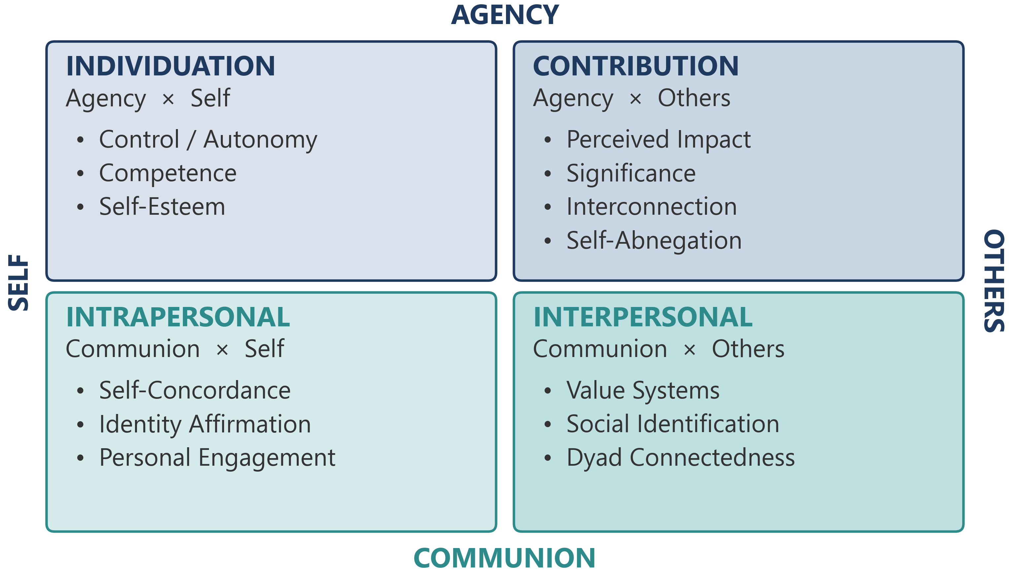
THE FRAMEWORK
Rosso et al. (2010): four pathways to meaningful work, 13 mechanism facets.
Monnot · SIOP LEC 2026 · letter tile
R2·C1

Slide 6
OPEN QUESTIONS WE TEST
• Additive vs. interactive combination of the four pathways.
• Possible plateau or curvilinear effect — too many active pathways may exhaust rather than sustain (Rosso et al., 2010, p. 116).
• Which pathways AI-driven redesign is most likely to strip.
Monnot · SIOP LEC 2026 · letter tile
R2·C2

Slide 7
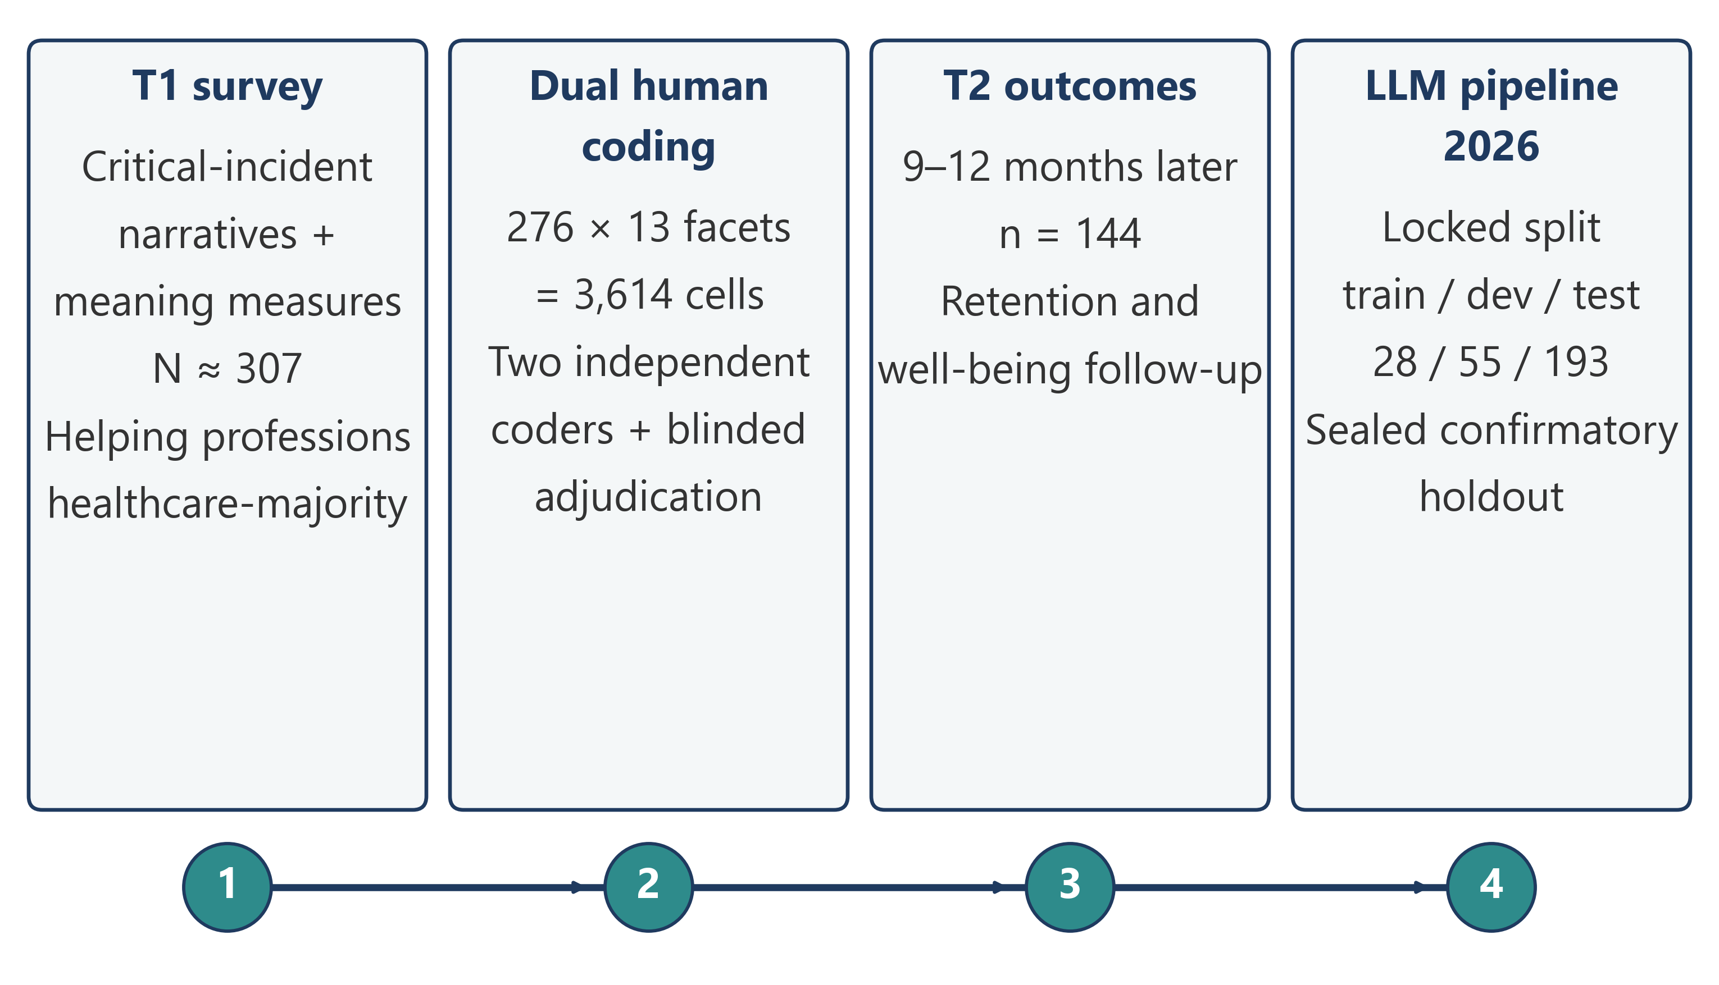
STUDY DESIGN
ML evaluation discipline, ported to survey research.
Monnot · SIOP LEC 2026 · letter tile
R2·C3

Slide 8
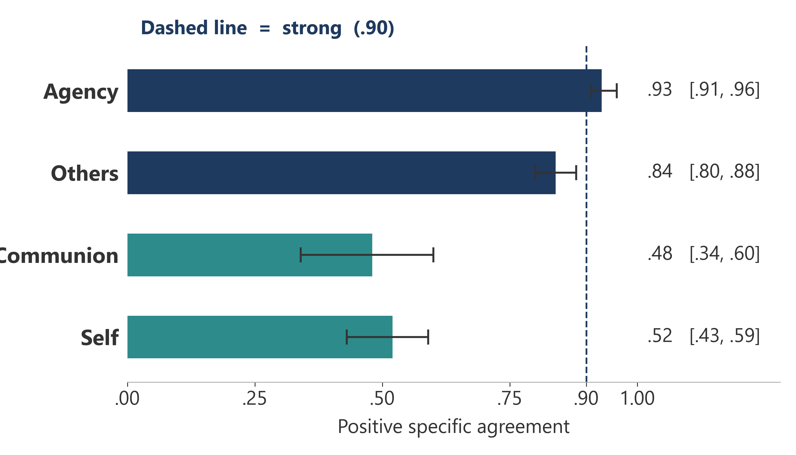
FINDING 1
Humans cannot reliably see communal meaning
Two trained human coders, 276 cases, dimension-level agreement.
Monnot · SIOP LEC 2026 · letter tile
R2·C4

Slide 9
WHAT FINDING 1 MEANS FOR PRACTICE
• Any vendor claiming to measure belonging or authenticity from text should be asked: against what human ceiling?
• For communal meaning that ceiling is ~.5, not .9.
• Validation targets must be dimension-specific.
• Agreement claims without a human benchmark are marketing.
Monnot · SIOP LEC 2026 · letter tile
R3·C1

Slide 10
FINDING 2
The one-shot failed. Human gold stayed.
Six frozen prompt architectures were scored once on the 55-case development set against bars locked to the human interval (Agency ≥ .910; Others ≥ .805). Every prompt was disqualified on false positives. Agency PSA sat at .750–.798. Study 1 stays on the human composite. The sealed test set was never opened.
• Communion and Self had no acceptance bar: human PSA was too low to validate against.
• A prompt tuned to this pair would export communion PSA .48 into every later corpus.
• The independent no-gold panel (ADR 0010) is a separate instrument, still unfrozen.
Monnot · SIOP LEC 2026 · letter tile
R3·C2

Slide 11
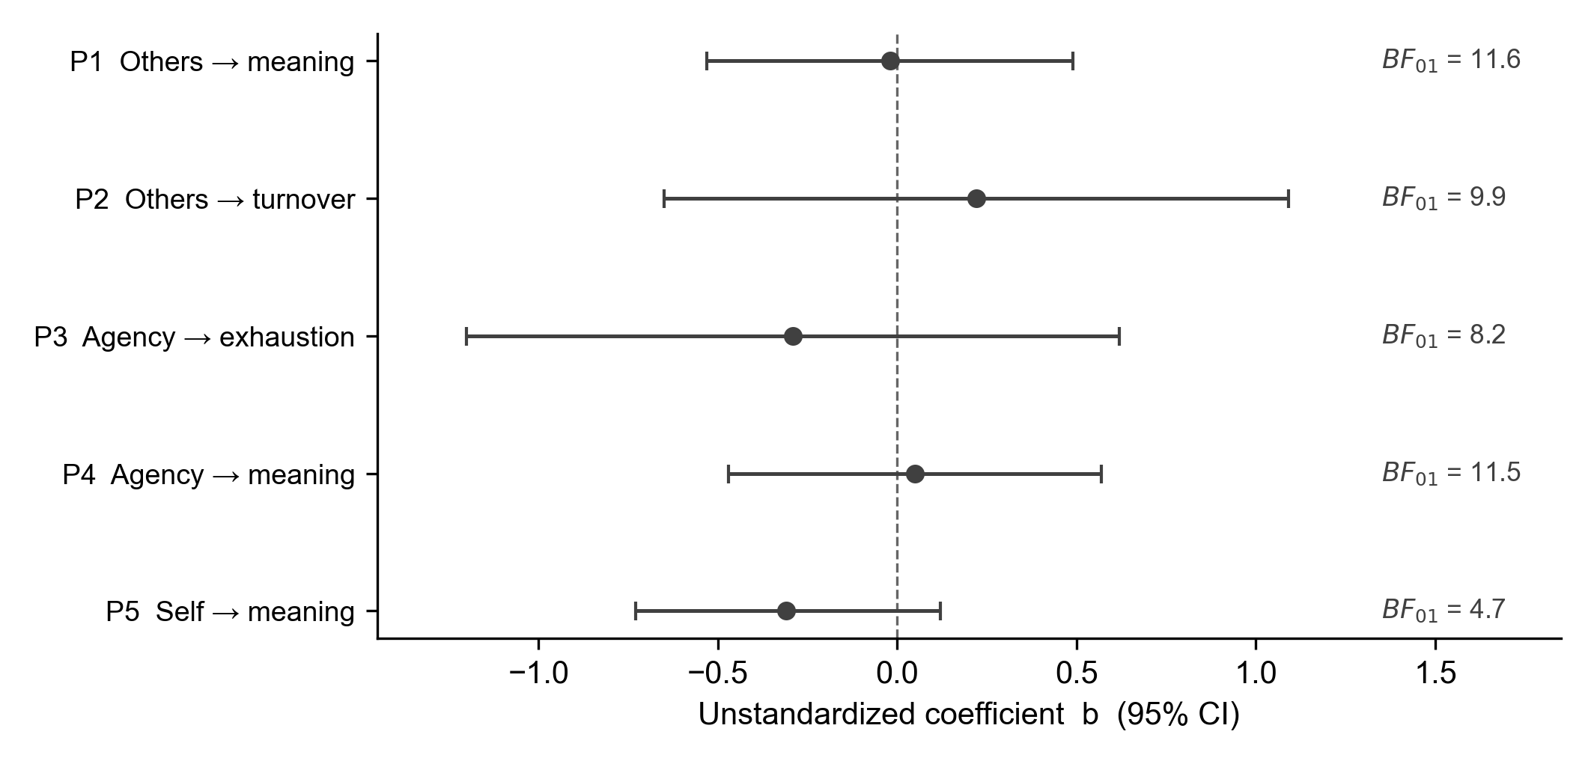
FINDING 3
Registered next-year tests were not supported
Others, agency, and self did not forecast T2 meaning, exhaustion, or turnover. Joint block ΔR² = .012. BF01 = 481.5 on next-year meaningfulness. The same codes tracked concurrent WAMI.
Monnot · SIOP LEC 2026 · letter tile
R3·C3

Slide 12
TRY THIS QUARTER
Seal a holdout before any prompt iteration.
1
Pre-register the acceptance bar against a human benchmark.
2
Automate leakage + PII checks in CI.
3
Shaping the future of people analytics means governing it.
Monnot · SIOP LEC 2026 · letter tile
R3·C4

Slide 13
WHAT'S NEXT
• Designed test of the competence → strain lead (n = 17 present cases).
• Transfer-validate forum salience on ~200 human-graded posts before any period contrast.
• Quasi-experimental test of AI adoption in helping work.
Monnot · SIOP LEC 2026 · letter tile
R4·C1

Slide 14
DIGITAL SWAG
https://mjmonnot.github.io/lec-2026/
Guardrails explainer
Plain-English one-pager on sealed holdouts, acceptance bars, and CI checks.
Methods & decision records
Locked split, pre-registered bars, and run provenance (model pin, prompt hash, git SHA).
Contact
Matthew J. Monnot · Vocentive · matt@vocentive.com
Monnot · SIOP LEC 2026 · letter tile
R4·C2

Slide 15
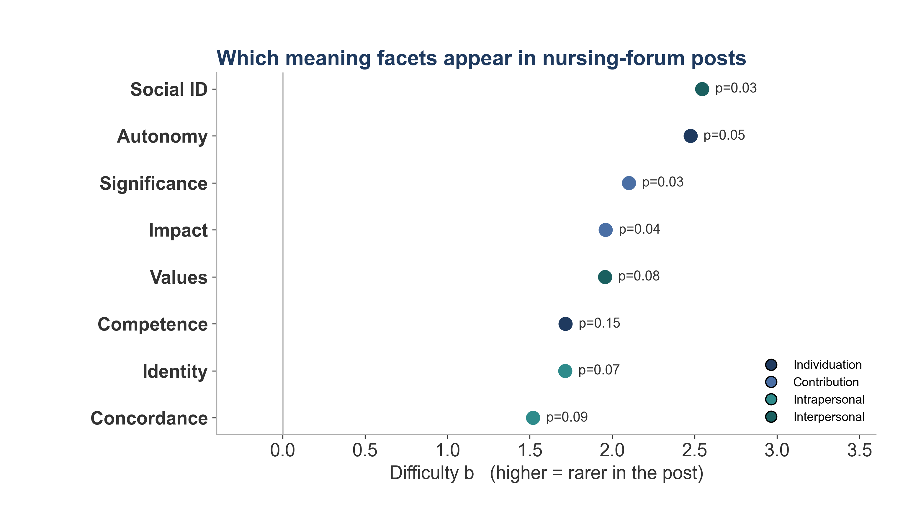
MEASUREMENT CAUTION
Do not treat forum scores as one theta
Draft 2PL on unvalidated LLM salience (cut at 34). Reliability ~.45. Capture year is coverage, not a period contrast. Transfer-validation still open.
Monnot · SIOP LEC 2026 · letter tile
R4·C3

Slide 16
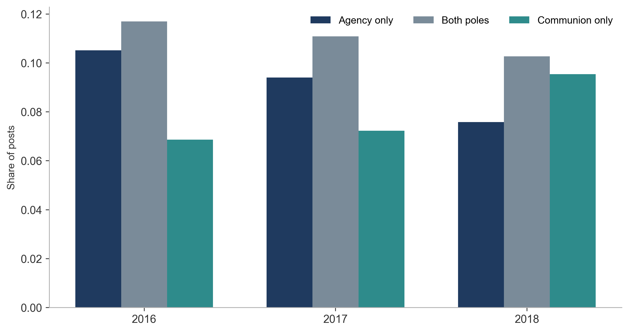
FINDING 5
One pole at a time
Product of two 0–100 scores is small whenever either pole is peripheral. That is arithmetic, not a complementarity test.
Monnot · SIOP LEC 2026 · letter tile
R4C4

Slide 17
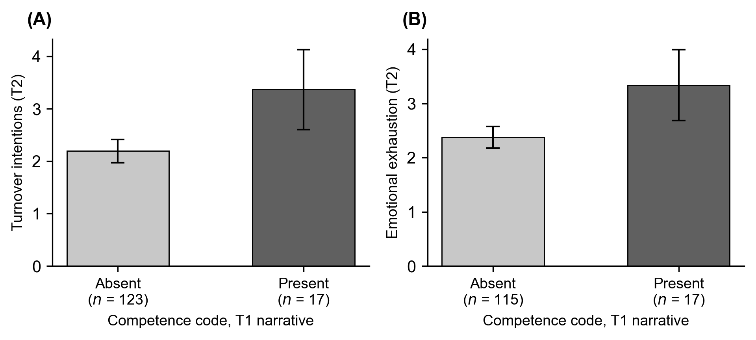
RESULT
Competence-coded stories and later strain
Exploratory. T1 competence/mastery codes, higher T2 turnover (b = 1.40) and exhaustion (b = 0.95). Seventeen present cases of 140. Not a product finding.
Monnot · SIOP LEC 2026 · letter tile
X1

Slide 18
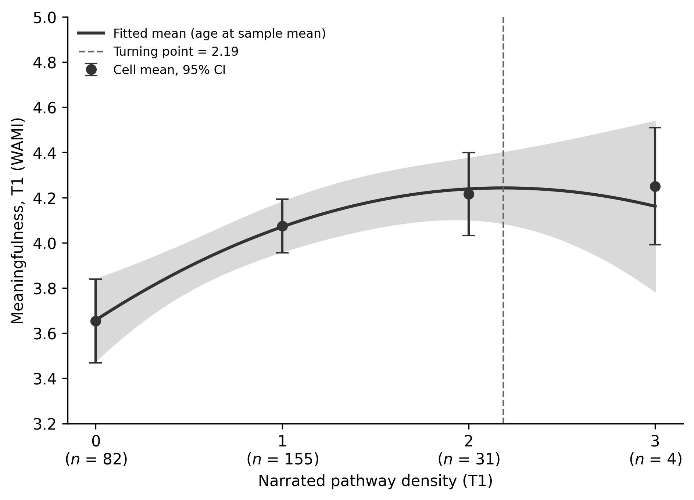
RESULT
Concurrent meaning tracks code density
The codebook was not empty. Pathway density tracks T1 WAMI. Quadratic flattening is exploratory; not the registered T2 block.
Monnot · SIOP LEC 2026 · letter tile
X2

Slide 19
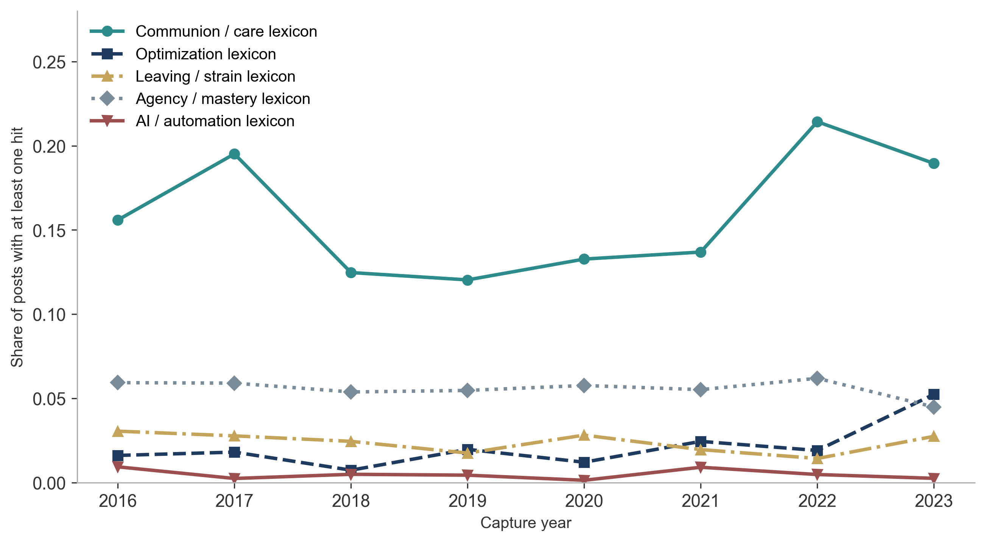
RESULT
Forum dictionaries, capture years 2016–2026
Care language did not fall in the late-AI window versus pre-2023. Capture year is coverage, not posted-at. Not scored Rosso facets.
Monnot · SIOP LEC 2026 · letter tile
X3

