Slide 1
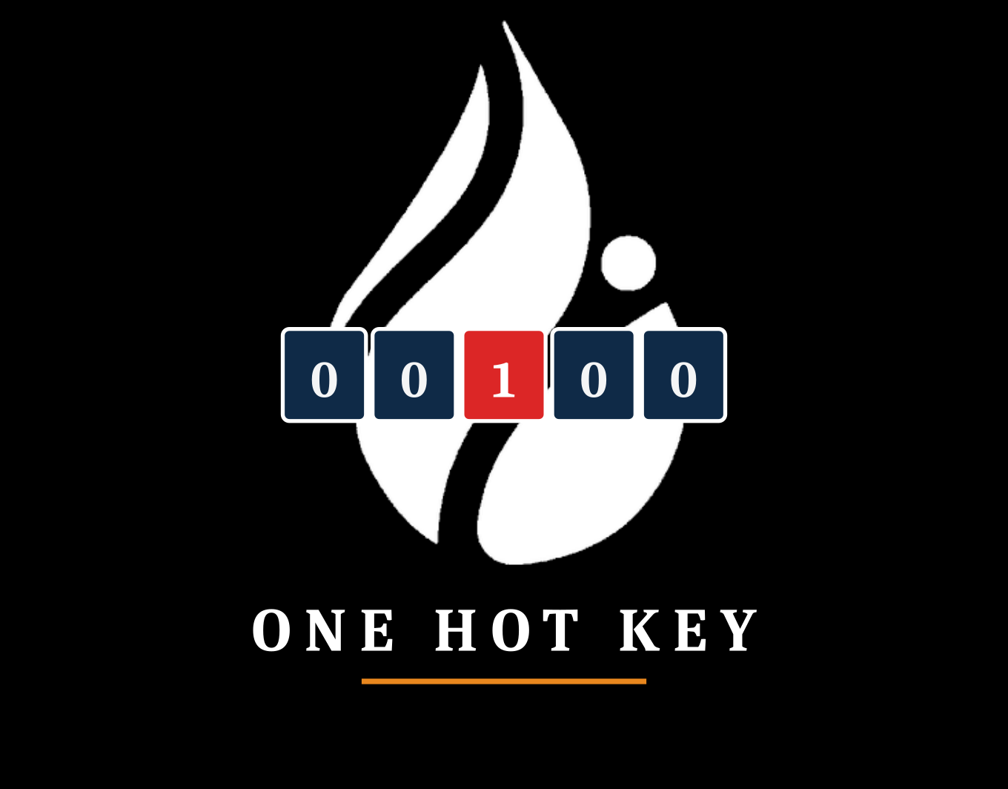
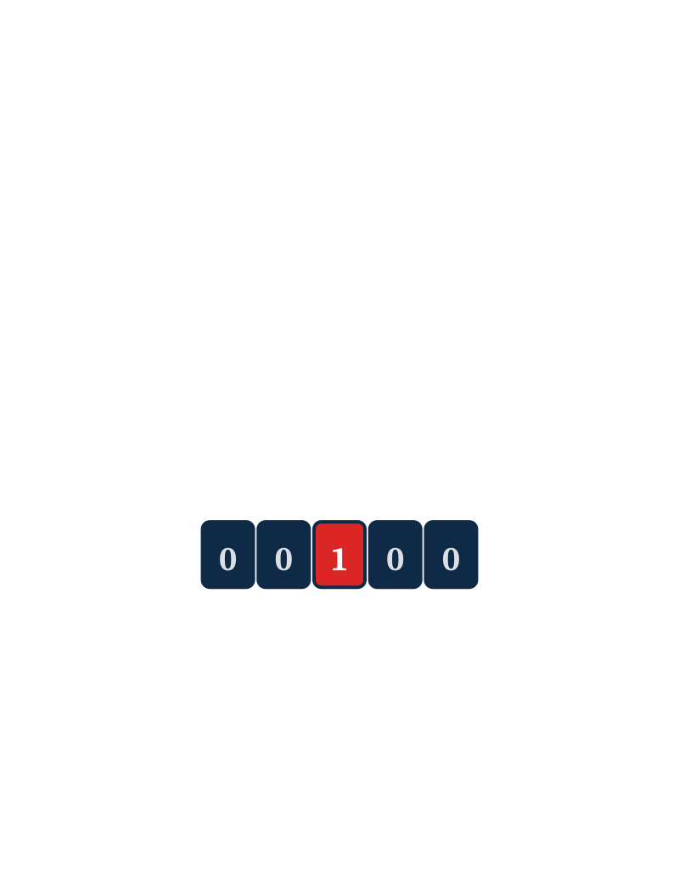
SIOP 2026 · ML COMPETITION
ONE PERSON + AGENTS vs HUMAN TEAMS
Bivariate Pearson r extraction · IO Psychology meta-analysis
Team: One Hot Key · Task: Hidden-Set MSE · Tool: Walt (RTX PRO 3000 Blackwell)

Slide 2
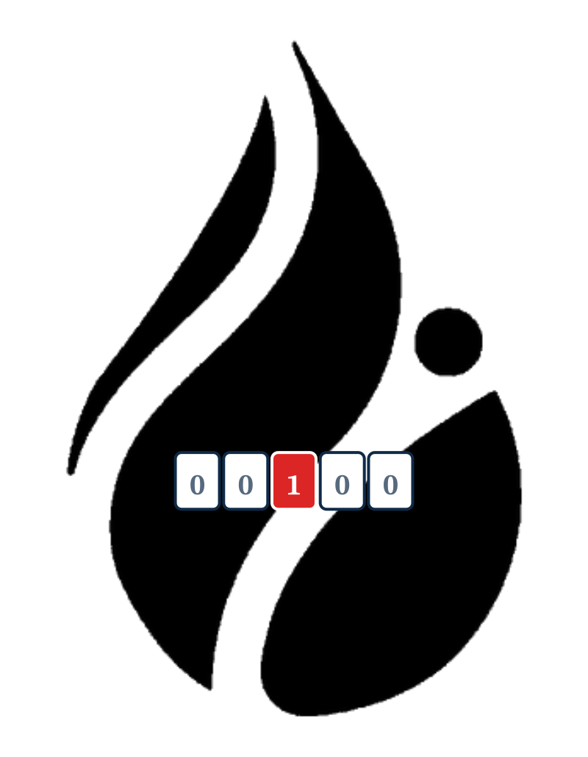
PROJECT OVERVIEW
The Challenge
Build an automated pipeline that reads academic PDFs and extracts zero-order bivariate Pearson r correlations for meta-analytic synthesis in industrial-organizational psychology.
0.013641
BEST DEV SET MSE
127 + 66
Dev set
127 studies on trust × subjective well-being
Test set
23 distinct construct pairs across 66 papers — out-of-distribution
STUDIES PROCESSED
23
CONSTRUCT PAIRS (TEST)
SCORED ON Mean Squared Error vs. hidden ground-truth r values
One Hot Key · SIOP 2026 ML Competition
2 / 15

Slide 3







SIX GATES, CASCADING FALLBACK
Pipeline Architecture
Each PDF passes through a cascade — earlier gates are cheap and high-precision, later gates are expensive and recover what slips through.
01
02
03
04
05
06
PDF
Acquisition
Layout
Extraction
Regex + phi4
Classifier
Vision
Fallback
Structured LLM
Extraction
Imputation
EARLY EXIT: if a high-confidence value is found at any gate, downstream gates are skipped for that pair.
One Hot Key · SIOP 2026 ML Competition
3 / 15

Slide 4
GATE 01 · PIPELINE STAGE
PDF Acquisition
Robust DOI-to-PDF resolution with a four-stage fallback chain
batch_pdf_agent.py walks each study's DOI through progressively more aggressive resolvers, saving as study1.pdf … study127.pdf with a download_log.json audit trail.
CrossRef → publisher metadata and direct PDF links
Unpaywall → open-access copies of paywalled articles
Semantic Scholar → corpus-level fallback when the above miss
Playwright → headless-browser scrape for HTML-gated PDFs
Playwright
PYTHON PACKAGE
ACQUISITION RATE 193/193 PDFs successfully retrieved across dev + test sets
One Hot Key · SIOP 2026 ML Competition
4 / 15

Slide 5
GATE 02 · PIPELINE STAGE
Layout-Aware Extraction
Two-tier table extraction — geometric first, ML for the hard cases
pdfplumber runs first (Tier 0): geometric table detection with cell-bbox metadata, fast and exact on regular layouts. Docling (Tier 1) takes the residual — multi-column papers, rotated pages, combined headers — using ML TableFormer to recover structure where geometry alone fails. PyMuPDF / fitz is the underlying PDF reader for both.
pdfplumber: geometric tables with proximity search across rows × columns
Docling: ML TableFormer for complex / combined-cell layouts, optionally cross-validated by qwen2.5vl on the table crop
Cell adjacency preserved end-to-end so downstream variable lookup works
Falls through to vision (Gate 4) only when both layout parsers come up empty
pdfplumber + docling
PYTHON PACKAGE
PRIMARY USE Correlation matrices, descriptive statistics tables, MBI subscale tables
One Hot Key · SIOP 2026 ML Competition
5 / 15

Slide 6
GATE 03 · PIPELINE STAGE
Regex + phi4 Classification
Pattern-matching candidate r values, then LLM-classifying which one matches the construct pair
Two-stage filter. Construct-aware regex walks PyMuPDF-extracted text and table cells to gather every plausible r candidate with its surrounding context. phi4 (via Ollama) then reads each candidate against construct definitions and decides which row × column pair the value belongs to — the role no rule-based pattern can do reliably.
Regex pass: distinguishes Pearson r from Spearman ρ, betas, and probit coefficients
Rejects ANOVA, imputation, and cross-wave correlation tables explicitly
phi4: classifies candidates against construct definitions, with same-wave longitudinal rule and inverse-label sign-flip logic in-prompt
Handles Unicode significance markers (∗ U+2217, ⁎ U+204E) vs. ASCII *
Python re + phi4
PYTHON PACKAGE
PRECISION FOCUS False positives cost as much as misses — phi4's job is rejecting wrong-table matches the regex couldn't filter
One Hot Key · SIOP 2026 ML Competition
6 / 15

Slide 7

GATE 04 · PIPELINE STAGE
Vision Fallback
Visual table parsing for cases where layout extraction fails
When pdfplumber and Docling both come up empty — typically scanned PDFs, image-embedded tables, or unusual layouts — the pipeline falls back to a local vision-language model. PyMuPDF rasterizes the relevant page; qwen2.5-VL reads the image directly and returns structured cells.
qwen2.5-VL:7B reads the rendered page image and emits structured JSON cells
Page rasterization handled by PyMuPDF (fitz) at the resolution the model needs
Runs entirely local — no API cost, no rate limits, full offline reproducibility
Construct classification and sign-flip logic still applied post-hoc by Gate 3 logic
via Ollama
PYTHON PACKAGE
WHEN IT FIRES Scanned PDFs, image-only tables, papers Docling parses but where text-layer extraction yields no candidates
One Hot Key · SIOP 2026 ML Competition
7 / 15

Slide 8
GATE 05 · PIPELINE STAGE
Structured LLM Extraction
How the hardest cases get extracted — process, not vendor
A separate module — pipeline_v9_opus_sweep.py — runs a custom extraction loop on a curated short-list of studies the open-source pipeline missed or low-confidenced. The model behind the call is interchangeable; the methodology is what makes the values trustworthy.
PROMPT: construct definitions, sign-flip rules, same-wave longitudinal rule, and explicit rejection criteria for ANOVA / regression beta / cross-wave traps
INPUT: full PDF + a list of which (X, Y) construct pair to extract for that paper, plus measure aliases pulled from each paper's methods section
OUTPUT: JSON-schema-constrained — { r, n, page, table_cell, confidence, supporting_quote } — parsed and type-validated before acceptance
AUDIT: every accepted value carries its supporting quote, so the manifest can be spot-checked by re-reading the cited sentence rather than re-running the model
Schema-constrained sweep
PYTHON PACKAGE
WHY THIS GATE EXISTS To recover the ~10% of correlations that survive bad layout, sign-flips, or table-cell ambiguity that defeats every upstream gate
One Hot Key · SIOP 2026 ML Competition
8 / 15

Slide 9
GATE 06 · PIPELINE STAGE
Imputation
Last-resort fill for studies where every gate above missed
When all five extraction gates return nothing, the pipeline imputes a single value chosen to minimize MSE under uncertainty. The optimal value is back-calculated from paired dev-set submissions.
Optimal imputation value ≈ 0.152 (data-driven, not a heuristic)
Back-calculated by submitting paired dev runs and solving for the minimum
U-curve flat at optimum — further imputation tuning yields no gain
Coverage at upstream gates is the only remaining lever for improvement
pandas · numpy
PYTHON PACKAGE
KEY INSIGHT Imputation is not a differentiator. Pipeline coverage is.
One Hot Key · SIOP 2026 ML Competition
9 / 15

Slide 10




HUMAN + AI WORKFLOW
Division of Labor
Matt
Claude
Strategic lead
Diagnostician
Pipeline strategy, GT coding, PDF reading, batch-log diagnosis, prompt-writing for Cursor.
PDF inspection, batch failure analysis, precise Cursor-prompt drafts, file-validation scripts.
Cursor
PowerShell
Implementer
Runtime
All code reading, concrete bug-finding, and pipeline implementation. No architectural decisions made unilaterally.
Batch runs and spot checks only — never used as an iterative debugging surface.
GOLDEN RULE Diagnose once, write one comprehensive prompt, let Cursor implement. Two cycles maximum.
One Hot Key · SIOP 2026 ML Competition
10 / 15

Slide 11
DEV → TEST OUT-OF-DISTRIBUTION
Validation Strategy
No traditional k-fold CV — the competition provides a fixed dev/test split with deliberate distribution shift in construct space.
DEV SET
TEST SET
127
66
studies on trust × subjective well-being
papers across 23 distinct construct pairs
Held-out ground-truth manifest manually coded
57 numeric, 8 confirmed BLANK, 1 PENDING
MSE used as fast iteration signal
Generalizes well beyond trust × wellbeing
Forces removal of all study-specific hardcodes
Hidden-set MSE — only visible after submission
PAIRED-SUBMISSION TRICK
Optimal imputation value back-calculated by submitting matched dev runs and solving the resulting two-equation system. The U-curve was confirmed flat at the optimum, ruling out further imputation tuning as a path forward.
One Hot Key · SIOP 2026 ML Competition
11 / 15

Slide 12
DEV vs. TEST
Results
DEV SET
TEST SET
0.0136
0.0351
Best MSE · submission_v11_study59
Best test MSE · 2026-04-11
Held-out trust × wellbeing manifest
Used as fast iteration signal
23 construct pairs across 66 papers
Out-of-distribution generalization
WHAT CLOSED THE GAP
Removing study-specific hardcodes from v11, generalizing construct classification to 23 pairs, and recovering false-negative regex matches on high-r studies (study41 = 0.73, study17 = 0.65, study56 = −0.57).
One Hot Key · SIOP 2026 ML Competition
12 / 15

Slide 13
ONE PERSON + AGENTS vs HUMAN TEAMS
Dev Set Leaderboard
How a one-person-plus-agents experiment landed against teams of researchers and analysts on the dev set.
RANK
TEAM
ERROR ↓
SUBMITTED
6 / 10
1
Hungry Llama
0.006336
2026-04-06
2
MetaML
0.009370
2026-03-25
3
Putka's Army
0.011521
2026-03-29
4
ILMNinsights
0.013198
2026-03-26
Dev set rank
5
STATS Lab at CMC
0.013510
2026-04-01
THE ASYMMETRY
6
One Hot Key
0.013641
2026-04-05
7
DSTST
0.015793
2026-04-08
1 developer + Claude + Cursor.
Within 0.0005 MSE of the lab and the squad ranked above. Test set ranking pending close of competition.
8
Cam the Ram
0.026518
2026-03-23
9
Chen-Chillas
0.029143
2026-04-10
10
Neural Nomads
0.054047
2026-04-08
One Hot Key · SIOP 2026 ML Competition
13 / 15

Slide 14
WHERE THE PIPELINE IS BOUND
Limitations
WORKSTATION · Walt
Core Ultra 9 285HX · 24 cores (8P+16E) / 24 threads · RTX PRO 3000 Blackwell · 12 GB GDDR7 · 64 GB DDR5
12 GB VRAM forces phi4 over the bigger model
Single-machine sequential
qwen2.5:72b — Ollama's strongest open-weights extraction tier — needs ~40 GB VRAM at Q4, over 3× what the RTX PRO 3000 Blackwell carries. Phi4 (~14B, ~9 GB Q4) is the largest model that stays fully GPU-resident; the 72B class would spill to CPU and lose roughly an order of magnitude in throughput.
All 193 PDFs run through six gates on one workstation. Cluster-scale competitors run dozens of pipeline variants in parallel; we run one full sweep at a time, which gates how many ideas we can test per day.
Ollama serializes inference
Vision gate capability ceiling
24 cores and 992 AI TOPS, but Ollama runs one vision query at a time per model. Effective throughput on Gate 4 is bounded by single-stream latency, not total compute — so even the model that fits is queue-bound on a 127-paper batch.
qwen2.5vl-7B fits the 12 GB budget, but the 32B-and-up vision tier that would close the scanned-table OCR gap doesn't fit without aggressive quantization that erodes the accuracy gain. Vision is the most accuracy-sensitive gate in the pipeline, and it's structurally capped one tier below state-of-the-art.
One Hot Key · SIOP 2026 ML Competition
14 / 15

Slide 15




WHAT THIS PROJECT TAUGHT
Key Learnings
No study-specific hardcodes
Silent failures are the hardest bugs
Every fix must generalize across the 23 construct pairs. Study-specific overrides were identified and removed during the v11 → v12 migration.
Dynamic mode never fired because process_study skipped build_study_config; Unicode asterisks vs ASCII broke parsing in study59. Both required targeted internal-state dumps to surface. Note: IO is much more fun than CS.
False positives cost as much as misses
Coverage, not imputation, is the lever
ANOVA tables, imputation tables, Spearman correlations, and cross-wave pairs all required explicit rejection logic. Precision is not free.
Optimal imputation was back-solved analytically. The U-curve is flat. The only remaining path to a lower MSE is recovering the missed high-r studies upstream.
ML Competitions are pretty fun.
One Hot Key · SIOP 2026 ML Competition
15 / 15

