Slide 1
P4 Flex
Paul Allen (Perforce)
Agnes Jacob (NetApp)
Notes:
Paul Allen – Sr Integration Engineer
Agnes Jacob – Product Partner Engineer

Slide 2
Agenda
Introduction
P4 Flex Overview – Agnes Jacob
P4 Flex Demo – Paul Allen

Slide 3
Introduction
At Merge 2013
“Managing Big Workspace
with Storage Magic”
Jointly demo’ed and presented by Perforce and NetApp
Notes:
This introduced Perforce developers to using Perforce and NetApp FlexClone to address the challenge of creating Perforce workspaces for large volumes of data (such as multimedia assets, video games, art and firmware designs.

Slide 4




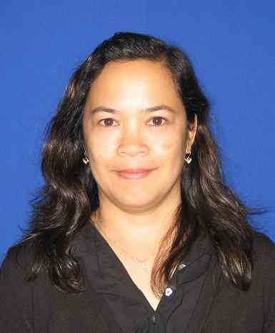

P4 Flex Team
PM Clary
Technology Partnerships
Manager
Paul Allen
Senior Integrations Engineer
Tim Brazil
Performance Engineer
Lawrence Bunka
Sr. Product Strategy Manager
Agnes Jacob
Senior Product Partner Engineer
John Wiser
Senior TME Manager

Slide 5
P4 Flex Overview
What is it?
P4 flex is an open-source p4broker script which is shared to the developer community to refine and customized to their own environment.
A starting reference
Notes:
Each development environment is unique and may have requirements of security, control, workflow, etc. Thus this script is meant to be only as a starting reference which can be enhanced to support requirements of customer’s specific development environment.

Slide 6
P4 Flex Overview
Support
Support is through the developer community forums in which Perforce and NetApp are members.
Posted on Perforce Workshop
Currently only supports Unix and NFS environments.
Notes:
Each development environment is unique and may have requirements of security, control, workflow, etc. Thus this script is meant to be only as a starting reference which can be enhanced to support requirements of customer’s specific development environment.

Slide 7

P4 Flex Components
P4 Client
P4D Server
p4broker
P4 Client
P4 FLEX:
broker.cfg
flex.cfg
flex.py
P4 Client
Notes:
The p4 flex script is written in python and is run in behalf of the user by the p4broker. Consists of the following files:
broker.cfg - p4broker configuration file that defines the ports and location of flex.py script
flex.cfg - p4 flex configuration file that defines the variables needed to run p4 flex such as p4 admin user information and NetApp admin user information
flex.py - python script that provides the functionality to create template, create clone and delete Perforce workspaces quickly
The Perforce Broker is a server process that mediates between Perforce client applications and Perforce Servers. Allows running of local policies or rules.

Slide 8
P4 Flex Commands
p4 flex volume -s size[M, G] name
p4 flex volume -d name
p4 flex volumes
p4 flex snapshot -V volume [-c client] name
p4 flex snapshots
p4 flex clone -V volume -S parent name
p4 flex clone -d name
p4 flex clones [-a]
Notes:
'p4 flex volume' will create a new volume. The '-d' flag will
delete the volume and associated snapshots.
'p4 flex volumes' will display a list of all volumes.
'p4 flex snapshot' will create a new snapshot based on volume template.
'p4 flex snapshots' will display a list of all flex snapshots.
'p4 flex clone' will create a new flex clone. The '-d' flag will
delete the flex clone and ascociated client.
'p4 flex clones' will display a list of all flex clones owned by that
user. The '-a' flag will list all flex clones globally.

Slide 9
Requirements
In order to be able to utilize P4 Flex the following is required:
Python 2.6 or later
P4 Python 2.6 or later APIs
NetApp Manageability Software Development Kit (NMSDK) 5.3.x or later

Slide 10
Assumptions
To use P4 flex, the following are assumed.
SERVER
P4D Server is installed and running
P4Broker installed
LDAP is running or an existence of user accounts and authentication management.
NetApp Cluster Mode Storage Data ONTAP 8.x is used with FlexClone and NFS license enabled
CLIENT:
NFS Client is running on client box
NetApp volume is mounted on client box
The "p4 client" is installed.

Slide 11
P4 Flex In Action

Slide 12
Workflow
Create a Volume & add content
Snapshot a Volume
Cloned by a User
Clean up
Notes:
Any artifact - not just build
Art, Render, Image

Slide 13
Workflow
User’s clones created at snapshot on the Volume
Volume
snapshot 1
snapshot 2
snapshot 3
Bob
clone at
snapshot 1
Joe
clone at
snapshot 3

Slide 14
Workflow
Create a Volume
p4 flex volume -s 1G projVolume
Mounts the volume at:
/p4/projVolume

Slide 15
Workflow
Snapshot a volume
p4 volumes
p4 flex snapshot -VprojVolume snap1
Creates a snapshot and hidden Perforce workspace to manage the have list.

Slide 16
Workflow
Clone a volume
p4 volumes
p4 snapshots
p4 flex clone -VprojACE -Ssnap1 myClone
Mounts the clone & P4CONFIG
/p4/myClone
.p4config

Slide 17
Workflow
Clean up Clones
p4 clones
p4 clone -d myClone
Clean up Volumes
p4 volumes
p4 volume -d projACE
(snapshots automatically removed)

Slide 18
Demo

Slide 19
Design Goals
Familiar and easy to use
P4 styled commands
Not just for build, but any asset
Extensible Open Source script

Slide 20
Value of P4 Flex
Increase developer’s productivity
Improved Collaboration
Faster Sync times (“-k”)
Less Disk space

Slide 21
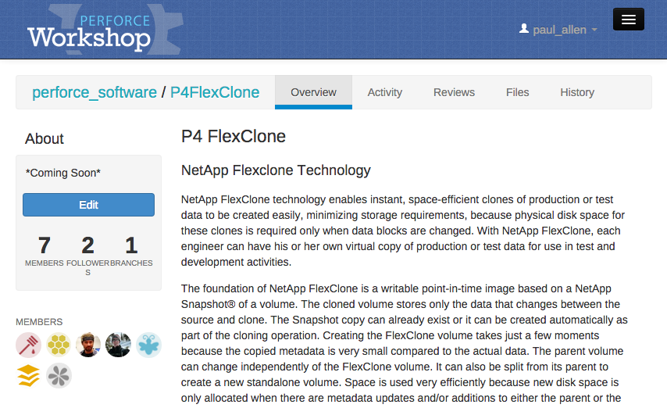
In the Workshop

Slide 22
References
Perforce Workshop – P4 Flex Project
https://swarm.workshop.perforce.com/projects/perforce-software-p4flexclone/
P4Broker
http://www.perforce.com/perforce/doc.current/manuals/p4dist/chapter.broker.html
FlexClone - A Thorough Introduction to FlexClone
http://www.netap.com/us/media/tr-4164.pdf
Deployment and Implementation Guide: Perforce Software on NetApp Clustered Data ONTAP
http://www.netapp.com/us/media/tr-4164.pdf
Data ONTAP Administration Manuals
http://now.netapp.com

Slide 23
Q & A

