Slide 1
3D OpenGL Game
CS 532 – B1
Fall 2015
Mark J. Musante
mark.musante@gmail.com

Slide 2
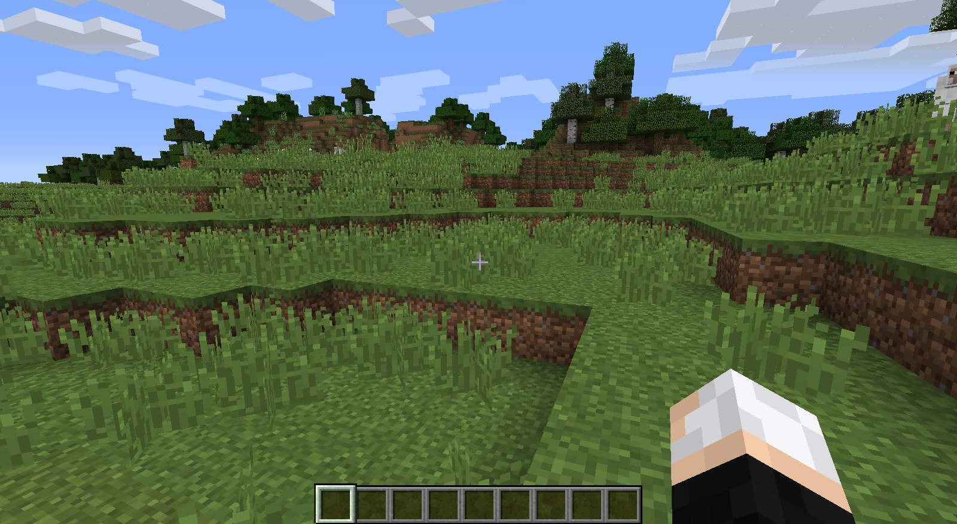
Minecraft

Slide 3
How far did I get?
Python 2.7 or 3.x
“Infinite” world
30fps
Using the mouse to look around
W/A/S/D keys to move around
Can place and remove blocks
Space bar to jump
“Fall” when moving over empty space

Slide 4
“Infinite” world
Using python's “tuple” to define the game space
A hash defines everything:
  Key: “tuple” coordinates
    e.g. (4, 5, 6) for the key means the block is at x=4, y=5, z=6
  Value: type of block
    Grass, dirt, stone. Others would be easy to add

Slide 5
Getting 30fps
Using glutTimerFunc()
  Glut will call it once only
  Each time, call glutTimerFunc() again
  Using 33ms gets us a bit over 30fps
Inside glutTimerFunc():
  Calculate new x,y,z coordinates for player
    (Jumping? Falling? Moving into a block?)
  Call glutPostRedisplay()

Slide 6
Using the mouse to look around
Grab x/y coordinates from the mouse
Convert to spherical coordinates
  mouse-X gives us phi
  mouse-Y gives us theta
    x = sin(phi) * cos(theta)
    y = sin(phi) * sin(theta)
    z = cos(phi)
Use spherical coordinates to pass to gluLookAt()

Slide 7
Using W/A/S/D
W=forward, S=backward, A=left, D=right
Re-use the x/y/z values from gluLookAt to move the player in the direction they're looking
Timer function:
  On key down, start moving
  On key up, stop moving
glutSetKeyRepeat() to turn off auto up/down

Slide 8
Placing and removing blocks
Left click places a block in the world
Right click removes a block from the world
How do we know which block?
  Again, re-use “LookAt” coordinates
  Start at player location, move outward until a block is intersected
  If removing, then remove it
  If placing, insert a block “before” it

Slide 9
Jumping
When keydown is the space bar:
  If we're not falling or jumping, start a jump
    Save start_time
  Jump is just sin() from 0 to pi.
  The part of the jump we're in is: (current_time – start_time) times a factor
When jump is complete, check space bar status and re-jump if no keyup event.

Slide 10
Falling
If player moves over a space without a block, start falling
Falling just decrements the y-value of the player's position until it intersects a block

Slide 11
Remaining Work
(To make it feel complete)
Falling should accelerate to terminal velocity

