Slide 1
Predicting Solar Energy Output Using ML
Capstone Project | AI/ML Certificate Program
- Junaid Mustafa

Slide 2
What Are We Solving?
Solar energy is clean, but unpredictable.
Fluctuations in sunlight, climate, and adoption rates make solar output hard to forecast.
Governments and grid operators need forecasts for planning energy supply, investments, and storage.
Can we forecast solar output using only economic indicators like GDP and population?

Slide 3

Data Set Information
Source: Kaggle - World Energy Consumption
129 features per record, including GDP, energy production by type, population
~22,000 country-year records
Target variable: solar energy consumption (TWh)

Slide 4
How was this approached?
Data cleaning: Removed null-heavy columns
Feature engineering: GDP per capita, solar per million people
EDA: Correlation matrices, distribution analysis, time series
Modeling: Linear regression baseline

Slide 5
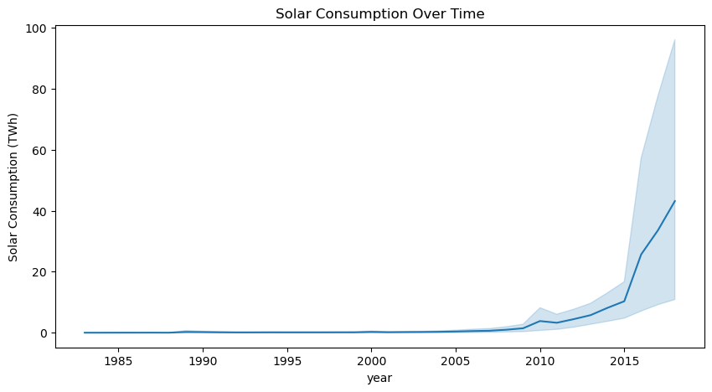
Solar Consumption Over Time

Slide 6
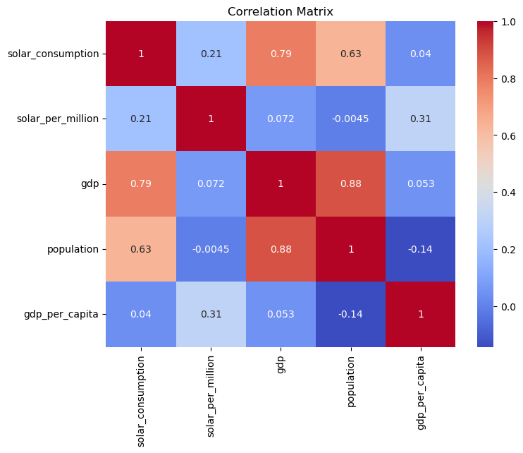
Correlation Matrix (Selected Features)

Slide 7
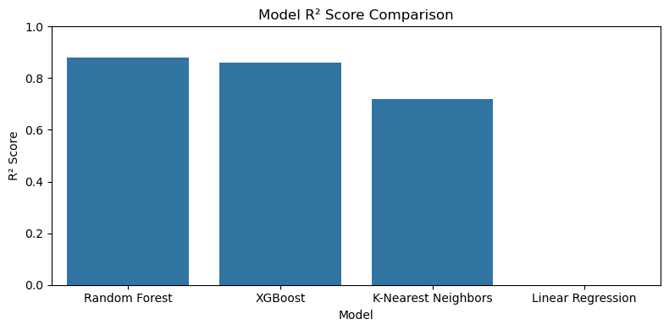

Slide 8

Model Comparison Summary
Model Performance:
- Linear Regression: RMSE = 39.41, R² = -1.27
- Random Forest: RMSE = 9.00, R² = 0.88
- XGBoost: RMSE = 9.92, R² = 0.86
- K-Nearest Neighbors: RMSE = 14.04, R² = 0.72
Observations:
- Random Forest performed best overall.
- XGBoost was nearly as strong.
- KNN provided a good middle-ground baseline.
- Linear Regression was the weakest, validating need for non-linear models.

Slide 9
Further Enhancements
Integrate weather data (sunlight hours, temperature)
Add policy/geographic indicators (subsidies, latitude, altitude)
Use tree-based models or deep learning
Build a dashboard for dynamic forecasting

