Slide 1
The mode less travelled: quantifying transport flexibility using agent-based models
Maria Wood
Professor Adam Dennett, Professor Esra Suel, Dr Gerry Casey
9th September 2026
Notes:
Morning everyone. I’m Maria, I’m a PhD student at UCL. Today I’m going to present on current and ongoing work I’m doing around assessing and quantifying transport flexibility, and how this might impact policy or planning in the future. Since this is work in progress, I’ll be focusing on concept, methods, and a few preliminary results at the end. I really welcome comments, thoughts, and questions!

Slide 2
Agenda
Motivations
The concept of flexibility
Methods
Case study
Future work and conclusions

Slide 3
The problem: global issues
Transport flexibility
CLIMATE CRISIS
GROWING INEQUALITY
Multi-modality
CAR-DEPENDENT TRANSPORT SYSTEM

Slide 4
The concept: flexibility
Flexibility is an individual’s ability to change their travel plans and still achieve their daily goals to the same standard
i.e., how much does changing travel plans affect your day?
Time
Route
Mode
Destination
Notes:
The answer to all of these issues is multimodality, i.e., the ability to switch from one mode to another for a given trip easily and smoothly. This is what I mean by flexibility in the present work: the ability to change travel plans and still manage to achieve daily goals. In this way, flexible individuals at once use lower-carbon transport, experience reduced car dependence, and are resilient and adaptable. Flexibility also applies to other dimensions of travel, such as temporal flexibility, route, or destination. But for the purposes of this study, we focus on modal flexibility.

Slide 5
Another problem: measurement vs reality
≠
TRANSPORT PROVISION
REALISABLE OPPORTUNITY
“There is a bus stop right outside my house”
“The bus doesn’t go where I need to go though”
The gap is real, and is distributed unevenly across geographies and socio-demographic groups

Slide 6
The concept: simulation of alternatives
Agent-based simulation provides a unique perspective on not only what an agent did but also what they could have done instead
The alternatives are ‘experienced’ in a realistic congested and dynamic network
Selected plan: realized choice
Home
Car
Work
Car
Home
~ observed behaviour e.g., NTS
Unselected plans: potential, unrealized choices
Home
Bus
Work
Walk
Home
~ stated preference in surveys – unreliable
Home
Cycle
Work
Cycle
Home

Slide 7
MATSim in a nutshell
Synthetic population
Population with demographics, activity plans, and activity locations derived from National Travel Survey and UK Census data
1
Network simulation
Agents complete activity plans in shared, congested network. Network includes real road and rail provision, PT services, and vehicle fleet
2
Innovation and scoring
Some agents “innovate” by randomly mutating their plans. All attempted plans are scored by utility (according to distance, duration, etc)
3
Repeated iterations
Simulation iterated hundreds of times to reach equilibrium where no agent can improve given the rest of the network
4
At equilibrium, all agents have a selected plan (what they did) and a set of unselected alternative plans (what they could have done). All plans have been experienced and scored in the shared network

Slide 8
The concept: simulation of alternatives
Agent-based simulation provides a unique perspective on not only what an agent did but also what they could have done instead
The alternatives are ‘experienced’ in a realistic congested and dynamic network
Selected plan: travel by car
U = 150
LOW FLEXIBILITY
HIGH COST OF MODE SWITCH
HOME
WORK
Unselected plan: travel by bus
U = 30

Slide 9
The concept: simulation of alternatives
Agent-based simulation provides a unique perspective on not only what an agent did but also what they could have done instead
The alternatives are ‘experienced’ in a realistic congested and dynamic network
Selected plan: travel by car
U = 150
HIGH FLEXIBILITY
LOW COST OF MODE SWITCH
HOME
WORK
Unselected plan: travel by bus
U = 145

Slide 10
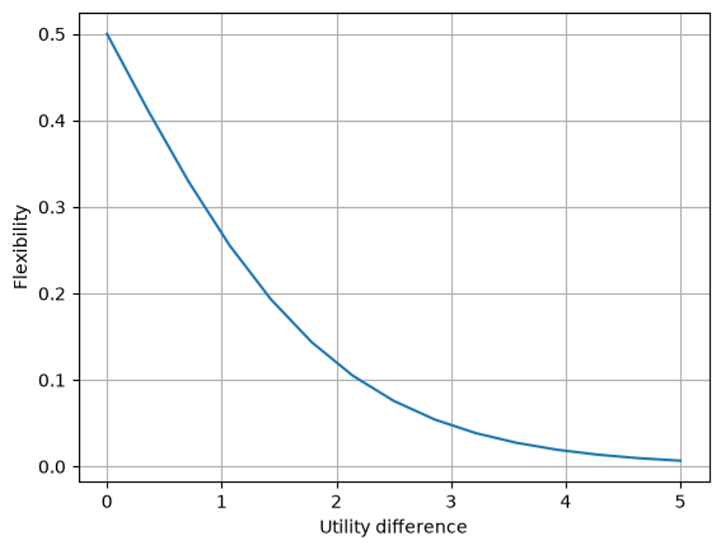
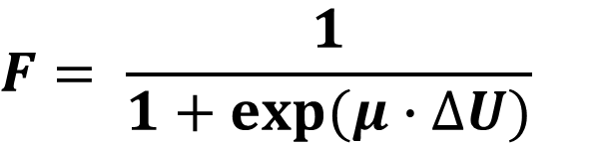

Flexibility from MATSim outputs
Compare the selected plan (highest-scoring plan) to the best alternative that invokes a mode shift
Transform the difference in utility using a logistic function
This gives the binary logit choice probability between these two plans in a head-to-head comparison
Perfect flexibility
Zero cost to mode switch
$$F= \frac{1}{1+exp⁡(μ∙∆U)}$$
Near-zero flexibility
Mode switch cost asymptotically large
$$∆U=U\left(selected\right)−U(alternative)$$
$μ=1$ for consistency with MATSim

Slide 11


Case study: car dependence in the East of England
Data: BERTIE (Behaviour and Transport: Impact and Equity)
Developed by Transport East and Arup
10% representative synthetic population
Activity and agent-based MATSim model of East of England
RQ: To what extant can agents who travel by car reduce their car use?
Select agents with car in selected plan (57%)
Identify best alternative plan that reduces car use (by distance)
Compare utilities and transform to find F
Weight F by proportion of car reduction
Validate results against DfT Connectivity (the “national measure of connectivity”)

Slide 12
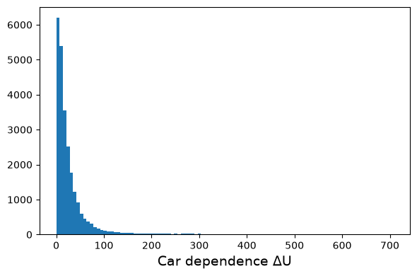
Results: flexibility distribution
34% agents have ΔU < 10 utils
Many agents have a decent car-reducing alternative
5% agents have ΔU > 100 utils
Some agents have only very poor car-reducing alternatives

Slide 13
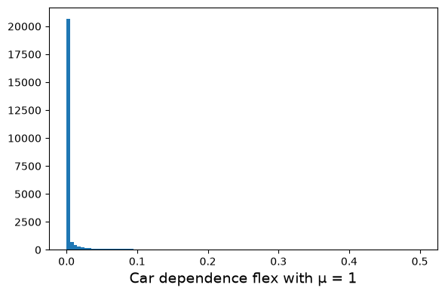
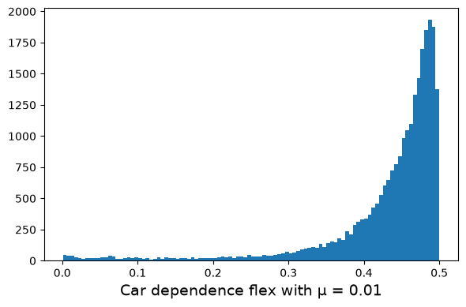
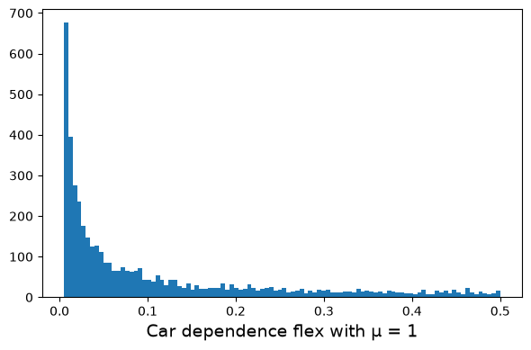
Results: flexibility distribution
94% agents have F < 0.05 at μ = 1
0.2% agents have F > 0.45 at μ = 1
Choice of μ influences shape of distribution

Slide 14
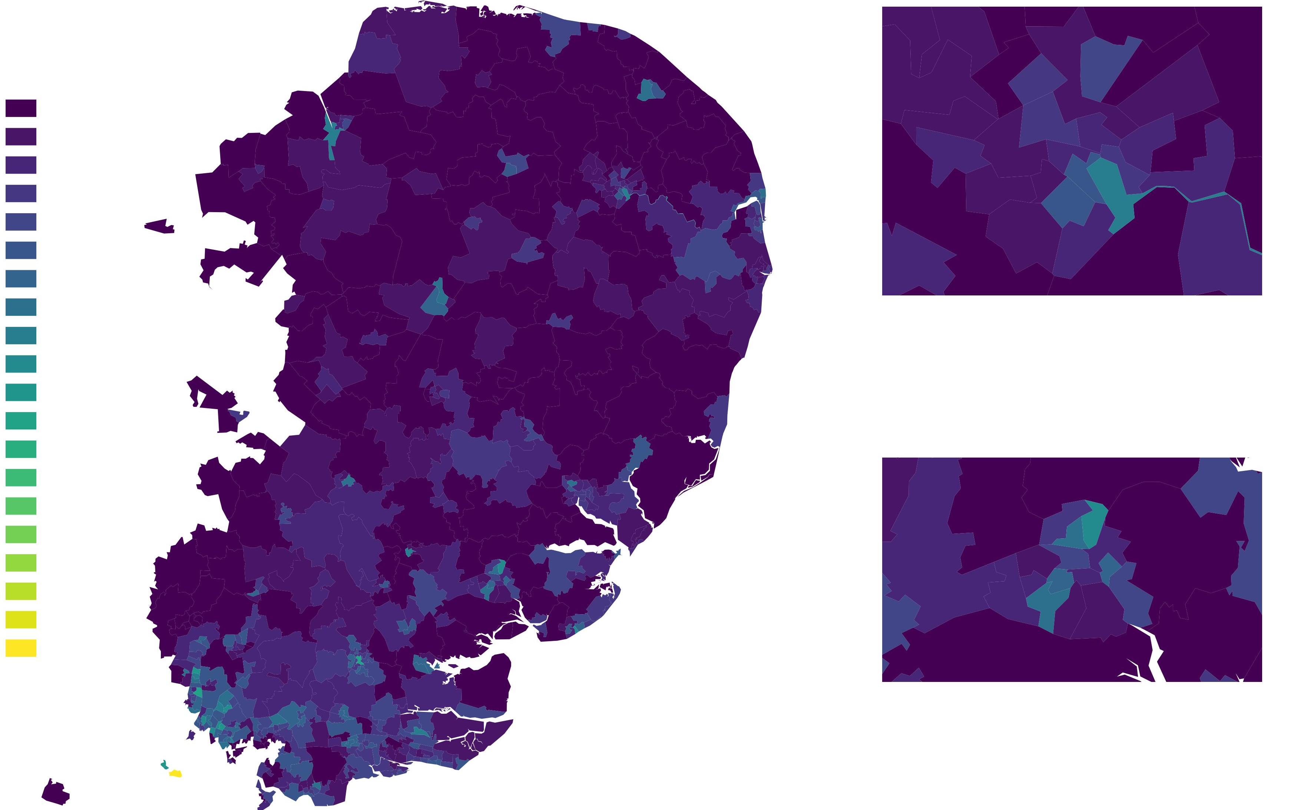
Results: geographical distribution
0
Norwich
0.14
Colchester

Slide 15
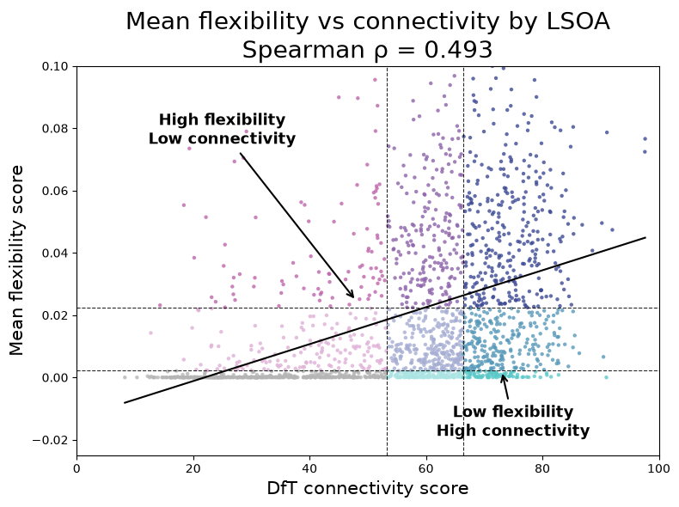
Results: comparison to connectivity
LSOAs in upper-left and lower-right quadrants show decoupling:
Resourceful mobility (3% of LSOAs)
High flexibility, low connectivity
Less deprived, lower PT stop density, higher car ownership, semi-urban
Unrealized provision (6% of LSOAs)
Low flexibility, high connectivity
More deprived, higher PT stop density, lower car ownership, highly urban
Spearman’s $ρ=0.5$
Moderate relationship but with much variance unexplained

Slide 16
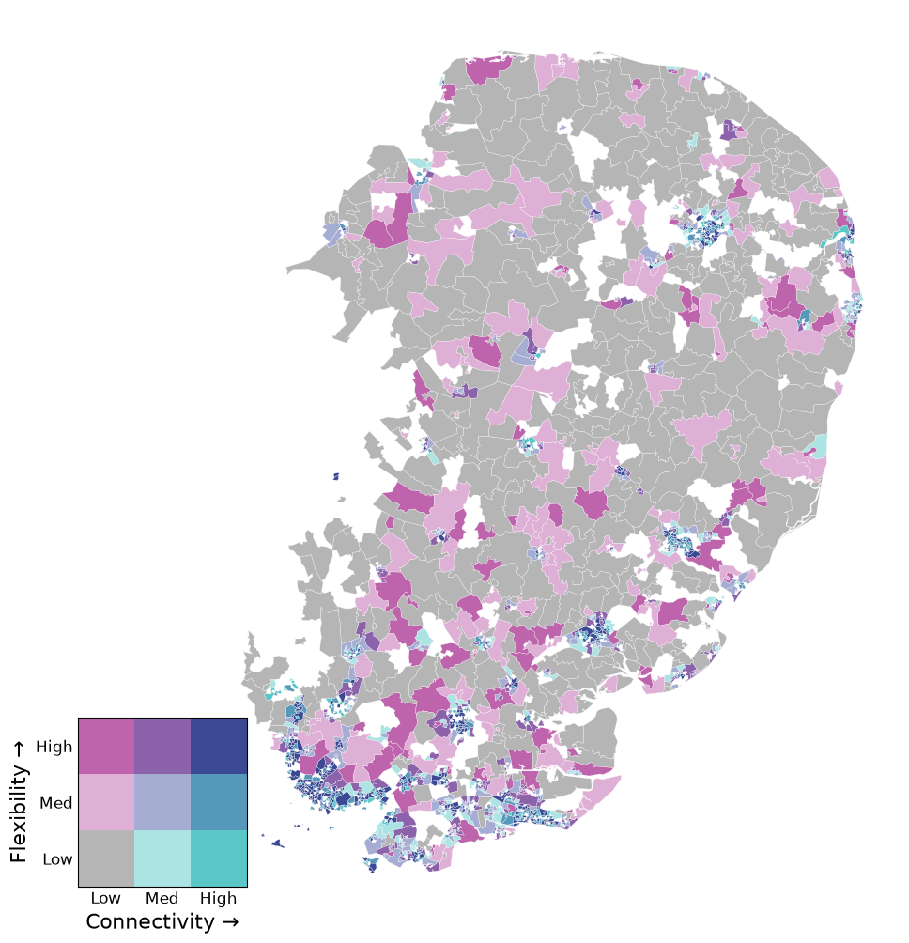
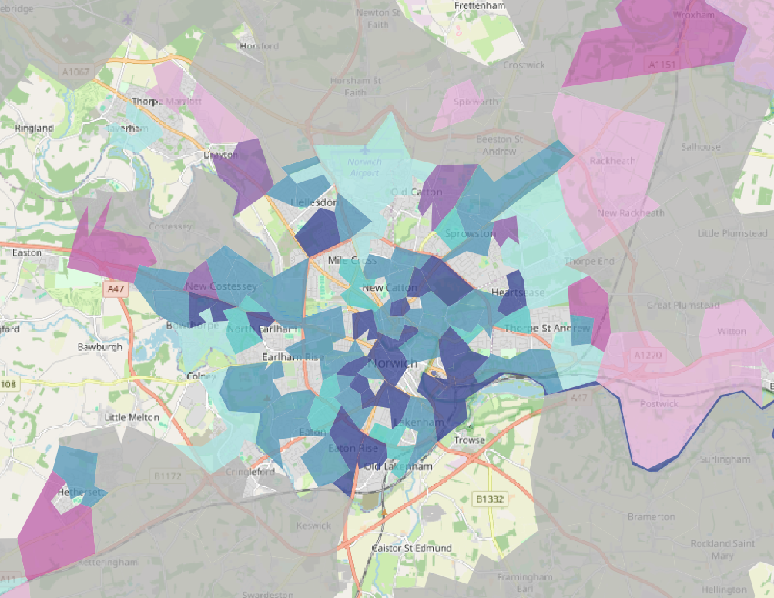
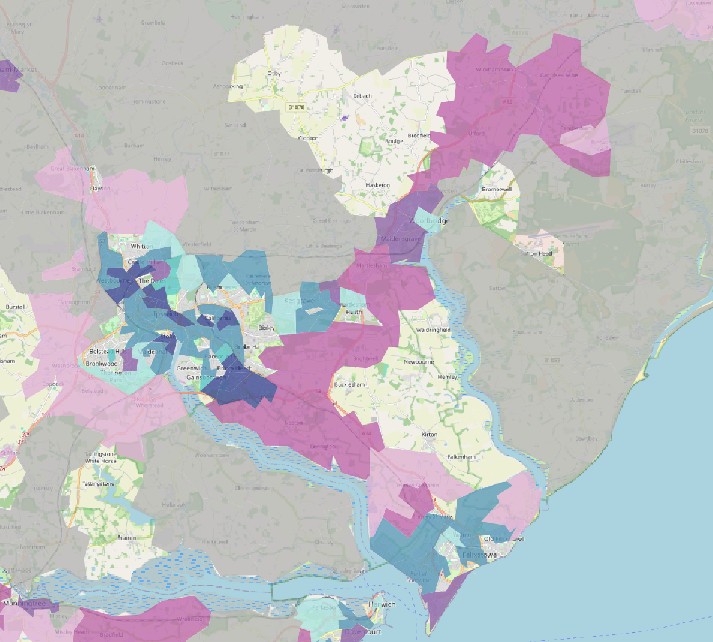
Results: comparison to connectivity
Resourceful mobility (high flex, low conn)
Mostly periphery of urban centres
Unrealized provision (low flex, high conn)
Low flexibility, high connectivity
Mostly within urban centres
Norwich
Ipswich + Woodbridge

Slide 17
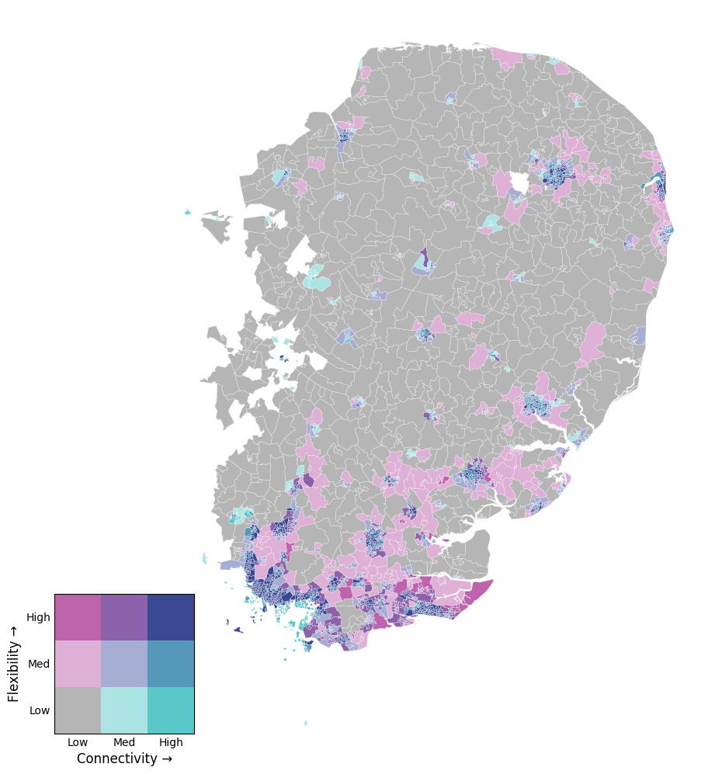
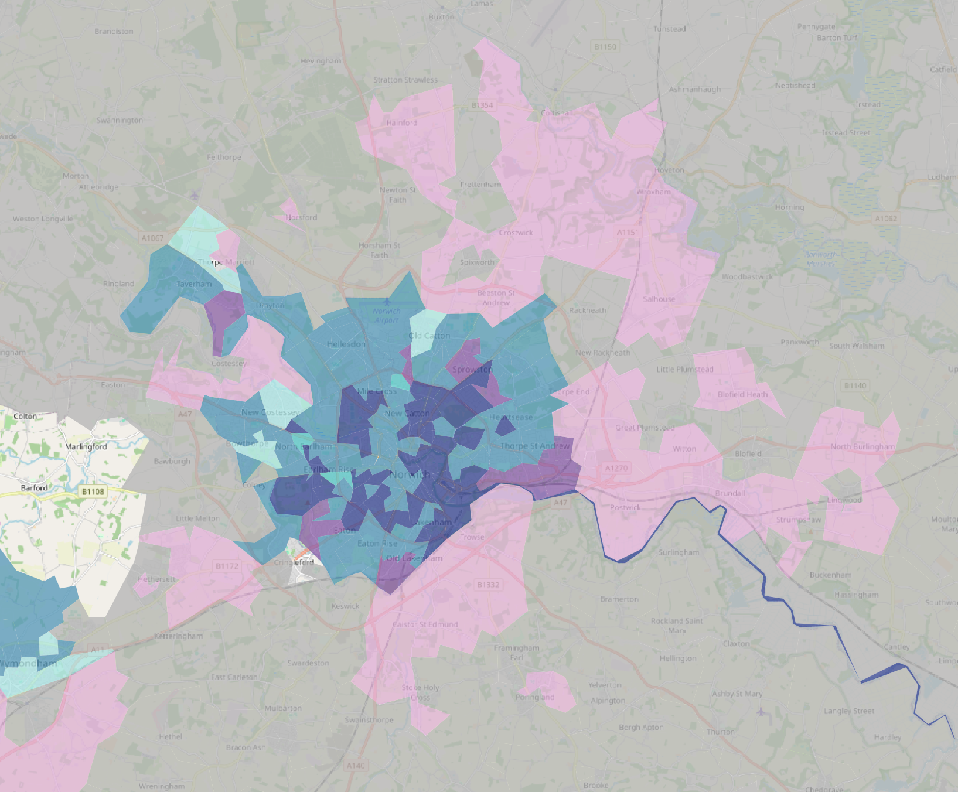
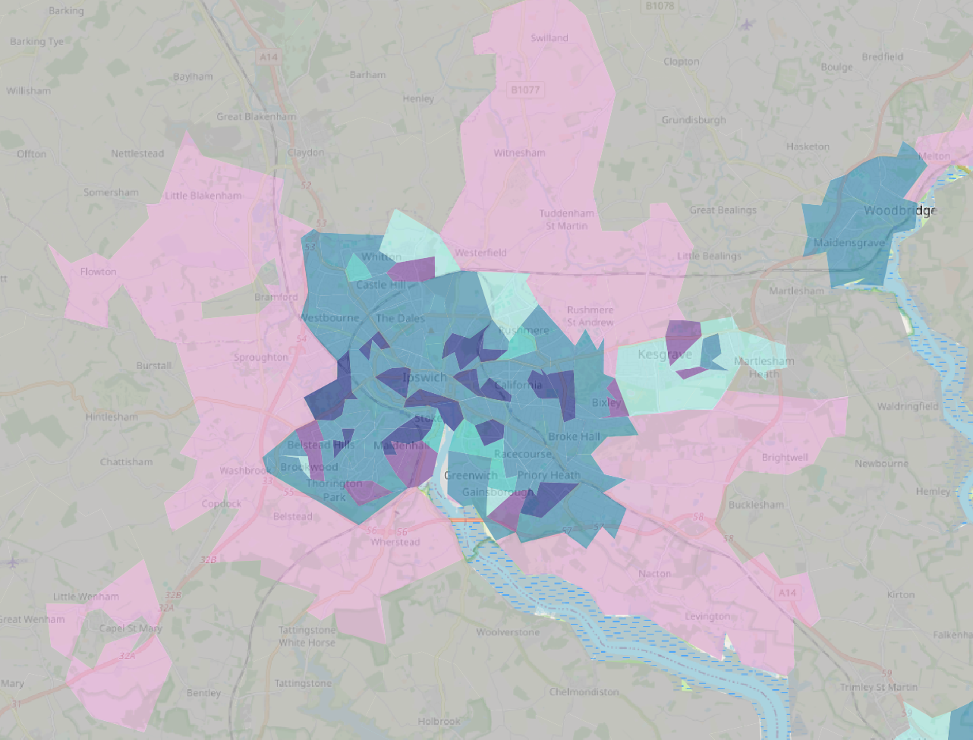
Results: comparison to connectivity – fullpop old methods
Resourceful mobility (high flex, low conn)
Mostly periphery of urban centres
Unrealized provision (low flex, high conn)
Low flexibility, high connectivity
Mostly within urban centres
Norwich
Ipswich

Slide 18
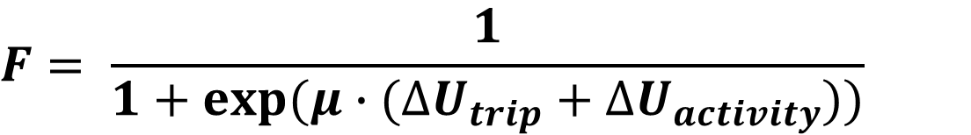
Extension: trip-level car dependence
Apply the methodology to a given trip in the day e.g., the commute or school drop-off
For agents who travel to work (or school dropoff) by car in their selected plan, compare the utility of this trip against alternative plans where car is not used
Include additional term to flexibility transform to account for downstream scheduling effects
$$F= \frac{1}{1+exp⁡(μ∙(∆U_{trip}+∆U_{activity}))}$$
We can find which agents are able to reduce car across the day, but not for essential trips
Notes:
Trip-level accounting obscures day-level trip-chain coherence but is often favoured in planning.

Slide 19

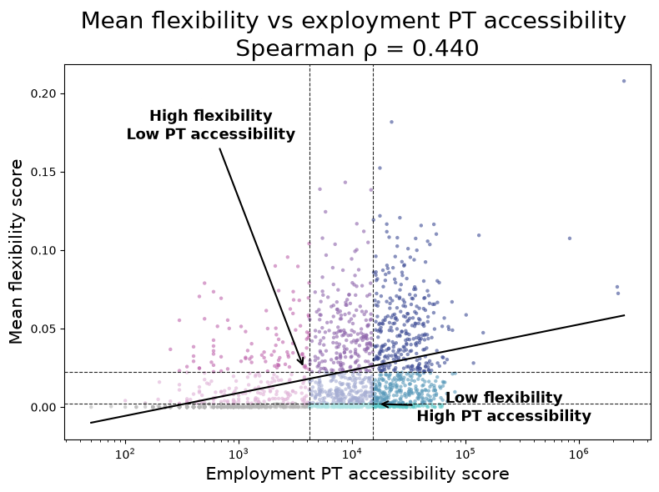
Extension: trip-level car dependence
Comparison to employment public transport accessibility indicators (30 minutes)

Slide 20
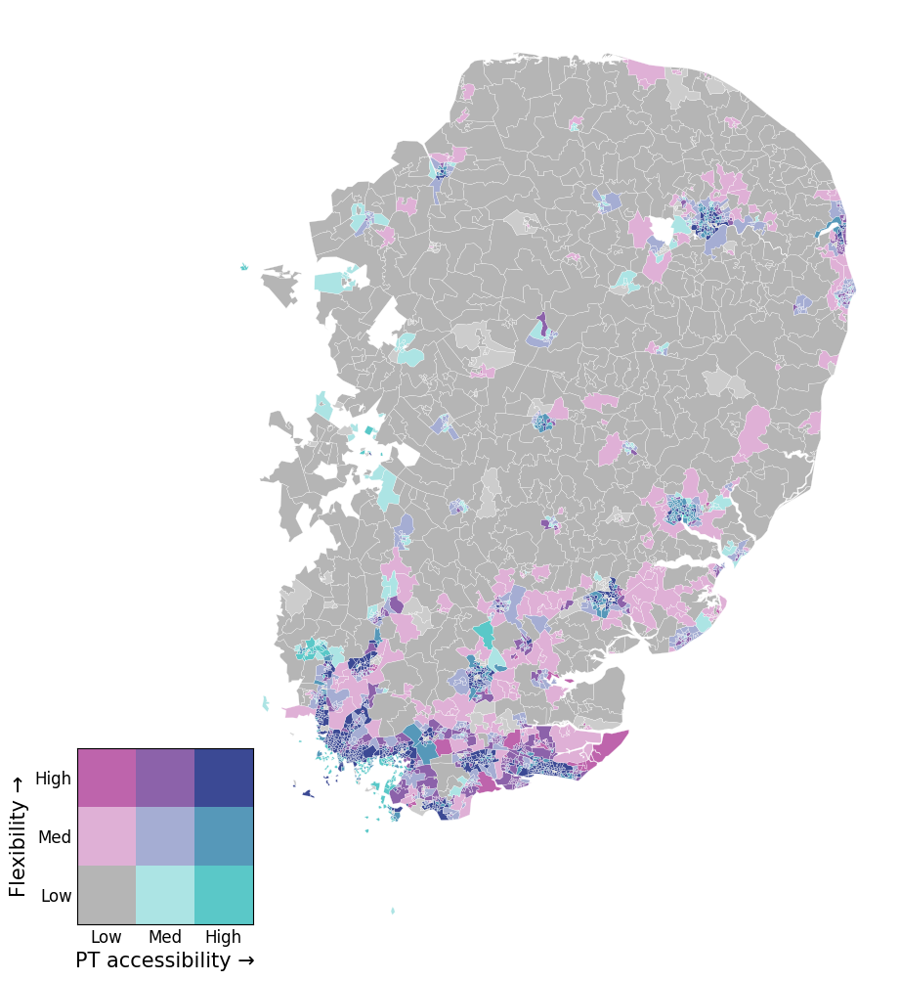
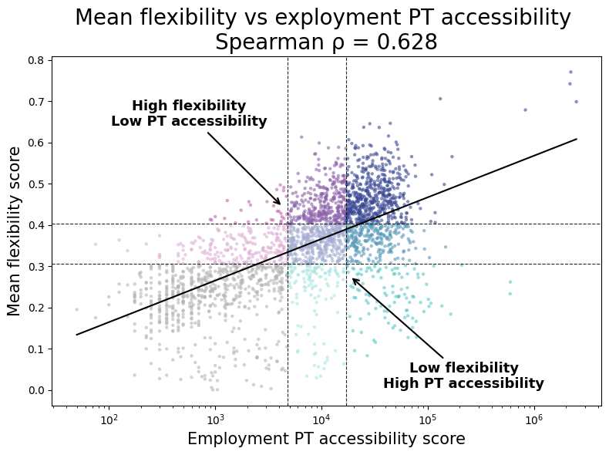
Extension: trip-level car dependence – fullpop old methods
Comparison to employment public transport accessibility indicators (30 minutes)

Slide 21
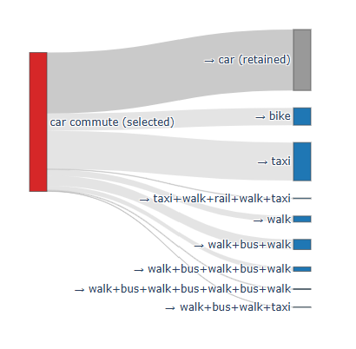
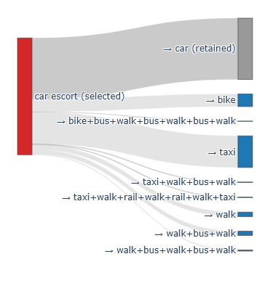
Extension: trip-level car dependence
Commute
42% of agents retain car in best day-level car-reducing alternative
School drop-off
49% of agents retain car in best day-level car-reducing alternative

Slide 22
Next steps
Modal elimination (100% car reduction)
Network-level modal resilience
Disaster scenario testing including route flexibility
Modelling of outcome distributions to understand relationships between demographics, geography, and flexibility more robustly
Policy scenario testing for efficacy of interventions to improve flexibility
Notes:
There’s lots more exciting parts of this project that I’m looking at, applying this methodology more widely. I’m looking at other case studies (with the BERTIE model) where I investigate flexibility to totally remove car as an option (extending the car reduction case study to a total removal of cars from their travel) and repeating this for various other travel modes such as bus, cycle, or rail. In this way we can understand how resilient agents are to individual-level circumstances or disruptions e.g., not being able to use a mode of transport for health, financial, or preference reasons. And finally, I want to look at network-level disruptions to understand how agents respond to a removal of a mode entirely from the network (e.g., rail strikes, a ban on ICEVs), or a natural disaster that also affects routes. Methodologically, I’m looking at modelling the flexibility distributions themselves, to understand more robustly if flexibility is experienced particularly more or less by certain demographic groups.

Slide 23
Conclusions
Examining at unselected simulated travel plans can generate a novel quantified description of modal flexibility
Flexibility can be assessed across an entire day or for a specific trip purpose
Flexibility is not the same as connectivity – provision does not always translate into usefulness
It’s not just rural areas that experience low car-reducing flexibility
Essential trips often hard to mode switch even in car-reducing alternatives
Notes:
So to wrap up, this work has been really illuminating working with MATSim and as im sure everyone whos worked with it before will know, these models are complex! But I think my work so far has shown that examining these under the cover simulated options is really revealing and helps us to understand agent’s full choice sets, and see them properly experienced and scored in a realistic network. These early results show that flexibility gives sensible-looking results when we compare it to what we know about connectivity and geography, but that in some cases highlights where accessibility measures are insufficient to represent how people actually interact with the transport available to them.

Slide 24
References
Salutin, G. (2023) Getting the measure of transport poverty. Available at: https://www.smf.co.uk/wp-content/uploads/2023/11/Getting-the-measure-of-transport-poverty-Nov-2023.pdf (Accessed: 10 July 2026).
Department for Transport (2025) NTS 2024: Introduction and main findings - gov.uk. Available at: https://www.gov.uk/government/statistics/national-travel-survey-2024/nts-2024-introduction-and-main-findings (Accessed: 10 July 2026).
Bi, W., MacAskill, K. and Schooling, J. (2023) ‘Old wine in new bottles? understanding infrastructure resilience: Foundations, assessment, and limitations’, Transportation Research Part D: Transport and Environment, 120, p. 103793. doi:10.1016/j.trd.2023.103793.
Powells, G. and Fell, M.J. (2019) ‘Flexibility capital and flexibility justice in Smart Energy Systems’, Energy Research &amp; Social Science, 54, pp. 56–59. doi:10.1016/j.erss.2019.03.015.
Doorn, N., Gardoni, P. and Murphy, C. (2018) ‘A multidisciplinary definition and evaluation of resilience: The role of social justice in defining resilience’, Sustainable and Resilient Infrastructure, 4(3), pp. 112–123. doi:10.1080/23789689.2018.1428162.
Horni, A., Nagel, K. and Axhausen, K.W. (2016) ‘Introducing matsim’, The Multi-Agent Transport Simulation MATSim. doi:10.5334/baw.1.
IMDb (no date) Groundhog day (1993) . Available at: https://www.imdb.com/title/tt0107048/ (Accessed: 10 July 2026).

Slide 25
Thank you! Any questions?
Maria Wood – UCL CASA
maria.wood.23@ucl.ac.uk
mjmwood@github.io
@mariawood.bsky.social

