Slide 1
DC Microgrid Control

Slide 2
% Define the correct range for piScalar and plScalar piRange = 10.^(-15:1:0); % Adjust the range as needed plRange = 10.^(-15:1:0); % Adjust the range as needed

Slide 3
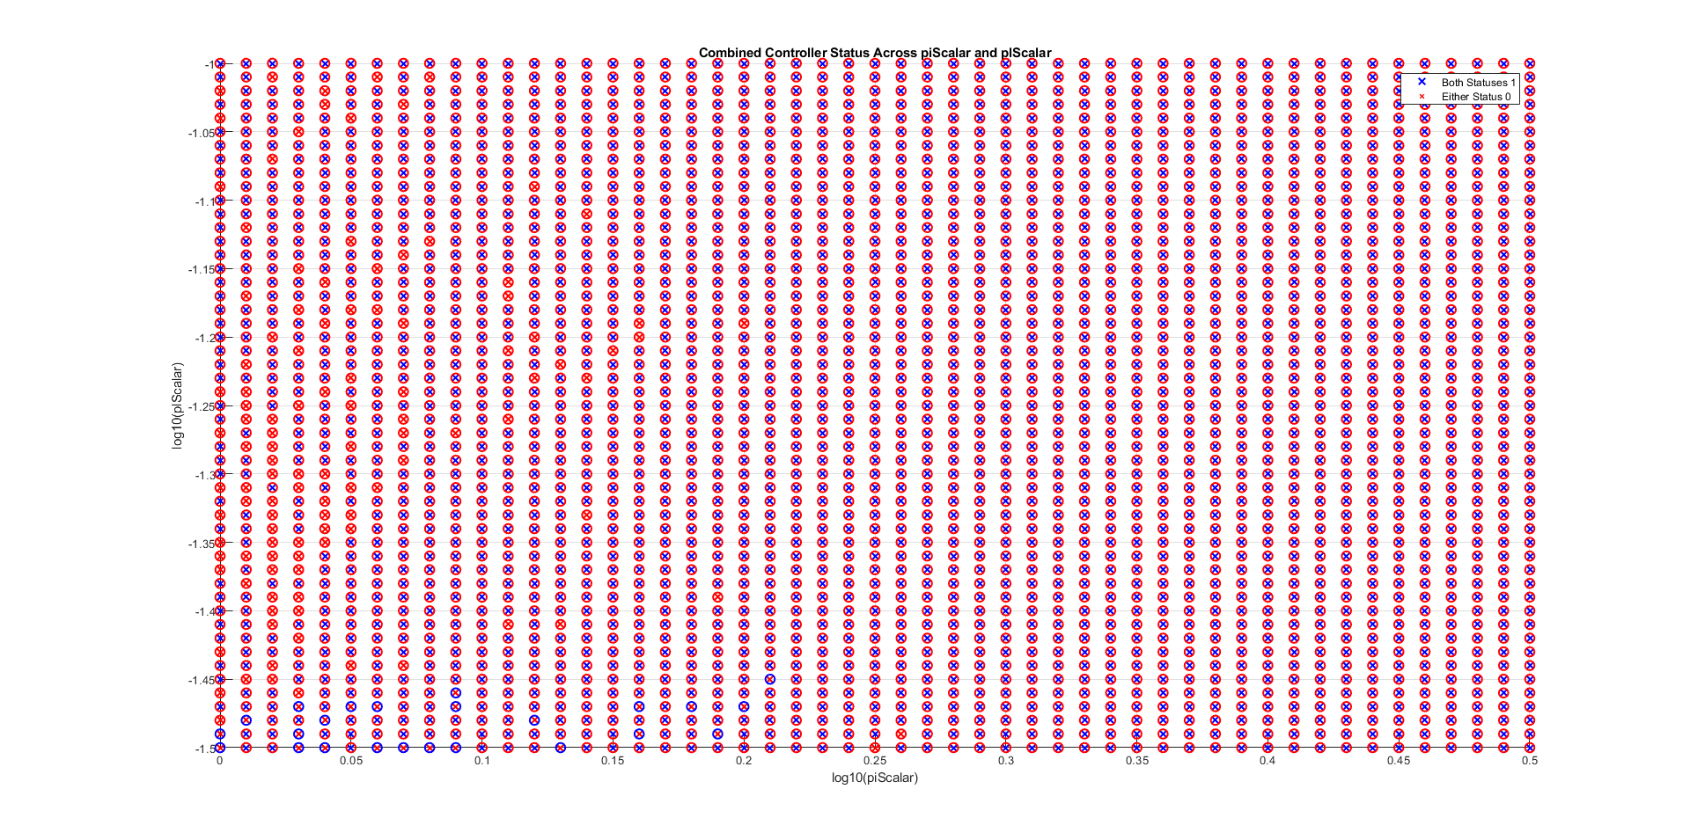
piRange = 10.^(0:0.01:0.5); % Adjust the range as needed plRange = 10.^(-1.5:0.01:-1); % Adjust the range as needed

Slide 4
Without Mat4_1

Slide 5
Without Mat4_1- omitting local infeasibility

Slide 6
With Mat4_1- omitting local infeasibility

Slide 7
Without Mat4_1: plotting p_iVals and P_lVals

Slide 8
With Mat4_1: plotting p_iVals and P_lVals

Slide 9
Fixed Values for P_i and P_l in the global controller – set them to 10^-4

