Slide 1
DC Microgrid Control

Slide 2
% Define the correct range for piScalar and plScalar piRange = 10.^(-15:1:0); % Adjust the range as needed plRange = 10.^(-15:1:0); % Adjust the range as needed

Slide 3
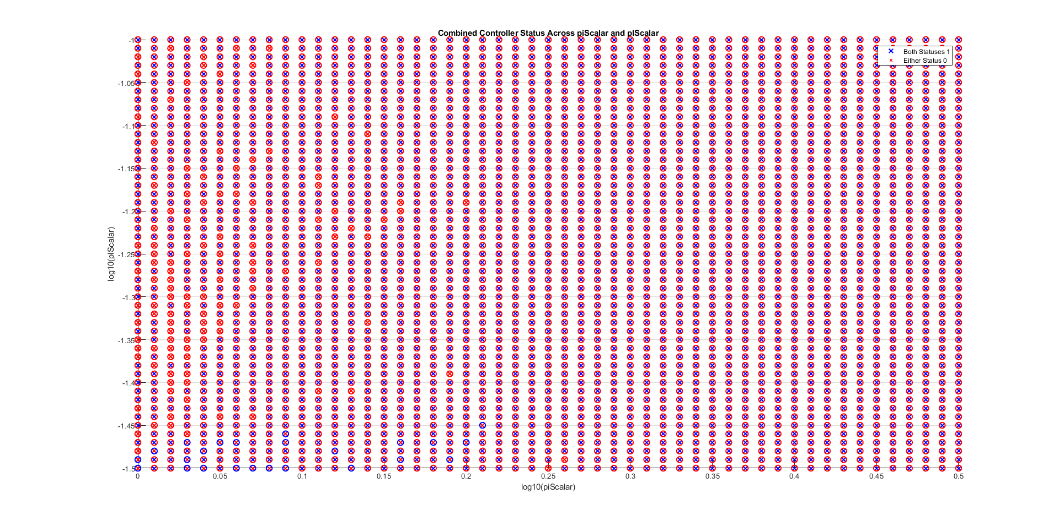
piRange = 10.^(0:0.01:0.5); % Adjust the range as needed plRange = 10.^(-1.5:0.01:-1); % Adjust the range as needed

Slide 4
Without Mat4_1

Slide 5
Without Mat4_1- omitting local infeasibility

Slide 6
With Mat4_1- omitting local infeasibility

Slide 7
Without Mat4_1: plotting p_iVals and P_lVals

Slide 8
With Mat4_1: plotting p_iVals and P_lVals

Slide 9
Fixed Values for P_i and P_l in the global controller – set them to 10^-4

Slide 10
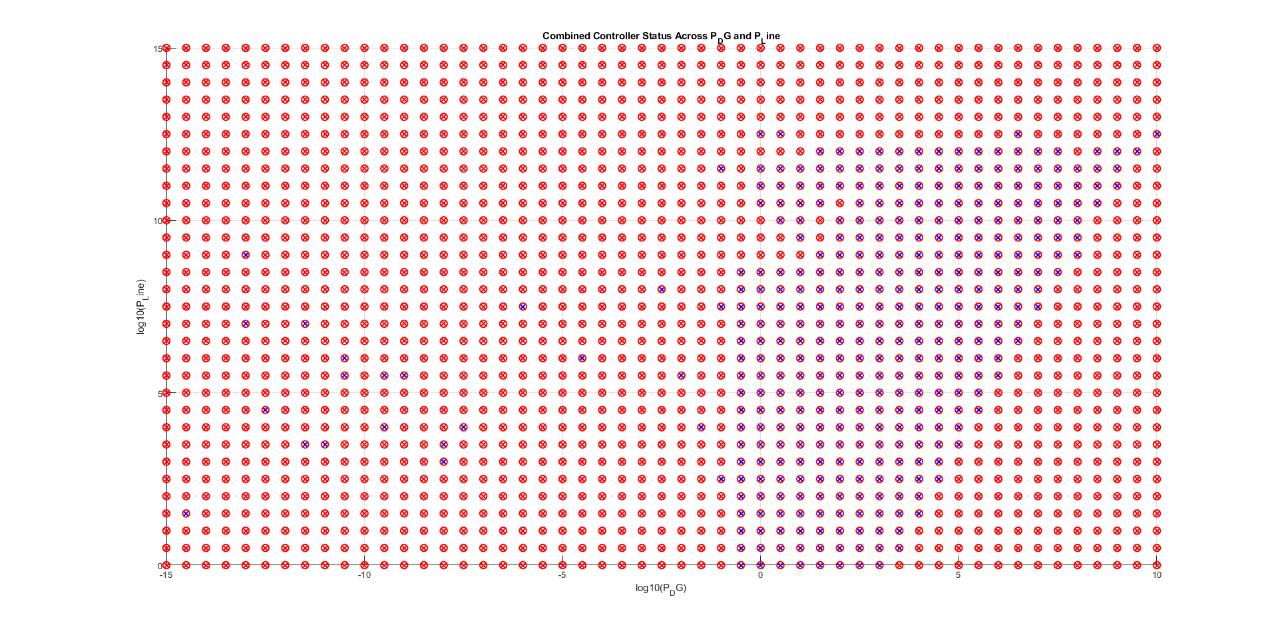
plotCombinedControlDesignVariation P_DG_Range = -15:step_size:10; % Range for P_DG in linear scale P_Line_Range = 0:step_size:15; % Range for P_Line in linear scale

Slide 11
plotCombinedControlDesignVariation piVals = P_DG + deltaP_DG * rand(1, numOfDGs); plVals = P_Line + deltaP_Line * rand(1, numOfLines);

Slide 12
plotCombinedControlDesignVariation piVals = P_DG + rand(1, numOfDGs) + 1/2 * deltaP_DG; plVals = P_Line + rand(1, numOfLines) + 1/2 * deltaP_Line;

Slide 13
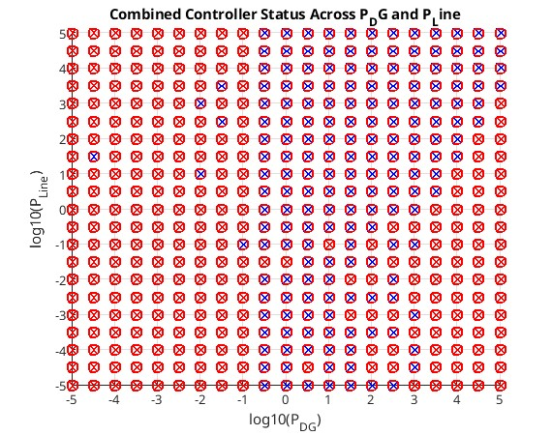
piVals = P_DG + deltaP_DG * rand(1, numOfDGs) - 1/2 * deltaP_DG;
plVals = P_Line + deltaP_Line * rand(1, numOfLines) - 1/2 * deltaP_Line;

Slide 14
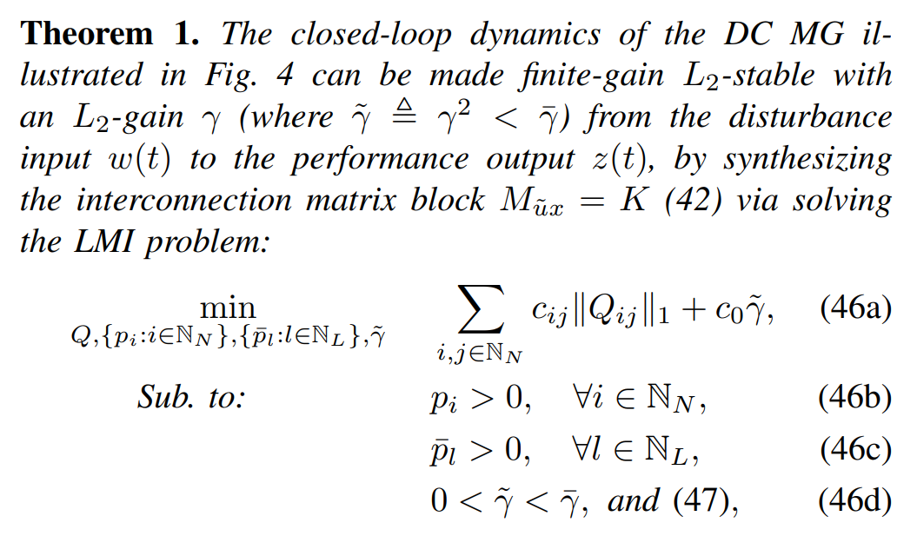
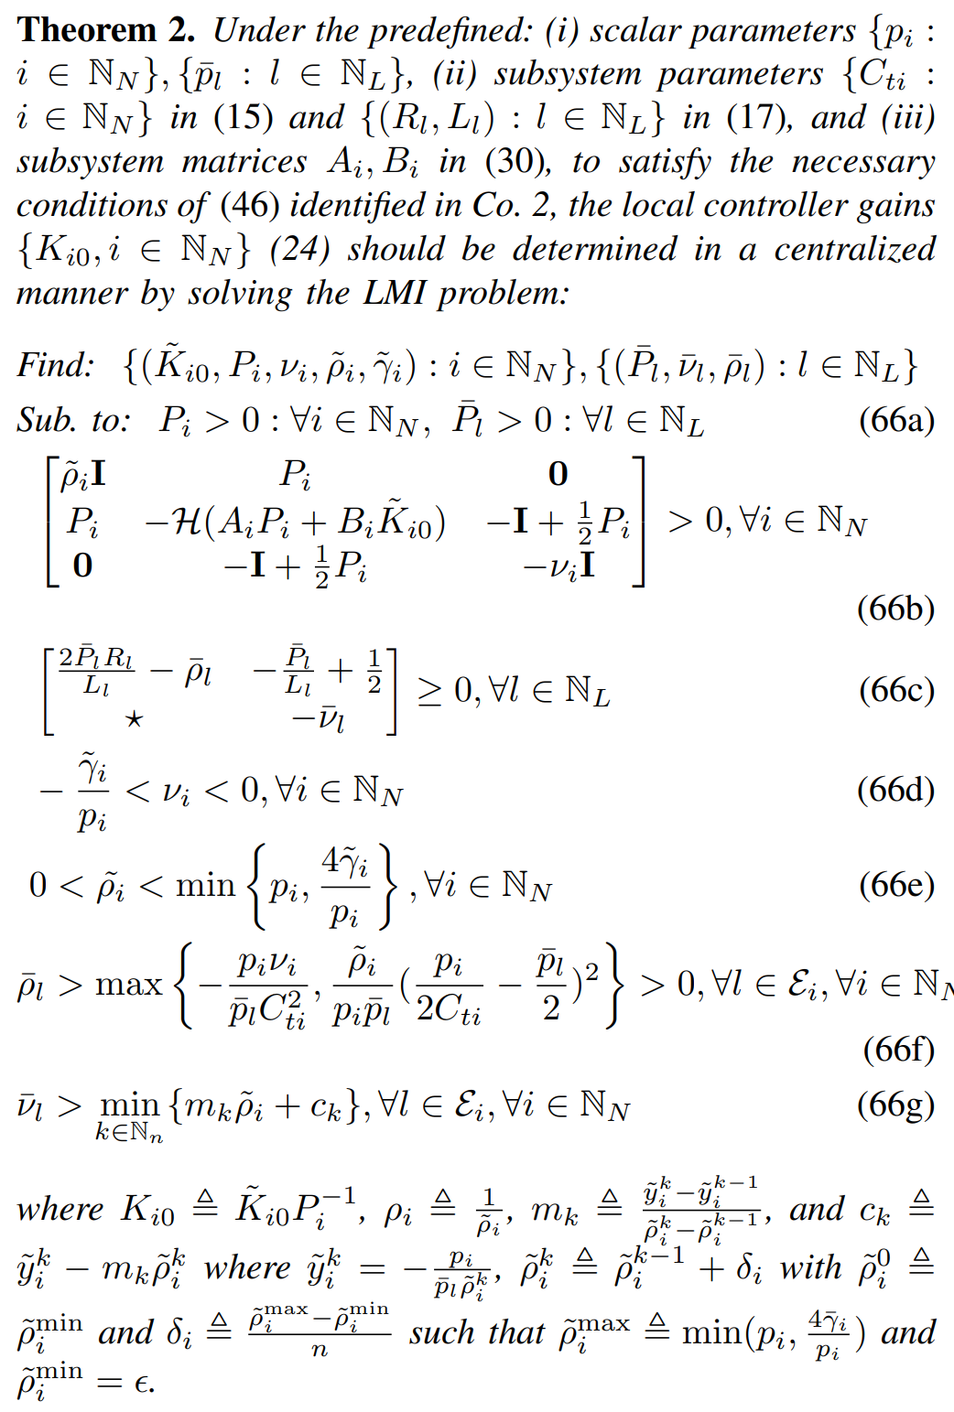
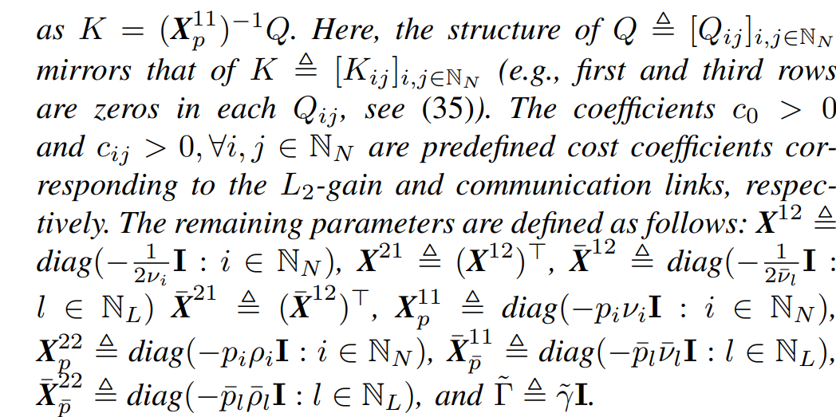
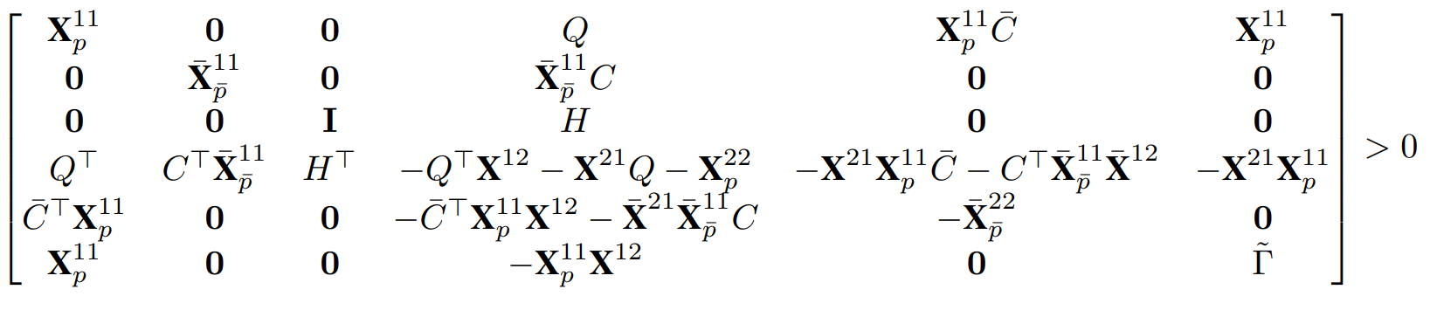

Slide 15
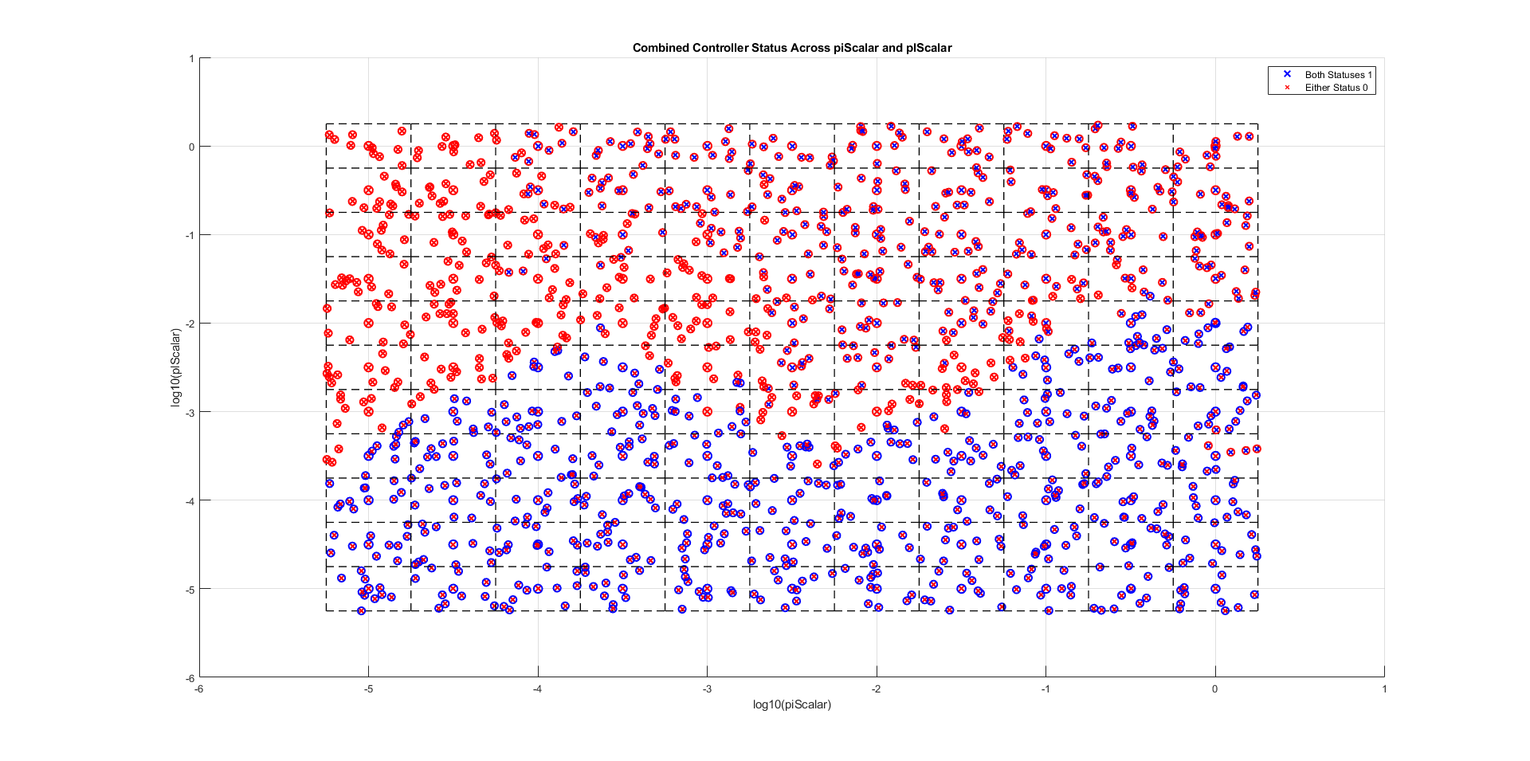
function plotTestBothFeasibility step_size = 0.5; piRange = 10.^(-5:step_size:0); plRange = 10.^(-5:step_size:0; squareSize = step_size numRandomPoints = 10;

Slide 16
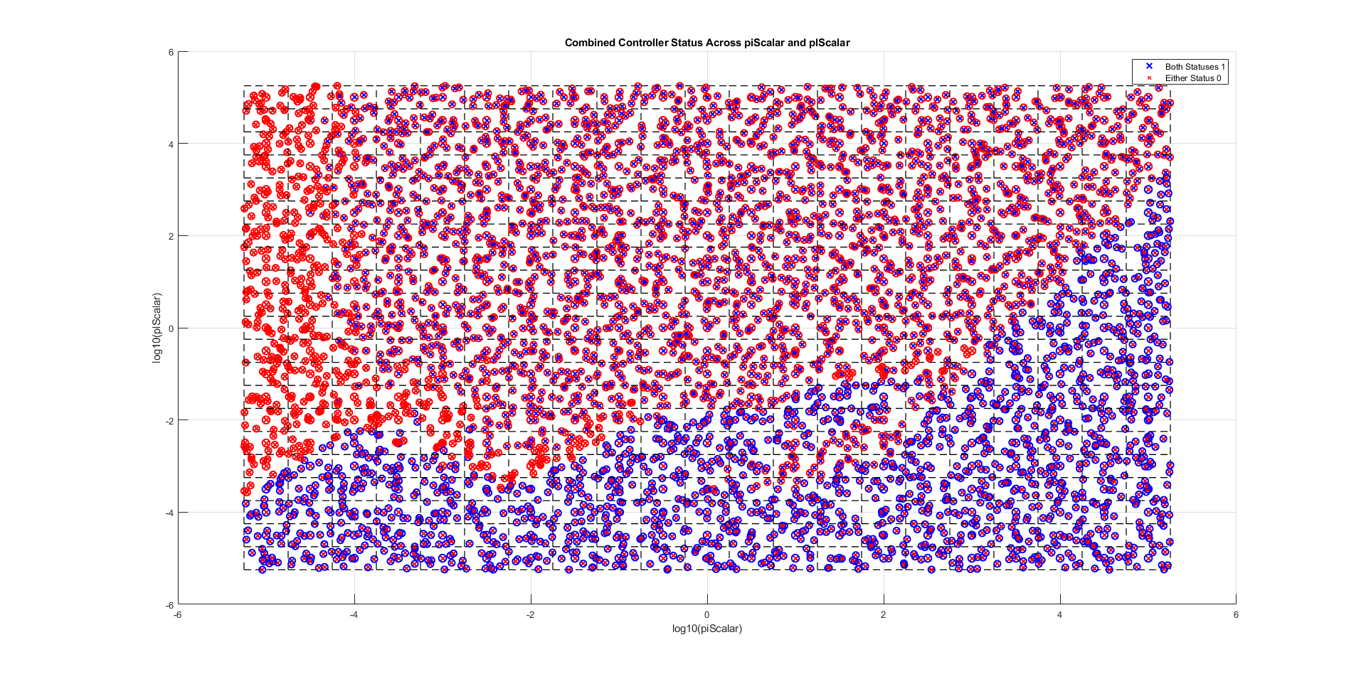
function plotTestBothFeasibility step_size = 0.5; piRange = 10.^(-5:step_size:5); plRange = 10.^(-5:step_size:5; squareSize = step_size numRandomPoints = 10;

Slide 19
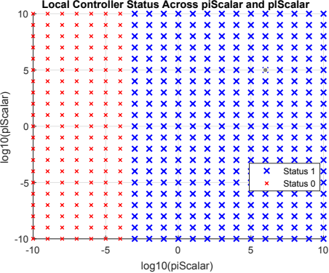
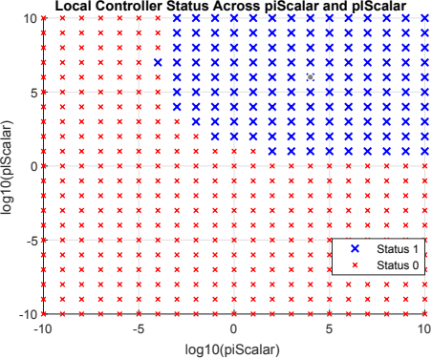
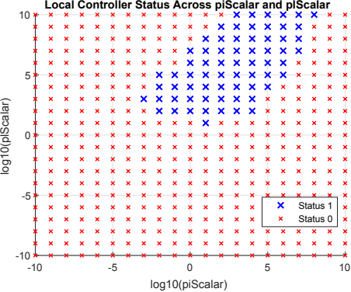
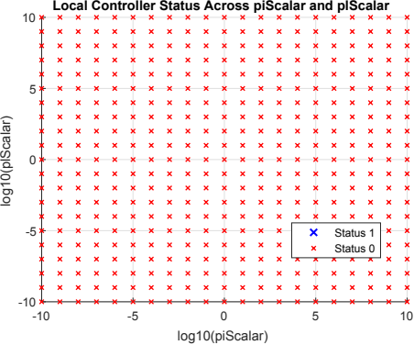
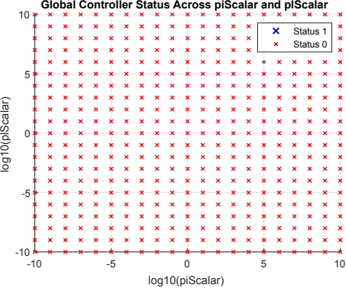
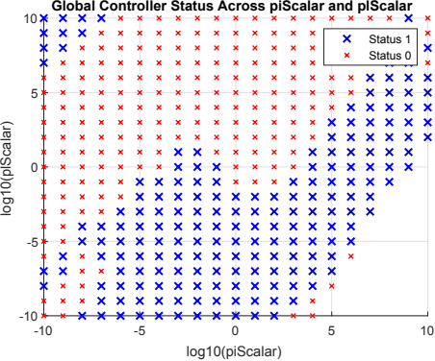
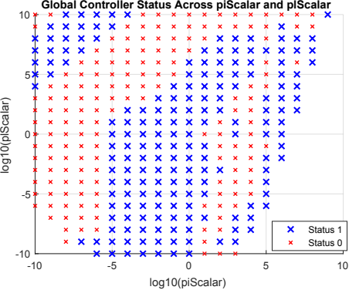
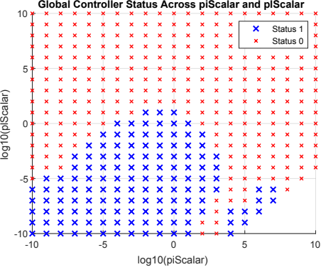
constraints = [constraints];
constraints = [constraints, con7_2];
constraints = [constraints, con7_2, con7_3];
constraints = [constraints, con7_2, con7_3, con8];

Slide 20
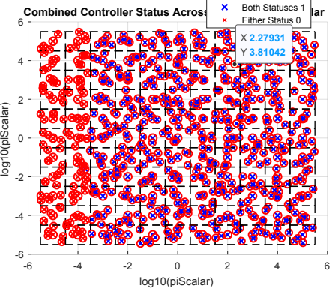
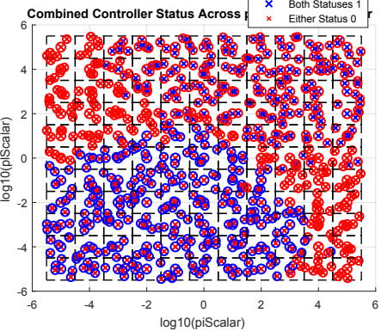
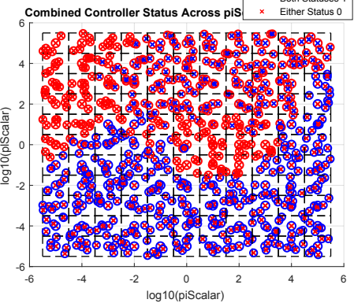
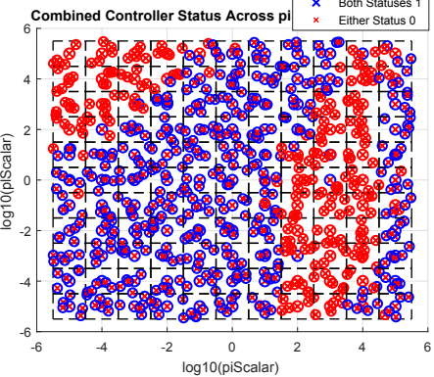
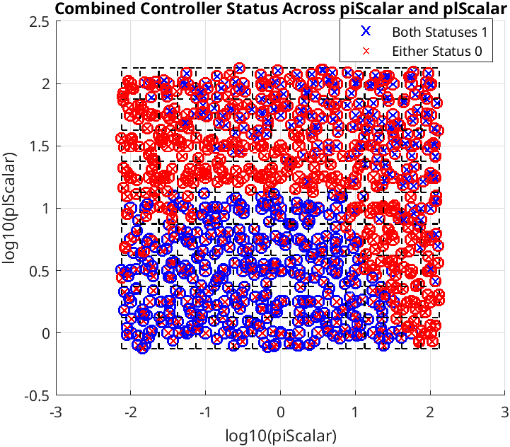
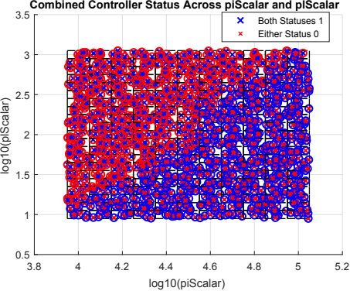
constraints = [constraints];
constraints = [constraints, con7_2];
constraints = [constraints, con7_2, con7_3];
constraints = [constraints, con7_2, con7_3, con8];

